Slide 1
Messages in Miracles
The importance of miracles is that they have a symbolic meaning

Slide 2
Most places in the New Testament that have the word “sign” comes from the same word as miracle. For Example: “And this shall be a “sign” unto you” could be said, “And this shall be a “miracle” unto you.”

Slide 3
Miracles of Christ are divided into 4 Categories:
Power over death
Power over elements
Power over Devils
Miracles of Healing

Slide 4
Many of Christ’s miracles were previously performed by ancient prophets but Christ’s miracle were more miraculous.

Slide 5
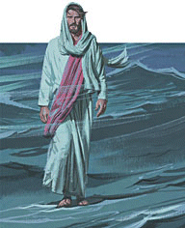
Elisha parts the Jordan River (2 Kings 2)
Moses parts the Red Sea (Exodus 14)
Christ walks on water and calms the storm

Slide 6
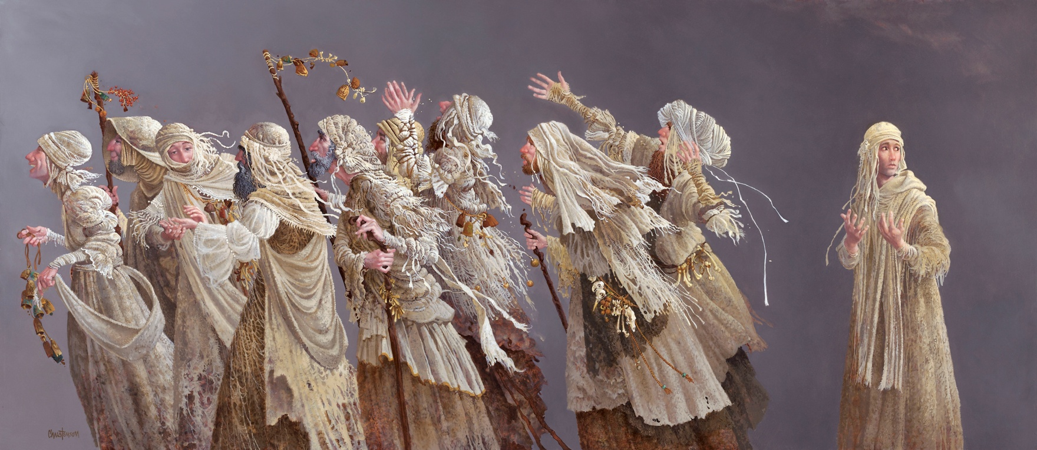
Naaman cured of leprosy (2 Kings 5)
Christ cleanses 10 lepers at once

Slide 7
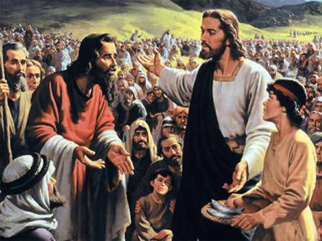
100 men fed with 20 loaves (2 Kings 4)
Christ multiplied the bread and fishes

Slide 8
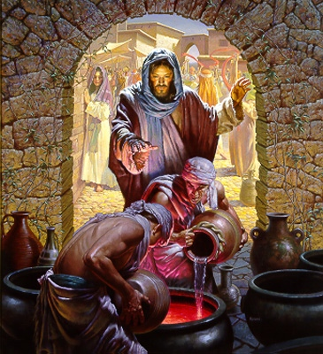
Moses turns Nile into blood (Exodus 7)
Christ turns water to wine

Slide 9
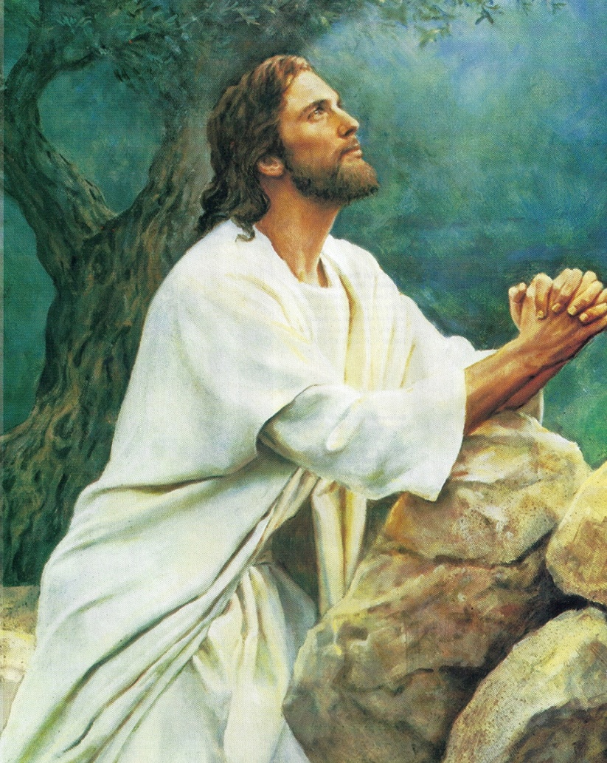
Moses Passover of the Destroying Angel (Exodus 12)
Christ's Atonement.

Slide 10
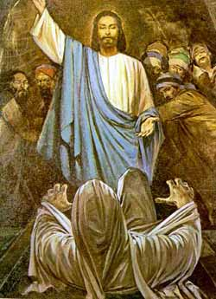
Widow’s son raised (1 King 17)
Christ restores Lazarus to life

Slide 11
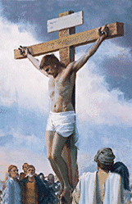
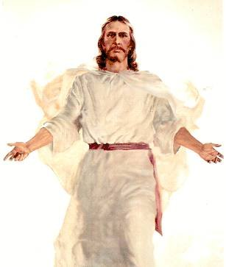
Jonah dies in whale and lives again
(Jonah 2)
Christ dies and is resurrected.

Slide 12
The original Greek word used to describe Jesus’ miracles is semeion. Semeion means “sign or indication”
From the Notes of Poway Institute
By Becky Davies and Lesley Meacham
Pictures from LDS picture site and internet

