Slide 1
Lesson 124
Judge Not, That Ye Be Not Judged
3 Nephi 14

Slide 2
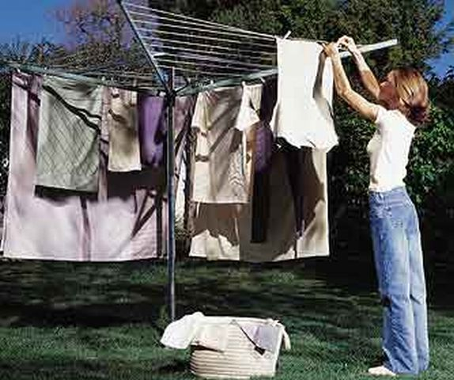
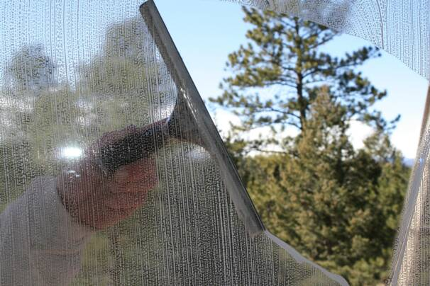
A young couple, Lisa and John, moved into a new neighborhood. One morning while they were eating breakfast, Lisa looked out the window and watched her next-door neighbor hanging out her wash.
“‘That laundry’s not clean!’ Lisa exclaimed. ‘Our neighbor doesn’t know how to get clothes clean!’
“John looked on but remained silent.
“Every time her neighbor would hang her wash to dry, Lisa would make the same comments.
“A few weeks later Lisa was surprised to glance out her window and see a nice, clean wash hanging in her neighbor’s yard. She said to her husband, ‘Look, John—she’s finally learned how to wash correctly! I wonder how she did it.’
“John replied, ‘Well, dear, I have the answer for you.
You’ll be interested to know that I got up early this morning and washed our windows!’”
President Thomas S. Monson

Slide 3
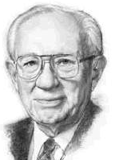
Judge not, that ye be not judged
The phrase “with what measure ye mete” refers to the standard a person uses to measure or judge other people.
Mete-- to measure or judge.
“What I am suggesting is that each of us turn from the negativism that so permeates our society and look for the remarkable good among those with whom we associate, that we speak of one another’s virtues more than we speak of one another’s faults.”
Gordon B. Hinckley
We will be judged according to the way we judge others
3 Nephi 14:1-2

Slide 4
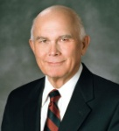
“Final judgment … is that future occasion in which all of us will stand before the judgment seat of Christ to be judged according to our works. … I believe that the scriptural command to ‘judge not’ refers most clearly to this final judgment. …
“… The gospel is a gospel of hope, and none of us is authorized to deny the power of the Atonement to bring about a cleansing of individual sins, forgiveness, and a reformation of life on appropriate conditions”
Dallin H. Oaks
“… Why did the Savior command that we not judge final judgments? I believe this commandment was given because we presume to make final judgments whenever we proclaim that any particular person is going to hell (or to heaven) for a particular act or as of a particular time. When we do this—and there is great temptation to do so—we hurt ourselves and the person we pretend to judge.
3 Nephi 14:1-2

Slide 5
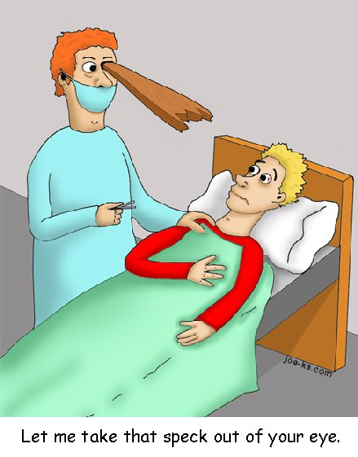
Mote--Beam
Mote (Speck)-- A fault we see in someone else
Beam-- Our own faults
The Savior’s analogy focuses on objects that are lodged in the eye.
Such objects would affect a person’s vision.
How can our faults affect the way we see others?
3 Nephi 14:3-5

Slide 6
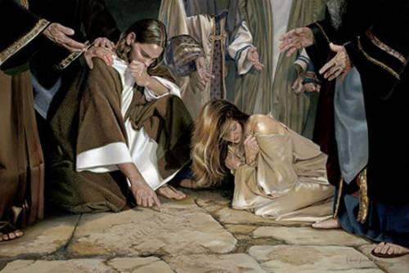
Unrighteous Judgment
“When the Lord warned against judging, he was counseling his people against condemning someone for his sins as well as against seeking to attribute motivation to a person when the observer cannot really know what is in that person’s heart.”
JFM and RLM
“He that is without sin among you, let him first cast a stone at her”
Read John 8:1-11
“Judge not unrighteously, that ye be not judged: but judge righteous judgment” JST Matthew 7:1
3 Nephi 14:3-5

Slide 7
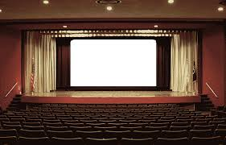
Making Judgments
“Sometimes people feel that it is wrong to judge others in any way. While it is true that you should not condemn others or judge them unrighteously, you will need to make judgments of ideas, situations, and people throughout your life. The Lord has given many commandments that you cannot keep without making judgments”
(True to the Faith: A Gospel Reference [2004], 90).
What are some judgments you have to face in keeping the commandments?
What sites to visit on the internet
What music to listen to
What movies to go to
What friends to hang out with
What books to read

Slide 8
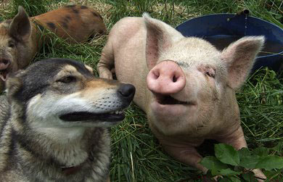
Keeping Things Sacred
“We all make judgments in choosing our friends, in choosing how we will spend our time and our money, and, of course, in choosing an eternal companion. …
“… A righteous judgment will be guided by the Spirit of the Lord, not by anger, revenge, jealousy, or self-interest”
Elder Dallin H. Oaks
“Give not that which is holy unto the dogs, neither cast ye your pearls before swine, lest they trample them under their feet, and turn again and rend you.”
To share something that is sacred with those who will not appreciate it or honor its sacredness
3 Nephi 14:6

Slide 9
Ask—Seek--Knock
“Ask, and it shall be given unto you; seek, and ye shall find; knock, and it shall be opened unto you.”
?
and he that seeketh, findeth;
For every one that asketh, receiveth;
and to him that knocketh, it shall be opened.
“Whatsoever thing ye shall ask the Father in my name, which is good, in faith believing that ye shall receive, behold, it shall be done unto you.” (Moroni 7:26)
3 Nephi 14:7-11

Slide 10
Do Ye Even So to Them
“Jesus did not intend to suggest that each person strive to love himself, nor did he mean to indicate that we should spend much time at all in trying to build our love for ourselves. He taught instead the ironic but infinitely true principle that only as we lose ourselves can we find ourselves…
(see Matthew 26:25)
“Therefore, all things whatsoever ye would that men should do to you, do ye even so to them, for this is the law and the prophets.”
We gain the inner peace and stability of soul promised by the Savior only as we lose ourselves in our quest for God and as we give of ourselves selflessly in service to others….
Love your neighbor as you would want him or her to love you. Treat others as you would want to be treated.
3 Nephi 14:12 JFM and RLM

Slide 11
Insert Video:
The Golden Rule (1:04)

Slide 12
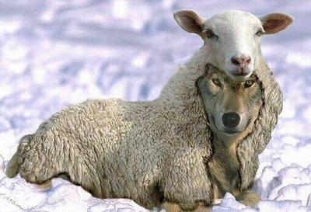
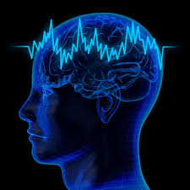
Doing His Will
3 Nephi 14:13-14
3 Nephi 14:15
3 Nephi 14:16-20
How is obeying the teachings of Jesus Christ like walking on a narrow path?
How is rejecting the teachings of Jesus Christ like walking on a wide path?
What are some ways the Savior’s teachings are different from the teachings of the world?
Why would a wolf dress in sheep’s clothing?
What does this analogy tell us about the desires and actions of false prophets?
If the trees represent people, what might the fruits represent?
Possible answers:
people’s thoughts, words, actions, and influence on others

Slide 13
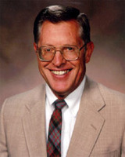
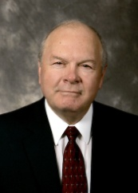
Not Just Those
“Not every one that saith unto me, Lord, Lord, shall enter into the kingdom of heaven; but he that doeth the will of my Father who is in heaven.”
3 Nephi 14:21
“It is not just those who cry out to the Lord, not just those whose voices are raised to Jehovah, not just those whose display of righteousness is public and whose commitment to the faith is spoken regularly, who shall be save. Rather, it is those who trust in the Lord, who perform the works of righteousness in a quiet but steadfast manner…
It is not just those who did all the right things, who carried out the assignments, who will be save….
The Lord’s true saints are the ones who do His works, under the influence of His Spirit.
JFM and RLM
We must do the will of Heavenly Father in order to enter into the kingdom of heaven

Slide 14
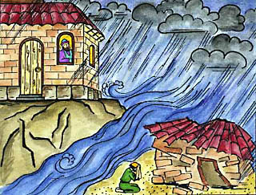
Building On A Rock
3 Nephi 14:24-27
When we hear the Savior’s words and follow them, how are we like a man who builds his house on a rock?
If we choose not to follow the Savior’s words, how are we like a man who builds his house on the sand?

Slide 15
What Have We Learned?
Who is narrating this account?
Who is speaking?
Who is receiving the message?
What is happening in this account?
What has happened before this event?
What is the message of this story?
What did the writer intend for us to learn from this story? (Doctrine or Principle)

Slide 16
Sources:
Suggested Hymn: 281 Children’s Songbook The Wise Man and the Foolish Man
President Thomas S. Monson(“Charity Never Faileth,” Ensign or Liahona, Nov. 2010, 122).
President Gordon B. Hinckley The Continuing Pursuit of Truth Ensign April 1986
Dallin H. Oaks (“‘Judge Not’ and Judging,” Ensign, Aug. 1999, 7, 9).
Joseph Fielding McConkie and Robert L. Millet Doctrinal Commentary on the Book of Mormon Vol. 4 pg. 89-90, 93, 96

