Slide 1
Lesson 66b
Dangers in the Water
Doctrine and Covenants 61-62
Therefore, follow me, and listen to the counsel which I shall give unto you.
D&C 100:2

Slide 2
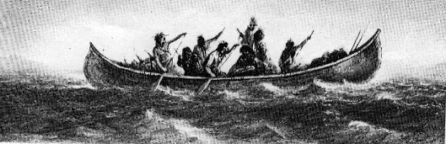
Background
August 12, 1831
On the bank of the Missouri River, Mcllwaine’s Bend
“On the 9th, in company with ten Elders, I left Independence landing for Kirtland. We started down the river in canoes, and went the first day as far as Fort Osage, where we had an excellent wild turkey for supper.
Nothing very important occurred till the third day, when many of the dangers so common upon the western waters, manifested themselves; and after we had encamped upon the bank of the river, at McIlwaine’s Bend, Brother Phelps, in open vision by daylight, saw the destroyer in his most horrible power, ride upon the face of the waters; others heard the noise, but saw not the vision.
“The next morning after prayer, I
received the following: [D&C 61].”
Prophet Joseph Smith

Slide 3
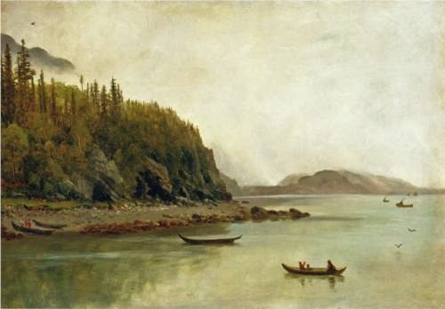
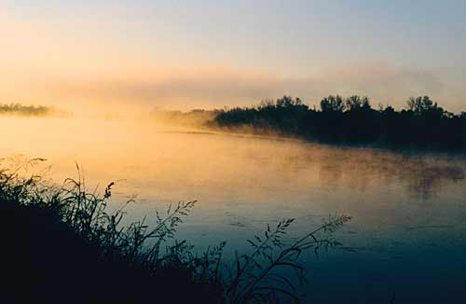
Bear Record of Satan
The Lord commanded the elders to bear record of Satan and his power upon the waters and of the power of God for the benefit of the faithful.
Albert Bierstadt
To fulfill this responsibility, it would be necessary for them to come in contact with people, hence, the Lord’s reminder that while traveling by canoe they were not able to meet people who needed to hear the gospel message. (vs. 23)
D&C 61:4, 19 Student Manual

Slide 4
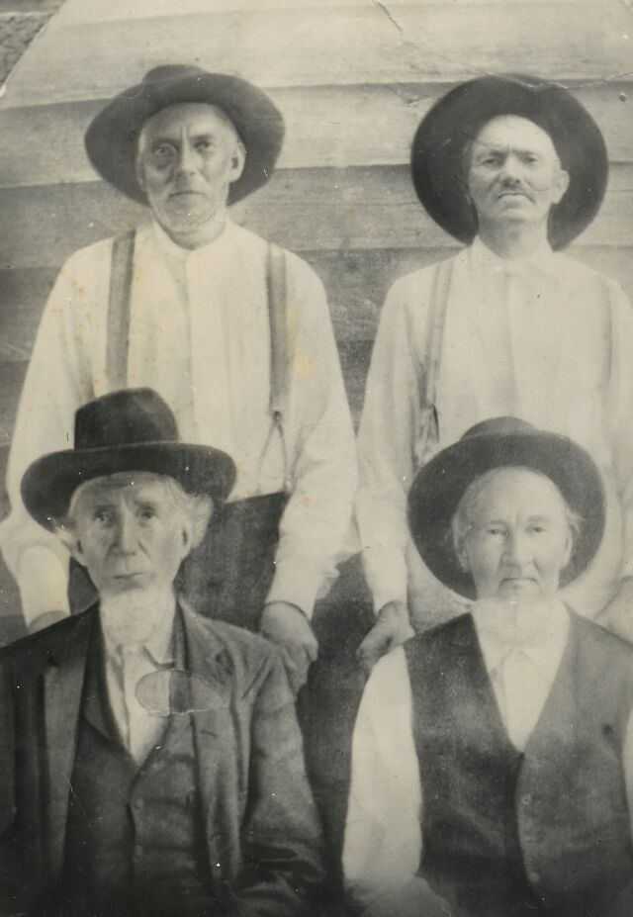
Be of Comfort
Prior to this experience the Elders had ill feelings and disagreements between them.
If they repented of their animosity of each other they were now forgiven (vs. 2)
The Lord was angry yesterday, but not today (vs. 20)
The Lord had not left them (vs. 36)
The blessings of the Kingdom was still theirs (vs. 37)
D&C 61:2, 20, 36-37

Slide 5
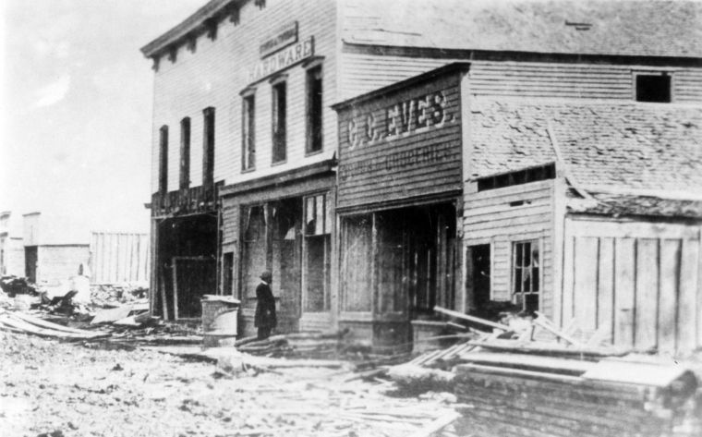
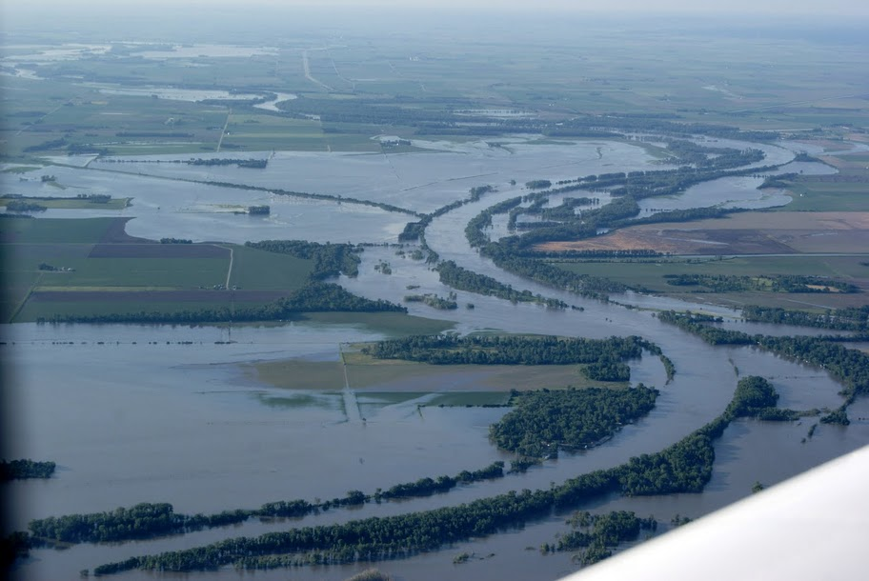
The Waters
The Lord’s words in do not prohibit Latter-day Saints from traveling on or swimming in the water.
The Lord refers specifically to the danger of “these waters,” meaning the Missouri River
Destruction had been decreed upon these rivers, and the Saints were to be warned.
During the year of 1834 the Missouri River lost one steamboat a day for many weeks with its destruction
D&C 61:5-19

Slide 6
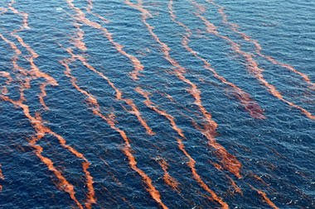
Dangers in Water
Prior to Second Coming
Many destructions” would occur on the waters in the last days
Read Revelation 8:8-11
In describing the curse on the waters in the last days, the Lord may have been referring to passages in the book of Revelation in which the Apostle John describes destruction that will occur in the waters prior to the Second Coming of Jesus Christ
Read Revelation: 16:2-6
D&C 61:5-19

Slide 7
Does Satan Have Power
Over the Waters?
Satan gets his power from us
…because of these things which are taken away out of the gospel of the Lamb, an exceedingly great many do stumble, yea, insomuch that Satan hath great power over them.
1 Nephi 13:29
However:
The Lord has all power
D&C 61:5-19

Slide 8
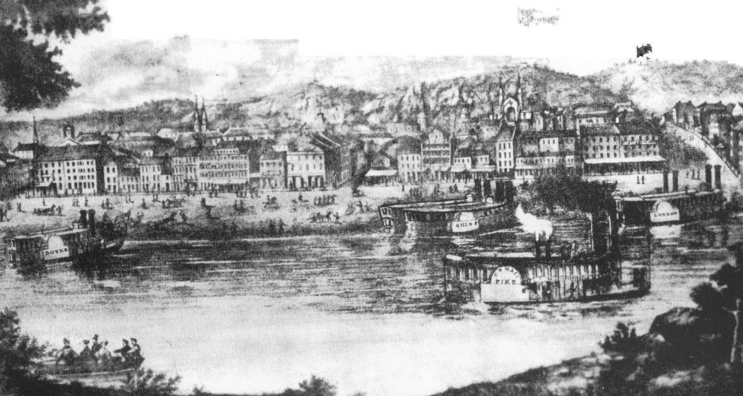
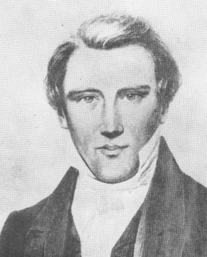
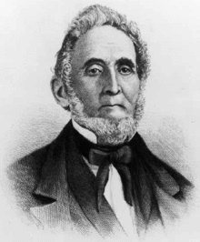
Cincinnati
“At the time of this revelation Cincinnati was only a village, yet it was like other western towns such as Independence, the gathering place of many who had been forced to flee from the larger cities because of the violation of the law.
Cincinnati in 1840
In all the border towns in that day wickedness to a very great extent prevailed. After fulfilling their mission in Cincinnati these two brethren [the Prophet Joseph and Sidney Rigdon] were to continue their journey back to Kirtland.” (Smith, Church History and Modern Revelation,1:225.)
D&C 61:30-32

Slide 9
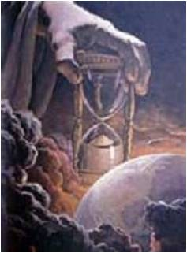
Christ’s Second Coming
No one knows the exact time of Christ’s coming. The Prophet Joseph Smith said: “Jesus Christ never did reveal to any man the precise time that He would come.
Go and read the Scriptures, and you cannot find anything that specifies the exact hour He would come; and all that say so are false teachers.” (History of the Church, 6:254.)
D&C 61:30-32

Slide 10
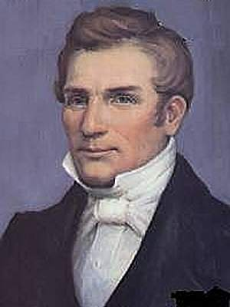
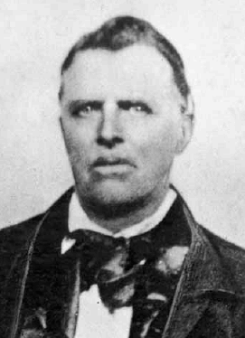
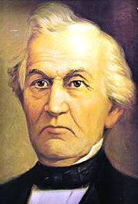
Background
“On the 13th [of August] I met several of the Elders on their way to the land of Zion, and after the joyful salutations with which brethren meet each other, who are actually ‘contending for the faith once delivered to the Saints,’ I received the following: [D&C 62]”
(History of the Church, 1:205).
Hyrum Smith
John Murdock
The elders were not identified in the Prophet’s history, but Reynolds Cahoon named them as follows: Hyrum Smith, John Murdock, Harvey Whitlock, and David Whitmer
Journal History, 13 August 1831.
Harvey Gilman Whitlock was an early member of the Latter Day Saint movement and one of the witnesses to the Book of Commandments. He was among those Latter Day Saints driven by mobs from Jackson County, Missouri in the summer of 1833.
Born: 1809
Died: 1874
*John Murdock was so ill on this occasion that he was unable to pursue his journey to Zion without some assistance. After this revelation was given, the four missionaries (John Murdock, David Whitmer, Harvey Whitlock, and Hyrum Smith) put their money together and bought a horse for John Murdock to ride, by which means they were able to continue their travels. (vs. 7-8)
David Whitmer
D&C 62

Slide 11
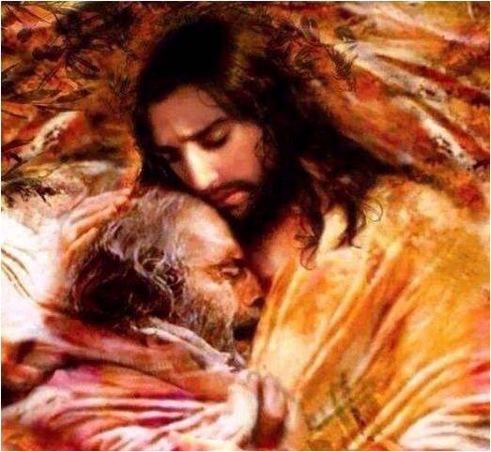
Succor
“Succor means ‘to go to the aid of one in want or distress’ or ‘to relieve.’
Fortunately, the Savior succors those ‘who are tempted’ so they will not commit sin, and if they should sin, he will succor them if they repent.” (Ludlow, Companion, 1:330.)
D&C 62:1

Slide 12
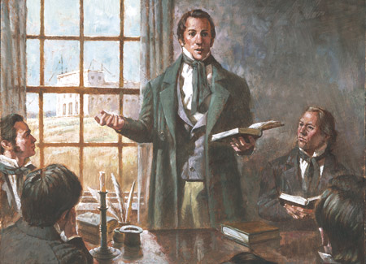
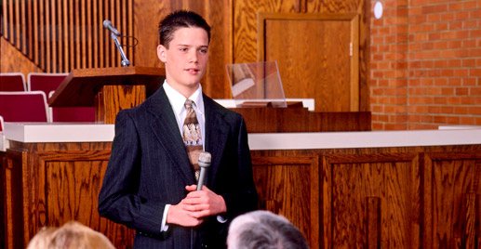
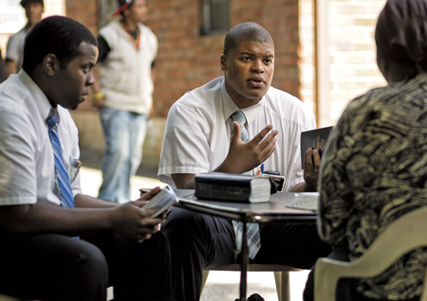
Elders Bearing Testimonies
“In this Revelation we are told that angels are scrutinizing the records kept of the testimonies of the Elders, and that they rejoice over the witnesses.
It appears from this that the ministry on earth has its effects beyond the veil as well as on this side.
An Elder who bears his faithful testimony to the truth does not know how far-reaching the result may be, though his visible audience may consist of but few.”
Smith and Sjodahl
D&C 62:3

Slide 13
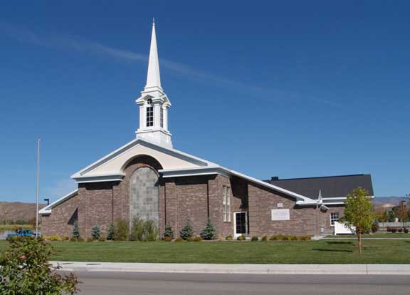
Making Decisions
What color of shirt should I wear today?
Should I go to Church on Sunday?
Should I serve a mission? If so, when?
If my mom offers to fix my favorite meal, what should I choose?
Whom should I date?
Where should we go to eat on our date?
The Lord helped the elders understand that some of the decisions they needed to make mattered more to Him than others
When we make decisions, we are to rely on our judgment and the directions of the Spirit.
D&C 62:8

Slide 14
Sources:
Suggested Hymn: #105 Master, the Tempest is Raging
Prophet Joseph Smith (History of the Church, 1:202–3.)
Doctrine and Covenants Student Manual Religion 324-325 Section 61
Albert Bierstadt (German-born American artist, 1830-1902)
Hyrum M. Smith and Janne M. Sjodahl Doctrine and Covenants Commentary pg. 371

Slide 15
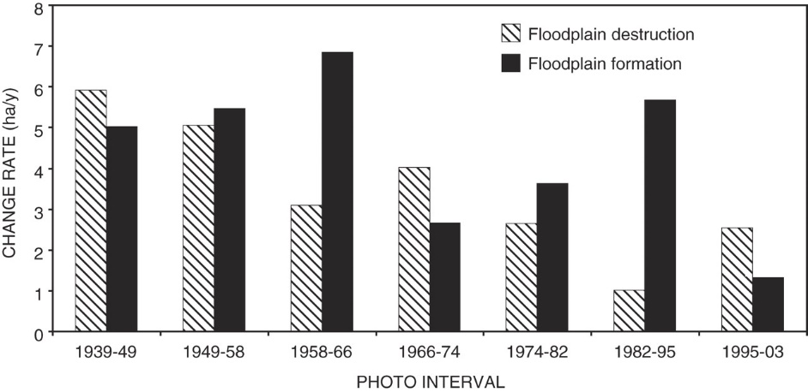
Curse of the Waters:
President Joseph Fielding Smith pointed out how “in the beginning the Lord blessed the waters and cursed the land, but in these last days this was reversed, the land was to be blessed and the waters to be cursed. A little reflection will bear witness to the truth of this declaration. In the early millenniums of this earth’s history, men did not understand the composition of the soils, and how they needed building up when crops were taken from them. The facilities at the command of the people were primitive and limited, acreage under cultivation was limited, famines were prevalent and the luxuries which we have today were not obtainable. Someone may rise up and say that the soil in those days was just as productive as now, and this may be the case. It is not a matter of dispute, but the manner of cultivation did not lend itself to the abundant production which we are receiving today. It matters not what the causes were, in those early days of world history there could not be the production, nor the varieties of fruits coming from the earth, and the Lord can very properly speak of this as a curse, or the lack of blessing, upon the land. In those early periods we have every reason to believe that the torrents, floods, and the dangers upon the waters were not as great as they are today, and by no means as great as what the Lord has promised us. The early mariners among the ancients traversed the seas as they knew them in that day in comparative safety. … Today this manner of travel in such boats would be of the most dangerous and risky nature. Moreover, we have seen the dangers upon the waters increase until the hearts of men failed them and only the brave, and those who were compelled to travel the seas, ventured out upon them. In regard to the Missouri-Mississippi waters, we have seen year by year great destruction upon them, and coming from them. Millions upon millions of dollars, almost annually are lost by this great stream overflowing its banks. Many have lost their lives in these floods as they sweep over the land, and even upon this apparently tranquil or sluggish stream there can arise storms that bring destruction. Verily the word of the Lord has been, and is being, fulfilled in relation to those waters. While the Lord has spoken of the sea heaving itself beyond its bounds, and the waves roaring, yet we must include the great destruction upon the waters by means of war, and especially by submarine warfare as we have learned of it in recent years.” (Church History and Modern Revelation, 1:224; see also Genesis 3:17–19;Ether 7:23–25; 9:16, 28; Revelation 16:1–6; Alma 45:16; D&C 59:3; 16–19.)
Student Manual
Elder B. H. Roberts explained: “During the three days upon the river some disagreements and ill feeling had developed among the brethren and explanations and reconciliations had become necessary; it had also been discovered that progress on their journey by the river in canoes was slow, and hence it became necessary for those who had been appointed to purchase the printing press, Sidney Gilbert and William W. Phelps; and the Prophet, Sidney Rigdon, and Oliver Cowdery, who had been commanded to hasten their return to Kirtland, found it imperative to find a more expeditious means of travel than by the canoes. The greater part of the night at McIlwaine’s Bend was devoted to these matters. The brethren became reconciled to each other, and those whose affairs more especially cried haste started overland the next morning for St. Louis, and the rest of the company continued the journey via the river.” (Comprehensive History of the Church, 1:262–63.)

