Slide 1
Parable of the Popcorn
—Hasten the Work

Slide 2
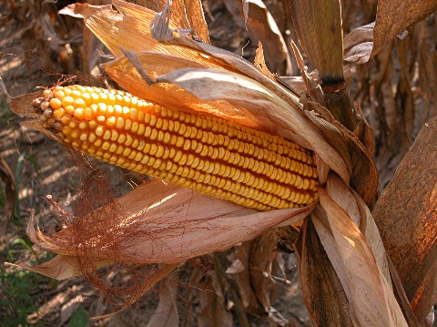
Behold at the time of the harvest, the ears of corn did bring forth kernels which we dried and prepared for the popper’s hand.

Slide 3
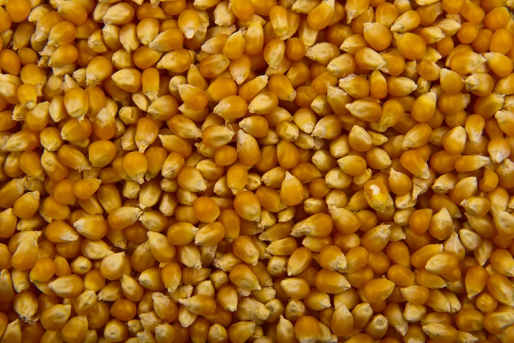
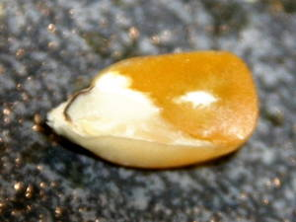
And then it was that the popper did take the kernels, all of which appeared alike unto him, and did apply the oil and the heat.
And it came to pass that when the heat was on some did explode with promise and did magnify themselves and hundred fold, and so did burst forth with whiteness which did both gladden the eye and satisfy the taste of the popper. And likewise, some others did pop, but not too much.

Slide 4
But lo, there were some that did just lie there and even though the popper’s heat was alike unto all, they did bask in the warmth of the oil and kept everything they had for themselves.
And so it came to pass that those which had given of themselves did bring joy and delight to many munchers, but those which kept of the warmth and did not burst forth were fit only to be cast out into the pail and thought of with hardness and disgust.

Slide 5
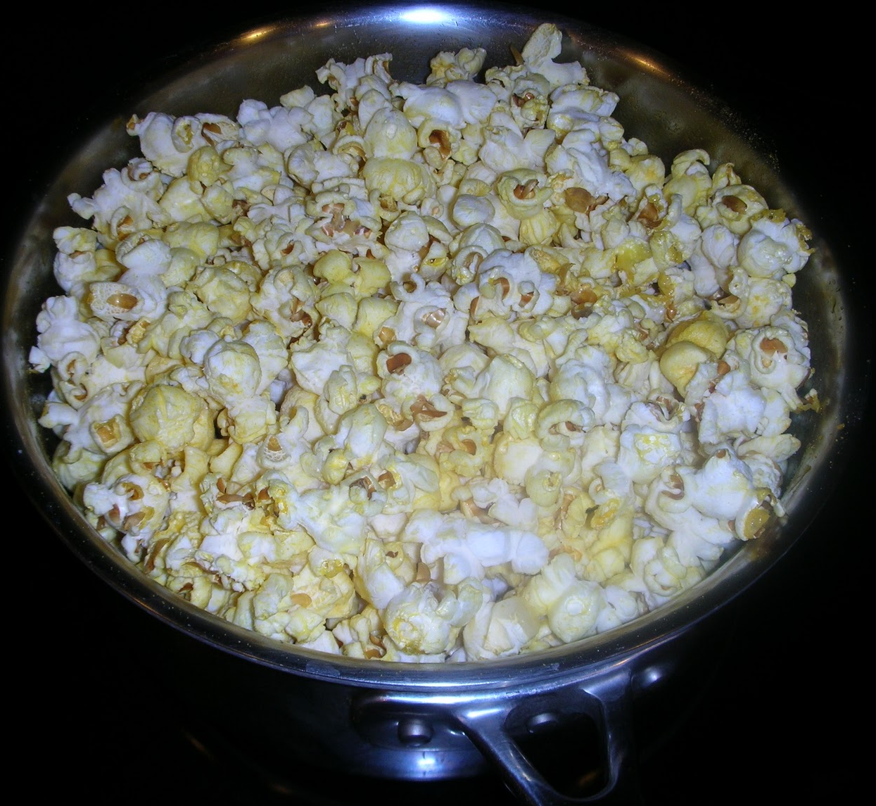
And thus we see that in the beginning all appear alike, but when the heat is on, some come forth and give their all, while others fail to pop and become as chaff to be discarded and forgotten.

Slide 6
Parable of the Popcorn—Hasten the Work
Behold at the time of the harvest, the ears of corn did bring forth kernels which we dried and prepared for the popper’s hand.
And then it was that the popper did take the kernels, all of which appeared alike unto him, and did apply the oil and the heat.
And it came to pass that when the heat was on some did explode with promise and did magnify themselves and hundred fold, and so did burst forth with whiteness which did both gladden the eye and satisfy the taste of the popper. And likewise, some others did pop, but not too much.
But lo, there were some that did just lie there and even though the popper’s heat was alike unto all, they did bask in the warmth of the oil and kept everything they had for themselves.
And so it came to pass that those which had given of themselves did bring joy and delight to many munchers, but those which kept of the warmth and did not burst forth were fit only to be cast out into the pail and thought of with hardness and disgust.
And thus we see that in the beginning all appear alike, but when the heat is on, some come forth and give their all, while others fail to pop and become as chaff to be discarded and forgotten.

