Slide 1
Lesson 14
The Fall and The Rescue
Moses 6:48-68
The F
A
L
L
Atonement

Slide 2
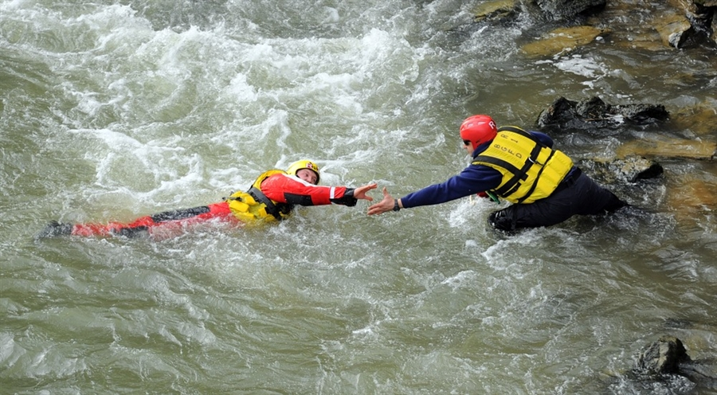
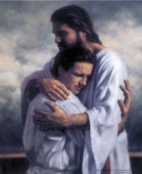
The Rescue
What did you have to do in order to be rescued?
What caused the need to be rescued?
Who rescued you?
Making a wrong choice
To be willing to receive the rescuer

Slide 3
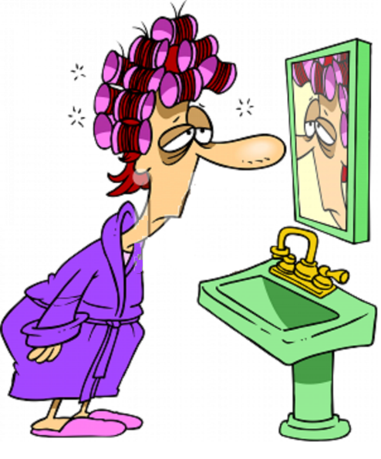
Enoch Teaches About The Fall
Because of the Fall…
Human life is made possible
We will experience death
Misery and woe becomes our fate--subject to the pains, sicknesses, sorrows, and difficulties of mortal life
Moses 6:48

Slide 4
Being Human
carnal and sensual-- being preoccupied with worldliness and the gratification of physical desires, lusts, and pleasures.
Devilish-- being influenced by the devil. Explain that these words do not mean that our bodies are evil. Rather, they describe an aspect of our fallen condition and the consequences of yielding to the enticements of Satan
Our bodies are not evil. This is a fallen condition and we are influenced by the enticements of Satan.
Moses 6:49

Slide 5
Original Sin
Because of the Fall of Adam and Eve, all people live in a fallen condition, separated from God and subject to physical death.
However, we are not condemned by what many call the “original sin.”
We are not accountable for Adam's transgression in the Garden of Eden.
“We believe that men will be punished for their own sins, and not for Adam's transgression”
(Articles of Faith 1:2)
Moses 6:49 LDS Topics

Slide 6
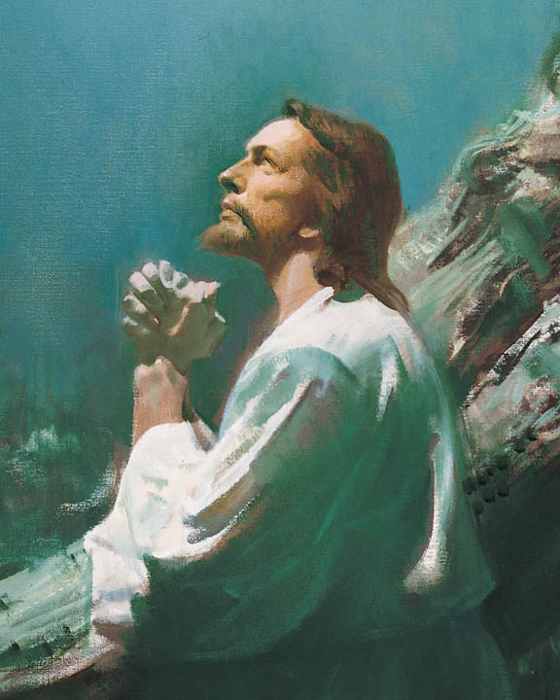
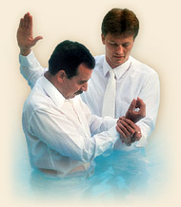
The Price to Be Paid
Through the Atonement, the Savior paid the price for the transgression in the Garden of Eden.
He has given us the assurance of resurrection and the promise that, based on our faithfulness, we can return to dwell in the presence of our Heavenly Father forever.
If we believe, repent, and are baptized in the name of Jesus Christ, then we will receive the gift of the Holy Ghost
Moses 6:50-53 LDS Topics

Slide 7
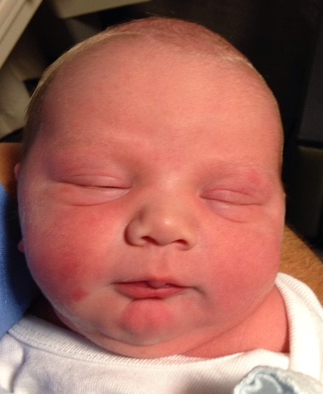
Born Into World of Sin
“thy children are conceived in sin” in verse 55 means that we are “born into a world of sin,” a world in which evil exists and influences us in our fallen state.
Elder Bruce R. McConkie
“There is no such thing as original sin as such is defined in the creeds of Christendom. Such a concept denies the efficacy of the atonement. Our revelation says: “Every spirit of man was innocent in the beginning’—meaning that spirits started out in a state of purity and innocence in pre-existence—’and God having redeemed man from the fall, men became again, in their infant state, innocent before God…meaning that all children start out their mortal probation in purity and innocence because of the atonement.”
Joseph Fielding Smith
But little children are holy, being sanctified through the atonement of Jesus Christ; and this is what the scriptures mean.
D&C 74:7
Moses 6:54-55

Slide 8
Agents Unto Themselves
He has given us our agency to think and act for ourselves, on our own volition, to obtain a testimony for ourselves from Him concerning the truth of the principles which he teaches, and then be firm and unshaken in the performance of all which is necessary for salvation.”
Wilford Woodruff
Wherefore, men are free according to the flesh; and all things are given them which are expedient unto man. And they are free to choose liberty and eternal life, through the great Mediator of all men…
2 Nephi 2:27
“…we frequently blame Satan for much of the misery that we are bringing upon ourselves. Satan has no power over us except as we give it to him.”
Sterling W. Sill
If we use our agency to repent, we can inherit the kingdom of God
Moses 6:54-55

Slide 9
The Pit
Lesley Meacham and Becky Davies
The F
A
L
L
Endure
Doctrine
of
Christ
Atonement
Receive the Holy Ghost
Baptism
Repentance
Faith
People in the Pit don’t know they need to be saved. What makes them aware of the Pit?
Testimony borne by others/scriptures
What moves them to find the ladder? Faith in the testimony and accompanying Spirit
What does one have to do to begin climbing? Shake off the dirt of the word—repent
What are the rungs on the ladder? Covenants
What can we do to keep our covenants? D&C 29:36
Where do we get our power? Personal Integrity. By keeping our word. By not simply knowing, but doing and “being” truth in everything.

Slide 10
Born Again
Baptized by Water
“Every child that comes into this world is carried in water, is born of water, and of blood, and of the spirit.
So when we are born into the kingdom of God, we must be born in the same way.
By baptism, we are born of the water.
Through the shedding of blood of Christ, we are cleansed and sanctified; and we are justified, through the Sprit of God, for baptism is not complete without the baptism of the Holy Ghost.”
Joseph Fielding Smith
Moses 6:59

Slide 11
A Spiritual Process
To be born again is the spiritual process by which we come alive to things of the Spirit and gradually lose our desire to break God’s commandments.
“We begin the process of being born again through exercising faith in Christ, repenting of our sins, and being baptized by immersion for the remission of sins.”
Elder David A. Bednar
Moses 6:59

Slide 12
Justified
To be pardoned from punishment for sin and declared guiltless.
A person is justified by the Savior’s grace through faith in him.
This faith is shown by repentance and obedience to the laws and ordinances of the gospel.
Jesus Christ’s atonement enables mankind to repent and be justified or pardoned from punishment they otherwise would receive.
Guide to the Scriptures
repentance
SIN
The process of becoming free from sin, pure, clean, and holy through the atonement of Jesus Christ
Moses 6:60

Slide 13
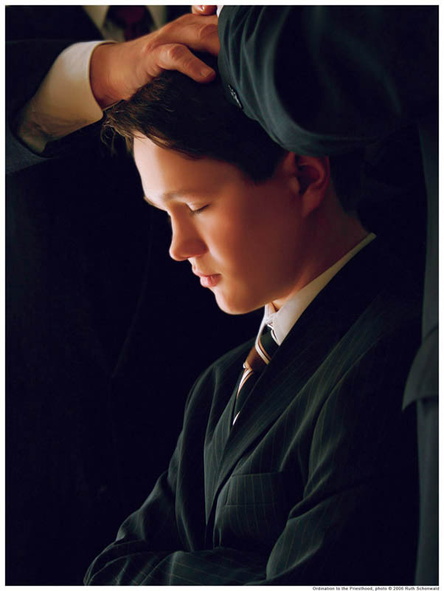
The Holy Ghost
“Reception of the Holy Ghost is the cleansing agent as the Atonement purifies you. …
“… And when he is your companion, you can have confidence that the Atonement is working in your life”
President Henry B. Eyring
Moses 6:60

Slide 14
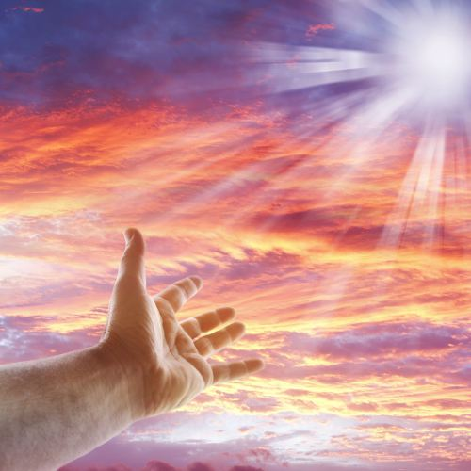
All Things Point to Christ
And behold, all things have their likeness, and all things are created and made to bear record of me, both things which are temporal, and things which are spiritual; things which are in the heavens above, and things which are on the earth, and things which are in the earth, and things which are under the earth, both above and beneath: all things bear record of me.
Moses 6:63

Slide 15
Sources:
Suggested Hymn: #190 In Memory of the Crucified
Video:
We Must Be “Born Again” (1:55)
Elder Bruce R. McConkie (see A New Witness for the Articles of Faith [1985], 101).
Joseph Fielding Smith Man: His Origin and Destiny , pp. 51-52
Way to Perfection, p. 190
Wilford Woodruff, in James R. Clark, Comp., Messages of the First Presidency, 3:137
Sterling W. Sill Conf. Report April 1970
Lesley Meacham and Becky Davies Poway Institute
Elder David A. Bednar (“Ye Must Be Born Again,” Ensign or Liahona, May 2007, 21).
President Henry B. Eyring (“Come Unto Christ” [Brigham Young University fireside, Oct. 29, 1989], 4; speeches.byu.edu).

Slide 16
“Four generations and some five hundred years later, according to Adam’s book of remembrance, Enoch, of Seth’s line, was called to become a great prophet-missionary-reformer. His ministry was needed, for the followers of the line and cult of Cain had become numerous, and violence was rampant already in the fifth generation after Cain (Moses 5:28–31, 47–57). Unto those who had become sensual and devilish Enoch preached repentance. The sons of God, distinguished from the ‘sons of men,’ were obliged to segregate themselves in a new home called ‘Cainan’ after their forefather, the son of Enos. (Do not confuse this Cainan with the wicked people of Canaan of Moses 7:6–10.
“Against the evils of the time, which he was called to combat (Moses 6:27–29), Enoch was successful; he was able to build up a righteous culture called ‘Zion,’ meaning, ‘the pure in heart.’ (Moses 7:18 ff.)
The teachings of Enoch cover some seven major categories and embrace some information found nowhere else in scripture. He dealt with:
(1) the fall of man and its results;
(2) the nature of salvation and the means of achieving it;
(3) sin, as seen in the evils of his times, in contrast to the righteousness of the godly who were his followers;
(4) the cause, purpose, and effects of the anticipated flood of Noah;
(5) the scope of Satan’s triumph and the resultant sorrows of God;
(6) the first advent of the Messiah;
(7) the second advent of the Messiah and his peaceful, millennial reign.
The details of his Gospel concepts are worth careful study and attention. Mention of this great man is also found in the New Testament (Jude 14, 15; Hebrews 11:5)
(Rasmussen, Introduction to the Old Testament, 1:24–25.)
Water, Spirit, and Blood
Elder Bruce R. McConkie of the Quorum of the Twelve Apostles taught how water, spirit, and blood are essential elements of both our physical and spiritual births:
“Two births are essential to salvation. Man cannot be saved without birth into mortality, nor can he return to his heavenly home without a birth into the realm of the Spirit. … The elements present in a mortal birth and in a spiritual birth are the same. They are water, blood, and spirit. Thus every mortal birth is a heaven-given reminder to prepare for the second birth. …
“In every mortal birth the child is immersed in water in the mother’s womb. At the appointed time the spirit enters the body, and blood always flows in the veins of the new person. Otherwise, without each of these, there is no life, no birth, no mortality.
“In every birth into the kingdom of heaven, the newborn babe in Christ is immersed in water, he receives the Holy Ghost by the laying on of hands, and the blood of Christ cleanses him from all sin. Otherwise, without each of these, there is no Spirit-birth, no newness of life, no hope of eternal life” (A New Witness for the Articles of Faith [1985], 288).
Essential For Our Salvation:
Elder D. Todd Christofferson of the Quorum of the Twelve Apostles explained how the gift of the Holy Ghost is essential to our salvation:
“The gift of the Holy Ghost is part of the new and everlasting covenant. It is an essential part of our baptism, the baptism of the Spirit. It is the messenger of grace by which the blood of Christ is applied to take away our sins and sanctify us (see2 Nephi 31:17). It is the gift by which Adam was ‘quickened in the inner man’ (Moses 6:65)” (“The Power of Covenants,” Ensign or Liahona, May 2009, 22).
…We frequently blame Satan for much of the misery that we are bringing upon ourselves. Satan has no power over us except as we give it to him.”

