Slide 1

The Descendants of Adam
Moses 6
Genesis 5

Slide 2


Linked to Our Ancestors
What have your parents (or ancestors) passed on to you?
What are the most useful things you could pass on to your future children?

Slide 3
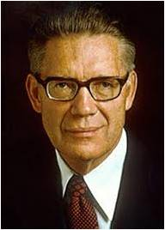
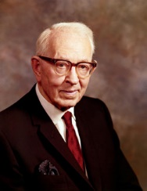
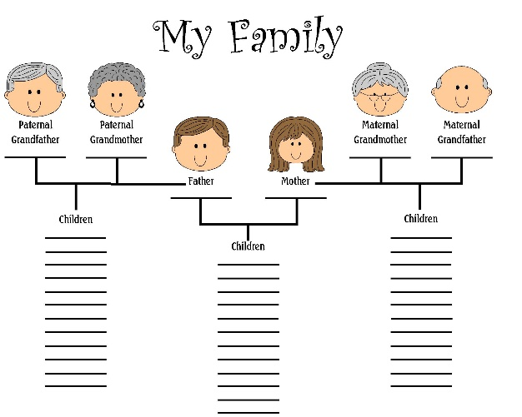
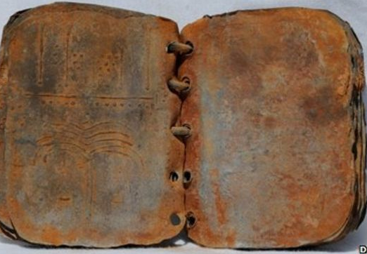
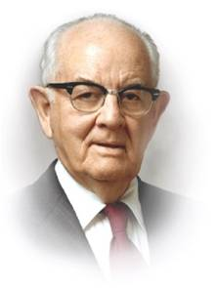

The Record
“Adam kept a written account of his faithful descendants to which he recorded their faith and works, their righteousness and devotion, their revelations and visions, and their adherence to the revealed plan of salvation… Adam called his record a book of remembrance.”
Bruce R. McConkie
Sugardoodle
“They were not only commanded to keep a record of important events, but they were also to keep a record of their families and preserve it that it might be of benefit in times to come.”
Joseph Fielding Smith
David Elkington
“Please follow the counsel you have been given in the past and maintain your personal journals. Those who keep a book of remembrance are more likely to keep the Lord in remembrance in their daily lives. Journals are a way of counting our blessings and of leaving an inventory of these blessings for our posterity.” President Spencer W. Kimball
Moses 6:4-7

Slide 4
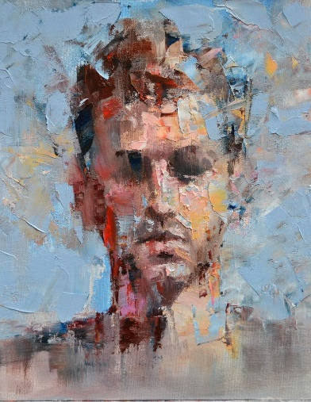
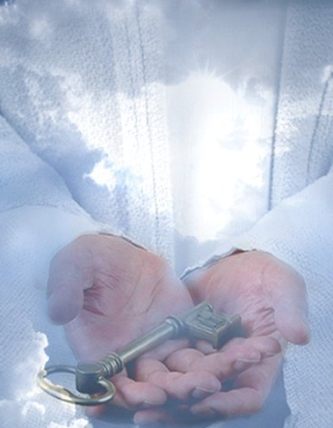
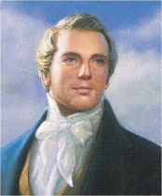
How Long Has the Priesthood on the Earth?
Which priesthood continueth in the church of God in all generations, and is without beginning of days or end of years.
D&C 84:17
“The Priesthood was first given to Adam; he obtained the First Presidency, and held the keys of it from generation to generation. He obtained it in the Creation, before the world was formed. …
Francisco Malonzo
“The Priesthood is an everlasting principle, and existed with God from eternity, and will to eternity, without beginning of days or end of years .
The keys have to be brought from heaven whenever the Gospel is sent. When they are revealed from heaven, it is by Adam’s authority”.
Joseph Smith Translation, Hebrews 7:3

Slide 5
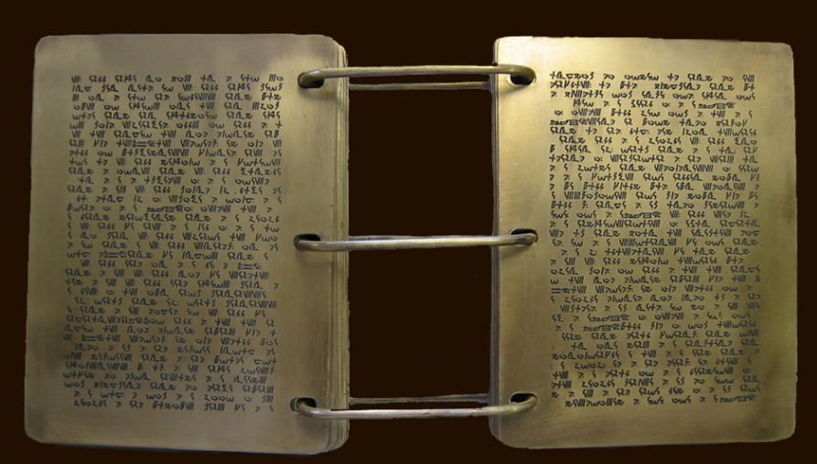

The Genealogy
And he desired of Laban the records which were engraven upon the plates of brass, which contained the genealogy of my father.
1 Nephi 3:12
And it came to pass that my father, Lehi, also found upon the plates of brass a genealogy of his fathers; wherefore he knew that he was a descendant of Joseph;
1 Nephi 5:14
And these plates of brass, which contain these engravings, which have the records of the holy scriptures upon them, which have the genealogy of our forefathers, even from the beginning—
Alma 37:3
See Also Abraham 1:28
Moses 6:8

Slide 6
Adam’s “chain” of Descendants
Adam--930
Seth--920
By faith Enoch was translated that he should not see death; and was not found, because God had translated him: for before his translation he had this testimony, that he pleased God.
Hebrews 11:5
Enos--905
Cainan--910
Mahalaleel--895
Jared--962
Enoch-- 365 (430-- translated)
Methuselah--969
Lamech--777
Noah
Shem
Ham
Japheth
Genesis 5 Moses 6:16-21, 25 Luke 3:36-38

Slide 7
Seth
He was a son of Adam and Eve, and his likeness was of his father
He was the replacement for Abel, whom Cain slew and a “perfect man” (D&C 107:43)
In Hebrew his name means to set, appoint, constitute
He offered an acceptable sacrifice to the Lord and was chosen to hold the priesthood keys
He was ordained by Adam at the age of 69 and blessed by him 3 years before Adam’s death
He received a promise from that blessing that his posterity would be the chosen people of the Lord
He is mentioned in Joseph Fielding Smith’s vision in Doctrine and Covenants 138
He had many children of whom one of them was Enos who was born when he was 105 years of age
He was one of the elect individuals gathered together to receive his benedictory blessing from Adam at Adam-ondi-Ahman (D&C 107:53)
He lived 912 years
Who’s Who

Slide 8
Enos
He was a son of Seth and grandson of Adam and Eve
His name means “mortal man”
He is mentioned in Corinthians 1:1 as Enosh
He was ordained at the age of 134 years by Adam (D&C 107:44)
He was a High Priest
He was a prophet like his father Seth
He was one of the elect individuals gathered together to receive his benedictory blessing at Adam-ondi-Ahman (D&C 107:53)
He had many children and was 90 years old when Cainan, his son, was born
He died at 905 years old
Who’s Who

Slide 9
Cainan
He was a son of Enos, great-grandson of Adam and was born in Shulon—the land of promise
Enos called the land of promise Cainan after his own son
God called upon him in the wilderness at the age of 40 and met Adam while journeying to the place Shedolamak
He was 70 years old when his son, Mahalaleel, was born
He was 87 Years old when he received his ordination
He was one of the elect individuals gathered to receive his benedictory blessing at Adam-ondi-Ahman (D&C 107:53)
He died at 910 years old
Moses 6:18-19, D&C 107:45, 53

Slide 10
Mahalaleel
He was a son of Cainan, great great-grandson of Adam and Eve
Luke mentions him as Maleleel (Luke 3:37)
He was 65 years old when Jared was born
He was 496 years and 7 days old when he received his ordination from Adam
He was one of the elect individuals gathered to receive his benedictory blessing at Adam-ondi-Ahman (D&C 107:53)
He died at 895 years old
Moses 6:19-20, D&C 107:46

Slide 11
Jared
He was a son of Mahalaleel, great great great-grandson of Adam and Eve
He was 162 years old when Enoch was born
He was 200 years old when he received his ordination from Adam
He was one of the elect individuals gathered to receive his benedictory blessing at Adam-ondi-Ahman (D&C 107:53)
He died at 962 years old
Moses 6:21, D&C 107:47

Slide 12
Enoch
He was a son of Jared, great great great great-grandson of Adam and Eve
He was taught in the ways of God
He was 25 years old when he was ordained under the hand of Adam, 65 years old when his son, Methuselah, was born and when Adam blessed him
He was called of God to teach repentance, the Fall, the temptations of Satan, and Jesus Christ’s mission of redemption and salvation
He was 200 years old when he received his ordination from Adam
He built a city called “City of Holiness”– even Zion and shown the Second Coming
The City of Zion was ‘taken up into heaven’ (Moses 7:21 D&C 38:4)
He was one of the elect individuals gathered to receive his benedictory blessing at Adam-ondi-Ahman (D&C 107:53)
He was translated at age 430 (Hebrews 11:5)
Moses 6 Moses 7, D&C 107:48-49, 53 Hebrews 11:5

Slide 13
Methuselah
He was a son of Enoch
His name means dart or javelin
He, along with Enoch, was the longest surviving of the ancient patriarchs
Luke names him as Mathusala
He was ordained by Adam at age 100 (D&C 107:50)
He was one of the elect individuals gathered to receive his benedictory blessing at Adam-ondi-Ahman (D&C 107:53)
He died at age 969 and was the oldest man having lived on the earth
Genesis 5:27, 1 Chronicles 1:3, Moses 6:25, Luke 3:37

Slide 14
Lamech
He was a son of Methuselah, grandson of Enoch (8th descendant of Adam and Eve)
He was ordained by Seth at age 32 (D&C 107:51)
He was 82 years old when Noah was born
He died at age 777 assuming he died before Adam and in the flood
Genesis 5:27, 1 Chronicles 1:3, Moses 6:25, Luke 3:37

Slide 15
Noah
He was a son of Lamech, great grandson of Enoch
His name means rest
He was ordained at age 10 by Methuselah, his grandfather…Adam having passed away by then (D&C 107:52)
He was 500 years old: and he begat Shem, Ham, and Japheth.
Genesis 5:32

Slide 16
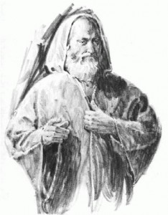
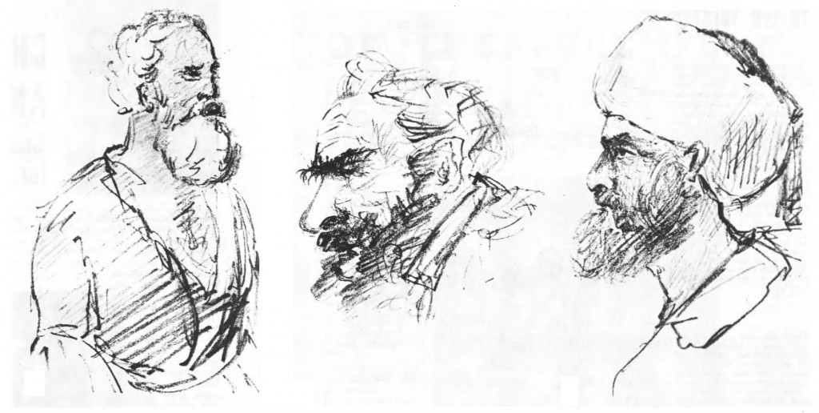
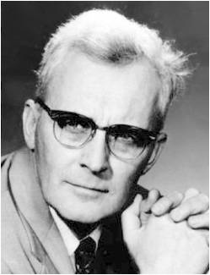
Enoch’s Time
“In the time of Enoch they committed murder, shedding of blood of the children of men; they enslaved them, they sold what did not belong to them, they entered homes without right, and took whatever they wanted … they rigged the laws in their favor, and imitated the abominable deeds of the rebellious angels of a former time in which, when Abel tried to check them they encompassed his death by a conspiracy.”
E. Kraeling quote by Hugh Nibley
Giants— Genesis 6:2, 4-5
Ambition was the motivating force in all this evil. “The giants were aspiring spirits who desired to be great in the manner of God on earth”;
Ben Sira 16:7
“the biblical term “men of name,” means “men who aspired to be great, ‘to make a name’ for themselves.”
E. Kraeling quoted by Hugh Nibley
Leo Tolstoy
Moses 6:26-28

Slide 17
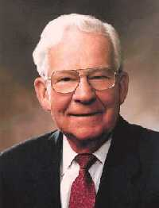
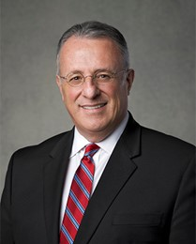
Enoch’s Calling
What concerns did Enoch express about his ability to fulfill the Lord’s call?
How does Enoch’s concern about his weaknesses show that he also could not “see afar off” at this time?
“All of us are particularly aware of our shortcomings and weaknesses. Therefore, it is easy for us to feel that we are unworthy of blessings we desire and that we are not as worthy to hold an office or calling as someone next door.”
Elder Marvin J. Ashton
If we faithfully do as the Lord commands, He will give us help and strength
“Upon acknowledging our dedication and perseverance, the Lord will give us that which we are not able to attain due to our imperfections and human weaknesses.”
Elder Ulisses Soares
Moses 6:26-28

Slide 18
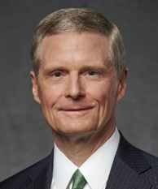
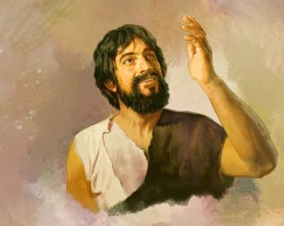
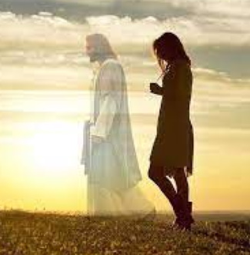
Abide and Walk With Him
Enoch ultimately became a mighty prophet and a tool in God’s hands to accomplish a great work, but he did not start his ministry that way! Rather, his capacity over time was magnified as he learned to abide in and walk with the Son of God. …
… [W]e abide in Christ as we are firm and steadfast in our devotion to the Redeemer and His holy purposes, in times both good and bad. …
Walking in and with the Savior highlights two vital aspects of discipleship: (1) obeying God’s commandments, and (2) remembering and honoring the sacred covenants that connect us to the Father and the Son. …
… If we abide in Him, He will abide in us. And as we walk in and with Him, we will be blessed to bring forth much fruit.
Moses 6:34 David A. Bednar

Slide 19
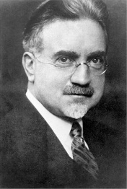
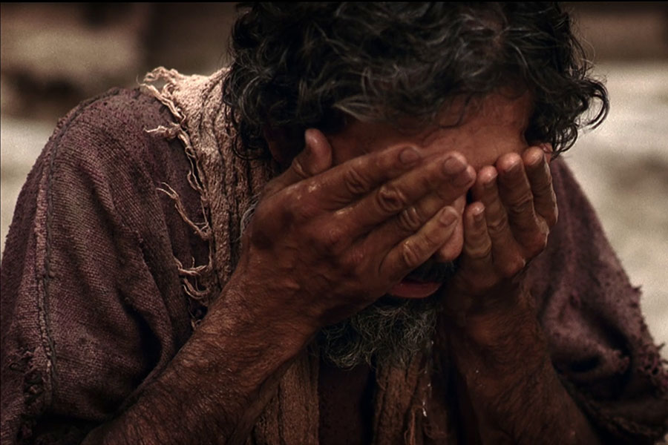
Enoch’s Instructions
Anointing the Eyes and washing
Compared to Jesus healing the blind
John 9:6-9
“A seer is one who sees with spiritual eyes. He perceives the meaning of that which seems obscure to others; therefore he is an interpreter and a clarifier of eternal truth.
He foresees the future from the past and the present.
This he does by the power of the Lord operating through him directly, or indirectly with the aid of divine instruments such as the Urim and Thummim.
He is the one who sees, who walks in the Lord’s light with open eyes.”
John A. Widtsoe
By strict obedience and with the Lord’s help, we can see with spiritual eyes.
Food for Thought:
Did Enoch have the Urim and Thummim?
Moses 6:35-38

Slide 20
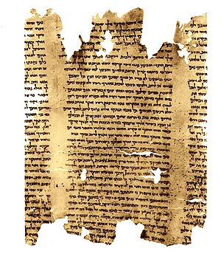
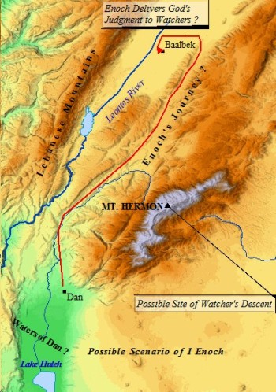
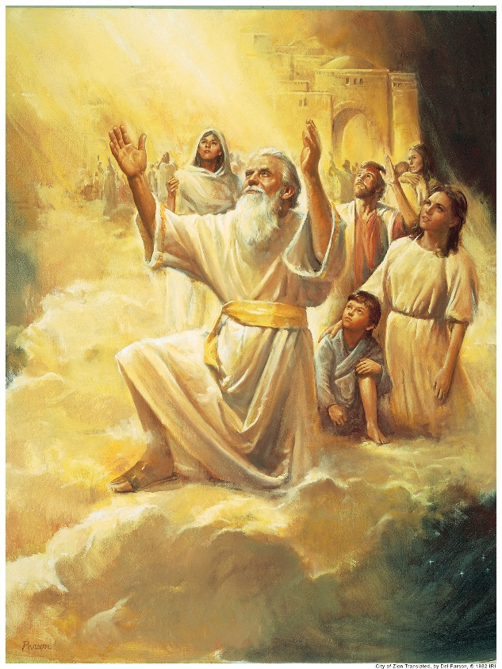
Mahijah
Where are you from?
Enoch declares his divine authority and his priesthood linage
Book of Enoch & Jubilees
Moses 6:40-42

Slide 21
The Fall and The Rescue
Moses 6:48-68
The F
A
L
L
Atonement

Slide 22


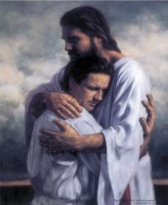
The Rescue
What did you have to do in order to be rescued?
What caused the need to be rescued?
Who rescued you?
Making a wrong choice
To be willing to receive the rescuer

Slide 23



Enoch Teaches About The Fall
Because of the Fall…
Human life is made possible
We will experience death
Misery and woe becomes our fate--subject to the pains, sicknesses, sorrows, and difficulties of mortal life
Moses 6:48

Slide 24
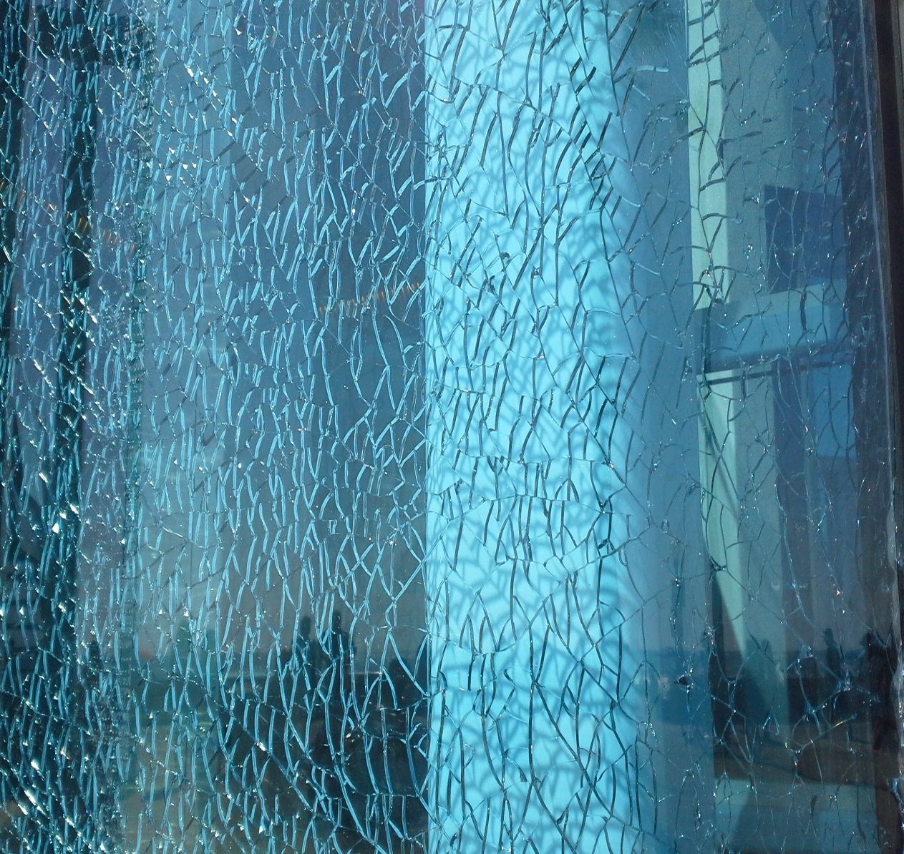
Being Human
carnal and sensual-- being preoccupied with worldliness and the gratification of physical desires, lusts, and pleasures.
Devilish-- being influenced by the devil. Explain that these words do not mean that our bodies are evil. Rather, they describe an aspect of our fallen condition and the consequences of yielding to the enticements of Satan
Our bodies are not evil. This is a fallen condition and we are influenced by the enticements of Satan.
Moses 6:49

Slide 25


Original Sin
Because of the Fall of Adam and Eve, all people live in a fallen condition, separated from God and subject to physical death.
However, we are not condemned by what many call the “original sin.”
We are not accountable for Adam's transgression in the Garden of Eden.
“We believe that men will be punished for their own sins, and not for Adam's transgression”
(Articles of Faith 1:2)
Moses 6:49 LDS Topics

Slide 26
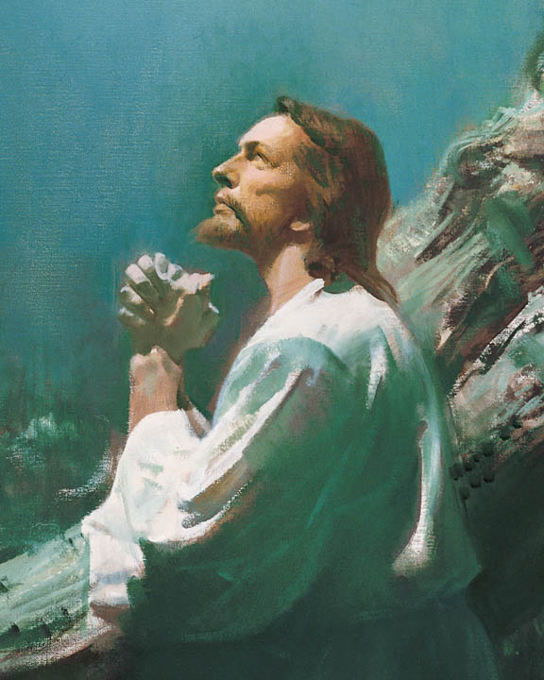
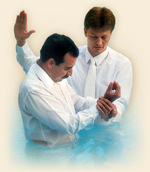
The Price to Be Paid
Through the Atonement, the Savior paid the price for the transgression in the Garden of Eden.
He has given us the assurance of resurrection and the promise that, based on our faithfulness, we can return to dwell in the presence of our Heavenly Father forever.
We can receive the blessings of salvation only through Jesus Christ
Moses 6:50-53 LDS Topics

Slide 27
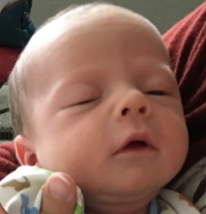


Born Into World of Sin
“thy children are conceived in sin” in verse 55 means that we are “born into a world of sin,” a world in which evil exists and influences us in our fallen state.
Elder Bruce R. McConkie
“There is no such thing as original sin as such is defined in the creeds of Christendom. Such a concept denies the efficacy of the atonement. Our revelation says: “Every spirit of man was innocent in the beginning’—meaning that spirits started out in a state of purity and innocence in pre-existence—’and God having redeemed man from the fall, men became again, in their infant state, innocent before God…meaning that all children start out their mortal probation in purity and innocence because of the atonement.”
Joseph Fielding Smith
But little children are holy, being sanctified through the atonement of Jesus Christ; and this is what the scriptures mean.
D&C 74:7
Moses 6:54-55

Slide 28

Agents Unto Themselves
He has given us our agency to think and act for ourselves, on our own volition, to obtain a testimony for ourselves from Him concerning the truth of the principles which he teaches, and then be firm and unshaken in the performance of all which is necessary for salvation.”
Wilford Woodruff
Wherefore, men are free according to the flesh; and all things are given them which are expedient unto man. And they are free to choose liberty and eternal life, through the great Mediator of all men…
2 Nephi 2:27
“…we frequently blame Satan for much of the misery that we are bringing upon ourselves. Satan has no power over us except as we give it to him.”
Sterling W. Sill
If we use our agency to repent, we can inherit the kingdom of God
Moses 6:54-55

Slide 29
The Pit
Lesley Meacham and Becky Davies
The F
A
L
L
Endure
Doctrine
of
Christ
Atonement
Receive the Holy Ghost
Baptism
Repentance
Faith
People in the Pit don’t know they need to be saved. What makes them aware of the Pit?
Testimony borne by others/scriptures
What moves them to find the ladder? Faith in the testimony and accompanying Spirit
What does one have to do to begin climbing? Shake off the dirt of the word—repent
What are the rungs on the ladder? Covenants
What can we do to keep our covenants? D&C 29:36
Where do we get our power? Personal Integrity. By keeping our word. By not simply knowing, but doing and “being” truth in everything.

Slide 30
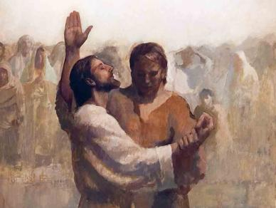
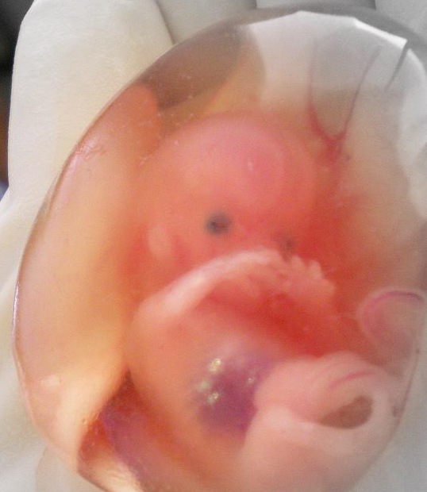

Born Again
“Every child that comes into this world is carried in water, is born of water, and of blood, and of the spirit.
So, when we are born into the kingdom of God, we must be born in the same way.
Baptized by Water
By baptism, we are born of the water.
Through the shedding of blood of Christ, we are cleansed and sanctified; and we are justified, through the Sprit of God, for baptism is not complete without the baptism of the Holy Ghost.”
Joseph Fielding Smith
We must be born again in order to be sanctified from all sin and to inherit eternal life
Moses 6:59

Slide 31
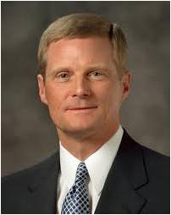


A Spiritual Process
To be born again is the spiritual process by which we come alive to things of the Spirit and gradually lose our desire to break God’s commandments.
“We begin the process of being born again through exercising faith in Christ, repenting of our sins, and being baptized by immersion for the remission of sins.”
Elder David A. Bednar
Moses 6:59

Slide 32
Justified
To be pardoned from punishment for sin and declared guiltless.
A person is justified by the Savior’s grace through faith in him.
This faith is shown by repentance and obedience to the laws and ordinances of the gospel.
Jesus Christ’s atonement enables mankind to repent and be justified or pardoned from punishment they otherwise would receive.
Guide to the Scriptures
repentance
SIN
The process of becoming free from sin, pure, clean, and holy through the atonement of Jesus Christ
Moses 6:60

Slide 33
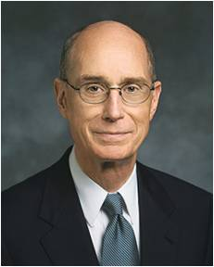
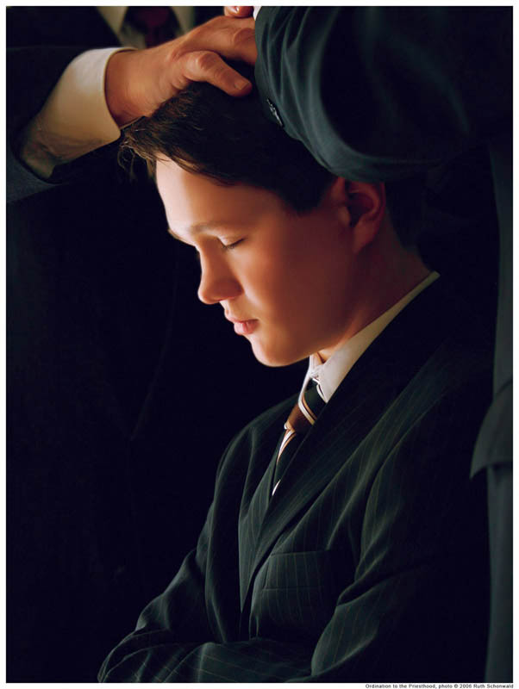
The Holy Ghost
“Reception of the Holy Ghost is the cleansing agent as the Atonement purifies you. …
“… And when he is your companion, you can have confidence that the Atonement is working in your life”
President Henry B. Eyring
Moses 6:60

Slide 34
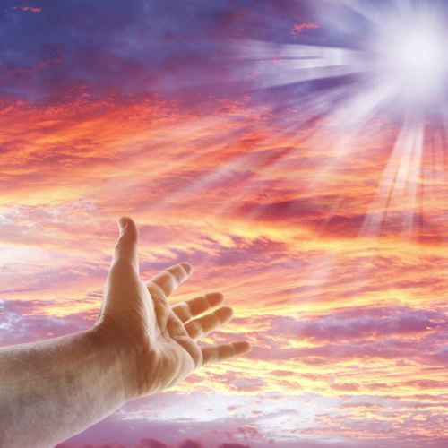
All Things Point to Christ
And behold, all things have their likeness, and all things are created and made to bear record of me, both things which are temporal, and things which are spiritual; things which are in the heavens above, and things which are on the earth, and things which are in the earth, and things which are under the earth, both above and beneath: all things bear record of me.
Moses 6:63

Slide 35
Sources:
Video:
We Must Be “Born Again” (1:55)
Old Testament Who’s Who by Ed J. Pinegar and Richard J. Allen pg. 170
Bruce R. McConkie Mormon Doctrine p. 100
Joseph Fielding Smith Doctrine of Salvation 2:200-201
Spencer W. Kimball Ensign May 1978
Teachings of Presidents of the Church: Joseph Smith [2007], 104
Elder Dennis B. Neuenschwander Bridges and Eternal Keepsakes April 1999 Gen. Conf.
Woodrow Wilson—quoated in Rebirth of a Nation 1986; 12
E. Kraeling, in Journal of Near Eastern Studies, 6 (1947):197. quoted by Hugh Nibley A Strange Thing in the Land: The Return of the Book of Enoch, Part 8 Dec. 1976 Ensign
Ben Sira and the Giants of the Land: A Note on Ben Sira 16:7 quoted by Hugh Nibley MATTHEW J. GOFF Journal of Biblical Literature Vol. 129, No. 4 (WINTER 2010), pp. 645-655
Presentation by http://fashionsbylynda.com/blog/
Elder Ulisses Soares Be Meek and Lowly of Heart October 2013 Gen. Conf.
David A. Bednar (“Abide in Me, and I in You; Therefore Walk with Me,” Liahona, May 2023, 123–24, 125)
Elder Marvin J. Ashton On Being Worthy April 1989 Gen. Conf.
John A. Widtsoe, Evidences and Reconciliations 1:205-206
Elder Bruce R. McConkie (see A New Witness for the Articles of Faith [1985], 101).
Joseph Fielding Smith Man: His Origin and Destiny , pp. 51-52
Way to Perfection, p. 190
Wilford Woodruff, in James R. Clark, Comp., Messages of the First Presidency, 3:137
Sterling W. Sill Conf. Report April 1970
Lesley Meacham and Becky Davies Poway Institute
Elder David A. Bednar (“Ye Must Be Born Again,” Ensign or Liahona, May 2007, 21).
President Henry B. Eyring (“Come Unto Christ” [Brigham Young University fireside, Oct. 29, 1989], 4; speeches.byu.edu).

Slide 36
The priesthood “is without beginning of days or end of years” (D&C 84:17). From the time of Adam and Eve, the priesthood and the ordinances of the gospel were available as we have them today (see Moses 5:58–59; see also D&C 107:40–42). The Prophet Joseph Smith taught:
“The Priesthood was first given to Adam; he obtained the First Presidency, and held the keys of it from generation to generation. He obtained it in the Creation, before the world was formed. …
“The Priesthood is an everlasting principle, and existed with God from eternity, and will to eternity, without beginning of days or end of years [see Joseph Smith Translation, Hebrews 7:3]. The keys have to be brought from heaven whenever the Gospel is sent. When they are revealed from heaven, it is by Adam’s authority” (Teachings of Presidents of the Church: Joseph Smith[2007], 104).
Why did the Prophets Live So Long?
While we are not entirely sure why many of the Old Testament patriarchs lived such long lives, here are a few possible explanations:
“The question is not completely resolved in scripture, but several possible answers are implied. Some have interpreted 2 Nephi 2:21 as referring to those living before the Flood: ‘The days of the children of men were prolonged, according to the will of God, that they might repent while in the flesh.’ Others have suggested that it was righteousness that increased the length of their lives. Josephus asserted that ‘God afforded [the ancients] a longer time of life on account of their virtue, and the good use they made of it in astronomical and geometrical discoveries, which would not have afforded the time of foretelling [the periods of the stars] unless they had lived six hundred years’ (Antiquities of the Jews, book 1, chapter 3, paragraph 9).
“President Brigham Young likewise attributed the patriarchs’ longevity to their obedience to the ‘laws of life.’ He urged the early Saints to cease ‘wasting their lives and the lives of their fellow-beings, and the precious time God has given us to improve our minds and bodies … , so that the longevity of the human family may begin to return’ (in Journal of Discourses,14:89). A passage in the Book of Mormon supports the idea that the Lord will ‘lengthen out’ the days of the righteous (Helaman 7:24).
“Others have suggested that the earth’s environment may have changed radically at the time of the Flood and that this accounts for the decrease in longevity immediately thereafter (see Moses 8:17).
“Among other possible purposes for the prolonged life span of the ancient patriarchs was the Lord’s need to establish truth through his law of witnesses. In Lectures on Faith, we read: ‘It is easily to be seen, not only how the knowledge of God came into the world, but upon what principle it was preserved; that from the time it was first communicated, it was retained in the minds of righteous men, who taught not only their own posterity but the world; so that there was no need of a new revelation to man, after Adam’s creation to Noah, to give them the first idea or notion of the existence of … the true and living God’ (Joseph Smith, compiler [1985], 20).
“All these factors are feasible explanations. They are not mutually exclusive, nor do they exhaust the possibilities” (Thomas R. Valletta, “I Have a Question: The Length of the Lives of the Ancient Patriarchs,” Liahona, Mar. 1998, 45).
Urim and Thummim
Hebrew term that means “Lights and Perfections.” An instrument prepared of God to assist man in obtaining revelation from the Lord and in translating languages. See Ex. 28:30; Lev. 8:8; Num. 27:21; Deut. 33:8; 1 Sam. 28:6; Ezra 2:63; Neh. 7:65; JS—H 1:35.
Using a Urim and Thummim is the special prerogative of a seer, and it would seem reasonable that such instruments were used from the time of Adam. However, the earliest mention is in connection with the brother of Jared (Ether 3:21–28). Abraham used a Urim and Thummim (Abr. 3:1–4), as did Aaron and the priests of Israel, and also the prophets among the Nephites (Omni 1:20–21; Mosiah 8:13–19; 21:26–28; 28:11–20;Ether 4:1–7). There is more than one Urim and Thummim, but we are informed that Joseph Smith had the one used by the brother of Jared (Ether 3:22–28; D&C 10:1; 17:1). (See Seer.) A partial description is given in JS—H 1:35. Joseph Smith used it in translating the Book of Mormon and in obtaining other revelations.
This earth in its celestial condition will be a Urim and Thummim, and many within that kingdom will have an additional Urim and Thummim (D&C 130:6–11).
The Urim and Thummim consist of two stones set in silver bows and sometimes used with a breastplate. Topical Guide to Scriptures
I, Abraham, had the Urim and Thummim: Abr. 3:1, 4;
Seer
“A seer is a revelator and a prophet also” (Mosiah 8:15–16), and when necessary he can use the Urim and Thummim or holy interpreters (Mosiah 8:13; 28:16). There have been many seers in the history of God’s people on this earth but not so many as there have been prophets. “A seer is greater than a prophet … and a gift which is greater can no man have …” (Mosiah 8:15–18). Joseph Smith is the great seer of the latter days. In addition, the First Presidency and the Council of the Twelve are sustained as prophets, seers, and revelators.
Bible Dictionary

Slide 37
Book of Enoch & Jubilees
Before the discovery of the Dead Sea Scrolls the apocryphal book of Enoch (more precisely, I Enoch) was known only in an Ethiopic translation. Now as many as twenty fragmentary copies of the Aramaic original have been found at Qumran, which suggests that Enoch and perhaps other books now considered apocryphal were regarded as authoritative Scripture at least by some groups. Allusions to Enoch occur at least fourteen times in the New Testament; the New Testament Letter of Jude quotes from Enoch as having the authority of inspired Scripture (Jude 14-15). In some copies of the Ethiopic Bible Enoch is included in the canon. By CK Quarterman
Book of Enoch & Jubilees

Slide 38
“Four generations and some five hundred years later, according to Adam’s book of remembrance, Enoch, of Seth’s line, was called to become a great prophet-missionary-reformer. His ministry was needed, for the followers of the line and cult of Cain had become numerous, and violence was rampant already in the fifth generation after Cain (Moses 5:28–31, 47–57). Unto those who had become sensual and devilish Enoch preached repentance. The sons of God, distinguished from the ‘sons of men,’ were obliged to segregate themselves in a new home called ‘Cainan’ after their forefather, the son of Enos. (Do not confuse this Cainan with the wicked people of Canaan of Moses 7:6–10.
“Against the evils of the time, which he was called to combat (Moses 6:27–29), Enoch was successful; he was able to build up a righteous culture called ‘Zion,’ meaning, ‘the pure in heart.’ (Moses 7:18 ff.)
The teachings of Enoch cover some seven major categories and embrace some information found nowhere else in scripture. He dealt with:
(1) the fall of man and its results;
(2) the nature of salvation and the means of achieving it;
(3) sin, as seen in the evils of his times, in contrast to the righteousness of the godly who were his followers;
(4) the cause, purpose, and effects of the anticipated flood of Noah;
(5) the scope of Satan’s triumph and the resultant sorrows of God;
(6) the first advent of the Messiah;
(7) the second advent of the Messiah and his peaceful, millennial reign.
The details of his Gospel concepts are worth careful study and attention. Mention of this great man is also found in the New Testament (Jude 14, 15; Hebrews 11:5)
(Rasmussen, Introduction to the Old Testament, 1:24–25.)
Water, Spirit, and Blood
Elder Bruce R. McConkie of the Quorum of the Twelve Apostles taught how water, spirit, and blood are essential elements of both our physical and spiritual births:
“Two births are essential to salvation. Man cannot be saved without birth into mortality, nor can he return to his heavenly home without a birth into the realm of the Spirit. … The elements present in a mortal birth and in a spiritual birth are the same. They are water, blood, and spirit. Thus every mortal birth is a heaven-given reminder to prepare for the second birth. …
“In every mortal birth the child is immersed in water in the mother’s womb. At the appointed time the spirit enters the body, and blood always flows in the veins of the new person. Otherwise, without each of these, there is no life, no birth, no mortality.
“In every birth into the kingdom of heaven, the newborn babe in Christ is immersed in water, he receives the Holy Ghost by the laying on of hands, and the blood of Christ cleanses him from all sin. Otherwise, without each of these, there is no Spirit-birth, no newness of life, no hope of eternal life” (A New Witness for the Articles of Faith [1985], 288).
Essential For Our Salvation:
Elder D. Todd Christofferson of the Quorum of the Twelve Apostles explained how the gift of the Holy Ghost is essential to our salvation:
“The gift of the Holy Ghost is part of the new and everlasting covenant. It is an essential part of our baptism, the baptism of the Spirit. It is the messenger of grace by which the blood of Christ is applied to take away our sins and sanctify us (see2 Nephi 31:17). It is the gift by which Adam was ‘quickened in the inner man’ (Moses 6:65)” (“The Power of Covenants,” Ensign or Liahona, May 2009, 22).
…We frequently blame Satan for much of the misery that we are bringing upon ourselves. Satan has no power over us except as we give it to him.”

