Slide 1
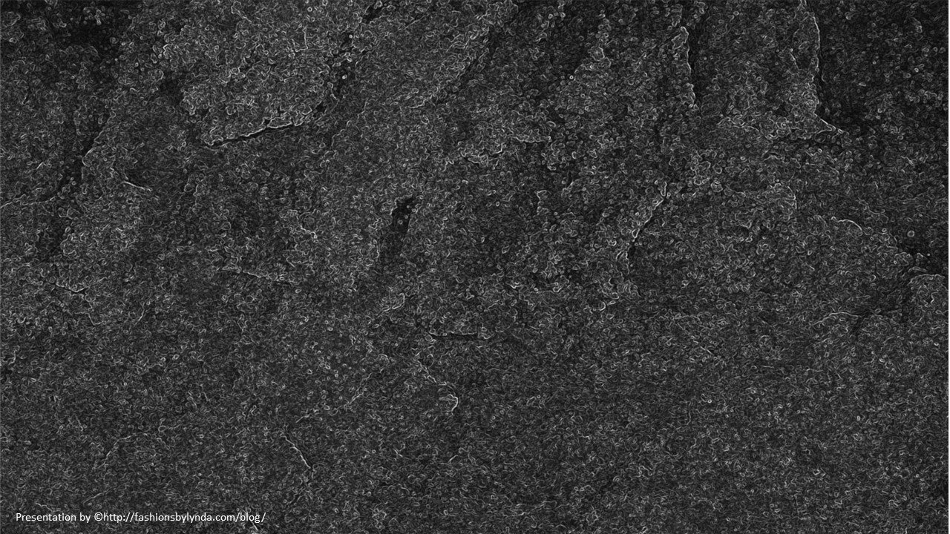
The Ten Commandments
Exodus 20:1-11
Part 1
And thou shalt observe to keep all my covenants wherein I covenanted with thy fathers; and thou shalt keep the commandments which I have given thee with mine own mouth, and I will be a God unto thee and thy seed after thee.
JST Genesis 17:12

Slide 2
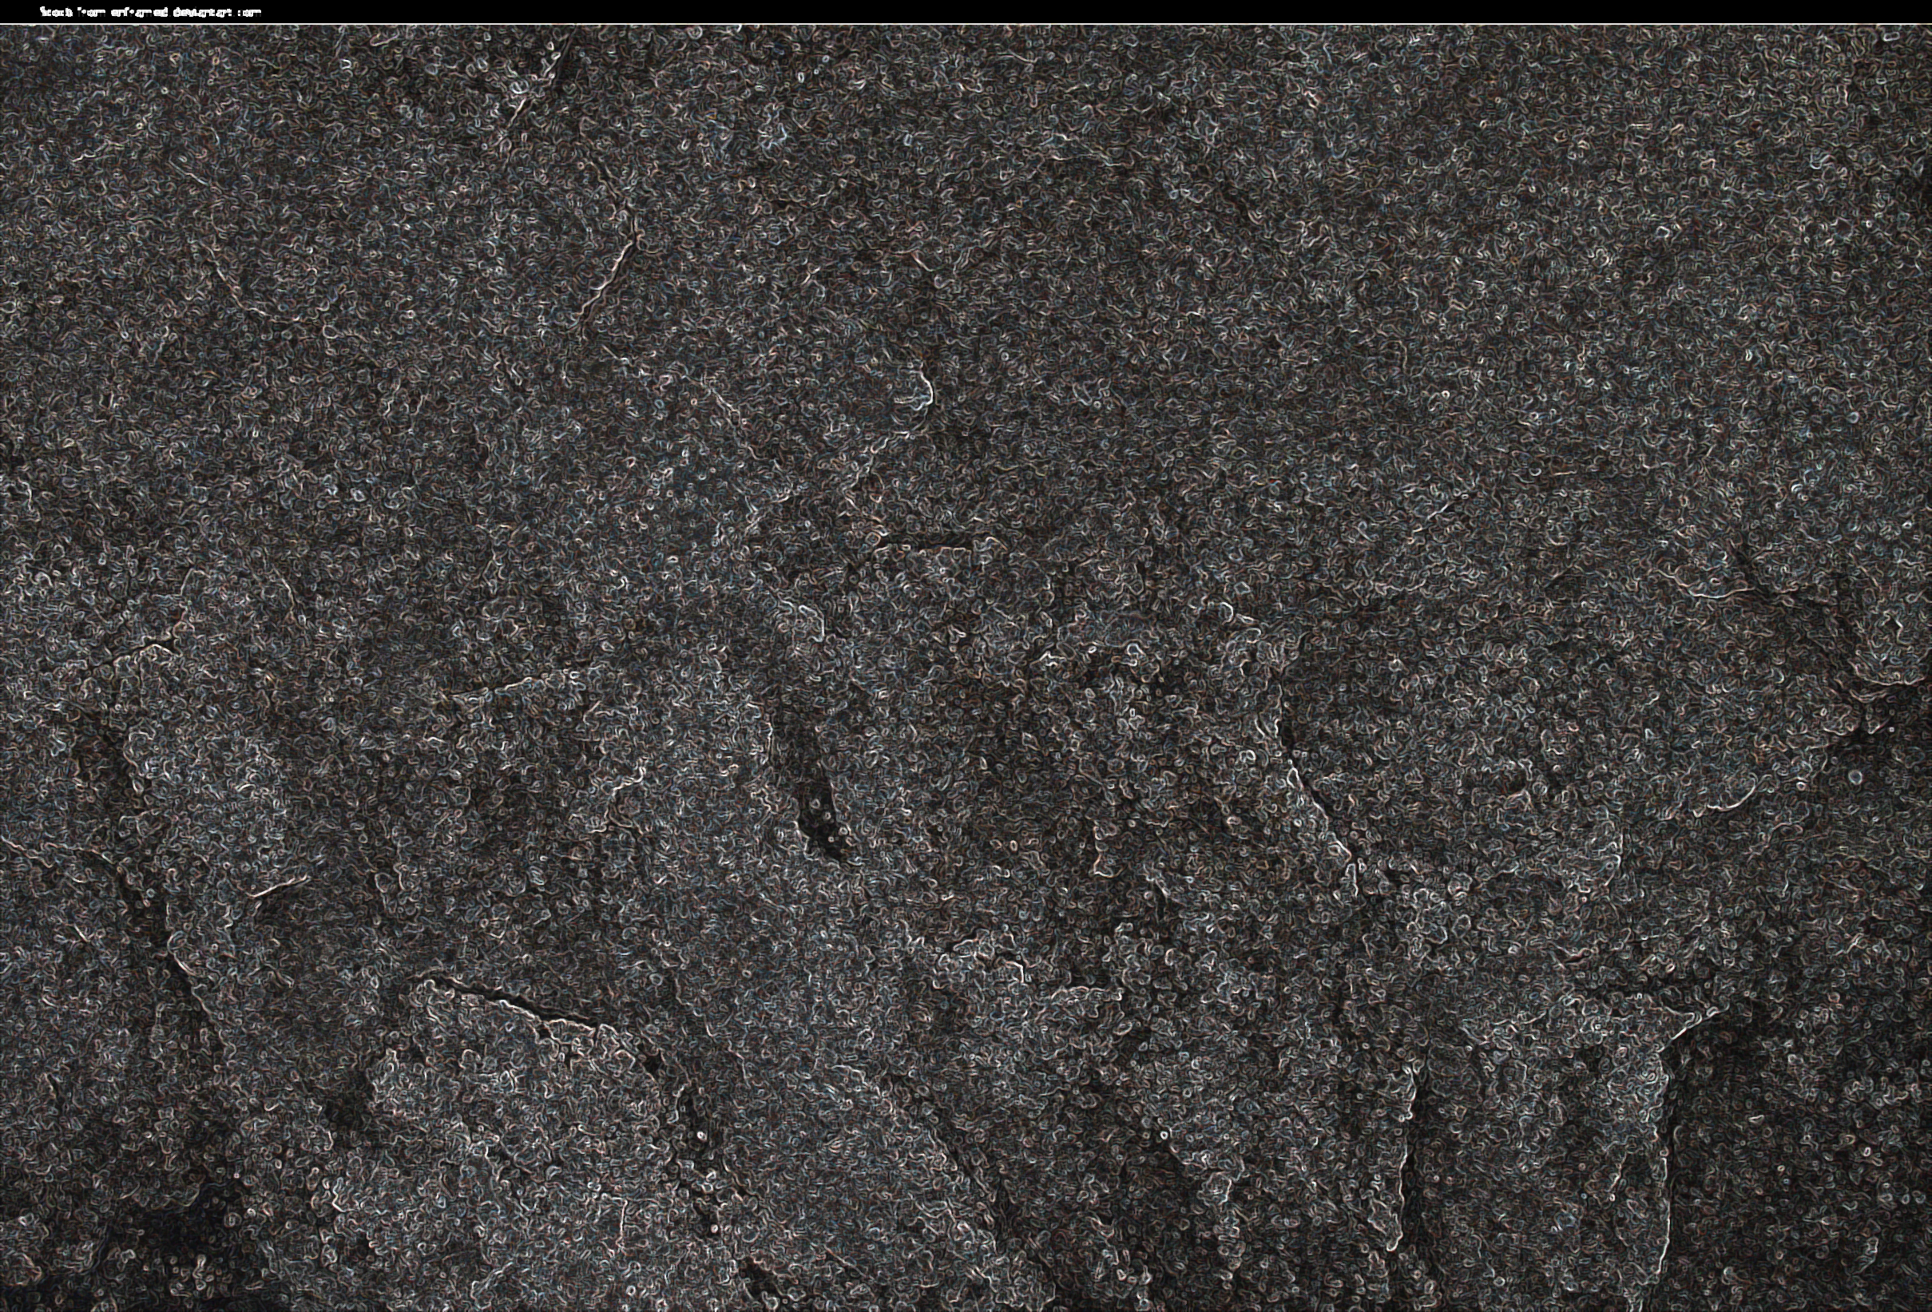
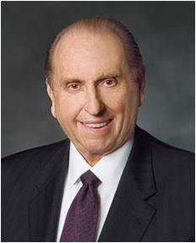
The Ten Commandments
“Although the world has changed, the laws of God remain constant. They have not changed; they will not change. The Ten Commandments are just that—commandments. They are not suggestions. They are every bit as requisite today as they were when God gave them to the children of Israel.”
(1)

Slide 3
Foundation Stones
Perhaps the greatest indication of the importance of the Ten Commandments is that they are found in three of the four standard works of the Church.
Old Testament
Although not given in the exact form that they appear in these scriptures, they are the same principles.
New Testament
1st time—
Exodus 20
2nd time—Deuteronomy 5:6-21
Holy Bible
Matthew 5:17-37
Doctrine and Covenants
The
Book
of
Mormon
Doctrine
And
Covenants
Book of Mormon
D&C 42:18-29
D&C 59:5-9
Mosiah 13:12-24
Abinadi quotes to wicked priests of King Noah
ANOTHER TESTAMENT
OF JESUS CHRIST
When the Lord emphasizes something with that much repetition, it must be important.
(2)

Slide 4
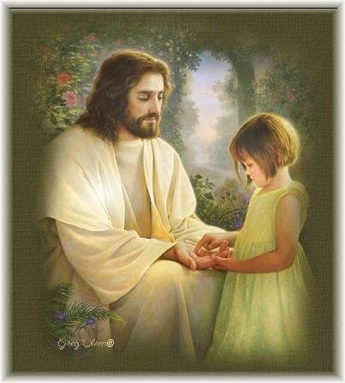
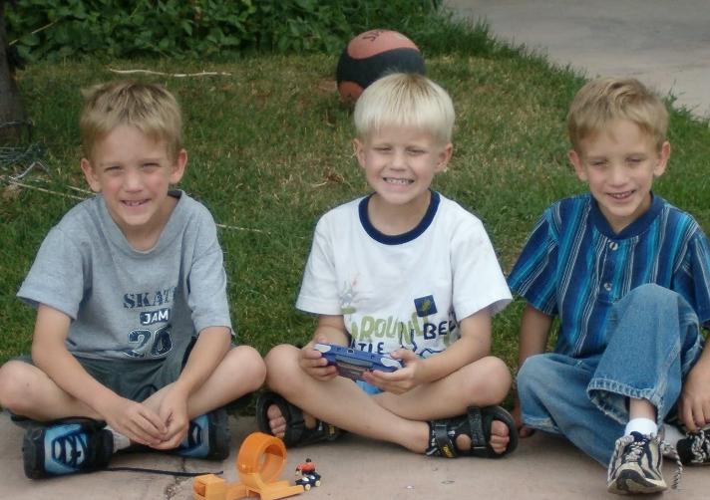
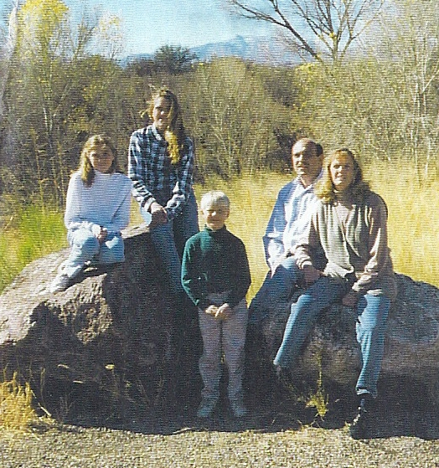
Being perfected in All Things
Commandment 6-10
Commandments 1-4
Shows us our proper relationship to God
Regulates our relationships with others
Commandment 5
Establishes the importance of the family and proper family relationships
If we are committed to the perfecting of our relationships with God, family, and others, we are well on our way to being perfected in all things.
(2)

Slide 5
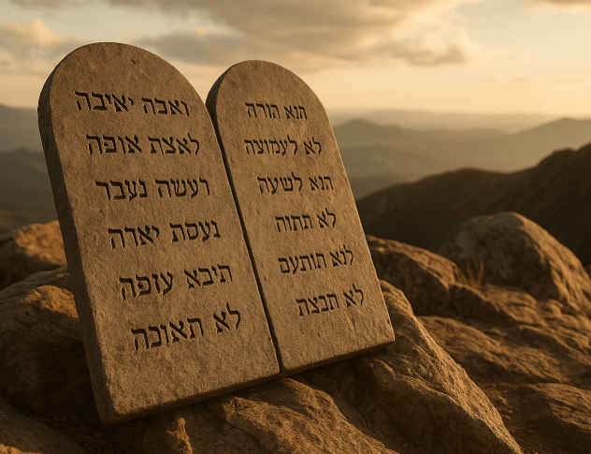
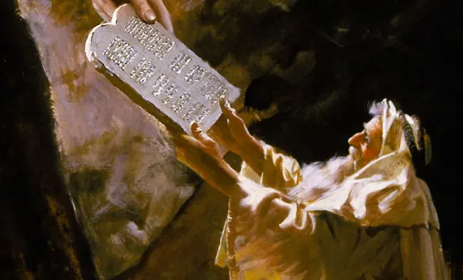
The lawGiver
For the Lord is our judge, the Lord is our lawgiver, the Lord is our king; he will save us. Isaiah 33:22
The Lawgiver, the Lord Himself gave the Ten Commandments to Israel by covenant.

Slide 6
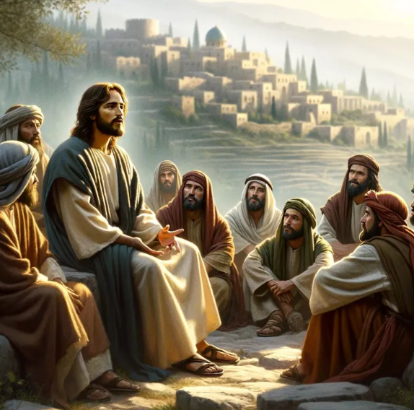
The Greatest Commandment
Master, which is the great commandment in the law?
Jesus said unto him, Thou shalt love the Lord thy God with all thy heart, and with all thy soul, and with all thy mind.
This is the first and great commandment.
And the second is like unto it, Thou shalt love thy neighbour as thyself.
Matthew 22:36-29

Slide 7
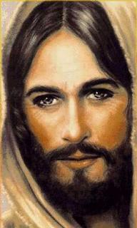
Our worship of God should be our highest priority, and we should give exclusive devotion to Him
Thou shalt have no other gods before me
Seek ye first the kingdom of God, and his righteousness.
Matthew 6:33
God commands us to love Him and put Him first in our lives.
Exodus 20:3

Slide 8
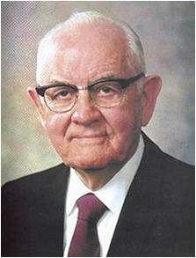
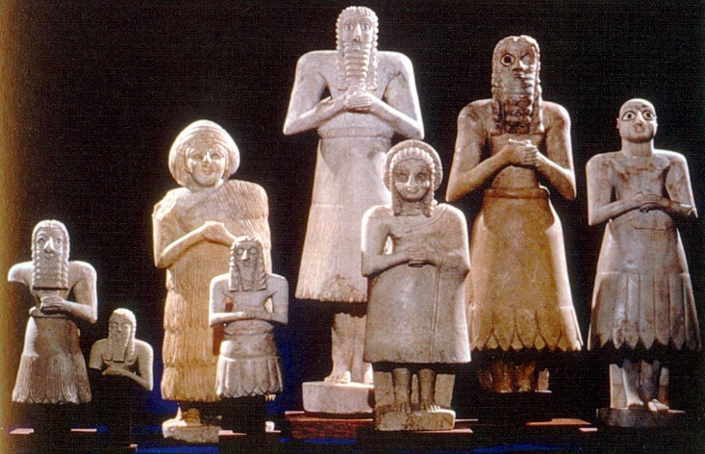
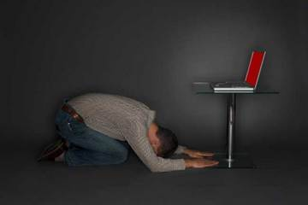
“The idolatry we are most concerned with here is the conscious worshipping of still other gods. Some are of metal and plush and chrome, of wood and stone and fabrics.
They are not in the image of God or of man, but are developed to give man comfort and enjoyment, to satisfy his wants, ambitions, passions and desires. Some are in no physical form at all, but are intangible. …
Thou shalt Not Make unto thee any graven image
“Modern idols or false gods can take such forms as clothes, homes, businesses, machines, automobiles, pleasure boats, and numerous other material deflectors from the path to godhood. What difference does it make that the item concerned is not shaped like an idol?”
Exodus 20:4
(3)

Slide 9
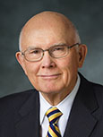
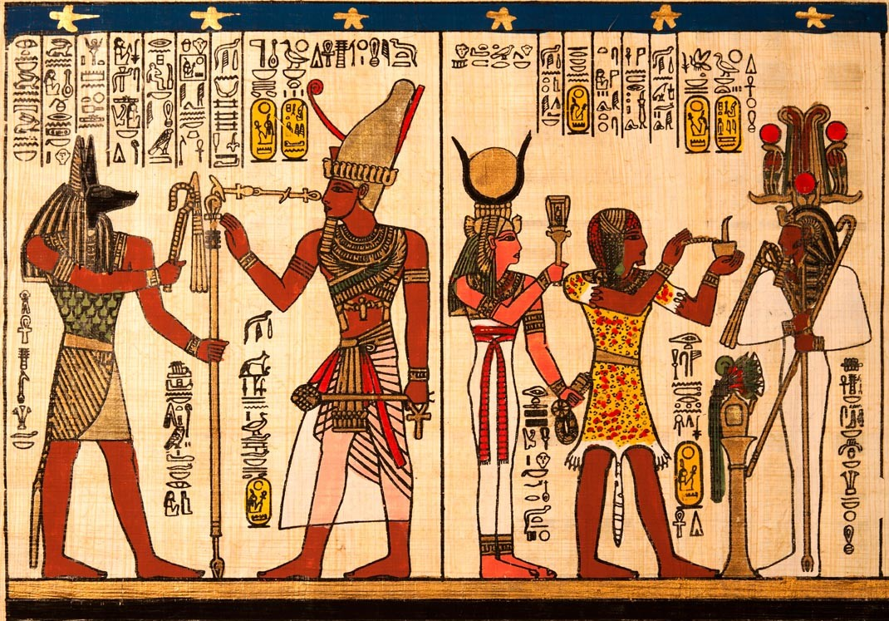
A jealous God
“The meaning of jealous is revealing. Its Hebrew origin means ‘possessing sensitive and deep feelings’
(Exodus 20:5, footnote b).
Thus we offend God when we ‘serve’ other gods—when we have other first priorities.”
When we love God and keep His commandments, He will show us mercy
Exodus 20:4-6
(4)

Slide 10
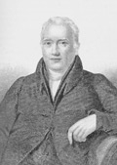
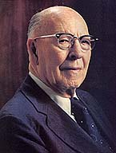
Uses of the names of Heavenly Father and Jesus Christ, including titles such as God and Lord, lightly, irreverently, or disrespectfully, would violate covenants that have been made in Their names.
Thou shalt not take the name of the Lord thy God in vain
“This precept not only forbids all false oaths, but all common swearing where the name of God is used, or where he is appealed to as a witness of the truth. It also necessarily forbids all light and irreverent mention of God, or any of his attributes.” (5)
“Profanity is incompatible with reverence. Surely at this critical time in our nation’s history, when we need the sustaining help of God, we should see that we do not offend him by reason of our language. We appeal to our young people everywhere to hold in reverence the sacred name of Deity, that they may walk acceptably before the Lord, so that, should there come a time in their lives when they need his sustaining help, they may go to him with good conscience and call upon him with faith that he will hear their plea.” (6)
His children must have a deep and reverential attitude about God and His name.
Exodus 20:7

Slide 11
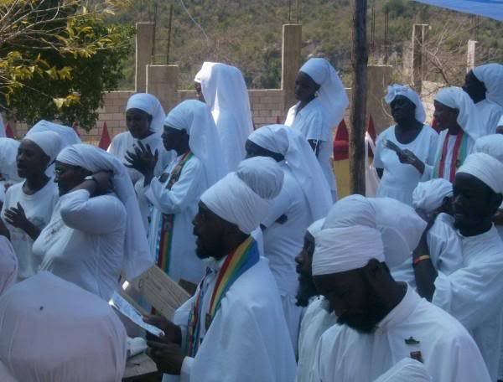
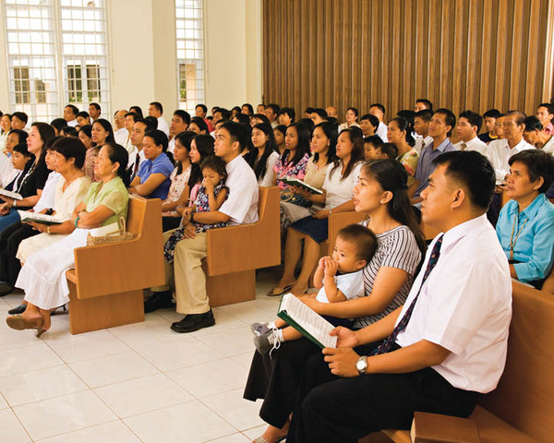
The Sabbath was given as a token or sign of the rest of the Gods after the work of the Creation.
The Hebrew word Shabbat means “rest,” or “the cessation of labor.”
The Sabbath is directly tied to the Creation not only in the actual commandment but in such scriptures as Genesis 2:1–2 and Exodus 31:17.
Remember the Sabbath day, to keep it Holy
“And that thou mayest more fully keep thyself unspotted from the world, thou shalt go to the house of prayer and offer up thy sacraments upon my holy day”
D&C 59:9
Ethiopia Africa Black International Congress
Now they, after being sanctified by the Holy Ghost, having their garments made white, being pure and spotless before God, could not look upon sin save it were with abhorrence; and there were many, exceedingly great many, who were made pure and entered into the rest of the Lord their God.
Alma 13:12
Exodus 20:8-11
(2)

Slide 12
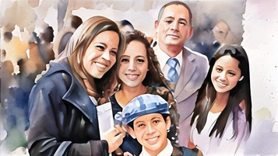


The Sabbath Day
The Sabbath is the Lord’s day and is holy.
Resting from our labors on the Sabbath can help us keep it a holy day.
For verily this is a day appointed unto you to rest from your labors, and to pay thy devotions unto the Most High;
D&C 59:10
The Sabbath day is already holy, our responsibility is to keep it holy..

Slide 13
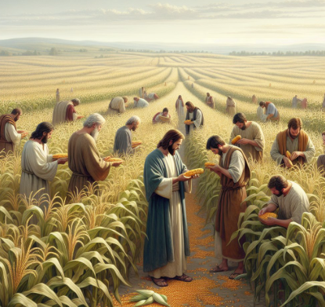
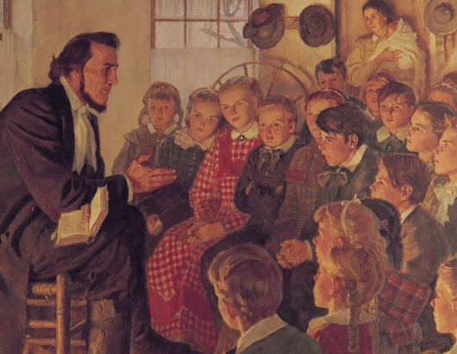
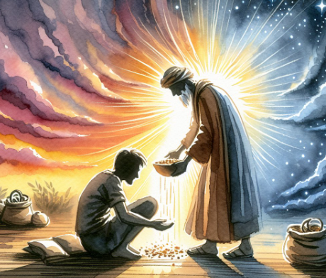
Keeping the Sabbath Day Holy
Matthew 12:1-13
Isaiah 58:13-14
D&C 59:9-17
Symbolizes the rich spiritual and material inheritance promised by God to those who honor Him by keeping the Sabbath day holy
And on this day thou shalt do none other thing, only let thy food be prepared with singleness of heart that thy fasting may be perfect, or, in other words, that thy joy may be full.
The act of picking and eating grain in the field also holds symbolic significance. In the Old Testament, grain is often used as a symbol of sustenance and provision from God. By engaging in this activity on the Sabbath, Jesus is highlighting the true purpose of the Sabbath as a day of rest and sustenance provided by God.

Slide 14
Doctrinal Mastery
Thou shalt have no other gods before me.
Thou shalt not make unto thee any graven image, or any likeness of any thing that is in heaven above, or that is in the earth beneath, or that is in the water under the earth:
Thou shalt not bow down thyself to them, nor serve them: for I the Lord thy God am a jealous God, visiting the iniquity of the fathers upon the children unto the third and fourth generation of them that hate me;
And shewing mercy unto thousands of them that love me, and keep my commandments.
Thou shalt not take the name of the Lord thy God in vain; for the Lord will not hold him guiltless that taketh his name in vain.
Remember the sabbath day, to keep it holy.
Six days shalt thou labour, and do all thy work:
But the seventh day is the sabbath of the Lord thy God: in it thou shalt not do any work, thou, nor thy son, nor thy daughter, thy manservant, nor thy maidservant, nor thy cattle, nor thy stranger that is within thy gates:
Exodus
20:3-17
(7)

Slide 15
For in six days the Lord made heaven and earth, the sea, and all that in them is, and rested the seventh day: wherefore the Lord blessed the sabbath day, and hallowed it.
Honour thy father and thy mother: that thy days may be long upon the land which the Lord thy God giveth thee.
Thou shalt not kill.
Thou shalt not commit adultery.
Thou shalt not steal.
Thou shalt not bear false witness against thy neighbour.
Thou shalt not covet thy neighbour’s house, thou shalt not covet thy neighbour’s wife, nor his manservant, nor his maidservant, nor his ox, nor his ass, nor any thing that is thy neighbour’s.
Exodus
20:3-17
(7)

Slide 16
Sources:
Videos:
“Upon My Holy Day—Honoring the Sabbath” (1:30)
“The Ten Commandments” (2:13)
“Obedience to the Commandments” (3:10)
President Thomas S. Monson (“Stand in Holy Places,” Ensign or Liahona, Nov. 2011, 83).
Old Testament Institute Manual
President Spencer W. Kimball (Miracle of Forgiveness, pp. 40–42.)
Elder Dallin H. Oaks (“No Other Gods,” Ensign or Liahona, Nov. 2013, 72).
(Clarke, Bible Commentary, 1:404.) excerpt in Old Testament Institute Manual
Elder LeGrand Richards (In “The Third Commandment,” The Ten Commandments Today, pp. 52–53.)
Presentation by ©http://fashionsbylynda.com/blog/

Slide 17
Elder Mark E. Petersen said:
“By his own finger the Lord wrote the Ten Commandments on tablets of stone. They represent the basic law of the Almighty and have formed the underlying elements of civil and religious law ever since.
“They are fundamental to our relationships with God. They are an integral part of the restored gospel of the Lord Jesus Christ and are essential to our becoming perfect as our Father in heaven is perfect. (D&C 42; D&C 59.)
“Variations of these laws are given in the rules laid down in Leviticus and Deuteronomy as they are applied to specific matters, but generally they form the foundation for all proper human conduct.” (Moses, p. 110.)
Sabbath:
Under the Mosaic dispensation, the violation of the Sabbath was a capital crime (see Exodus 31:14–15). A noted Bible scholar made an important point about why this punishment was the case:
“The death penalties attached to the violation of the sabbath in the Old Testament era convey two very obvious assumptions. First, the sabbath law involves a principle so important and basic that violation thereof is a capital offense. Second, the law conveys also the fact that violation of the sabbath laws involves a kind of death in and of itself, i.e., that violation brings on death. The prophets clearly made this assumption. Obedience, by implication, means life.” (Rushdoony, Institutes of Biblical Law, p. 137.)
The commandment to observe the Sabbath was not just for an individual himself but included servants (employees), family members, and animals. Under the Mosaic law even the land itself was to have its rest once each seven years (see Exodus 20:10; Leviticus 25:1–7). Imagine the faith required to trust wholly in the providence of God rather than in the labors of one’s own hands every seventh year. (That challenge was given in Leviticus 25:20–22.)
Joseph F. Smith:
I believe with all my soul in the gospel of Jesus Christ, and in the law of God, and I do not think any honest and intelligent man or woman could help but believe in the justice, the righteousness and the purity of the laws that God wrote upon the tablets of stone., These principles that I propose to read to you are the foundation and basic principles of the Constitution of our country, and are eternal, enduring forevermore, and cannot be changed nor ignored with impunity. (Gospel Doctrine: Selections from the Sermons and Writings of Joseph F. Smith, compiled by John A. Widtsoe [Salt Lake City: Deseret Book Co., 1939], 401)
Ezra Taft Benson:
I would urge you to heed strictly the commandments of God, particularly the Ten Commandments. As long as we regard God as our Sovereign and uphold His laws, we shall be free from bondage and be protected from external danger.
God has not left us alone to flounder over right and wrong in the area of personal ethics and morality. His laws are circumscribed in the Decalogue-the Ten Commandments. These laws embody our relationships with God, family, and fellowmen. Yes, the Ten Commandments and the Sermon on the Mount are the foundation principles upon which our personal happiness is predicated. To disregard them will lead to inevitable personal character loss and ruin. (The Teachings of Ezra Taft Benson [Salt Lake City: Bookcraft, 1988], 353)
Spencer W. Kimball:
Moses came down from the quaking, smoking Mount Sinai and brought to the wandering children of Israel the Ten Commandments, fundamental rules for the conduct of life. These commandments were, however, not new. They had been known to Adam and his posterity, who had been commanded to live them from the beginning, and were merely reiterated by the Lord to Moses. (The Teachings of Spencer W. Kimball, edited by Edward L. Kimball [Salt Lake City: Bookcraft, 1982], 150)

Slide 18
Possible Calendar of the Israelites in the Wilderness
Sun | Mon | Tues | Wed | Thurs | Fri | Sat
 |  |  | 56 Thunder and Lightening and thick clouds on Mt. Sinai on the morning of the third day. | 57 Moses descend a 4th time to warn people with Aaron (Ex. 19:21-25) | 58 Moses descends 5th time with Aaron and ascends with Aaron, Nadab, Abihu, 70 elders (Ex. 24:9-11) | 59 4th Sabbath kept by Israel since in Wilderness of Sin
60 6th ascension Ex 24:18 Moses spends 40 days at summit | 61-100 Moses Reveals the 10 Commandments
God reveals for the first time, the 10 Commandments and the plan for the tabernacle.
The people party and build the Golden calf. from day 56 to day 96 when Moses returns.
So about 100 days after leaving Egypt, Moses descends Mt. Sinai.
Moses physically throws 10 commandments at the people who had made the golden calf.
http://www.bible.ca/archeology/bible-archeology-exodus-route-travel-times-distances-days.htm

Slide 19
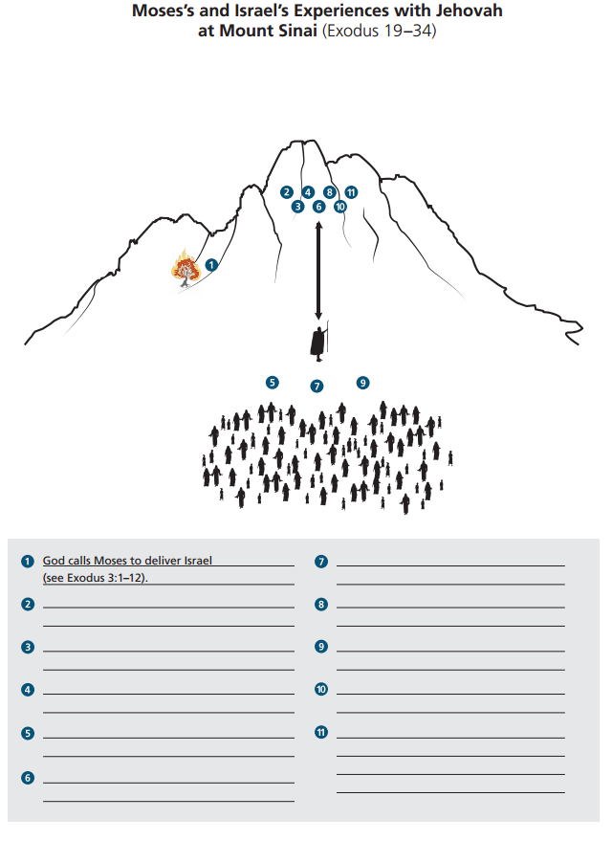
God invites Israel to be His covenant People (Exodus 19:3-6)
Moses reports Israel’s desire to enter God’s Covenant (Ex. 19:7-8)
God warns that the people are not yet prepared to enter His presence (Ex. 19:20-21, 25)
God Speaks the Ten Commandments to Israel (Ex. 19-20)

