Slide 1

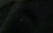
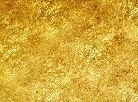












Two Stone Tablets
Exodus 28-29 and 31
And he gave unto Moses, when he had made an end of communing with him upon mount Sinai, two tables of testimony, tables of stone, written with the finger of God.
Exodus 31:18

Slide 2

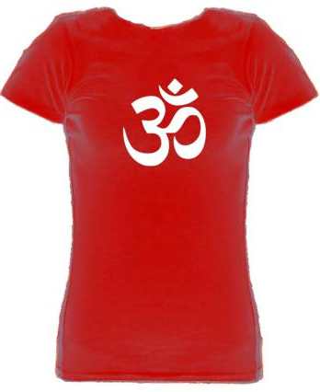
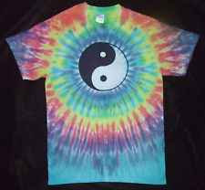
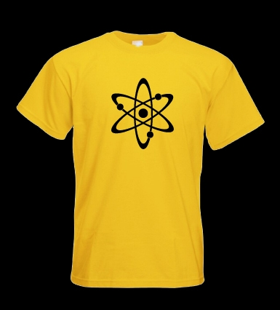
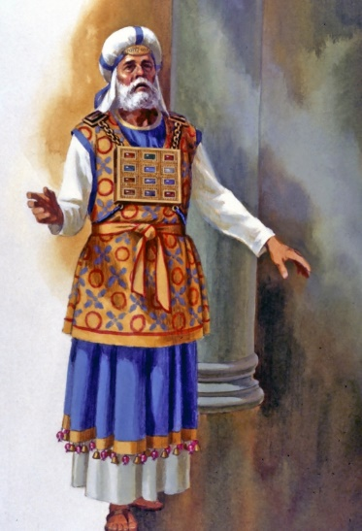
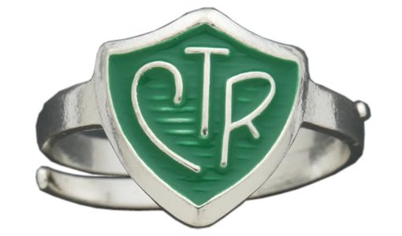
Symbols on Clothing
Yin Yang symbol—opposites or contrary
Dark/bright
Good/bad
Female/Male
Ohm om aum yoga symbols
Atomic symbol—Big Bang Theory
The Lord often uses symbols to teach or remind us of gospel truths.
Items of clothing are sometimes used as symbols for this purpose.

Slide 3
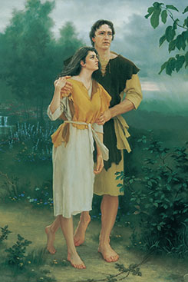
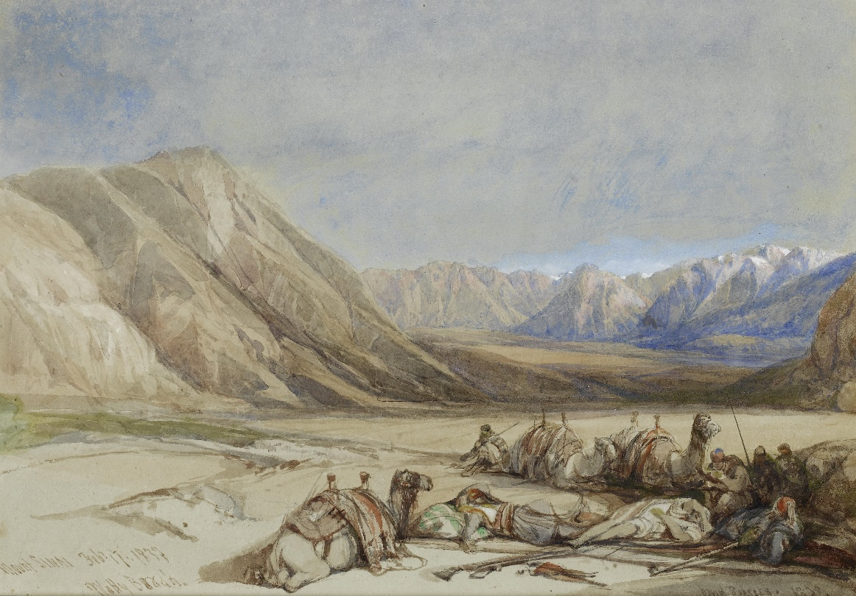
Sacred Religious Clothing
When Moses was on Mount Sinai for 40 days, the Lord revealed to him details concerning the tabernacle as well as the sacred clothing that was to be worn by the priests who would serve in the tabernacle.
Sacred religious clothing has been used symbolically since the Lord made “coats of skins” for Adam and Eve before they were cast out of the Garden of Eden
Genesis 3:21

Slide 4
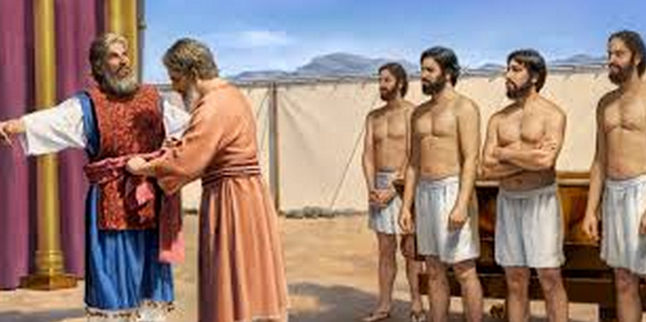
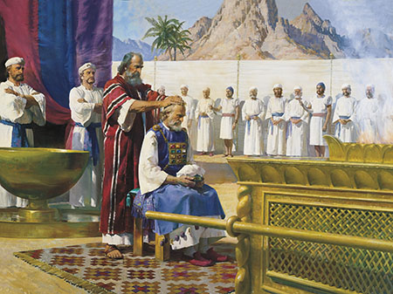
Aaron and Priests Clothing
Nadab and Abihu, Eleazar and Ithamar, Aaron’s sons.
The purpose of the clothing
was to consecrate them
Exodus 28:1-3

Slide 5

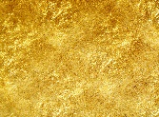







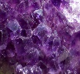




The Clothing
The Undergarment
(White Tunic)
The Upper Robe (Blue)
The robe was] woven in one piece, which set forth the idea of wholeness or spiritual integrity; and the dark-blue colour indicated nothing more than the heavenly origin and character of the office with which the robe was associated. (Ex. 28:31)
The golden diadem and the mitre—
Engraved on the band were the words “Holiness to the Lord”
(Ex. 28:36-38)
The Fringe— Pomegranate and gold
Every Israelite is directed to make a fringe in the border of his garment, of dark-blue purple thread, and when he looks at the fringe to remember the commandments of God and do them.
(Ex. 28:33-34)
Breastplate--was made of fabric rather than of metal. It was twice as long as it was wide and when folded became a square pocket into which the Urim and Thummim was placed.
Stones inscribed with the names of each of the tribes of Israel.
(Ex. 28:13-29)
Ephod--This garment was fastened at each shoulder and had an intricately woven band with which it could be fastened around the waist.
(Ex. 28:12)
Onyx Stones--engraved with the names of the 12 sons of Israel as a ‘memorial’ as the priest served before the Lord (Ex. 28:9)

Slide 6






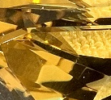



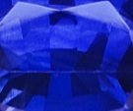
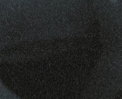
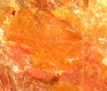
The Stones--Breastplate
The Lord instructed Moses to have the names of the twelve sons of Israel engraved on twelve stones in the breastplate of the high priest. The exact order, arrangement, and type of each stone was explicitly stated in Ex. 28:17-21, but the name to be written on each stone was not given, perhaps because it was obvious to Moses.
After the destruction of the temple, the knowledge of which tribe was associated with which stone was lost, and even the identity of some of the stones has been uncertain..
One of the long unsolved mysteries in the Bible is the identification of the twelve stones in the breastplate of the high priest. Most of those stones are mentioned only in that context, and so they have been extremely hard to identify.
The Lord specified birth order for listing the names of six tribes on each of the two shoulder stones of the high priest (Ex. 28:10), so many scholars assume the same order for the twelve stones. (2)
The high priest bore “the names of the children of Israel in the breastplate of judgment upon his heart … for a memorial before the Lord continually” (vs. 29)
Exodus 28:17-21

Slide 7
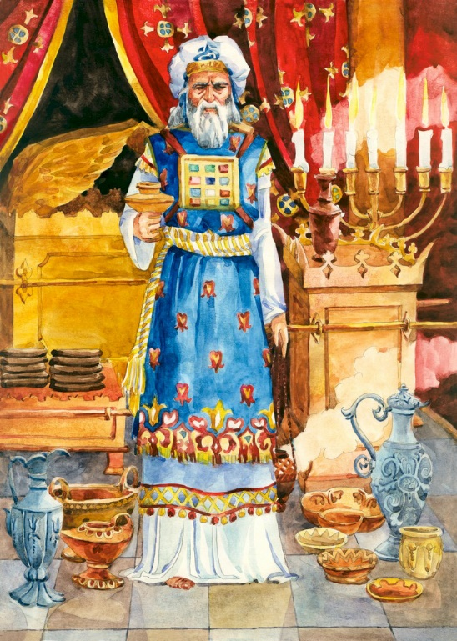
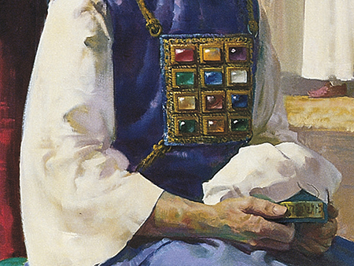
Jewels of Israel
Thou hast been in Eden the garden of God; every precious stone was thy covering, the sardius, topaz, and the diamond, the beryl, the onyx, and the jasper, the sapphire, the emerald, and the carbuncle, and gold: the workmanship of thy tabrets and of thy pipes was prepared in thee in the day that thou wast created. (Ezek 28:13).
The high priest bore “the names of the children of Israel in the breastplate of judgment upon his heart … for a memorial before the Lord continually” (vs. 29)
For I, the Lord, rule in the heavens above, and among the armies of the earth; and in the day when I shall make up my jewels, all men shall know what it is that bespeaketh the power of God. D&C 60:4
Yet I will own them, and they shall be mine in that day when I shall come to make up my jewels. D&C 101:3
Exodus 28:17-21

Slide 8
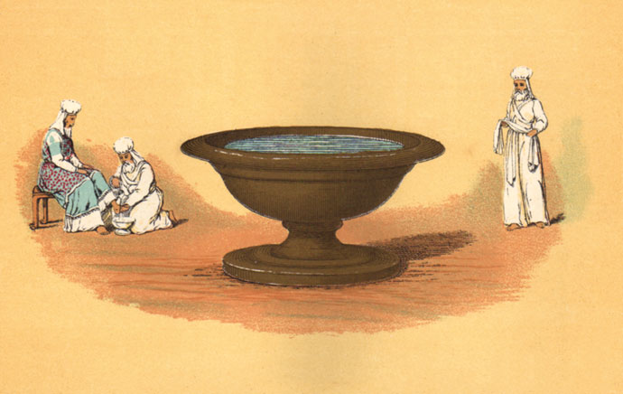
Becoming Clean
The distinction that the Israelites drew between clean and unclean had a great effect upon the whole of their religious and social life
Physically Clean
Ceremonially Clean
Certain animals, birds, and fish were regarded as clean and acceptable to eat, while others were unclean and were forbidden.
Touching a dead person was unclean.
7-14 days after childbirth a woman was unclean.
Some diseased persons were also considered unclean. (3)
In a spiritual sense, to be clean is to be free from sin and sinful desires. In this sense the word is used to describe a person who is virtuous and has a pure heart.
God’s covenant people have always had special instructions to be clean.
Exodus 29 Lev. 11; Deut. 14:3-20; Ps. 24:4

Slide 9
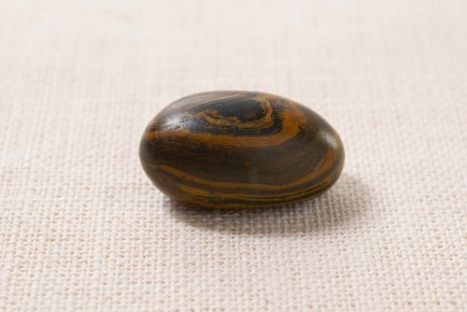
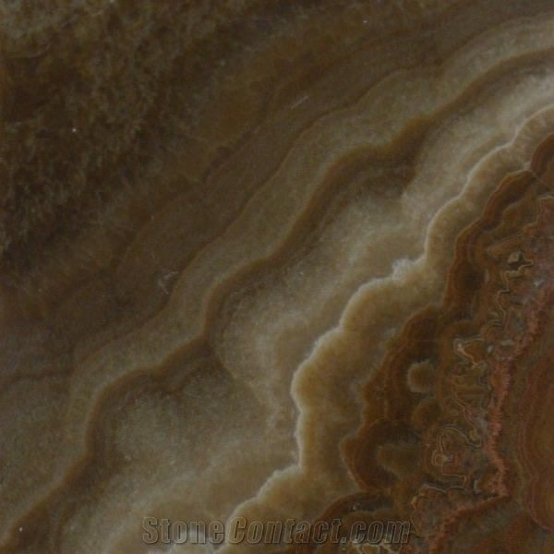
Urim and Thummim
Light and Protection
And thou shalt put in the breastplate of judgment the Urim and the Thummim; and they shall be upon Aaron’s heart, when he goeth in before the Lord: and Aaron shall bear the judgment of the children of Israel upon his heart before the Lord continually.
Seer Stone Belonging to Joseph Smith
An instrument prepared of God to assist man in obtaining revelation from the Lord and in translating languages.
The stone for the tribe of Joseph is an Onyx. It is described as a chocolate colored oval shape. This stone passed from Joseph Smith to Oliver Cowdery and then to the Church through Brigham Young and others.
Exodus 28:30

Slide 10
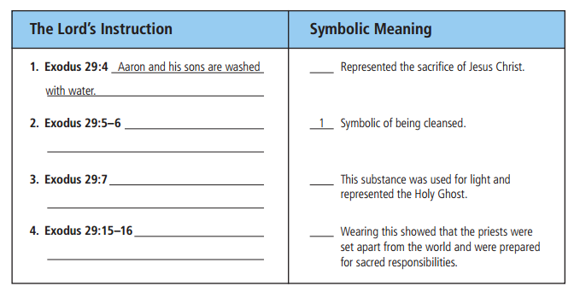
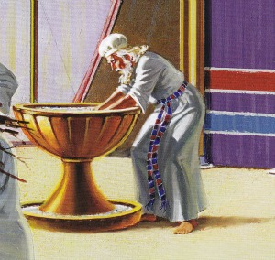
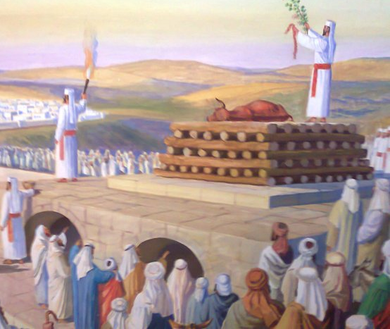
Symbolic Meaning
4
Dressing in the Robes of the Priesthood
Anointing Oil—on the head
3
Sacrifice the Ram
2

Slide 11
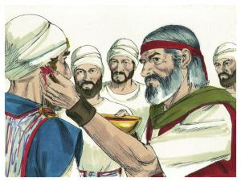
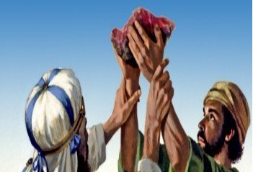
The Ram’s Blood
Right Ear
HEARING
The priest would listen to and follow Him
Thumb
ACTING
Toe
WALKING
If we will apply the atoning blood of Jesus Christ by listening to the word of the Lord, acting upon it, and walking in His paths, we will be sanctified.
The wave offering (Hebrew: tenufah תנופה) or sheaf offering or omer offering (korban omer) was an offering made by the Jewish priests in token of a solemn special presentation to God
Exodus 29:20-21, 24-26

Slide 12
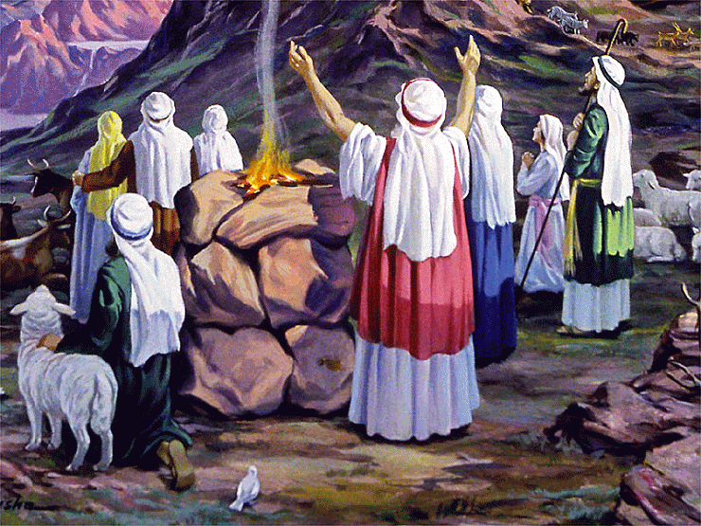
Ram, Bullock, and Lamb
Just as animal sacrifice was the divinely instituted means of maintaining ancient Israel’s purity and holiness before God, so too the Atonement of Jesus Christ, the Great High Priest, is necessary in order to purify men and women of all ages from sin and to prepare them to come into the presence of God. (4)
And then the angel spake, saying: This thing is a similitude of the sacrifice of the Only Begotten of the Father, which is full of grace and truth. Moses 5:7
The incompleteness of the priestly sacrifices, being offered annually, stands in contrast to the “infinite and eternal sacrifice” of Jesus Christ, the Great High Priest, and is further illustrated by the fact that Israel’s priests stood while offering sacrifice, whereas Jesus “offered one sacrifice for sins for ever” and thereafter “sat down on the right hand of God.”
But this man, after he had offered one sacrifice for sins for ever, sat down on the right hand of God;
Hebrews 10:12
Exodus 29:22-46

Slide 13
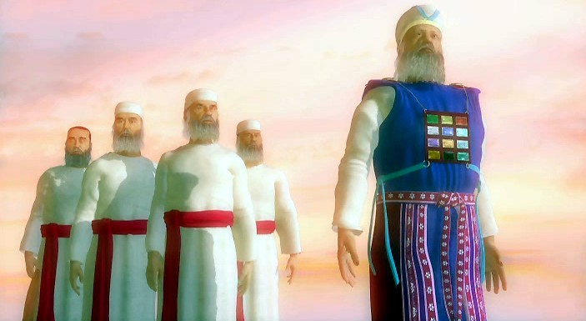
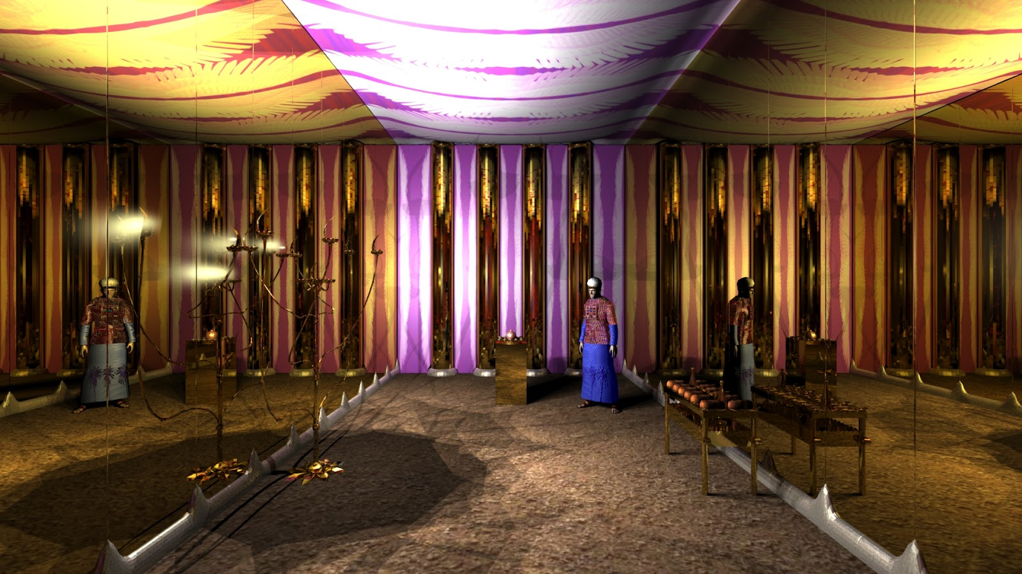
Priests Are Set Apart
Now that the priests had performed these rituals, they were set apart to enter into the Temple
God would meet with the children of Israel in the tabernacle, He would sanctify the tabernacle and the priests, He would dwell among the Israelites, He would be their God, and they would know that He is the Lord their God
Exodus 29:43-46

Slide 14
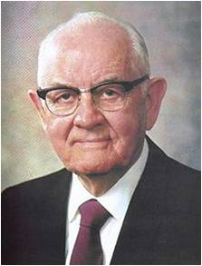
“The setting apart may be taken literally; it is a setting apart from sin, apart from the carnal; apart from everything which is crude, low, vicious, cheap, or vulgar; set apart from the world to a higher plane of thought and activity” (5)

Slide 15
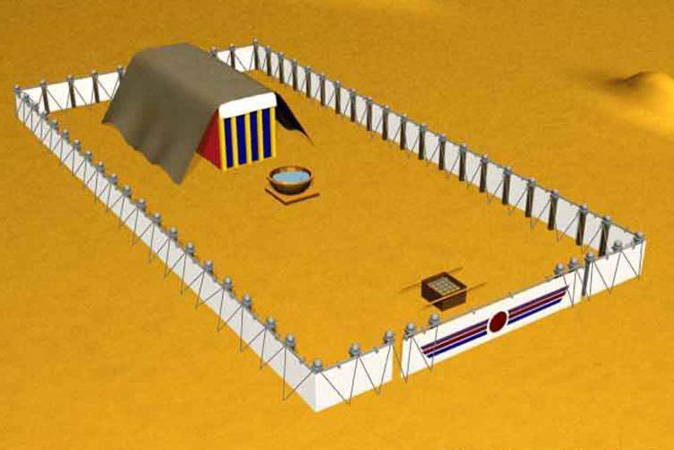
Bezaleel And Aholiah
Bezaleel was the son of Uri, who was the son of Hur, of the tribe of Judah
His name means: in the shadow of God, or under God’s protective care
He was one of the skilled craftsmen given by the Lord to Moses, along with Aholiab, to help prepare the Tabernacle under the inspiration of the Spirit of God
Aholiah’s name = tent of the father
Exodus 31:2

Slide 16
Sabbath and Stone Tablets
The Lord often uses signs or symbols to remind His children of what they have promised Him and what He has promised them.
Verily my sabbaths ye shall keep: for it is a sign between me and you throughout your generations; that ye may know that I am the Lord that doth sanctify you.
Exodus 31:13
Before the Lord concluded His revelation to Moses at Mount Sinai, He gave him an additional reminder of His law and covenant with Israel.
Exodus 31:12-18

Slide 17

Sabbath Day
“How do we hallow the Sabbath day?
In my much younger years, I studied the work of others who had compiled lists of things to do and things not to do on the Sabbath.
It wasn’t until later that I learned from the scriptures that my conduct and my attitude on the Sabbath constituted a sign between me and my Heavenly Father.
With that understanding, I no longer needed lists of dos and don’ts. When I had to make a decision whether or not an activity was appropriate for the Sabbath, I simply asked myself, ‘What sign do I want to give to God?’
That question made my choices about the Sabbath day crystal clear” (6)
The Sabbath day and keeping it holy is a sign between us and the Lord
Exodus 31:13-14; Ezekiel 20:12,20

Slide 18
Sources:
Old Testament Institute Manual
2. Pratt, John P., "Twelve Sons, Twelve Constellations" Meridian Magazine (13 Jul 2005)
3. Bible Dictionary Clean and Unclean
Presentation by ©http://fashionsbylynda.com/blog/
4. Stephen D. Ricks The Law of Sacrifice June 1998 Ensign
5. President Spencer W. Kimball (The Teachings of Spencer W. Kimball, ed. Edward L. Kimball [1982], 478).
6. Russell M. Nelson, “The Sabbath Is a Delight,” Ensign or Liahona, May 2015, 130).

Slide 19
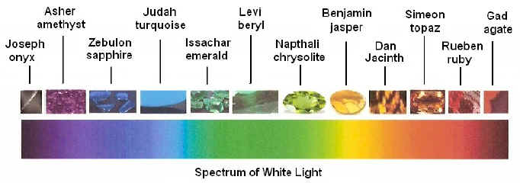
Something of Interest—nothing to do with the lesson
Yin Yang Symbol:
Yin is the black side with the white dot in it, and yang is the white side with the black dot in it. The relationship between yin and yang is often described in terms of sunlight playing over a mountain and a valley. Yin (literally the 'shady place' or 'north slope') is the dark area occluded by the mountain's bulk, while yang (literally the 'sunny place' or 'south slope') is the brightly lit portion. As the sun moves across the sky, yin and yang gradually trade places with each other, revealing what was obscured and obscuring what was revealed.
Yin is characterized as slow, soft, yielding, diffuse, cold, wet, and passive; and is associated with water, earth, the moon, femininity, and nighttime.
Yang, by contrast, is fast, hard, solid, focused, hot, dry, and aggressive; and is associated with fire, sky, the sun, masculinity and daytime.
Yin and yang applies to the human body. In traditional Chinese medicine good health is directly related to the balance between yin and yang qualities within oneself. If yin and yang become unbalanced, one of the qualities is considered deficient or has vacuity. Wikipedia

Slide 20
SEER STONE
In Joseph Smith’s day, some individuals claimed that they had a gift to “see,” or receive divine or supernatural messages, through seer stones. These beliefs came from the Bible and from European cultural traditions brought to early America by immigrants. Joseph Smith and his family accepted these beliefs, and Joseph occasionally used stones he located in the ground to help neighbors find missing objects or search for buried treasure.
When Joseph Smith received the golden plates in 1827, he also received a translation instrument with them, “two stones in silver bows” used by “‘seers’ in ancient or former times” (Joseph Smith—History 1:35). This instrument was referred to in the Book of Mormon as the “interpreters.” During the translation of the Book of Mormon, Joseph Smith apparently used both of these instruments—the interpreters and his seer stone—interchangeably. They worked in much the same way, and the early Saints sometimes used the term “Urim and Thummim” to refer to the seer stone as well as the interpreters. The Prophet also received several of the revelations found today in the Doctrine and Covenants by means of these instruments of revelation.³ As Joseph became more experienced in spiritual matters, he eventually started receiving revelation without these aids.
https://www.churchofjesuschrist.org/study/history/topics/seer-stones?lang=eng
Urim and Thummim
Hebrew term that means “Lights and Perfections.” An instrument prepared of God to assist man in obtaining revelation from the Lord and in translating languages. See Ex. 28:30; Lev. 8:8; Num. 27:21; Deut. 33:8; 1 Sam. 28:6; Ezra 2:63; Neh. 7:65; JS—H 1:35.
Using a Urim and Thummim is the special prerogative of a seer, and it would seem reasonable that such instruments were used from the time of Adam. However, the earliest mention is in connection with the brother of Jared (Ether 3:21–28). Abraham used a Urim and Thummim (Abr. 3:1–4), as did Aaron and the priests of Israel, and also the prophets among the Nephites (Omni 1:20–21; Mosiah 8:13–19; 21:26–28; 28:11–20; Ether 4:1–7). There is more than one Urim and Thummim, but we are informed that Joseph Smith had the one used by the brother of Jared (Ether 3:22–28; D&C 10:1; 17:1). (See Seer.) A partial description is given in JS—H 1:35. Joseph Smith used it in translating the Book of Mormon and in obtaining other revelations.
This earth in its celestial condition will be a Urim and Thummim, and many within that kingdom will have an additional Urim and Thummim (D&C 130:6–11)
Bible Dictionary.

Slide 21
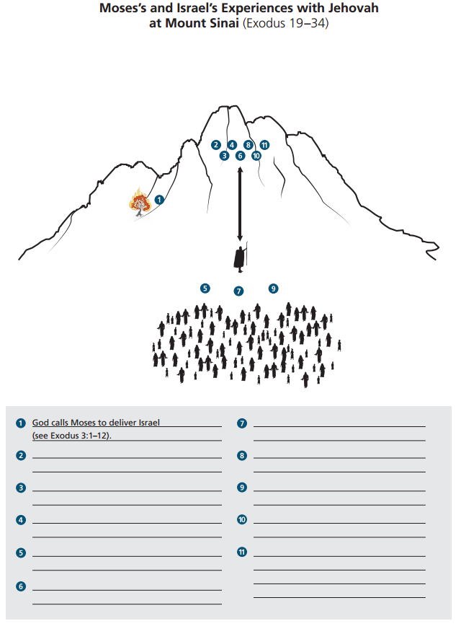
Israel enters into a Covenant (Ex. 23)
God invites Israel to be His covenant People (Exodus 19:3-6)
God writes His law on Stone Tablets
(Ex. 31:18)
Moses reports Israel’s desire to enter God’s Covenant (Ex. 19:7-8)
God warns that the people are not yet prepared to enter His presence (Ex. 19:20-21, 25)
God Speaks the Ten Commandments to the Israelites (Ex. 19-20)
God give Israel additional laws (Ex. 21-23)

