Slide 1
Part 1

Slide 2
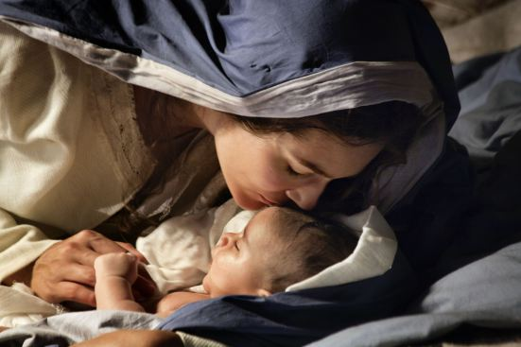
Video
A Savior is Born
https://www.mormon.org/christmas?cid=HP_SU_11-29-2015_dMIS_fSPC_xLIDyL1-A_

Slide 3
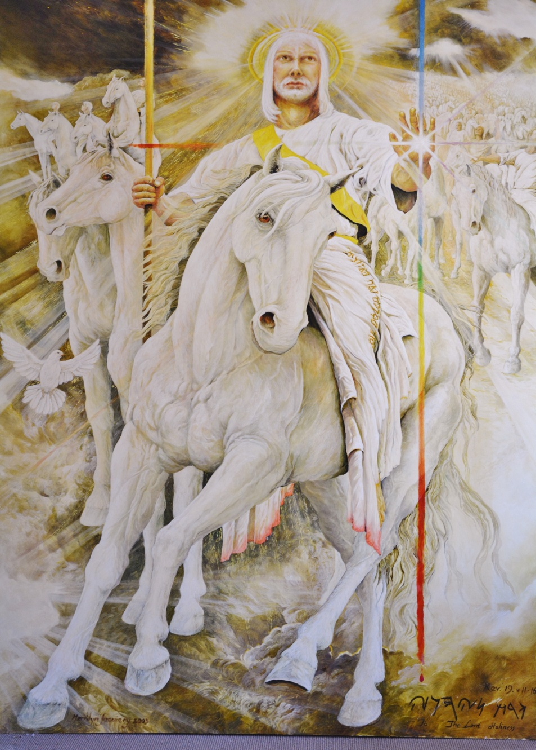
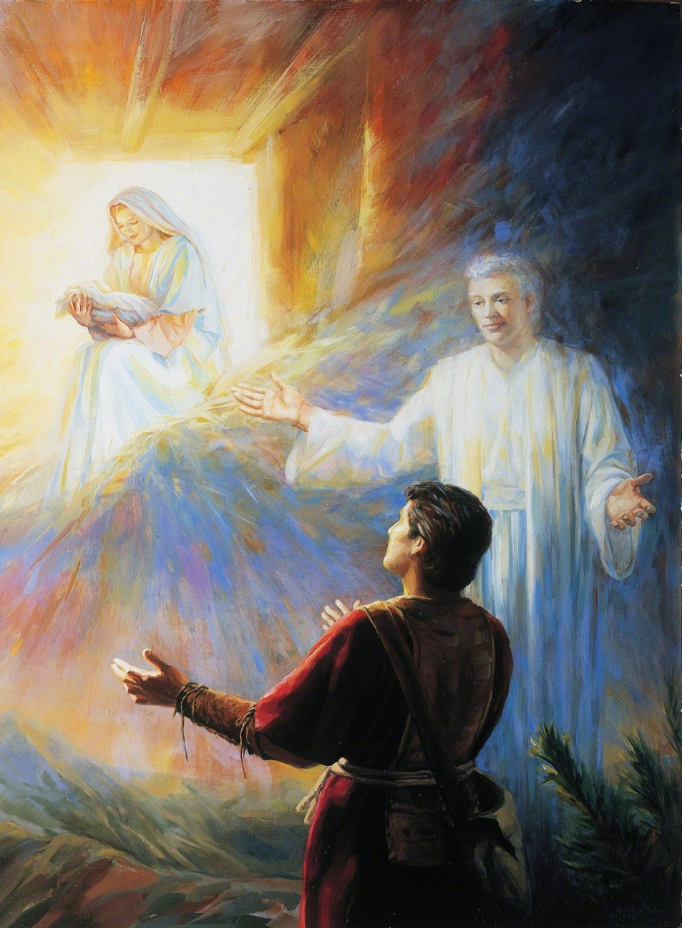
Old Testament vs. Book of Mormon Prophecy
Old Testament Messiah
Book of Mormon Messiah

Slide 4
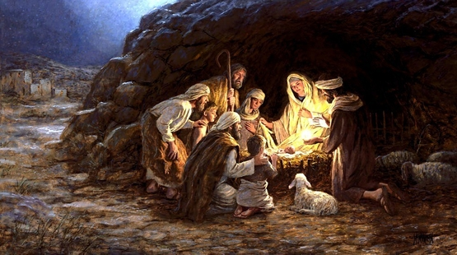
When Was Jesus Born?

Slide 5
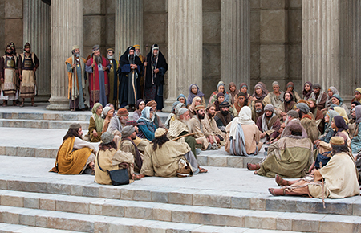
The Meridian of Time

Slide 6
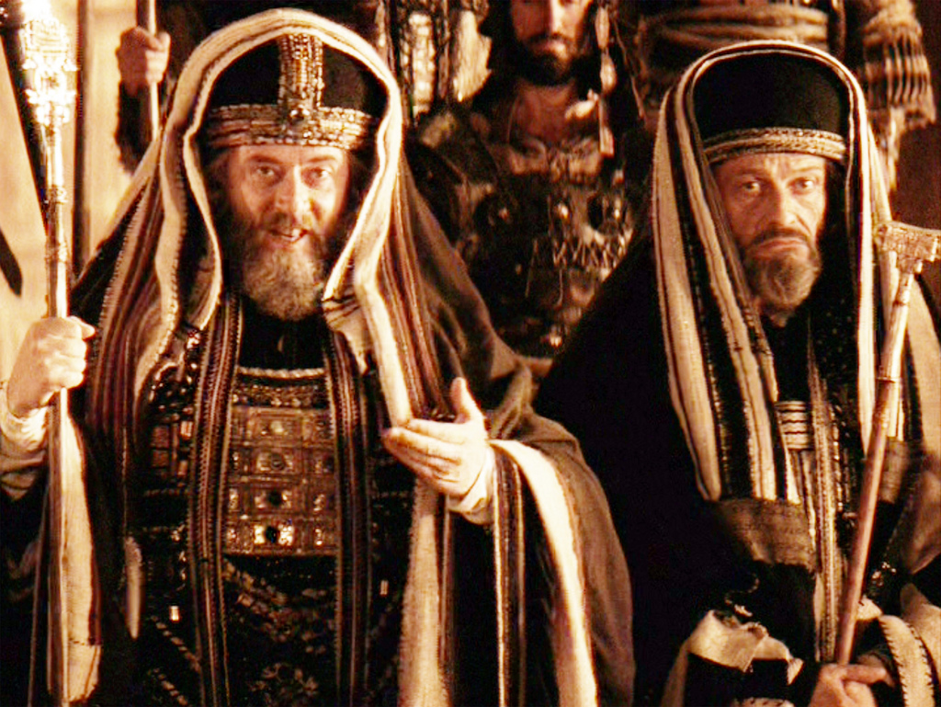
Chief Priests and Sadducees

Slide 7
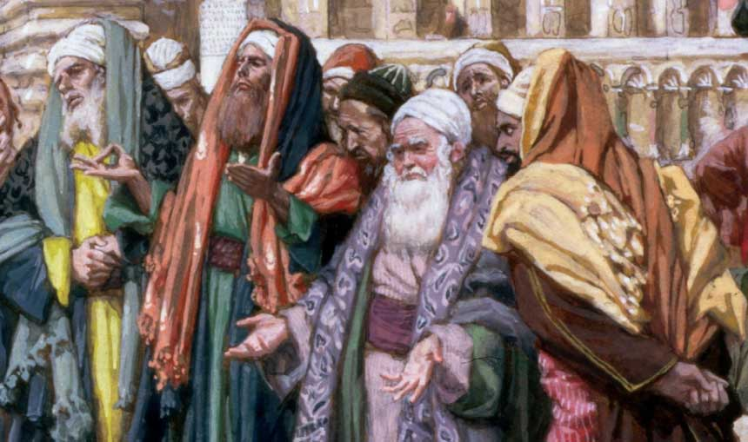
Pharisees and Scribes

Slide 8
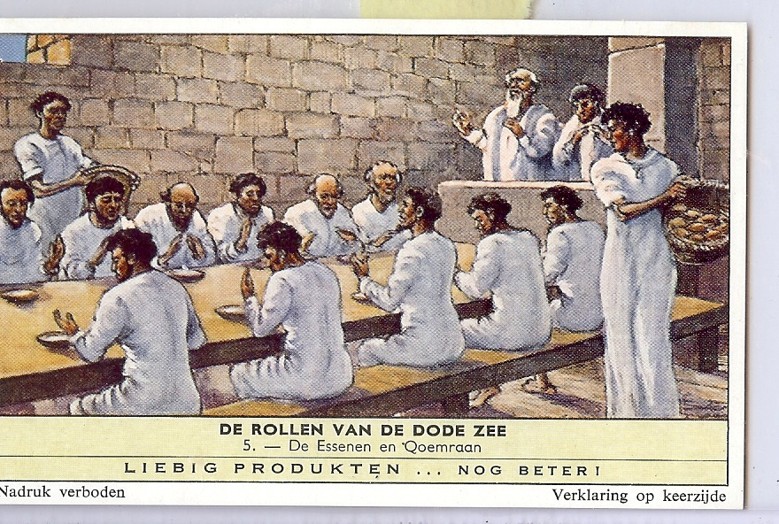
Essenes
or Herodians

Slide 9
Nativity Quiz
1. How many wise men were there?
A. 3
B. 7-8
C. The Bible doesn’t say
2. Did Joseph meet the wise men?
A. Yes, in the stable
B. Yes in their home
C. The Bible doesn’t say.
3. What animal did Mary ride to Bethlehem?
A. A donkey
B. A horse
C. A camel
D. The Bible doesn’t say
4. The Parents named the child Jesus because
A. An angel told Mary
B. An angel told Joseph
C. All of the above
6. What animals were present at the Nativity?
A. Goats, Sheep, and Cattle
B. Chicken and pigeons
C. Pigs
D. Oxen
E. The Bible doesn’t say
7. Who besides the wise men saw the star?
A. Shepherds
B. Herod
C. The Bible does not say
8. How did the star compare in brightness with the
other stars?
A. Far brighter than the other stars.
B. Lots brighter than the other stars.
C. The Bible does not say
9. How soon after Joseph and Mary reached Bethlehem
was Jesus born?
A. Immediately, the same day.
B. The same week.
C. The Bible does not say.
5. What kind of a building was Jesus born in?
A. A stable
B. A cave
C. A hospital
D. The Bible doesn’t say

Slide 10
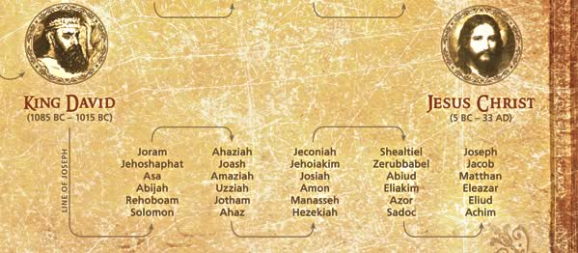
The Lineage of Jesus Christ

Slide 11
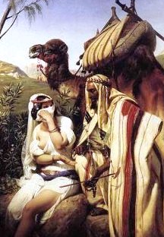
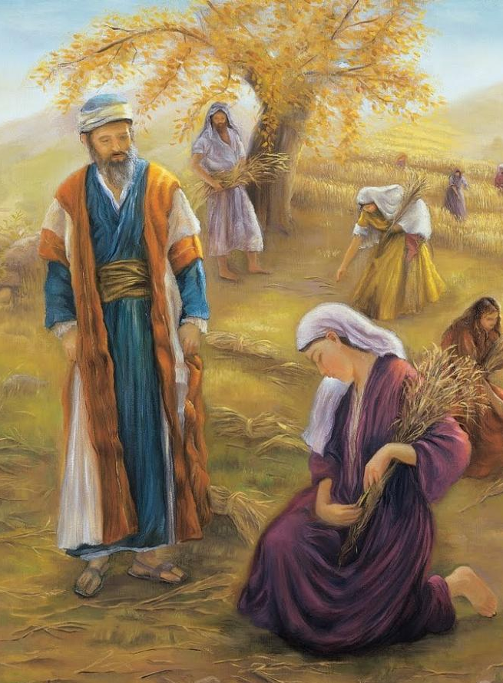
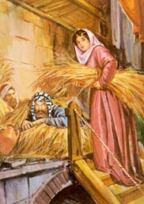
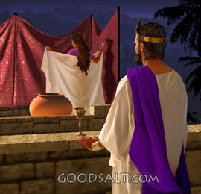
Women in Jesus’ Genealogy
Ruth
Tamar
Rahab
Bathsheba

Slide 12
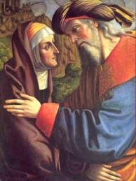
Mary’s Parents - Joachim and Anna
Childless Couple
"You are not worthy
to offer sacrifice
with those childless hands."
"Anna, your wife,
shall bring you a daughter and you shall
call her name Mary.”

Slide 13
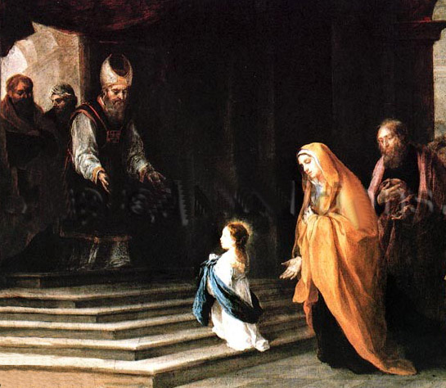
Mary Being Presented at the Temple
Miriam or Mary
“Excellence”
or “Bitterness”
Mary may have been dedicated to temple service
as a small child

Slide 14
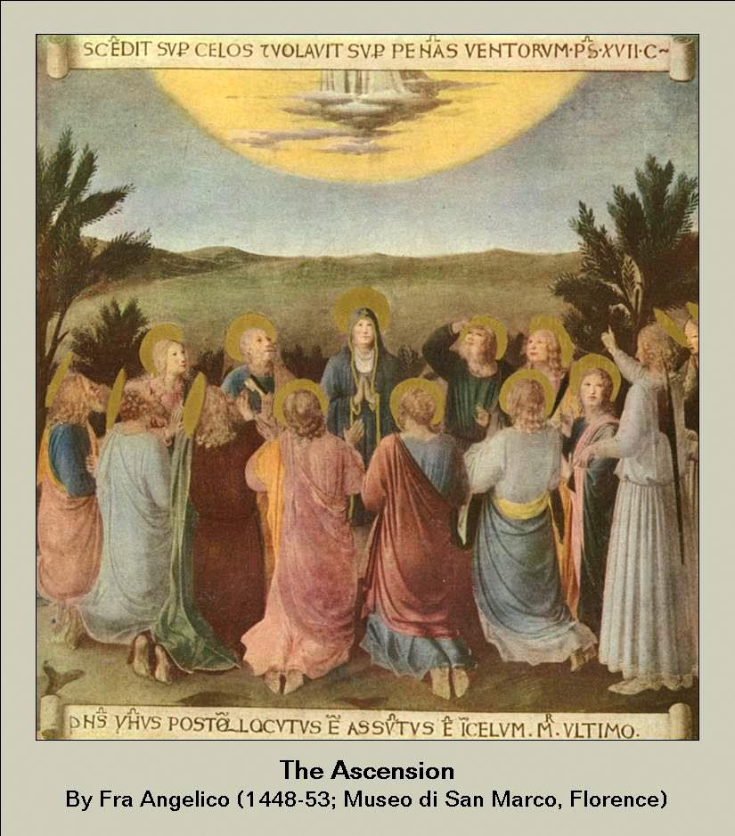
Ancient Prayer Circle

Slide 15
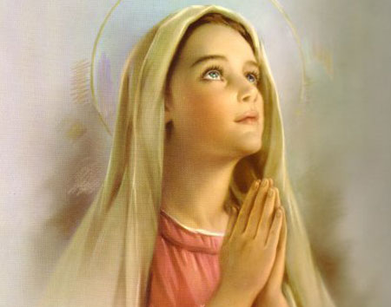
Vision
in the
Temple

Slide 16
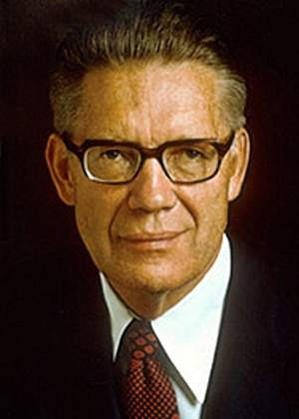
Mary – the Greatest Female Spirit
"Can we speak too highly of her whom the Lord has blessed above all women? There was only on Christ, and there is only one Mary. Each was noble and great in the pre-mortal existence and each was foreordained to the ministry he or she performed. We cannot but think that the Father would choose the greatest female spirit to be the mother of His Son, even as He chose the male spirit like unto Him to be the Savior."
The Mortal Messiah Bruce R McConkie

Slide 17
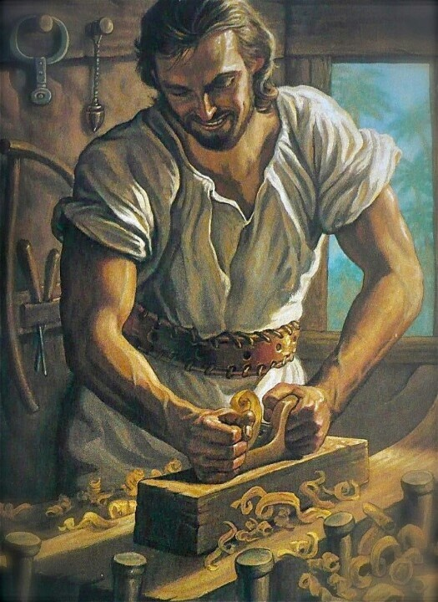
Joseph the Carpenter
He was a Just man
Tzaddik
A Master builder
Learned
In tune
with the Spirit
Beyond Reproach

Slide 18
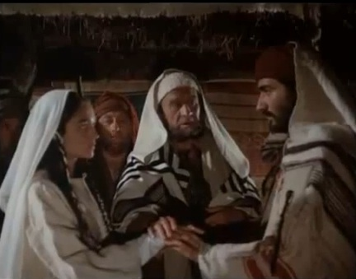
Betrothal of Joseph & Mary

Slide 19
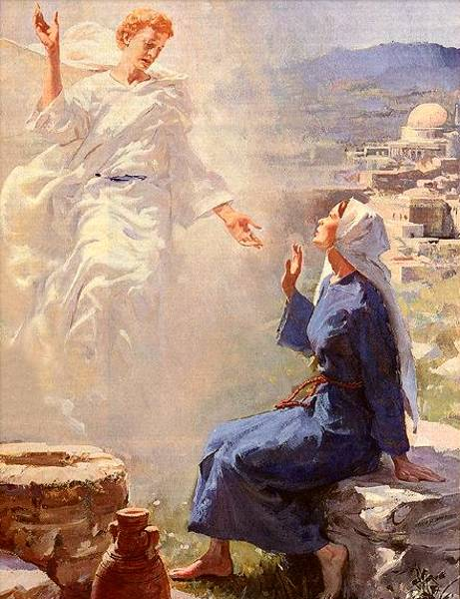
The
Annunciation

Slide 20
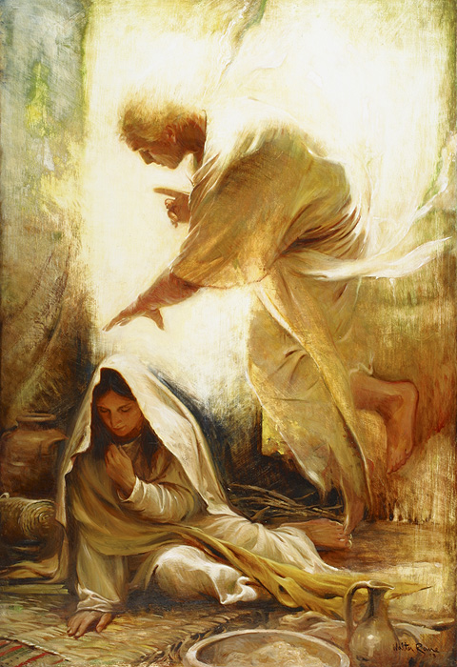
“How Shall
this be,
seeing
I know not
a Man”

Slide 21
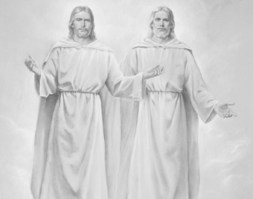
The Only Begotten of the Father

Slide 22
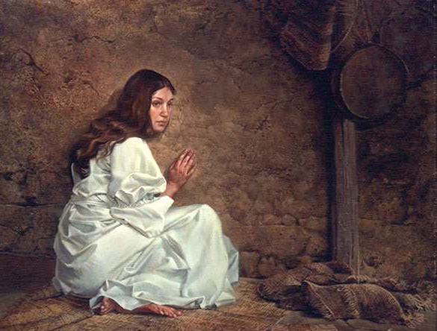
Mary’s Call
"So we find Mary,
about 13 years of age
and inexperienced
in meeting the trials of life, under contract to marry,
but with the child
of God the Father
by the power
of the Holy Ghost.”
Bruce R. McConkie

Slide 23
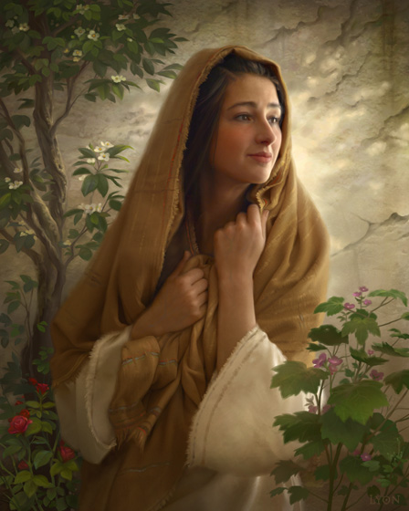
“Mary, Thou Hast Found Favor”
“Behold
the handmaid
of the Lord….
…..Be it unto me according
to thy word.”

Slide 24
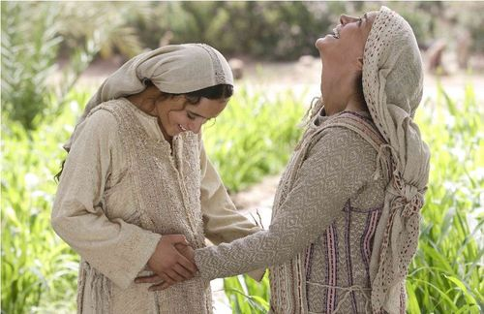
Blessed Art Thou Among Women”

Slide 25
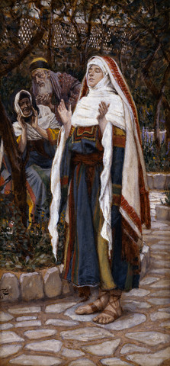
The Magnificat
My soul doth magnify the Lord,
And my spirit hath rejoiced
in God my Saviour.
For he hath regarded the low estate of his handmaiden:
for, behold, from henceforth
all generations
shall call me blessed.
For he that is mighty
hath done to me great things;
and holy is his name.

Slide 26
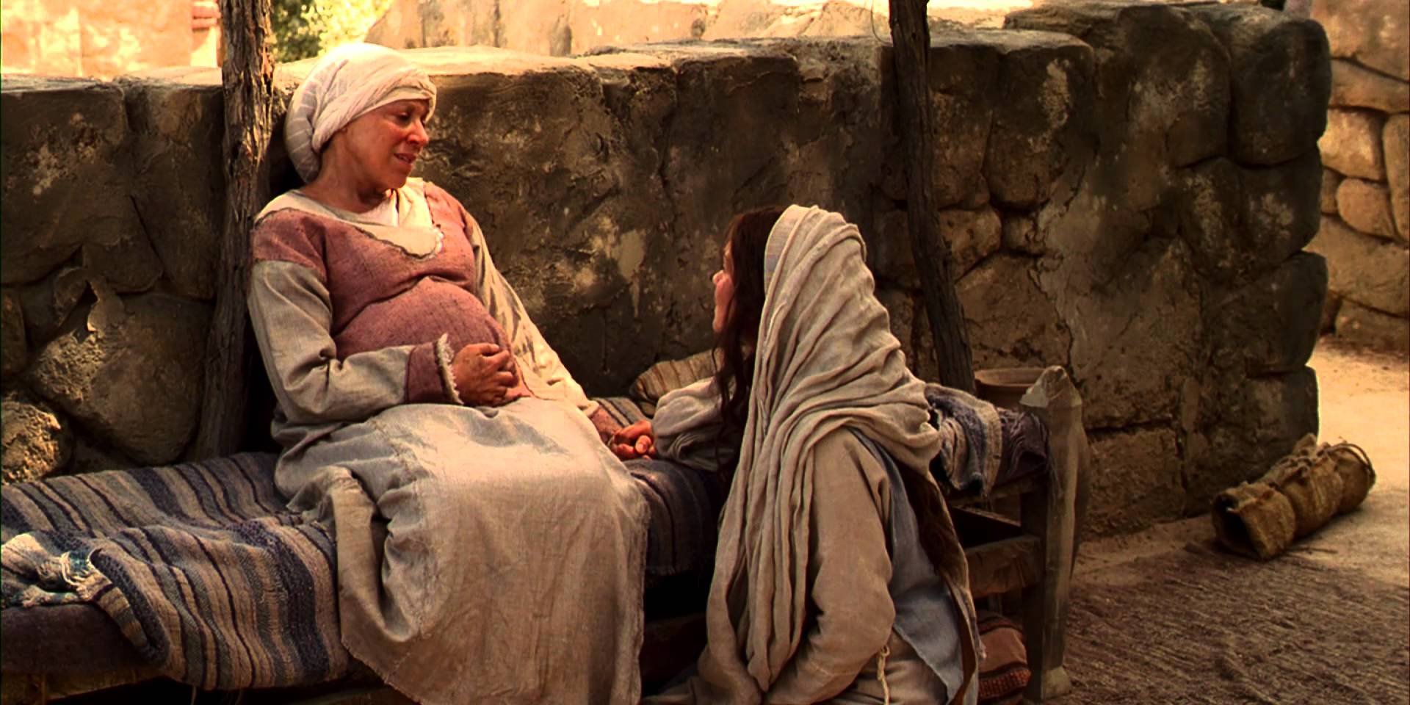
Video Mary & Elizabeth Rejoice Together
https://www.lds.org/bible-videos/videos/mary-and-elisabeth-rejoice-together?lang=eng

Slide 27
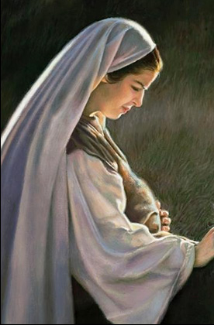
“Mary was Found to Be with Child”
James,
brother of Jesus:
“And Mary was in her sixth month and behold Joseph came….
…..and entering into her house, he discovered she was big with child.
And he…..
…….wept bitterly."

Slide 28
Video
The Nativity Story
https://www.youtube.com/watch?v=Ezwp10egu-c

Slide 29
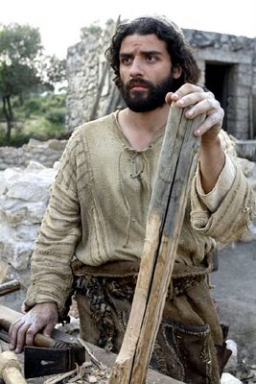
“Joseph
was
Minded
to Put
Her Away
Privily”

Slide 30
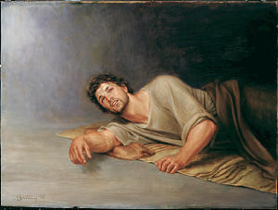
Joseph’s Vision
That which is
conceived in her
Is of the Holy Ghost

Slide 31
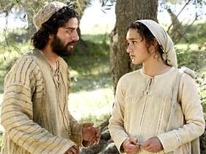
Video
The Nativity Story
https://www.youtube.com/watch?v=Ezwp10egu-c

Slide 32
Continue with
Celebrating the Birth of Christ
Part 2

