Slide 1
Part 2

Slide 2
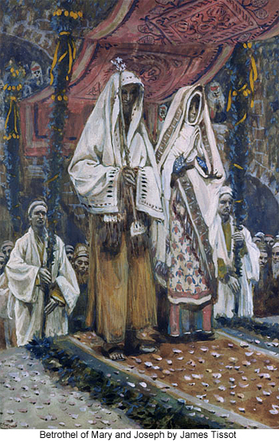
The Marriage of
Joseph & Mary
Either Joseph and Mary were married immediately
Or they traveled to Bethlehem and were formally married after Christ’s birth
He “knew her not.”

Slide 3
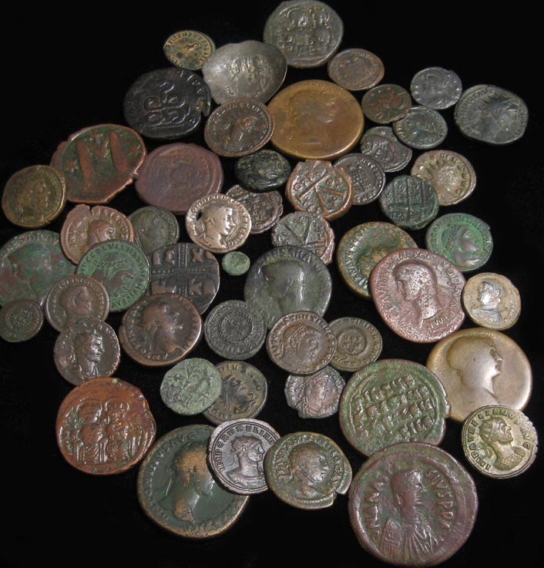
“All the World Should be Taxed”
Rome required
a Census
and a Tax
The law required that both
Joseph & Mary were to be taxed
In Bethlehem

Slide 4
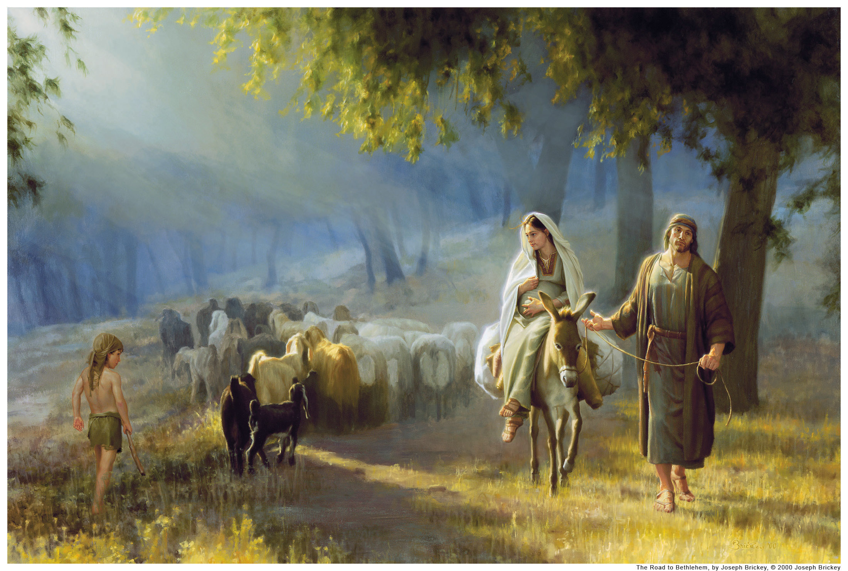
Mary & Joseph went “Up”
to Bethlehem

Slide 5
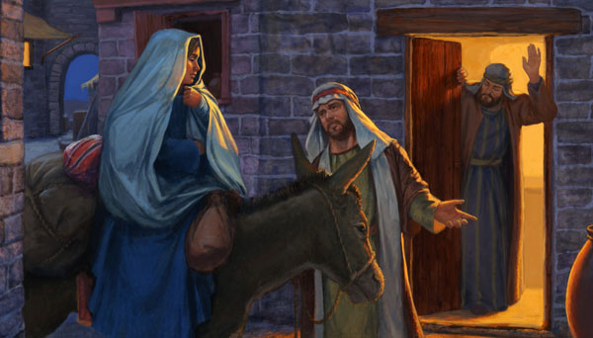
“No Room in the Inn”

Slide 6
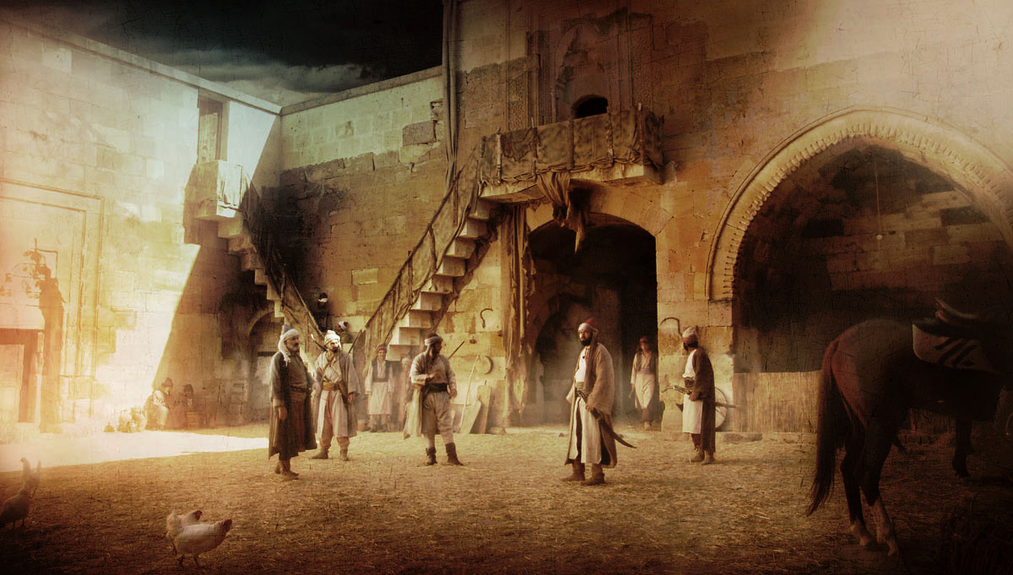
Caravanserai

Slide 7
No Room in the “Kataluma.”
Manger
Family Area
Guest Room
kataluma
“Stable”
Steps
There was no “room” available in the “kataluma”
or guest room so Joseph and Mary shared
the Family Room attached to the “stable.”

Slide 8
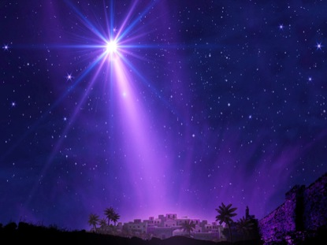
The Star
A star announced
the births
of Abraham
& Moses
What do Stars represent?
People

Slide 9
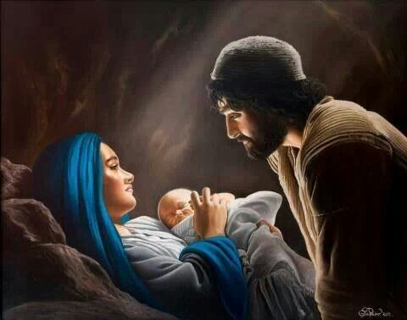
The Savior’s Birth

Slide 10
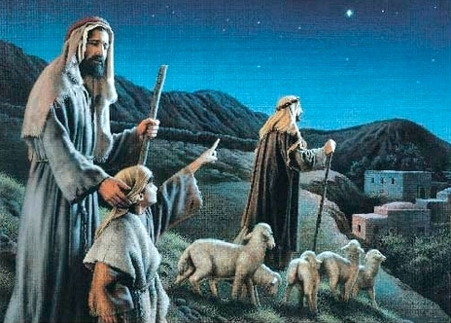
Shepherds
The Outcasts

Slide 11
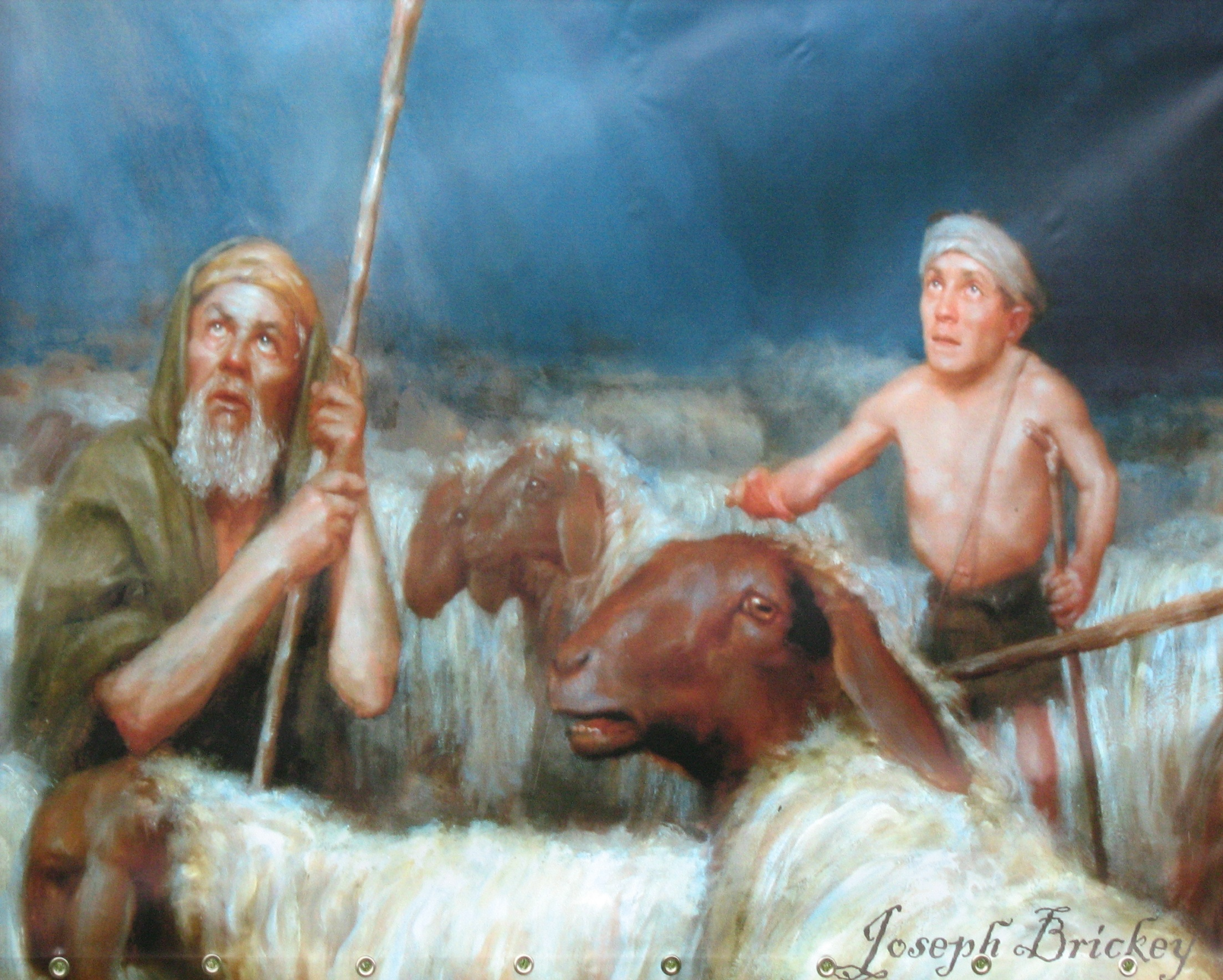
The First Witnesses
Shepherd Priests

Slide 12
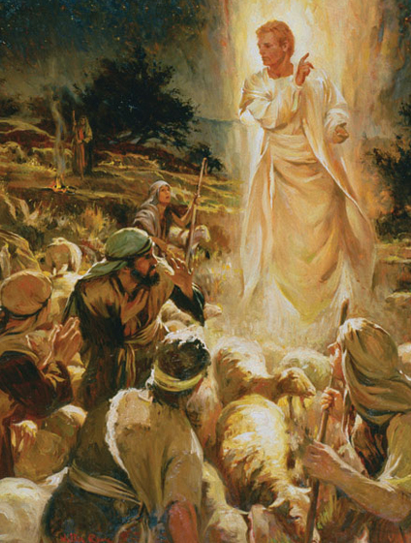
“Fear Not”
I bring you
good tidings
of great joy!
For unto you
is born….
a Savior,
which is
Christ the Lord!

Slide 13
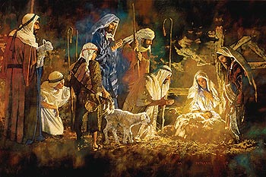
“Ye shall find Him wrapped in Swaddling Bands”

Slide 14
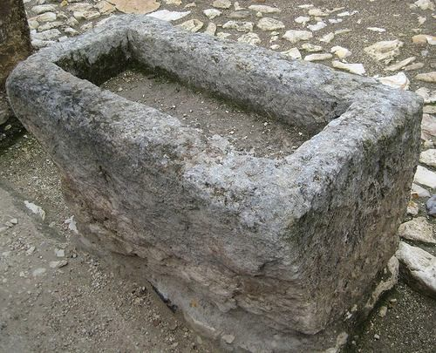
….Lying in
a manger

Slide 15
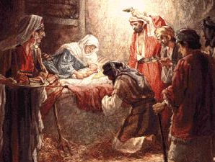
A Name and a Blessing
Circumcision

Slide 16
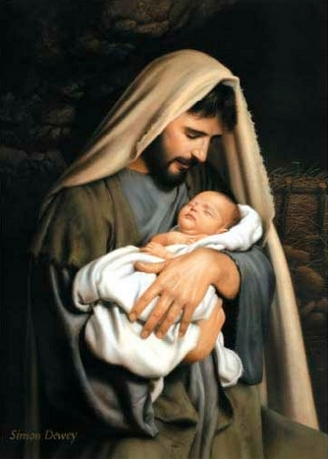
Joseph
named him
“Yeshua”
“Jehovah is Salvation”

Slide 17
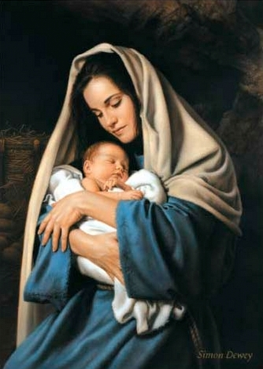
“Immanuel”
“He is God!”
“God is
with us!”

Slide 18
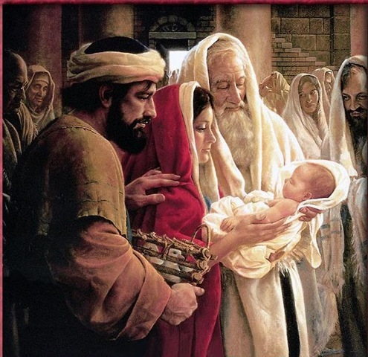
Herod’s Temple

Slide 19
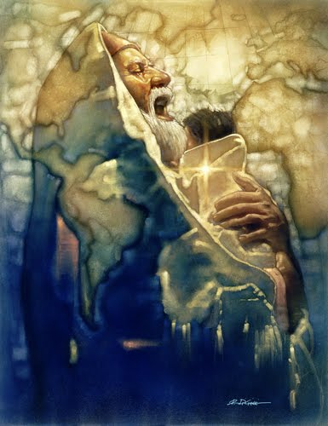
Simeon
a “token”
Personal Revelation
He would not die
until he had seen
the Messiah.
He came
by the Spirit
into the Temple

Slide 20
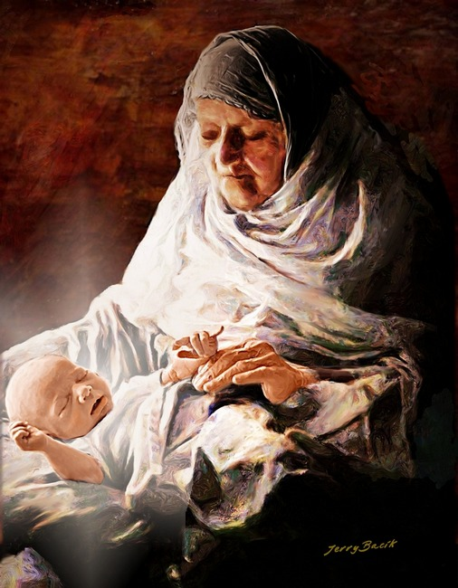
Anna
Married at 12-14
Widowed at 19-21
Unmarried for 84 years
101 years old
when she saw the Savior
Anna = Grace
Phanuel = Face of God
Asher = Happy & blessed
“Happy am I” for I have seen “the face of God”
through His “Grace.”

Slide 21
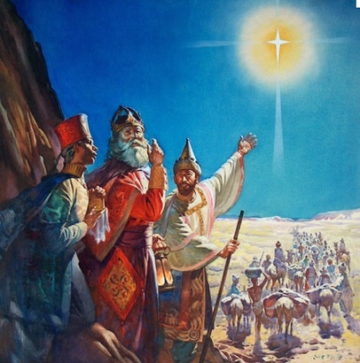
The Magi
or Wise Men
Religious men from the Diaspora

Slide 22
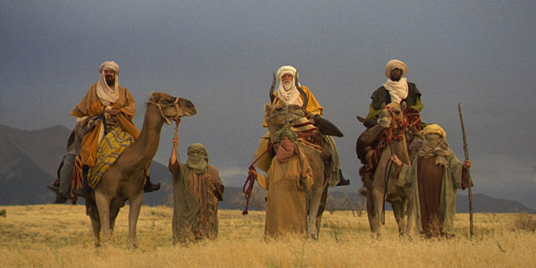
Video
The Wise Men Seek Jesus
https://www.youtube.com/watch?v=xhD8lG9VDVc

Slide 23
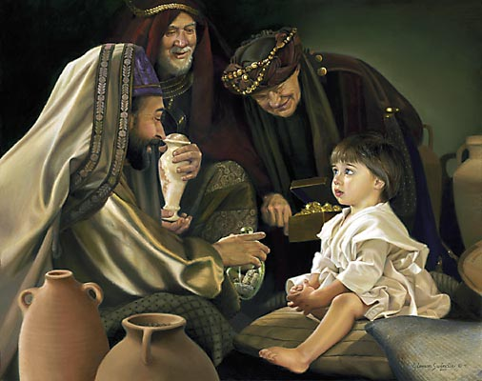

Slide 24
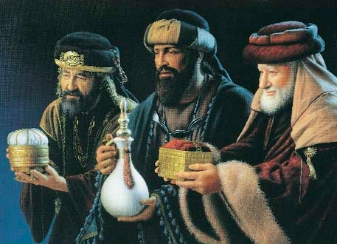
The Gifts
Gold = King
Frankincense = Priest
Myrrh = Healer

Slide 25
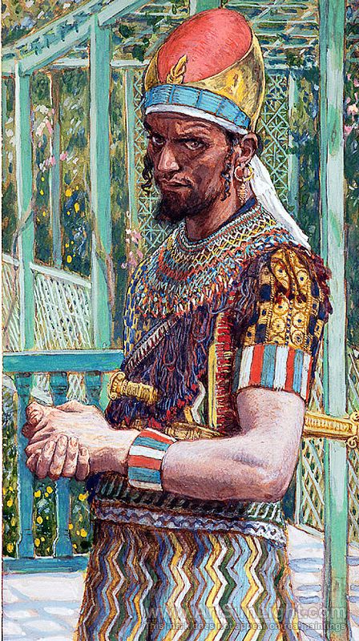
Herod
the Great
Arabian ancestry
Convert to Judaism
Brilliant genius
Master Builder
Richest man in the Roman Empire
Baby Killer

Slide 26
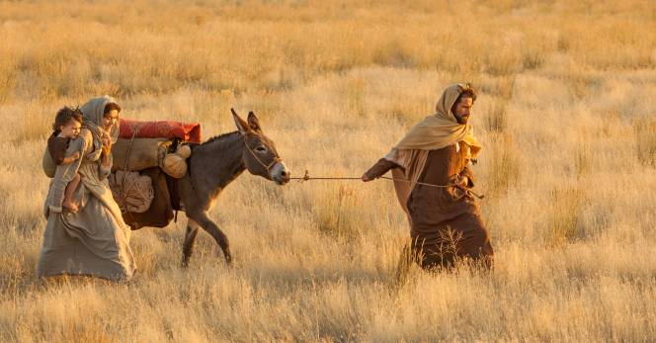
Flight into Egypt

Slide 27
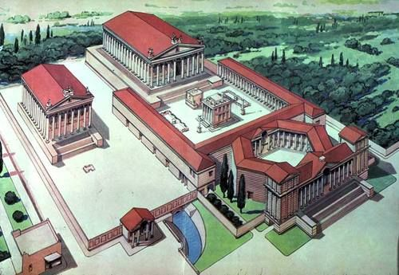
Goshen where the Israelite slaves lived
Heliopolis = Zi - On

Slide 28
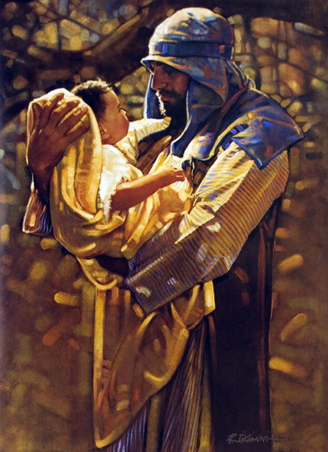
Zacharias
is Killed
“Take my blood! But my spirit the Lord will receive, for you shed innocent blood in the forecourt of the temple of the Lord.”

Slide 29
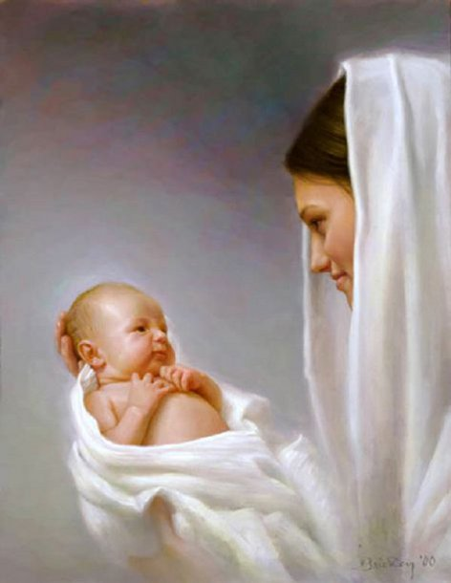
The
Glorious Advent of our Savior

Slide 30
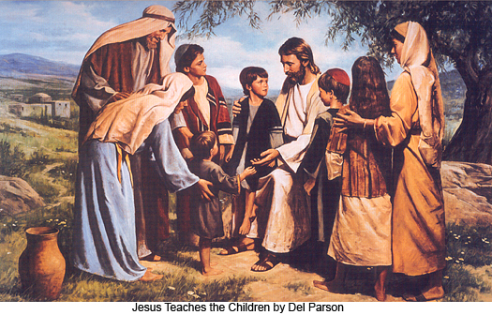
The Family of Christ

Slide 31
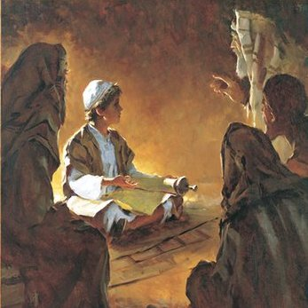
Wisdom & Stature
“Mozart had musical ability at the age of six that only a handful of men have ever gained in a whole lifetime. Jesus, when yet a child, had spiritual talents that no other man in a hundred lifetimes could obtain.. . .
In his study, and in the learning process, he was guided from on high in a way that none other has ever been. Being without sin—being clean and pure and spotless—he was entitled to the constant companionship of the Holy Spirit. Bruce. R McConkie

Slide 32
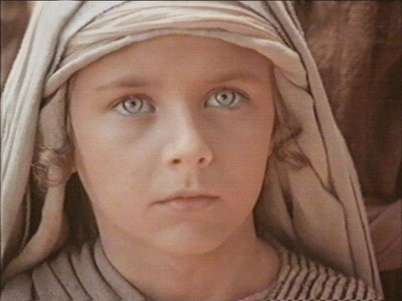
“Jesus, in favor with God and man.”

