Slide 1


Under the Sun
Proverbs 31/Ecclesiastes/Song of Solomon
Why are We Here on Earth?

Slide 2
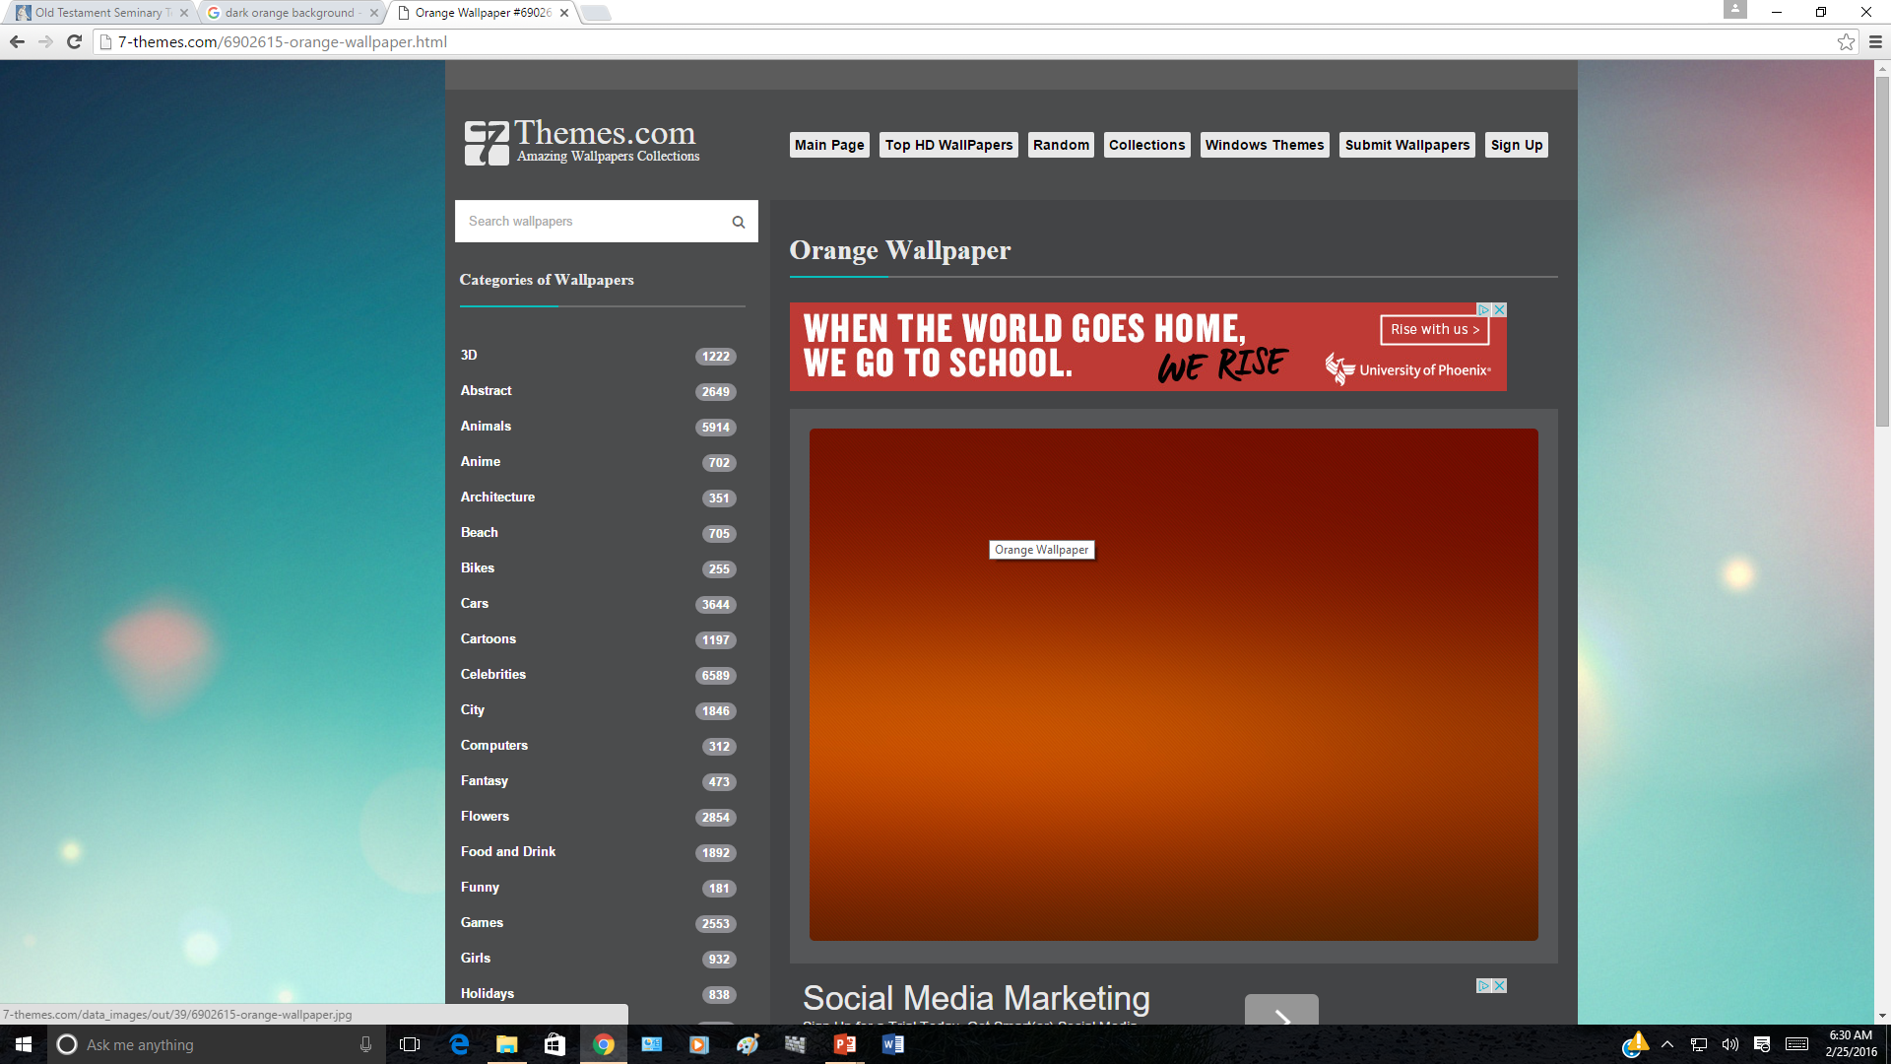
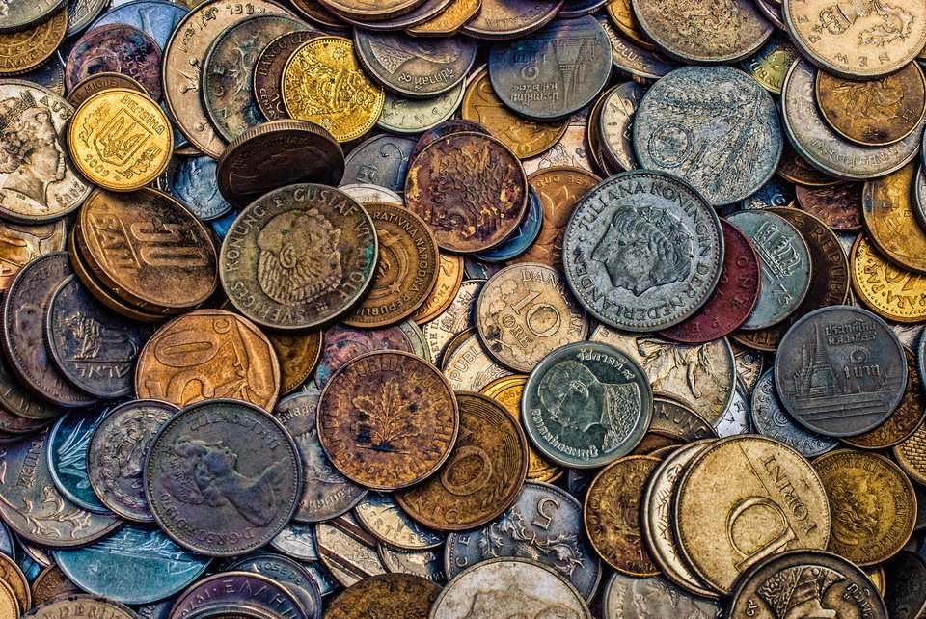

Previously in Proverbs 31
Wisdom is more valuable than gold (see Proverbs 16:16).
Who can find a virtuous woman? for her price is far above rubies.
“Virtue originates in your innermost thoughts and desires. It is a pattern of thought and behavior based on high moral standards. Since the Holy Ghost does not dwell in unclean tabernacles, virtue is prerequisite to receiving the Spirit’s guidance. What you choose to think and do when you are alone and you believe no one is watching is a strong measure of your virtue” (5)
Virtue is more valuable than worldly wealth

Slide 3


The Stage
“Your mind is like a stage in a theater; in the theater of your mind, however, only one actor can be on stage at a time. If the stage is left bare, thoughts of darkness and sin often enter the stage to tempt.
But these thoughts have no power if the stage of your mind is occupied by wholesome thoughts, such as a memorized hymn or verse of scripture that you can call upon in a moment of temptation.
By controlling the stage of your mind, you can successfully resist persistent urges to yield to temptation and indulge in sin. You can become pure and virtuous” (5)

Slide 4
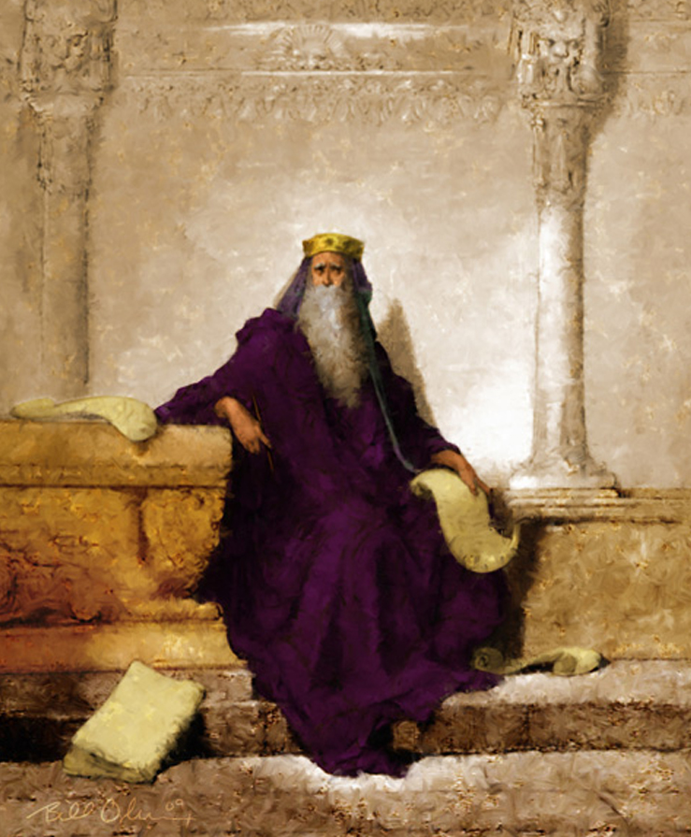
Ecclesiastes—The Preacher
Traditionally understood as Solomon
The author describes himself as “son of David, king in Jerusalem” (1:1).
The name Ecclesiastes is a translation of the Hebrew word koheleth, = “one who convenes an assembly” or simply a preacher
However:
Little is known about the writer of Ecclesiastes beyond his own description of himself as “the Preacher, the son of David, king in Jerusalem”
Throughout this book, the writer presents a series of questions in search of the purpose of life.
His questions and subsequent conclusions illustrate his own journey of seeking to understand why we are here on the earth.
(1)

Slide 5




Meanings to Phrases
“under the sun”
“from a worldly point of view”
“vanity”
“Temporary, or meaningless during mortality
That the dead “know not any thing,” and there is no knowledge “in the grave.”
observations by the Preacher about how things appear to men on the earth “under the sun.”
(1)

Slide 6


OR
Knowing the plan of salvation
Not knowing the plan of salvation
The Purpose of Life Is…

Slide 7

Seeking the Purpose of Life
I said of laughter, It is mad: and of mirth,
He pursued amusement, pleasure, and laughter.
He built houses, gardens, planted fruits, built pools, hired servants and maids, had children, and livestock
He kept busy building up his mortal world
“vexation of spirit” = the Preacher was discouraged with the results of his labors, realizing that they would bring no real profit.
Ecclesiastes 2:1-11

Slide 8
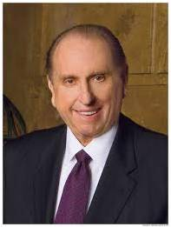
A House of Order
Our house is to be a house of order.
"To every thing there is a season, and a time to every purpose under the heaven," advised Ecclesiastes, the Preacher. Such is true in our lives. Let us provide time for family, time for work, time for study, time for service, time for recreation, time for self-but above all, time for Christ.
Then our house will be a house of order.”
Ecclesiastes 3:1
(4)

Slide 9
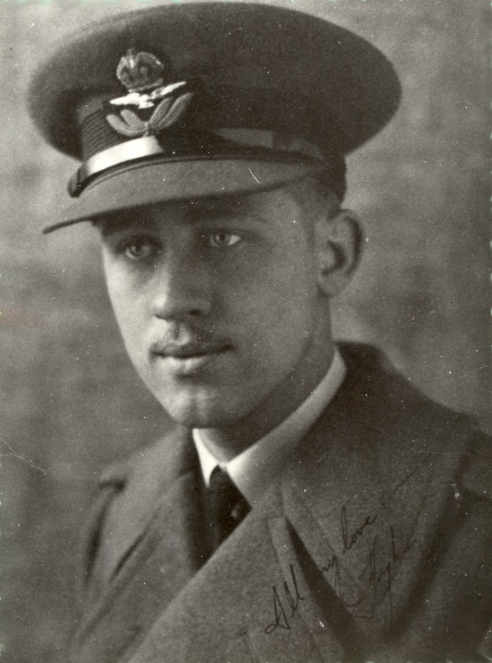
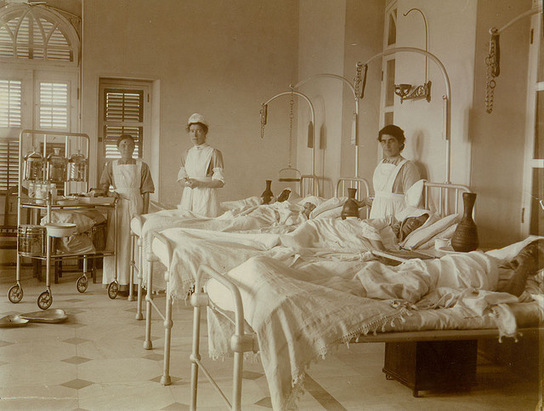
Hugh B. Brown
So many men spend their lifetime accumulating this world's goods, and sometimes they are not particular how they get them; but most men, if they live to old age, get a new sense of values, but too often it is too late.
May I illustrate my point by referring to an experience I had in 1917 as I was returning from my first trip overseas in World War I where I was serving with the Canadian Army.
I arrived in New York and while there learned of the presence in the hospital of an aged man whom I had known. As I had some time before the train left for the West, I called on him in the hospital. He was a very wealthy man, had racing stables in Cuba, in the Northwest, and in California, had millions invested in various places, but at the age of eighty he was lying at death's door.
Ecclesiastes 2:12
(3)

Slide 10

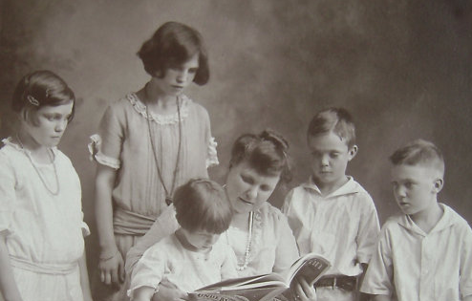
As I stood by his bedside and thought over various parts of his life as I had known it, as I thought of his divorced wife, of his five children, all of whom were estranged, and none of whom cared enough to come to the hospital to see him, as I thought of the things he had lost which money could not buy and noted his tragic situation and the depth of his misery.
I asked him what he would do if he had the privilege of living his life over again and could start it with the wisdom which had come through the years, what he considered the real values in life as he stood near the end of it.
I asked him what he considered the most important things in life, and if he would tell me as a young man how I could get the greatest riches and enjoy them when I grew old.
Ecclesiastes 2:12
(3)

Slide 11

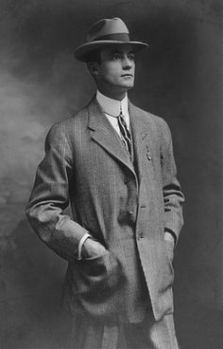
This old gentleman, who died a few days later, said to me, "As I think back over life the most important and valuable asset which I might have had but which I lost in the process of accumulating millions, was the simple faith my mother had in God and in the immortality of the soul.“
...That was the dying testimony of a man who was born in the Church but had drifted far from it.
That was the brokenhearted cry of a lonely man who could have anything that money could buy, but who had lost the most important things of life in order to accumulate this world's goods. He realized as he lay upon his deathbed that he could not take any of it with him.
Ecclesiastes 2:12
(3)

Slide 12
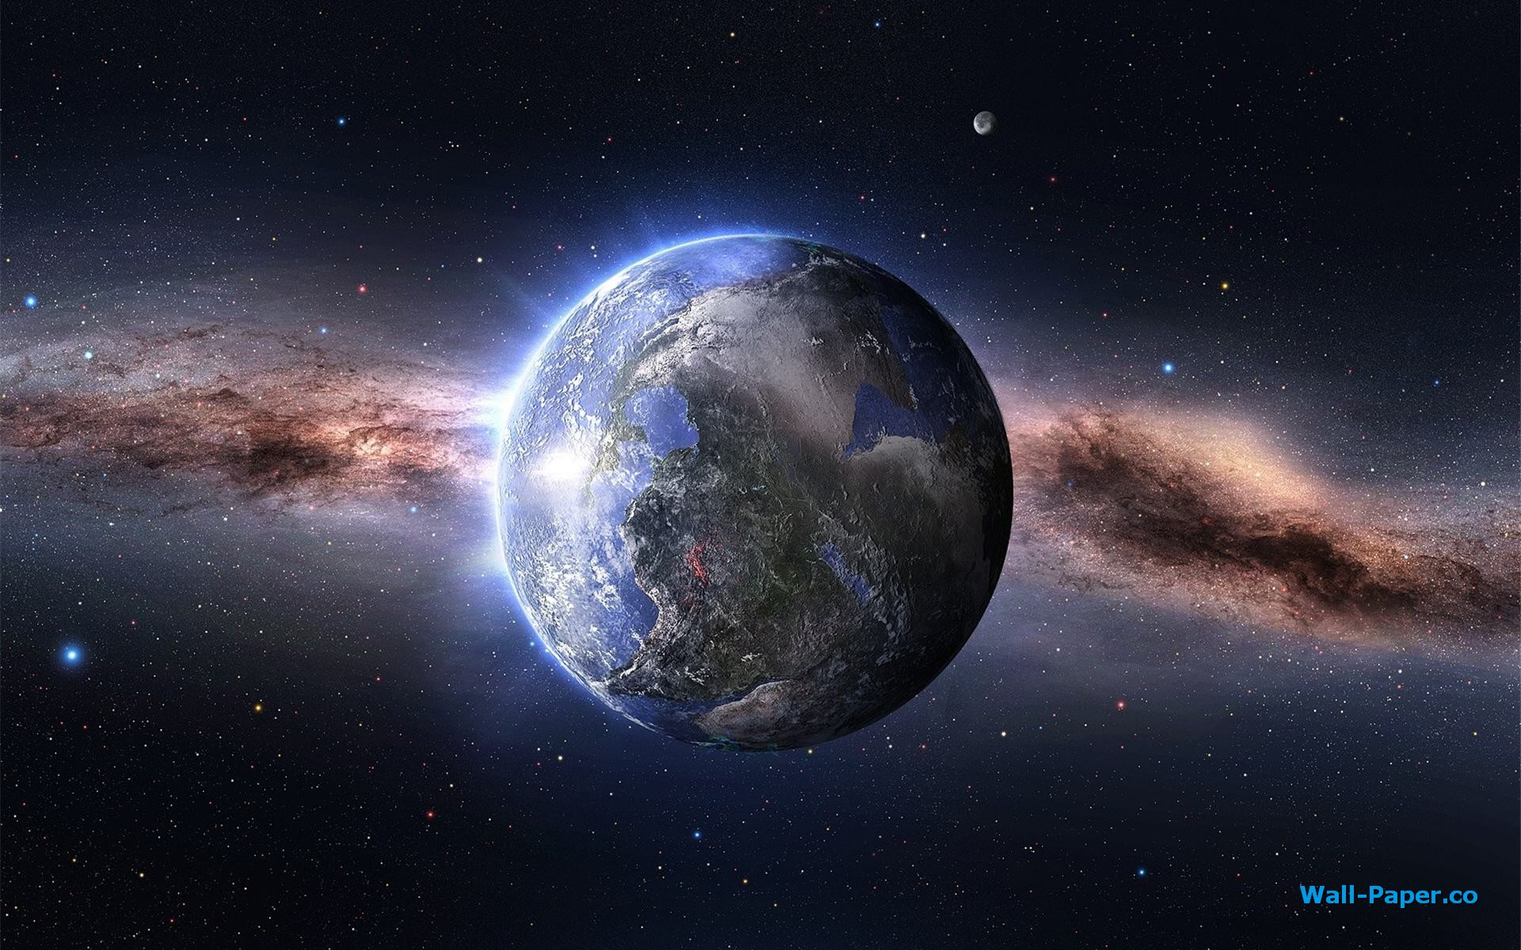
The Good and the Bad
The Preacher wrote that even though good and bad things happen to all of us and even though one day we will all die, we can do many things to make our mortal life better before it ends.
Ecclesiastes 3-10

Slide 13
Match Scripture with Statement
f
____1. Ecclesiastes 4:9–10 | a. Whatever you do, work hard and do your best.
____2. Ecclesiastes 5:10–11 | b. Even though at times the wicked seem to prosper, in the end it will not be well with them.
____3. Ecclesiastes 7:9 | c. Do not set your heart on money, for it will never satisfy.
____4. Ecclesiastes 7:10 | d. Avoid idleness, for it can cause us to lose things we care about.
____5. Ecclesiastes 8:11–13 | e. Do not spend the present day longing for the past to return.
____6. Ecclesiastes 9:10 | f. Good friends will help us through difficult times.
____7. Ecclesiastes 10:18 | g. Learn to control your temper.
c
g
e
b
a
d
Ecclesiastes 4-10

Slide 14

The Youth
Rejoice, O young man, in thy youth; and let thy heart cheer thee in the days of thy youth, and walk in the ways of thine heart, and in the sight of thine eyes: but know thou, that for all these things God will bring thee into judgment.
Ecclesiastes 11:9

Slide 15
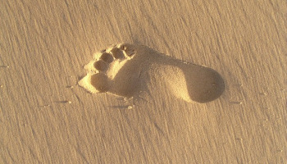
One Day We Die
“then shall the dust return to the earth as it was”
At the time of our death, our physical bodies will decay and return to the earth
Although we experience physical death, our spirits continue to live and will return to God
Ecclesiastes 12:1-7

Slide 16
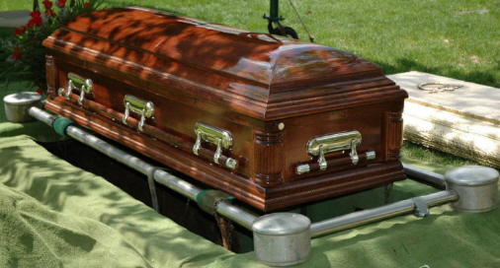
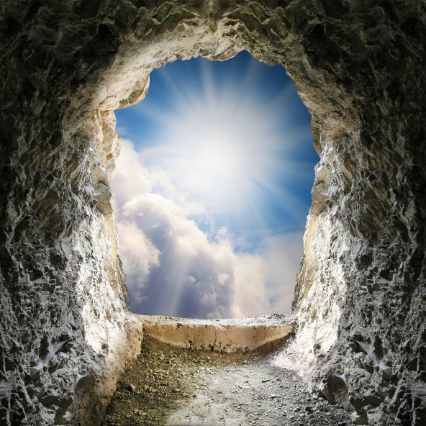
Going to the Spirit World
At death our spirits do not immediately return to the presence of God but rather go to the spirit world
Those who chose not to obey in this life and did not repent live in a state of unhappiness. In the spirit world the gospel is preached to those who did not obey the gospel or have the opportunity to hear it while on earth.
“Death does not change our personality or our desires for good or evil. Those who chose to obey God in this life live in a state of happiness, peace, and rest from troubles and care.
We remain in the spirit world until we are resurrected.” (5)
Ecclesiastes 12:1-7, D&C 138:11-24

Slide 17
If we choose to focus on God and keeping His commandments rather than on worldly pursuits, we will find purpose in mortality and be prepared for the judgment of God.
How Long Is Our Mortal Life?
Ecclesiastes 12:13-14

Slide 18
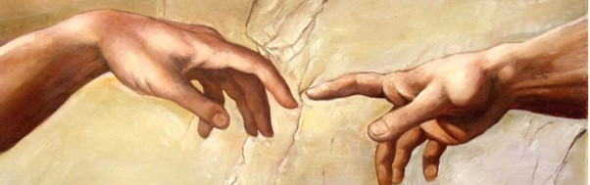
The Joseph Smith Translation states, “The Songs of Solomon are not inspired writings”
Both Jews and Christians have at times been reluctant to accept it into the canon of scripture because of its romantic content but have permitted it on the basis of its being an allegory of God’s love for Israel and of the Church.
We do not know who wrote the Song of Solomon. “Whether Solomon is actually the author is doubtful”
Song of Solomon
We do not know when or where the Song of Solomon was written.
“[The Song of Solomon is] sometimes called Canticles (as in Latin) or Song of Songs (as in Hebrew). …
The Song of Solomon is the only book in the standard works that is considered uninspired
Jewish Talmudic tradition attributes the book of Solomon but suggests that Hezekiah's scribes may have edited the text (Prov. 25:1) (2)
(1)

Slide 19
Sources:
Videos:
What Matters Most (1:35)
Seeing Life from an Eternal Perspective (1:29)
Bible Dictionary
Talk Thru the Bible by Bruce Wilkinson and Kenneth Boa
Presentation by ©http://fashionsbylynda.com/blog/
3. Hugh B. Brown Continuing the Quest [Salt Lake City: Deseret Book Co., 1961], 33-34
4. President Thomas S. Monson ("Building Your Eternal Home," Ensign, Oct. 1999, 5
5. Preach My Gospel [2004], 52, 118-119.

Slide 20
Ecclesiastes Theme:
The overriding theme of the entire book is that mortality is full of events, possessions, and problems that are ultimately insignificant and fleeting; they pertain to mortality and have virtually no eternal significance. "All is vanity under the sun" is the main theme of the book. The words vanity or vanities occur 37 times. The phrase "under the sun" occurs 29 times. The phrase "vexation of spirit" occurs 9 times.
Ecclesiastes 9:5 Death:
What happens to the spirit of man at death? This is a crucial theological question. Ecclesiastes says "the spirit shall return unto God who gave it." (Eccl. 12:7)
However, the Jehovah Witnesses have misinterpreted another Ecclesiastes passage to claim that there is nothing at death-no spirit, no soul, nothing-not until the resurrection. "The dead know not any thing, neither have they any more a reward; for the memory of them is forgotten... neither have they any more a portion for ever in any thing that is done under the sun." To the Jehovah Witnesses it means, there is nothing after death. They have taken the quote out of context. They have missed the crucial perspective of Ecclesiastes that the dead no longer have anything "under the sun" or in the mortal world.
Book of Mormon teaches:
The spirits of all men, as soon as they are departed from this mortal body, yea, the spirits of all men, whether they be good or evil, are taken home to that God who gave them life... [the] righteous into a state of happiness, which is called paradise... the wicked, yea, who are evil... shall be cast into outer darkness (Alma 40:11-13)
Gospeldoctrine.com
The Preacher:
The book of Ecclesiastes is unique because although the Preacher is a believer, he often poses questions and makes statements as if he were not. Everything that he says, therefore, must be taken in context of his final conclusion in Ecclesiastes 12:13–14 that all of our works in this life will one day be judged by God. The teachings of this book seem to be directed at individuals who do not believe in God or at least are not yet fully committed to Him. The Preacher presents questions and statements that many of these individuals may feel inclined to agree with, but then he helps them to see how much purpose and meaning can come into our lives when we seek to live in accordance with God’s will.
The Preacher:
The book of Ecclesiastes is unique because although the Preacher is a believer, he often poses questions and makes statements as if he were not. Everything that he says, therefore, must be taken in context of his final conclusion in Ecclesiastes 12:13–14 that all of our works in this life will one day be judged by God. The teachings of this book seem to be directed at individuals who do not believe in God or at least are not yet fully committed to Him. The Preacher presents questions and statements that many of these individuals may feel inclined to agree with, but then he helps them to see how much purpose and meaning can come into our lives when we seek to live in accordance with God’s will.
Wealth ethically acquired and properly used is not evil-it is good. It is the love of it, the coveting of it, the lust for it, the compromises made for it which are evil.
...Perhaps the sin is not in "things" but in our attitude toward and worship of "things." Unless an acquisitive person can positively accumulate and hold wealth while still giving full allegiance to God and his program-unless the rich man can keep the Sabbath, keep his mind and body and spirit uncontaminated, and give unstinted service to his fellowmen through God's appointed way-unless the affluent man has total control and can hold all his possessions in trust, subject to the call of the Lord through his authorized servants, then that man, for the good of his soul, should certainly "go and sell that thou hast and give to the poor, and come and follow me." (Matthew 19:21.)
"For where your treasure is, there will your heart be also." (Matthew 6:21.) (The Teachings of Spencer W. Kimball, edited by Edward L. Kimball [Salt Lake City: Bookcraft, 1982], 358)
Ecclesiastes 9:11: Endure to the End
God, our Father, and Jesus Christ, our Lord, have marked the way to perfection. They beckon us to choose to follow eternal verities and to become perfect as they are perfect. (See Matt. 5:48; 3 Ne. 12:48.) The Apostle Paul likened life to a race with a clearly defined goal. To the Saints at Corinth he urged: "Know ye not that they which run in a race run all, but one receiveth the prize? So run, that ye may obtain." (1 Cor. 9:24.)
In our zeal, let us not overlook this sage counsel: "The race is not to the swift, nor the battle to the strong." (Eccl. 9:11.) Actually, the prize belongs to him who endures to the end. Pres. Thomas S. Monson ("Invitation to Exaltation," Ensign, June 1993, 4)

Slide 21
Decisions to Make Now
“We understand that we will live a postmortal life of infinite duration and that we determine the kind of life it will be by our thoughts and actions in mortality. Mortality is very brief but immeasurably important. …
“That understanding helps us to make wise decisions in the many choices of our daily lives. Seeing life from an eternal perspective helps us focus our limited mortal energies on the things that matter most. …
“… By virtue of the Savior’s atoning sacrifice, we all will be resurrected. Each of us will stand before the judgment bar of the great Jehovah and be rewarded according to our deeds in mortality.
“If we make every earthly decision with this judgment in mind, we will have used our mortal probation wisely and its days will give us peace in this life and eternal life in the world to come” Elder Joseph B. Wirthlin (“The Time to Prepare,” Ensign, May 1998, 14, 16–17).
Decisions to Make Now
“We understand that we will live a postmortal life of infinite duration and that we determine the kind of life it will be by our thoughts and actions in mortality. Mortality is very brief but immeasurably important. …
“That understanding helps us to make wise decisions in the many choices of our daily lives. Seeing life from an eternal perspective helps us focus our limited mortal energies on the things that matter most. …
“… By virtue of the Savior’s atoning sacrifice, we all will be resurrected. Each of us will stand before the judgment bar of the great Jehovah and be rewarded according to our deeds in mortality.
“If we make every earthly decision with this judgment in mind, we will have used our mortal probation wisely and its days will give us peace in this life and eternal life in the world to come” Elder Joseph B. Wirthlin (“The Time to Prepare,” Ensign, May 1998, 14, 16–17).
Decisions to Make Now
“We understand that we will live a postmortal life of infinite duration and that we determine the kind of life it will be by our thoughts and actions in mortality. Mortality is very brief but immeasurably important. …
“That understanding helps us to make wise decisions in the many choices of our daily lives. Seeing life from an eternal perspective helps us focus our limited mortal energies on the things that matter most. …
“… By virtue of the Savior’s atoning sacrifice, we all will be resurrected. Each of us will stand before the judgment bar of the great Jehovah and be rewarded according to our deeds in mortality.
“If we make every earthly decision with this judgment in mind, we will have used our mortal probation wisely and its days will give us peace in this life and eternal life in the world to come” Elder Joseph B. Wirthlin (“The Time to Prepare,” Ensign, May 1998, 14, 16–17).
Decisions to Make Now
“We understand that we will live a postmortal life of infinite duration and that we determine the kind of life it will be by our thoughts and actions in mortality. Mortality is very brief but immeasurably important. …
“That understanding helps us to make wise decisions in the many choices of our daily lives. Seeing life from an eternal perspective helps us focus our limited mortal energies on the things that matter most. …
“… By virtue of the Savior’s atoning sacrifice, we all will be resurrected. Each of us will stand before the judgment bar of the great Jehovah and be rewarded according to our deeds in mortality.
“If we make every earthly decision with this judgment in mind, we will have used our mortal probation wisely and its days will give us peace in this life and eternal life in the world to come” Elder Joseph B. Wirthlin (“The Time to Prepare,” Ensign, May 1998, 14, 16–17).

Slide 22
Ecclesiastes 1-2 | The Preacher concludes that everything in this life is vanity or fleeting and will not last. In support of this conclusion, he shares various efforts he made to find meaning and purpose in life. He sought after frivolity and pleasure, built “great works” (2:4), and gained riches but found that none of it satisfied him.
Ecclesiastes 3 | The Preacher explains that good and bad things happen to everyone. The works of man do not last. The works of God, however, are eternal.
Ecclesiastes 4-8 | The Preacher teaches that although this life is temporary and all will one day die, there are things we can do to find contentment in this life. He also identifies things that will surely lead to an unfulfilled life, including oppressing others, accumulating wealth for no other purpose than to have more than another, and failing to seek wisdom.
Ecclesiastes 9-10 | The Preacher asserts that both the wicked and the righteous will experience tragedy. Everyone has a limited amount of time on this earth and will benefit much more from gaining wisdom than from gaining riches or power.
Ecclesiastes 11-12 | The Preacher concludes that unlike most things in life, obedience to God’s commandments is of lasting importance because one day we will die, our spirits will return to God, and He will judge us according to the way we lived during our mortal lives.

Slide 23
Series of sermons by the Preacher illustrating that life under the sun is futile without a relationship with the One who made the sun
Life Under the Sun | Ecclesiastes | Life Under the Son | Other References
What advantage is work under the sun | 1:3 | He who has begun a good work in you will complete it until the day of Jesus Christ | Phil. 1:6
Nothing new under the sun | 1:9 | Therefore, if anyone is in Christ, he is a creation…all things have become new | 2 Cor. 5:17
All deeds are vanity under the sun | 1:14 | Be steadfast, immovable…know that your labor is not in vain in the Lord | 1 Cor. 15:58
The fruit of labor is hated under the sun | 2:18 | Being fruitful in every good work and increasing in the knowledge of God | Col. 1:10
Man is mortal under the sun | 6:12 | Whoever believes in Him should not perish but have everlasting life | John 3:16
Pleasure is temporary under the sun | 8:15 | For it is God who works in you both to will and to do for His good pleasure | Phil. 2:13
Man cannot discover God’s work under the sun | 8:17 | Now I know in part, but then I shall know just as I also am known | 1 Col. 13:12
All men die under the sun | 9:3 | God has given us eternal life, and this life is in His Son | 1 John 5:11
Strength and speed under the sun | 9:11 | God has chosen the weak things of the world to put to shame the things which are mighty | 1 Cor. 1:27
Life under the sun will cease | 12:2 | That you may know that you have eternal life | 1 John 5:13
Talk thru the Bible by Bruce Wilkinson and Kenneth Boa

