Slide 1
Lesson 19
Receiving and Strengthening Our Testimony
Matthew 16
Surely the Lord God will do nothing, but he revealeth his secret unto his servants the prophets.
Amos 3:7
REVELATION

Slide 2
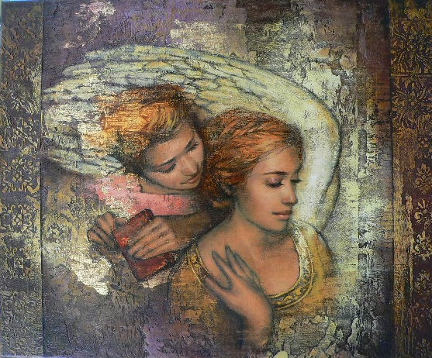
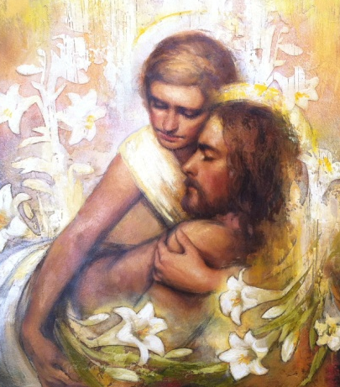
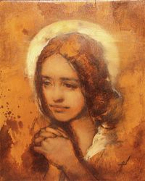
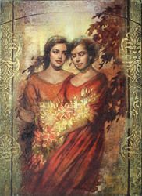
How would you like to receive a testimony of the gospel?
Through believing the words of a friend or family member
Through the appearance of an angel
Through witnessing a miracle
Through the Holy Ghost
Annie Henrie Artist

Slide 3
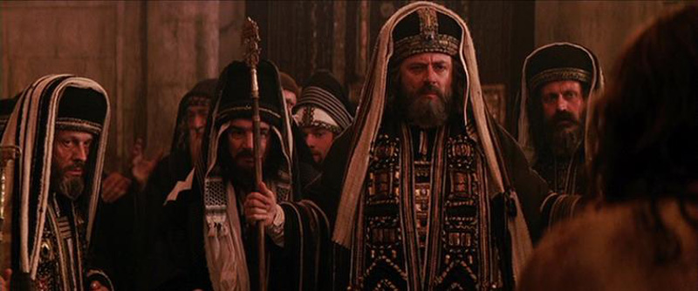
Show Me A Sign
The Savior rebuked the Pharisees and Sadducees for insisting that He show them a sign from heaven.
He declared that they were able to forecast the weather based on the appearance of an evening sky, yet they were unable to discern the “signs of the times”, by which the Savior meant the evidence that He was the promised Messiah.
…Why doth this generation seek after a sign? verily I say unto you, There shall no sign be given unto this generation.
Mark 8:12
Matthew 16:1-3

Slide 4
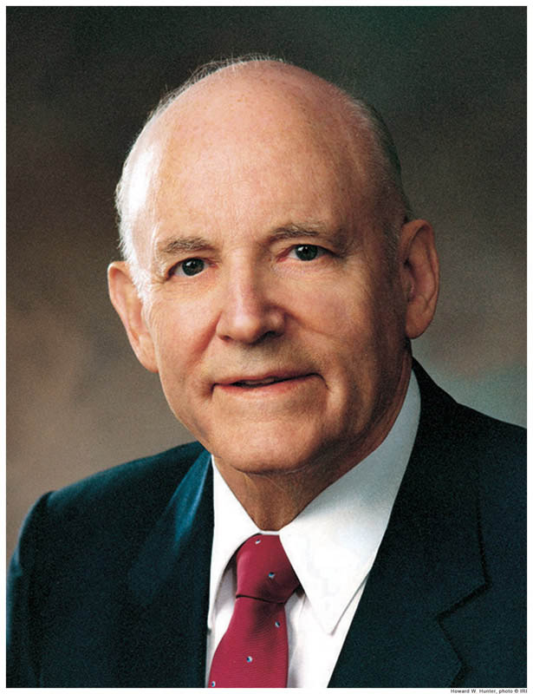
"Perhaps it was with them, as with many today, that truth is not recognized as truth unless it is accompanied by the sensational. What would have been accomplished had the Lord called down thunder and lightning, or plucked a star from the sky, or divided the water to satisfy the curiosity of men?
They would probably have said that it was the work of the devil, or that their eyes deceived them.
"Signs are evident to the faithful. Sick persons are healed; prayers are answered; changes are wrought in the lives of those who believe, accept, and live the commandments. We prove Christ by living the principles of his gospel.”
(1)

Slide 5
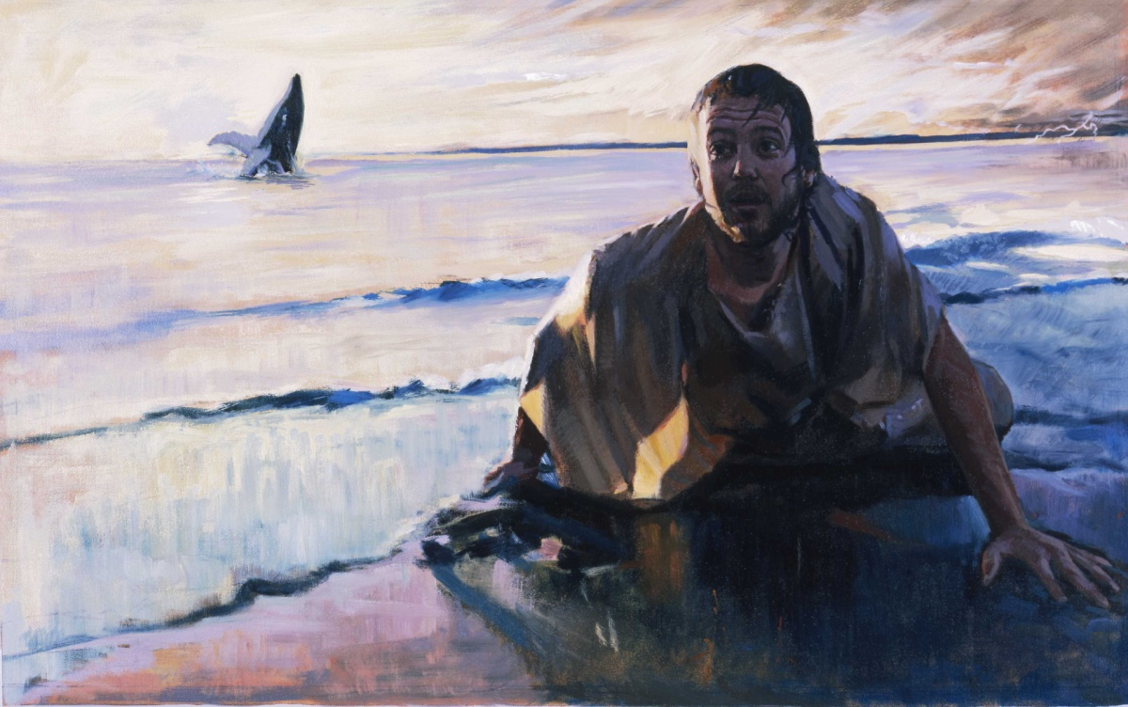
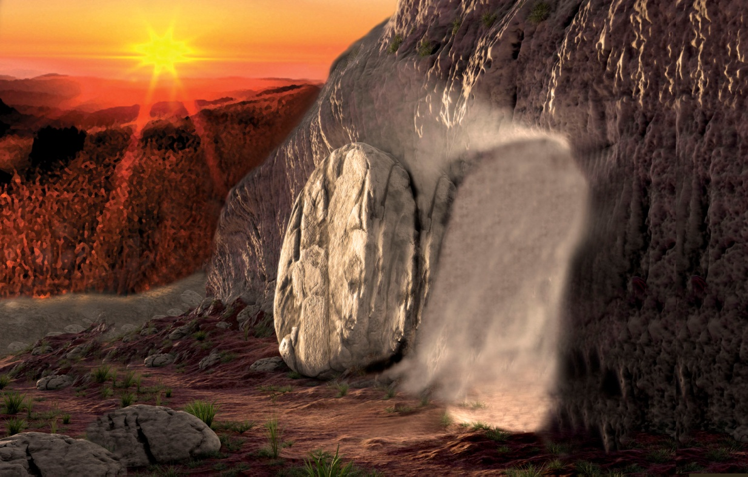
The Sign of Jonas
Jonah’s “burial” in and then coming forth from the belly of the fish after three days symbolized the death, burial, and Resurrection of Jesus Christ from the tomb on the third day.
We do not receive spiritual truth by seeking for signs
Matthew 16:4

Slide 6
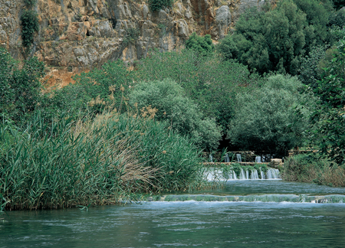
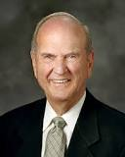
Caesarea Philippi
Caesarea Philippi is a region (“coasts” means region) composed of small towns.
It is located near the base of Mount Hermon, is one of the sources of the Jordan River, and is overlooked by the most prominent geological feature of the area—a huge rock formation at the base of Mount Hermon.
Could it be that the Savior brought His disciples to this spot to teach the lesson that this majestic mountain symbolized the rock of Christ from whom revelation would flow?—revelation to bring light and life to them, just as that flowing water of the River Jordan nourishes Israel” (2)
Headwaters of the Jordan River near Caesarea Philippi
Matthew 16:13-19; Mark 8:27

Slide 7
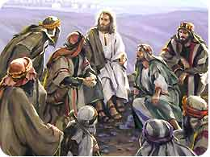
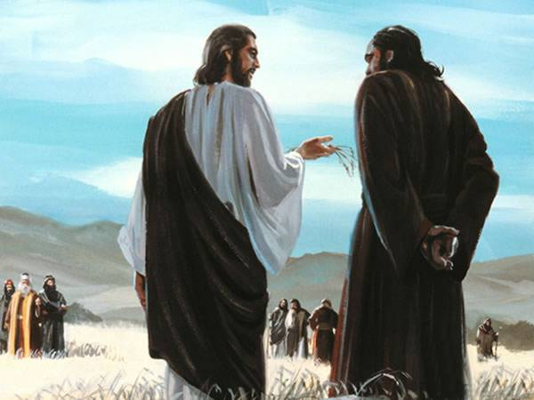
Whom Say Ye That I Am?
"Many profess to be Christians and yet do not believe that Jesus Christ is the literal Son of God, indeed, the eldest son of God the Father. Men are willing to follow some of his teachings but do not recognize the divine, eternal purpose and the significance of his life to all mankind.
'What think ye of Christ?' and 'Whom say ye that I am?'
These were questions asked by Jesus to make men think, so that he might teach them who he was, that they might use their own free agency, come to their own conclusions and commitments, follow him, and gain a testimony that he is the Son of God, our Redeemer.
Matthew 16:13-19

Slide 8
Scripture Mastery
He saith unto them, But whom say ye that I am?
And Simon Peter answered and said, Thou art the Christ, the Son of the living God.
And Jesus answered and said unto him, Blessed art thou, Simon Bar-jona: for flesh and blood hath not revealed it unto thee, but my Father which is in heaven.
And I say also unto thee, That thou art Peter, and upon this rock I will build my church; and the gates of hell shall not prevail against it.
And I will give unto thee the keys of the kingdom of heaven: and whatsoever thou shalt bind on earth shall be bound in heaven: and whatsoever thou shalt loose on earth shall be loosed in heaven.
New Testament
Matthew 16:15-19

Slide 9
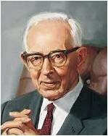
“The Spirit of God speaking to the spirit of man has power to impart truth with greater effect and understanding than the truth can be imparted by personal contact even with heavenly beings.
Through the Holy Ghost the truth is woven into the very fiber and sinews of the body so that it cannot be forgotten” (4)

Slide 10
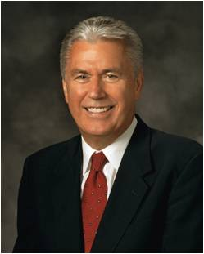
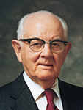
Individual Revelation
“We cannot depend on the testimonies of other people. We need to know for ourselves.
President Gordon B. Hinckley said, ‘Every Latter-day Saint has the responsibility to know for himself or herself with a certainty beyond doubt that Jesus is the resurrected, living Son of the living God’ (5)
Matthew 16:17-18

Slide 11
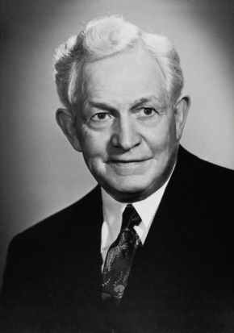
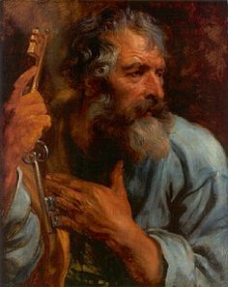
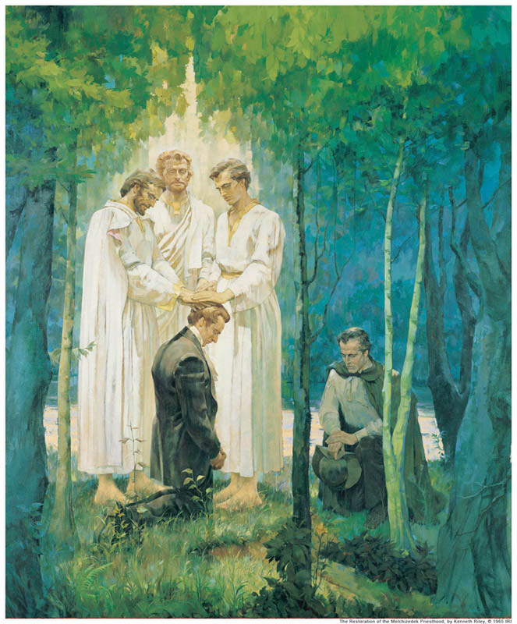
Upon This Rock
"By that He meant that as Simon's name 'Peter' means rock, so this testimony that comes by revelation shall be the rock upon which Christ's Church shall be built. Because when one receives such divine assurance in his soul that the gospel is true, no views of men, nor waves of temptation nor 'the power of hell' can deprive him of it. You remember when Jesus first met Simon, He said He should be called 'the Rock.’
Ever since then it would seem that Jesus has been waiting for the time when Peter's testimony would be like his character-expressive and firm. That time has come; and Peter is now prepared to receive a greater responsibility." (6)
The Greek word petros means an isolated small rock or stone. The Greek word petra can also mean “a stone,” but in addition it can refer to stony soil, bedrock, or a large mass of rock.
Matthew 16:18

Slide 12
“The Church of Jesus Christ of Latter-day Saints was founded upon direct revelation, as the true Church of God has ever been, according to the Scriptures .” (7)
Holy Bible
The
Book
of
Mormon
ANOTHER TESTAMENT
OF JESUS CHRIST
Jesus Christ’s Church is built upon revelation from God
REVELATION

Slide 13
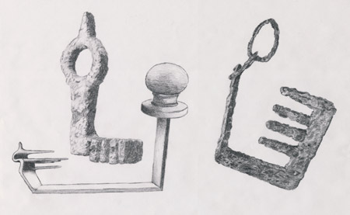
Ancient Keys
In the first century A.D., keys were typically made of iron and were bulkier, more expensive, and less common than modern house keys.
To hold the keys of a house was a position of great trust.
Thus, keys were a fitting symbol of special authority, responsibility, and purpose.
Ancient scriptures make repeated use of the symbol of keys, which represents the power to lock and unlock, open and shut, and permit or prevent entrance. (8)
Roman keys found in Israel
Matthew 16:19

Slide 14
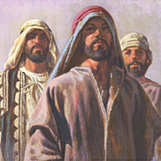
What Are the Keys of the Kingdom?
Peter, together with James and John, received the promised keys on the Mount of Transfiguration. Matthew 17:1-9
"These keys, as we are aware, are the right and power to preside over the kingdom which is the Church.
They enable the legal administrators who hold them to perform the ordinances of salvation so they will be binding on earth and sealed in heaven.
These sealing keys were, in fact, given to Peter, James, and John about a week later, when they climbed nearby Mount Hermon to meet with Moses and Elijah and to participate in the glory of the Transfiguration.
Later they were given to all of the Twelve, so that all had the power to bind and loose both on earth and in heaven. (Matt. 18:18.)" (9)
Matthew 16:19

Slide 15
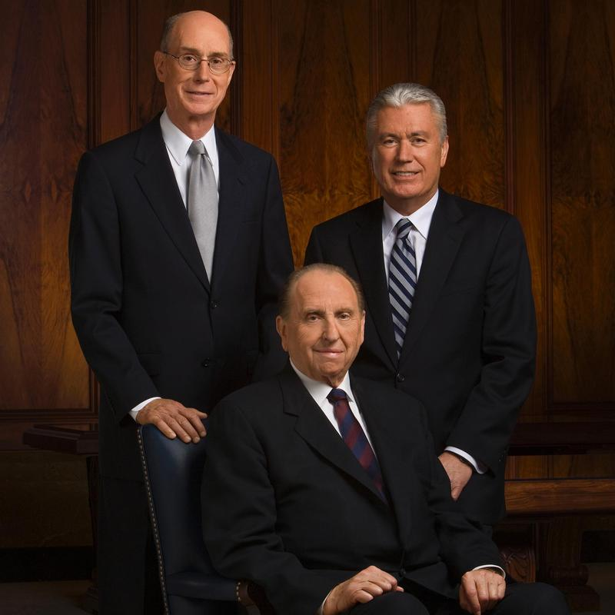
Peter and the Keys
Peter exercised these priesthood keys when he presided over the selection of a new Apostle (see Acts 1:15–26)
He oversaw the spreading of the gospel to Samaria (see Acts 8:14–25)
He received a revelation regarding Gentile converts (see Acts 10:9–48), and presided over the Jerusalem conference
The President of The Church of Jesus Christ of Latter-day Saints holds all the keys of the kingdom. The President and his counselors—the First Presidency—have the right to preside over the Church.
Unto whom I have given the keys of the kingdom, which belong always unto the Presidency of the High Priesthood: D&C 81:2
Matthew 16:19
(8)

Slide 16
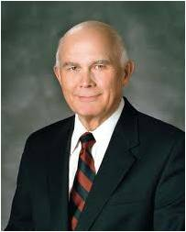
“‘Priesthood keys are the authority God has given to priesthood [holders] to direct, control, and govern the use of His priesthood on earth’.
Every act or ordinance performed in the Church is done under the direct or indirect authorization of one holding the keys for that function” (10)
Priesthood keys are necessary to administer the Lord’s Church upon the earth
(8)

Slide 17
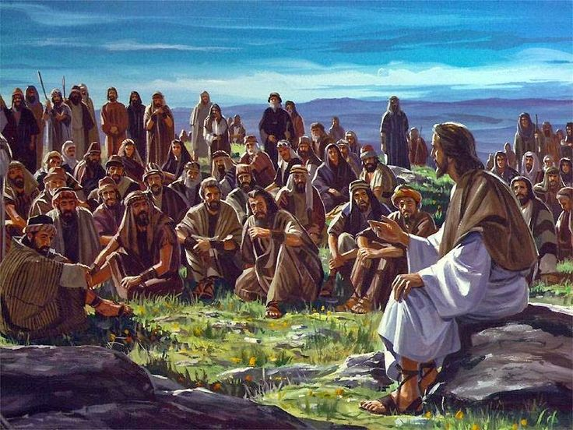
Tell No Man—Idea 1
Jesus Christ instructed His disciples and others not to speak about miracles He had done or about who He was.
The scriptures suggest several possible reasons why the Savior might have asked for secrecy or silence on certain occasions:
Mark relates that Jesus’s fame grew so great that it created difficulties. At times Jesus could not enter certain villages, people who wanted to see Him could not get through the crowds, and He and His disciples were so beset by throngs of people that they could not even find time or space to eat
Matthew 16:20; Mark 1:34, 44
(8)

Slide 18
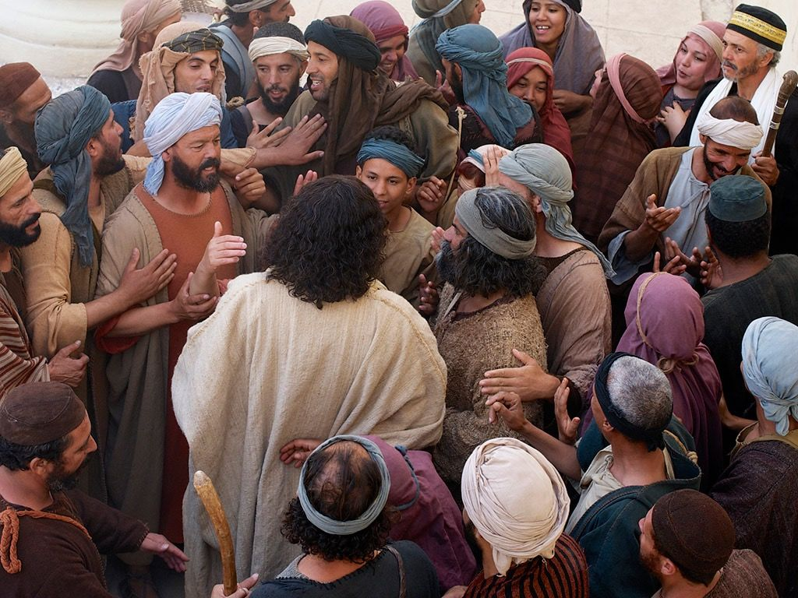
Tell No Man—Idea 2
The Savior may also have asked for silence in order to forestall the opposition that would lead to His Crucifixion—until the time was right.
The more people learned about Jesus, the more the chief priests increased their opposition to Him, for they did not want Him to undermine their place in society.
After Jesus entered Jerusalem in a way that clearly and publicly proclaimed Him as the Messiah, less than a week passed before He was arrested and put to death.
Matthew 16:20; Mark 9:30-31; John 7:1-10
(8)

Slide 19
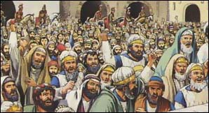
Tell No Man—Idea 3
Some of the Savior’s commandments for silence were directed at devils, who vocally acknowledged Jesus as the Son of God.
“Jesus “consistently refused to permit [devils] to bear record of his divinity.
Converting testimony comes from God, not from Lucifer. Had Jesus let unclean spirits go unrebuked, or had he acquiesced in their testimony of him (though in fact it was true), the Jews would have claimed greater justification for their false charge against him, ‘He hath a devil, and is mad; why hear ye him?’ (9)
Matthew 16:20; Mark 1:24, 34; 3:11-12; Acts 16:16-18; John 10:20
(8)

Slide 20
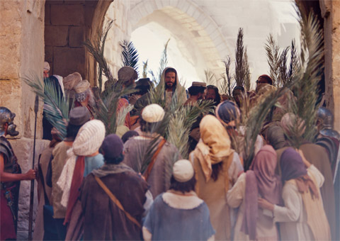
Tell No Man—Idea 4
The Savior knew that most Jews of His day were expecting the Messiah to put an end to Israel’s political enemies and reign as a Jewish king. It is clear that Jesus wanted to avoid presenting Himself as the Messiah of popular expectation. Therefore, one likely reason the Savior instructed His disciples not to tell people He was the Christ.
He was that He wanted to teach people a new understanding of what kind of salvation He had come to bring. He had come not to overthrow Rome but to conquer the eternal enemies of mankind—death, sin, and suffering.(9)
Matthew 16:20; Mark 8:29-30
(8)

Slide 21
Translated
Verily I say unto you, There be some standing here, which shall not taste of death, till they see the Son of man coming in his kingdom.
Christ did not say that one would not taste of death, but that some would not taste of death.
Was another disciple to be translated?
Tradition suggests that all the disciples, save Judas Iscariot and John, were killed as martyrs.
So why did Christ say that some would not taste of death?
Perhaps there were others who were also translated.
Matthew 16:28
(11)

Slide 22
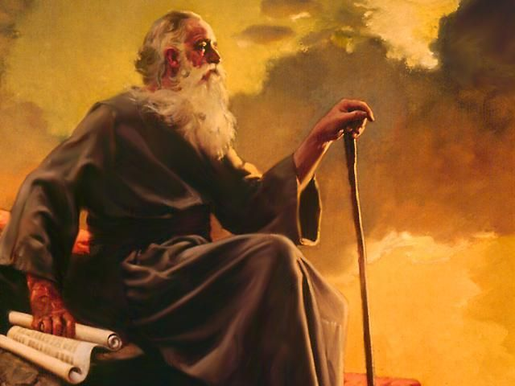
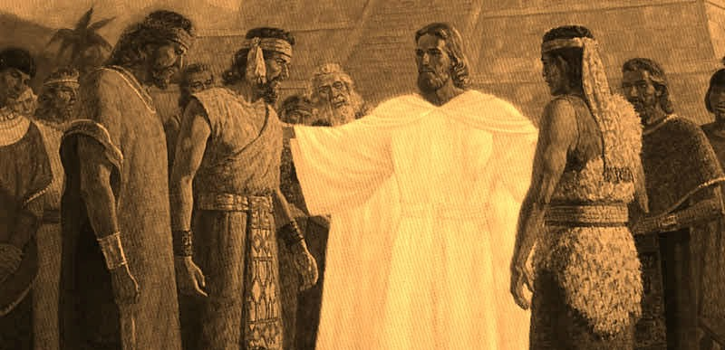
"...for special purposes a few persons who have lived in the Christian Era have been translated. Our Lord said on one occasion, 'There be some standing here, which shall not taste of death, till they see the Son of man coming in his kingdom.‘
The Lord may have had reference to these or other translated persons when he said in March, 1831, 'All are under sin, except those which I have reserved unto myself holy men that ye know not of.'
In any event John was translated.
And on the American continent, among the Nephites, three of the Twelve were also given power over death so that they could continue their ministry until the Second Coming.
"There are no other known instances of translation during the Christian Era, and unless there is some special reason which has not so far been revealed.
Matthew 16:28; John 21:20-23; Rev. 10; D. & C. 7; 77:14 3 Nephi 28; Isaiah 65:17-25
(9)

Slide 23
Perhaps others were translated, but perhaps John was the only one, and the scripture has another meaning. We are told that 'those that die in me shall not taste of death, for it shall be sweet unto them'.
Perhaps Christ's message had another layer of meaning-that although many of the apostles would die-and die as martyrs-they would not 'taste of death', for God's mercy would make even martyrdom 'sweet unto them.'
(8)

Slide 24
Sources:
Suggested Hymn: #20 God of Power, God of Right
Video:
Increase Your Testimony 5:00
Thou Art the Christ (1:30)
Priesthood Keys: The Restoration of Priesthood Keys (2:08)
Howard W. Hunter That We Might Have Joy, 24
Elder Russell M. Nelson (“Why This Holy Land?” Ensign, Dec. 1989, 15–16).
Robert D. Hales “What Think Ye of Christ?” “Whom Say Ye That I Am?” Ensign, May 1979, 77
Joseph Fielding Smith(Teachings of Presidents of the Church: Joseph Fielding Smith [2013], 183–84)
President Dieter F. Uchtdorf (‘Fear Not to Do Good,’ Ensign, May 1983, 80.
David O. McKay (Ancient Apostles, 48.)
Teachings: Joseph Smith, 195
New Testament Institute Student Manual Chapter 6
Elder Bruce R. McConkie The Millennial Messiah: The Second Coming of the Son of Man, 125; Elder Bruce R. McConkie (Doctrinal New Testament Commentary, 1:168; Mormon Doctrine, 806
Elder Dallin H. Oaks (“The Keys and Authority of the Priesthood,” Ensign or Liahona, May 2014, 49) Handbook 2: Administering the Church (2010), 2.1.1.
Gospeldoctrine.com

Slide 25
Annie Henrie:
With a Bachelors of Fine Arts degree from the Illustration program at Brigham Young University, and has shown her work in galleries since the age of 16. Her work is now shown at Bronze Coast Gallery in Cannon Beach, Oregon, Deseret Bookstores throughout Utah, along with Authentique Gallery in St. George Utah.
Annie grew up in Bountiful, Utah, and is the daughter of Cary and Sauni Henrie. Her father, a professional illustrator and fine artist, has taught his daughter how to paint and draw since kindergarten. Annie remembers her first art lessons in church when her father would keep her busy by drawing little pictures for her to copy. Her parents have been a huge source of support and encouragement through her progression in art, and to this day are her favorite art critics. Annie gained much of her inspiration from studies abroad in England, Italy and traveling throughout Europe. Her religious art stems from the early Renaissance art she saw in Italy, combined with her experiences serving as a missionary for the Church of Jesus Christ of Latter-Day Saints in southern England. Annie currently lives in Salt Lake City, Utah.
Annie is grateful for her friends, family, teachers and Altus Fine Art for their enthusiasm and support in sharing her work, and is grateful to God for giving her the opportunity to create art.
Feel free to observe and comment on Annie’s art. For information regarding portrait commissions and gallery work, please refer to the Contact page of this site.
“These are a few images of what it looks like when I go to ‘work’. I love being an artist- it is forever challenging, rewarding, frustrating, and SO MUCH FUN.” – Annie Henrie
Peter the Rock Matthew 16:18-19
"Jesus said to him 'thou art Peter,' adding, 'and upon this rock I will build my church.' In the course of the general apostasy subsequent to the ancient apostolic ministry, the Bishop of Rome laid claim to supreme authority as the alleged lineal successor to Peter; and an erroneous doctrine gained currency to the effect that Peter was the 'rock' upon which the Church of Christ was founded. Detailed consideration of this inconsistent and infamous claim cannot be undertaken here; it is sufficient to say that a church founded or dependent upon Peter or any other man would be Peter's or the other man's church, and not the Church of Jesus Christ. (See The Great Apostasy, chap. 9; also 3 Ne. 27:1-8; also chapter 40 herein.)“ James E. Talmage (Jesus The Christ, 341)
Priesthood Keys Matthew 16:19
“The Priesthood in general is the authority given to man to act for God. Every man ordained to any degree of the Priesthood has this authority delegated to him. But it is necessary that every act performed under this authority shall be done at the proper time and place, in the proper way, and after the proper order. The power of directing these labors constitutes the keys of the Priesthood” (Teachings of Presidents of the Church: Joseph F. Smith [1998], 141).
Tell No Man Matthew 16:"Proclamation of Jesus as the Messiah, particularly if made by the apostles who were publicly known as His most intimate disciples and associates, or open assumption of the Messianic title by Himself, would have aggravated the hostility of the rulers, which had already become a grave interference if not an actual menace to the Savior's ministry; and seditious uprisings against the political government of Rome might easily have resulted. A yet deeper reason for the secrecy enjoined upon the Twelve appears in the fact that the Jewish nation was not prepared to accept their Lord; and to ignore Him through lack of certain knowledge involved a lesser degree of culpability than would have attached to an unpalliated rejection. The particular mission of the apostles at the time then future was to proclaim to all nations Jesus, the crucified and resurrected Christ." James E. Talmage (Jesus the Christ,337)
Sign Seeking: Matthew 16:1-3
The Lord has poured and is pouring out the signs of the times on every hand. He is showing forth the very things, promised of old, that are to herald the coming of the Son of Man. And the issue before all men is whether they are able to read the signs of the times or whether they will ignore the divine warnings and continue on their godless course to an assured destruction. The true saints have this promise: 'Unto you it shall be given to know the signs of the times, and the signs of the coming of the Son of Man.' (D&C 68:11.)" Elder Bruce R. McConkie(The Millennial Messiah: The Second Coming of the Son of Man, 400.)

Slide 26
Event | Matthew | Mark | Luke | John
Another Discourse on Signs | 16:1-4 | 8:11-13
Beware of the Leaven of the Pharisees | 16:5-12 | 8:14-21
Peter Testifies That Jesus is the Christ (The Rock) | 16:13-20 | 8:27-30 | 9:18-21
Jesus Foretells His Death and Resurrection | 16:21-28 | 8:31-9:1 | 9:22-27
Source: Horizontal Harmony of the Four Gospels by Thomas M. Mumford

