Slide 1
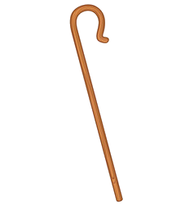
Lesson 70
Jesus is the Good Shepherd
John 10
Behold, I say unto you, that the good shepherd doth call you; yea, and in his own name he doth call you, which is the name of Christ; and if ye will not hearken unto the voice of the good shepherd, to the name by which ye are called, behold, ye are not the sheep of the good shepherd.
Alma 5:38

Slide 2
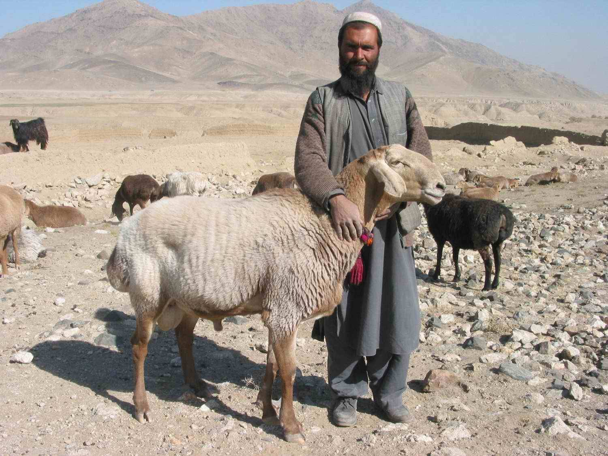
Knowing My Sheep
A shepherd in the Middle East was once asked how well he knew his sheep. He responded,
“If you were to put a cloth over my eyes, and bring me any sheep and only let me put my hands on its face, I could tell in a moment if it was mine or not.”
(2)

Slide 3
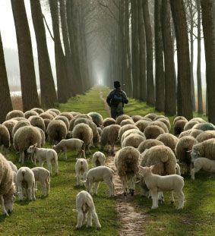
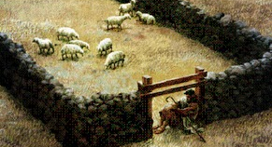
Shepherds
Shepherds led their flocks to food, water, and shelter during the day.
At night, several shepherds gathered their individual flocks into a common sheepfold.
A sheepfold is a cave or enclosure surrounded by rock walls that have sharp thorns placed along the top to prevent wild animals from entering.
John 10:2-5
(2)

Slide 4
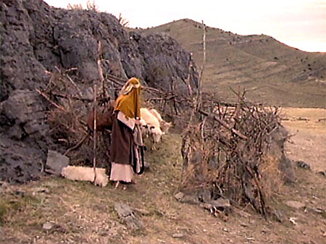
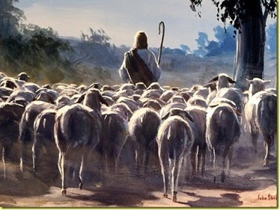
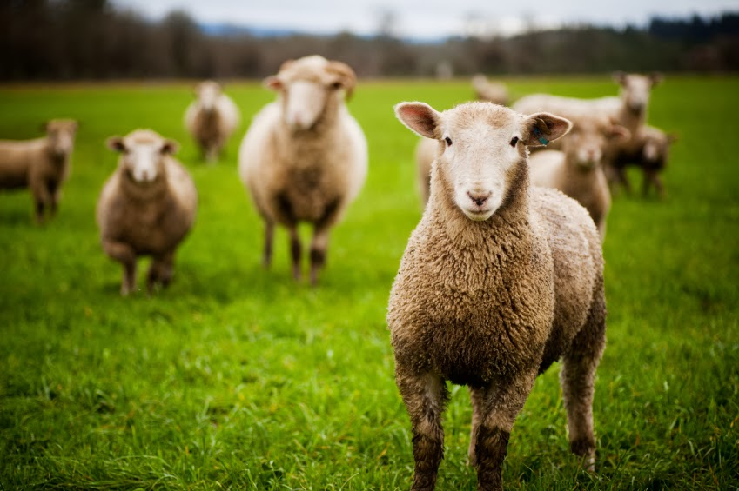
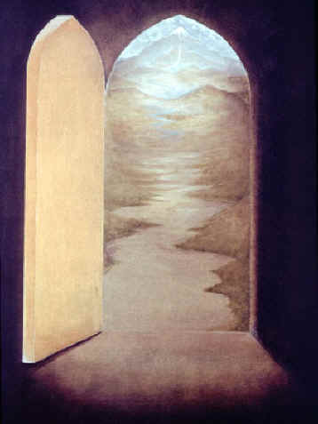
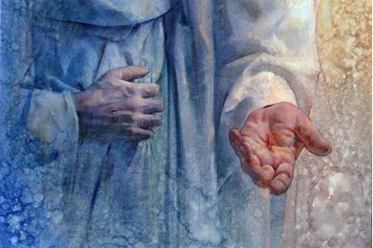
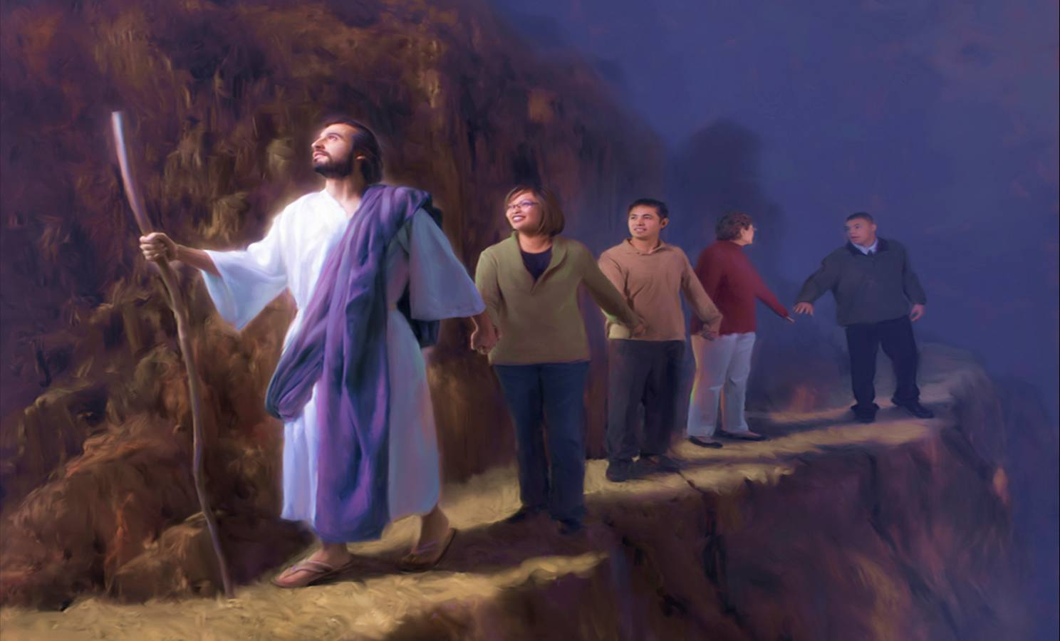
Our Shepherd
He enters by the door
He calls us by name
He leads His sheep
John 10:2-5
Yongsung Kim

Slide 5
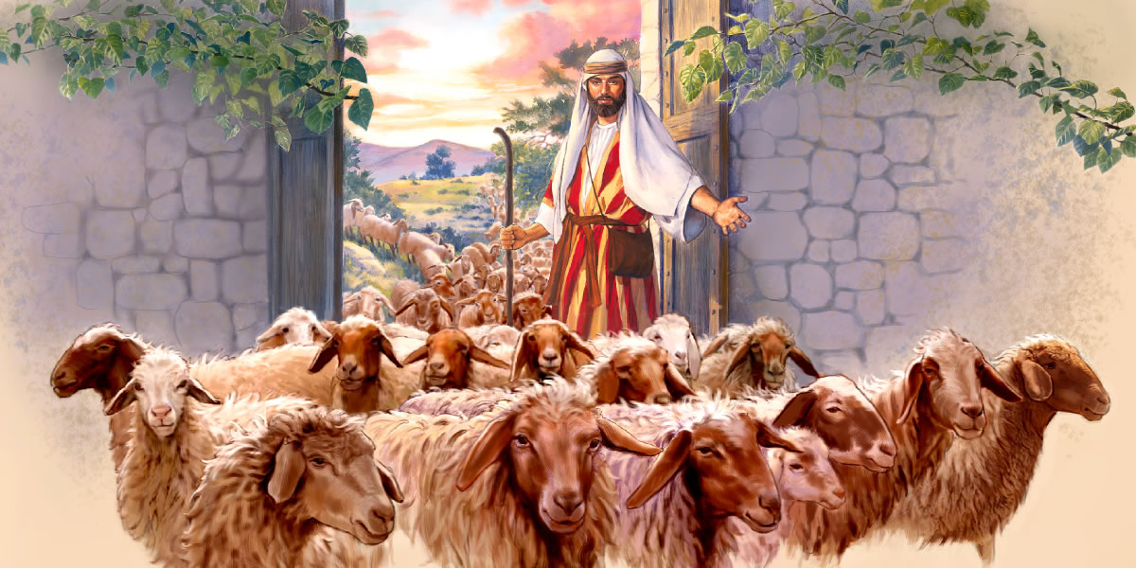
I Am The Door
Shepherds in Israel stood at the entrance of a sheepfold and inspected each sheep as it entered, treating injuries as needed.
After the sheep were gathered in the enclosure for the night, the shepherd would lie down to sleep in the entrance, barring the way so predators or thieves could not hurt the sheep.
“I am the door,” makes clear that He was willing to “lay down [His] life for the sheep”, and that He ultimately will decide who will enter the kingdom of heaven.
John 10:7, 15
(2)

Slide 6
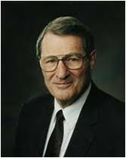
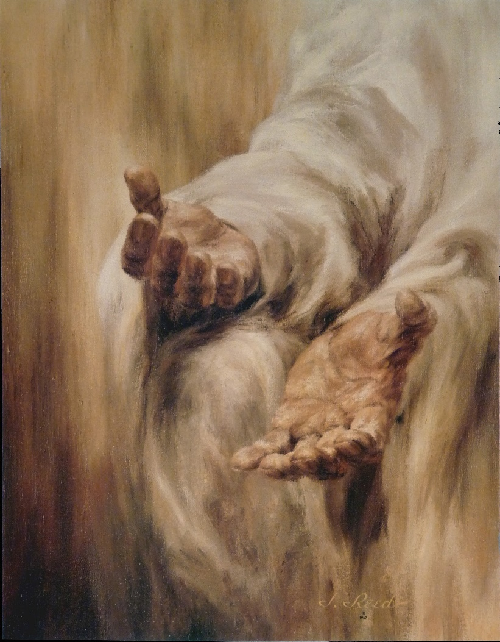
“He waits for you ‘with open arms.’ That imagery is too powerful to brush aside. …
It is imagery that should work itself into the very center core of one’s mind—a rendezvous impending, a moment in time and space, the likes of which there is no other.
And that rendezvous is a reality. I certify that to you.
He does wait for us with open arms, because his love of us is perfect.”
John 10:7, 15
(4)

Slide 7
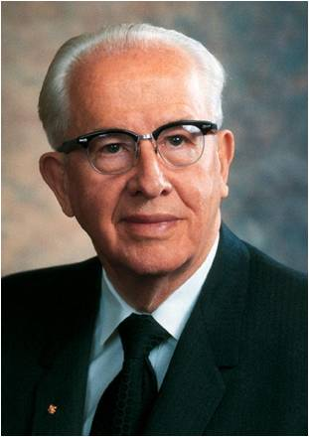
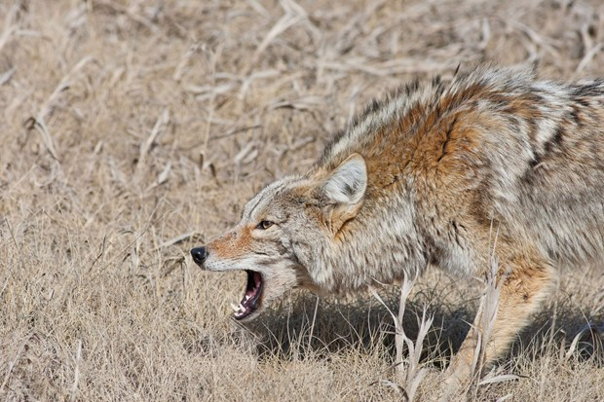
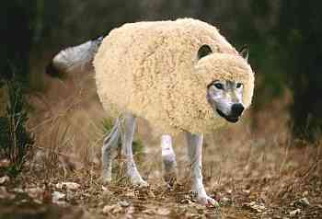
Strangers In A Sheepfold
“At night shepherds would bring their sheep to a corral called a sheepfold. High walls surrounded the sheepfold, and thorns were placed on top of these walls to prevent wild animals and thieves from climbing over.
“Sometimes, however, a wild animal driven by hunger would leap over the walls into the midst of the sheep, frightening them.
Such a situation separated the true shepherd—one who loved his sheep—from the hireling—one who worked only for pay and duty.”
John 10:6
(3)

Slide 8
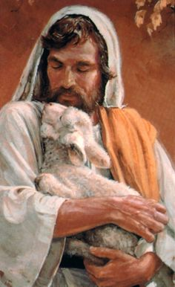
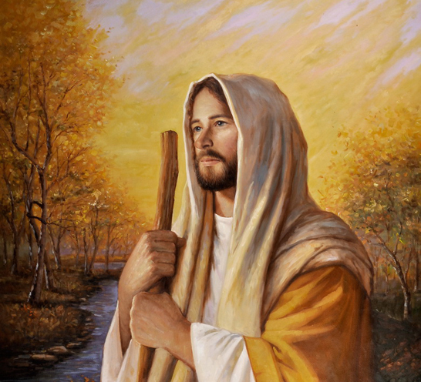
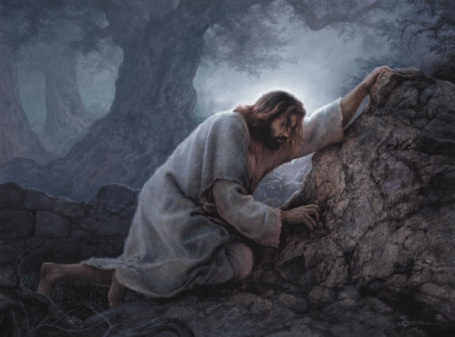
A True Shepherd
“The true shepherd was willing to give his life for the sheep. He would go in amongst the sheep and fight for their welfare. The hireling, on the other hand, valued his own personal safety above the sheep and would usually flee from the danger.
“Jesus used this common illustration of his day to declare that He was the Good Shepherd, the True Shepherd.
Because of His love for His brothers and sisters, He would willingly and voluntarily lay down His life for them.”
John 10:14, 17-18
(3)

Slide 9
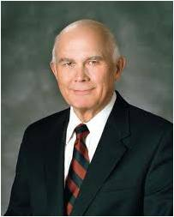
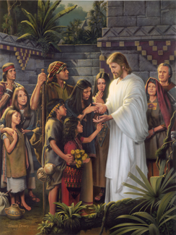
Who Are These Other Sheep?
When the resurrected Jesus Christ ministered to the Nephites, He told them that they were the ones He had spoken of when He said,
“Other sheep I have which are not of this fold; them also I must bring, and they shall hear my voice; and there shall be one fold, and one shepherd”
3 Nephi 15:21–24
“The Savior told His followers in the Americas that he was going ‘to show [Himself]’ to these ‘lost tribes of Israel, for they are not lost unto the Father, for he knoweth whither he hath taken them.’” (3 Nephi 17:4).
Simon Dewey
And verily, verily, I say unto you that I have other sheep, which are not of this land, neither of the land of Jerusalem, neither in any parts of that land round about whither I have been to minister. 3 Nephi 16:1
John 10:16
(5)

Slide 10
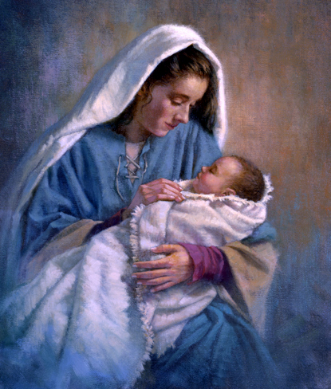
As the literal Son of God, Jesus Christ had power to lay down His life and take it up again
Why did the Savior have both the ability to die and the ability to rise again after dying?
From His mother, Mary, a mortal woman, Jesus inherited mortality, including the capacity to die. From Elohim, His Father, He inherited immortality, the power to live forever.
Thus, He had inherited the abilities to die and to rise again, which were necessary for Jesus to be able to perform the Atonement.
John 10:17-18
(5)

Slide 11
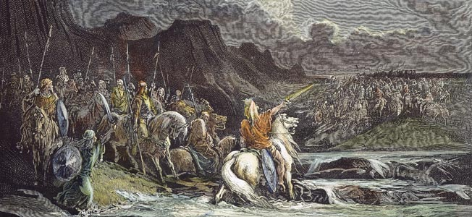
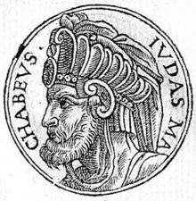
Feast of Dedication
The Feast of Dedication is also known as Hanukkah or the Festival of Lights.
Hanukkah = “dedication” in Hebrew
This commemoration celebrates the rededication of the Jerusalem temple and its new altar in about 165 BC Syrian warriors led by Antiochus Epiphanes had desecrated the temple in 168 B.C. and tried to wipe out the Jewish religion.
But freedom fighters led by a family of priests—Judah Maccabee being the most famous—repulsed the Syrians in a war of liberation for the Jewish people.
John 10:22-23
(1)

Slide 12
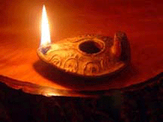
Burning for 8 Days
A story in the Talmud recounts that the Maccabees found only a small amount of oil when they captured the temple and witnessed the oil miraculously burn for eight days.
Hanukkah
Based on this account, the Feast of Dedication lasts eight days beginning on the 25th of the month of Kislev, which roughly corresponds to the beginning of the month of December.
John 10:22-23
(1)

Slide 13
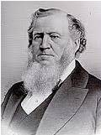
The Voice of the Shepherd
“How are we to know the voice of the Good Shepherd from the voice of a stranger?”
“When an individual, filled with the Spirit of God, declares the truth of heaven, the sheep hear that, the Spirit of the Lord pierces their inmost souls and sinks deep into their hearts; by the testimony of the Holy Ghost light springs up within them, and they see and understand for themselves.”
And ye are called to bring to pass the gathering of mine elect; for mine elect hear my voice and harden not the irhearts; D&C 29:7
John 10:25
(6)

Slide 14
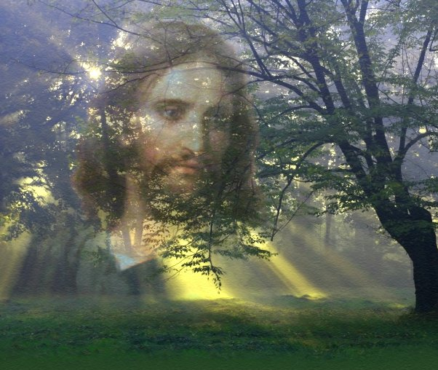
The Voice:
My sheep hear my voice
John 10:25
(6)

Slide 15
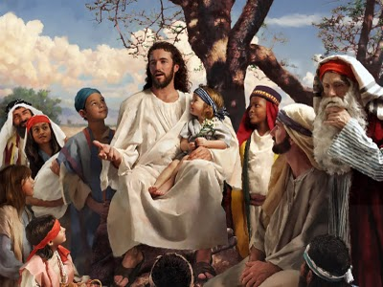
“The Lord loves all of His children. He desires that all have the fulness of His truth and the abundance of His blessings.
He knows when they are ready, and He wants us to hear and heed His directions on sharing His gospel.
When we do so, those who are prepared will respond to the message of Him who said, ‘My sheep hear my voice … and they follow me.’”
John 10:27
(5)

Slide 16
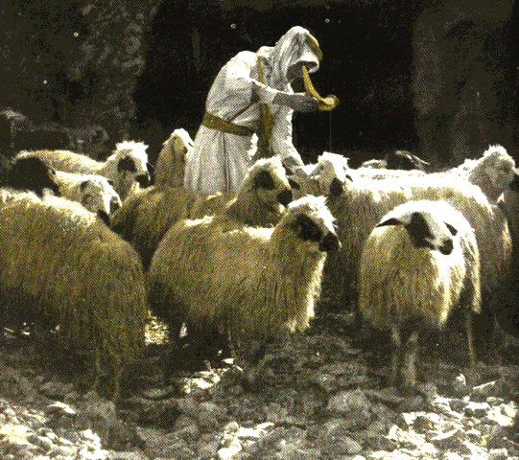
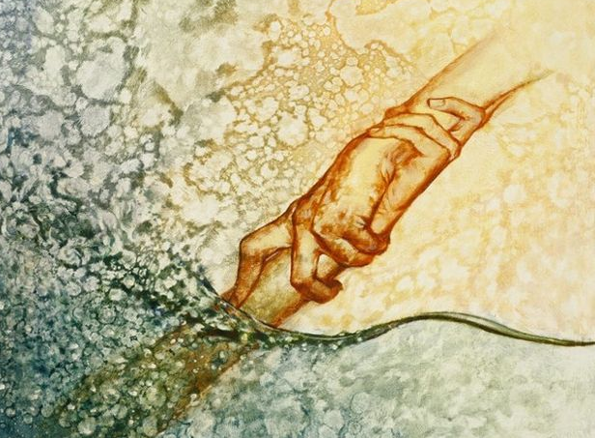
Eternal Safety
We have eternal safety in the sheepfold of the Savior, who promised that no man can “pluck” His sheep out of His hand and that “no man is able to pluck them out of my Father’s hand”
Neither shall Satan have power to pluck them out of his hand, for they are the elect of God. Christ's mission of salvation includes giving eternal life to all those elect souls foreordained to this glory.
Of these, Jesus would lose none, 'but the son of perdition; that the scripture might be fulfilled' It is truly amazing that the Savior can save all these souls without violating their agency.
He encourages them, he admonishes them, he leads them, and they follow him-not by coercion-but because they know his voice.
John 10:27-28; John 17:22; John 6:37-39
(8)

Slide 17
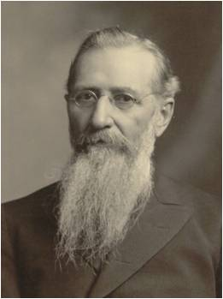
I and My Father Are One
Singleness of purpose and shared love
“Jesus and his Father are … one in knowledge, in truth, in wisdom, in understanding, and in purpose; just as the Lord Jesus himself admonished his disciples to be one with him, and to be in him, that he might be in them.
“It is in this sense that I understand this language, and not as it is construed by some people, that Christ and his Father are one person.
I declare to you that they are not one person, but that they are two persons, two bodies, separate and apart, and as distinct as are any father and son.”
John 10:30, 37-38
(7)

Slide 18
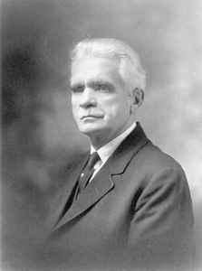
“Let it be observed that in the above conversation when Jesus was accused of making himself God, he did not deny the charge; but on the contrary, called their attention to the fact that God in the law he had given to Israel had said to some of them—‘ye are Gods.’
And further, Jesus argued, if those unto whom the word of God came were called Gods in the Jewish law, and the scripture wherein the fact was declared could not be broken, that is, the truth denied or gainsaid [declared untrue or invalid]—why should the Jews complain when he, too, that is Christ, who had been especially sanctified by God the Father, called himself the Son of God?”
(11)
John 10:30

Slide 19
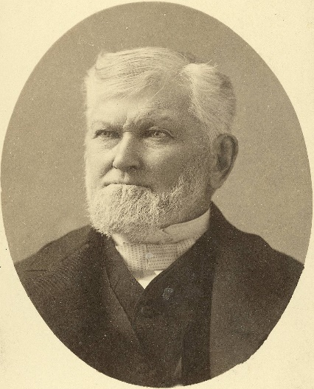
"'I and my Father are one,' says Jesus; what, one body? No, it never entered the Savior's mind that such a rendering of this saying would ever enter into the minds of persons holding the least claim to good sense. They are no more one person than I and one of my sons are one person. If my son receives my teaching, will walk in the path I mark out for him to walk in, if his faith is the same as mine, his purpose is the same, and he does the work of his father as Jesus did the work of his Father, then is my son one with me in the Scriptural sense." (6)
"There is a principle connected with this that I think is very important to us as a people and as a Church on the earth. With all the divisions, and all the discontent, and the quarrelings and opposition among the powers on earth, or that have been revealed from heaven, I have never heard that it has ever been revealed to the children of men that there was any division between God the Father, God the Son, and God the Holy Ghost.
They are one. They always have been one. They always will be one, from eternity unto eternity.“ (9)
John 10:30, 37-38

Slide 20
“We believe these three divine persons constituting a single Godhead are united in purpose, in manner, in testimony, in mission. We believe Them to be filled with the same godly sense of mercy and love, justice and grace, patience, forgiveness, and redemption.
I think it is accurate to say we believe They are one in every significant and eternal aspect imaginable except believing Them to be three persons combined in one substance, a Trinitarian notion never set forth in the scriptures because it is not true.”
John 10:30; Articles of Faith 1:1
(10)

Slide 21
Sources:
Suggested Hymn: #108 The Lord is My Shepherd
Video: The Good Shepherd and Other Sheep I have (3:19)
New Testament Institute Student Manual Chapter 24
(G. M. Mackie, Bible Manners and Customs [n.d.], 35).
President Ezra Taft Benson (“A Call to the Priesthood: ‘Feed My Sheep,’” Ensign, May 1983, 43).
Elder Neal A. Maxwell (“But a Few Days” [address to CES religious educators, Sept. 10, 1982], 7; si.lds.org).
Elder Dallin H. Oaks (“All Men Everywhere,” Ensign or Liahona, May 2006, 79–80). And (“Sharing the Gospel,” Ensign, Nov. 2001, 9).
President Brigham Young (Teachings of Presidents of the Church: Brigham Young [1997], 319). And (Journal of Discourses, 10: 192.)
President Joseph F. Smith Teachings of Presidents of the Church: Joseph F. Smith [1998], 357.
Gospeldoctrine.com
Wilford Woodruff The Discourses of Wilford Woodruff, edited by G. Homer Durham [Salt Lake City: Bookcraft, 1969], 136.
Elder Jeffrey R. Holland (“The Only True God and Jesus Christ Whom He Hath Sent,” Ensign or Liahona, Nov. 2007, 40).
Elder B. H. Roberts (New Witnesses for God, 3 vols. [1909–11], 1:465–66).
Presentation by ©http://fashionsbylynda.com/blog/

Slide 22
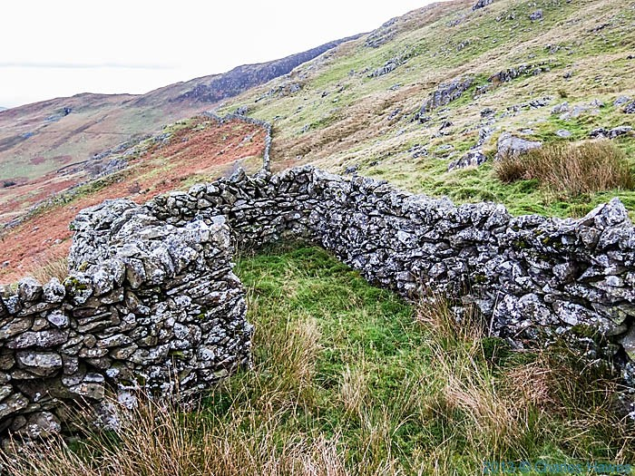
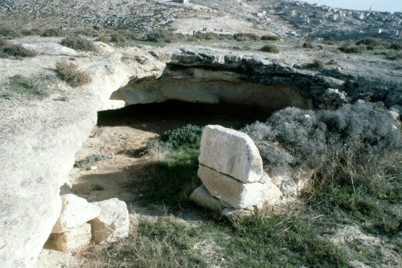
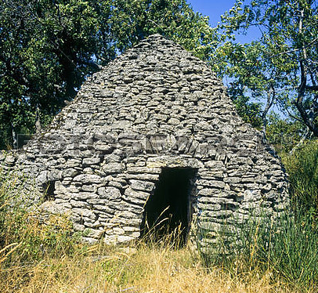
Event | Matthew | Mark | Luke | John
Jesus is the Good Shepherd |  |  |  | 10:1-21
Jesus at the Feast of Dedication in Jerusalem |  |  |  | 10:22-39
Jesus Escapes from the Jews by going across the Jordan |  |  |  | 10:39-42
Sheepfold John 10:1-5:
Most sheep folds were constructed of low stone walls, unroofed (although sheepcotes were sometimes sheds with roofs), and quite often circular. The shepherd could lay across the threshold or entrance of the holding pen and that way anything (or anyone) coming or going would literally have to pass by him. It was quite a security system. The shepherd was that gate and, one might also say, the gatekeeper (see verse 3).
The gatekeeper opens the sheepfold for the shepherd. In much the same way, the Holy Spirit opens the Church (the sheep and sheepfold) for the shepherd (The Word) to lead and protect. The sheep obey the shepherd who has conditioned them to know his voice. They know when that voice speaks there is safety for it is the shepherd’s leading that takes them to graze on verdant slopes and rest by running waters which are always fresh and clean rather than stagnant puddles and ponds. The shepherd values his sheep, so much in fact that he names them and calls them by their names much like we name our pets. But for shepherds in Biblical times – and most likely even today in herds not run by agribusiness – sheep are not just pets, and yet are more than just livestock. The sheep provided wool, leather, meat, and a sacrificial victim for important feasts and rites. Shepherds invested time and effort in caring for the sheep because they were a major component of their lives. They took care of the sheep because they needed the sheep; to fail to take care of them would be to abandon them. Scripture uses the imagery of sheep and shepherd to describe the relationship between Israel and Jehovah. Sheep are the most-mentioned animals in the Bible – at least 200 times – and the shepherds are often mentioned with them.
We also tend to think of sheep being driven, like other domesticated herd animals. But sheep are better led than driven. The shepherd is at the head of his flock. He goes where they are going and gets there before them. If they are going to the sheepfold, he enters first. If they are leaving, he exits first. If they are going to pastures for grazing, he finds those pastures. The sheep follow only the shepherd; they run from strangers; they panic when attacked by carnivores like wolves or lions. They form a sort of attachment to the shepherd – something like we do with our pets – and they are contented to remain in that relationship. Moon beam network blog http://www.aloha-friday.org/archives/5974
Sheep Folds on foothills of Moel Hebog in Snowdonia, photographed by Charles Hawes
Holy Land sheepfold
Borie ancient dry stone sheepfold, Provence France

Slide 23
Other Sheep Not of This Fold John 10:16:
“The Bible contains no related passage affording explanation. Commentators treat this verse as an isolated and unconnected utterance, and content themselves with the suggestion that the ‘other sheep’ may be the Gentile nations who are to be brought into the Jewish fold under the one Shepherd. The Jews who heard the Lord speak so understood Him”
James E. Talmage (The Vitality of Mormonism [1919], 151).
"I had the privilege of talking to a group of ministers just a few years ago by assignment from President McKay, and I quoted some of these scriptures. I asked them if they knew why the verses were in the Bible and if they knew of any Church in the world that did know why they were in the Bible, and the next record that I quoted was the one where Jesus said:
'And other sheep I have, which are not of this fold: them also I must bring, and they shall hear my voice; and there shall be one fold, and one shepherd.' (John 10:16.)
"I asked those men if they knew anything about those other sheep or the fulfillment of the promise of the Lord that he would visit them, and they would hear his voice, and there should be one fold and one shepherd. None of them could tell, and so I just turned to the Book of Mormon and showed them that when Jesus, following his crucifixion and resurrection and ascension, visited his people here in the land of America, he told them they were the other sheep of whom he spoke to his disciples in Jerusalem, and he said that never at any time did the Lord command him that he should tell his disciples in Jerusalem who the other sheep were; only that he had other sheep that were not of that fold, and them should he visit. He told them they were the other sheep. No one can answer intelligently that statement in John 10:16 without the knowledge that the Book of Mormon has brought to us."
Legrand Richards (Conference Report, April 1963, Afternoon Meeting 117 - 118.)
Dedication is the act of consecrating an altar, temple, church, or other sacred building. It also refers to the inscription of books or other artifacts when these are specifically addressed or presented to a particular person. This practice, which once was used to gain the patronage and support of the person so addressed, is now only a mark of affection or regard. In law, the word is used of the setting apart by a private owner of a road to public use.
The Feast of Dedication, today Hanukkah, once also called "Feast of the Maccabees," was a Jewish festival observed for eight days from the 25th of Kislev (usually in December, but occasionally late November, due to the lunisolar calendar). It was instituted in the year 165 B.C. by Judas Maccabeus, his brothers, and the elders of the congregation of Israel in commemoration of the reconsecration of the Jewish Temple in Jerusalem, and especially of the altar of burnt offerings, after they had been desecrated during the persecution under Antiochus Epiphanes (168 BC). The significant happenings of the festival were the illumination of houses and synagogues, a custom probably taken over from the Feast of Tabernacles, and the recitation of Psalm 30:1-12. J. Wellhausen suggests that the feast was originally connected with the winter solstice, and only afterwards with the events narrated in Maccabees.
The Feast of Dedication is also mentioned in John 10:22 where it mentions Jesus being at the Jerusalem Temple during "the Feast of Dedication" and further notes "and it was winter." The Greek term used in John is "the renewals" (Greek ta engkainia τὰ ἐγκαίνια). Josephus refers to the festival in Greek simply as "lights.“
Wikipedia
Follow Me John 10:27:
“If we will live worthy, then the Lord will guide us—by a personal appearance, or by His actual voice, or by His voice coming into our mind, or by impressions upon our heart and our soul. And oh, how grateful we ought to be if the Lord sends us a dream in which are revealed to us the beauties of the eternity or a warning and direction for our special comfort. Yes, if we so live, the Lord will guide us for our salvation and for our benefit” President Harold B. Lee (Teachings of Presidents of the Church: Harold B. Lee [2000], 51–52).
“How do we follow the Savior? By exercising faith. By believing in Him. By believing in our Heavenly Father. By believing that God speaks to man on earth today.
“We follow the Savior by repenting of our sins—by experiencing sorrow because of them and forsaking them.
“We follow the Savior by entering the waters of baptism and receiving a remission of our sins, by receiving the gift of the Holy Ghost and allowing that influence to inspire, instruct, guide, and comfort us.
“How do we follow the Savior? By obeying Him. He and our Heavenly Father have given us commandments—not to punish or torment us, but to help us come to a fulness of joy, both in this life and for the eternities to come, worlds without end” elder Joseph B. Wirthlin (“Follow Me,” Ensign, May 2002, 16–17).

Slide 24
A Shepherd--Symbolically, a person who cares for the Lord’s children.
John 10:11 | I am the good shepherd: the good shepherd giveth his life for the sheep.
Ezekiel 34:23 | And I will set up one shepherd over them, and he shall feed them, even my servant David; he shall feed them, and he shall be their shepherd.
Alma 5:38 | Behold, I say unto you, that the good shepherd doth call you; yea, and in his own name he doth call you, which is the name of Christ; and if ye will not hearken unto the voice of the good shepherd, to the name by which ye are called, behold, ye are not the sheep of the good shepherd.
Psalm 23:1 | The Lord is my shepherd; I shall not want.
Isaiah 40:11 | He shall feed his flock like a shepherd: he shall gather the lambs with his arm, and carry them in his bosom, and shall gently lead those that are with young.
Hebrews 13:20 | Now the God of peace, that brought again from the dead our Lord Jesus, that great shepherd of the sheep, through the blood of the everlasting covenant,
Jeremiah 31:10 | Hear the word of the Lord, O ye nations, and declare it in the isles afar off, and say, He that scattered Israel will gather him, and keep him, as a shepherd doth his flock
1 Nephi 22:25 | And he gathereth his children from the four quarters of the earth; and he numbereth his sheep, and they know him; and there shall be one fold and one shepherd; and he shall feed his sheep, and in him they shall find pasture.
Alma 5:60 | And now I say unto you that the good shepherd doth call after you; and if you will hearken unto his voice he will bring you into his fold, and ye are his sheep; and he commandeth you that ye suffer no ravenous wolf to enter among you, that ye may not be destroyed.
Jesus Christ is the Good Shepherd.
Symbolically, his followers are like sheep whom Jesus watches over
Bible Dictionary and Guide to criptures

