Slide 1
Lesson 148
Receiving the Lord’s Servants
2 John and 3 John
And the arm of the Lord shall be revealed; and the day cometh that they who will not hear the voice of the Lord, neither the voice of his servants, neither give heed to the words of the prophets and apostles, shall be cut off from among the people;
D&C 1:14

Slide 2
John 2 --History
Early Saints often housed and supported
traveling Church leaders and teachers.
False teachings travelers took advantage of the hospitality of the Saints, John tells his readers to use discernment and avoid supporting these people
The 2 letters were written about A.D. 85-95 somewhere in the Roman Empire.

Slide 3
The Elect Lady and Her Children
May have been either a direct address to a female Church member and her children or symbolic language to describe a Church congregation.
In D&C 25:3 Emma Smith, wife of the Prophet Joseph Smith, was called “an elect lady”
2 John 1-4
(2)

Slide 4
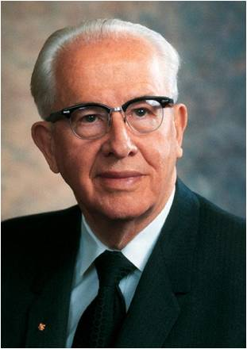
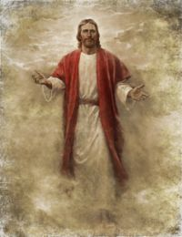
Walk After His Commandments
We must put God in the forefront of everything else in our lives. He must come first, just as He declares in the first of His Ten Commandments: "Thou shalt have no other gods before me" (Exodus 20:3).
When we put God first, all other things fall into their proper place or drop out of our lives. Our love of the Lord will govern the claims of our affection, the demands on our time, the interests we pursue, and the order of our priorities.
2 John 1:6
(3)

Slide 5
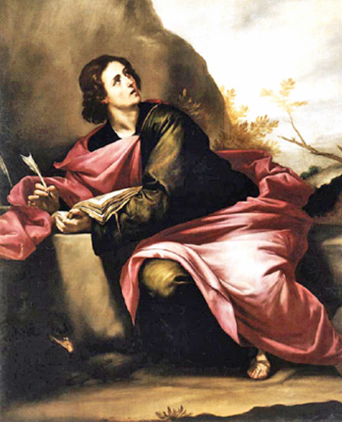
Deceivers of the World
John advised the Saints that if they encountered a false teacher, they should “receive him not into your house, neither bid him God speed”
John was not suggesting that the Saints should fail to extend common courtesy to those who taught contrary doctrines.
However, since early Christian congregations gathered to worship in the homes of Church members, traditional customs of hospitality could inadvertently enable heretical teachers to infiltrate congregations.
2 John 1:7-10
(1)

Slide 6
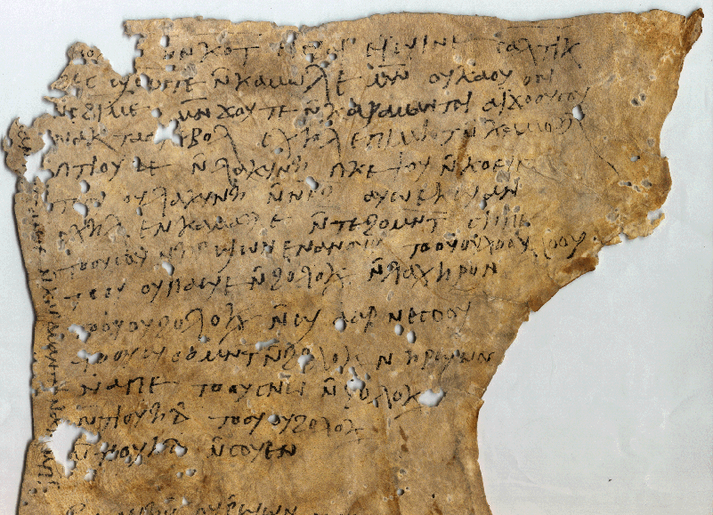
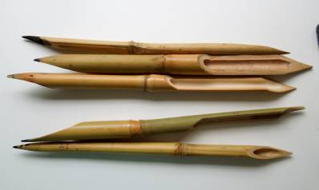
Paper and Ink
"How were the sacred words recorded? It appears that anciently two main substances were used in writing. Papyrus was made from the inner bark of a reed plant that grew beside rivers and marshes...
The second material on which writing was done was parchment. Parchment was formed through shaving and scraping clean the skins of sheep, goats, antelope, and other animals in order to produce a material for writing which was more durable than papyrus...
Cyperus Papyrus
... Pen and ink were used to write on papyrus or parchment. The pen was a reed 'fashioned from rushes about 6-16 in. long, the end being cut to a flat chisel-shape to enable thick and thin strokes to be made with
the broad or narrow sides.
' The ink was made of charcoal,
gum, and water.
2 John 1:12
(1)

Slide 7
Gaius—the Name Only
1. A Christian Gaius is mentioned in Macedonia as a traveling companion of Paul, along with Aristarchus (Acts 19:29).
One chapter later, a Gaius from Derbe is named as one of Paul's seven traveling companions who waited for him at Troas(Acts 20:4).
2. A Gaius is mentioned residing in Corinth as being one of only a few people there (the others being Crispus and the household of Stephanas) who were baptized by Paul, who founded the Church in that city (1 Corinthians 1:14).
3. A Gaius is referred to in a final greeting portion of the Epistle to the Romans (Romans 16:23) as Paul's "host" and also host of the whole church, in whatever city Paul is writing from at the time. In all likelihood, this was Corinth.
Lastly, Gaius of Ephesus to whom the third Epistle of John is addressed (3 John 1). He may be one of the men mentioned in any of the other contexts. (2)
(2)

Slide 8
Diotrephes
"John's third letter is a letter of apostasy.
In it he made reference to one Diotrephes, a local church leader who had refused to receive John.
Diotrephes, according to John, 'loveth to have the preeminence' among the saints.
John - the presiding authority of the church - had written to him; but Diotrephes would not receive John. Neither would he receive 'the brethren,' and he would not let his congregation do so either. In fact, he excommunicated those who would.
3 John 1:9-10
(5)

Slide 9
Gaius—A Faithful Member
John praised Gaius for his willingness to receive traveling Church leaders or missionaries.
Church members ought to receive and sustain all servants of the Lord.
3 John 1:5-14
(2)

Slide 10
Sources:
Suggested Hymn: #21 Come Listen to a Prophet’s Vioce
New Testament Institute Student Manual Chapter 51
Wikipedia
President Ezra Taft Benson CR April 1988, Ensign 18 [May 1988]: 4.) (The Teachings of Ezra Taft Benson [Salt Lake City: Bookcraft, 1988], 349 - 350.)
Robert Millet (Selected Writings of Robert L. Millet: Gospel Scholars Series [Salt Lake City: Deseret Book Co., 2000], 4 - 5.)
(John M. Lundquist and Stephen D. Ricks, eds., By Study and Also by Faith: Essays in Honor of Hugh W. Nibley on the Occasion of His Eightieth Birthday, 27 March 1990, 2 vols. [Salt Lake City and Provo: Deseret Book Co., Foundation for Ancient Research and Mormon Studies, 1990], 1: 111 - 112.)
Presentation by ©http://fashionsbylynda.com/blog/

Slide 11
2 JOHN: TO A BRANCH OF THE CHURCH
3 JOHN: TO GAIUS, A CHRISTIAN CONVERT
Written between 70 – 100 AD
False Prophets and teachers 2 John 1:7-10:
“Let us beware of false prophets and false teachers, both men and women, who are self-appointed declarers of the doctrines of the Church and who seek to spread their false gospel and attract followers by sponsoring symposia, books, and journals whose contents challenge fundamental doctrines of the Church. Beware of those who speak and publish in opposition to God’s true prophets and who actively proselyte others with reckless disregard for the eternal well-being of those whom they seduce. …
“Perhaps most damningly, they deny Christ’s Resurrection and Atonement, arguing that no God can save us. They reject the need for a Savior. In short, these detractors attempt to reinterpret the doctrines of the Church to fit their own preconceived views, and in the process deny Christ and His messianic role” Elder M. Russell Ballard (“Beware of False Prophets and False Teachers,” Ensign, Nov. 1999, 63).
John 2
Saints Are Commanded to Teach the Law of Love | 1:1–6
Do Not Aid the Enemies of Christ | 1:6
3 John
Gaius Praised for His Labors | 1:1–8
Beware of the Example of Diotrephes | 1:9–11
Demetrius Commended | 1:12–14
Diotrephes 3 John 1:9-10:
“Here is Diotrephes, a local church officer of prominence and influence: (1) Who refuses to permit the doctrine and instructions of a member of the First Presidency of the Church to be read in his congregation; (2) Who preaches against the apostolic heads of the Church; (3) Who refuses to receive the church representatives sent to him; (4) Who refuses to let others in the congregation care for or give heed to the church authorities; and (5) Who casts out (apparently excommunicates) worthy members of the Church” Elder Bruce R. McConkie (Doctrinal New Testament Commentary, 3 vols. [1965–73], 3:413–14).
Life and Teachings of Jesus and His Apostles Chapter 53

