Slide 2
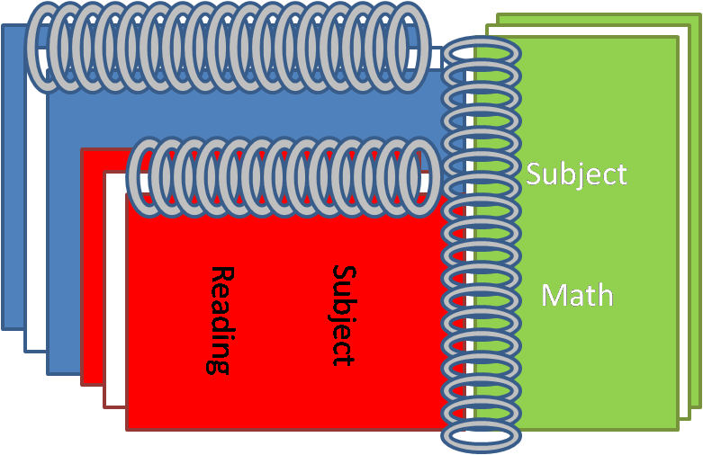
Exercise
The
Book
of
Mormon
ANOTHER TESTAMENT
OF JESUS CHRIST
How Do You Exercise?

Slide 3
How Do You Exercise in Faith?
Zenos
“For he said: Thou art merciful, O God, for thou hast heard my prayer, even when I was in the wilderness; yea, thou wast merciful when I prayed concerning those who were mine enemies, and thou didst turn them to me.”
Alma 33:4

Slide 4
Where Can We Pray?
We can exercise faith in God by sincerely praying to Him at any time and in any place
Read Alma 33:5-7

Slide 5
Where Can We Worship?
Alma 33:5-7

Slide 6
Do You Believe in the Scriptures?
Alma is familiar with the words of Zenock and Zenos…
Alma suggests that the Zoramites were also familiar with these prophets…hence, they had the scriptures.
The Brass Plates of Laban
Alma 33:12-17

Slide 7
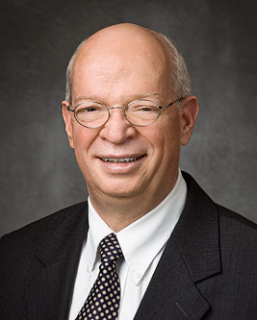
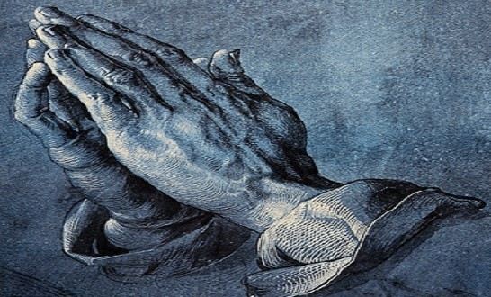
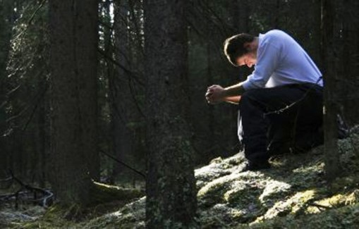
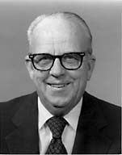
Prayer, an Exercise of Faith
“We must not imagine that any kind of prayer, no matter how sincere, will be very effective if all we do is to say the prayer. We must not only say our prayers; we must also live them. The Lord is much more pleased with the person who prays and then goes to work than with the person who only prays. Much like medicine, prayer works only when we use it as directed.”
J. Devn Cornish
“Secret prayer should have a place in every person’s life. Again the Savior gave us the pattern when he said: “… when thou prayest, enter into thy closet, and when thou hast shut thy door, pray to thy Father which is in secret; and thy Father which seeth in secret shall reward thee openly.” (Matt. 6:6.)
The Prophet Joseph Smith, speaking on this subject, stated: “We would say to the brethren, seek to know God in your closets, call upon him in the fields. Follow the directions of the Book of Mormon, and pray over, and for your families, your cattle, your flocks, your herds, your corn, and all things that you possess; ask the blessing of God upon all your labors, and everything that you engage in.” (DHC, vol. 5, p. 31.)”
Franklin D. Richards
Alma 33:12-15

Slide 8
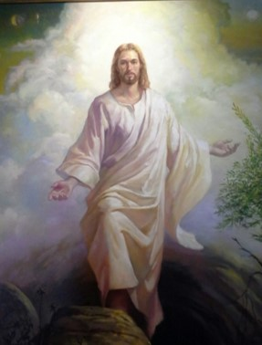
Because of Thy Son
Prophets often emphasize truths through repetition.
Thou didst hear me
Thou hast been merciful
Thou hast turned thy judgment away from me
Mercies are bestowed upon them
We receive Heavenly Father’s mercy, including forgiveness for our sins, because of the Atonement of Jesus Christ
Wilson J. Ong
Alma 33:11-16

Slide 9
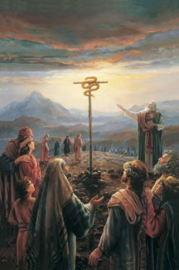
Moses Exercised Faith
If we study the scriptures, we can learn of Jesus Christ and strengthen our faith in Him
“And the Lord said unto Moses, Make thee a fiery serpent, and set it upon a pole: and it shall come to pass, that every one that is bitten, when he looketh upon it, shall live.
And Moses made a serpent of brass, and put it upon a pole, and it came to pass, that if a serpent had bitten any man, when he beheld the serpent of brass, he lived.”
Moses 21:8-9
Alma 33:19-20

Slide 10
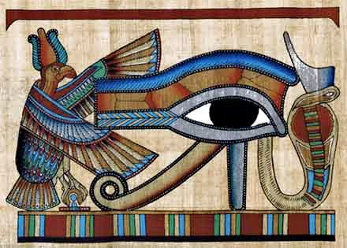
Cast About Your Eyes
Anyone who is to be saved from his sins must “cast” his eye upon the saving power of the Master. As the children of Israel could be saved from the serpent’s deadly sting simply by looking upon the brazen serpent that Moses had fashioned and raised upon a rod, so a man may be saved from the sting of sin simply by looking to the Savior.
He who will open his eyes and look upon the Lord will find it easy to recognize him as the divine source from which relief of sin comes.
The Healer—Medical Symbol
Alma 33:19-20
Student Manual

Slide 11
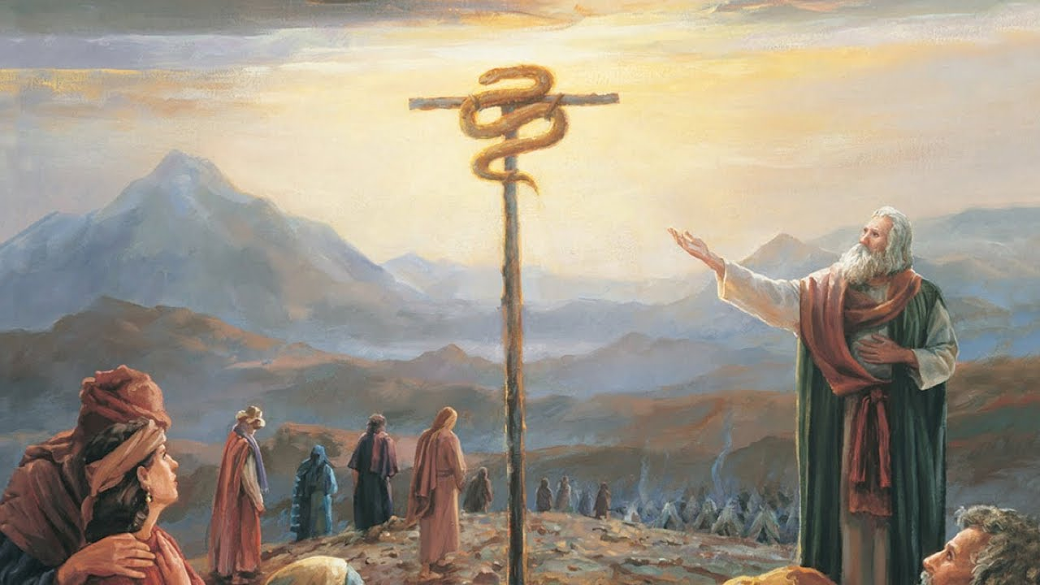
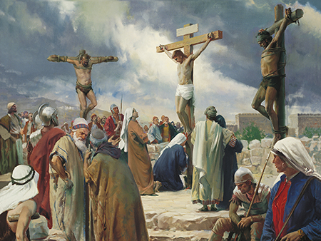
Symbol of Brass Serpent
The brass serpent on the pole was a “type”.
In other words, it was a symbol of something that was going to happen in the future.
It represented Jesus Christ on the cross.
And as Moses lifted up the serpent in the wilderness, even so must the Son of man be lifted up:
John 3:14
The Healer—Atonement Symbol
Alma 33:19-20

Slide 12
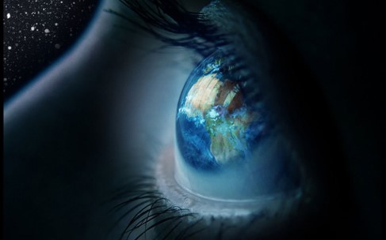
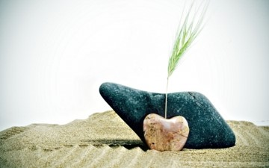
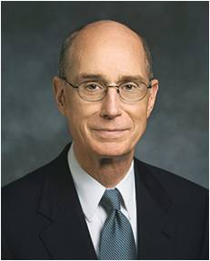
“If Ye Will Do”
Casting about your eyes to be healed
Plant this word in your hearts, nourish by faith
That your burdens will be light through the joy of His Son
We exercise faith by choosing to believe in Jesus Christ and His Atonement
“Each child in each generation chooses faith or disbelief. Faith is not an inheritance; it is a choice”
President Henry B. Eyring
Alma 33:21-23

Slide 13
How has your choice to believe in the Savior influenced your everyday life?
How has personal scripture study strengthened your faith in Heavenly Father and Jesus Christ?
How has daily personal prayer and worship strengthened your faith in Heavenly Father and Jesus Christ?
What do you feel Heavenly Father would like you to do to exercise greater faith?

Slide 14
Sources:
J. Devn Cornish The Privilege of Prayer Oct. 2011 Gen. Conf.
Franklin D. Richards The Importance of Prayer April 1972 Gen. Conf.
Jesus Art Work: Wilson Ong. (b. 1958) Oil on Canvas 1997
Student Manual Region 121-122 Book of Mormon pg. 301
Henry B. Eyring ---The statement is found in “Inquire of the Lord” [address to CES religious educators, Feb. 2, 2001], 1, si.lds.org.)
Presentation by ©http://fashionsbylynda.com/blog/

Slide 15
•How has your choice to believe in the Savior influenced your everyday life?
•How has personal scripture study strengthened your faith in Heavenly Father and Jesus Christ?
•How has daily personal prayer and worship strengthened your faith in Heavenly Father and Jesus Christ?
•What do you feel Heavenly Father would like you to do to exercise greater faith?

