Slide 1
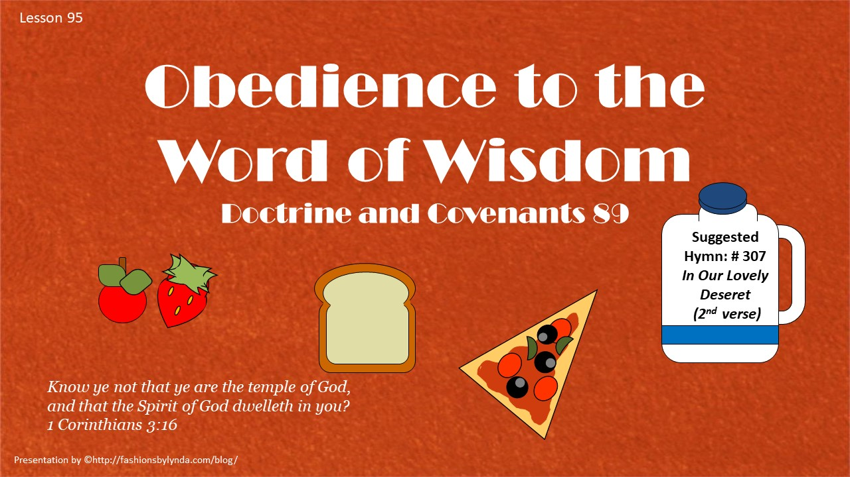

Slide 2

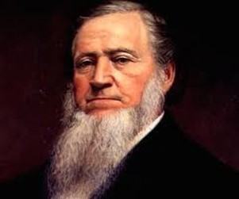
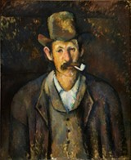
Background
February 27, 1833 Kirtland, Ohio
President Brigham Young said: “I think I am as well acquainted with the circumstances which led to the giving of the Word of Wisdom as any man in the Church, although I was not present at the time to witness them. The first school of the prophets was held in a small room situated over the Prophet Joseph’s kitchen, in a house which belonged to Bishop Whitney. …
“The brethren came to that place for hundreds of miles to attend school in a little room probably no larger than eleven by fourteen. When they assembled together in this room after breakfast, the first they did was to light their pipes and, while smoking, talk about the great things of the kingdom and spit all over the room, and as soon as the pipe was out of their mouths a large chew of tobacco would then be taken.

Slide 3

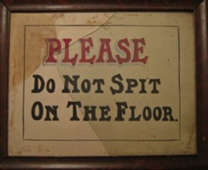
A Cloud of Smoke
Often when the Prophet entered the room to give the school instructions he would find himself in a cloud of tobacco smoke.
This, and the complaints of his wife at having to clean so filthy a floor, made the Prophet think upon the matter, and he inquired of the Lord relating to the conduct of the Elders in using tobacco, and the revelation known as the Word of Wisdom was the result of his inquiry.
“You know what it is and can read it at your leisure.”

Slide 4

Questions People Ask
What is the Word of Wisdom?
Why do you have the Word of Wisdom?
Why can’t you drink coffee, tea, or smoke?

Slide 5
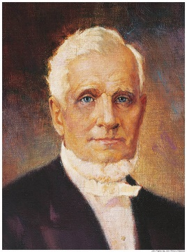
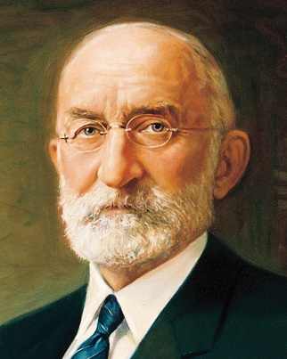
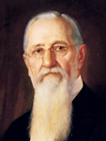
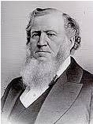
History of the Word of Wisdom
The Lord did not initially give the Word of Wisdom to the Saints as a commandment
1833
1851
October 13, 1882
1919
In the fall general conference Brigham Young proposed that all Saints formally covenant to abstain from tea, coffee, tobacco, and whiskey.
The Lord revealed to President John Taylor that the Word of Wisdom was to be considered a commandment.
The First Presidency, under President Heber J. Grant, made the observance of the Word of Wisdom a requirement for receiving a temple recommend.
“If [the Word of Wisdom] had been given as a commandment it would have brought every man, addicted to the use of these noxious things, under condemnation; so the Lord was merciful and gave them a chance to overcome, before He brought them under the law”
D&C 89:2 Joseph F. Smith

Slide 6
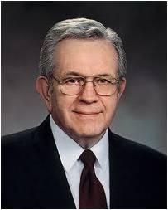


Temporal Salvation
Our physical well being
“Your body really is the instrument of your mind and the foundation of your character.”
President Boyd K Packer
In order to receive a fulness of joy, we must strive to be clean and pure, both in mind and in body.
“The temporal salvation of the children of men is a most important thing, but sadly neglected by many religious teachers. The truth is that the spiritual salvation is dependent upon the temporal far more than most men realize.
Joseph Fielding Smith
D&C 89:2

Slide 7
What is the Word of Wisdom?
A law of health revealed by the Lord for the physical and spiritual benefit of His children.
The Lord revealed which foods are good for us to eat and which substances are not good for the human body.
We abstain from drugs, tobacco, alcohol, coffee, and tea, and are encouraged to eat wholesome food and grains, and not eat excessive meat.
However: There are many habit-forming, addictive things that one can drink or chew or inhale or inject which injure both body and spirit which are not mentioned in the revelation.
Boyd K. Packer
D&C 89:5-9 True to the Faith Gospel Principles

Slide 8

Why Do We Have the Word of Wisdom?
The Word of Wisdom was “given for a principle with promise”
That word principle in the revelation is a very important one. A principle is an enduring truth, a law, a rule you can adopt to guide you in making decisions.
Generally principles are not spelled out in detail. That leaves you free to find your way with an enduring truth, a principle, as your anchor.
D&C 89:3-4 Boyd K. Packer

Slide 9
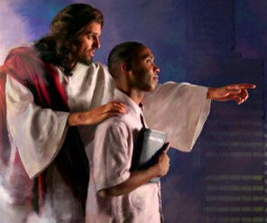

Why can’t you drink coffee, tea, or smoke?
It is a law of obedience both physically and spiritually
While the Word of Wisdom requires strict obedience, in return it promises health, great treasures of knowledge, and that redemption bought for us by the Lamb of God, who was slain that we might be redeemed.
Surely the Word of Wisdom was given so that you may keep the delicate, sensitive, spiritual part of your nature on proper alert. Learn to “listen” to your feelings. You will be guided and warned and taught and blessed.
D&C 89:3-4 President Boyd K. Packer

Slide 10


The Deception
In what ways does a fisherman deceive a fish into biting a hook?
Because of evil designs in the last days, the Lord warns us not to use harmful substances
Evil Designs of Men
D&C 89:4

Slide 11


Strong or Hot Drinks
“It is not only drunkenness that is prohibited here, but the indulgence in wine or strong drink, no matter how moderately, on all occasions, public or private.”
Smith and Sjodahl
Church leaders have stated that the term “hot drinks” refers to tea and coffee.
D&C 89:5-7, 9 Student Manual

Slide 12

But…What About?
What about cola drinks, kava, some health or sports drinks, or other drinks containing stimulants?
An official statement by the Church’s leaders reads:
“With reference to cola drinks, the Church has never officially taken a position on this matter, but the leaders of the Church have advised, and we do now specifically advise, against the use of any drink containing harmful habit-forming drugs under circumstances that would result in acquiring the habit.
Any beverage that contains ingredients harmful to the body should be avoided.”
Priesthood Bulletin
D&C 89:5-7, 9 Student Manual

Slide 13
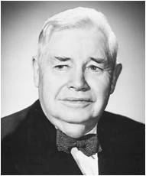
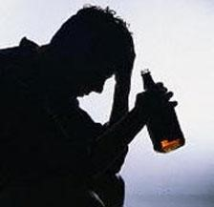
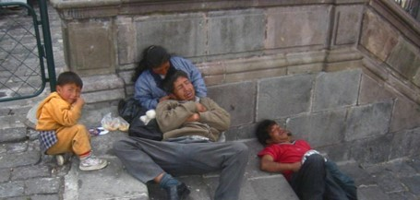
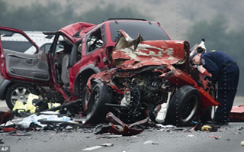
Consequences of Strong Drink
“Over the earth … the demon drink is in control. Drunken with strong drink, men have lost their reason; their counsel has been destroyed; their judgment and vision are fled; they reel forward to destruction.
“Drink brings cruelty into the home; it walks arm in arm with poverty; its companions are disease and plague; it puts chastity to flight; and it knows neither honesty nor fair dealing; it is a total stranger to truth; it drowns conscience; it is the bodyguard of evil; it curses all who touch it.
“Drink has brought more woe and misery, broken more hearts, wrecked more homes, committed more crimes, filled more coffins than all the wars the world has suffered.”
D&C 89:5-7, 9 J. Reuben Clark Jr.

Slide 14

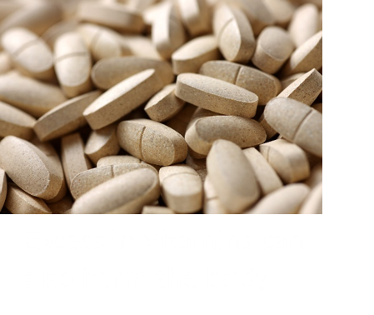

Other Substances
Today there are other substances that can be misused and consequently become harmful and addictive.
Church leaders have warned against the use of any drink, drug, chemical, or dangerous practice that produces a “high” or other artificial effect that can harm our bodies or minds.
Some of these include marijuana, hard drugs, prescription or over-the-counter medications that are abused, and household chemicals.
D&C 89:5-7, 9 For the Strength of Youth

Slide 15
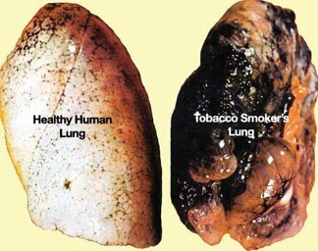
Tobacco—Would You Really Want to Do This To Yourself?
“Tobacco contains several poisonous alkaloids, the principal one of which is nicotine. There is only one other poison—strychnine—more deadly.”
Parts of the Body | What Tobacco Does to the Body
Blood | Makes it thin and poor
Stomach | Weakens the digestion system, causing loss of appetite and giving rise to sickness
Heart | Weakness and irregularity
Eye | Confusion and even loss of sight
Ear | Whistling or ringing sounds, unable to hear distinctly
Brain | First stimulating and then depressing its action
Nerve | Lessening their power and sensitiveness
Inside of mouth | Causes enlargement of tonsils (smoker’s throat), redness, dryness, and sometimes peeling, unnatural firmness, shrinking, or sponginess of the gums Cancer of lips, tongue, etc.
Lungs | Irritable state, increasing coughing
Breath | BAD (my own insert)
The Temperance Catechism of the Four-fold Pledge (Tobacco Article)
D&C 89:8 Smith and Sjodahl

Slide 16
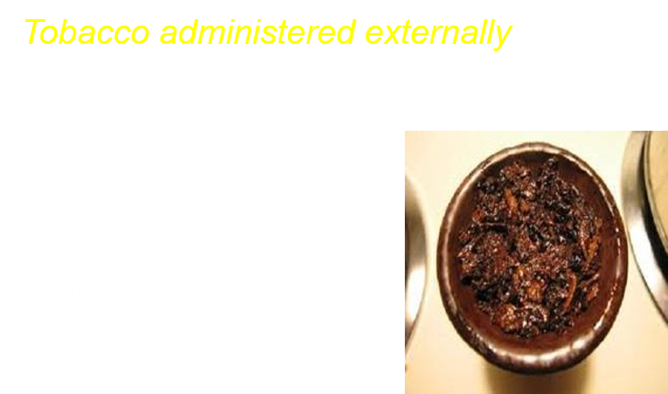


A Time and Need
D&C 89:8 Student Manual

Slide 17
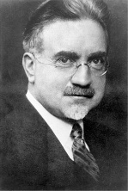

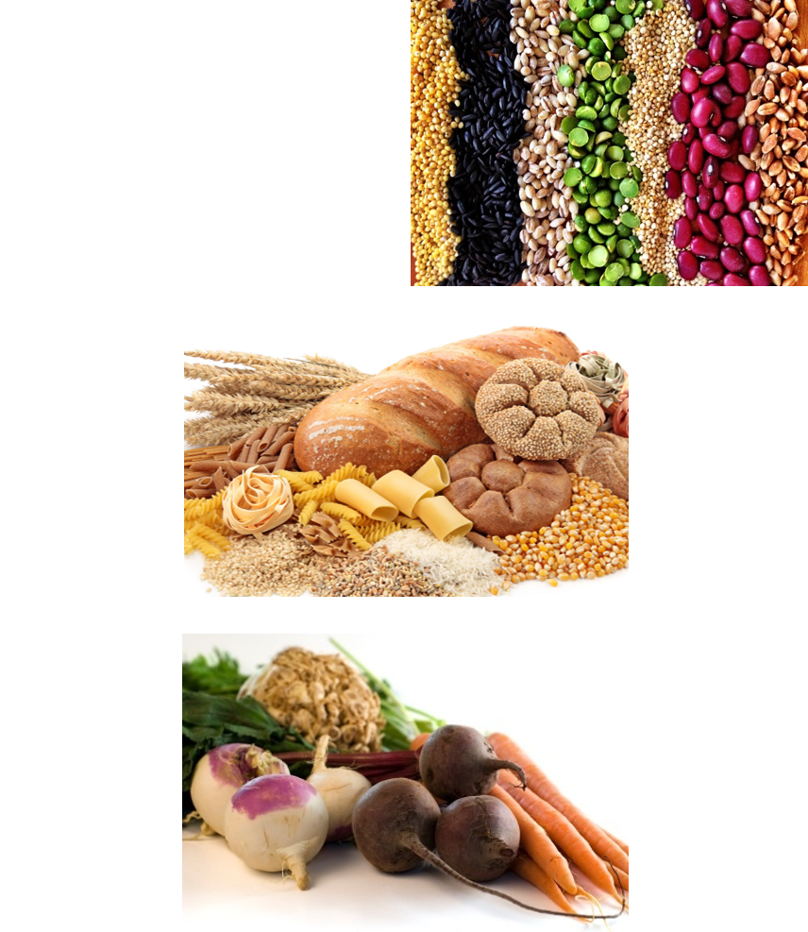
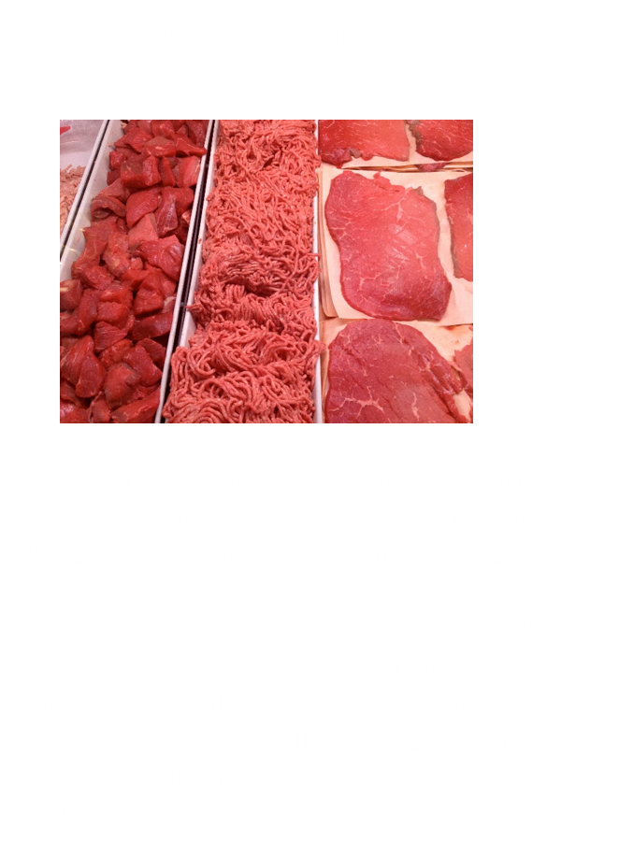
What is Good For Man?
D&C 89:11-12

Slide 18
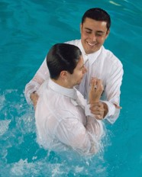
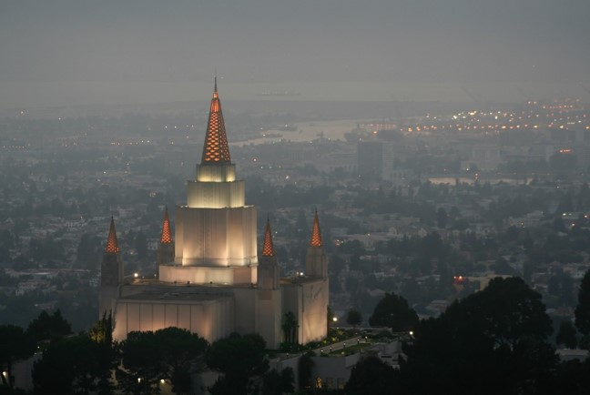
Restrictions
“The Word of Wisdom put restrictions on members of the Church.
To this day those regulations apply to every member and to everyone who seeks to join the Church.
They are so compelling that no one is to be baptized into the Church without first agreeing to live by them. No one will be called to teach or to lead unless they accept them.
“When you want to go to the temple, you will be asked if you keep the Word of Wisdom. If you do not, you cannot go to the house of the Lord until you are fully worthy.”
D&C 89:18-21 President Boyd K. Packer

Slide 19

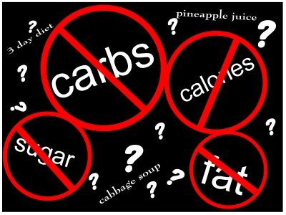
Obedience to the Word
“Learn to use moderation and common sense in matters of health and nutrition, and particularly in medication. Avoid being extreme or fanatical or becoming a faddist.”
“I have come to know … that a fundamental purpose of the Word of Wisdom has to do with revelation. …
“If someone ‘under the influence’ can hardly listen to plain talk, how can they respond to spiritual promptings that touch their most delicate feelings?
“As valuable as the Word of Wisdom is as a law of health, it may be much more valuable to you spiritually than it is physically.”
D&C 89:18-21 President Boyd K. Packer

Slide 20


Promises of Obedience
“He also promised health, protection, knowledge, and wisdom to those who obey the Word of Wisdom.”
However:
“The Word of Wisdom does not promise you perfect health, but it teaches how to keep the body you were born with in the best condition and your mind alert to delicate spiritual promptings.”
D&C 89:18-21

Slide 21
Doctrinal Mastery
And all saints who remember to keep and do these sayings, walking in obedience to the commandments, shall receive healthin their navel and marrow to their bones;
And shall find wisdom and great treasures of knowledge, even hidden treasures;
And shall run and not be weary, and shall walk and not faint.
And I, the Lord, give unto them a promise, that the destroyingangel shall pass by them, as the children of Israel, and not slay them. Amen.
D&C 89:18-21

Slide 22







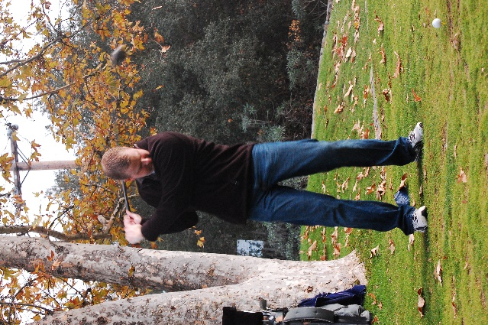
Exercise?
It’s a Given

Slide 23

Freedom VS Responsibility
“A resistance to anything that limits one’s conduct has almost taken over society.
“Our whole social order could self-destruct over the obsession with freedom disconnected from responsibility, where choice is imagined to be somehow independent of consequences.”
D&C 89 President Boyd K. Packer

Slide 24

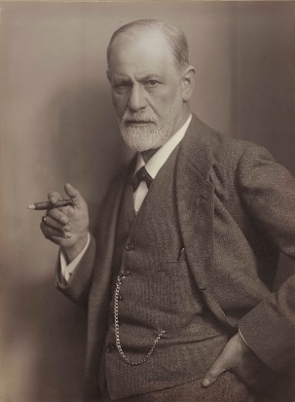

Slide 25
Sources:
Video:
The Word of Wisdom and Revelation (0:36)
Brigham Young (In Journal of Discourses, 12:158.)
Joseph F. Smith (in Conference Report, Oct. 1913, 14).
Boyd K. Packer The Word of Wisdom: The Principle and the Promises Apriol 1996 Gen. Conf.
“Ye Are the Temple of God” October 2000
“Prayers and Answers,” Ensign, Nov. 1979, 20
Joseph Fielding Smith Church History and Modern Revelation, 1:383
Hyrum M. Smith and Janne M. Sjodahl Doctrine and Covenants Commentary pg. 572
Doctrine and Covenants Student Manual Religion 324-325 Section 89
Presentation by ©http://fashionsbylynda.com/blog/
J. Reuben Clark Jr., in Conference Report, Oct. 1942, p. 8; see also Kimball, Miracle of Forgiveness, pp. 55–57.
(See For the Strength of Youth [booklet, 2011], 26.)
(Priesthood Bulletin, Feb. 1972, p. 4.)
Thayne Anderson Blog
(Widtsoe, Evidences and Reconciliations, 3:156–57.)
Presentation by ©http://fashionsbylynda.com/blog/

Slide 26
Pure Wine:
The Lord’s instruction in verse 6 that for the sacrament the Saints use “pure wine of the grape of the vine, of your own make” reinforces His earlier instruction that “you shall not purchase [for the sacrament] wine neither strong drink of your enemies;
“Wherefore, you shall partake of none except it is made new among you” (D&C 27:3–4).
The “pure wine” in Doctrine and Covenants 89:6 “is understood to mean new or unfermented grape juice, since the Word of Wisdom declares unequivocally against the internal use of alcohol in any form.
“This interpretation is reinforced by the fact that … water was early in the history of the Church substituted for wine, for sacramental purposes. The revelation reads:
“‘For, behold, I say unto you, that it mattereth not what ye shall eat or what ye shall drink when ye partake of the sacrament, if it so be that ye do it with an eye single to my glory—remembering unto the Father my body which was laid down for you, and my blood which was shed for the remission of your sins.’ [D&C 27:2].” (Widtsoe, Word of Wisdom, pp. 60–61.)
Tobacco
One Latter-day Saint physician noted the effects of tobacco on the body:
“Time and time again the medical and psychological sciences have brought forth evidence which points toward the destructive nature of the cigarette. In addition to the evidences recently found which link cigarette smoking to lung cancer, [there are] a number of interesting and arresting discoveries respecting the cigarette. E. A. Murphy and J. F. Mustard discovered that chronic smokers were less able to withstand the effects of radiation than were nonsmokers, and that smoking interfered with action of the bone marrow, the part of the body that manufactures blood. A. J. Schaffer points out that there is a higher premature birthrate among children whose mothers smoke than among nonsmokers, and that the mortality rate of these premature births was higher among offspring of smokers than of nonsmokers. There is a good deal of evidence, according to A. R. Lindesmith and A. I. Strauss, that in general, nonsmokers are more prone to be ‘steady and dependable, hard workers, with stable marriages,’ and that they have statistically less difficulty with marriage than do smokers.
“And so the evidence piles up. Bit by bit, piece by piece, a great mass of evidence is accumulating to substantiate from a purely scientific viewpoint the words of the Lord that ‘tobacco is not for the body.’ Nicotine in large quantities can take over the nervous system, causing severe convulsions. Smoking causes a man to perform at an altitude as much as 5,000 feet higher than he really is, because of the oxygen space it preempts in his blood.” (W. Dean Belnap, “Tobacco and the Spirit of Man,” Instructor, Dec. 1966, p. 464.)
As serious as the physical dangers are for using tobacco, the spiritual dangers, especially for members of the Church who know the law, are even more serious. “In my judgment,” said Elder George Albert Smith, “the use of tobacco, a little thing as it seems to some men, has been the means of destroying their spiritual life, has been the means of driving from them the companionship of the Spirit of our Father, has alienated them from the society of good men and women, and has brought upon them the disregard and reproach of the children that have been born to them, and yet the devil will say to a man, Oh, it’s only a little thing!” (in Conference Report, Apr. 1918, p. 40).
The Doctrine and Covenants does not specifically mention;
heroin, cocaine, marijuana, ecstasy, other illegal drugs, or the abuse of prescription drugs. President Joseph Fielding Smith said: “Such revelation is unnecessary. The Word of Wisdom is a basic law. It points the way and gives us ample instruction in regard to both food and drink, good for the body and also detrimental. If we sincerely follow what is written with the aid of the Spirit of the Lord, we need no further counsel. …
“Thus by keeping the commandments we are promised inspiration and the guidance of the Spirit of the Lord through which we will know what is good and what is bad for the body, without the Lord presenting us with a detailed list separating the good things from the bad that we may be protected. We will learn by this faithful observance that the promises of the Lord are fulfilled.” (Improvement Era, Feb. 1956, pp. 78–79.)
Only in Times of Winter, or of Cold, or Famine”
This verse has caused some to ask if meat should be eaten in the summer. Meat has more calories than fruits and vegetables, which some individuals may need fewer of in summer than winter. Also, before fruits and vegetables could be preserved, people often did not have enough other food to eat in winter. Spoiled meat can be fatal if eaten, and in former times meat spoiled more readily in summer than winter. Modern methods of refrigeration now make it possible to preserve meat in any season. The key word with respect to the use of meat is sparingly (D&C 89:12). Student Manual

Slide 27
What if something is not specifically mentioned in the Word of Wisdom?
Doctrine and Covenants 89 does not mention every drink, food, or substance that is forbidden. Sometimes questions arise about items not mentioned in the revelation or why tea and coffee are prohibited even though they are not mentioned. The following statement helps explain this:
“There has been no official interpretation of [the] Word of Wisdom except that which was given by the Brethren in the very early days of the Church when it was declared that ‘hot drinks’ meant tea and coffee.
“With reference to cola drinks, the Church has never officially taken a position on this matter, but the leaders of the Church have advised, and we do now specifically advise, against the use of any drink containing harmful habit-forming drugs under circumstances that would result in acquiring the habit. Any beverage that contains ingredients harmful to the body should be avoided” (Priesthood Bulletin, Feb. 1972 [volume 8, number 1], 3–4; see also “Staying Healthy: Welfare Services Suggests How,” Ensign, Jan. 1981, 15–16).
President Boyd K. Packer of the Quorum of the Twelve Apostles explained the need for us to live by the principles in the Word of Wisdom and trust the promises:
“Members write in asking if this thing or that is against the Word of Wisdom. It’s well known that tea, coffee, liquor, and tobacco are against it. It has not been spelled out in more detail. Rather, we teach the principle together with the promised blessings. There are many habit-forming, addictive things that one can drink or chew or inhale or inject which injure both body and spirit which are not mentioned in the revelation.
“Everything harmful is not specifically listed; arsenic, for instance—certainly bad, but not habit-forming! He who must be commanded in all things, the Lord said, ‘is a slothful and not a wise servant’ (D&C 58:26).
“In some cultures, native drinks are claimed to be harmless because they are not specifically mentioned in the revelation. Yet they draw members, particularly men, away from their families to parties which certainly offend the principle. Promises made in the revelation will be denied to the careless or the reckless.
“Obedience to counsel will keep you on the safe side of life” (“The Word of Wisdom: The Principle and the Promises,” Ensign, May 1996, 17–18).
“The destroying angel shall pass by them”
Elder Russell M. Nelson of the Quorum of the Twelve Apostles explained the spiritual symbolism of the destroying angel passing by those who follow the Word of Wisdom:
“There is special significance in the last verse of section 89, which states, ‘The destroying angel shall pass by them, as the children of Israel, and not slay them’ (v. 21). This reference to the Passover emphasizes the precedence of spiritual faith. When Abraham indicated his willingness to offer Isaac in sacrifice, there was no suggestion that obedience would necessarily bring physical benefit. When Joshua led the Israelites across the River Jordan swollen at flood time, confirmation of physical reward was not a prerequisite for faithful followers. We obey the Word of Wisdom because it represents the will of the Lord for our spiritual preparation to be his worthy sons and daughters. Achieving spiritual supremacy over the appetites of the flesh is part of our testing process” (“Twenty Questions” [address to CES religious educators, Sept. 13, 1985],LDS.org).
President Boyd K. Packer of the Quorum of the Twelve Apostles explained the spiritual significance of the promise that the “destroying angel shall pass by”:
“It is not from mortal death that we shall be spared in such a passover if we walk in obedience to these commandments, for each of us in time shall die. But there is spiritual death which you need not suffer. If you are obedient, that spiritual death will pass over you, for ‘Christ our passover is sacrificed for us,’ the revelation teaches (1 Cor. 5:7)” (“The Word of Wisdom: The Principle and the Promises,” Ensign, May 1996, 19).

