Slide 1
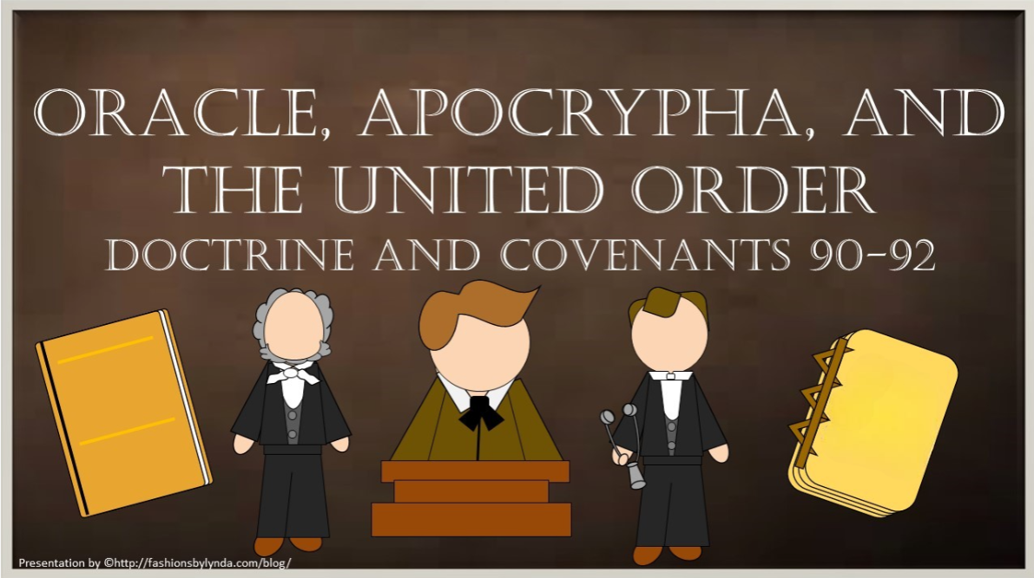

Slide 2

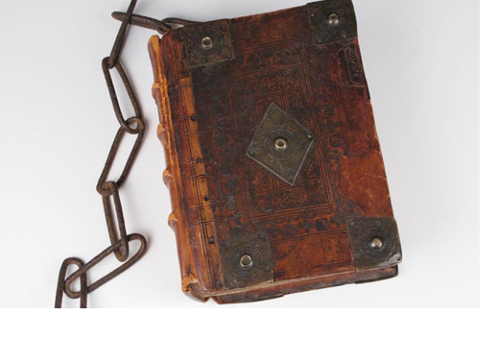
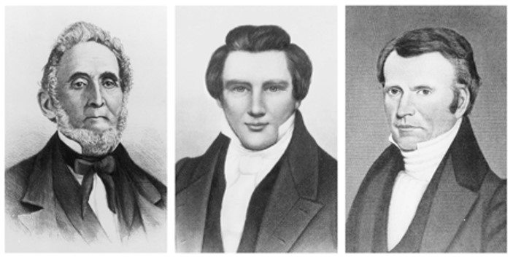
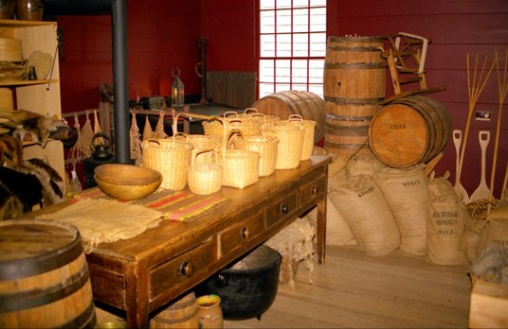
Background
March 8, 1833
The Development of the First Presidency
Section 90
March 9, 1833
Joseph Smith inquired whether he should include the Apocrypha in his translation of the Bible.
The Lord’s response is in Section 91
March 15, 1833
Fredrick G. Williams to be an active member in the United Firm, which had been established to oversee the welfare and business affairs of the Church.
Section 92

Slide 3
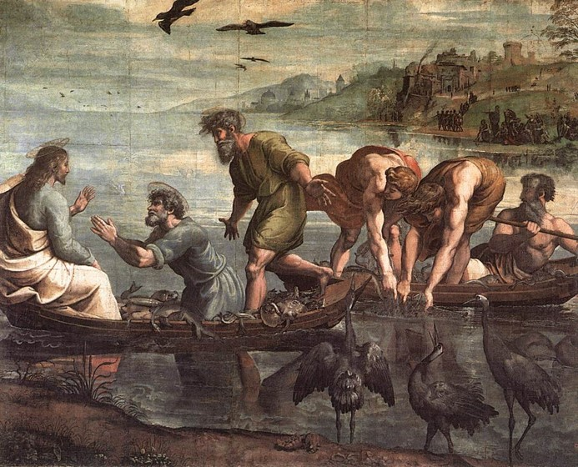
Sins Are Forgiven
“Neither the Prophet Joseph, nor his brethren, had any great transgressions, as measured by worldly standards, on their consciences, but no mortal is entirely free from sin.
The fact is that, the nearer a man draws to the presence of God, the more keenly he feels his imperfections and shortcomings.”
When Simon Peter saw it, he fell down at Jesus’ knees, saying, Depart from me; for I am a sinful man, O Lord.
Luke 5:8
D&C 90:1

Slide 4
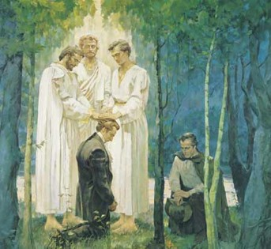
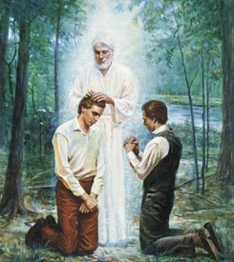
Power To Direct
On May 15, 1829 Joseph Smith received the keys of the Aaronic Priesthood under the hand of John the Baptist, and was baptized by Oliver Cowdery, who had also been ordained to that Priesthood
Joseph Smith received the Melchizedek Priesthood within the 13-day period from 16 May to 28 May 1829 by Peter, James and John
Keys—Stand for Authority
“Keys of the kingdom held by the President of the church are held jointly with him by the counselors in the First Presidency.
The counselors use these key under the direction of the President.”
Otten and Caldwell
Jesus Christ leads His Church on earth through the priesthood keys He has given to His First Presidency.
D&C 90:2 Larry C. Porter

Slide 5
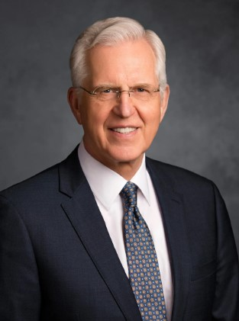
In the authority of these keys, the Church’s priesthood officers preserve the purity of the Savior’s doctrine and the integrity of His saving ordinances.
They help prepare those who wish to receive them, judge the qualification and worthiness of those who apply, and then perform them.
With the keys of the kingdom, the Lord’s servants can identify both truth and falsehood and once again authoritatively state, “Thus saith the Lord.”
D. Todd Christofferson

Slide 6
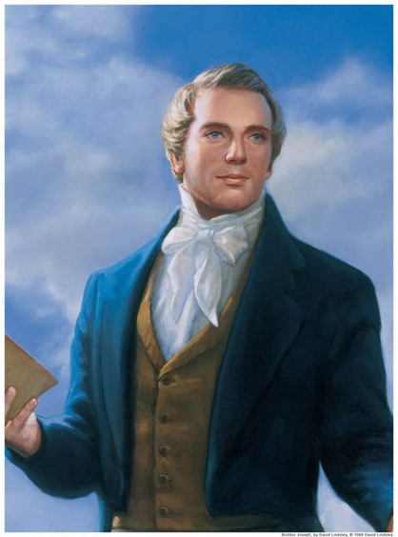
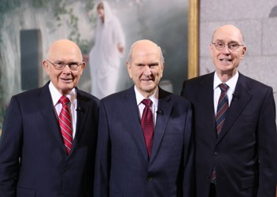
Oracles of God
“An oracle of God is a person through whom the Lord speaks His mind and will to the people.”
“The term oracle is also used to identify that which a prophet speaks, or the revelations that come, from the Lord to the people.”
“The Lord informs the world in this revelation that it is through His prophet that His revelations will be given unto His church.”
“As the prophet and his counselors constitute the First Presidency, it is through this presidency that the Lord will counsel, direct and give His oracles to the membership of His Church and to the world if they would receive it.”
D&C 90:4-5 Otten and Caldwell

Slide 7
“as a light thing”
His gifts are not to be treated lightly
An Example:
In 1829, the Lord warned the Saints that they are not to trifle with sacred things
If we treat lightly the revelations God gives through His prophets, we will stumble and fall.
In 1832, as some early missionaries returned from their fields of labor, the Lord reproved them for treating the Book of Mormon lightly.
If the early Saints were rebuked for treating the Book of Mormon lightly, are we under any less condemnation if we do the same?
Do we take the Book of Mormon for granted or are we receiving it as the center of our lives?
D&C 90:5

Slide 8
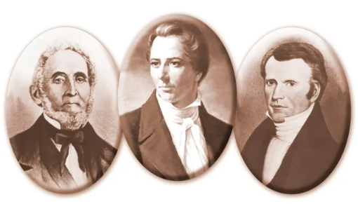
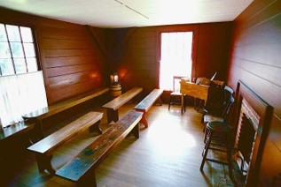
Ordained As Counselors
Sidney Rigdon and Fredrick G. Williams
On March 18th 1833, Joseph Smith ordained Sidney Rigdon and Fredrick G. Williams to be his counselors in the First Presidency.
The High Priests were organized in the room used by the School of the Prophets
The First Presidency holds the keys of the kingdom
Although each member of the First Presidency holds the keys of the kingdom, the President of the Church is the only one who can receive revelation for the whole Church.
A release of a President, Bishop, or any other Presidency in the Church is also a release of the counselors.
D&C 90:6

Slide 9
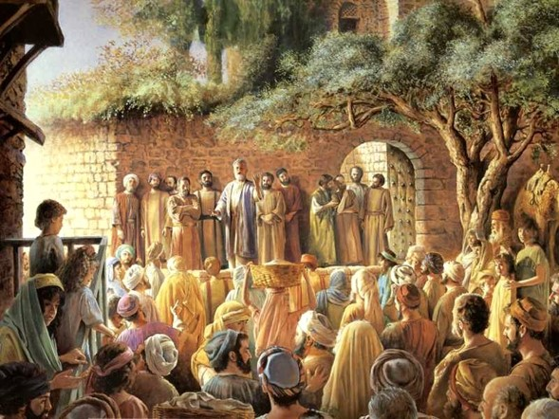
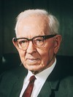
School of the Prophets
To prepare to preach the Gospel to the World
Perfected in their ministry
“In order that the Gospel might be declared among the nations and kindreds and tongues, the Lord commanded that the elders should study languages and with all good books be prepared to carry the message so that people could hear it in their own tongue. …
[For example], the gift of tongues as it was made manifest on the day of Pentecost, when Peter and the apostles stood up and spoke to the assembled people from all countries who had come to Jerusalem to the celebration of Pentecost.
Elders who have labored in foreign fields who have relied upon the Spirit of the Lord and have been diligent in their labors can testify from all parts of the Church that through the help of the Spirit they were able to speak the languages of the people among whom they were appointed to labor, and this beyond their natural powers.”
President Joseph Fielding Smith
D&C 90:7-11

Slide 10
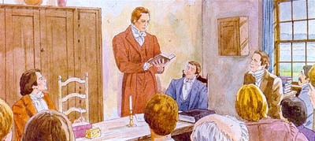
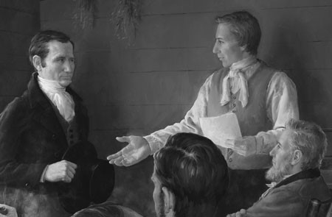
Counsel
1. Continue in the work of the ministry and presiding
2. Finish work on the Joseph Smith Translation
3. Preside over the School of the Prophets
4. Receive the revelations and “unfold” them
5. Read, study, and learn languages
6. Preside in council and set the affairs of the Church in order
7. Repent of pride and sin
8. Set their own homes in order
D&C 90:12-18

Slide 11


Difficult Times
“all these things shall give thee experience, and shall be for thy good” (D&C 122:7)
Work together for our good?
If we will search diligently, pray always, believe, and keep our covenants, all things will work together for our good
D&C 90:24

Slide 12
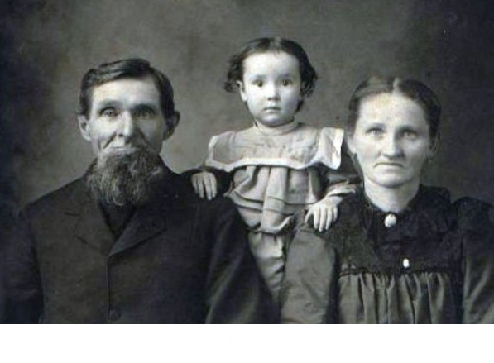
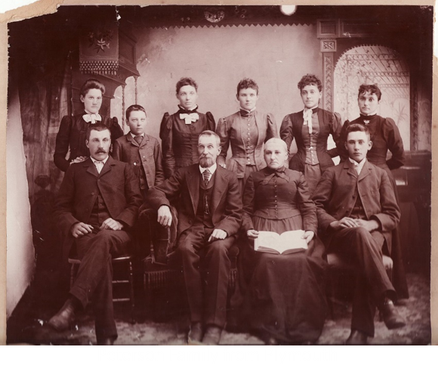
Families to Be small
“The Lord warns His servants, particularly the Prophet’s father, to let their families be small in order that the substance provided for them by the Church be not used up by the unworthy, who were prone to take advantage of a situation.
When the Lord advises them to let their families be small, He does not mean their immediate children; the visitors and hangers-on who had a tendency to take advantage of the brethren’s open houses and open hearts are the ones meant.
The brethren would not be hindered in accomplishing the Lord’s work if they watched this matter.”
Student Manual, Sperry
D&C 90:25-27

Slide 13
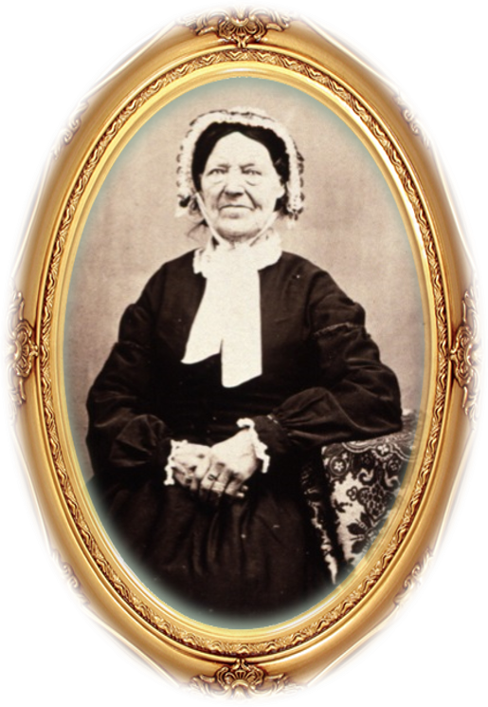
Faith during difficult times
Vienna Jaques
She was born June 10, 1787. After she met the missionaries in Boston, Massachusetts, USA, she traveled to Kirtland, Ohio, in 1831.
She stayed there six weeks and was baptized. Upon returning to Boston, Vienna helped bring several members of her family into the Church.
She then “settled up her business, and went back to Kirtland to unite her interests forever with the Church”
In 1833 Vienna consecrated all her possessions, including $1,400, to the Church during a time when the money was desperately needed.
She then traveled to Missouri to receive her inheritance in Zion. However, soon after she arrived she suffered persecution with the Saints.
D&C 90:28-31

Slide 14
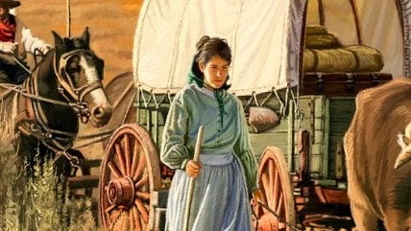
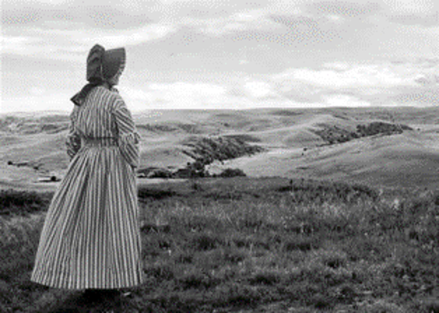
Vienna Jaques Continued
After being driven from her home in Missouri, she attended to the sick in Zion’s Camp. Heber C. Kimball wrote, “I received great kindness … from Sister Vienna Jaques, who administered to my wants and also to my brethren—may the Lord reward [her] for [her] kindness”
While in Missouri, Vienna married Daniel Shearer, a widower, in about 1838. (according to article he died on trail, (Susan Easton Black) but another record is found by ancestors*)
She traveled west to Utah in 1847 and, at the age of 60, drove her own wagon across the plains.
She settled in Salt Lake City and for the rest of her life worked hard to support herself and diligently study the scriptures. Vienna died on February 7, 1884, at the age of 96.
Her obituary stated, “She was true to her covenants and esteemed the restoration of the Gospel as a priceless treasure.”
D&C 90:28-31

Slide 15
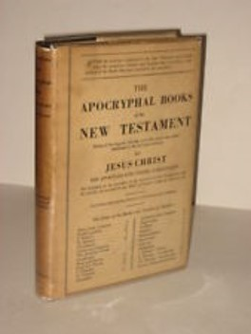
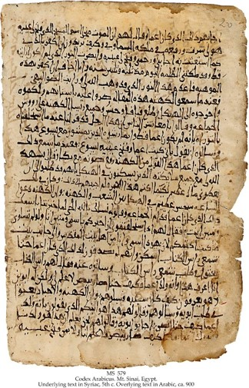
A Collection
The Apocrypha is a collection of sacred books of the Jewish people that were not originally included in the Hebrew Bible (Old Testament) but were included in the Greek translation of the Bible shortly before the time of Christ.
Some of the books bridge the time periods between the Old Testament and the New Testament.
When early Christians compiled the books of the Bible centuries later, they included the books of the Apocrypha, but there were questions about whether they belonged as part of the scriptures.
The copy of the Bible Joseph Smith was using to create his inspired translation contained the Apocrypha.
However, because the validity of the Apocrypha was in question, Joseph asked the Lord if his translation of the Bible should include these books.
Seminary Student Manual
D&C 91:1-6

Slide 16
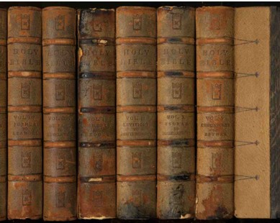
Apocrypha
1 Esdras
2 Esdras
Tobit
Judith
Additions to Esther
Wisdom of Solomon
Ecclesiasticus
Baruch
Letter of Jeremiah
Prayer of Azariah
Susanna
Bel and the Dragon
Prayer of Manasseh
1 Maccabees
2 Maccabees
Word—means Hidden
Applied to certain ancient writing which come regard as part of the bible, while others consider them as without divine authority.
D&C 91:1-6

Slide 17

Truth or Ideas?
The revelation recorded in Doctrine and Covenants 91 instructed Joseph Smith how to discern if something he was reading was true
The Holy Ghost can help us know if the things we read are true.
Are the books we read the Words of God, or are they the Words of Men?
But what if it is an LDS author?
D&C 91:1-6

Slide 18

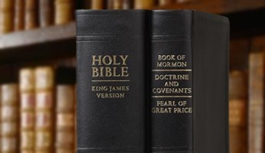
Manifested By the Spirit
Therefore, whoso readeth it, let him understand, for the Spirit manifesteth truth; And whoso is enlightened by the Spirit shall obtain benefit therefrom; And whoso receiveth not by the Spirit, cannot be benefited. Therefore it is not needful that it should be translated.
“Obviously, to gain any real value from a study of apocryphal writings, the student must first have an extended background of gospel knowledge, a comprehensive understanding of the standard works of the Church, plus the guidance of the Spirit.”
Bruce R. McConkie
D&C 91:1-6

Slide 19
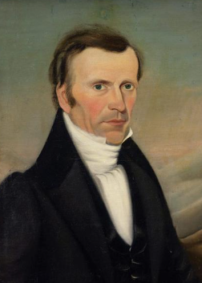
The Order of Enoch—United Order
This revelation commands the members of the United Order to receive Frederick G. Williams as a member.
A lively member of a group is one who works diligently to advance the goals and principles of the group.
A major purpose of the order of Enoch was to help the Church become “independent above all other creatures beneath the celestial world”
D&C 92

Slide 20

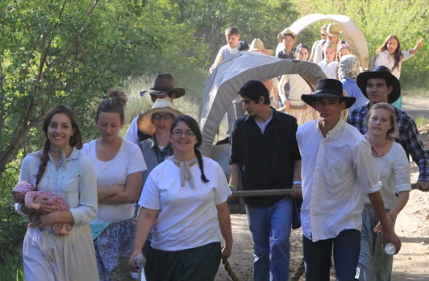
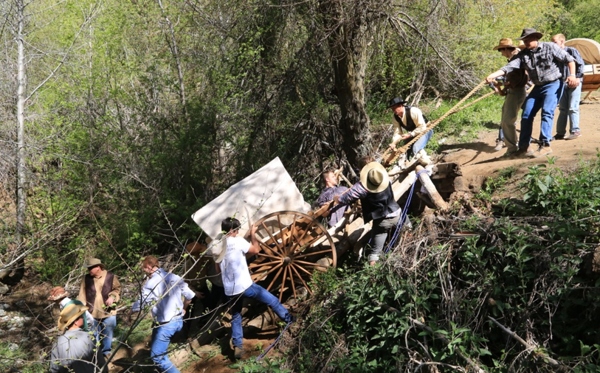
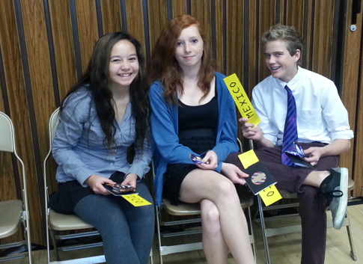
A Lively Member
When the Lord asked Frederick G. Williams to be a lively member of the united order, it was a simple way of asking him to contribute and be proactive in his service.
The Lord expects the same of each of us: be a lively member of the Church.
D&C 92

Slide 21
Sources:
Video: The Keys of the Kingdom (3:01)
Hyrum M. Smith and Janne M. Sjodahl Doctrine and Covenants Commentary pg. 576-77
Larry C. Porter The Restoration of the Aaronic and Melchizedek Priesthoods December 1996 Ensign
L.G. Otten and C.M. Caldwell Sacred Truths of the Doctrine and Covenants Vol. 2 pg. 129
Presentation by ©http://fashionsbylynda.com/blog/
D. Todd Christofferson, “Why the Church,” Ensign or Liahona, Nov. 2015, 110)
President Ezra Taft Benson The Book of Mormon—Keystone of Our Religion October 1986 General Conference
Joseph Smith (History of the Church, 1:334.)
President Joseph Fielding Smith (Church History and Modern Revelation, 1:390.)
Doctrine and Covenants Student Manual Religion 324-325 Section 90 and (Sperry, Compendium, p. 462.)
Vienna Jaques (“Home Affairs,” Woman’s Exponent, July 1, 1878, 21), (“Extracts from H. C. Kimball’s Journal,” Times and Seasons, Mar. 15, 1845, 839–40), ” (“In Memoriam,” Woman’s Exponent, Mar. 1, 1884, 152). (See also Susan Easton Black, “Happiness in Womanhood,” Ensign, Mar. 2002, 12–14.)
*see notes on Daniel Shearer
Bruce R. McConkie (Mormon Doctrine, pp. 41–42.)
Presentation by ©http://fashionsbylynda.com/blog/

Slide 22
Oracles:
President Joseph Fielding Smith wrote: “The word of the Lord was fulfilled wherein he said that through Joseph Smith the oracles should be given to the Church, and by command of the Lord the Prophet, in Nauvoo a few months before his death, called the apostles together and said to them that the Lord had commanded him to confer upon them all the keys and authorities which he had had conferred upon him, so that the work could be ‘rolled off’ of his shoulders onto theirs. He thereupon conferred upon them this divine governing power, but this governing power could not be exercised by any one of the twelve while the Prophet was living. Upon his death the right to preside and set in order and to hold the keys of authority in the Priesthood and in the Church, rightfully belonged to President Brigham Young and by authority of the ordination he had received under the hands of Joseph Smith and by being sustained by his brethren and the Church, he was vested with the supreme power.” (Church History and Modern Revelation, 1:388–89.)
Ordination:
“Elder Rigdon expressed a desire that himself and Brother Frederick G. Williams should be ordained to the offices to which they had been called, viz., those of Presidents of the High Priesthood, and to be equal in holding the keys of the kingdom with Brother Joseph Smith, Jun., according to the revelation given on the 8th of March, 1833. Accordingly I laid my hands on Brothers Sidney and Frederick, and ordained them to take part with me in holding the keys of the last dispensation and to assist in the Presidency of the High Priesthood, as my Counselors.” Joseph Smith
Truths: President Dieter F. Uchtdorf of the First Presidency taught:
“Never in the history of the world have we had easier access to more information—some of it true, some of it false, and much of it partially true.
“Consequently, never in the history of the world has it been more important to learn how to correctly discern between truth and error. …
“The Holy Ghost is a revelator. He is the Comforter, who teaches us ‘the truth of all things; [who] knoweth all things, and hath all power according to wisdom, mercy, truth, justice, and judgment’ [Moses 6:61]. …
“The Witness of truth from the Holy Ghost is available to all, everywhere, all around the globe. All who seek to know the truth, who study it out in their minds [see D&C 9:8], and who ‘ask with a sincere heart, with real intent, having faith in Christ, [will know] the truth … by the power of the Holy Ghost’ [Moroni 10:4].” (“What Is Truth?” [Church Educational System devotional address, Jan. 13, 2013], 3, 6; speeches.byu.edu).
Apocrypha:
“Scholars and Biblical students have grouped certain apparently scriptural Old Testament writings, which they deem to be of doubtful authenticity or of a spurious nature, under the title of the Apocrypha. There has not always been agreement as to the specific writings which should be designated as apocryphal, but the following are now generally so listed: 1st and 2nd Esdras (sometimes called 3rd and 4th Esdras, because in the Douay Bible, Ezra is 1st Esdras, and Nehemiah, 2nd Esdras); Tobit; Judith; the rest of the chapters of Esther; Wisdom of Solomon; Wisdom of Jesus the Son of Sirach or Ecclesiasticus; Baruch and the Epistle of Jeremiah; additional parts of Daniel, including the Song of the Three Holy Children, the History of Susanna, and the History of the Destruction of Bel and the Dragon; Prayer of Manasses; 1st and 2nd Maccabees (called in the Douay Version, 1st and 2nd Machabees).
“These apocryphal writings were never included in the Hebrew Bible, but they were in the Greek Septuagint (the Old Testament used by the early apostles) and in the Latin Vulgate. Jerome, who translated the Vulgate, was required to include them in his translation, though he is quoted as having decided they should be read ‘for example of life and instruction of manners’ and should not be used ‘to establish any doctrine.’ Luther’s German Bible grouped the apocryphal books together (omitting 1st and 2nd Esdras) at the end of the Old Testament under the heading: ‘Apocrypha: these are books which are not held equal to the sacred scriptures, and yet are useful and good for reading.’
“The Apocrypha was included in the King James Version of 1611, but by 1629 some English Bibles began to appear without it, and since the early part of the 19th century it has been excluded from almost all Protestant Bibles. The American Bible Society, founded in 1816, … and the British and Foreign Bible Society [excluded the Apocrypha from most of their Bibles during the 19th century].
“From these dates it is apparent that controversy was still raging as to the value of the Apocrypha at the time the Prophet began his ministry. Accordingly, in 1833, while engaged in revising the King James Version by the spirit of revelation, the Prophet felt impelled to inquire of the Lord as to the authenticity of the Apocrypha. From the answer it is clear that the books of the Apocrypha were inspired writings in the first instance, but that subsequent interpolations and changes had perverted and twisted their original contexts so as to leave them with doubtful value.

Slide 23
Joseph thou art indebted to thy God for the offering of thy Sister Vienna which proved a [savior] of life … , therefore she should not be forgotten of thee. (Joseph Smith, in History, 1838–1856, volume A-1 addenda, josephsmithpapers.org)
She married Daniel Shearer in Missouri
Daniel Shearer—found ancestor blog
Summer 1852 - Council Bluffs evacuated to Salt Lake City, though Daniel is not found in the Pioneer Index. Likely he traveled in the Council Point Emigration Company.
24 Oct 1852 - rebaptized in 13th Ward, Salt Lake City, by Bryant Stringham, confirmed by Joseph B. Noble (Historian's Office ref. no. 2538, p. 136), indicating he migrated since Sep 1851; as travel in the long wdinter was impractical, this indicates that the summer of 1852 was his time of migration.
8 Jan 1854 - married at Salt Lake City to Mary Wilkie, sealed same day (in the IGI); likely this was a formality uniting them in her maiden name; both Marys b. CT; Jane Maria listed only one Mary, as Wilkie; Daniel accounted for a limited number of wives in letters to brother Thomas.
1860 Census - UT, SLCo., SLCity, 13th Ward, p. 15, fam. 84: Daniel, 69, NY whipmaker, $2,000/300: Mary, 71, CT
1853 to 1864 - wrote a series of letters to his brother Thomas, of which six have been preserved in typescript by Tom's descendants. In the one, dated 31 Aug 1862, says his wife died 3 Apr 1862, 45, although SLC City Cemetery record says 31 Oct 1862 and daughter, Jane Maria said 3 Apr 1863.
21 Dec 1862 - At Salt Lake City married Sarah Dive (in the IGI). The 1850 census of Salt Lake County, p. 187, has a Sarah Dives, 45, born in England, with a child, Verulam, 17, England; but in 1859 a Sarah Gilbert immigrated to Salt Lake City from England (see below).
18 Dec 1867 - At Salt Lake City, married Sarah Gilbert (listed in IGI, and again this might have been a formality uniting him to her using her maiden name). Jane Maria only listed one Sarah, as Gilbert.
1870 Census - Index shows for Salt Lake City as 79, NY, 2 total for household. Sarah, 66, Eng., 13th Ward, p. 642, fam. 181, as Sheares, whipmaker.
18 Apr 1874 - Daniel died in Salt Lake City (Deseret News), of old age (cemetery list). Buried in Plat E, Block 7, Lot 9, sharing with Mary (City Cemetery List, Book A, p. 158). His will listed Sarah Gilbert, Jane Maria and Norman, and Vienna Jaques in order to cut her out with a token amount.
http://www.softcom.net/users/paulandsteph/dshearer/homepage.html#daniel

