Slide 1
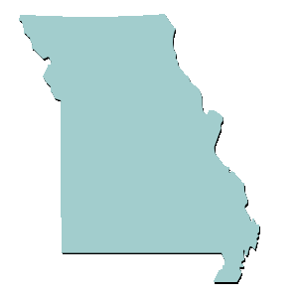
The Missouri Mormon War
of 1838
Church History In The Fulness Of Times Student Manual
Chapter 16: Persecutions and Expulsion
Presentation by ©http://fashionsbylynda.com/blog/

Slide 2
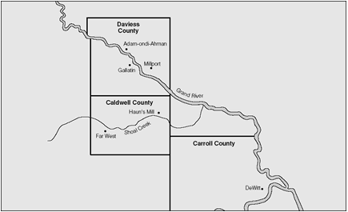
Gallatin, Missouri
The town had a row of ten houses, three of which were saloons
William Peniston was an enemy to the Saints in Gallatin, Missouri and was a candidate for the seat. The original settlers naturally wanted to elect a state legislator who was one of their own.
He feared he would not win the election because of the rapid growth of the Mormons in this area, and they supported John A. Williams.
July of 1838 just before the election, Judge Joseph Morin of Millport told two elders of the Church to be prepared for an attack by mobbers.
The mobbers were determined to stop the Saints from voting.
Church History In The Fulness Of Times Student Manual

Slide 3
August 6, 1838—Election Day
Unarmed a number of Mormon’s went to vote hoping that Judge Morin was wrong.
Before the vote William Peniston addressed the crowd of voters saying, “The Mormon leaders are a set of horse thieves, liars, counterfeiters, and you know they profess to heal the sick, and cast out devils, and you all know that is a lie.”
This is not William Peniston—depiction only
Church History In The Fulness Of Times Student Manual

Slide 4
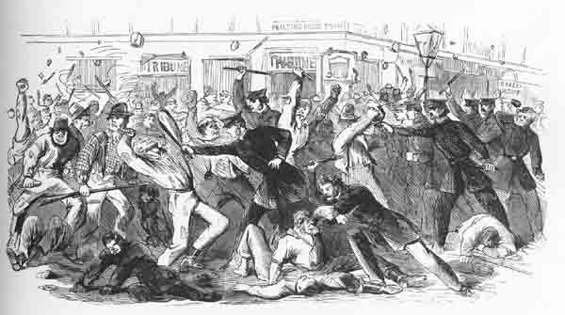
The Brawl
“Election days in the West were rarely orderly”
With Peniston’s speech, and some of the men filled with whiskey, a fight broke out. Dick Welding, a Missourian, punched one of the Saints and knocked him down.
The Mormon’s were outnumbered but John L. Butler grabbed an oak stake from a nearby woodpile and began to strike the Missourians with all his strength.
With clapboards and other weapons, the Missourians armed themselves. Several persons on both sides were seriously hurt during the brawl.
Only a few Mormons voted on August 6, 1838 in which William Peniston lost.
Church History In The Fulness Of Times Student Manual

Slide 5
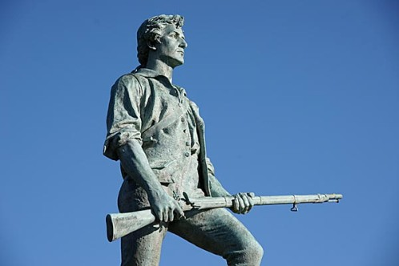
Rumors
On August 7, 1838 distorted reports reached Church leaders in Far West that two or three of the brethren had been killed.
On August 8, 1838 The First Presidency and about 20 men left for Daviess County armed for protection.
Some of the men who were attacked by the ‘election mob’ were joined by the brethren coming from Far West.
In the evening they reached Adam-ondi-Ahuman and learned that none of the saints had been killed.
Church History In The Fulness Of Times Student Manual

Slide 6
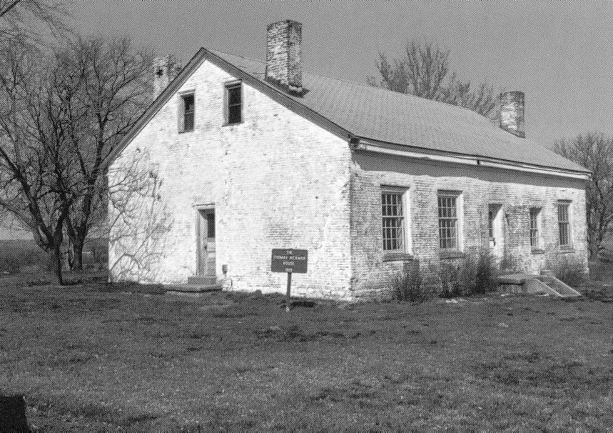
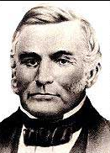
Tensions, Rumors in Daviess and Carroll Counties
“Adam Black falsely claimed that 154 Mormons had threatened him with death unless he signed the agreement of peace.”
The Prophet responded that Black’s statement “shows him in his true light—a detestable, unprincipled mobocrat and perjured man.”
Rumors and false stories were circulating and these rumors reached governor Lilburn W. Boggs.
Home in Carroll county 1819—Thomas Hickman House
Church History In The Fulness Of Times Student Manual
Lilburn Boggs

Slide 7
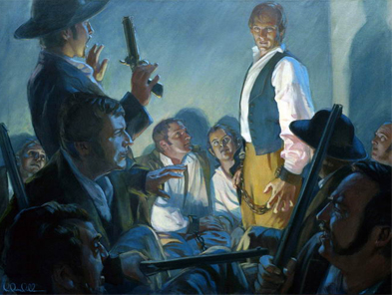
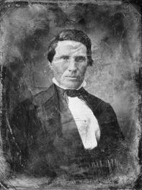
Joseph Smith’s Statement
“There is great excitement at present among the Missourians, who are seeking if possible an occasion against us. They are continually chafing us, and provoking us to anger if possible, one sign of threatening after another, but we do not fear them, for the Lord God, the Eternal Father is our God, and Jesus … is our strength and confidence. …
“… Their father the devil, is hourly calling upon them to be up and doing, and they, like willing and obedient children, need not the second admonition; but in the name of Jesus Christ … we will endure it no longer, if the great God will arm us with courage, with strength and with power, to resist them in their persecutions. We will not act on the offensive, but always on the defensive.”
Alexander William Doniphan
Church History In The Fulness Of Times Student Manual

Slide 8
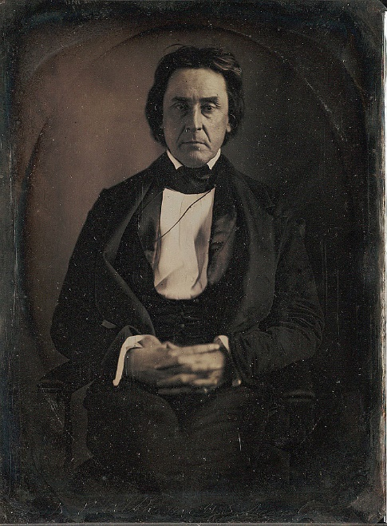
Missouri State Militia
Both Major General David Atchison and Brigadier General Alexander Doniphan had been lawyers for the Saints in Jackson County in 1833-34 and had been friendly towards the Church.
Joseph Smith asked for advice on how to end the hostilities in Daviess County.
Alexander William Doniphan
Their advise was for the Prophet and Lyman Wight, who was also present, to volunteer to be tried in Daviess County.
September 7, 1838 Trial held
Joseph Smith stationed a company of men at the county line “so as to be ready at a minute’s warning, if there should be any difficulty at the trial.”
“No incriminating evidence against the two leaders was presented, but bowing to pressures, Judge King ordered them to stand trial before the circuit court and released them on a $500 bond.”
General Atchison promised he would “do all in his power to disperse the mob.”
David Rice Atchison
Church History In The Fulness Of Times Student Manual

Slide 9
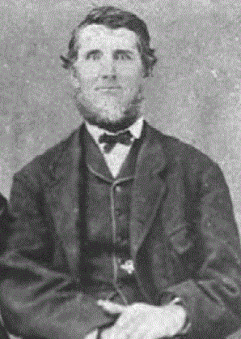
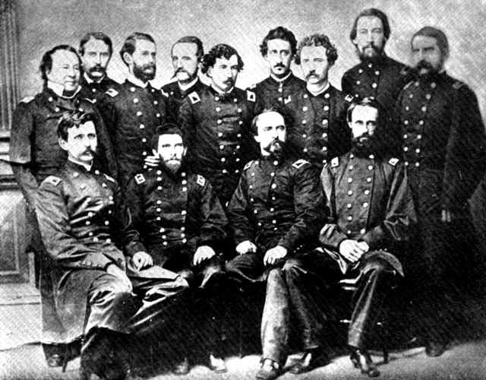
Rumors
Enemies of the Church prepare for an attack at Adam-ondi-Ahman
Under General H. G. Parks, Lyman Wight, holding a colonel’s commission in the 59th regiment of the Missouri Regiment, directed a group of over 150 men, part of the state militia, to defend the town against the mobs.
“Both Mormons and mobbers sent scouts throughout the countryside, occasionally took prisoners, and generally insulted each other. Only the prudent actions of generals Atchison and Doniphan prevented violence.”
Lyman Wight
Late in September, General Atchison wrote to the governor: “Things are not so bad in that county [Daviess] as represented by rumor, and, in fact, from affidavits I have no doubt your Excellency has been deceived by the exaggerated statements of designing or half crazy men. I have found there is no cause of alarm on account of the Mormons; they are not to be feared; they are very much alarmed.”
Not actual regiment…a latter version of a Missouri group
Church History In The Fulness Of Times Student Manual

Slide 10
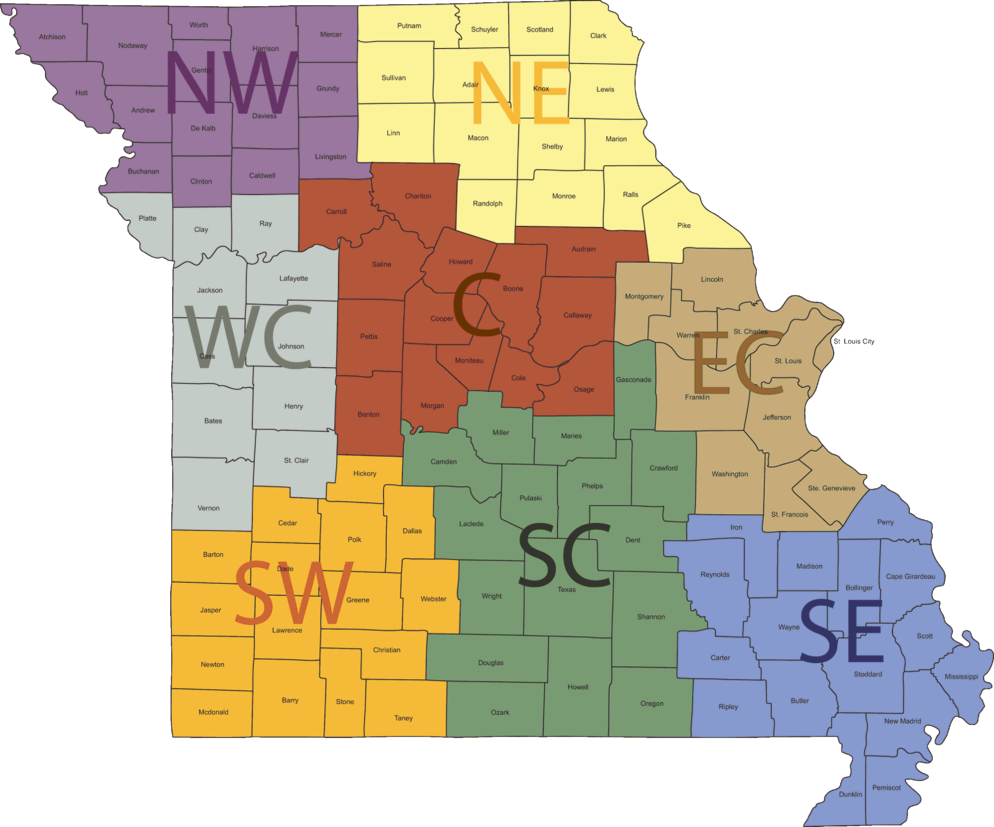
Meanwhile…
“About this same time a committee of “old citizens” in Daviess County agreed to sell their property to the Saints.
Joseph Smith immediately sent messengers to the East and South to try and raise the necessary funds, but the rapidly escalating conflict made this tentative agreement impossible to fulfill.”
Church History In The Fulness Of Times Student Manual

Slide 11
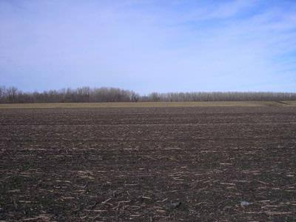
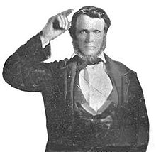
DeWitt, Carroll County, Missouri Siege
Not very many Mormons had been welcomed when they began arriving in June of 1838
George M. Hinkle, a leader of the Saints, and colonel in the Missouri state militia, declared that the Saints should defend their right to remain in DeWitt.
By July the Latter-day Saints outnumbered the residence of DeWitt.
Three separate meetings were held by the Dewitt townsfolk to unify the citizens and expel the Mormons.
George M. Hinkle
Late in September of 1838, the Saints at DeWitt sent a letter to Governor Lilburn W. Boggs asking for assistance in defending themselves against “a lawless mob” from Carroll and other counties, but they received no response.
Church History In The Fulness Of Times Student Manual

Slide 12
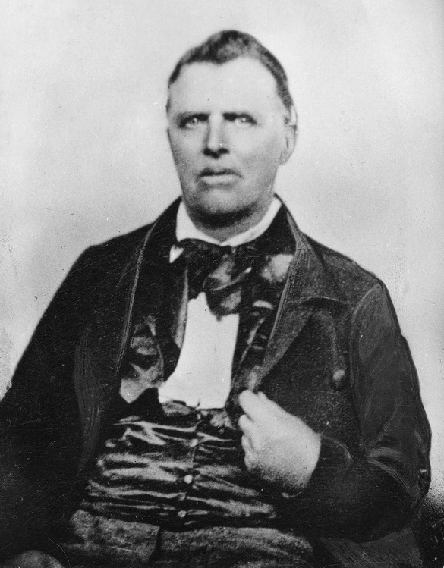
Building Barricades
1st Week in October:
“We were continually employed day and night guarding [the Saints]. … One night … I traveled all night from one sentinel to another to keep them to their duty.” The need for food and shelter became critical. The anti-Mormon forces considered this siege “a war of extermination.”
John Murdock
Non-Mormon Troops from Ray, Howard, and Clay counties began to arrive in DeWitt.
The Saints also received reinforcements and began to build barricades.
John Murdock
“Joseph traveled secretly on back roads to avoid enemy guards and slipped into DeWitt, where he found a few defenders opposing the large mob. The Prophet found that the Saints were experiencing systematic starvation and grievous privations.”
Church History In The Fulness Of Times Student Manual

Slide 13
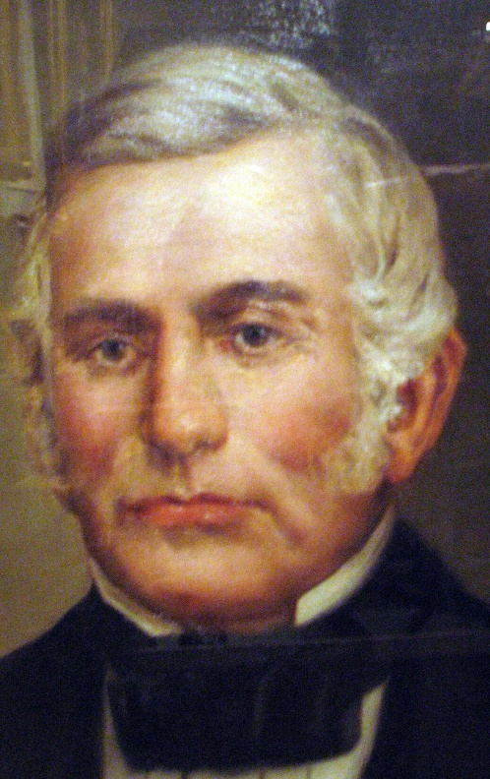
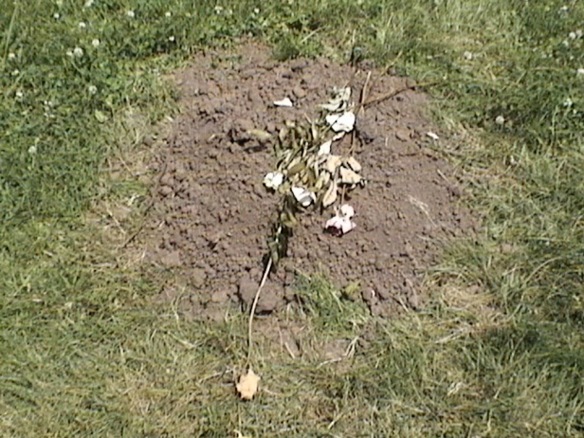
Appeal and Reply
Early Mormon settlers urged the Saints to leave in peace.
The Saints, Joseph Smith included, gathered up 70 wagons and sadly abandoned DeWitt on October 11, 1838.
“That evening a woman, of the name of Jensen, who had some short time before given birth to a child, died in consequence of the exposure occasioned by the operations of the mob, and having to move before her strength would properly admit of it. She was buried in the grove, without a coffin.”
“The mob “continually harassed and threatened” the traveling Saints, and several more of them died from “fatigue and privation.”
Church leaders decided to appeal once again to the governor for assistance because of the treatment of the Saints.
On October 9, 1838 the Saints received a reply, “The quarrel was between the Mormons and the mob,’ and that ‘we might fight it out.”
Governor Lilburn Boggs
Church History In The Fulness Of Times Student Manual

Slide 14
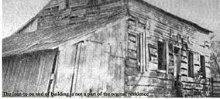
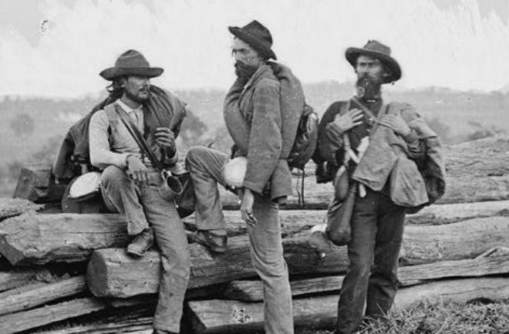
Anti-Mormon March to Daviess County
Anti-Mormon forces marched toward Daviess County to remove the Mormons from there.
The Church leaders were alarmed when they received news of 800 men advancing on Adam-ondi-Ahman.
“General Doniphan, who was in Far West when the message was
received, ordered Colonel
Hinkle to muster a militia
from among the local
residents to protect the
Saints.”
Lyman Wight home In Adam-ondi-Ahman
In Daviess County many houses were burned, and livestock was driven off. In addition, many of the scattered families were forced to flee to Adam-ondi-Ahman for safety and shelter amid a heavy snowstorm on October 17-18, 1838.
Joseph Smith remembered, “My feelings were such as I cannot describe when I saw them flock into the village, almost entirely destitute of clothes, and only escaping with their lives.”
Church History In The Fulness Of Times Student Manual

Slide 15
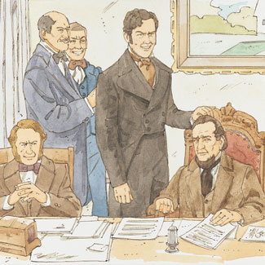
3 Appeals
“General Atchison appealed to Governor Boggs warning him that the Missourians intended to drive the Mormons from Daviess and Caldwell counties, and he strongly urged the governor to visit the scene of trouble. This was Atchison’s third futile appeal to the governor, but, as with others to follow, it was ignored.
Governor Boggs never appeared willing to hear the Saints’ side of the story, even from trustworthy sources such as General Atchison, but instead he chose to believe inflammatory anti-Mormon reports.”
Lyman Wight
Hostility increased in Davies County.
General Parks authorized Lyman Wight, a colonel in the militia, to organize a force of Mormon men and use them to disperse all mobs found in Daviess County.
Church History In The Fulness Of Times Student Manual

Slide 16
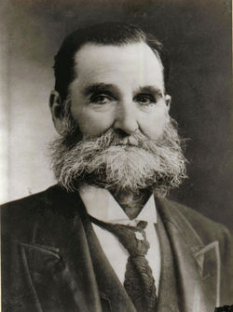
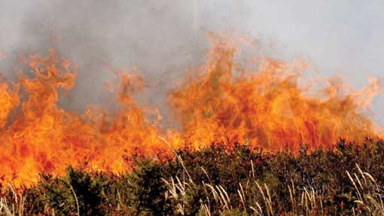
Warfare
“A young Mormon militia officer, Benjamin F. Johnson, said, “We were being hemmed in on all sides by our enemies and were without food. All the grain, cattle, hogs, and supplies of every kind were left in the country, or so far from home they could not be obtained except with a strong guard. So our only possible chance was to go out in foraging companies and bring in whatever we could find, without regard to ownership.”
Both sides, the Mormons and anti-Mormon forces raged warfare by plundering and burning homes.
Anti-Mormon’s would set fire to their own property or haystacks and blame the fires on the Mormons.
Benjamin F. Johnson in later years
Church History In The Fulness Of Times Student Manual

Slide 17
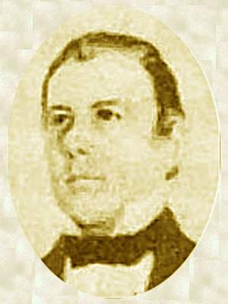
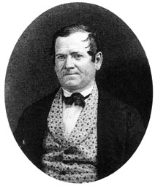
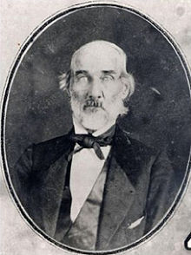
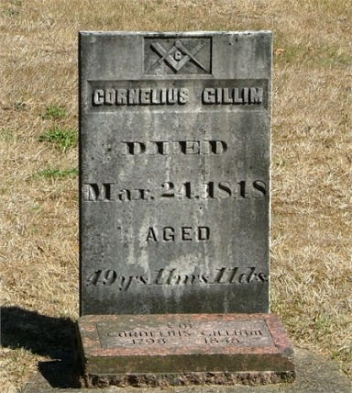
Prepare For Defense
“In Far West the Saints were warned that two notorious anti-Mormons, Cornelius Gilliam and Samuel Bogart, officers in the militia, were planning assaults on the Caldwell County settlements.”
The city was instructed to quickly prepare for defense.
Thomas B. Marsh
Orson Hyde
Thomas B. Marsh and Orson Hyde, deserted the cause of the Church on October 18, 1838 and joined with the enemy at Richmond.
Cornelius Gilliam
Samuel Bogart
Church History In The Fulness Of Times Student Manual

Slide 18
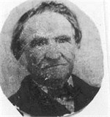
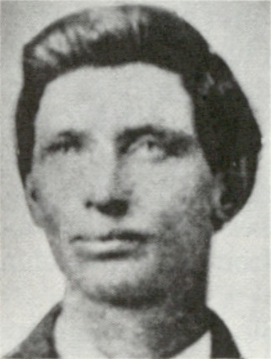
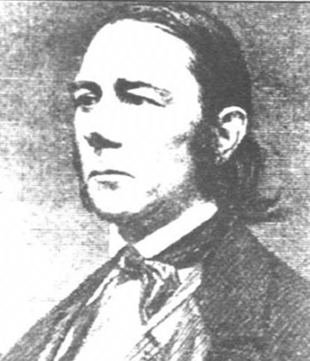
Battle at Crooked River
October 25, 1838--A turning point in the “Mormon War
Samuel Bogart patrolled the range between Caldwell and Ray counties.
However, Bogart’s men twice entered Caldwell County and attacked the homes of the Saints, ordering the members to leave the state and taking three Mormon men prisoners.
“On hearing the report, Judge Elias Higbee, the first judge of the county, ordered Lieutenant Colonel Hinkle, the highest officer in command in Far West, to send out a company to disperse the mob and retake their prisoners, whom, it was reported, they intended to murder that night.”
Judge Elias Higbee
Lieutenant Colonel Hinkle
Members of the militia, commanded by David W. Patten and Charles C. Rich had been waiting several days for a call to arms. The drums beat at midnight calling them to the public square, and 75 men were mobilized into two companies.
Church History In The Fulness Of Times Student Manual
David W. Patten
Charles C. Rich

Slide 19
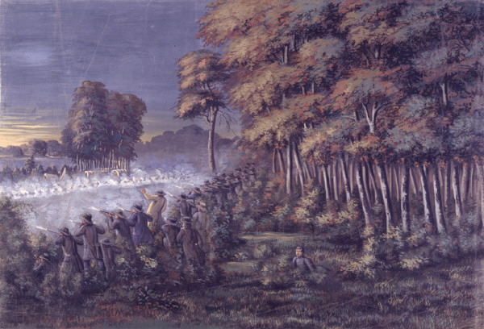
At Dawn
The Mormons arrived on the banks of the Crooked River, 20 miles from Far West.
Bogart’s men were hiding along the river banks. Patten’s patrol approached the crossing.
“Suddenly one of Bogart’s guards opened fire. Elder Patten ordered a charge, but silhouetted by the dawn, his men made good targets. In the quick, hard-fought skirmish, several men on each side were wounded. Elder Patten was wounded in the belly. He was one of the Quorum of the Twelve Apostles.
The Prophet also reported, “Brother Gideon Carter was shot in the head, and left dead on the ground so defaced that the brethren did not know him.”
“The brethren freed the three prisoners, one of them was also wounded, then drove the enemy across the river, and then turned to care for their wounded.
Elder Patten was carried to the home of Stephen Winchester near Far West, where he died several hours later. He thus became the first martyred Apostle in this dispensation.”
Church History In The Fulness Of Times Student Manual

Slide 20
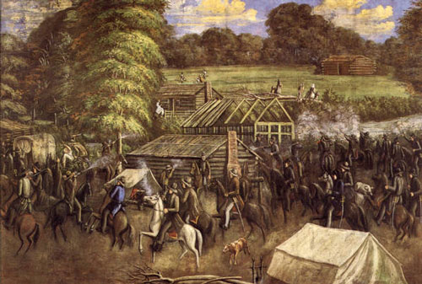
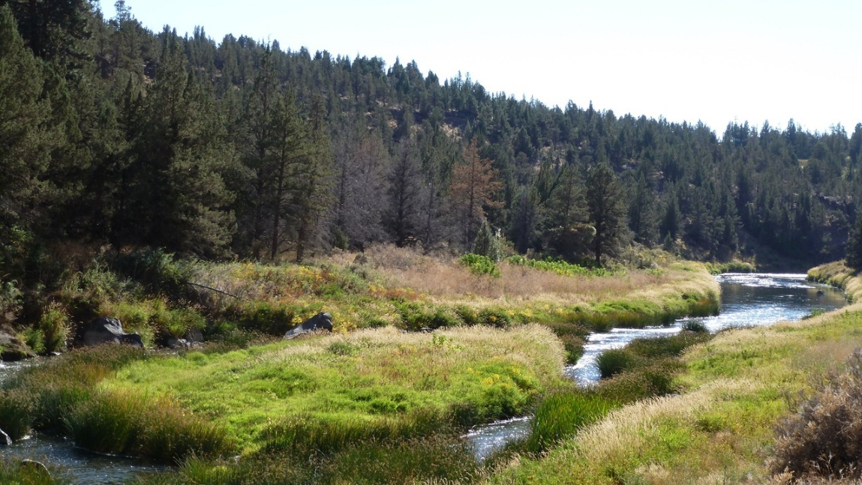
Militia to War
Governor Boggs received exaggerated accounts of the battle in Jefferson City. “One rumor was that Bogart’s entire force was massacred or imprisoned and that the Mormons intended to sack and burn Richmond. These reports provided Boggs with the excuse he needed to order an all-out war against the Saints.”
General Atchison urged the Governor to come to the area where the mobs had burned houses and crops, rustled cattle, detained prisoners, and threatened the Saints with death.
But instead, on October 27, 1838, he ordered his militia to war.
“The Mormons must be treated as enemies and must be exterminated or driven from the state, if necessary for the public good. Their outrages are beyond all description.” Boggs
Crooked River, Missouri
Church History In The Fulness Of Times Student Manual

Slide 21
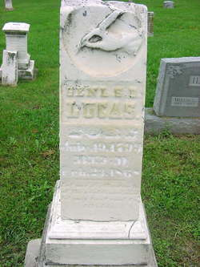
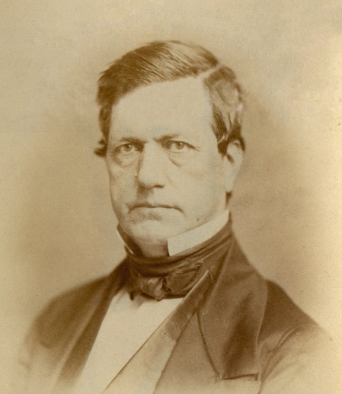
Missouri Executive Order 44
Governor Boggs’s “extermination order”
October 27, 1838
General Samuel D. Lucas
“The command was given to General John B. Clark. General Clark did not arrive at Far West until a few days after the surrender.
General Samuel D. Lucas, a long-time anti-Mormon from Jackson County, was left in temporary command of the militia that was rapidly gathering from all sides to encircle Far West.
By October 31, 1838 over 2,000 men surrounded Far West, and most of them were determined to fulfill the governor’s order.
Prior to the surrender of Far West General Atchison was dismissed by the governor.
General John B. Clark
General David Rice Atchison
The Extermination Order was finally rescinded on June 25, 1976 by Governor Christopher Samuel "Kit" Bond
Church History In The Fulness Of Times Student Manual

Slide 22
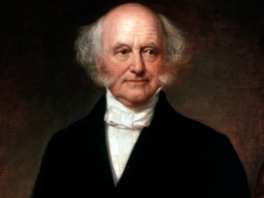
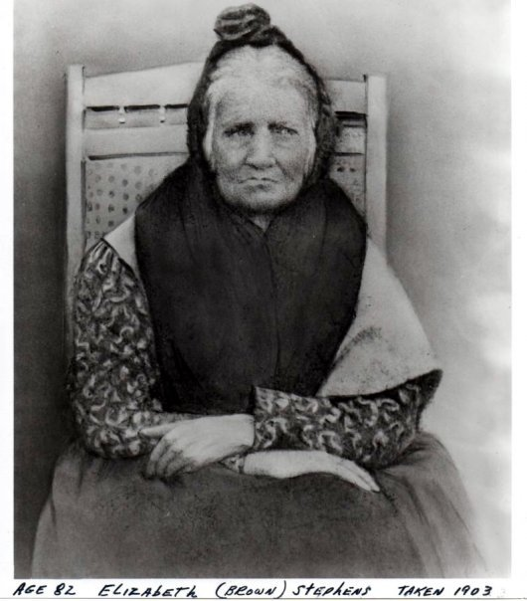
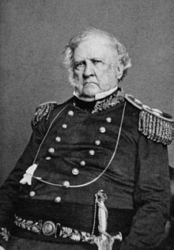
Cherokee People Also Exterminated
President :Martin Van Buren
In 1838, the Cherokee people were forcibly removed from their lands in the Southeastern United States to the Indian Territory (present day Oklahoma) in the Western United States. In the same year of 1838 only about 2,000 Cherokee had left their homes in Georgia.
It took Winfield Scott and his army to forcible kick people out of their homes and home land, which was an order at the time by President Martin Van Buren, which resulted in the deaths of approximately 4,000 Cherokees.
A Cherokee Woman who walked the “Trail of Tears”
In the winter of 1838 the Cherokee began the thousand-mile march with scant clothing and most on foot without shoes or moccasins. The march began in Red Clay, Tennessee…crossing through southern Illinois…initially settled near Tahlequah, Oklahoma.
General Winfield Scott

Slide 23
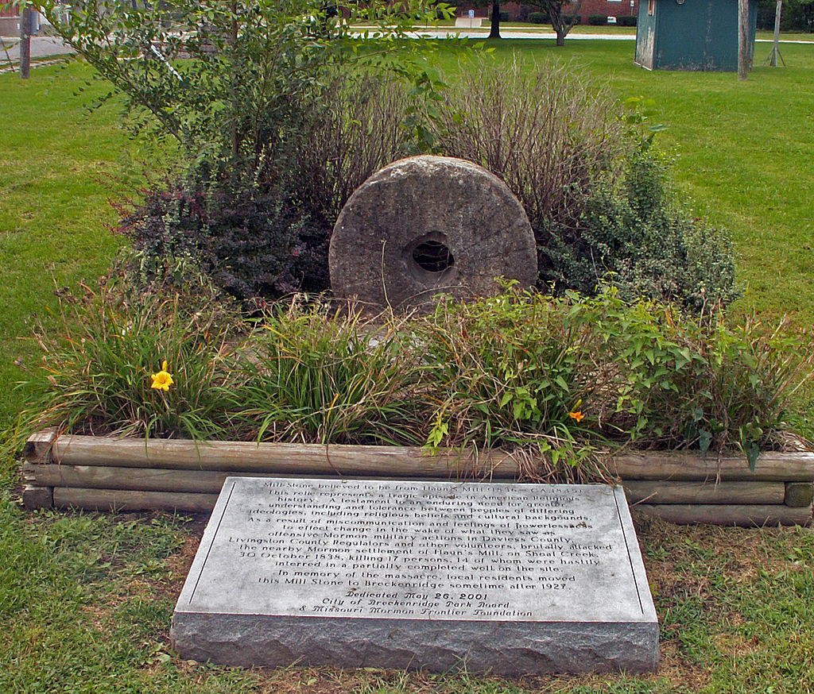
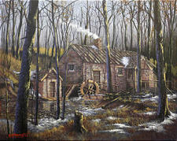
The Prophet’s Advice to the Saints
“Immediately after the battle of Crooked River, the Prophet Joseph Smith advised all Saints in outlying areas to move to Far West or Adam-ondi-Ahman.”
This small settlement twelve miles east of Far West was founded by Jacob Haun.
“Jacob Haun disregarded the Prophet’s counsel and instructed the small community to remain. This unwise decision proved fatal. Haun’s group planned to use the blacksmith shop as a fort in the event of an enemy attack. Guards were posted to protect the mill and the settlement.”
Church History In The Fulness Of Times Student Manual

Slide 24
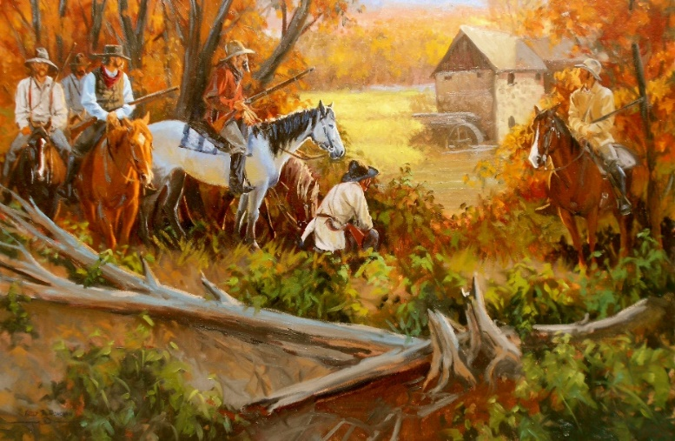
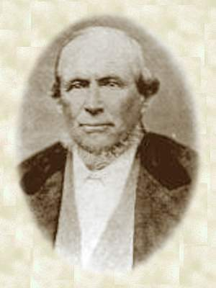
The Prophet’s Advice to the Saints
“On Sunday, October 27, 1838 Colonel Thomas Jennings of the Livingston County militia sent one of his men to the settlement to conclude a peace treaty. Both sides pledged not to attack each other.
The non-Mormons, however, did not disband as promised. On Monday a group of Missourians in Livingston County decided to attack Haun’s Mill.
On Tuesday afternoon, October 30, 1838, approximately 240 men approached Haun’s Mill.”
“At about 4:00 P.M.the mob approached Haun’s Mill. The women and children fled into the woods, while the men sought protection in the blacksmith shop. David Evans, the military leader of the Saints, swung his hat and cried for peace.”
Church History In The Fulness Of Times Student Manual
David Evans

Slide 25
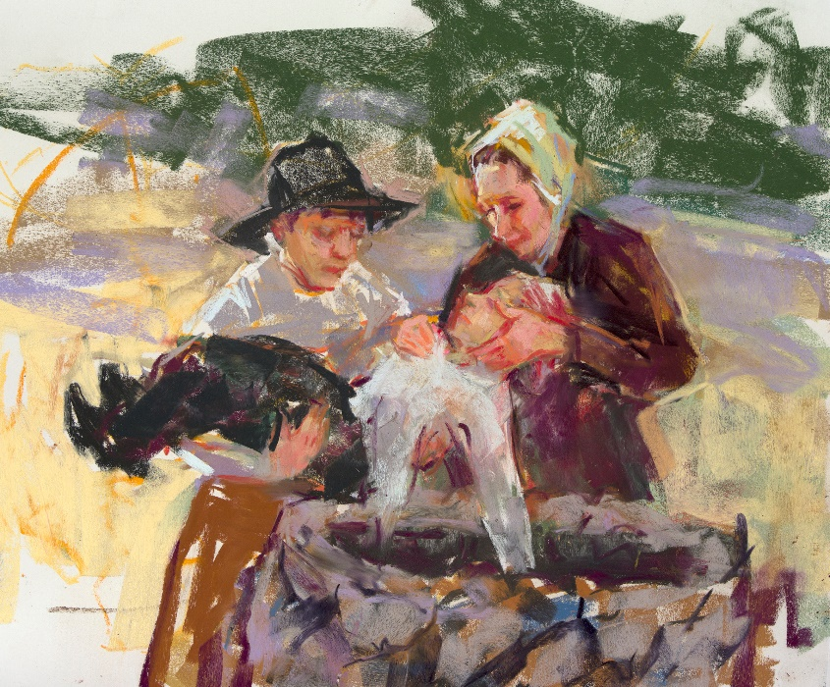
The Massacre
The mobbers aimed mostly at the blacksmith shop. They shot everyone in site, including women, elderly men, and children.
Buried in Well painting by Julie Rogers
“Alma Smith, Sardius’s seven-year-old brother, witnessed the murder of his father and brother and was himself shot in the hip. He was not discovered by the mob and was later miraculously healed through prayer and faith.
Thomas McBride was hacked to death with a corn knife. Although a few men along with women and children escaped across the river into the hills, at least seventeen people were killed, and about thirteen were wounded.
Jacob Haun was among the wounded, but he recovered.”
Church History In The Fulness Of Times Student Manual

Slide 26
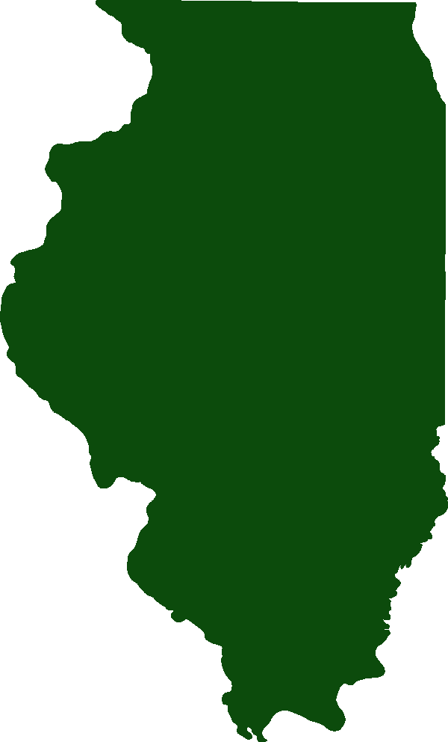
The Survivors
Fearing another attack those that survived hid throughout the night. And the next day the men buried the dead in a dry hole that had been dug for a well.
Thomas McBride, | Augustine Harmer,
Levi N. Merrick, | Simon Cox,
Elias Benner, | Hiram Abbott,
Josiah Fuller, | John York,
Benjamin Lewis, | John Lee,
Alexander Campbell, | John Byers,
George S. Richards, | Warren Smith,
William Napier, | Charles Merrick, aged 9,
Sardius Smith, aged 10.
Those Who Died
The devastated survivors left Missouri during the winter and following spring along with other Church members.
Church History In The Fulness Of Times Student Manual

Slide 27
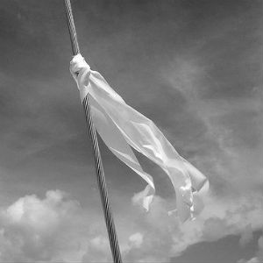
Meanwhile in Far West
“The anti-Mormon militia forces continued to gather around Far West in preparation for an attack.
The militia of Far West barricaded the city with wagons and timber, but by Wednesday, October 31, 1838 the anti-Mormon forces outnumbered those of the Saints by five to one. Neither side was eager to begin the battle, and the day was spent in a standoff, with each side trying to decide what to do.
In the evening General Lucas sent a flag of truce, which was met by Colonel Hinkle, the leading officer for the Saints. Colonel Hinkle secretly agreed to Lucas’s demands that certain leaders surrender for trial and punishment, Mormon property be confiscated to pay for damages, and the balance of the Saints surrender their arms and leave the state.”
Church History In The Fulness Of Times Student Manual

Slide 28
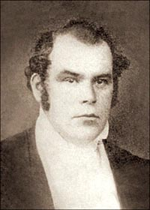
The Traitor
“Returning to Far West, Hinkle convinced Joseph Smith, Sidney Rigdon, Lyman Wight, Parley P. Pratt, and George W. Robinson that Lucas wanted to talk to them in a peace conference. The brethren were shocked when Hinkle turned them over to Lucas as prisoners.”
Lieutenant Colonel Hinkle
“The haughty general [Lucas] rode up, and, without speaking to us, instantly ordered his guard to surround us. They did so very abruptly, and we were marched into camp surrounded by thousands of savage looking beings, many of whom were dressed and painted like Indian warriors. These all set up a constant yell, like so many bloodhounds let loose upon their prey, as if they had achieved one of the most miraculous victories that ever graced the annals of the world.” Parley P. Pratt
Parley P. Pratt
Church History In The Fulness Of Times Student Manual

Slide 29
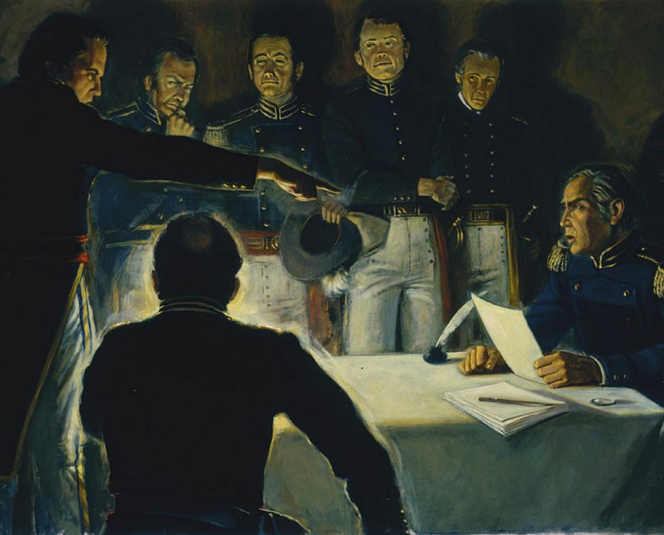
General Doniphan’s Rescue
“That night General Samuel Lucas issued the following order to Brigadier-General Doniphan: “Take Joseph Smith and the other prisoners into the public square of Far West, and shoot them at 9 o’clock tomorrow morning.
Doniphan’s response to his superior officer was: “It is cold-blooded murder. I will not obey your order. My brigade shall march for Liberty tomorrow morning, at 8 o’clock; and if you execute these men, I will hold you responsible before an earthly tribunal, so help me God.” http://www.moroni10.com/mormon_history/general-doniphan.html
Hyrum Smith and Amasa Lyman were also arrested latter and joined Joseph and the other brethren.
Church History In The Fulness Of Times Student Manual

Slide 30
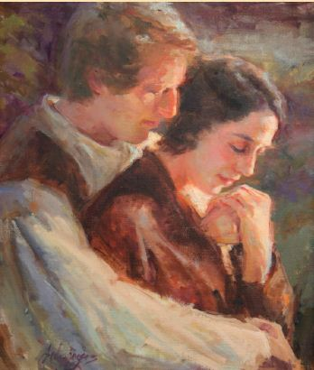
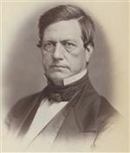
Those Left in Far West
“Plans were made to take the Church leaders to Independence for public display and trial. Thinking they might yet be executed, Joseph Smith and his fellow prisoners begged to see their families one last time, and they returned to Far West on 2 November. Joseph found his wife and children in tears because they thought he had been shot.”
“On the morning of 1 November, as George Hinkle marched the Mormon troops out of Far West, the Missouri militia entered the city.
While searching for arms they vandalized the town, plundered valuable possessions, raped some of the women, and forced the leading elders at bayonet point to sign promises to pay the expenses of the militia.
Many prominent men were arrested and taken as prisoners to Richmond. The rest of the Saints were told to leave the state.”
“Meanwhile, General John B. Clark, the governor’s designated commanding officer for the Mormon War, arrived in Far West. He ordered everyone to stay in the city, and the starving Saints were forced to live on parched corn.”
John B. Clark
Church History In The Fulness Of Times Student Manual

Slide 31
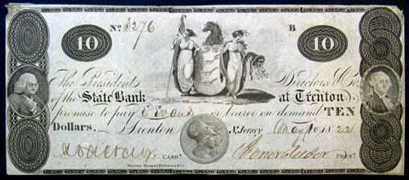
Those in Adam-ondi-Ahman
Militia surrounded the Saints who fled to Adam-ondi-Ahman.
The Mormons were ordered out of Davies County but they could go to Far West until the spring.
The Saints prepared for the move and sought relief from Missouri legislature. There were many sympathizers but an official investigation was never sought.
Instead, the legislature appropriated a meager $2,000 for the relief of the citizens of Caldwell County.
Church History In The Fulness Of Times Student Manual

Slide 32
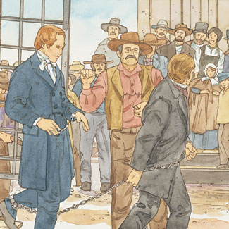
The Prisoners
“Joseph Smith and a few other prisoners were taken to Independence and placed on public display.
They were then transferred to Richmond, where they were chained together under guard in an old vacant house for over two weeks.”
Judge Austin A. King presided over a 13-day trial in November of 1838. However, the evidence was stacked against the Church leaders.
Judge Austin A. King
Church History In The Fulness Of Times Student Manual

Slide 33
Liberty Jail
“At the end of the trial, Judge King bound Joseph Smith and five others over for further prosecution and ordered them placed in Liberty Jail in Clay County.
Parley P. Pratt and several others were to remain confined in Richmond, and most of the other prisoners were released.”
“For four winter months the Prophet and his companions suffered from cold, filthy conditions, smoke inhalation, loneliness, and filthy food.”
Church History In The Fulness Of Times Student Manual

Slide 34
While in Prison
“Perhaps worst of all, they were unable to accompany the faithful Saints, who were being driven from the state. Yet these were months of special significance to Joseph Smith and the Church.”
Liz Lemon Swindle
Brigham Young, Heber C. Kimball, and John Taylor demonstrated superior leadership ability and commitment during this time and trial.
Joseph Smith received spiritual instructions from the Lord. “Because of the things revealed there, Liberty Jail could be called a temple-prison.”
Heber C. Kimball
Brigham Young
John Taylor
Church History In The Fulness Of Times Student Manual

Slide 35
Revelation While In Jail
March 1839—D&C 121, 122, 123
Joseph Smith
The Lord
“Oh God, where art thou? And where is the pavilion that covereth thy hiding place?
“How long shall thy hand be stayed, and thine eye, yea thy pure eye, behold from the eternal heavens the wrongs of thy people and of thy servants, and thine ear be penetrated with their cries?
“Yea, O Lord, how long shall they suffer these wrongs and unlawful oppressions, before thine heart shall be softened toward them, and thy bowels be moved with compassion toward them?”
(D&C 121:1–3).
“My son, peace be unto thy soul; thine adversity and thine afflictions shall be but a small moment;
“And then, if thou endure it well, God shall exalt thee on high; thou shalt triumph over all thy foes.
“Thy friends do stand by thee, and they shall hail thee again with warm hearts and friendly hands”
(D&C 121:7-9)
Church History In The Fulness Of Times Student Manual

Slide 36
Escape and Release
“By April the prisoners in Liberty were sent to Daviess County for trial. A grand jury brought in a bill against them for “murder, treason, burglary, arson, larceny, theft, and stealing.”
“While en route to Boone County for trial, the prisoners were allowed by the sheriff and other guards to escape to Illinois because some officials had concluded that the prisoners could not be successfully prosecuted.”
“Later in the summer Parley P. Pratt and Morris Phelps also escaped from a jail in Columbia, Boone County, and made their way to Nauvoo.
King Follett, a fellow prisoner, was recaptured but finally released in October 1839, being the last of the Saints held in bond.”
(See King Follett Sermon—April 1971 Ensign)
Morris Phelps
Church History In The Fulness Of Times Student Manual

Slide 37
A Place of Refuge
“The Saints began to leave Missouri in February 1839, when it was very cold. They were told that people in the state of Illinois might be friendly to them, so they traveled about 200 miles to western Illinois. Many of them went to the town of Quincy, where people were kind and gave them shelter, food, and jobs.”
Joseph said in his letter to the Saints: “As well might man stretch forth his puny arm to stop the Missouri river in its decreed course, or to turn it up stream, as to hinder the Almighty from pouring down knowledge from heaven upon the heads of the Latter-day Saints.”
D&C 121:33
Nauvoo, Illinois 1840
Church History In The Fulness Of Times Student Manual

Slide 38
Dewitt on October 23, 1838—same time during the Mormon War of 1838

Slide 39
Gallatin, Missouri:
In 1831 a family named Peniston had become the first white settlers in what was to become Daviess County. The next year they built a mill on the Grand River to grind flour and meal for incoming settlers. They developed the village of Millport. When the county was created in 1836, there were still fewer than a hundred settlers. The town of Gallatin was platted to serve as the county seat, and as it grew, Millport, three miles to the east, declined. The Saints poured into Adam-ondi-Ahman, some four miles north of Gallatin, in the summer of 1838. They quickly began to outnumber the Gentiles in Daviess County.
David Rice Atchison (August 11, 1807 – January 26, 1886) was a mid-19th century Democratic United States Senator from Missouri. He served as President pro tempore of the United States Senate for six years. He is best known for the claim that for one day (March 4, 1849) he may have been Acting President of the United States.
In 1830 he moved to Liber in Clay County in western Missouri, and set up practice there, where he also farmed. Atchison's law practice flourished, and his best-known client was Latter Day Saint Movement founder Joseph Smith. Atchison represented Smith in land disputes with non-Mormon settlers in Caldwell County] and Daviess County.]
Alexander William Doniphan joined Atchison's law practice in Liberty in May, 1833. The two became fast friends and spent many leisure time hours playing cards, going the horse races, hunting, fishing, attending social functions and political events. Atchison, already a member of the Liberty Blues, a volunteer militia in Missouri, got Doniphan to join.
The Adam Black Incident:
While in that vicinity the Prophet determined that it would be wise to ride around the region with some of the other brethren to determine political conditions and to calm fear that had arisen in the county. They visited several of the old settlers in the vicinity, including Adam Black, the justice of the peace and newly-elected judge for Daviess County. Knowing that Black had participated in the anti-Mormon activities, they asked him if he would administer the law justly and if he would sign an agreement of peace. According to Joseph Smith, after Black signed an affidavit certifying that he would disassociate himself from the mob, the brethren returned to Adam-ondi-Ahman. The next day a council composed of prominent Mormons and non-Mormons “entered into a covenant of peace, to preserve each other’s rights, and stand in each other’s defense; that if men did wrong, neither party would uphold them or endeavor to screen them from justice, but deliver up all offenders to be dealt with according to law and justice.”
The goodwill lasted less than twenty-four hours. On 10 August, William Peniston swore out an affidavit in Richmond, Ray County, before the circuit judge, Austin A. King, stating that Joseph Smith and Lyman Wight had organized an army of five hundred men and had threatened death to “all the old settlers and citizens of Daviess county.”⁶Upon hearing this information, Joseph waited at home in Far West for further developments. When the sheriff learned that Joseph was willing to submit to arrest if he could be tried in Daviess County, he declined serving the writ and went to Richmond to consult with Judge King.
Dewitt, Missouri:
In the spring of 1838, Henry Root, a non-Mormon who was a major land-owner in Carroll County, visited Far West and sold his plots in the mostly vacant town of De Witt to church leaders. De Witt possessed a strategically important location near the intersection of the Grand River and the Missouri River. Two members of the Far West High Council, George M. Hinkle and John Murdock, were sent to take possession of the town and to begin to colonize it.
On July 30, citizens of Carroll County met in Carrollton to discuss the Mormon colonization of De Witt. The question of whether or not Mormons should be allowed to settle in the county was placed on the August 6 ballot; a heavy majority favored expulsion of the Mormons. A committee sent to De Witt ordered the Latter Day Saints to leave. Hinkle and Murdock refused, citing their right as American citizens to settle where they pleased.
Sentiment among the anti-Mormon segment of Carroll County's population hardened, and some began to take up arms. On August 19, 1838, Mormon settler Smith Humphrey reports that 100 armed men led by Colonel William Claude Jones took him prisoner for two hours and threatened him and the rest of the Mormon community.
Initial reaction by Missourians was mixed. While Mormons were viewed as deluded or worse, many Missourians agreed with the sentiment expressed in the Southern Advocate:
Alexander William Doniphan (July 9, 1808 – August 8, 1887) was a 19th-century American attorney, soldier and politician from Missouri who is best known today as the man who prevented the summary execution of Mormon founder Joseph Smith, Jr. at the close of the 1838 Mormon War in that state. He also achieved renown as a leader of American troops during the Mexican–American War, as the author of a legal code that still forms the basis of New Mexico's Bill of Rights, and as a successful defense attorney in the Missouri towns of Liberty, Richmond and Independence.

Slide 40
Dewitt, Missouri:
In the spring of 1838, Henry Root, a non-Mormon who was a major land-owner in Carroll County, visited Far West and sold his plots in the mostly vacant town of De Witt to church leaders. De Witt possessed a strategically important location near the intersection of the Grand River and the Missouri River. Two members of the Far West High Council, George M. Hinkle and John Murdock, were sent to take possession of the town and to begin to colonize it.
On July 30, citizens of Carroll County met in Carrollton to discuss the Mormon colonization of De Witt. The question of whether or not Mormons should be allowed to settle in the county was placed on the August 6 ballot; a heavy majority favored expulsion of the Mormons. A committee sent to De Witt ordered the Latter Day Saints to leave. Hinkle and Murdock refused, citing their right as American citizens to settle where they pleased.
Sentiment among the anti-Mormon segment of Carroll County's population hardened, and some began to take up arms. On August 19, 1838, Mormon settler Smith Humphrey reports that 100 armed men led by Colonel William Claude Jones took him prisoner for two hours and threatened him and the rest of the Mormon community.
Initial reaction by Missourians was mixed.
As tensions built in Daviess County, other counties began to respond to Carroll County's request for assistance in expelling the Mormons from their county. Citizens in Saline, Howard, Jackson, Chariton, Ray, and other nearby counties organized vigilance committees sympathetic to the Carroll County expulsion party.
Some isolated Mormons in outlying areas also came under attack. In Livingston County, a group of armed men forced Asahel Lathrop from his home, where they held his ill wife and children prisoner. Lathrop wrote "I was compeled[sic] to leave my home my house was thronged with a company of armed men consisting of fourteen in number and they abusing my family in allmost[sic] every form that Creturs[sic] in the shape of human Beeings[sic] could invent.“ After more than a week, a company of armed Mormons assisted Lathrop in rescuing his wife and two of his children (one had died while prisoner). Lathrop's wife and remaining children died shortly after their rescue.
On September 20, 1838, about one hundred fifty armed men rode into De Witt and demanded that the Mormons leave within ten days. Hinkle and other Mormon leaders informed the men that they would fight. They also sent a request for assistance to Governor Boggs, noting that the mob had threatened "to exterminate them, without regard to age or sex."
On October 1, the mob burned the home and stables of Smith Humphrey. The citizens of De Witt sent non-Mormon Henry Root to appeal to Judge King and General Parks for assistance. Later that day, the Carroll County forces sealed off the town.
The besieged town resorted to butchering whatever loose livestock wandered into town in order to avoid starvation while waiting for the militia or the Governor to come to their aid. General Parks arrived with the Ray County militia on October 6, but his order to disperse was ignored by the mob. When his own troops threatened to join the attackers, Parks was forced to withdraw to Daviess County in hopes that the Governor would come to mediate. Parks wrote his superior, General Atchison, that "a word from his Excellency would have more power to quell this affair than a regiment."
On October 9, A C Caldwell returned to De Witt to report that the Governor's response was that the "quarrel was between the Mormons and the mob" and that they should fight it out.
On October 11, Mormon leaders agreed to abandon the settlement and move to Caldwell County.
On the first night of the march out of Carroll County, two Mormon women died. One woman died of exposure, the other (a woman named Jenson) died in childbirth. Several children also became ill during the ordeal and died later.

Slide 41
Thomas B. Marsh and Orson Hyde:
Marsh swore out an affidavit, which was also mostly endorsed by Hyde, stating that “the Prophet inculcates the notion, and it is believed by every true Mormon, that Smith’s prophecies are superior to the laws of the land. I have heard the Prophet say that he would yet tread down his enemies, and walk over their dead bodies; and if he was not let alone, he would be a second Mohammed to this generation.”
This statement further justified the actions of the anti-Mormons in their own minds.Regarding this treachery, Joseph Smith remarked that Thomas B. Marsh “had been lifted up in pride by his exaltation to office and the revelations of heaven concerning him, until he was ready to be overthrown by the first adverse wind that should cross his track, and now he has fallen, lied and sworn falsely, and is ready to take the lives of his best friends. Let all men take warning by him, and learn that he who exalteth himself, God will abase.” Thomas Marsh was excommunicated 17 March 1839, while Orson Hyde was relieved of his duties in the Council of the Twelve. On 4 May 1839 Orson Hyde was officially suspended from exercising the functions of his office until he met with the general conference of the Church and explained his actions. On 27 June, after repenting and confessing his error, he was restored to the Quorum of the Twelve Apostles. After years of misery, Brother Marsh returned to the Church in 1857.
Hinkle made a secret deal to hand over his own leaders, including the prophet Joseph Smith, to their sworn enemies
Haun’s Mill:
Founded by Jacob Haun, a convert from Green Bay, Wisconsin. He had moved to Shoal Creek in 1835, hoping to avoid the persecutions his fellow Saints were experiencing elsewhere in Missouri. Haun’s Mill consisted of a mill, a blacksmith shop, a few houses, and a population of about twenty to thirty families at the mill itself and one hundred families in the greater neighborhood. On 30 October nine wagons with immigrants from Kirtland had arrived at the site. They had decided to rest a few days before traveling to Far West.
David Evans—Haun’s Mill
Born 1804 Cecil County, Maryland
Married Mary Beck 1826; later practiced plural marriage; forty-one children
Baptized 1833
Ordained Elder 1833
Zions Camp 1834
Ordained Seventy and called to First Quorum of Seventy 1835
Ordained High Priest and called as Bishop of Eleventh Ward in Nauvoo
Trekked west with saints, arriving in Utah in 1850
Settled in Lehi, Utah where he was Bishop, Mayor, etc.
Died 1883 Lehi, Utah
While inn Missouri he bought land and made a home. He was with the Saints through all their persecutions in Missouri, among which was the terrible massacre at Haun's Mill
http://www.gapages.com/evansd1.htm
Joseph Young, Sr., a member of the seven presidents of Seventy and a recent arrival at Haun’s Mill, described the late afternoon setting: “The banks of Shoal creek on either side teemed with children sporting and playing, while their mothers were engaged in domestic employments, and their fathers employed in guarding the mills and other property, while others were engaged in gathering in their crops for their winter consumption. The weather was very pleasant, the sun shone clear, all was tranquil, and no one expressed any apprehension of the awful crisis that was near us—even at our doors.”³²

Slide 42
Joseph in Far West bids farewell to family November 1838
“When I entered my house, they clung to my garments, their eyes streaming with tears, while mingled emotions of joy and sorrow were manifested in their countenances,” he wrote. He was denied the privilege of a few private moments with them, but Emma wept and his children clung to him until “they were thrust from me by the swords of the guards.” The other prisoners suffered similarly as they bade farewell to their loved ones.
Lucy Smith, Joseph and Hyrum’s mother, hurried to the wagon where they were kept under guard and was barely able to touch their outstretched hands before the wagon departed. After several hours of grief, she was comforted by the Spirit and blessed with the gift of prophecy: “Let your heart be comforted concerning your children, they shall not be harmed by their enemies.”
A similar revelation came to the Prophet Joseph Smith. The next morning as the prisoners began their march, Joseph spoke to his companions in a low, but hopeful tone. “Be of good cheer, brethren; the word of the Lord came to me last night that our lives should be given us, and that whatever we may suffer during this captivity, not one of our lives should be taken.”
Who was King Follett? When he was fatally injured digging a well in Nauvoo in March 1844, why did Joseph Smith use his death to deliver the monumental doctrinal sermon now known as the King Follett Discourse? Much has been written about the sermon, but little about King. Although King left no personal writings, Joann Follett Mortensen, King's third great-granddaughter, draws on more than thirty years of research in civic and Church records and in the journals and letters of King's peers to piece together King's story from his birth in New Hampshire and moves westward where, in Ohio, he and his wife, Louisa, made the life-shifting decision to accept the new Mormon religion. From that point, this humble, hospitable, and hardworking family followed the Church into Missouri where their devotion to Joseph Smith was refined and burnished. King was the last Mormon prisoner in Missouri to be released from jail. According to family lore, King was one of the Prophet's bodyguards. He was also a Danite, a Mason, and an officer in the Nauvoo Legion. After his death, Louisa and their children settled in Iowa where some associated with the Cutlerities and the RLDS Church; others moved on to California. One son joined the Mormon Battalion and helped found Mormon communities in Utah, Nevada, and Arizona. While King would have died virtually unknown had his name not been attached to the discourse, his life story reflects the reality of all those whose faith became the foundation for a new religion. His biography is more than one man's life story. It is the history of the early Restoration itself. Amazon books
24/26 July 1788–9 Mar. 1844.
Born at Winchester, Cheshire Co., New Hampshire.
Son of John Follett and Hannah Oak (Oake) Alexander.
Married Louisa Tanner, by 1815.
Baptized into LDS church, spring 1831. Member of Whitmer branch at Jackson Co., Missouri, by 1833.
Moved to Clay Co., Missouri, 1833.
Moved to what became Caldwell Co., Missouri, 1835.
Ordained an elder, 28 Jan. 1836, at Kirtland, Geauga Co., Ohio. Likely ordained a high priest, by Apr. 1837.
During difficulties in Missouri in 1839, imprisoned at Richmond, Ray Co., Missouri, and Columbia, Boone Co., Missouri. Moved to Illinois, 1839.
Served as a constable in Hancock Co., Illinois, by 1843.
Died at Nauvoo, Hancock Co while digging a well in Nauvoo
Joseph Smith Papers
Joseph and Others in Prison:
For two horrible weeks, the prisoners were abused by the guards. One November night the brethren listened for several hours to “obscene jests, the horrid oaths, the dreadful blasphemies and filthy language” as the guards rehearsed the atrocities they had inflicted on the Saints. Parley P. Pratt lay next to the Prophet and listened until he could “scarcely refrain from rising … and rebuking the guards.” Suddenly Joseph Smith rose to his feet shackled and unarmed and spoke in a “voice of thunder”: “‘SILENCE, ye fiends of the infernal pit. In the name of Jesus Christ I rebuke you, and command you to be still; I will not live another minute and bear such language. Cease such talk, or you or I die THIS INSTANT!’
“He ceased to speak. He stood erect in terrible majesty. Chained and without a weapon; calm, unruffled and dignified as an angel, he looked upon the quailing guards, whose weapons were lowered or dropped to the ground; whose knees smote together, and who, shrinking into a corner, or crouching at his feet, begged his pardon, and remained quiet till a change of guards.”

