Slide 1
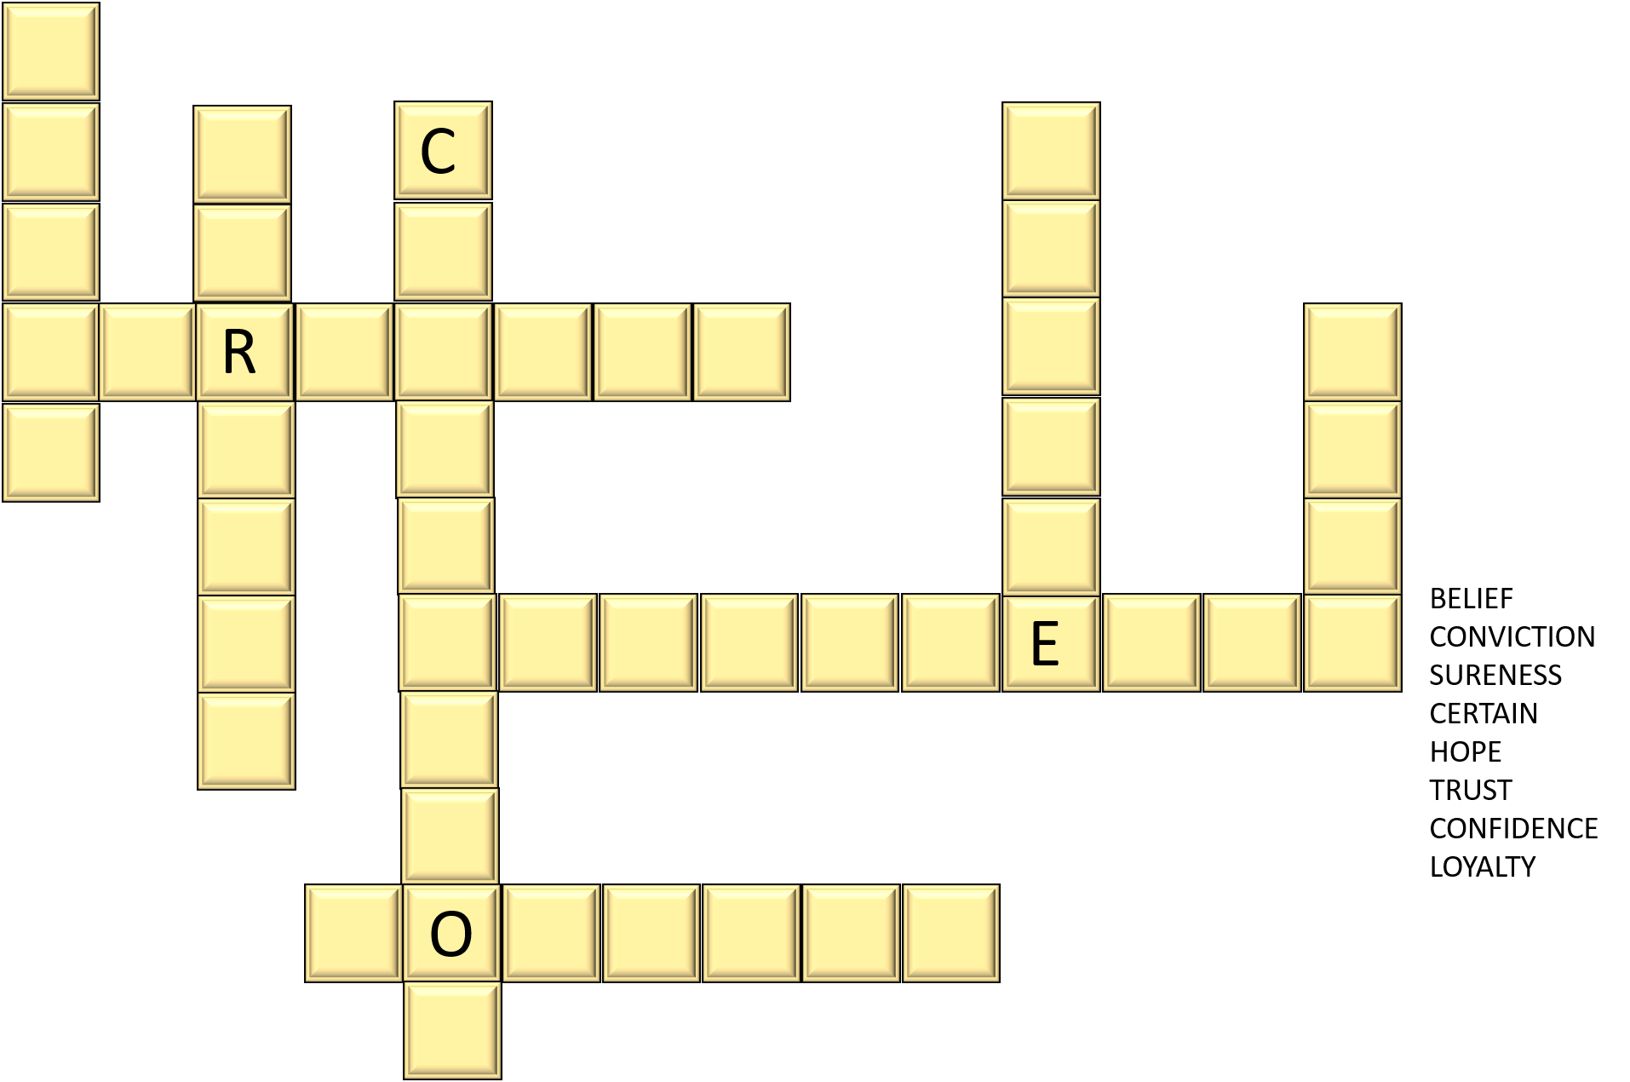
F
A
I
T
H
Two word puzzles
SAMPLE

Slide 2
F
A
I
T
H

Slide 3
F
A
I
T
H

Slide 4
BELIEF
CONVICTION
SURENESS
CERTAIN
HOPE
TRUST
CONFIDENCE
LOYALTY

Slide 5
Instructions on Puzzles
Fill in Tiles with words (hint: count the tiles VS number of letters in words)
Find the words in a word scramble
The words may go all ways
Answers

