Slide 1
SAMPLE
Blessings That Come Through the Priesthood Concentration Game
Created by ©http://fashionsbylynda.com/blog/

Slide 3
v

Slide 4
Receiving a Name and a Blessing
Being Baptized
Receiving The gift of the holy ghost
Receiving a blessing when sick
Partaking of the sacrament
Serving a mission
Being married in the temple

Slide 5
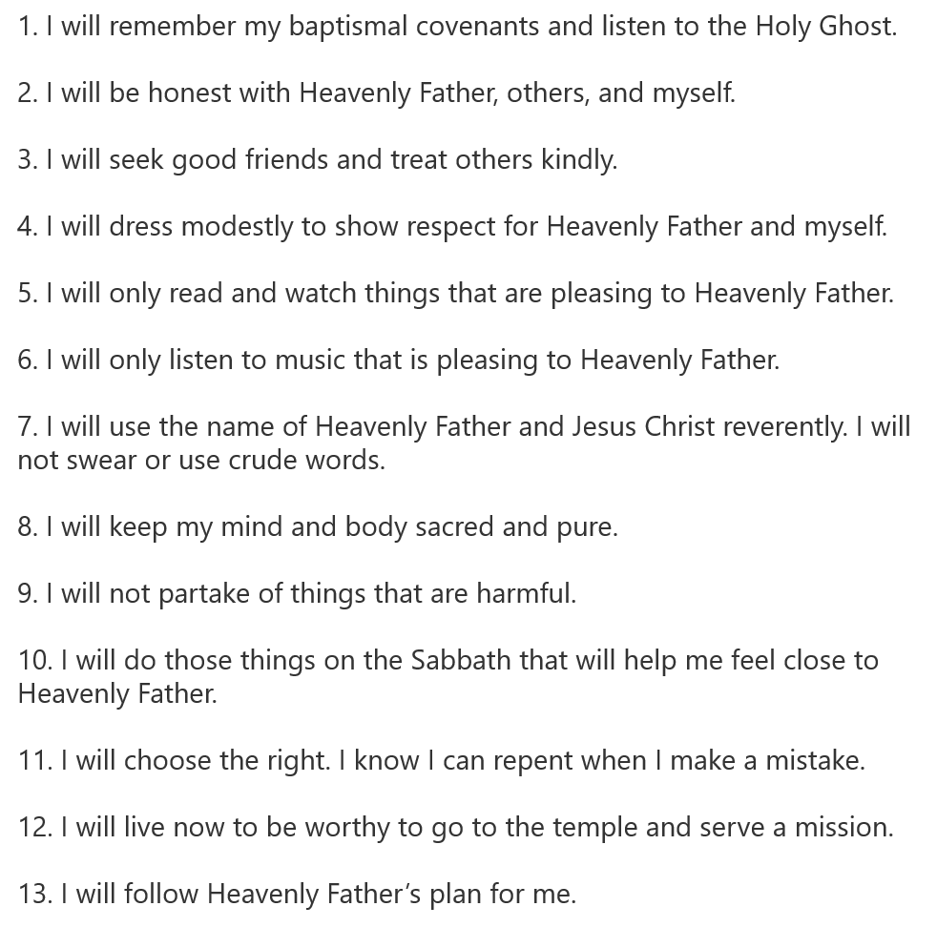
My Gospel Standards
My Gospel Standards

Slide 6
Instructions:
Copy page 2(or 3) and 4
Cut, laminate and cut. (for page 3 color)
Put upside down on floor and play concentration game matching the Priesthood Ordinances with the pictures
For Younger use only the pictures
Page 5 Handout

