Slide 1
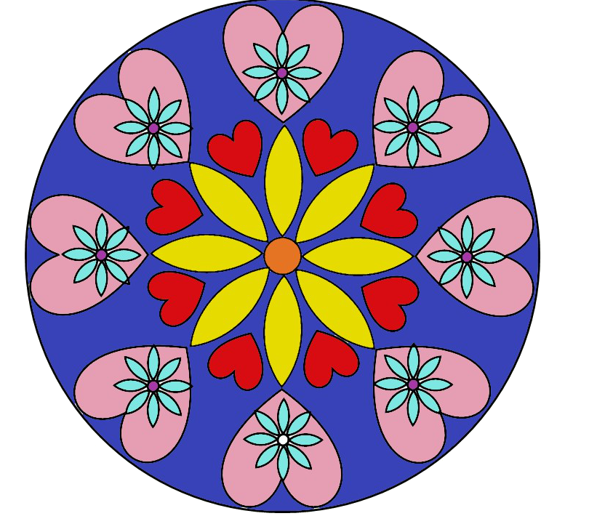
Circle Fun
Part 10
Shapes

Slide 2
Fruit Pizza

Slide 3
Circle Circle

Slide 4
Jamie’s World

Slide 5
Spinning vine

Slide 6
Round and Round

Slide 7
Carousel

Slide 8
Daisy Mine

