Slide 2
What attitudes and actions can increase in the influence of the Holy Ghost in your life?
Mormon recorded that the Lord withdrew His Spirit from the Nephites and began to pour out His Spirit on the Lamanites
The Influence of the Spirit of the Holy Ghost
What attitudes and actions can decrease the Holy Ghost’s influence in your life?
The Nephites had “become weak, because of their transgression”
“The Spirit of the Lord did no more preserve them”
They were “ripening for destruction”
Helaman 4:26, 4:24, 5:2, 6:35-36

Slide 3
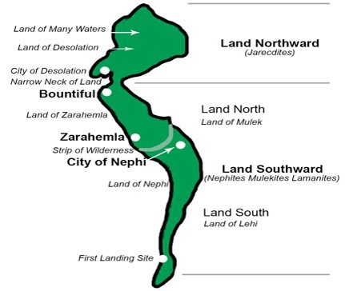
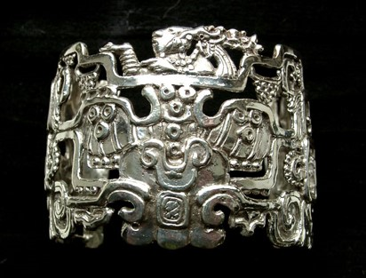
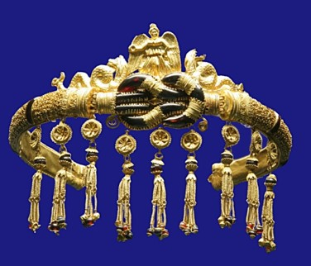
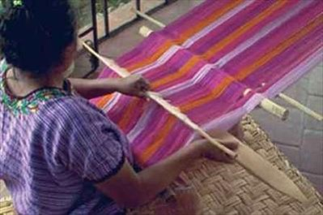
Peace and Prosperity
62nd – 65th Year of the Reign of the Judges
Both Lamanites and Nephites share in peace and gained much wealth in the land north and in the land south
Helaman 6:7-14

Slide 4
Two Chief Judges Murdered
66th Year of the Reign of the Judges
Cezoram and his son, Cezoram were murdered in the same year
Helaman 6: 16-17

Slide 5
The Heart
The heart is essential to our physical survival.
It pumps blood through our bodies so oxygen and other nutrients can reach all our cells.
About the size of a fist, the average adult heart pumps 2,000 gallons (7,570 liters) of blood daily.
It beats about 70 times per minute, or 100,000 beats per day.
Knowing the vital nature of your physical heart, what would you be willing to do to keep it healthy?
Helaman 16-17

Slide 6
Righteousness
Helaman
11:18-19
Reign of Judges
76th Year
Humility and Repentance
Prosperity and Blessings
11:6-9
Reign of Judges
75th Year
6: 1, 6-14
Reign of Judges
63rd Year
2nd Cycle of Nephite Disease
Destruction and Suffering
Pride
11:1-5
Reign of Judges
72nd Year
6: 15-17
Reign of Judges
66th and 67thYear
Wickedness
6:15-18
Reign of Judges
67th Year
Postscript to the war
6:18 Secret Combinations
6:31 Most Choose Evil
6:35 Spirit Withdrawal

Slide 7
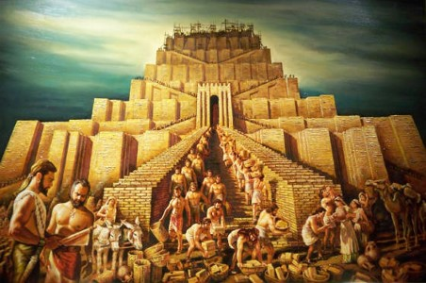
To Enable Satan
Helaman 6:17
Helaman 6:21
Helaman 6:26
Helaman 6:28-31
Hearts set on riches of the world, seek to get gain
Satan stirs up the heart and Nephite unite with band of robbers
The heart of Gadianton…same who enticed our first parents
Put into their hearts to build a tower to get to heaven---biblical Tower of Babel…Carry on in darkness…to get a hold of the hearts of the children of men

Slide 8
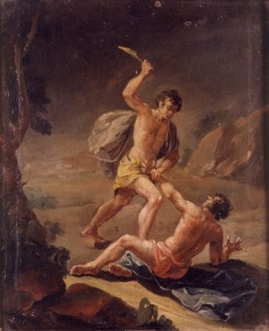
The Hearts of Two Groups
“Ye are of your father the devil, and the lusts of your father ye will do. He was a murderer from the beginning, and abode not in the truth, because there is no truth in him. When he speaketh a lie, he speaketh of his own: for he is a liar, and the father of it.”
John 8:44
The Plot with Cain
The story of the origin and rise of secret combinations on earth was once contained in the record of Old Testament times. …And the manner in which Cain plotted with Satan to become Master Mahan, master of the great secret, that he could murder and get gain—these matters were deleted from the Bible records before that book was compiled.
These were known among the Nephites through that scriptural record we know as the brass plates…(See Moses 5)
JFM and RLM
The Nephites lost the Spirit because …
The Lord poured out His Spirit on the Lamanites because …
Helaman 6:27-36

Slide 9
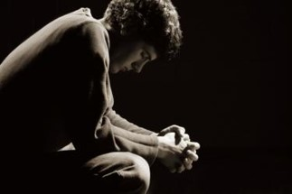
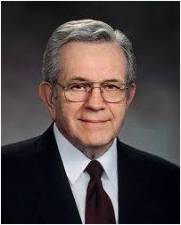
Satan Tries to Plant Temptation in Our Hearts
“There can be counterfeit revelations, promptings from the devil, temptations!
As long as you live, in one way or another the adversary will try to lead you astray. …
“If ever you receive a prompting to do something that makes you feel uneasy, something you know in your mind to be wrong and contrary to the principles of righteousness, do not respond to it!”
President Boyd K. Packer
Helaman 6:17-31

Slide 10
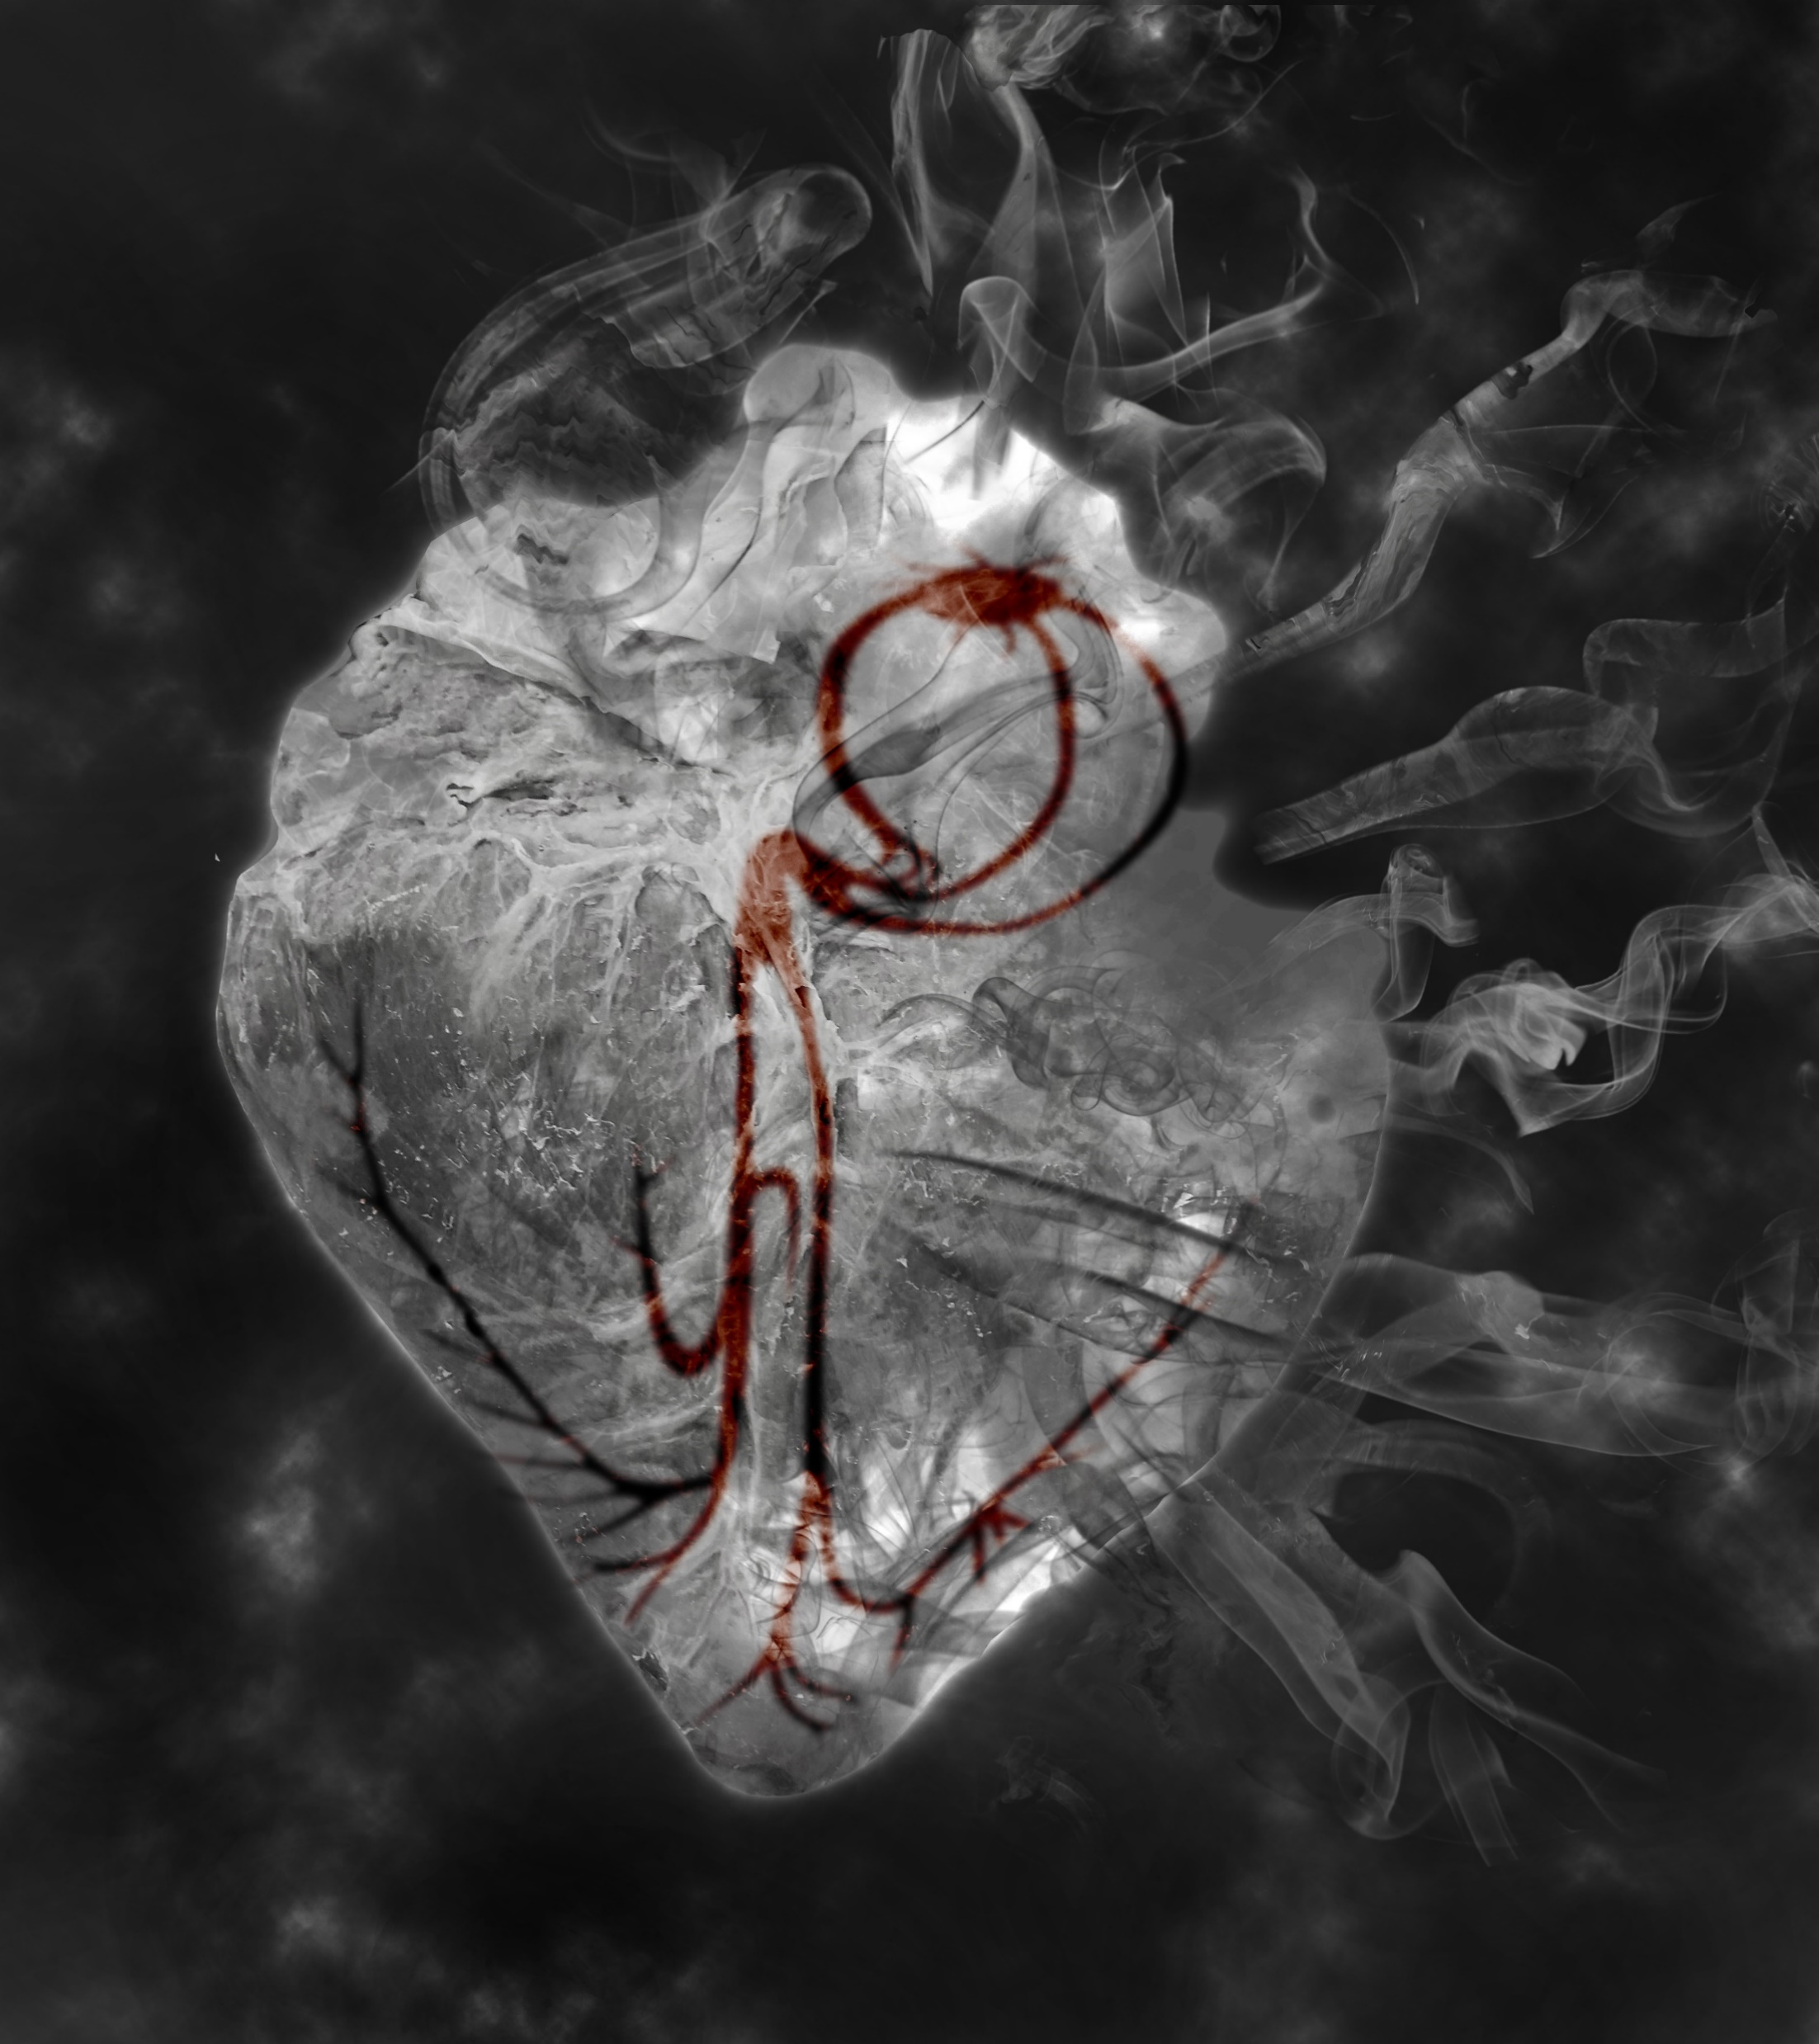
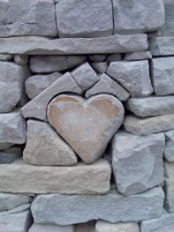
Satan carries on his works of darkness by getting hold upon the hearts of the children of men
If we are wicked and harden our hearts, then the Spirit of the Lord will withdraw from us.
If we choose to willingly believe in the Lord’s words, then He will pour out His Spirit upon us.
Helaman 6:17-31

Slide 11
Secret Combinations
The devil is the inspiration and source of all such organizations. Mormon clearly points out who is the grand conspirator, the real organizer of all such organizations.
Student Manual

Slide 12
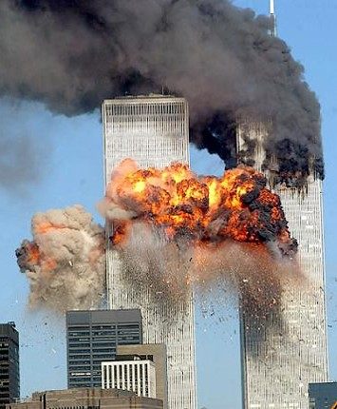
Secret Combinations
Such organizations are viewed by the Lord as constituting wickedness “above all the wickedness of the whole earth.”
(3 Nephi 9:9)
While individuals may rob, steal, plunder, and murder, the truly vast crimes of mankind involved plunder and killing on a national or an international scale involving millions of lives.
Student Manual

Slide 13
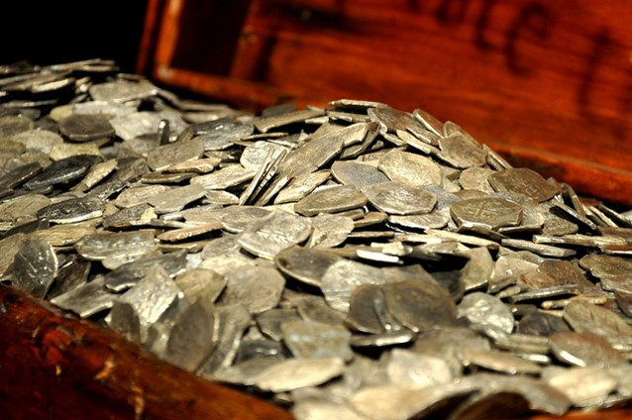
Secret Combinations
Such combinations flourish and thrive when the “more part” (Helaman 6;21) of the people are wicked and seek to benefit from the spoils of such wickedness
Student Manual

Slide 14
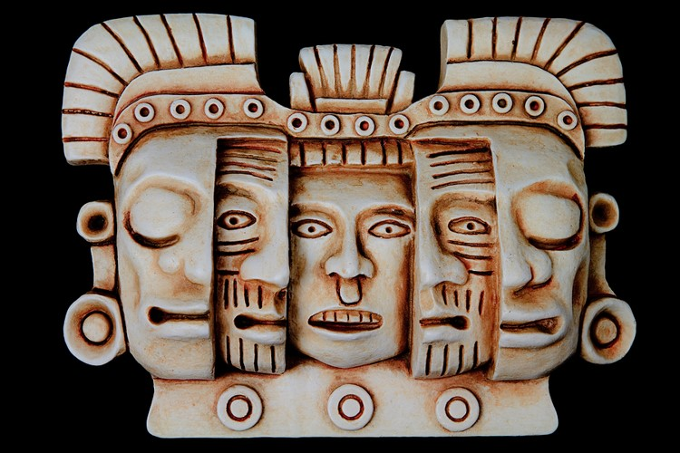
Secret Combinations
Secrecy is one of the basic operating tenets (code of belief) of such organizations
Student Manual

Slide 15
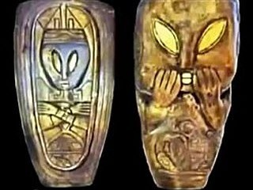
Secret Combinations
Joined with the idea of secrecy is the idea of covenant making. An oath of loyalty to the organization is made which involves a vow to maintain the secret of the conspiracy.
After a murder of the chief judge, Kishkumen “went unto those that sent him, and they all entered into a covenant, yea, swearing by their everlasting Maker, that they would tell no man.”
(Helaman 1:11)
Student Manual

Slide 16
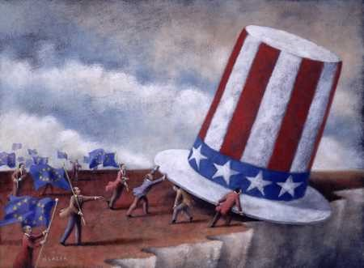
Secret Combinations
The objectives of such secret combinations are power or gain or both. Since the government is a source of great power, it is not surprising that often the target of their action is to take over the reins of government.
Student Manual

Slide 17
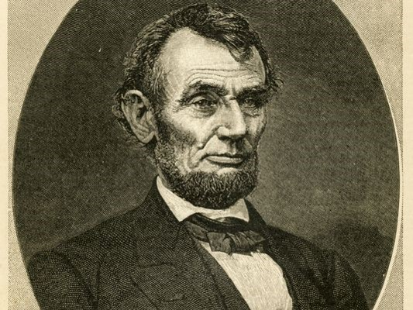
Secret Combinations
These combinations use immorality, money, and violence to achieve their ends. Assassinations of government leaders to bring their own people to power is the common tale of the Book of Mormon.
Student Manual

Slide 18
Secret Combinations
The only way to stamp out these organizations, once they are established and begin to flourish, is through conversion of the people to righteousness
Righteousness
“Righteousness exalteth a nation: but sin is a reproach to any people.”
Proverbs 14:34
Student Manual

Slide 19
Wickedness of the People
Helaman 7:1
Who returned from the land northward?
Helaman 7:2
What did Nephi teach the people in the land northwards?
Helaman 7:3
Why did Nephi leave the land northward?
Helaman 7:4
Who had filled the judgment seats by the time Nephi returned to Zarahemla?
The Word of God
Rejected
The Word of God

Slide 20
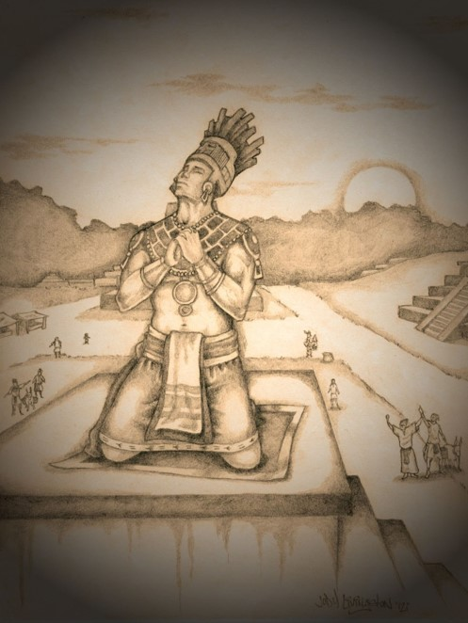
Pouring Out His Soul
The Prayer of Nephi
“bowed himself upon the tower”
“There are some prayers, some pleading to God, in which the supplicant truly bends and stretches his soul…Nephi is pained over the sins and iniquities of his day and raises his voice high that it reaches the heavens”
JFM and RLM
Nosmelone
Helaman 7:10-11

Slide 21
Entice
…how could you have given way to the enticing of him who is seeking to hurl away your souls down to everlasting misery and endless wo?
Do you recognize someone or something who wants to entice us?
Our tempters are those who entice to be impatient, frustrated, doubtful, fearful, or angry
“…inherent in every enticement to do wrong is a spiritual growth opportunity to do right…
Every enticement can be a blessing to us if we allow it to be.” Joy D. Jones
Helaman 7:16

Slide 22
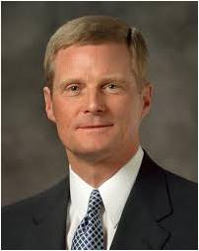
Spiritually Unattended
“We should also endeavor to discern when we ‘withdraw [ourselves] from the Spirit of the Lord, that it may have no place in [us] to guide [us] in wisdom’s paths that [we] may be blessed, prospered, and preserved’ (Mosiah 2:36).
Precisely because the promised blessing is that we may always have His Spirit to be with us, we should attend to and learn from the choices and influences that separate us from the Holy Spirit.
“The standard is clear. If something we think, see, hear, or do distances us from the Holy Ghost, then we should stop thinking, seeing, hearing, or doing that thing. If that which is intended to entertain, for example, alienates us from the Holy Spirit, then certainly that type of entertainment is not for us.
Because the Spirit cannot abide that which is vulgar, crude, or immodest, then clearly such things are not for us. Because we estrange the Spirit of the Lord when we engage in activities we know we should shun, then such things definitely are not for us.”
Elder David A. Bednar
Helaman 7:17

Slide 23
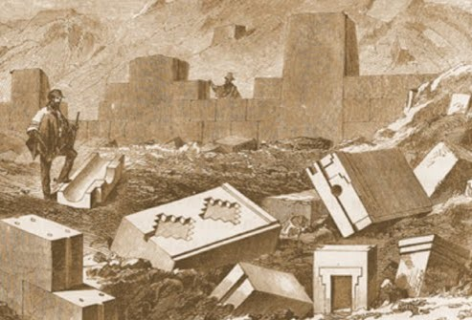
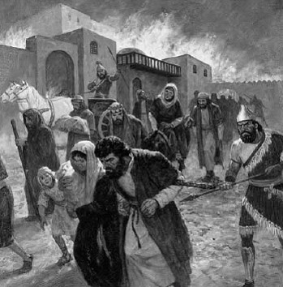
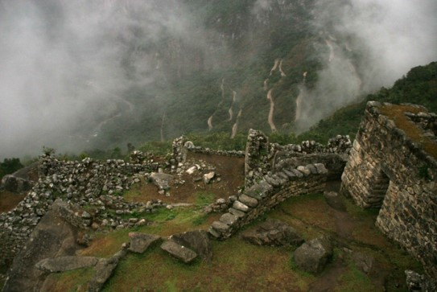
Knowledge from God
Those who do not repent:
The city will be taken away from you and the land
You will not have a place to live
You will not have the strength to withstand the enemy
You will be destroyed from off the face of the earth
Helaman 7:17-28

Slide 24
If we refuse to repent of our sins, we will lose the Lord’s protection and the blessings of eternal life.
“ Behold now, I do not say that these things shall be, of myself, because it is not of myself that I know these things; but behold, I know that these things are true because the Lord God has made them known unto me, therefore I testify that they shall be.”
The Seal of a Testimony
Helaman 7:29

Slide 25
Sources:
Video:
Secret Combinations (0:46)
Book of Mormon Student Manual Religion 121-122 pg. 359-360
President Boyd K. Packer(“Personal Revelation: The Gift, the Test, and the Promise,” Ensign, Nov. 1994, 61)
Joseph Fielding McConkie and Robert L. Millet Doctrinal Commentary on the Book of Mormon Vol. 3 pg. 366-369
Elder David A. Bednar (“That We May Always Have His Spirit to Be with Us,” Ensign or Liahona, May 2006, 30).
President Spencer W. Kimball What is True Repentance? May 1974 Ensign
The Nephite Cycle—Ezra Taft Benson (God, Family, Country pg 363-364)
Joy D. Jones BYU Devotional April 2018 “Look unto Him in Every Thought”
Presentation by ©http://fashionsbylynda.com/blog/

Slide 26
Righteousness
Helaman
11:18-19
Reign of Judges
76th Year
Humility and Repentance
Prosperity and Blessings
11:6-9
Reign of Judges
75th Year
6: 1, 6-14
Reign of Judges
63rd Year
2nd Cycle of Nephite Disease
Destruction and Suffering
Pride
11:1-5
Reign of Judges
72nd Year
6: 15-17
Reign of Judges
66th and 67thYear
Wickedness
6:15-18
Reign of Judges
67th Year
Postscript to the war
6:18 Secret Combinations
6:31 Most Choose Evil
6:35 Spirit Withdrawal

Slide 27
Characteristics of a Prophet
Helaman 7:17–19 (Prophets exhort people to repent.)
Helaman 7:29 (A prophet’s message is not his own. It comes from the Lord.)
Helaman 8:1–7 (Prophets are not popular with the wicked.)
Helaman 8:13–19 (Prophets testify of Jesus Christ.)
Helaman 8:27–9:38 (The words of prophets are all fulfilled.)
Helaman 10:5–7 (The Lord gives prophets the sealing power.)
Helaman 11:18 (Prophets are esteemed by righteous people.)

