Slide 2
Believe It Or Not
King Lamoni’s servants believed the king to be dead and his body was decaying
The Queen believed the king to be alive and sent for Ammon
believing him to be a prophet
Ammon reassured her that the king ‘sleepeth in God’
He knew King Lamoni was overpowered by the Spirit of God
Alma 19:1-9

Slide 3
The Queen
She was a Lamanite and wife of King Lamoni
She was an exemplary woman depicted in the Book of Mormon
She remains unnamed
She had sons and daughters
She exhibited her faith in Christ and all that Ammon had blessed her with
She was a devoted wife
She was overcome by the Spirit of the Lord—also fell to the ground and awakened by servant Abish
She followed in her husband’s footsteps
She was instrumental in bringing many of the Lamanite people into the fold
Who’s Who

Slide 4
Abish
She was a Lamanite servant
She was a servant to the Queen
She had been converted unto the Lord for many years by her father’s vision (Alma 19:16)
She kept her conversion a secret until she observed the Spirit on the queen, the king, and Ammon and the servants
She informed the people of her conversion and what miracle was taking place with her queen and the king. She knew it was the power of God
Some did not believe Abish and were angry with Ammon
When she touched the queen’s hand while the queen was overpowered by the Spirit…the queen came to
Who’s Who

Slide 5
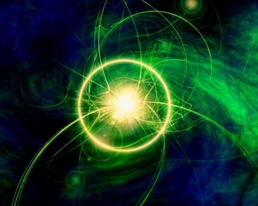
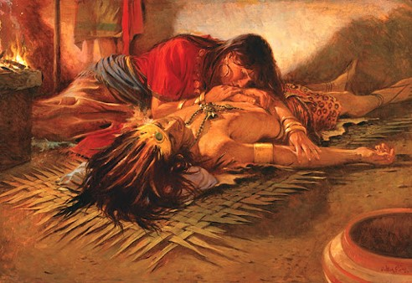
Carried Away in God
Overcome by the Spirit
“It appears that a trance is a state in which the body and its functions become quiescent in order that the full powers of the Spirit may be centered on the revelations of heaven.”
“…it can hear what otherwise could not be heard and see what otherwise could not be seen—”
However:
Does it teach faith in Christ, repentance, sacrifice, and obedience?
“The trance might be likened to another medium of revelation…”
JFM and RLM

Slide 6
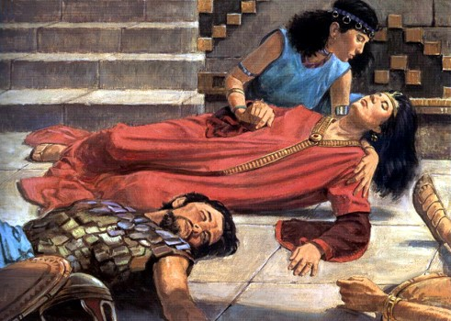
Servants Converted
“Now, when the servants of the king had seen that they had fallen, they also began to cry unto God, for the fear of the Lord had come upon them also, for it was they who had stood before the king and testified unto him concerning the great power of Ammon.
And it came to pass that they did call on the name of the Lord, in their might, even until they had all fallen to the earth, save it were one of the Lamanitish women, whose name was Abish, she having been converted unto the Lord for many years, on account of a remarkable vision of her father—”
Alma 19:15-16

Slide 7
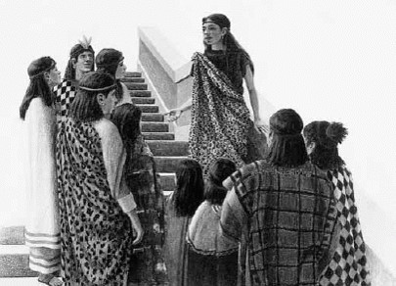
Abish Testifies
“Thus, having been converted to the Lord, and never having made it known, therefore, when she saw that all the servants of Lamoni had fallen to the earth, and also her mistress, the queen, and the king, and Ammon lay prostrate upon the earth, she knew that it was the power of God; and supposing that this opportunity, by making known unto the people what had happened among them, that by beholding this scene it would cause them to believe in the power of God, therefore she ran forth from house to house, making it known unto the people.”
Alma 19:17

Slide 8
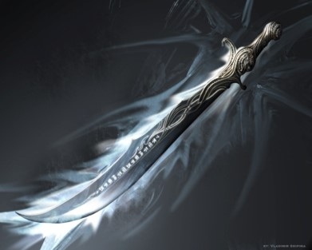
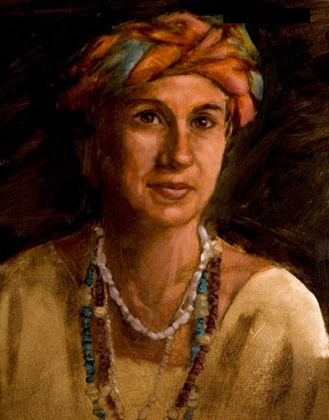
The Gathering
After Abish testifies of God and the people gather and saw Ammon, the king, the queen, and the servants unconscious, a great contention arose among them.
One man tried to kill Ammon but fell dead in the attempt.
Some claimed that Ammon was the Great Spirit, and others said he was a monster.
When Abish saw all the contention that had resulted from her bringing the people together, she was very sad.
Jame H. Fullmer
Alma 19:18-24

Slide 9
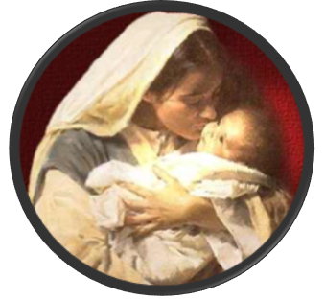
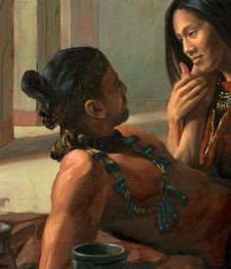
Awaken
King Lamoni awakes testifying he has seen the Redeemer and announces His birth and mortal mother
Jordan Weistling
The Power of King Lamoni’s testimony has an effect on his wife, the Queen
Together they had fallen into the revelations of heaven
Alma 19:13, 30

Slide 10
By Sharing Our Testimony:
King Lamoni
Queen
Abish
Many Other Lamanites
servants
Like ripples that expand from the splash of a rock, other people can be influenced by our actions.

Slide 11
By sharing our testimonies and setting righteous examples, we can help others turn to the Lord.
Ask yourself:
When has someone’s example or testimony influenced me for good?
What can I do today that might have a good influence on people around me?

Slide 12
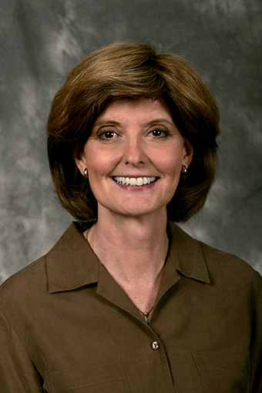
Miracles…Like Seeing Angels
Those born of God do not require miracles for conversion but respond to teachings of the Spirit.
Camille Fronk
Alma 19:34-36

Slide 13
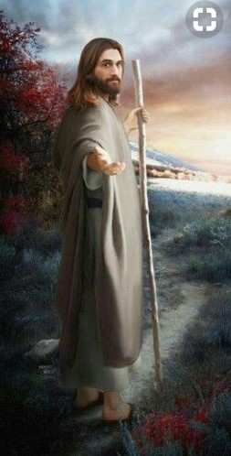
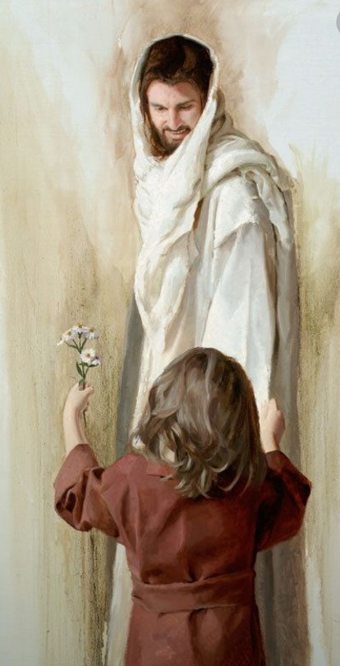
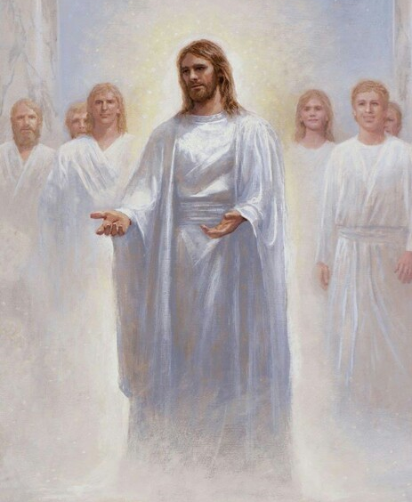
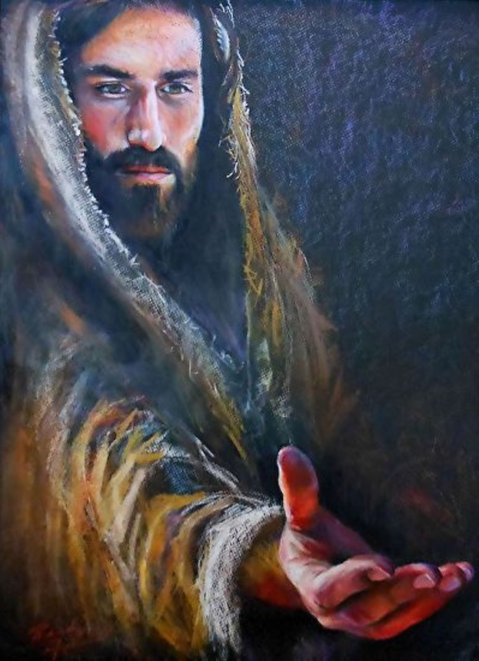
The Lord’s arm is extended to all people who will repent and believe on his name
Jared Barnes

Slide 14
The Voice of the Lord
King Lamoni wanted to take Ammon to the festival in the Land of Nephi and introduce him to his father
The Lord warned Ammon of not going to the Land of Nephi because the King would slay him
The Lord also wanted Ammon to go rescue his brethren, Aaron, Muloki, and Ammah in the land of Middoni where they were imprisoned
Alma 20:1-7

Slide 15
By Revelation
Sometimes the Lord reveals things which will impact our lives
Sometimes He does not give instructions on how to accomplish what He sends us to do
Sometimes we need to rely on the Spirit to get us from “A to B”
B
“I was led by the spirit, not knowing beforehand the things which I should do.”
1 Nephi 4:6
A
Alma 20:1-7

Slide 16
Father of King Lamoni
He was the king over all the land
He tried to have his son kill Ammon
He tried to take the life of son
He was touched by Ammon’s great love for his son
He was later converted by the teachings of Aaron

Slide 17
The Meeting
King Lamoni rehearses his conversion story and where they were going
Why did you not come to the feast?
Why are you with this Nephite who is a liar?
Alma 20:8-12

Slide 18
The Anger—The Steadfast
The Nephites are sons of liars
They have robbed our fathers out of our lands
I will not kill Ammon or return home
I will go with Ammon to Middoni and help release his brethren
I want you to kill this Nephite
And go back to the land of Ishmael
For they are just men and holy prophets of the true God
Alma 20:8-15

Slide 19
The Assalt
Then I will kill you
You will not kill your son. He has repented of his sins
You will become a murderer
The king went to kill Ammon but could not.
Ammon smote his arm that he could not use it
Alma 20:16-20

Slide 20
The Bargain
Please spare my life!
I will spare your life if you release my brethren out of prison
You may have whatever you want, even half my kingdom
And let your son return home to his kingdom and let him live the way he desires
Alma 20:21-24

Slide 21
The Influence
I see you have a great love for my son
Your brethren will be released and my son will retain his kingdom
I will not govern his life anymore
I desire to meet your brethren and I desire to learn more from them
Alma 20:25-27

Slide 22
We can stand up for what we know is right, even when others try to persuade us to do what is wrong

Slide 23
As we show love and teach truth, we can help others soften their hearts and become receptive to the gospel

Slide 24
Ammon Finds His Brethren
King Lamoni journey to the land of Middoni and found favor in the eyes of the king.
Aaron, Muloki, and Ammah were released from prison
Ammon was sorrowful because of the prison conditions in which they were in and that they suffered many afflictions
And the rest of the story continues…
Alma 20:28-30

Slide 25
Sources:
Videos:
“Anger Is an Indication of Weakness” (0:30)
“Inviting All to Come unto Christ: Sharing the Gospel”
Who’s Who of the Book of Mormon Ed J. Pinegar and Richard J. Allen pg. 5-6, 105, 157-158
Joseph Fielding McConkie and Robert L. Millet Doctrinal Commentary on the Book of Mormon Vol. 3 pg. 141-142
Camille Fronk, "Show Forth Good Examples in Me," in Studies in Scripture: Book of Mormon, Part 1, pp. 321-332
Presentation by ©http://fashionsbylynda.com/blog/

Slide 26
1. Alma 20:8–14 | How did Lamoni’s father react to seeing Lamoni with Ammon?
2. Alma 20:15–16 | How did Lamoni respond to his father?
3. Alma 20:17–25 | When Lamoni’s father saw that Ammon could kill him, what did he offer Ammon? What did Ammon ask instead?
4. Alma 20:26–27 | How did Ammon’s love for Lamoni influence Lamoni’s father? In what ways did the words of Ammon and Lamoni influence Lamoni’s father?
1. Alma 20:8–14 | How did Lamoni’s father react to seeing Lamoni with Ammon?
2. Alma 20:15–16 | How did Lamoni respond to his father?
3. Alma 20:17–25 | When Lamoni’s father saw that Ammon could kill him, what did he offer Ammon? What did Ammon ask instead?
4. Alma 20:26–27 | How did Ammon’s love for Lamoni influence Lamoni’s father? In what ways did the words of Ammon and Lamoni influence Lamoni’s father?
1. Alma 20:8–14 | How did Lamoni’s father react to seeing Lamoni with Ammon?
2. Alma 20:15–16 | How did Lamoni respond to his father?
3. Alma 20:17–25 | When Lamoni’s father saw that Ammon could kill him, what did he offer Ammon? What did Ammon ask instead?
4. Alma 20:26–27 | How did Ammon’s love for Lamoni influence Lamoni’s father? In what ways did the words of Ammon and Lamoni influence Lamoni’s father?
1. Alma 20:8–14 | How did Lamoni’s father react to seeing Lamoni with Ammon?
2. Alma 20:15–16 | How did Lamoni respond to his father?
3. Alma 20:17–25 | When Lamoni’s father saw that Ammon could kill him, what did he offer Ammon? What did Ammon ask instead?
4. Alma 20:26–27 | How did Ammon’s love for Lamoni influence Lamoni’s father? In what ways did the words of Ammon and Lamoni influence Lamoni’s father?

