Slide 2
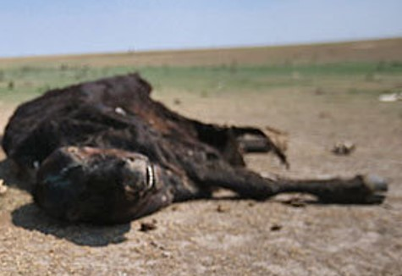
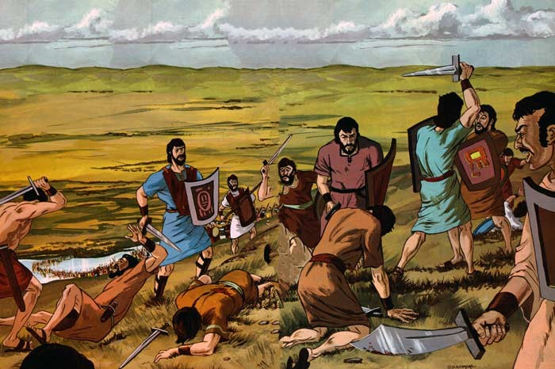
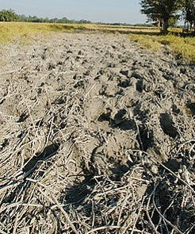
Trodden Down by the Hosts of Men
Many women and children had been slain, their flocks and their herds, and the fields of grain were destroyed
Alma 3:2

Slide 3
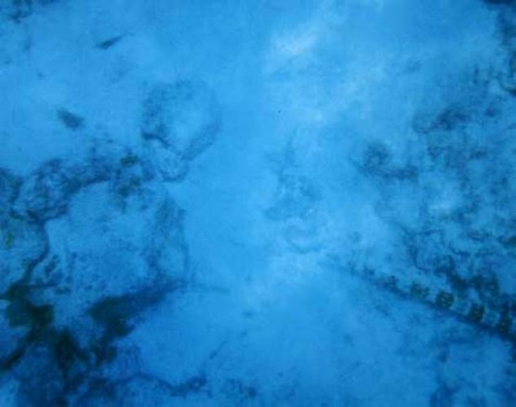
The Waters of Sidon
Many Lamanites and Amlicites who were slain were cast into the River
Alma 3:3

Slide 4
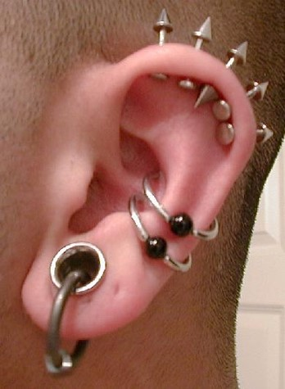
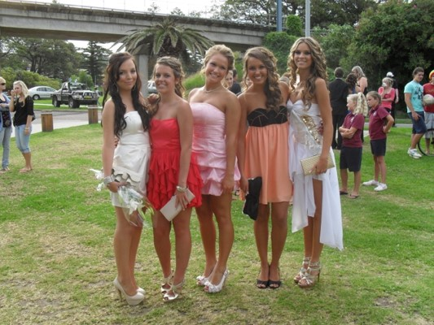
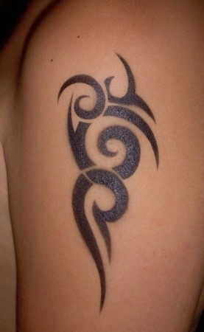
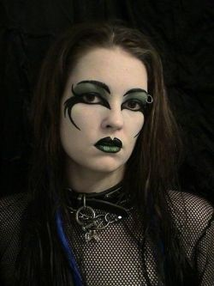
Messages
What Messages might one send, either intentionally or unintentionally

Slide 5
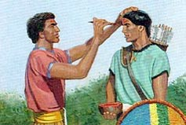
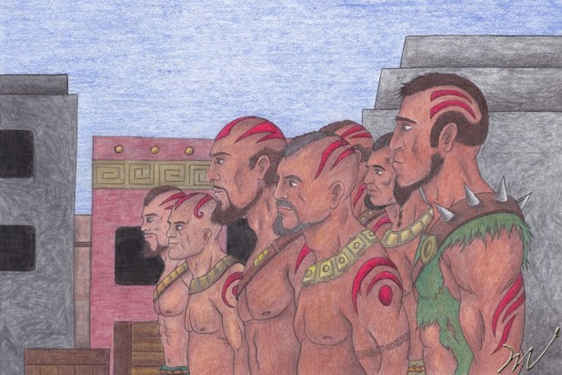
Change of Appearance
The Amliciites had marked themselves with red in their foreheads after the manner of the Lamanites
Alma 3:4

Slide 6
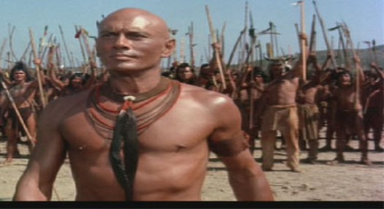
The Appearance of the Lamanites
“Now the heads of the Lamanites were shorn; and they were naked, save it were skin which was girded about their loins, and also their armor, which was girded about them, and their bows, and their arrows, and their stones, and their slings, and so forth.
And the skins of the Lamanites were dark, according to the mark which was set upon their fathers, which was a curse upon them because of their transgression and their rebellion against their brethren, who consisted of Nephi, Jacob, and Joseph, and Sam, who were just and holy men.”
Alma 3:5-6

Slide 7
The Curse—their own doing
Those who mingled with the seed of the Lamanites brought that same curse upon themselves
God set the mark of the dark skin upon the Lamanites
While the people of Amlici marked themselves with red
Those who come out in open rebellion against God bring negative consequences upon themselves
Alma 3:5-6

Slide 8
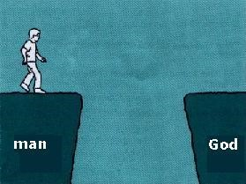
Curses-- Opposite of Blessings
“Now I would that ye should see that they brought upon themselves the curse; and even so doth every man that is cursed bring upon himself his own condemnation.”
If we are separated from God, it is because we have separated ourselves from Him
Alma 3:19

Slide 9
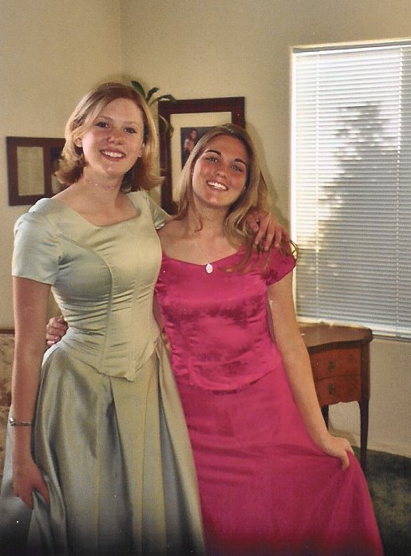
Our Own Appearance
What are some ways we can show through our dress and appearance that we are disciples of Jesus Christ?
Alma 3:19

Slide 10
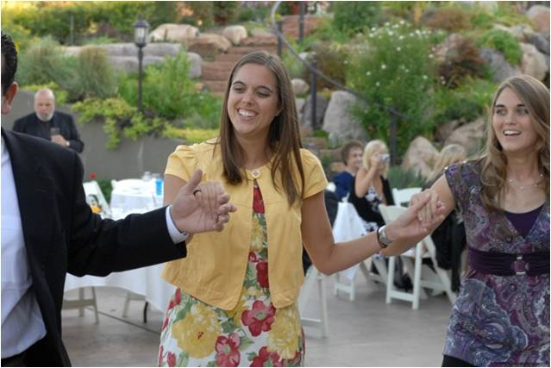
For the Strength Youth
Your body is sacred. Respect it and do not defile it in any way. Through your dress and appearance, you can show that you know how precious your body is. You can show that you are a disciple of Jesus Christ and that you love Him.
Prophets of God have continually counseled His children to dress modestly. When you are well groomed and modestly dressed, you invite the companionship of the Spirit and you can be a good influence on others. Your dress and grooming influence the way you and others act.
Never lower your standards of dress. Do not use a special occasion as an excuse to be immodest. When you dress immodestly, you send a message that is contrary to your identity as a son or daughter of God. You also send the message that you are using your body to get attention and approval.
Page 6-8

Slide 11
Choosing Sides
“And in one year were thousands and tens of thousands of souls sent to the eternal world, that they might reap their rewards according to their works, whether they were good or whether they were bad, to reap eternal happiness or eternal misery, according to the spirit which they listed to obey, whether it be a good spirit or a bad one.
For every man receiveth wages of him whom he listeth to obey, and this according to the words of the spirit of prophecy; therefore let it be according to the truth…”
We receive happiness or misery depending on whom we choose to obey
Alma 3:26-27

Slide 12
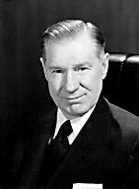
We as individual members of the Church also have identity of our own. Each of us stands for something, either strong or not strong; either good or not so good.
In Revelation there is a strong warning to the fence sitters:
“I know thy works, that thou art neither cold nor hot: I would thou wert cold or hot.
“So then because thou art lukewarm, and neither cold nor hot, I will spue thee out of my mouth.” (Rev. 3:15, 16)
From that and many other experiences, I learned that even though others do not share your beliefs, in fact may be hostile to them, they will respect you if you are willing to stand up and be counted.
Almost. What a heartbreaking sound is the word “almost”! Almost some of our good members keep the Word of Wisdom, or just about go to priesthood meeting and sacrament meeting, or almost hold family home evening. Some of us almost but not quite—pay our tithing.
Elder James E. Faust

Slide 13
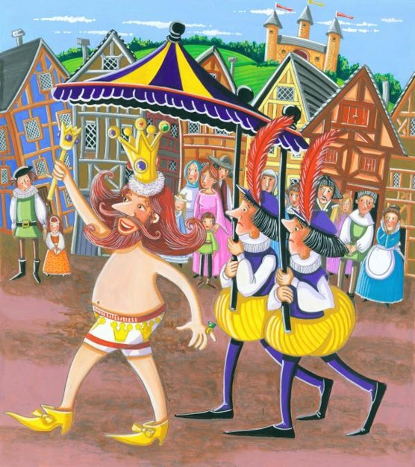
Inward Appearances
We cannot hide what we are, try as we will. It shines from within us. We are transparent. When we attempt to deceive, we deceive only ourselves. We are like the emperor in the fairy tale who was deceived into thinking he was arrayed in beautiful garments, but he was in fact unclothed.
Those who stand firm, steadfast, and immovable are given great inner hidden powers and unseen strengths. They will be endowed with full and potent spiritual resources.
Elder James E. Faust

Slide 14
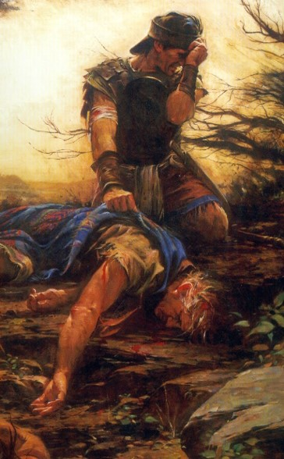
6th Year of the Reign of the Judges
‘Afflicted and caused to morn’
It is normal and natural when things go wrong to begin to search for causes, to begin to look careful at one’s attitudes and behaviors to ascertain whether one has offended God. If a person is sincere in his searching, if he asks God to reveal his weakness, if he is indeed open enough to ask, “What lack I yet?” the Lord can awaken him to a remembrance of his duty.
The Spirit of Jesus Christ can bring a remembrance of commitments and covenants.
JFM and RLM
Alma 4:1-3

Slide 15
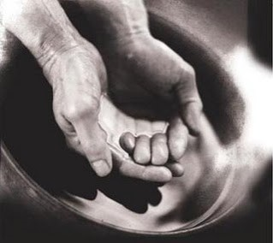
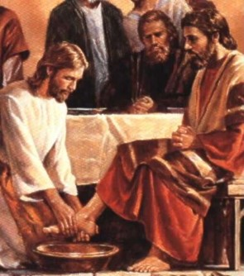
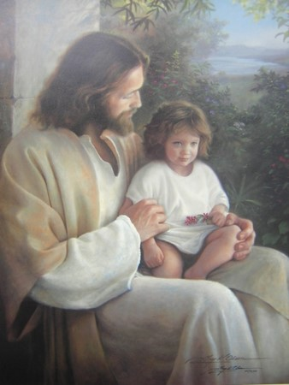
Humble--Teachable
To be teachable and to recognize with gratitude our dependence on the Lord—to understand that we have constant need for His support
God will have a humble people. Either we can choose to be humble or we can be compelled to be humble. Alma said, “Blessed are they who humble themselves without being compelled to be humble.” (Alma 32:16.)
We must yield “to the enticings of the Holy Spirit,” put off the prideful “natural man,” become “a saint through the atonement of Christ the Lord,” and become “as a child, submissive, meek, humble.”
(Mosiah 3:19; see also Alma 13:28.)
Alma 4:1-5

Slide 16
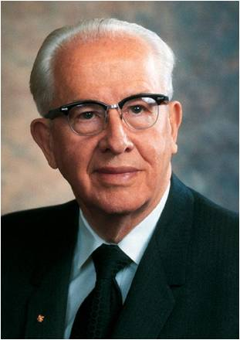
We can choose to humble ourselves by conquering enmity toward our brothers and sisters, esteeming them as ourselves, and lifting them as high or higher than we are.
We can choose to humble ourselves by receiving counsel and chastisement.
We can choose to humble ourselves by forgiving those who have offended us.
We can choose to humble ourselves by rendering selfless service.
We can choose to humble ourselves by going on missions and preaching the word that can humble others.
We can choose to humble ourselves by getting to the temple more frequently.
We can choose to humble ourselves by confessing and forsaking our
sins and being born of God.
We can choose to humble ourselves by loving God, submitting our
will to His, and putting Him first in our lives.
Ezra T. Benson

Slide 17
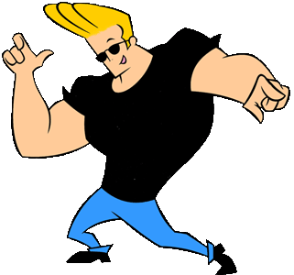
8th Year of the Reign of the Judges
Pride
People who are proud place themselves in opposition to each other and to God. They place themselves above those around them and follow their own desires rather than God’s will.
“Some prideful people are not so concerned as to whether their wages meet their needs as they are that their wages are more than someone else’s. Their reward is being a cut above the rest. This is the enmity of pride.
When pride has a hold on our hearts, we lose our independence of the world and deliver our freedoms to the bondage of men’s judgment. The world shouts louder than the whisperings of the Holy Ghost. The reasoning of men overrides the revelations of God, and the proud let go of the iron rod. ”
Ezra T. Benson
Alma 4:6

Slide 18
Pride is a sin that can readily be seen in others but is rarely admitted in ourselves.
“Pride is:
Faultfinding, gossiping, backbiting, murmuring, living beyond our means, envying, coveting, withholding gratitude and praise that might lift another, and being unforgiving and jealous.
Disobedience is essentially a prideful power struggle against someone in authority over us. It can be a parent, a priesthood leader, a teacher, or ultimately God.
A proud person hates the fact that someone is above him. He thinks this lowers his position.
Selfishness is one of the more common faces of pride. “How everything affects me” is the center of all that matters—self-conceit, self-pity, worldly self-fulfillment, self-gratification, and self-seeking.
Contentions and arguments, fights, unrighteous dominion, generation gaps, divorces, spouse abuse, riots, and disturbances all fall into this category of pride.
The proud do not receive counsel or correction easily. Defensiveness is
used by them to justify and rationalize their frailties and failures.
Depending upon the world to tell them whether they have value or not.”
Ezra T. Benson

Slide 19
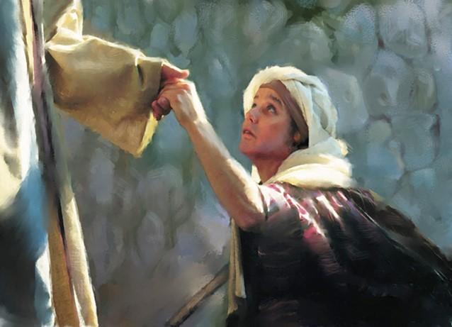
An Example
If we set an unrighteous example, our actions can hinder others from accepting the gospel
Our best example is the way Jesus Christ led His life.
Alma 4:10-12

Slide 20
Calling People to Repent
Alma Resigns as Chief Judge
He remains High Priest
He commits himself to preaching the word of God
He appoints Nephihah over the judgment seat
Alma 4:15-20

Slide 21
Nephihah
He is the 2nd chief judge in Zarahemla around 83 BC
He was a wise man who was among the elders of the Church
Alma gave him power by the authority of the voice of the people
He served in his public leadership until his death around 67 BC
He was involved in the invasion of the Lamanite, and in the Lamanite conversion
During his tenure the people increase in their commercial ventures and prosperity
He declined Alma’s offer to manage the sacred records so the records were conferred upon Alma’s son Helaman
Pahoran, son of Nephihah, succeeded his father as chief judge and governor of the land
Who’s Who

Slide 22
Bear Down in Pure Testimony
“Alma was determined to bear down in pure testimony against the people. His expressions were not motivated by anger or spite, nor directed against the people in the spirit of condemnation. Rather, his heart—motivated by the pure love of Christ—was bent upon saving their souls. He loved them and simply could not stand by and allow them to destroy themselves.”
JFM and RLM
Would you change your position or your circumstances for the betterment of someone else's salvation?
Alma 4:20

Slide 23
Sources:
Video:
A Man Without Eloquence (6:06)
Elder James E. Faust Stand Up and Be Counted 1982 Feb. Ensign
Joseph Fielding McConkie and Robert L. Millet Doctrinal Commentary on the Book of Mormon Vol. 3 pg. 18-19
Ezra Taft Benson Beware of Pride April 1989 Conf. Report (Read whole Article)
Who’s Who in the Book of Mormon Ed. J. Pinegar and Richard J. Allen pg 145
Presentation by ©http://fashionsbylynda.com/blog/

