Slide 2
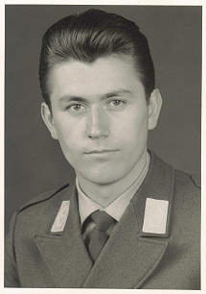
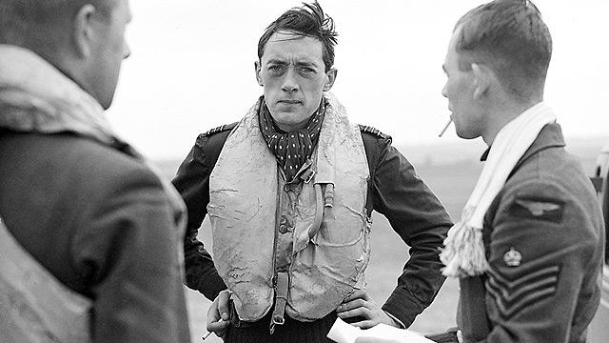
“I remember when I was preparing to be trained as a fighter pilot. We spent a great deal of our preliminary military training in physical exercise. I’m still not exactly sure why endless running was considered such an essential preparatory part of becoming a pilot. Nevertheless, we ran and we ran and we ran some more.
“As I was running I began to notice something that, frankly, troubled me. Time and again I was being passed by men who smoked, drank, and did all manner of things that were contrary to the gospel and, in particular, to the Word of Wisdom.
“I remember thinking, ‘Wait a minute! Aren’t I supposed to be able to run and not be weary?’ But I was weary, and I was overtaken by people who were definitely not following the Word of Wisdom. I confess, it troubled me at the time. I asked myself, was the promise true or was it not?”

Slide 3
Jarom
He was the great grandson of Sariah and Lehi
He was the grandson of Jacob and son of Enos
He was a record keeper of the small plates of Nephi around 420 to 361 BC
He had the shortest book in the Book of Mormon
He declines his own personal words of inspiration
(Jarom 1:2)
He described the ‘hardness of hearts’ of the people
He had the spirit of prophecy and revelation
He counsels Omni, his son, to read large plates for further history of the people

Slide 4
Book of Jarom
Written in commandment from his father.
Written for the benefit of his brethren the Lamanites.
Jarom did not record his own prophecies and revelations because he felt that his father’s revelations were sufficient.
He described labors of the Nephite leaders during the time of his ministry.
Jarom observed that when the people chose to follow the counsel of their righteous leaders, they prospered and were able to fortify themselves against the Lamanites.
The Book of Jarom
Jarom’s Testimony:
“The word of the Lord was verified, which he spake unto our fathers, saying that: Inasmuch as ye will keep my commandments ye shall prosper in the land” (Jarom 1:9)

Slide 5
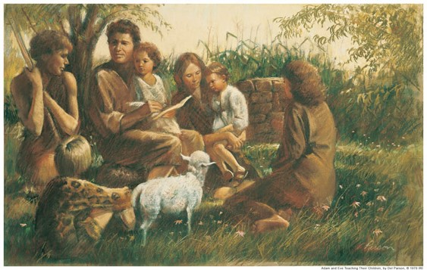
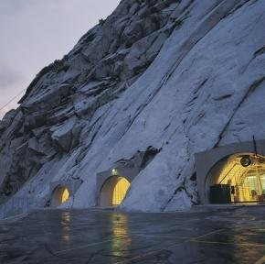
Records
Adam—kept a record of faithful descendants =
A Book of Remembrance
The Nephites who kept the record even at this early period understood that it would be for the benefit of the Lamanites
The Church keeps similar records today D&C 85
The Church urges us to keep our own personal family records
Jarom 1:2 Book of Mormon Student Manual and JFM and RLM

Slide 6
Apostasy
Apostasy was rampant among the Nephites
Hardness of Hearts
Deafness of Ears
Blindness of Mind
Stiffness of Necks
However:
God is merciful and hasn’t swept them off the face of the earth yet
Jarom 1:3 Book of Mormon Student Manual and JFM and RLM

Slide 7
Believers
200 years had past
There was a strong group of believers who communed with the Holy Spirit and kept the commandments.
The faithful will not be without revelation
Without the Spirit we can neither preach or teach the gospel.
Without revelation there can be no religion
Jarom 1:4-5 Book of Mormon Student Manual and JFM and RLM

Slide 8
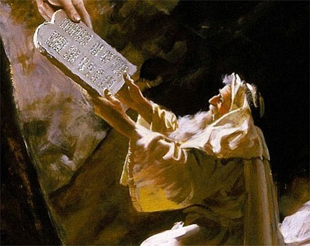
Law of Moses Kept
The Nephite laws were exceedingly strict
Our obligation to keep the Sabbath holy is a part of the fulness of the gospel (D&C 59:9-14)
“Some have falsely supposed that Sabbath observance commenced with the law of Moses. This is not the case. The commandment given on Sinai was to “remember the sabbath day” –beginning on the 7th day. (Genesis 2:2-3)
To profane is to pollute…to violate…to desecrate that which is sacred
Jarom 1:5 Book of Mormon Student Manual and JFM and RLM

Slide 9
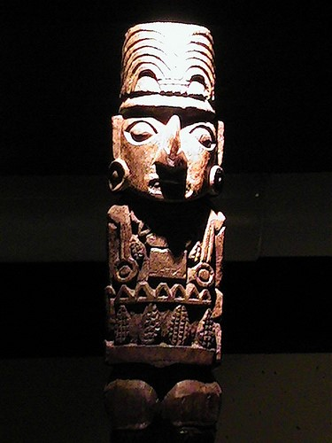
Idolatry
Drink the Blood of their beasts--The Lamanites were worshiping physical idols and images of their own making
The Lamanites were more numerous than the Nephites and had degenerated into a primitive state of existence.
“To create one’s own god is to have control over the demands, and appetites of that god. It is said that religion is the system in which man serves a higher will, while magic is a system whereby man attempts to control higher powers. Such is the distinction that exists between true religion and idolatry.”
Jarom 1:6 Book of Mormon Student Manual and JFM and RLM

Slide 10
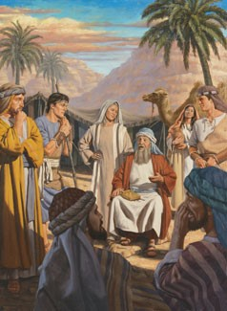
Great Leaders
“…it was not mighty warriors, men mighty in strength, but men mighty in the faith of the Lord that consistently led the Nephites to victory over their enemies, the Lamanites.”
The Nephites were led by men of great righteousness and thus prevailed in battle
Faith in God is a weapon more to be feared than the sharpness of a sword or the muscle and sinew that wields it (3 Nephi 3:19)
Jarom 1:7, 10-12 Book of Mormon Student Manual and JFM and RLM

Slide 11
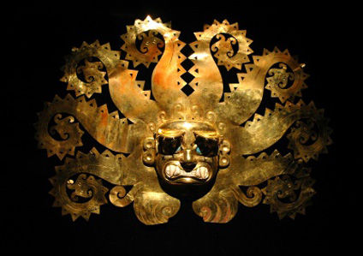
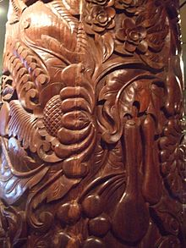
Exceedingly Rich
The Nephites expanded far beyond a simple agricultural form of society
Rich in gold and silver
Precious things
Fine workmanship of wood
Building and machinery
Tools (iron, copper, brass and steel) for the ground and for war
Those who are a righteous people will prosper in the land…
“And inasmuch as ye shall keep my commandments, ye shall prosper, and shall be led to a land of promise; yea, even a land which I have prepared for you; yea, a land which is choice above all other lands.” 1 Nephi 2:20
Jarom 1: 8 Book of Mormon Student Manual and JFM and RLM

Slide 12
The Word of God
Only constant preaching kept the Nephites from being destroyed by the Lamanites.
Jarom says that their prophets “did prick their hearts with the word”
Prick:
The word of God is “quick and powerful, sharper than a two-edged sword, to the dividing asunder of both joints and marrow” (D&C 6:2)
It was this principle that later motivated Alma to resign the position of chief judge in order to preach the gospel
(Alma 4:19; 31:5)
Jarom 1:12 Book of Mormon Student Manual and JFM and RLM

Slide 13
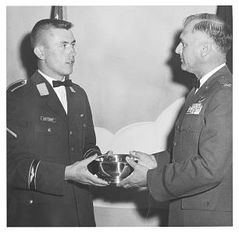
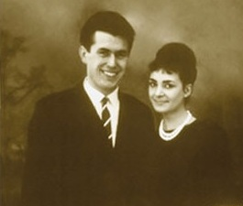
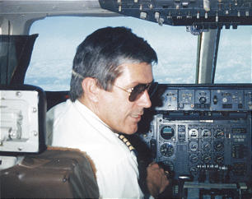
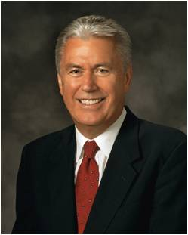
Dieter F. Uchtdorf Story Continues….
“The answer didn’t come immediately. But eventually I learned that God’s promises are not always fulfilled as quickly as or in the way we might hope; they come according to His timing and in His ways.
Years later I could see clear evidence of the temporal blessings that come to those who obey the Word of Wisdom—in addition to the spiritual blessings that come immediately from obedience to any of God’s laws.
Looking back, I know for sure that the promises of the Lord, if perhaps not always swift, are always certain.”
Dieter F. Uchtdorf—actual pictures

Slide 14
Omni
He was the grandson of Enos and son of Jarom
His record was recoreded around 361 BC
He preserved the genealogy and records for 44 years during turmoil and warfare
He had not ‘kept statutes and commandments’ as he should have
He was a defender of his people

Slide 15
Records Handed Down
Son of Omni
Brother of Amaron
The Small Plates of Nephi
The Small Plates of Nephi
Amaron
Son of Chemish
Chemish
Son of Abinadom
Abinadom
Approximately between 500 – 130 BC
Amaleki

Slide 16
Book of Omni
The book of Omni was written by five different men:
Omni, Amaron, Chemish, Abinadom, and Amaleki.
Each added small entries and the last entry of the small plates
Omni spans a longer period of time than any other book in the small plates.
Abinadom’s son Amaleki wrote most of the book of Omni and was the last person to write on the small plates of Nephi. He entrusted the plates to King Benjamin.
Omni wrote for the benefit of his descendants. The next three writers in the book of Omni do not address a particular audience or state a purpose for their writing. But Amaleki’s invitation for all people to “come unto Christ … and partake of his salvation” (Omni 1:26) indicates that he was concerned about the salvation of those who would read his words.
The Book of Omni

Slide 17
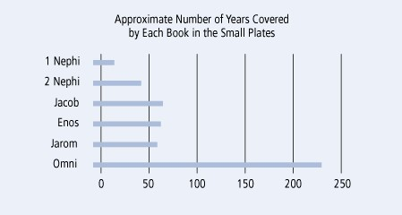
The Small Plates of Nephi

Slide 18
Other Facts on the Book of Omni
Omni is the first book in the Book of Mormon to mention the Jaredites. It also mentions that some Nephites left Zarahemla to return to the land of Nephi, foreshadowing the events recounted in Mosiah 7–24.
The Book of Omni also provides details about the reign of the first King Mosiah, who was the father of King Benjamin and grandfather of the second King Mosiah.
The first King Mosiah led the righteous Nephites out of the land of Nephi and united them with the people of Zarahemla.
The Book of Omni relates that the Lord guided the people of Zarahemla (also known as the Mulekites) from Jerusalem to the land of promise not long after Lehi and his family departed from Jerusalem.
The Book of Omni
Finally, the Book of Omni introduces King Benjamin and explains why Amaleki entrusted him with the sacred records.
Omni 1:12–23, 25; Mosiah 7-24

Slide 19
Omni Writes
Omni writes only the first 3 verses:
He refers to himself as “a wicked man” because he had not kept the statues and commandments of the Lord
“It need not be supposed from such an admission that he was guilty of any gross immorality, but rather that he was not zealous in honoring the law of Moses and in keeping other religious obligation.”
Not living by the Spirit will cause you to not be prepared to teach or write after the manner of the Spirit…therefore he found it necessary to pass the plates to his son, Amaron
Omni 1:1-3 JFM and RLM

Slide 20
Amaron and Chemish Write
Amaron writes of the destruction of the more wicked part of the Nephites.
Amaron understood that:
Those who acknowledge the hand of the Lord in all things find evidence of his word in all things.
Chemish was the Brother of Amaron.
Chemish watched as Amaron wrote on the same day that Amaron turned the plates to Chemish.
Chemish also keeps the record according to the commandments of our fathers
Omni 1:4-9 JFM and RLM

Slide 21
Abinadom Writes
Abinadom announced that the other authors were sufficient and passed the plates to his son Amaleki
Abinadom was saying that there had been no revelation given at this time period.
Would you hand down information or records that you haven’t written about?
The tradition to hand down records was still in effect with Abinadom even though nothing was added Spirituality to it.
Omni 1:10-11 JFM and RLM

Slide 22
Amaleki Writes
Mosiah’s discovery of the Mulekites, a people who had fled Jerusalem in the days of King Zedekiah
Mosiah’s kingship over the Land of Zarahemla
Amaleki introduces a new epoch in the history of the Nephiet peoples.
Taking refuge in the wilderness—a clear separation from the powers, authorities, and influences of worldly societies
Symbolic—among the children of God might find it necessary to leave the refinements of the world and find refuge in the simplicity of that which God created
How can you take yourself “away from it all”?
Omni 1:12-24 JFM and RLM

Slide 23
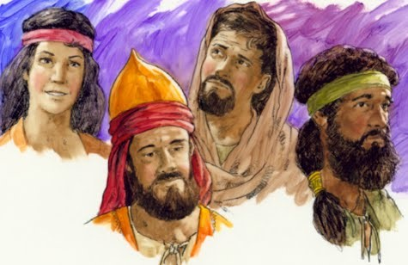
Zarahemla
Zarahemla was a descendant of Mulek, son of Zedekiah
Mosiah 25:2
They brought no records with them
They were taught in the language of Mosiah and Zarahemla gave him his genealogy of his fathers and are written on the large plates
The people of Zarahemla and the people of Mosiah joined together and Mosiah was appointed King.
Omni 1:14-19 JFM and RLM

Slide 24
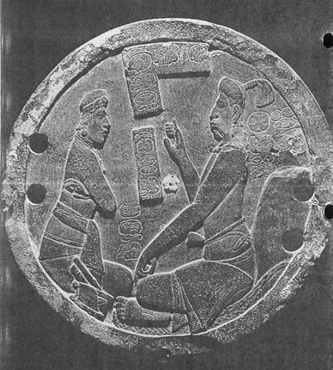
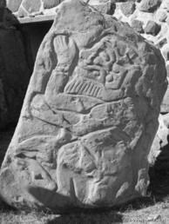
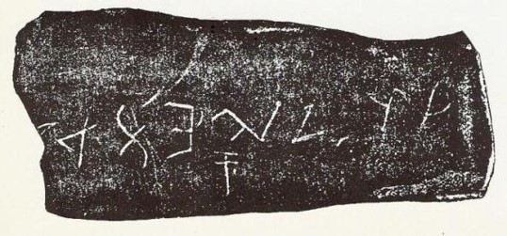
The Stone
“And it came to pass in the days of Mosiah, there was a large stone brought unto him with engravings on it; and he did interpret the engravings by the gift and power of God.”
Mosiah by the power of the Holy Spirit was able to read this stone.
Omni 1:20 JFM and RLM

Slide 25
Coriantumr
Land of Desolation
The people of Zarahemla encountered Coriantumr, who was one of the last two survivors of the Jaredite nation (the other was the prophet Ether).
Land of Desolation= “bones lay scattered”—Jaradite People—they were destroyed
There were two groups from Zarahemla who attempted to return to the land of Nephi.
The first group failed and went back to Zarahemla.
As Amaleki closed his record, he mentioned that he did not know the fate of the second group.
Land of Zarahemla
West Sea
Land of Nephi
Land of First Inheritance
Omni 1:20-22, 29-30

Slide 26
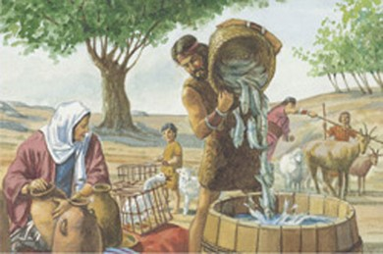
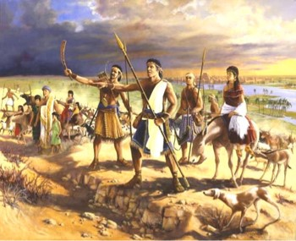
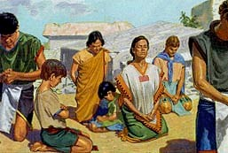
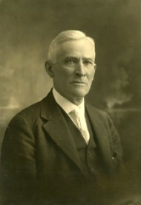
Peoples in Americas
After King Mosiah and his followers fled the land of Nephi, they discovered a group of people who were called the people of Zarahemla (also called the Mulekites).
Besides the Mulekites, Lehi’s group, and the Jaredites, there were likely other groups of people who came to the American continent.
“We must be careful in the conclusions that we reach. The Book of Mormon teaches the history of three distinct peoples … who came from the old world to this continent. It does not tell us that there was no one here before them. It does not tell us that people did not come after. And so if discoveries are made which suggest differences in race origins, it can
very easily be accounted for, and reasonably, for we do believe that other people came to this continent.”
Anthony W. Ivins
Omni 1:14-19

Slide 27
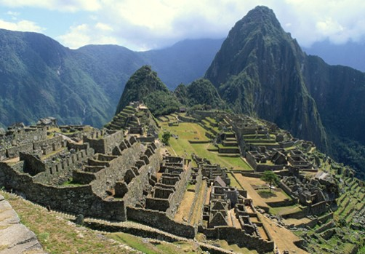
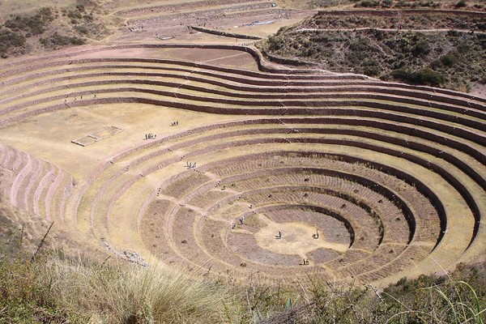
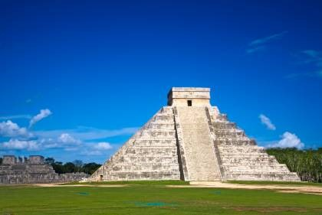
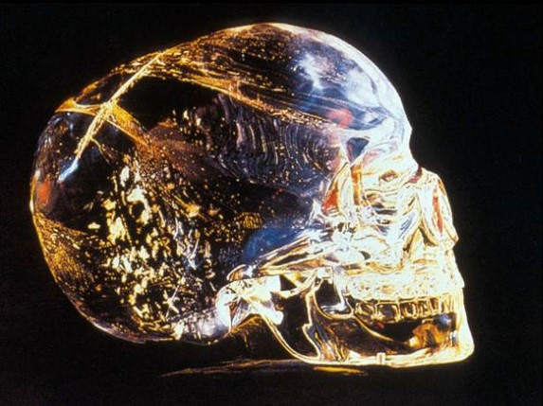
The Book of Mormon does not claim to be the record of all peoples who inhabited the ancient Americas. Besides the Jaredites, Mulekites, and Lehi’s group, there were likely other groups of people who came to the American continent.
Omni 1:14-19

Slide 28
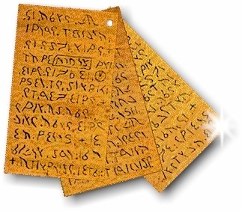
An Invitation
Amaleki concluded his record, he wrote an important invitation to those who would read his words.
Believe in the prophesying…
revelation…
ministering of angels…
gift of speaking with tongues…
gift of interpreting languages….
believing all things which are good…
All Good comes from the Lord
“And now, my beloved brethren, I would that ye should come unto Christ, who is the Holy One of Israel, and partake of his salvation, and the power of his redemption. Yea, come unto him, and offer your whole souls as an offering unto him, and continue in fasting and praying, and endure to the end; and as the Lord liveth ye will be saved.”
Omni 1:25-26

Slide 29
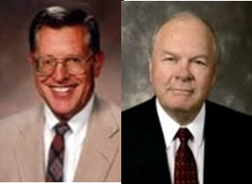
Come Unto Him
If we come unto Christ and offer our whole souls unto Him, we will be saved.
Partake of His Salvation
The Power of Redemption
“When we covenant to live the law of sacrifice we are announcing that our sacrifice will in like manner be one of complete submission and total dedication.”
JFM and RLM

Slide 30
Sources:
Video:
Omni Through Alma and Brief Overview
Whole Soul Unto God
Book of Mormon Student Manual Religion 121-122 pg. 147
Joseph Fielding McConkie and Robert L. Millet Doctrinal Commentary on the Book of Mormon Vol. 2 pg. 106-110
Dieter F. Uchtdorf (“Continue in Patience,” Ensign or Liahona, May 2010, 58
Anthony W. Ivins (in Conference Report, Apr. 1929, 15).
Presentation by ©http://fashionsbylynda.com/blog/

