Slide 2
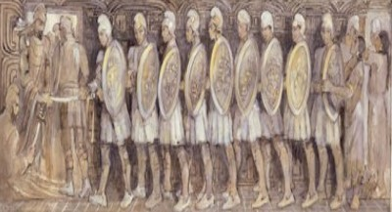
Helaman’s Epistle to Moroni
The 30th Year of the Reign of the Judges—Moroni received the epistle
Verse 1, about 62 B.C.
Verses 2–19, about 66 B.C.
Verses 20–57, about 65–64 B.C.
The state of the war with the Lamanites
Antipus and Helaman’s victory over the Lamanites in the city of Antiparah
The miraculous power of the 2,000 stripling sons fight in which none of them were slain
Alma 56

Slide 3
Antipus
He served as a general in the Nephite armies when Moroni was commander and Helaman was leading his 2,ooo warriors.
He was the leader in the city of Judea.
The city of Judea’s people were depressed trying to maintain their cities from Ammoron’s grasp.
With the aid of Helaman’s forces, Antipus and his forces were able to deadlock the Lamanites.
During this time additional provisions and reinforcements came to strengthen the Nephite cause.
Antipus ordered Helaman and his army to march forth as if delivering supplies to a neighboring city which lured the Lamanites away from their strongest station.
Antipus beseiged the Lamanites to the rear.
After a three day battle Antipus came upon the Lamanites, the battle ensued and as Helaman’s army retraced their steps and they arrived in time to assist.
Antipus had fallen by the sword in battle leaving his men in disarray, but eventually the Nephites defeated the Lamanites
Who’s Who

Slide 4
Places of War
Land Bountiful
Ammonihah
Land of Jershon
These are the cities that Helaman and Anitpus were trying to fight for—Anitpus was in Judea
These are the cities that the Lamanites had a hold of
Zarahemla
Judea
North
Antiparah
Cumeni
Zeezrom
Manti
Nephi
Alma 56:14-15,33

Slide 5
Helaman’s Army
1.Descendants of Laman, eldest son of Lehi
2.Their father’s covenanted to not take up their weapons of war against their brethren
3.Helaman, as leader marches to aid Antipus
4.Helaman calls them “my two thousand sons”
5.Helaman’s army brought provisions to Antipus
6.Helaman calls his army “my little sons”
7.They were taught by their mothers
8.Not one soul is lost
a. Alma 56:9
b. Alma 56:10,46
c. Alma 56:3
d. Alma 56:30,39
e. Alma 56:6
f. Alma 56:47
g. Alma 56:56
h. Alma 56:28
Alma 56

Slide 6
T
What does it mean to be true to the faith? That word true implies commitment, integrity, endurance, and courage. It reminds us of the Book of Mormon’s description of the 2,000 young warriors:
“And they were all … exceedingly valiant for courage, and also for strength and activity; but behold, this was not all—they were men who were true at all times in whatsoever thing they were entrusted.“Yea, they were men of truth and soberness, for they had been taught to keep the commandments of God and to walk uprightly before him” (Alma 53:20–21).
In the spirit of that description I say to our returned missionaries—men and women who have made covenants to serve the Lord and who have already served Him in the great work of proclaiming the gospel and perfecting the Saints—are you being true to the faith?
Do you have the faith and continuing commitment to demonstrate the principles of the gospel in your own lives, consistently?
You have served well, but do you, like the pioneers, have the courage and the consistency to be true to the faith and to endure to the end?
Dallin H. Oaks
R
U
E

Slide 7
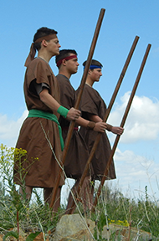
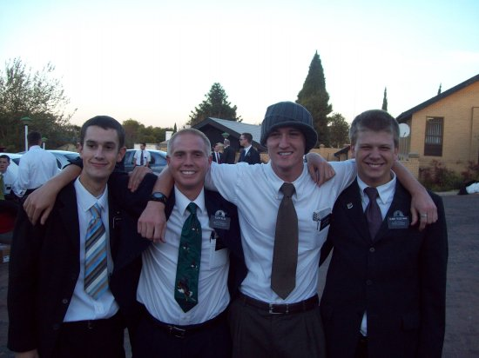
To Be A Stripling Warrior
“In the spiritual battles you are waging, I see you as today’s sons of Helaman”
“Before the final triumphal return of the Lord, the question as to whether we may save our constitutional republic is simply based on two factors—the number of patriots and the extent of their obedience.” ---Teachings of Ezra T. Benson

Slide 8
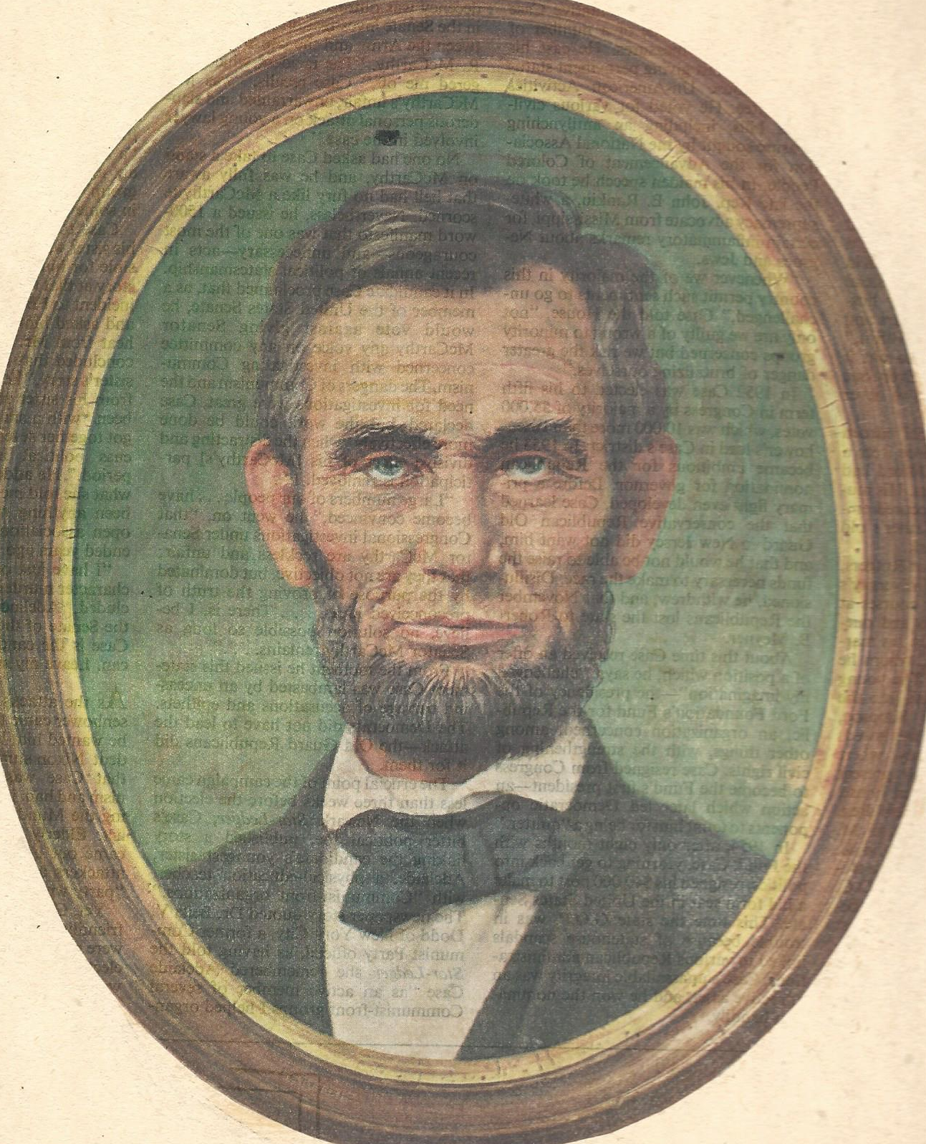
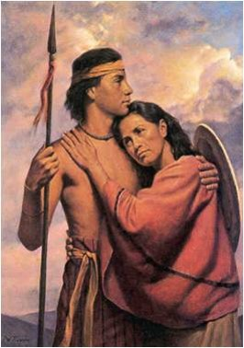
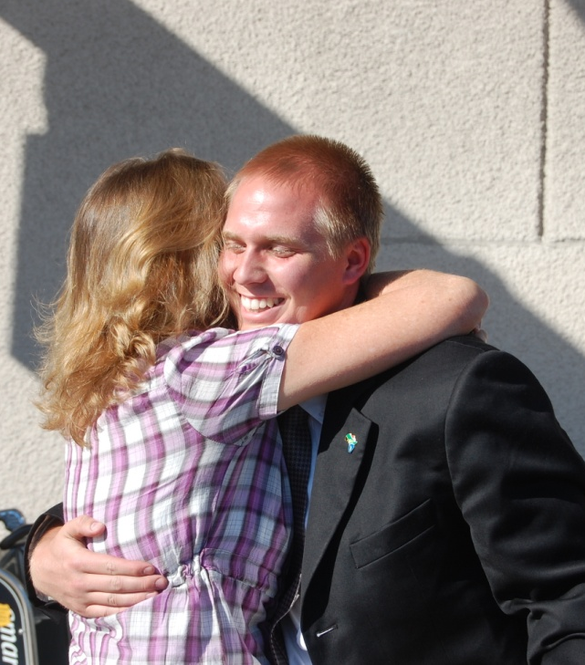
To Be A Mother
“All that I am, or hope to be I owe to my angel mother.” --Abraham Lincoln
“The noblest calling in the world is that of mother. True motherhood is the most beautiful of all the arts, the greatest of all professions. She who can paint a masterpiece or who can write a book that will influence millions deserves the plaudits and admiration of mankind; but she who rears successfully a family of…sons and daughters whose immortal souls will be exerting an influence throughout the ages long after paintings shall have faded, and books and statues shall have been destroyed, deserves the highest honor that man can give.”
David O. McKay
Alma 56:47-48

Slide 9
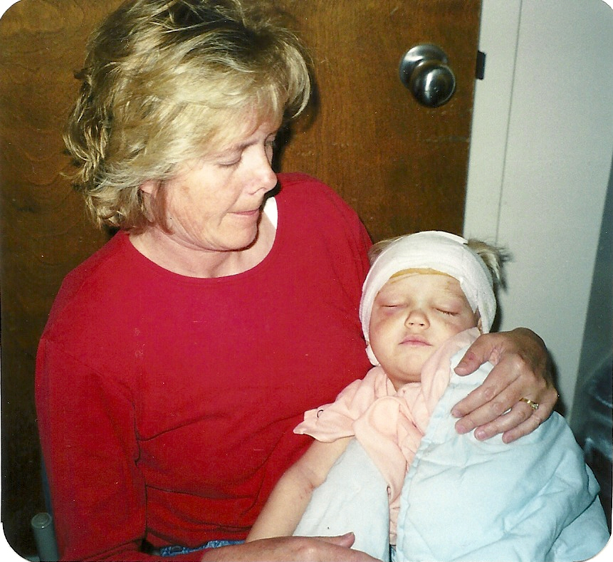
“Your mother is your best friend. Never forget that. She gave you life. She cared for you, nurtured you, nursed you when you were sick, and looked after your every need. Listen to her now. Talk with her candidly and confidentially. You will find that she will keep your confidence and that her wisdom will prove to be wonderful.” Gordon B. Hinckley
Righteous mothers can bless their children by teaching them to trust in God.

Slide 10
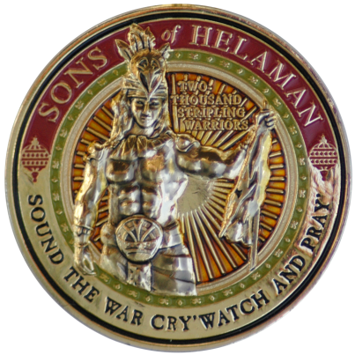
To Act in Faith
"[You are] out there as the sons of Helaman in a world that is full of destructive influences. . . . But if you put your trust in the Almighty and follow the teachings of this Church and cling to it notwithstanding your wounds, you will be preserved and blessed and magnified and made happy." Gordon B. Hinckley
If we act in faith and do not doubt, then we will receive strength from God
"Men and women who turn their lives over to God will discover that He can make a lot more out of their lives than they can. He will deepen their joys, expand their vision, quicken their minds, strengthen their muscles, lift their spirits, multiply their blessings, increase their opportunities, comfort their souls, raise up friends, and pour out peace." Ezra Taft Benson
Alma 56:56

Slide 11
6,000 Men
About 63 BC
29th Year of the Reign of the Judges
The prisoners of the Nephites did ‘raise up in numbers’ causing riots that the Nephites had to slay 2,000 of them.
The prisoners were taken to Zarahemla by Helaman’s young soldiers—with Gid as their leader
Ammonihah
The Nephites desire to battle with the Lamanites at Cumeni—the Lamanites are low on provisions.
When the provisions arrived the Nephites confiscated them and took the provisions to Judea
Zarahemla
Judea
North
Antiparah
Cumeni
Zeezrom
Manti
The Lamanites received new supply from Ammoron and they were “upon” them
Nephi
Alma 57:1-18

Slide 12
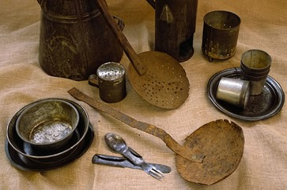
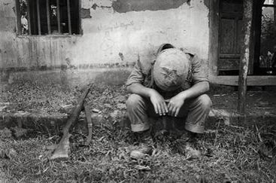
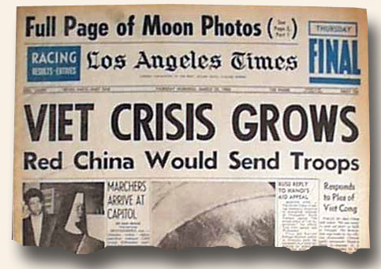
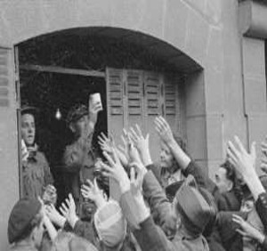
Hardships of War
No sleep, no food, sleeping in the rain, snow, on hard ground; no toilets, no baths, no proper hygiene for one's teeth; etc. Those are the hardships of fighting men.
What were some of the hardships of the Revolutionary war?
Some of the greatest hardships during the revolutionary war:· Harsh weather
· Lack of food
· Lack of clothing
· Lack of sanitation
· Sickness
· Exposure
· Desertions
shortage of goods, prices of beef and wheat doubled, the colonists face an inflation, and there was a falling value of colonial money
What were some of the hardships of the Vietnam war?
Living without a toilet/bath/shower/hot food/sleeping on the ground in the rain for a year.

Slide 13
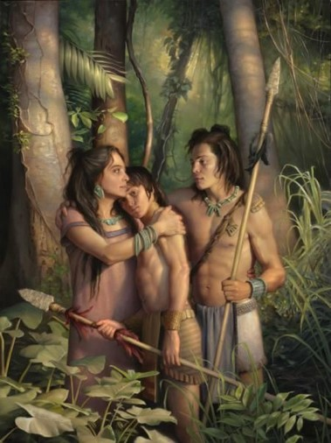
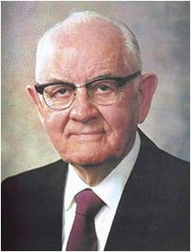
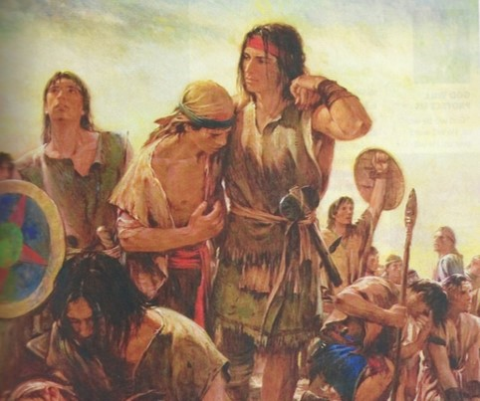
“Is there not wisdom in his giving us trials that we might rise above them, responsibilities that we might achieve, work to harden our muscles, sorrows to try our souls? Are we not exposed to temptations to test our strength, sickness that we might learn patience, death that we might be immortalized and glorified? …
“[Orson F. Whitney said:] ‘No pain that we suffer, no trial that we experience is wasted. It ministers to our education, … builds up our characters, purifies our hearts, expands our souls, and makes us more tender and charitable, more worthy to be called the children of God.’ …
“We knew before we were born that we were coming to the earth for bodies and experience and that we would have joys and sorrows, ease and pain, comforts and hardships, health and sickness, successes and disappointments, and we knew also that after a period of life we would die. We accepted all these eventualities with a glad heart, eager to accept both the favorable and unfavorable. We eagerly accepted the chance to come earthward even though it might be for only a day or a year”
President Spencer W. Kimball

Slide 14
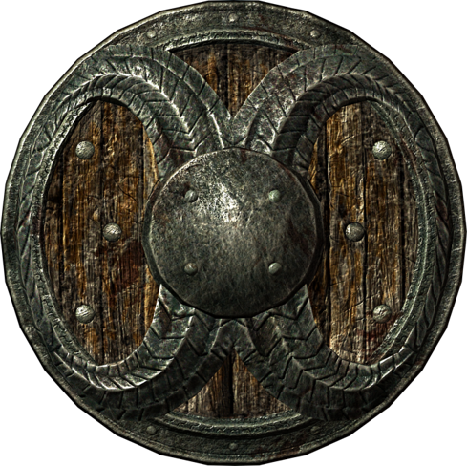
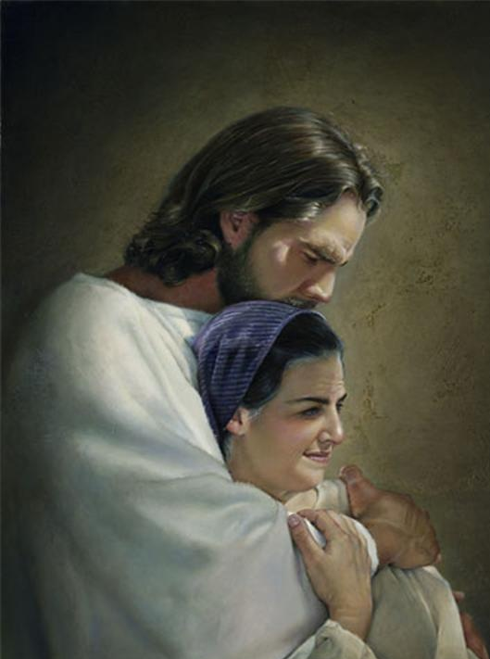
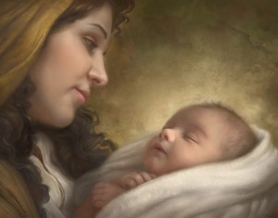
If we obey the commands of God with exactness and put our trust in Him continually, then He will bless us by His marvelous power.
Howard Lyon
Liz Lemon Swindle

Slide 15
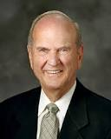
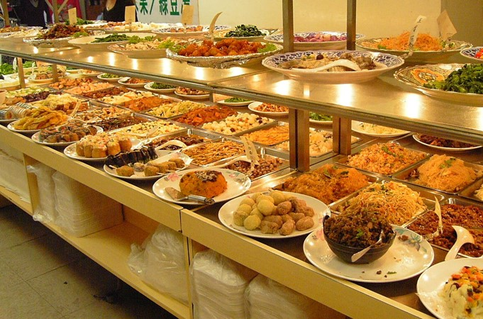
The Obedience—With Exactness
“[You] will encounter people who pick which commandments they will keep and ignore others that they choose to break. I call this the cafeteria approach to obedience. This practice of picking and choosing will not work. It will lead to misery. To prepare to meet God, one keeps all of His commandments. It takes faith to obey them, and keeping His commandments will strengthen that faith.”
Russell M. Nelson
Alma 57:21

Slide 16
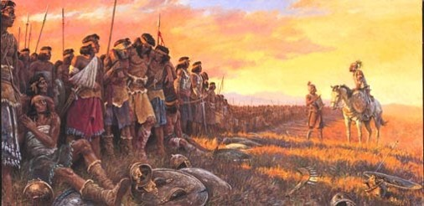
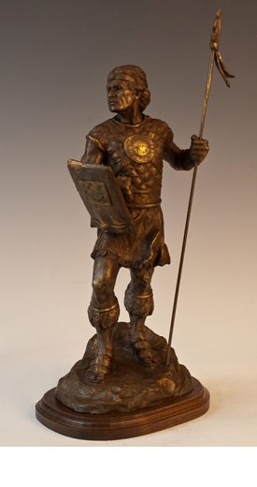
Why Did the Lord Preserve the 2,000?
“And it came to pass that there were two hundred, out of my two thousand and sixty, who had fainted because of the loss of blood; nevertheless, according to the goodness of God, and to our great astonishment, and also the joy of our whole army, there was not one soul of them who did perish; yea, and neither was there one soul among them who had not received many wounds.”
”And now, their preservation was astonishing to our whole army, yea, that they should be spared while there was a thousand of our brethren who were slain.
And we do justly ascribe it to the miraculous power of God, because of their exceeding faith in that which they had been taught to believe—that there was a just God, and whosoever did not doubt, that they should be preserved by his marvelous power.
Now this was the faith of these of whom I have spoken; they are young, and their minds are firm, and they do put their trust in God continually.”
Alma 57:25-27

Slide 17
Gid And Teomner
He was a captain under Helaman
Helaman had taken many prisoners during the recovery of the cities of Antiparah and Cumeni around 63 BC—the numbers were so large that Helaman commissioned Gid to be chief captain over the band to guard the prisoners to the land of Zarahemla
He and his band returned quickly, as the Lamanites had received provisions, and aided Helaman…as a result the Lamanites were forced to retreat to the city of Manti.
Gid had to take matters into his own hands of the revolt of the prisoners and slew many of them, the remainder escaped.
Gid and another Nephite military leader, Teomner, took over the city Manti
Who’s Who Alma 57:29-36 and Alma 58:1-27

Slide 18
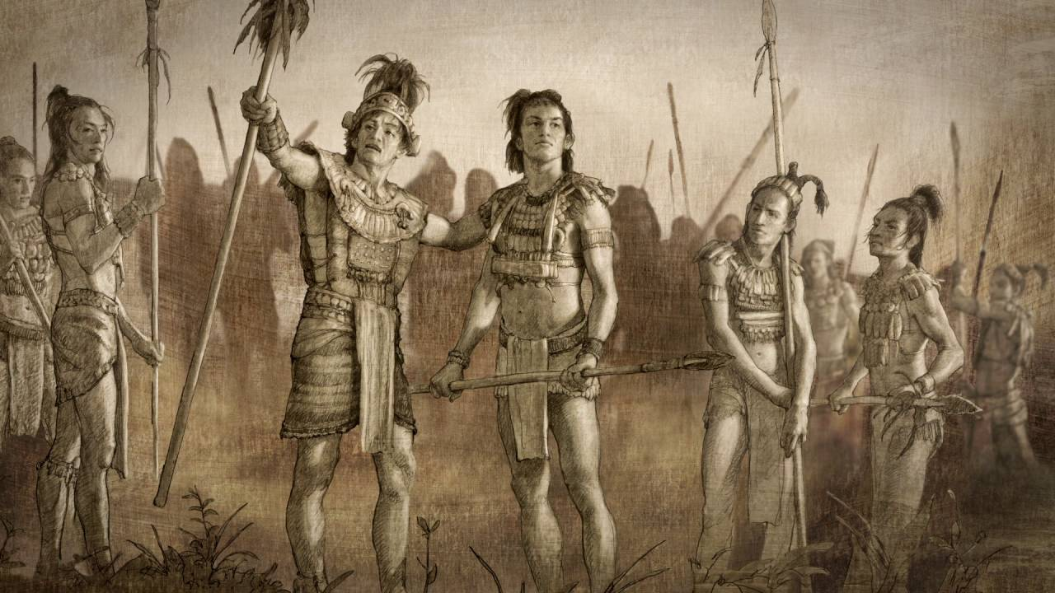
The Nephite army’s successful efforts to retake the cities that had been captured by the Lamanites
How did Helaman’s young warriors show their faith in God, despite the “many wounds” they received?
As you face challenges in life, how can you benefit from following the example of the sons of Helaman?
If we turn to God in times of difficulty, we can receive divine assurance that can strengthen our faith and give us hope
Alma 58:31-40

Slide 19
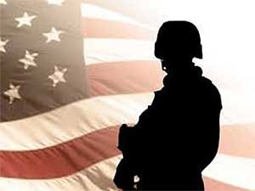
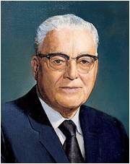
“It is my conviction that the present devastating scourge of war in which hundreds of thousands are being slain, many of whom are no more responsible for the causes of the war than are our own boys, is making necessary an increase of missionary activity in the spirit world and that many of our boys who bear the Holy Priesthood and are worthy to do so will be called to that missionary service after they have departed this life.
Harold B. Lee

Slide 20
Sources:
We Do Not Doubt Our Mothers Knew It (1:22)
After the Storm (5:20)
Book of Mormon Who’s Who by Ed J. Pinegar and Richard J. Allen p. 29,56, 179
Dallin H. Oaks Following the Pioneers Ensign Nov. 1997
Teachings of Ezra Taft Benson pg. 344, 520
Abraham Lincoln Lincoln's Life—Stories and Speeches, Selby, pg. 221
David O. McKay Secrets of a Happy Life p 2-4
Gordon B. Hinckley (LDS Church News, 09/21/96)
Ezra Taft Benson ("Jesus Christ-Gifts and Expectations," Christmas Devotional, Salt Lake City, Dec. 7, 1986).
President Spencer W. Kimball (Faith Precedes the Miracle [1972], 97–98, 106).
Russell M. Nelson (“Face the Future with Faith,” Ensign or Liahona, May 2011, 34).
Harold B. Lee Conference Report, Oct. 1942 Pg. 72-73
Presentation by ©http://fashionsbylynda.com/blog/

Slide 21
Issued by the First Presidency:
“The Church is and must be against war. The Church itself cannot wage war, unless and until the Lord shall issue new commands. It cannot regard war as a righteous means of settling international disputes; these should and could be settled—the nations agreeing—by peaceful negotiation and adjustment.
“But the Church membership are citizens or subjects of sovereignties over which the Church has no control. The Lord Himself has told us to ‘befriend that law which is the constitutional law of the land’ [see D&C 98:4–7]. …
“… When, therefore, constitutional law, obedient to these principles, calls the manhood of the Church into the armed service of any country to which they owe allegiance, their highest civic duty requires that they meet that call. If, harkening to that call and obeying those in command over them, they shall take the lives of those who fight against them, that will not make of them murderers, nor subject them to the penalty that God has prescribed for those who kill” (in Conference Report, Apr. 1942, 94).
“In the Book of Mormon we read about 2,000 exemplary young men who were exceedingly valiant, courageous, and strong. ‘Yea, they were men of truth and soberness, for they had been taught to keep the commandments of God and to walk uprightly before him’ (Alma 53:21). These faithful young men paid tribute to their mothers. They said, ‘Our mothers knew it’ (Alma 56:48). …
“The responsibility mothers have today has never required more vigilance. More than at any time in the history of the world, we need mothers who know. … When mothers know who they are and who God is and have made covenants with Him, they will have great power and influence for good on their children” (Julie B. Beck, “Mothers Who Know,” Ensign or Liahona, Nov. 2007, 76).
“If I were asked to name the world’s greatest need, I should say unhesitatingly wise mothers” (David O. McKay, Secrets of a Happy Life, comp. Llewelyn R. McKay [1967], 2).
Alma 57:20: War
We can only imagine Moroni's delight in reading this epistle from Helaman. More than anyone else, Moroni understood that wars are not won by superior armor, stronger fortifications, larger armies, and superior strategy. He understood that wars are won by those internal qualities which were exemplified so vividly among the stripling warriors. They were perfectly obedient (v. 21); they had remembered their spiritual heritage (v. 21); they exercised exceeding faith (v. 26); they did not doubt (v. 26); their minds were firm, and they had learned to put their trust in God. Our spiritual wars are won using just the same principles.
Alma 57: The Battle
Elder M. Russell Ballard of the Quorum of the Twelve Apostles:
“Today we are fighting a battle that in many ways is more perilous … than the battle between the Nephites and the Lamanites. Our enemy is cunning and resourceful. We fight against Lucifer, the father of all lies, the enemy of all that is good and right and holy. …
“… We battle literally for the souls of men. The enemy is unforgiving and relentless. He is taking eternal prisoners at an alarming rate. And he shows no sign of letting up.
“While we are profoundly grateful for the many members of the Church who are doing great things in the battle for truth and right, I must honestly tell you it still is not enough. We need much more help. … We need you. Like Helaman’s 2,000 stripling warriors, … you too can be endowed with power to build up and defend His kingdom. We need you to make sacred covenants, just as they did. We need you to be meticulously obedient and faithful, just as they were” (“The Greatest Generation of Missionaries,” Ensign or Liahona, Nov. 2002, 46–47).
Alma 58:3 Provisions
"So now they settle down to a long wait. They say the war should be over by now. What's wrong? Now this long and painful wait starts, and it's the biggest trial of all. They waited for provisions from Zarahemla, but they were just a little trickle. They weren't getting any at all. The Lamanites were receiving great strength from day to day on their part. This is beginning to look bad. What about ending this war? The Lamanites began sallying forth against them, taking courage and giving them a bad time. They waited and waited many months. They were just stuck in this particular place for many months. Remember what Clausewtiz said? The longer a war drags on, the greater the losses and the greater the uncertainty of what's going to happen. It's a terrible thing, and wars have that habit of dragging on whether you like them to or not. This inaction became terrible." Hugh Nibley (Teachings of the Book of Mormon, p. 178.)
Alma 58:11:
One of the best descriptions of how the Lord responds to us, again through thoughts or feelings. He seems to do these four things:
He visits us with assurances that he will deliver us.
He speaks peace to our souls.
He grants us great faith.
He causes us that we should hope for our deliverance in him.
Gene R. Cook Raising Up a Family to the Lord, p. 127-8

Slide 22
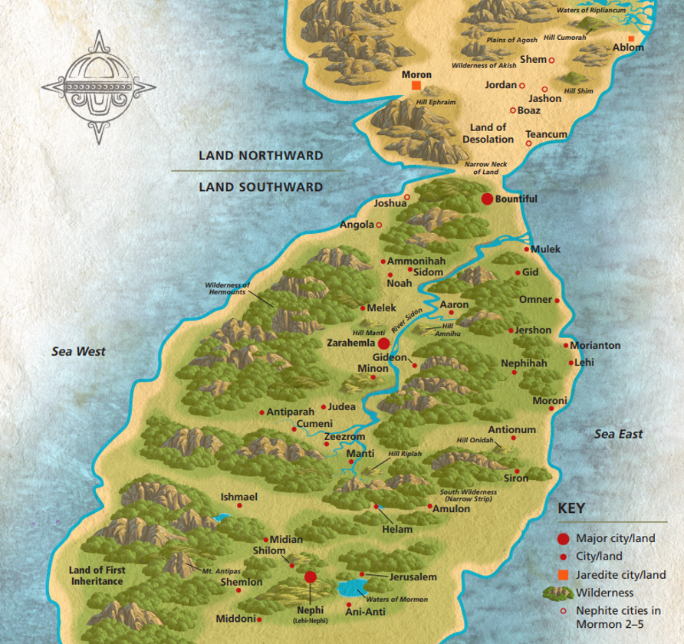
Possible Book of Mormon sites in relation to each other
Possible Book of Mormon sites in relation to each other

Slide 23
Possible Book of Mormon sites in relation to each other
Possible Book of Mormon sites in relation to each other

