Slide 2
Mormon compiled and abridged records from the large plates of Nephi to create the book of Helaman
The book is named for Helaman, who was a son of Helaman and a grandson of Alma the Younger.
Helaman received the records from Shiblon, his uncle, and served as a righteous chief judge over the Nephites.
He taught his sons Nephi and Lehi to keep the commandments and to remember their Redeemer and make Him the foundation of their lives
Introduction
Inspired by these teachings and concerned about the wickedness of the people, Nephi and Lehi preached repentance to the Nephites and the Lamanites.
After thousands of Lamanites were converted, a Lamanite prophet named Samuel was inspired to preach repentance and prophesy among the Nephites.
The book of Helaman draws from the records kept during the reigns and ministries of Helaman and Nephi.
Nephi gave up his position as chief judge to do so.

Slide 3
The Book of Helaman
To whom was this book written and why?
Mormon wrote the book of Helaman for the people in the latter days who would receive his record. Like his other abridgments from the large plates of Nephi, the book of Helaman testifies of the divinity and redeeming mission of Jesus Christ.
When and where was it written?
The original records used as sources for the book of Helaman were likely written between 52 B.C. and 1 B.C. Mormon abridged those records sometime between A.D. 345 and A.D. 385. Mormon did not record where he was when he compiled this book.
Introduction

Slide 4
Interesting Details
The book of Helaman portrays the Nephites fluctuating between righteousness and wickedness with greater frequency than at any other time in their history.
The book relates multiple instances of dissension, war, murder, and secret combinations. It also introduces and describes the activities of the Gadianton robbers, whose works of darkness eventually brought about the destruction of the Nephites.
The book of Helaman is also unique because it describes a period when “the more part” of the Lamanites were converted and “their righteousness did exceed that of the Nephites”.
The book demonstrates the power God gives to His prophets, such as when Nephi revealed the murder of a chief judge and prophesied the confession of the judge’s brother and when Nephi received the sealing power from the Lord and then exercised it to induce and revoke a famine.
This book contains the only record of a sermon of a Lamanite prophet delivered to the Nephites. In this sermon, Samuel prophesied the signs of the birth and death of Jesus Christ.
Introduction

Slide 5
Discussing VS Contending
Discussing
Contending
1. To explain your position through friendly persuasion and facts
2. To show respect for others opinions
3. To remain calm about issues that you are passionate about
1. To argue or state (something) in a strong and definite way
2. To show disrespect toward a person whose views are different from yours
3. To feel that winning an argument is more important than another person’s well-being
Contention-can be like a path that leads to other sins and negative consequences
Helaman 1:1-9

Slide 6
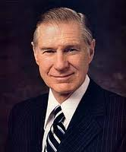
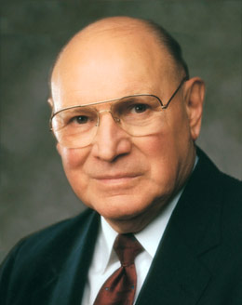
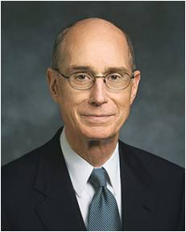
Contention makes us vulnerable to the influence of the adversary
“When there is contention, the Spirit of the Lord will depart, regardless of who is at fault.” President James E. Faust
“Where people have that Spirit with them, we may expect harmony. The Spirit puts the testimony of truth in our hearts, which unifies those who share that testimony. The Spirit of God never generates contention.
It never generates the feelings of distinctions between people which lead to strife.
It leads to personal peace and a feeling of union with others.
It unifies souls.
A unified family, a unified Church, and a world at peace depend on unified souls.”
President Henry B. Eyring
“The sins of corruption, dishonesty, strife, contention, and other evils in this world are not here by chance. They are evidences of the relentless campaign of Satan and those who follow him.
He uses every tool and device available to him to deceive, confuse, and mislead.”
Elder Joseph B. Wirthlin
3 Ne. 11:29
Joseph F. Smith, Gospel Doctrine, 13th ed. [1963], 131

Slide 7
Contention Divides a Nation
After Parohan’s death, who would take the role of chief judge and governor over the people of Nephi?
Pahoran had many sons:
About 52 BC
Pahoran II
The people elected him
Kishkumen, a follower of Paanchi, assassinated him
Paanchi
He tried to destroy the liberty of the people and was arrested and condemned to death--treason
His followers laid the foundation for the secret works of Gadianton—a collaborator
Pacumeni
He accepted the vote
After the death of Pahoran II he was installed as chief judge and governor for a year
He was killed by invading Lamanites under Coriantumr
Helaman 1:1-13
Who’s Who

Slide 8
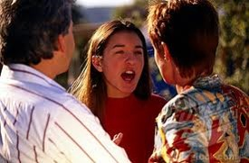
Contention Divides People
If a young woman has been arguing with her parents about her friends, how might it affect her attitude toward her parents’ counsel in other areas of her life?
If siblings have been contentious, how might their behavior affect their long-term relationship? How might it affect the entire family?
How can contention in a ward or branch make Church members more vulnerable to Satan’s attacks?
If a young man has angry feelings toward someone in his priesthood quorum, how might his feelings affect his actions at church? How might they affect his attendance at church?
How might contentious feelings weaken us when we face temptation?

Slide 9
Kishkumen
He was an assassin around 52 BC
Paanchi, son of Pahoran I, revolted against the decision of the people to have his brother Pahoran II as the chief judge and governor of the people of Nephi so he hired one of his followers, Kishkumen, to murder Pahoran I
He fled from the forces of Pahoran and made his sponsors take a secret oath not to expose who he was
Because Kishkumen went in a disguise, no one ever found him
He founded the band of Kishkumen who became the Gadiaton Robbers, with Gadiaton as their leader
He attempted to murder Helaman II, son of Helaman
He died by the sword of one of Helaman’s servants
The band had fled into the wilderness and could not be found
Helaman 1:9-12
Who’s Who

Slide 10
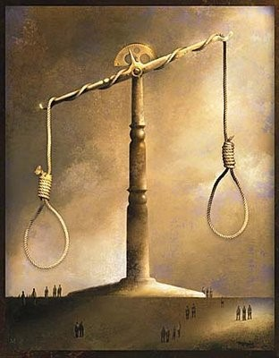
Setting the Stage for a Downfall
The contention helped to set the stage for much evil and also for the eventual downfall of the Nephite nation
Capital punishment was the accepted punishment for treason
Those who seek to circumvent the law for power are willing to resort to violence to get their ways
The contention over the judgment seat gave the attacking Lamanites a decided advantage against the Nephites
Helaman 1:8

Slide 11
Tubaloth
He was the son of Ammoron
He was king of the Lamanites after his father’s death around 51 BC
He stirred up his people in anger against the Nephites
He placed Coriantumr in charge of his army
His forces came up against Moronihah and Lehi
The Lamanites were defeated and Coriantumr was killed
He is not mentioned again
Helaman 1:16-17
Who’s Who

Slide 12
Coriantumr
He was a Nephite dissenter and a descendent of Zarahemla of Mulekite heritage
He was placed in charge of the Lamanite armies by the Lamanite King Tubaloth, son of Ammoron (a Zoramite)
He plunged his army into the heart of the Nephite territories and took control of the capital city Zarahemla in the year 51 BC
He killed Pacumeni
Overconfident, Coriantumr’s army soon were defeated by the Nephites with the leadership of generals Moronihah and Lehi
He was killed in the battle around 51 BC
Helaman 1:17-30
Who’s Who

Slide 13
Helaman
He was the Son of Helaman, and grandson of Alma the Younger
He was chief judge in Zarahemla around 50 BC
He survived an assassination attempt by Kishkumen, one of Gadianton’s accomplices
He brought spiritual rejuvenation to the people of Nephi
He presided over a period of great economic development and growth within the church
He had two sons, Nephi and Lehi, whom he named after two of their ancestors, the prophets Nephi and Lehi
He bestowed upon Nephi and Lehi the patriarchal blessing
Helaman 2:2
Who’s Who

Slide 14
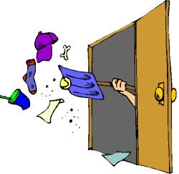
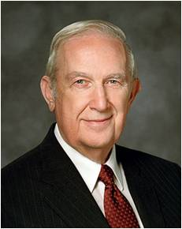
Keeping a Secret
Why is it better to clean up a mess rather than to cover it up?
Why might someone want to cover up something he or she has done?
“If you have seriously transgressed, you will not find any lasting satisfaction or comfort in what you have done. Excusing transgression with a cover-up may appear to fix the problem, but it does not. The tempter is intent on making public your most embarrassing acts at the most harmful time. Lies weave a pattern that is ever more confining and becomes a trap that Satan will spring to your detriment.”
Elder Richard G. Scott
Helaman 2:2-3

Slide 15
To Cover Up—The Rights of the Priesthood
“Behold, there are many called, but few are chosen. And why are they not chosen?
Because their hearts are set so much upon the things of this world, and aspire to the honors of men, that they do not learn this one lesson—
That the rights of the priesthood are inseparably connected with the powers of heaven, and that the powers of heaven cannot be controlled nor handled only upon the principles of righteousness.”
“That they may be conferred upon us, it is true; but when we undertake to cover our sins, or to gratify our pride, our vain ambition, or to exercise control or dominion or compulsion upon the souls of the children of men, in any degree of unrighteousness, behold,
the heavens withdraw themselves; the Spirit of the Lord is grieved; and when it is withdrawn, Amen to the priesthood or the authority of that man.”
D&C 121:34-37

Slide 16
Gadianton
He was associated with trying to overthrow the free government during the time of Captain Moroni
Over the years the band grew and Kishkumen was one of the men who was in the revolt against the government
He was the successor of Kishkumen around 50 BC
He was the promoter of slavery and destruction
He was a destroyer bent on deceiving people into using secret combinations to allow evil to triumph over good and to empower Satan to enslave the Lord’s people
His goal was to undermine the Nephite nation
He and his band murdered Cezoram and his son around 26 BC
His band overcame the government
The band, along with others, were eventually destroyed with the coming of the Savior
His doctrine rose again among the Nephites and it eventually led to the destruction of the Nephites
Who’s Who

Slide 17
Giving a Sign
Gadianton’s band is an example of a secret combination society
Secret combinations can lead to the destruction of societies
Secret combinations led to the destruction of the Jaredites.
(Ether 8:20–21.)
Helaman 2:7

Slide 18
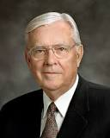
“The Book of Mormon teaches that secret combinations engaged in crime present a serious challenge, not just to individuals and families but to entire civilizations. Among today’s secret combinations are gangs, drug cartels, and organized crime families. …
“If we are not careful, today’s secret combinations can obtain power and influence just as quickly and just as completely as they did in Book of Mormon times. …
“… [The devil] uses secret combinations, including gangs, ‘from generation to generation according as he can get hold upon the hearts of the children of men.’ His purpose is to destroy individuals, families, communities, and nations.
To a degree, he was successful during Book of Mormon times. And he is having far too much success today. That’s why it is so important for us … to take a firm stand for truth and right by doing what we can to help keep our communities safe”
Elder M. Russell Ballard
WANTED

Slide 19
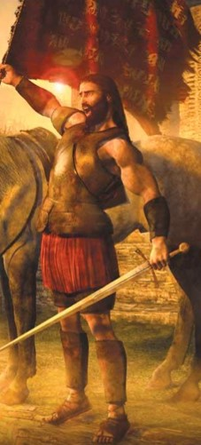
The Destruction of the Nephites
The end of the 42nd year of the Reign of the Judges
“And behold, in the end of this book ye shall see that this Gadianton did prove the overthrow, yea, almost the entire destruction of the people of Nephi.
Behold I do not mean the end of the book of Helaman, but I mean the end of the book of Nephi, from which I have taken all the account which I have written.”
Helaman sent forth to take Gadianton’s band but they secretly went into the wilderness
Helaman 2:10-14

Slide 20
Sources:
Videos:
Evil Secret Words Can Destroy Society (2:09)
Nephi Prophesies Death of Chief Judge (2:18)
Book of Mormon Who’s Who by Ed J. Pinegar and Richard J. Allen pg 41, 54-55, 65-66, 94, 152-154, 181-182
President James E. Faust (“What I Want My Son to Know before He Leaves on His Mission,” Ensign, May 1996, 41).
Elder Joseph B. Wirthlin (“Deep Roots,” Ensign, Nov. 1994, 76).
President Henry B. Eyring (“That We May Be One,” Ensign, May 1998, 67).
Richard G. Scott (“Finding Forgiveness,” Ensign, May 1995, 77).
Elder M. Russell Ballard (“Standing for Truth and Right,” Ensign, Nov. 1997, 38).
March madness chart http://justifiedbythescriptures.wordpress.com/tag/duke/
Presentation by ©http://fashionsbylynda.com/blog/

Slide 21
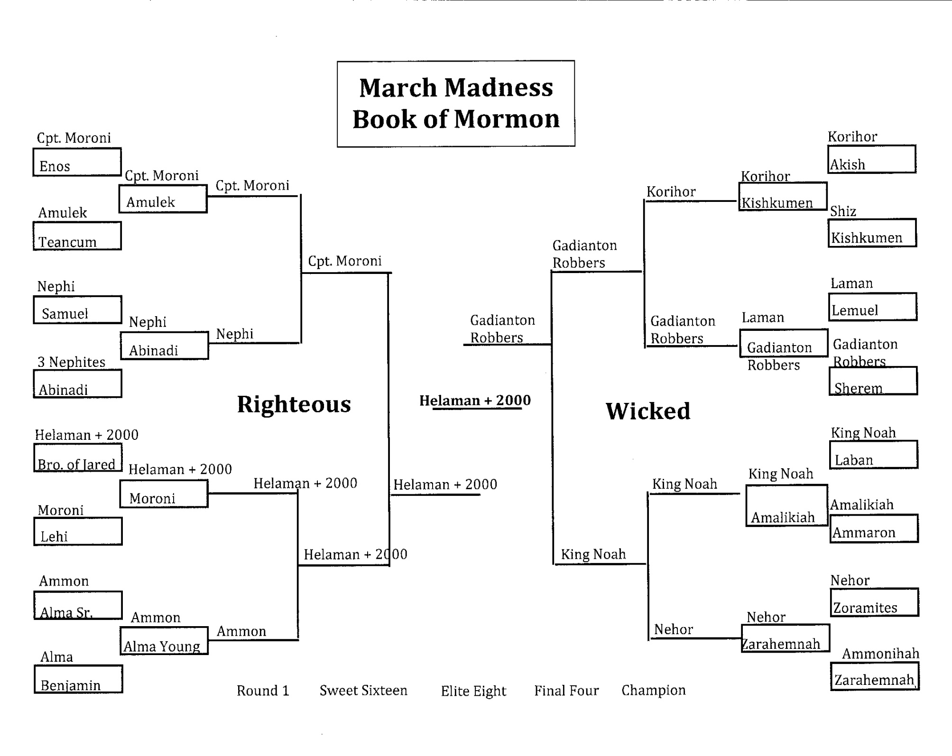

Slide 22
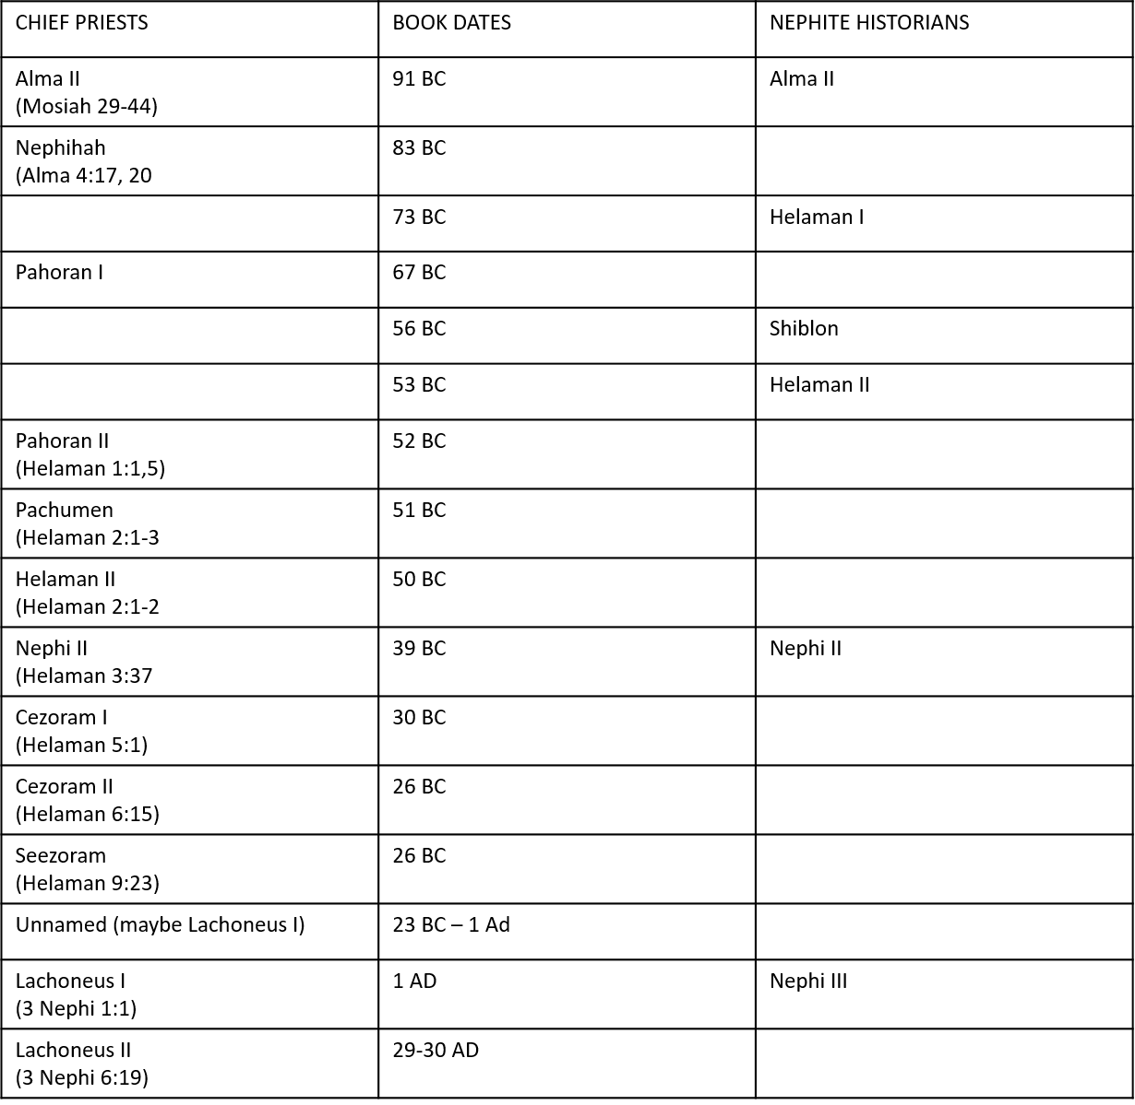

Slide 24
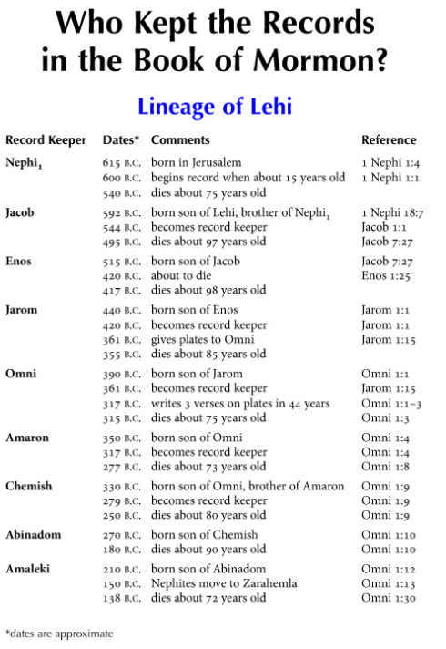

Slide 25
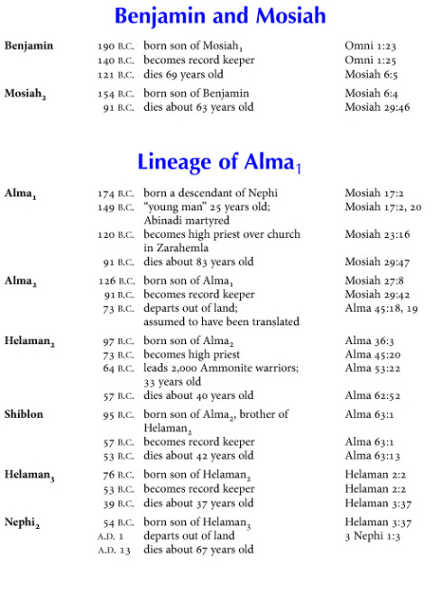

Slide 26
