Slide 2
Actions of Others
Of all the people listed on the board, who do you feel that you can control?
Have you ever been discouraged because of others’ actions?
Have you been been discouraged recently because of the unrighteous actions of others?
People in the … (Country)
People in…(City)
People in the ward or branch…
People in my family
Myself

Slide 3
Helaman
Righteousness
6:1-8
Reign of Judges
61st and 62nd Year
Humility and Repentance
Prosperity and Blessings
4:15-17
Reign of Judges
61st and 62nd Year
3:22, 24-25
Reign of Judges
49th Year
1st Cycle of Nephite Disease
Destruction and Suffering
Pride
4: 10-13
Reign of Judges
61st Year
3:33-34, 36
Reign of Judges
51st Year
Wickedness
4:1-10
Reign of Judges
54th Year
Postscript to the war
3:23 Secret Combinations
4:24 Spirit Withdrawal
5:2 Most Choose Evil

Slide 4
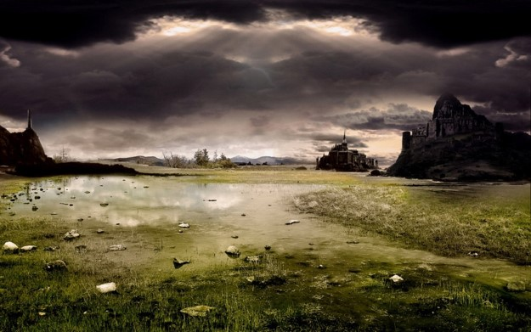
A Time to Leave
In the 43rd - 45th Year of the Reign of the Judges there was no contention
However: In the 46th Year there began to be ‘much contention’
Many of the Nephites, including the people of Ammon, migrated north for a safer haven…
Alma 63:1-17 Helaman 3:1-12

Slide 5
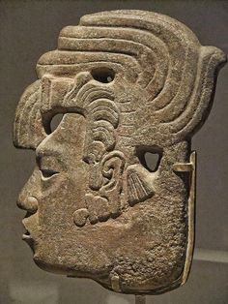
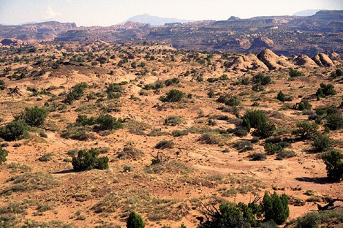
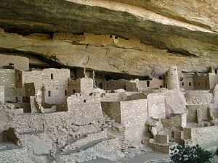
Concrete Homes
They pitched their tents and made concrete homes because timber was scarce
Helaman 3:9

Slide 6
Helaman II
Helaman was chief judge and also kept the sacred records
He had two sons:
Nephi and Lehi
The unbelievable peace “…for I will work a work in your days, which ye will not believe, though it be told you.”
Habakkuk 1:5
47th – 49th year very little contention---much prosperity
Helaman 3:20-28

Slide 7
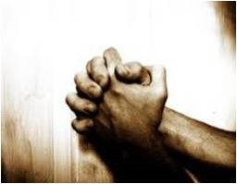
Thus We See
The Lord is merciful to those who, in sincerity, call on his holy name
The gate of heaven is open to all who believe in Jesus Christ’
The word of God has three effects:
It divides asunder the cunning and the wiles of the devil
It leads the “man of Christ” in a straight and narrow course across the gulf of misery
It helps to land faithful men’s immortal souls at the right hand of God
Helaman 3:17-30—Student Manual

Slide 8
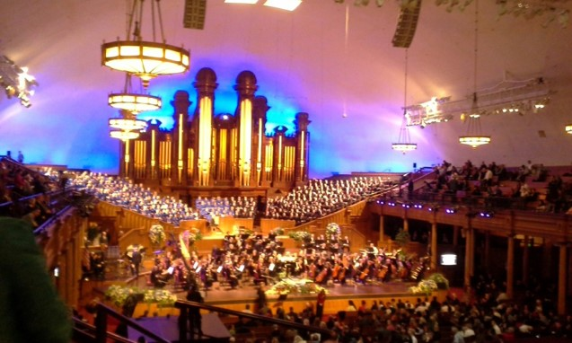
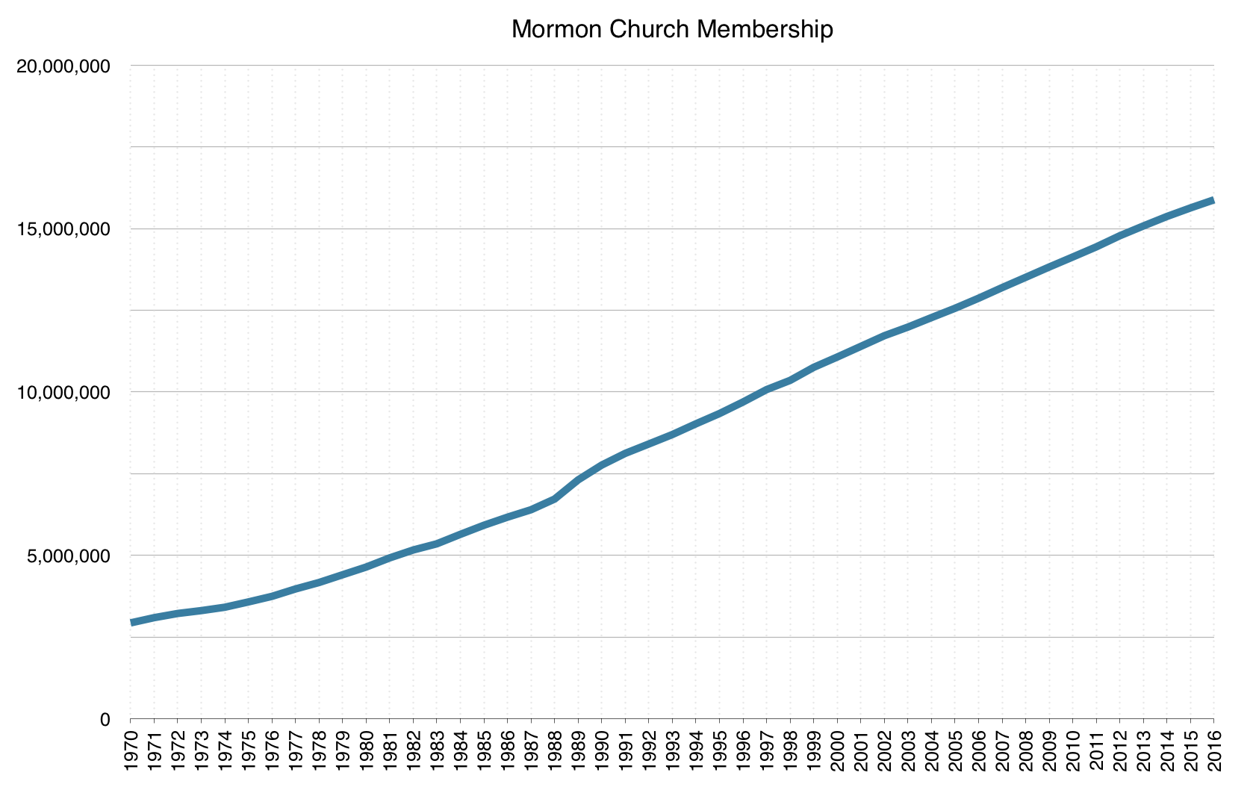
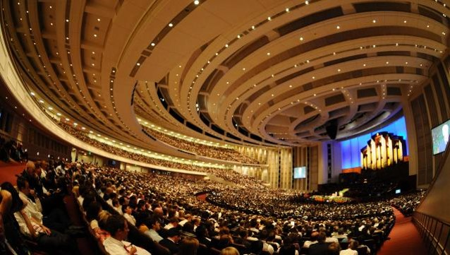
Prosperity
Not only in the temporal—worldly things but also in the spiritual aspects
Helaman 3:24

Slide 9
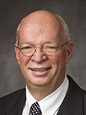
Mormon Wants Us to Learn
The Lord is merciful unto all who will call upon His name in the sincerity of their hearts
The gate of heaven is open unto all who will believe on the name of Jesus Christ
Whosoever will may lay hold upon the word of God, which will lead them to the kingdom of God
“The God of heaven is not a heartless referee looking for any excuse to throw us out of the game. He is our perfectly loving Father, who yearns more than anything else to have all of His children come back home and live with Him as families forever.
He truly gave His Only Begotten Son that we might not perish but have everlasting life. Please believe, and please take hope and comfort from, this eternal truth. Our Heavenly Father intends for us to make it! That is His work and His glory.
“… None of us will ever be ‘good enough,’ save through the merits and mercy of Jesus Christ but because God respects our agency, we also cannot be saved without our trying.”
J. Devn Cornish
Helaman 3:27-30; John 3:16; Moses 1:39; 2 Nephi 2:6-8

Slide 10
Pride and Persecution
“The Great Evil”— Saints against Saints
Many humble members experience persecution
1. A young woman makes fun of another girl in her ward.
2. A young man teases a member of his quorum for being too eager to answer questions in class or to volunteer for priesthood duties.
3. A group of young men in a ward exclude another young man from their conversations and activities outside of church.
4. A group of young women make hurtful remarks about the clothes that other young women wear.
“For of him unto whom much is given much is required; and he who sins against the greater light shall receive the greater condemnation.”
D&C 82:3
Helaman 3:33-34

Slide 11
The Spirit is the Sanctifier
Fast and pray oft
Be strong in humility
Increase firmness of faith in Christ
Yield your hearts unto God
Helaman 3:35 Student Manual

Slide 12
The Rebellious
“And the rebellious part were slain and driven out of the land, and they did go unto the king of the Lamanites.
And it came to pass that they did endeavor to stir up the Lamanites to war against the Nephites; but behold, the Lamanites were exceedingly afraid, insomuch that they would not hearken to the words of those dissenters.”
54th Year of the Reign of the Judges
The Work of Death---They lost Zarahemla and even up to the Land Bountiful
Moronihah helped in regaining back half of the cities
57th - 61st Year of the Reign of the Judges
Helaman 4:2-3

Slide 13
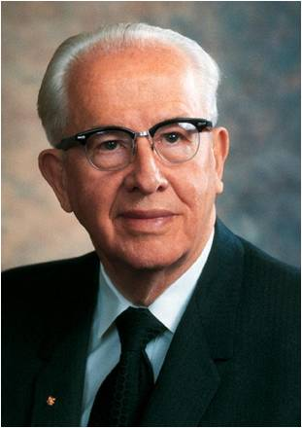
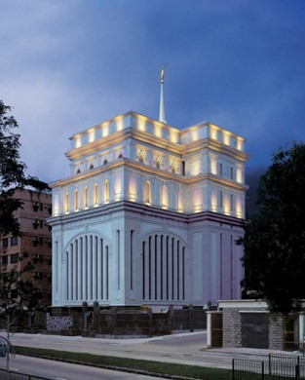
“Think of what pride has cost us in the past and what it is now costing us in our own lives, our families, and the Church.
“Think of the repentance that could take place with lives changed, marriages preserved, and homes strengthened, if pride did not keep us from confessing our sins and forsaking them.
“Think of the many who are less active members of the Church because they were offended and their pride will not allow them to forgive or fully sup at the Lord’s table.
“Think of the tens of thousands of additional young men and couples who could be on missions except for the pride that keeps them from yielding their hearts unto God.
Pride and wickedness separate us from the Spirit of the Lord and leave us to our own strength
“Think how temple work would increase if the time spent in this godly service were more important than the many prideful pursuits that compete for our time.”
Ezra Taft Benson
Helaman 4:2-3

Slide 14
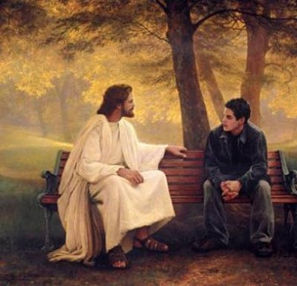
The Key—winning the Battle
What do you think your chances of winning the battle would be if you had the Lord on your side?
In the Nephites’ experience, being left to their own strength meant losing battles and lands.
What “battles” might we lose if we
do not have the Holy Ghost with us?

Slide 15
Sources:
Book of Mormon Student Manual Religion 121-122 Pg. 355
Ezra Taft Benson (“Beware of Pride,” Ensign, May 1989, 6).
J. Devn Cornish, “Am I Good Enough? Will I Make It?” 33, 34
Nephite Disease Cycle—Ezra Taft Benson (God, Family, country, pg 363-364 quoted in Latter-day Commentary on the Book of Mormon compiled by K. Douglas Bassett
Presentation by ©http://fashionsbylynda.com/blog/

Slide 16
Helaman
Righteousness
6:1-8
Reign of Judges
61st and 62nd Year
Humility and Repentance
Prosperity and Blessings
4:15-17
Reign of Judges
61st and 62nd Year
3:22, 24-25
Reign of Judges
49th Year
1st Cycle of Nephite Disease
Destruction and Suffering
Pride
4: 10-13
Reign of Judges
61st Year
3:33-34, 36
Reign of Judges
51st Year
Wickedness
4:1-10
Reign of Judges
54th Year
Postscript to the war
3:23 Secret Combinations
4:24 Spirit Withdrawal
5:2 Most Choose Evil

