Slide 1
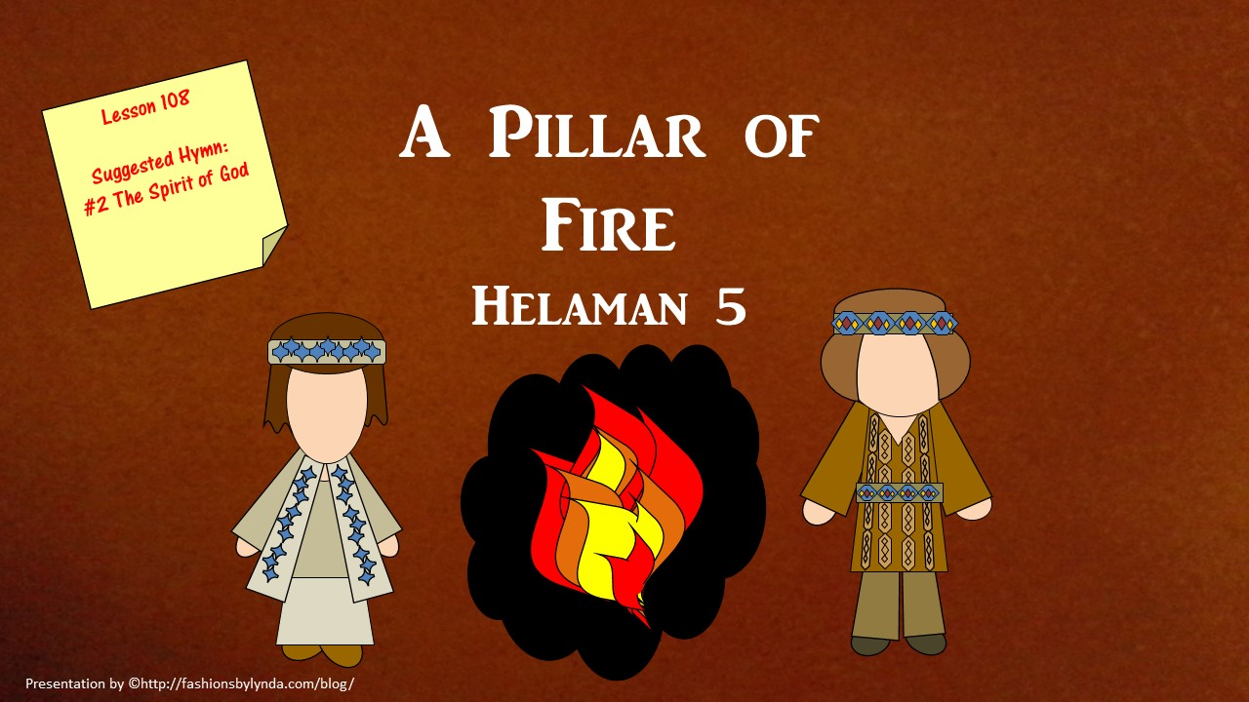

Slide 2

Your Name.
Parents.
The Atonement of Jesus Christ
Was it easy or hard to remember these words and phrases?
Prophets.
Repentance.
Keep the commandments
What difference do you think it made that you were told in advance that you needed to remember what was on the paper strips?

Slide 3
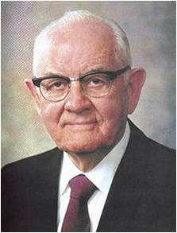


Remember
“When you look in the dictionary for the most important word, do you know what it is?
It could be remember.
Because all of you have made covenants—you know what to do and you know how to do it—our greatest need is to remember.”
Spencer W. Kimball
“Satan wants us to be slow to remember what we have received and heard. He wants us to minimize and even forget the quiet witnesses of the Spirit that have told us who we really are.”
Susan L. Warner

Slide 4
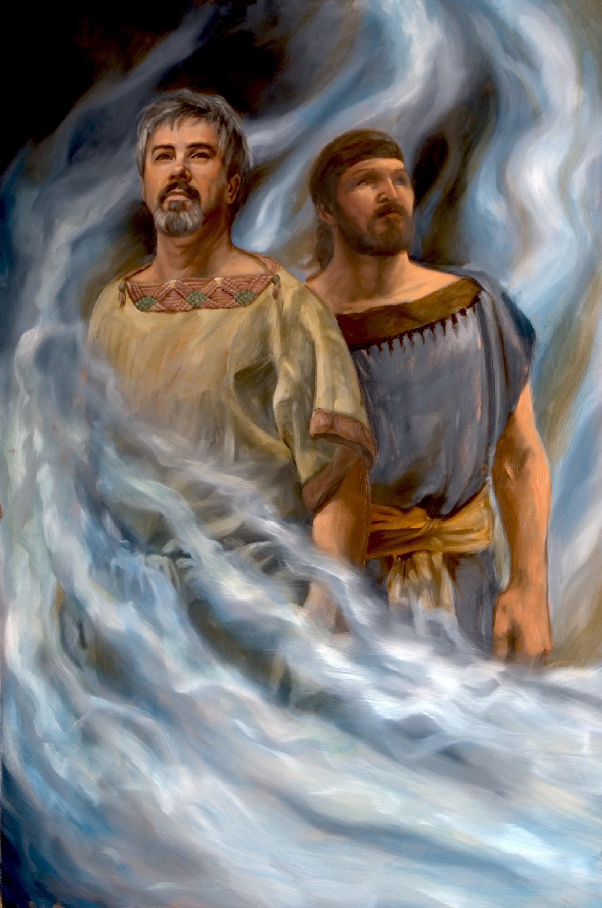
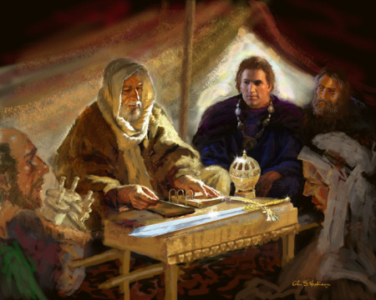
What’s In a Name?
Remembering our ancestors and their good works can inspire us to do good.
Glen S. Hopkinson
James H. Fullmer
Helaman 5:5-7

Slide 5
Nephi And Lehi
They were the son’s of Helaman, grandson’s of Alma
They were taught by their father whose leadership was anchored in the Redeemer, Jesus Christ
Nephi succeeded his father as chief judge around 39 BC until 30 BC and had kept the sacred record
Nephi gave up the judgment seat to Cezoram in order to serve the Lord, Lehi also went with Nephi
They went from city to city preaching repentance
Through Nephi and Lehi’s endeavors some 8,000 Lamanites were brought into the fold living in the vicinity of Zarahemla
They labored 6 years and witnessed that pride had crept in among the people
They endured prison and fire, but were not burned (Hel. 5)
Nephi was granted sealing powers (Helaman 10:7)
Around AD 1 Nephi’s ministry was completed and he turned the sacred records over to his eldest son Nephi
Lehi served in Zarahemla
Nephi left the land and ‘whither he went, no man knoweth’
Who’s Who

Slide 6
Cezoram I and Cezoram II
He was the chief judge of the land for the Nephite people in around 30 BC following Helaman, son of Helaman
At this time the laws had become corrupt
He was murdered by an ‘unknown hand’ in around 26 BC on the judgment seat
His son, Cezoram, was appointed by the people after his father’s death
He was also assassinated by the Gadianton conspiracy who were rapidly gaining power
Who’s Who

Slide 7

Laws Corrupt
A corrupt government is when the people choose corrupt leaders
King Mosiah had warned against:
“And if the time comes that the voice of the people doth choose iniquity, then is the time that the judgments of God will come upon you; yea, then is the time he will visit you with great destruction even as he has hitherto visited this land.”
Mosiah 29:27
“We have learned by sad experience that it is the nature and disposition of almost all men, as soon as they get a little authority, as they suppose, they will immediately begin to exercise unrighteous dominion.
Hence many are called, but few are chosen.”
D&C 121:39-40
Helaman 5:3

Slide 8
What makes a Good Leader?
John MacArthur

Slide 9
?
When you are looking for a leader you want someone who asks lots of questions.
A leader is someone who asks the right questions and genuinely looking for answers.
Curiosity is critical for leadership.
Leaders have a need, or hunger, for answers.
Knowledge is power (whoever has the information has the lead)
The best problem solvers are those who are driven by an unquenchable enthusiasm for knowing and understanding things.
Inquisitiveness
?
?
?
?
?
People who are content with what they don’t know, happy to remain ignorant about what they don’t understand, complacent about what they haven’t analyzed, and comfortable living with problems they haven’t solved…such people can not lead.

Slide 10
Initiative
A leader has drive, ambition, and energy.
A true leader must be the kind of person who makes things happen.
He/She is a starter.
A leader should be physically fit and spiritually sound.
People who are passive and hesitant do not make strong leaders.

Slide 11
Involvement
True leaders are always in the middle of the action.
They do not sit on the background and tell others what to do.
A true leader goes around with a cloud of dust around them.
A true leader must show the way.
A true leader goes before his followers into battle.
A true leader has courage.
People can not follow someone who is distant or ignores problems around them.
People who bail out of problems instead of facing them do not make good leaders.
People who blame others for their mistakes do not make good leaders.

Slide 12
Integrity
Making a commitment and being consistent.
Taking ownership of your mistakes.
Being a good role model.
Follow ethical standards and rules.
Committing to your core values.
Being honest with family and associates
Strong Moral Principles
What makes a Righteous Leader?

Slide 13
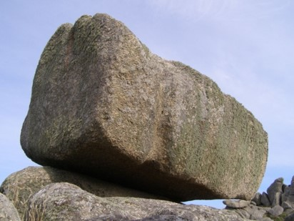
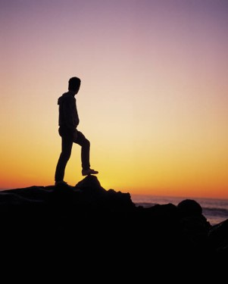
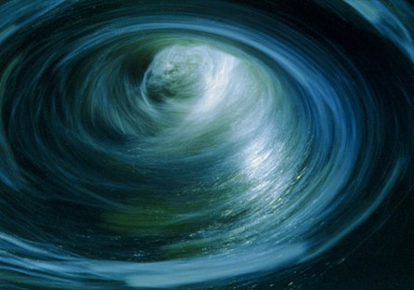
Doctrinal Mastery
“And now, my sons, remember, remember that it is upon the rock of our Redeemer, who is Christ, the Son of God, that ye must build your foundation; that when the devil shall send forth his mighty winds, yea, his shafts in the whirlwind, yea, when all his hail and his mighty storm shall beat upon you, it shall have no power over you to drag you down to the gulf of misery and endless wo, because of the rock upon which ye are built, which is a sure foundation, a foundation whereon if men build they cannot fall.”
Helaman 5:12

Slide 14

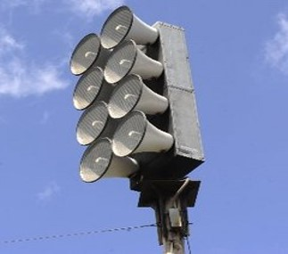
“We, too, are faced with powerful, destructive forces unleashed by the adversary. Waves of sin, wickedness, immorality, degradation, tyranny, deceitfulness, conspiracy, and dishonesty threaten all of us. They come with great power and speed and will destroy us if we are not watchful.
“But a warning is sounded for us. It behooves us to be alert and to listen and flee from the evil for our eternal lives. Without help we cannot stand against it. We must flee to high ground or cling fast to that which can keep us from being swept away. That to which we must cling for safety is the gospel of Jesus Christ. It is our protection from whatever force the evil one can muster.
An inspired Book of Mormon prophet counseled his people: ‘Remember that it is upon the rock of our Redeemer, who is Christ, the Son of God, that ye must build your foundation; that when the devil shall send forth his mighty winds, yea, his shafts in the whirlwind, yea, when all his hail and his mighty storm shall beat upon you, it shall have no power over you to drag you down to the gulf of misery and endless wo’ (Hel. 5:12).”
President Spencer W. Kimball

Slide 15

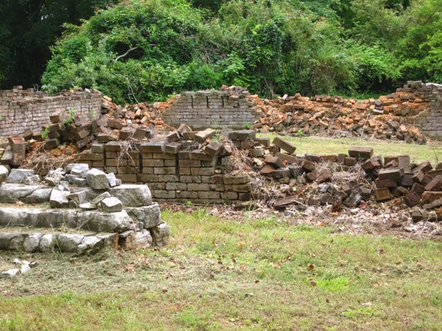
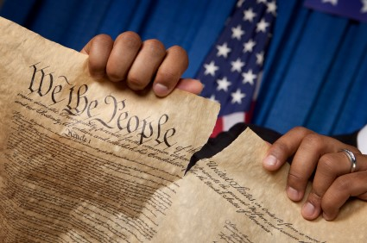
If we build our foundation on Jesus Christ, Satan will have no power over us.
Do you recognize when Satan is trying to destroy your foundation?

Slide 16
Helaman 5:20-21
Helaman 5:22-25
Helaman 5:26-28
Helaman 5:29-34
Helaman 5:35-41
Helaman 5:42-44
Repent Ye,
Repent Ye

Slide 17
Aminadab
He was a Nephite dissenter who had gone over to the Lamanite side during the days of Nephi and Lehi
While Nephi and Lehi were in prison Aminadab observed the radiant faces of the prisoners as they were encircled by fire
He told the crowd , who were encircled by a dark cloud, that the prisoners were in ‘converse with the angels of God’
The crowd asked Aminadab what to do, and he responded, “You must repent…”
Aminadab knew of the words preached by Alma, Amulek, and Zeezrom
The crowd immediately followed Aminadab’s suggestion and the darkness left and they were filled with ‘that joy which is unspeakable and full of glory’
There were about 300 people converted at that time
Who’s Who

Slide 18

Encircled By Fire
The Lord’s Protection
This particular experience could refer to a general protective influence of the Spirit or, more likely, to the presence of heavenly beings in the prison with Lehi and Nephi”
JFM and RLM
“Lo, I see four men loose, walking in the midst of the fire, and they have no hurt; and the form of the fourth is like the Son of God.”
(See Daniel 3:19-27)
Joseph Smith sees his brother Alvin
“I saw the transcendent beauty of the gate through which the heirs of that kingdom will enter, which was like unto circling flames of fire;”
D&C 137:2
Helaman 5:23-24

Slide 19
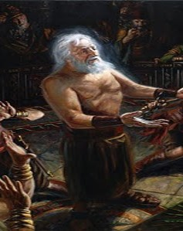
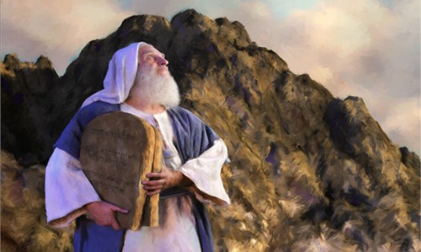
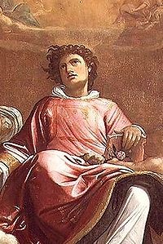
Faces of Angels
“Now it came to pass after Abinadi had spoken these words that the people of king Noah durst not lay their hands on him, for the Spirit of the Lord was upon him; and his face shone with exceeding luster, even as Moses’ did while in the mount of Sinai, while speaking with the Lord.”
Mosiah 13:5
“…that Moses wist not that the skin of his face shone while he talked with him… And the children of Israel saw the face of Moses, that the skin of Moses’ face shone:”
Exodus 24:29, 35
Stephen
“And all that sat in the council, looking steadfastly on him, saw his face as it had been the face of an angel.”
Acts 6:15
Helaman 5:36

Slide 20
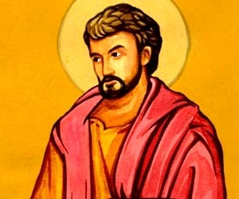
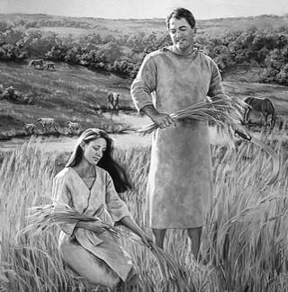
Filled as if with Fire
“The reception of the Holy Ghost is the baptism of fire spoken of in the scriptures”
JFM and RLM
John the Baptist
“I indeed baptize you with water unto repentance: but he that cometh after me is mightier than I, whose shoes I am not worthy to bear: he shall baptize you with the Holy Ghost, and with fire:”
Matthew 3:11
Adam
“And he heard a voice out of heaven, saying: Thou art baptized with fire, and with the Holy Ghost. This is the record of the Father, and the Son, from henceforth and forever;”
Moses 6:66
Helaman 5:45

Slide 21
The 4th Article of Faith
“Wherefore, my beloved brethren, I know that if ye shall follow the Son, with full purpose of heart, acting no hypocrisy and no deception before God, but with real intent, repenting of your sins, witnessing unto the Father that ye are willing to take upon you the name of Christ, by baptism—yea, by following your Lord and your Savior down into the water, according to his word, behold, then shall ye receive the Holy Ghost; yea, then cometh the baptism of fire and of the Holy Ghost; and then can ye speak with the tongue of angels, and shout praises unto the Holy One of Israel.”
2 Nephi 31:13
Faith
Repentance
Baptism
The Gift of the Holy Ghost
Helaman 5:45

Slide 22
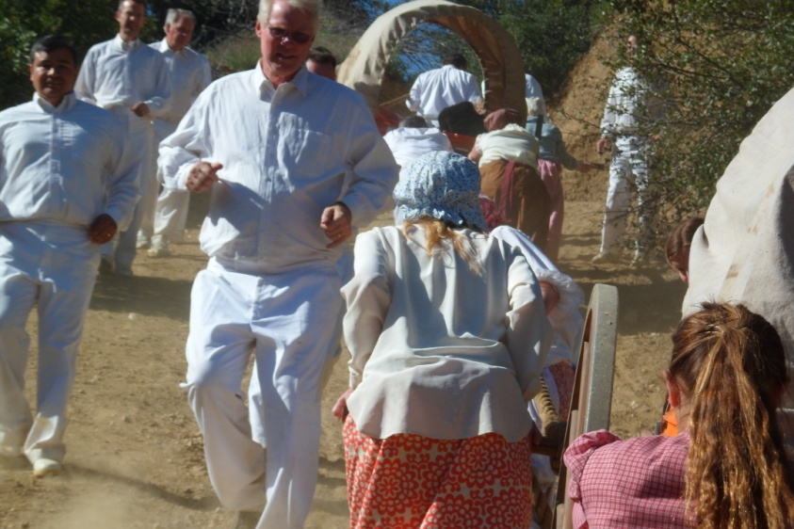
Ministering Angels
When we exercise faith in Jesus Christ and repent of our sins, the Holy Ghost will fill our hearts with peace and joy
Peace unto you because of your faith
“And now, when they heard this they cast up their eyes as if to behold from whence the voice came; and behold, they saw the heavens open; and angels came down out of heaven and ministered unto them.”
“And it came to pass that they did go forth, and did minister unto the people, declaring throughout all the regions round about all the things which they had heard and seen, insomuch that the more part of the Lamanites were convinced of them, because of the greatness of the evidences which they had received.”
“But there are no angels who minister to this earth but those who do belong or have belonged to it.
The angels do not reside on a planet like this earth;
But they reside in the presence of God, on a globe like a sea of glass and fire, where all things for their glory are manifest, past, present, and future, and are continually before the Lord.”
D&C 130:5-7
Helaman 5:47-52

Slide 23
Sources:
Videos:
“Heritage of Hope” (1:27)
“Courage: I Think I Get It from Him” (1:38).
Spencer W. Kimball (“Circles of Exaltation” [address to CES religious educators, June 28, 1968], 5, si.lds.org). (“Hold Fast to the Iron Rod,” Ensign, Nov. 1978, 6).
Susan L. Warner Ensign May 1996 PP. 78-79
Book of Mormon Who’s Who by Ed J. Pinegar and Richard J. Allen pg. 16-17, 37-38, 109-110. 140-142
Elder Paul E. Koelliker Recognizing Righteous Leadership July 2010 Ensign
Joseph Fielding McConkie and Robert L. Millet Doctrinal Commentary on the Book of Mormon Vol. 3 pg. 158
Saint Stephen in Glory (detail) (1601) by Giacomo Cavedone
What makes a good leader? John MacArthur Twelve Ordinary Men pg 39-43
Presentation by ©http://fashionsbylynda.com/blog/

Slide 24
Helaman 5:21–25 | Helaman 5:26–28 | Helaman 5:29–34 | Helaman 5:35–41 | Helaman 5:42–45
Helaman 5:21–25 | Helaman 5:26–28 | Helaman 5:29–34 | Helaman 5:35–41 | Helaman 5:42–45
Draw a Picture Activity—set of 2

