Slide 2
Previously on the Prophet Nephi:
“Yea, wo be unto you because of your wickedness and abominations!
And except ye repent ye shall perish; yea, even your lands shall be taken from you, and ye shall be destroyed from off the face of the earth.”
Nephi 7:27-28

Slide 3
Influences
What are some influences that try to persuade you not to believe the words of prophets?
One sip won’t hurt
But you look so cute in it
Just take one look…that won’t hurt
We are just friends

Slide 4
Judges
Some Judges were part of Gidianton’s band
“Those whose wickedness was exposed by Nephi responded with the ferociousness of a trapped animal”
JFM and RLM
We are angry with your words
Why wouldn’t the judges punish Nephi?
Helaman 8:1-8

Slide 5
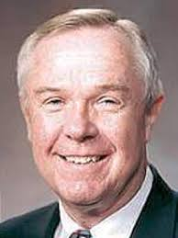
Unpopularity
The teachings of a living prophet are often contrary to the trends of the world. We, as Latter-day Saints… must understand that there is an expanding gulf between the standards of the world and those of the gospel and kingdom of God, and that living prophets will always teach the standards of God.
As much as we may want the gospel to accommodate to the world, it can’t, it won’t, it never has, and it never will.
Dennis B. Neuenschwander
How can we resist influences that attempt to persuade us against the words of prophets?
What are some appropriate ways to speak out against evil influences and in favor of the words of prophets?

Slide 6
Does the World Dictate How you live…
…Or Do You dictate Your own destiny?

Slide 7
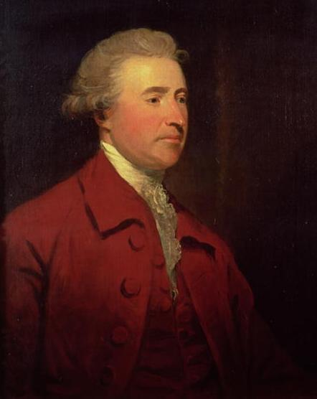
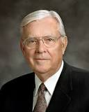
Raising Our Voices
We can raise our voices in support of the prophet, even when it is not the popular thing to do.
What difference did it make when some people supported the prophet?
Why do you think it is important for us to do this today?
“We need to raise our voices with other concerned citizens throughout the world in opposition to current trends. We need to tell the sponsors of offensive media that we have had enough. We need to support programs and products that are positive and uplifting. Joining together with neighbors and friends who share our concerns, we can send a clear message to those responsible”
Elder M. Russell Ballard
“The only thing necessary for the triumph of evil is for good men to do nothing.”
Edmund Burke
Helaman 8:7-9

Slide 8
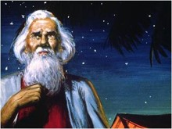
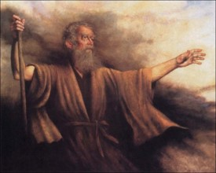
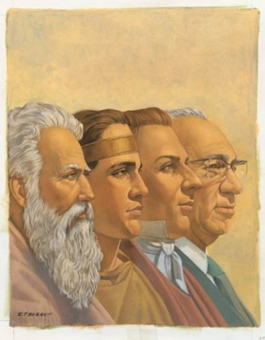
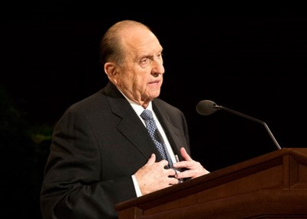
Prophets testify
Abraham (JST Genisis 15:12)
Zenos
Zenock
Ezias
Isaiah
All the sons of Zedekiah (Mulek)
(2 Kings 25:7)
Jeremiah (same prophet that testified of destruction of Jerusalem)
Lehi
Prophets of today
Moses 1:11
“But now mine own eyes have beheld God; but not my natural, but my spiritual eyes, for my natural eyes could not have beheld; for I should have withered and died in his presence; but his glory was upon me; and I beheld his face, for I was transfigured before him.”
Recorded in brass plates
Helaman 8:11-24

Slide 9
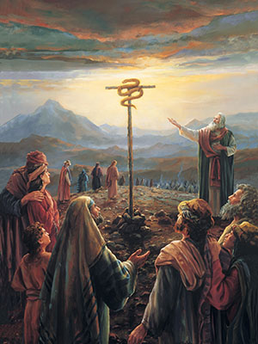
Look Upon With Faith
If we look upon the Son of God with faith, having a contrite spirit, then we will receive eternal life
Contrite Spirit= to be humble, repentant, and receptive to the Lord’s will
Helaman 8:15

Slide 10
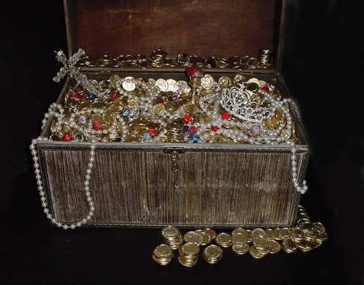
corruption
But behold, ye have rejected the truth, and rebelled against your holy God; and even at this time, instead of laying up for yourselves treasures in heaven, where nothing doth corrupt, and where nothing can come which is unclean, ye are heaping up for yourselves wrath against the day of judgment.
“Lay not up for yourselves treasures upon earth, where moth and rust doth corrupt, and where thieves break through and steal:
“But lay up for yourselves treasures in heaven, where neither moth nor rust doth corrupt, and where thieves do not break through nor steal:
“For where your treasure is, there will your heart be also.”
Matthew 6:19-21
Helaman 8:25

Slide 11
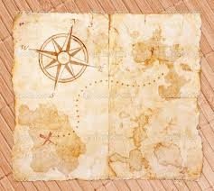
Treasures in Heaven
“The promised reward was not a treasure of ivory, gold, or silver. Neither did it consist of acres of land or a portfolio of stocks and bonds. The Master spoke of riches within the grasp of all—even joy unspeakable here and eternal happiness hereafter.
Today I have chosen to provide the three pieces of your treasure map to guide you to your eternal happiness.
They are:
1. Learn from the past.
2. Prepare for the future.
3. Live in the present.”
President Thomas S. Monson
Helaman 8:25

Slide 12
An Investigation
Day Two of the Investigation:
3. Who was set free?
(See Helaman 9:10–13, 18.)
4. Who was accused?
(See Helaman 9:16–17, 19.)
5. What additional information did Nephi share?
(See Helaman 9:25–36.)
6. Who was the murderer?
(See Helaman 9:37–38.)
Day One of the Investigation:
1. When five people investigated Nephi’s claims, what did they find? Why did they fall to the ground? (See Helaman 9:1–5.)
2. Who did the people suspect were the murderers?
(See Helaman 9:7–9.)
Helaman 9

Slide 13
Seezoram & Seantum
He was chief judge during the ministry of Nephi, son of Helaman
He was murdered by his brother, Seantum
He was the brother of Seezoram from about 23 to 20 BC
He murdered Seezoram
Nephi had announced this while preaching repentance to the people from his garden tower
Helaman 9:12-40 Who’s Who

Slide 14
Those who Believe
“And there were some of the Nephites who believed on the words of Nephi; and there were some also, who believed because of the testimony of the five, for they had been converted while they were in prison.
And now there were some among the people, who said that Nephi was a prophet.
And there were others who said: Behold, he is a god, for except he was a god he could not know of all things. For behold, he has told us the thoughts of our hearts, and also has told us things; and even he has brought unto our knowledge the true murderer of our chief judge.”
Nephi is a prophet
Nephi is a God
I believe the five testimonies
Helaman 9:39-41

Slide 15
Sources:
Joseph Fielding McConkie and Robert L. Millet Doctrinal Commentary of the Book of Mormon Vol. 3 pg. 373
http://www.ldsliving.com/story/72742-10-ways-to-support-your-bishop
Dennis B. Neuenschwander Living Prophets, Seers, and Revelators Oct. 2002 Gen. Conf.
Edmund Burke statement: [Attributed in John Bartlett, comp., Familiar Quotations, 15th ed. (1980), ix.]
Elder M. Russell Ballard (“Let Our Voices Be Heard,” Ensign or Liahona, Nov. 2003, 18).
First Counselor in the First Presidency Thomas S. Monson In Search of Treasure April 2003 Gen. Conf.
Book of Mormon Who’s Who by Ed J. Pinegar and Richard J. Allen pg 166-167
Video Presentation Option:
Instead of using the investigation activity in the lesson, you may want to show the video presentation titled “The Pride Cycle,” which is a depiction of the account in Helaman 7–9 and the first few verses in Helaman 10.
The presentation is available on Book of Mormon DVD Presentations 1–19 (54011) and LDS.org.
Presentation by ©http://fashionsbylynda.com/blog/

Slide 17
10 ways to support a bishop: (this could also be 10 ways to support the prophets)
1. Pray for him specifically, just as you would the prophet. A prayer uttered on behalf of someone, by name, can yield great results.
2. Magnify your calling. When members anxiously go about serving as they are assigned, the Lord blesses not only them but the entire ward with an outpouring of inspiration and unity.
3. The most difficult calling in the ward belongs to the bishop’s wife. Often times, my wife feels like the loneliest person in my ward. I am happy when my ward recognizes my wife’s (and my children’s) sacrifices.
4. Earnestly prepare when asked to speak in Sacrament meeting. Teach with the Spirit.
5. Never ask to be released. If circumstances change that are making it difficult for you to serve, inform your bishop and then allow him to seek inspiration. Don’t short-change yourself of heaven’s blessings because life gets a little hectic. 6. Make temple attendance a priority. When you go to the temple often, you are able to be a more effective instrument in the Lord’s hands, and you have a greater resistance to temptation and sin. Every bishop wants his ward to be unified, charitable, obedient, and willing to sacrifice. The temple helps in all those areas.
7. Don’t murmur or be contentious.
8. Be reverent, especially during the Sacrament.
9. Don’t just do your duty as a home or visiting teacher. Rather, truly minister to those you are called to serve. This is the first line of defense for a family, and an engaged home and visiting teacher can literally change a family’s life.
10. Follow his counsel—even when you see things a little differently. There is power and protection in following your leaders. This isn’t blind obedience, it is obedience founded on faith and trust. Those two things are very different.
Helaman 8:14-15 Brazen Serpent:
When Nephi spoke of Moses lifting up a “brazen serpent,” he referred to a time when the children of Israel were plagued by “fiery serpents” (see Numbers 21:6–9; note that the word brazen means brass). The prelude to the Israelites’ trouble was that they had spoken evil of God and His prophet (see Numbers 21:5). Those who looked at the brazen serpent were healed, and those who chose not to look at it perished (see Numbers 21:9; 1 Nephi 17:41).
Like those Israelites, many of the people in Nephi’s day spoke against God and His prophet. When Nephi referred to the account of the brazen serpent, he emphasized that his people should “look upon the Son of God with faith” and live (Helaman 8:15; see also John 3:14–15, in which Jesus Christ Himself referred to the brazen serpent as a symbol of His coming Crucifixion). Nephi then reminded the people that all the prophets had testified of Christ (see Helaman 8:16–23).

