Slide 2
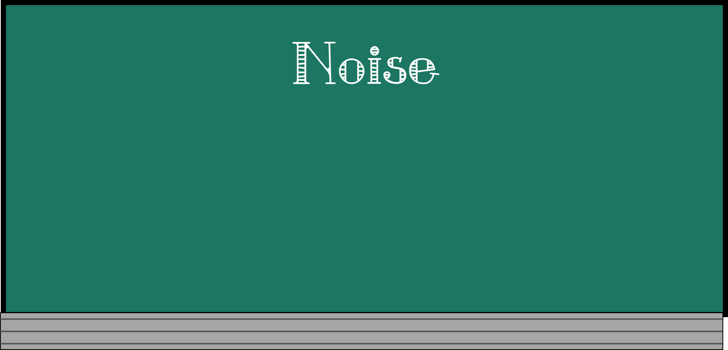
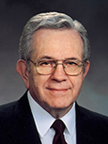
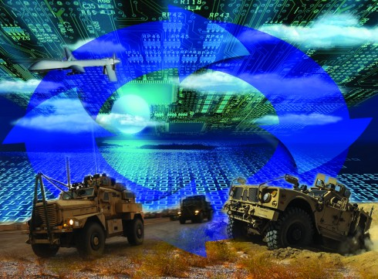
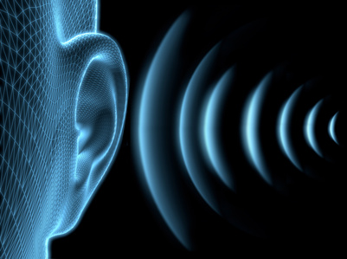
“something that attracts attention”
“This trend to more noise, more excitement, more contention, less restraint, less dignity, less formality is not coincidental nor innocent nor harmless.
“The first order issued by a commander mounting a military invasion is the jamming of the channels of communication of those he intends to conquer.”
Boyd K. Packer
Helaman 10:1-3

Slide 3
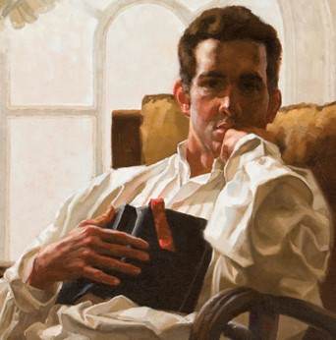
Pondering
Nephi realizes the division among the people
Pondering things of the Lord prepares us to receive revelation
To Ponder: to give serious reflection and thought to something.
Jessica Pingel
“Never did any passage of scripture come with more power to the heart of man than this did at this time to mine. It seemed to enter with great force into every feeling of my heart. I reflected on it again and again, knowing that if any person needed wisdom from God, I did; for how to act I did not know, and unless I could get more wisdom than I then had, I would never know;
for the teachers of religion of the different sects
understood the same passages of scripture so
differently as to destroy all confidence in settling
the question by an appeal to the Bible.”
Joseph Smith History 1:12
Helaman 10:1-3

Slide 4
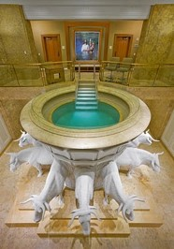
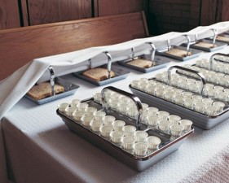
Receiving Your Own Revelations
When has pondering helped you receive personal revelation?
Receiving personal revelation is not usually as dramatic as some of the examples in the scriptures.
Revelatory experiences are usually moments of sudden enlightenment, such as when we suddenly understand something we have struggled with before.
During and after sacrament meeting
Before and after personal prayers and scripture study
After watching or listening to general conference
While fasting
While serving in the temple
While honoring the Lord on the Sabbath
What are some times or situations when pondering the things of the Lord would be especially appropriate?

Slide 5
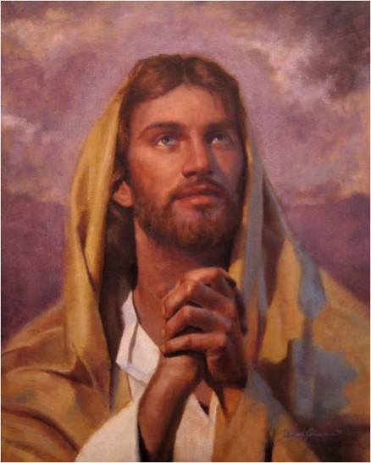
Seeking God’s Will
An eye single to the glory of God seek to only do which is pleasing to God. They strive to know the will of God.
Nephi had no desire to “do his own thing”
Jesus said, “And he that sent me is with me: the Father hath not left me alone; for I do always those things that please him.”
John 8:29
The Lord entrusts us with blessings and responsibilities when we seek His will and keep His commandments
Helaman 10:4

Slide 6
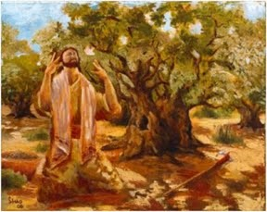
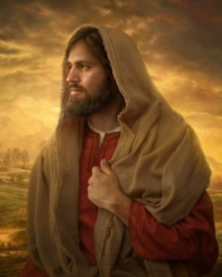
A Blessing Forever
“Even the timeless waves of eternity will not be able to wear away the blessings that God will place on the head of his faithful servant.”
JFM and RLM
A Representative of God:
Nephi’s words were God’s words and his works were to be God’s works.
All things were done according to the Word
The Word—Jesus Christ
“He that asketh in the Spirit asketh according to the will of God; wherefore it is done even as he asketh.”
D&C 46:30
Helaman 10:5

Slide 7
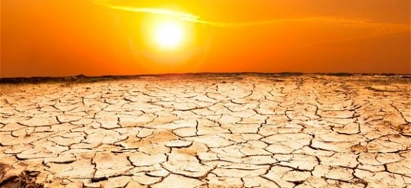
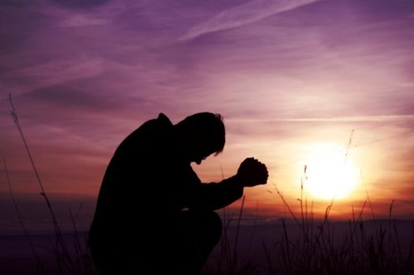
The Power
To have power over the people—smite the earth with famine, pestilence, and destruction---according to the wickedness of the people
“Beloved, if our heart condemn us not, then have we confidence toward God.
And whatsoever we ask, we receive of him, because we keep his commandments, and do those things that are pleasing in his sight.”
1 John 21-22
However:
“And it came to pass that after I had prayed and labored with all diligence, the Lord said unto me: I will grant unto thee according to thy desires, because of they faith.”
Enos 1:12
Helaman 10:5

Slide 8
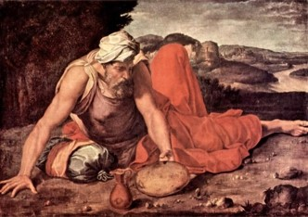
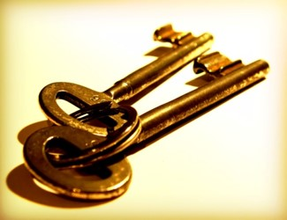
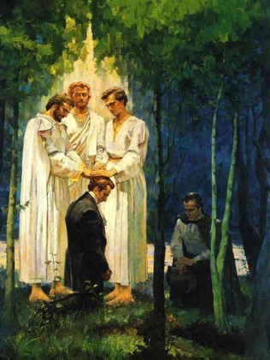
Keys of the Sealing Power
Same keys held by the prophet Elijah
The sealing power binds and looses on earth and in heaven
This authority is to bring forth blessings or to bring forth disasters
To seal (bind) on earth and in the heavens
The authority of these keys that Elijah sealed the heavens for three and half years, and by the same authority broke that seal and brought forth rain
(1 King 17: 1, 18:1, 45)
This authority was conferred upon Peter, James, and John on the Mount of Transfiguration
(Matthew 17:3)
And also on Joseph Smith and Oliver Cowdery
(D&C 110:13-16)
Helaman 10:6-7

Slide 9
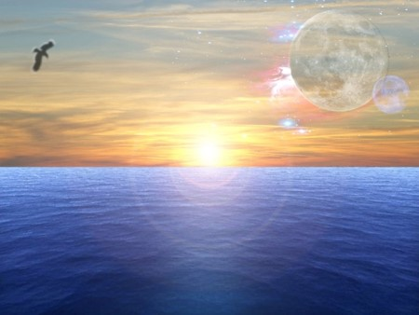
Nephi Was Given This Same Power
To Joseph Smith
“For I have conferred upon you the keys and power of the priesthood, wherein I restore all things, and make known unto you all things in due time.
And verily, verily, I say unto you, that whatsoever you seal on earth shall be sealed in heaven; and whatsoever you bind on earth, in my name and by my word, saith the Lord, it shall be eternally bound in the heavens; and whosesoever sins you remit on earth shall be remitted eternally in the heavens; and whosesoever sins you retain on earth shall be retained in heaven.
And again, verily I say, whomsoever you bless I will bless, and whomsoever you curse I will curse, saith the Lord; for I, the Lord, am thy God.”
(D&C 132:45-47)
Even though it is not mentioned more than likely these others had same power:
Lehi
Nephi
Jacob
Mosiah
Alma
Mormon
Moroni
How do we know this?
“And I, Nephi, did build a temple…”
2 Nephi 5:16—(see also Helaman 10:8)
“The fact that temples were established, sealings, marriages, and ordinances of the Melchizedek Priesthood were a part of their religious life”
JFM and RLM
Helaman 10:6-8
Phoenix-Kakashi19

Slide 10
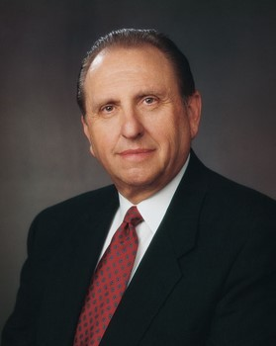
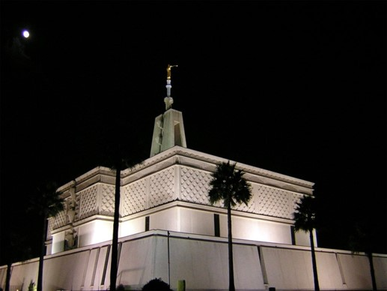
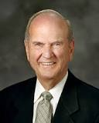
Responsibility of Church Presidents
The keys of this same power are held today by the President of The Church of Jesus Christ of Latter-day Saints. Like Nephi, the Presidents of the Church have served unwearyingly and shown that the Lord can entrust them with great blessings and responsibilities.
We most often refer to the sealing power in relation to the sealing of families through temple ordinances.
“Temples, ordinances, covenants, endowments, and sealings have been restored, precisely as prophesied.
Ordinances of the temple provide for reconciliation with the Lord and seal families together forever. Obedience to the sacred covenants made in temples qualifies us for eternal life—the greatest gift of God to man.”
Elder Russell M. Nelson

Slide 11
Nephi Returns to Preach
The power of God was with him
The people hardened their hearts
They sought to slay him
God protected him—he was ‘taken by the Spirit and conveyed away out of the midst of them’
With the Spirit he declared the word of God
The people hardened their hearts
The people began to be contentious and slay one another
What message might we send to others when we delay doing what they ask of us?
What do we show the Lord when we respond quickly to His counsel and commandments?
What does Nephi’s example teach us?
How can you show your determination to serve the Lord?
How did the Lord help Nephi?
When we respond promptly to the Lord’s direction, we will have His power to help us.
Helaman 10:11-19

Slide 12
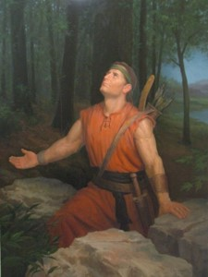
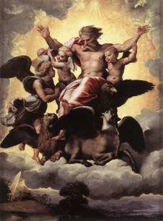
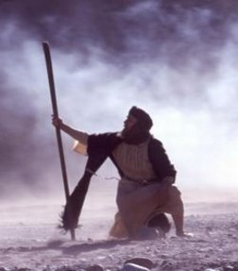
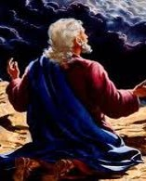
For He Was Taken By the Spirit
Ezekiel: “In the visions of God brought he me into the land of Israel, and set me upon a very high mountain, by which was as the frame of a city on the south.”
Ezekiel 40:2—transported from captivity in Babylon to the temple mount in Jerusalem
The other Nephi: “And upon the wings of his Spirit hath my body been carried away upon exceedingly high mountains. And mine eyes have beheld great things, yea, even too great for man; therefore I was bidden that I should not write them.”
2 Nephi 4:25
John the Revelator: “And he carried me away in the spirit to a great and high mountain, and shewed me that great city, the holy Jerusalem, descending out of heaven from God,”
Revelation 21:10
Moses: “The words of God, which he spake unto Moses at a time when Moses was caught up into an exceedingly high mountain,”
Moses 1:1
Helaman 10:16-17

Slide 13
Sources:
Video:
The Sealing Power (3:38)
Boyd K. Packer “Reverence Invites Revelation,” Ensign, Nov. 1991, 22).
Joseph Fielding McConkie and Robert L. Millet Doctrinal Commentary on the Book of Mormon Vol. 3 pg. 285-287
Elder Russell M. Nelson (“Prepare for the Blessings of the Temple,” Ensign, Oct. 2010, 42).
The end of the 71st year of the Reign of the Judges
Presentation by ©http://fashionsbylynda.com/blog/

