Slide 2
The Cycle
1.
Righteousness and Prosperity
4.
Remembering the Lord:
Humility and Repentance
2.
Forgetting the Lord:
Pride and Wickedness
3.
Suffering and Destruction

Slide 3
Helaman 11
The people rejoice and glorify God. They are righteous, and they begin to prosper again
Verses 21-23
Stage 3,4
Because of Nephi’s request to the Lord, famine replaced war, and thousands begin to perish with hunger
Verses 3-6
The robbers kill many people and carry some people, including women and children, captive into the wilderness. The trials lead the people to remember the Lord
Verse 27-35
Prosperity and peace are restored. Contentions are small, and they are resolved by revelations and gospel teaching
Verse 21-23
Stage 2,3
Stage 2,3
The Reign of the Judges
Stage 4,1
72-73
73-75
75
76
77-79
80
80-81
Contention and wars increase, and the secret band of robbers carries on the work of destruction
Verses 1-2
The People begin to remember the Lord and humble themselves, and they sweep the band of Gadianton from
among them
Verses 17-20
The people become prideful angry, and wicked again. A Wicked band of robbers develops again among the people, with their murders and secret plans.
The robbers cause havoc and destruction, and the armies of the Nephites and Lamanites are unable to destroy the wicked band
Verses 24-26
Stage 3,4
Stage 2,3
Stage 1
Description of the People’s Condition
Helaman 11

Slide 4
Recurring Cycles of Nations
“Great nations rise and fall—the people go from bondage to spiritual faith,
from spiritual faith to great courage,
from courage to liberty,
from liberty to abundance,
from abundance to selfishness,
from selfishness to complacency,
from complacency to apathy,
from apathy to dependency,
from dependency back again into bondage.”
Robert Muntzel
74th year
Helaman 11

Slide 5
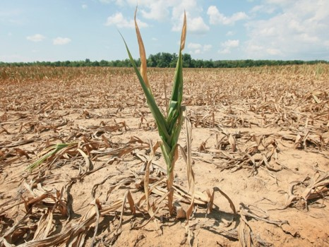
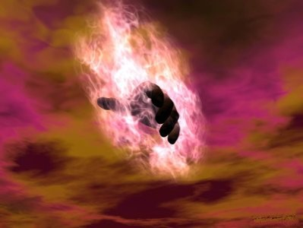
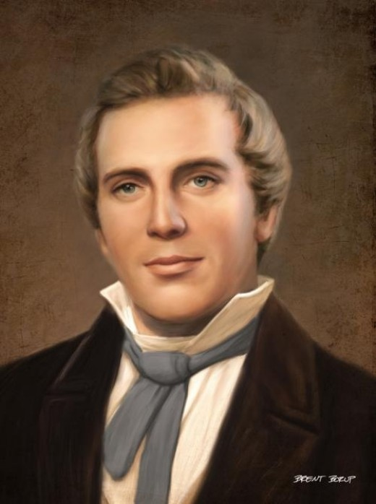
Famine—Getting the Attention of the Rebellious
A famine is a widespread scarcity of food, caused by several factors including crop failure, population unbalance, or government policies. This phenomenon is usually accompanied or followed by regional malnutrition, starvation, epidemic, and increased mortality.
Nearly every continent in the world has experienced a period of famine throughout history. Some countries, particularly in sub-Sahara Africa, continue to have extreme cases of famine.
74th year
Nephi had the power from God to send famine among the people
“Behold I speak for mine elect’s sake; for nation shall rise against nation, ad kingdom against kingdom; there shall be famines, and pestilences, and earthquakes, in divers places”
Joseph Smith—Matthew 1:29
Read D&C 43:25
Helaman 11:1-23
Helaman 11

Slide 6
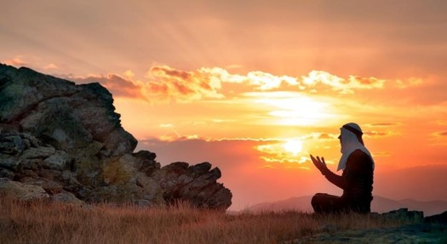
Getting Back on Track
Through humility and repentance, we can avoid pride and destruction.
74th year
The Nephites could have lived righteously and humbly always, repenting without delay whenever they sinned. If they had lived this way, they still would have experienced some trials, but they would not have needed to endure the terrible suffering and destruction that came as a result of their wickedness.
How long after remembering the Lord did it take for the Nephites to be “ripening again for destruction”?
4 years
Helaman 11

Slide 7
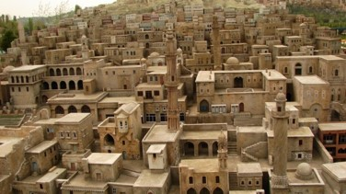
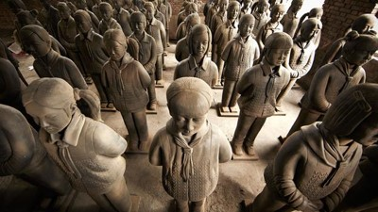
Nations Decline
Worship of money
Loss of idealism
Good men staying away from politics
The lessening of national pride as people become concerned with only their private affairs
A preponderance of the great cities
A general desire to limit the number of children
The loss of respect for representative government
The substitution of ‘unparliamentary methods’ such as economic pressure
Above all—anti-national peace movements which mean the abdication of the nation not in favor of everlasting peace
Oswald Spengler
74th year
Helaman 11

Slide 8
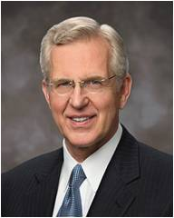
Chasten
Chasten means to correct someone through punishment or suffering of some kind
If we are not careful, our prosperity can lead us to forget the Lord; the Lord chastens His people to stir them up in remembrance of Him
74th year
“Divine chastening has at least three purposes:
(1) to persuade us to repent,
(2) to refine and sanctify us, and
(3) at times to redirect our course in life to what God knows is a better path”
Elder D. Todd Christofferson
Why do you think people who are prosperous sometimes forget the Lord?
Why do you think people sometimes need to be chastened before they remember the Lord?
Helaman 12:2-3
Helaman 11

Slide 9
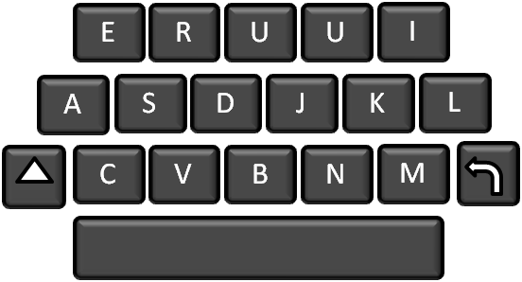
Quick or Slow
How r u?
How quick are you to reply a text from a friend?
74th year
How quick are you at trying something new?
How quick are you at getting up in the morning?
How quick are you at completing an assignment?
Helaman 12:4-6
Helaman 11

Slide 10
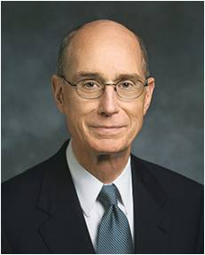
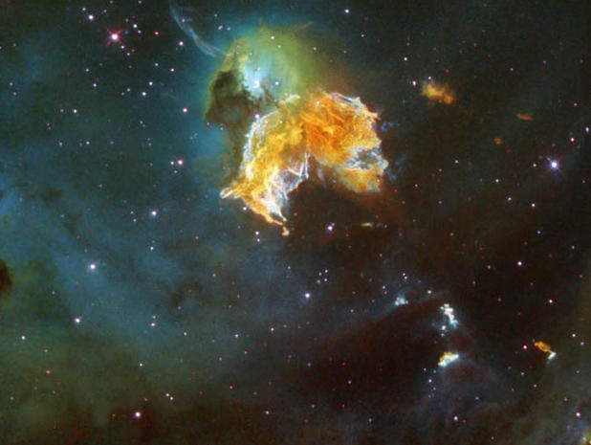
Easy to Forget
“We so easily forget that we came into life with nothing. Whatever we get soon seems our natural right, not a gift. And we forget the giver. Then our gaze shifts from what we have been given to what we don’t have yet. …
74th year
“Confronting death and difficulty does return memory and therefore gratitude to righteous people as well as the wicked. But there must be another way to remember, one we can choose. …
“You can choose to remember the greatest gift of all.
Next week, you can go to a meeting where the sacrament is administered. You will hear the words, ‘Always remember him.’ You can pledge to do that, and the Holy Ghost will help you” Henry B. Eyring
Helaman 11

Slide 11
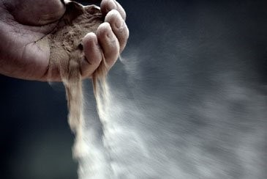
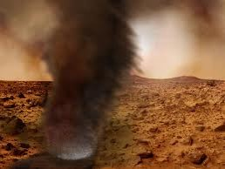
Less Than the Dust
Why could such people be considered “less than the dust of the earth”?
Mormon was not teaching that people are of less worth to Heavenly Father than the dust of the earth. Rather, he was drawing attention to the fact that dust always obeys God’s commands, but people often do not.
74th year
“For behold, if the knowledge of the goodness of God at this time has awakened you to a sense of your nothingness, and your worthless and fallen state—”
Mosiah 4:5
Helaman 12:7
Helaman 11

Slide 12
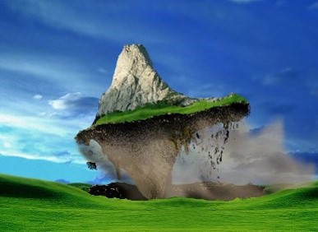
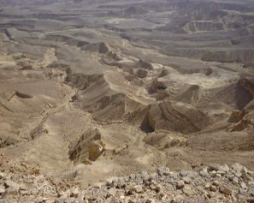
The Power of God
Mormon reminds us of the Lord’s great power—that the Lord can command physical elements to move or change and that He can cause a sinful person to be cut off from His presence.
74th year
“Every valley shall be exalted, and every mountain and hill shall be made low: and the crooked shall be made straight, and the rough places plain:”
Isaiah 40:4
“And it shall be a voice as the voice of many waters, and as the voice of a great thunder, which shall break down the mountains, and the valleys shall not be found.
He shall command the great deep, and it shall be driven back into the north countries, and the islands shall become one land;
And the land of Jerusalem and the land of Zion shall be turned back into their own place, and the earth shall be like as it was in the days before it was divided.”
D&C 133:22-24
Helaman 12:9-13
Helaman 11

Slide 13
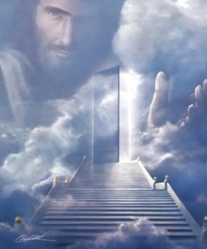
All Men Might Be Saved
“No person came into this life incapable of gaining salvation”
JFM and RLM
74th year
“We believe that through the Atonement of Christ all mankind may be saved by obedience to the laws and ordinances of the Gospel.”
Articles of Faith 1:3
“The contention in heaven was—Jesus said there would be certain souls that would not be saved; and the devil said he could save them all.”
Joseph Smith
“And I pray the Father in the name of Christ that many of us, if not all, may be saved in his kingdom at that great and last day.”
2 Nephi 33:12
Helaman 12:25
Helaman 11

Slide 14
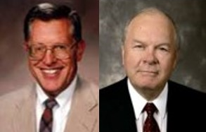
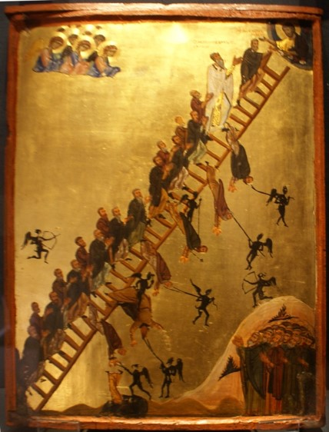
Everlasting Damnation
74th year
“The phrase “everlasting life” describes more than a life that does not end; it is descriptive of the kind and quality of life enjoyed by the obedient and faithful, the life of exalted and glorified beings.
Conversely, “everlasting damnation” is not properly understood to mean an endless stint in hell, but rather is descriptive of the kind of punishment—Gods’ punishment—which will be meted out to the defiant”
JFM and RLM
Read D&C 19:4-12
Helaman 12:26
Helaman 11

Slide 15
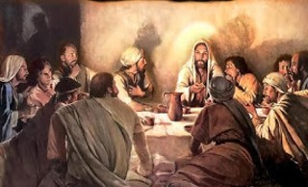
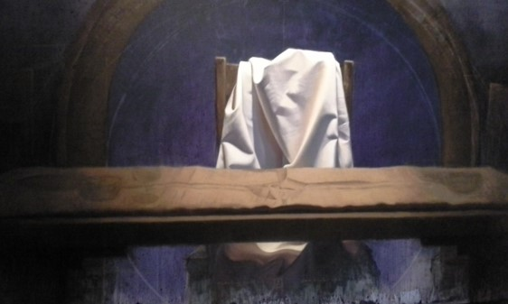
Let Us Remember Our God
“…be not faithless, but believing” John 20:27
“Let us not personally be diverted from our course
Let us seek the Lord to establish his righteousness (D&C 1:16)
Let us prove worthy to live with him eternally in the heavens.
Let us not be deceived by the learning and sophistries and the wickedness of this world
Let us not forget that God lives, that we are his children, that his purpose is to bring us to immortality and eternal life.
Let us love the Lord our God with all our heart, soul, mind, and strength.
Let us be constantly aware that we are living in the last gospel dispensation and that Satan has all his forces for war in this final premillennium stage
Let us understand that the Church of Jesus Christ of latter-day Saints is the literal kingdom of God in the earth”
Excerpts from Romney
74th year
Helaman 11

Slide 16
Sources:
Video: Power in the Priesthood (1:37)
Robert Muntzel (Manage Magazine, January, 1961) from Student Manual Religion 121-122 pg 369
http://en.wikipedia.org/wiki/Famine
Elder D. Todd Christofferson (“As Many as I Love, I Rebuke and Chasten,” Ensign or Liahona, May 2011, 98).
Oswald Spengler (Today and Destiny: vital Excerpts from Decline of the West of Oswald Spengler, arranged by Edward F. Dakin.) (Ernest L. Wilkinson, BYU commencement address, 21 Aug. 1970, p. 6.) from Student Manual Religion 121-122 pg. 370
Excerpts from Romney, Look to God and Live pp. 12-13---from Student Manual Religion 121-122 pg. 371
Joseph Smith McConkie and Robert L. Millet Doctrinal Commentary on the Book of Mormon Vol. 3 pg. 397
Henry B. Eyring, “Remembrance and Gratitude,” Ensign, Nov. 1989, 12, 13).
Joseph Smith Teachings pg. 357
Ladder of Divine Ascent Sinai 12th century.jpg
Presentation by ©http://fashionsbylynda.com/blog/

Slide 17
Helaman 11
The people rejoice and glorify God. They are righteous, and they begin to prosper again
Verses 21-23
Stage 3,4
Because of Nephi’s request to the Lord, famine replaced war, and thousands begin to perish with hunger
Verses 3-6
The robbers kill many people and carry some people, including women and children, captive into the wilderness. The trials lead the people to remember the Lord
Verse 27-35
Prosperity and peace are restored. Contentions are small, and they are resolved by revelations and gospel teaching
Verse 21-23
Stage 2,3
Stage 2,3
The Reign of the Judges
Stage 4,1
72-73
73-75
75
76
77-79
80
80-81
Contention and wars increase, and the secret band of robbers carries on the work of destruction
Verses 1-2
The People begin to remember the Lord and humble themselves, and they sweep the band of Gadianton from
among them
Verses 17-20
The people become prideful angry, and wicked again. A Wicked band of robbers develops again among the people, with their murders and secret plans.
The robbers cause havoc and destruction, and the armies of the Nephites and Lamanites are unable to destroy the wicked band
Verses 24-26
Stage 3,4
Stage 2,3
Stage 1
Description of the People’s condition

Slide 18
Righteousness
Helaman 11-13
11:18-19
Reign of Judges
76th Year
Humility and Repentance
Prosperity and Blessings
Remembering the Lord
11:7-11
End in peace
11:20-21
Reign of Judges
76th Year
3rd Cycle of Nephite Disease
Destruction and Suffering
Pride
Start
11:24 (War)
11:37
Reign of Judges
80th-85th Year
Secret robbers/famine
11:2-6
Reign of Judges
72nd - 76th Year
11:6 earth smitten
11:6 death toll high
Wickedness
13:1
Reign of Judges
86th Year
11:26 Secret Combinations
13:8 Spirit Withdrawal
Prophecy of Samuel the Lamanite
16:10 Majority Choose Evil

Slide 19
“In 1787 Edward Gibbon completed his noble work The Decline and Fall of the Roman Empire. Here is the way he accounted for the fall.
The undermining of the dignity and sanctity of the home, which is the basis of human society.
2 Higher and higher taxes and the spending of public monies for free bread and circuses for the populace.
3. The mad craze for pleasure, sports becoming every year more and more exciting and brutal.
4. The building of gigantic armaments when the real enemy was within the decadence of the people.
5. The decay of religion—faith fading into mere form, losing touch with life, and becoming impotent to warn and guide the people.
Is there a parallel for us in America today? Could the same reasons that destroyed Rome destroy America?...The lessons of history, many of them very sobering, ought to be turned to during this hour of our great achievements, because during the hour of our success is our greatest danger. Even during the hour of our great prosperity, a nation may sow the seeds of its own destruction. History reveals that rarely is a great civilization conquered from without unless it has weakened or destroyed itself within.”
--Ezra Taft Benson (God, Family, Country, pp. 363-364)

