Slide 2
Samuel
He was sent by the Lord in 6 BC to call the people of Zarahemla to repentance
This was on the eve of the birth of the Savior in the Holy Land (Helaman 13:2)
He quoted an angel who had been sent to instruct him and spoke on top of a city wall
He prophesied of a day and a night and a day without darkness at the time of the Savior’s birth
He prophesied of three days of darkness between the death of the Savior and the Resurrection of the Savior
He prophesied of many catastrophic upheavals across the land at the moment of the Savior’s death
He prophesied of many who would rise from their graves and appear to the people
Many people believed Samuel and sought out Nephi to baptize them
Some unbelievers threw stones and shot arrows at him, but he was protected by the Spirit of the Lord
He found himself under assault from their captains and was force to flee back to his own land
He was never heard of again
Who’s Who

Slide 3
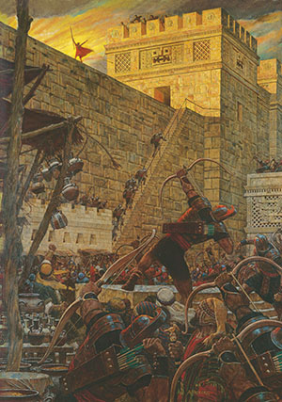
The Prophet Samuel
86th Year of the Reign of the Judges
Samuel declares that because of the Nephites’ wickedness, the Lord will curse the land so the wicked will not be able to retain the riches they hide in the earth.
The Lord calls Samuel the Lamanite to preach to the Nephites.
Samuel warns the people of the consequences of rejecting the prophets and refusing to repent.
Samuel Warns the Nephites that they will be destroyed within 400 years if they do not repent.
Helaman 13:1–4
Helaman 13:5-16
Helaman 13:17-23
Helaman 13:24-39
The prophet Samuel did not take it upon himself to decide what to preach to the Nephites.

Slide 4
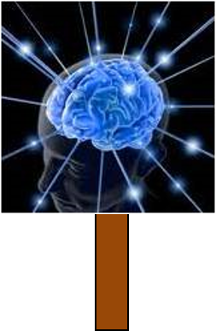
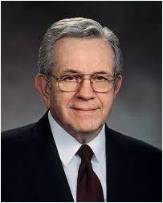
Whatsoever Things Should Come Into His Heart
Expressions of Revelation:
‘The veil was taken from our minds, and the eyes of our understanding were opened
‘I will tell you in your mind and in your heart,’
‘I did enlighten thy mind,’
‘Speak the thoughts that I shall put into your hearts.’
Prophets speak the messages God puts into their hearts.
“Revelation comes as words we feel more than hear.
Nephi told his wayward brothers, who were visited by an angel, ‘Ye were past feeling, that ye could not feel his words.’
There are hundreds of verses which teach of revelation”
President Boyd K. Packer
Helaman 13:1-4

Slide 5
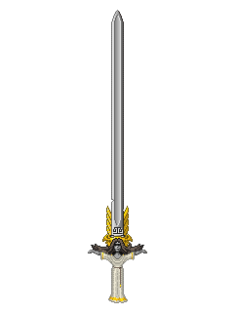
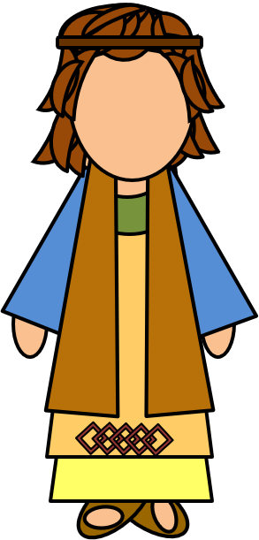
The Sword of Justice Hangeth Over This People
Prophesied by Alma:
But behold, I have somewhat to prophesy unto thee; but what I prophesy unto thee ye shall not make known; yea, what I prophesy unto thee shall not be made known, even until the prophecy is fulfilled; therefore write the words which I shall say.
And these are the words: Behold, I perceive that this very people, the Nephites, according to the spirit of revelation which is in me, in four hundred years from the time that Jesus Christ shall manifest himself unto them, shall dwindle in unbelief.
Yea, and then shall they see wars and pestilences, yea, famines and bloodshed, even until the people of Nephi shall become extinct
Helaman 13:5 and Alma 45:9-11

Slide 6
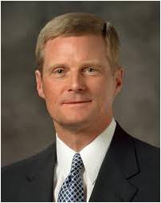
Spirit Taken Away
If we do not repent, then the Lord will withdraw the Holy Spirit from us
“We should also endeavor to discern when we “withdraw [ourselves] from the Spirit of the Lord, that it may have no place in [us] to guide [us] in wisdom’s paths that [we] may be blessed, prospered, and preserved”
(Mosiah 2:36).
Precisely because the promised blessing is that we may always have His Spirit to be with us, we should attend to and learn from the choices and influences that separate us from the Holy Spirit.”
David A. Bednar
Helaman 13:8

Slide 7
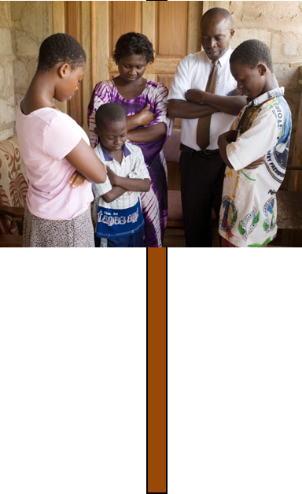
The Wicked are Spared Because of the Righteous
The Righteous will suffer because of the transgressions of others,
Nevertheless the Lord goes to great lengths to protect and spare the righteous.
Amulek:
“But it is by the prayers of the righteous that ye are spared; now therefore, if ye will cast out the righteous from among you then will not the Lord stay his hand; but in his fierce anger he will come out against you; then ye shall be smitten by famine, and by pestilence, and by the sword; and the time is soon at hand except ye repent.”
Alma 10:23
If we repent and return unto the Lord, then we will be blessed
Helaman 13:10-14

Slide 8
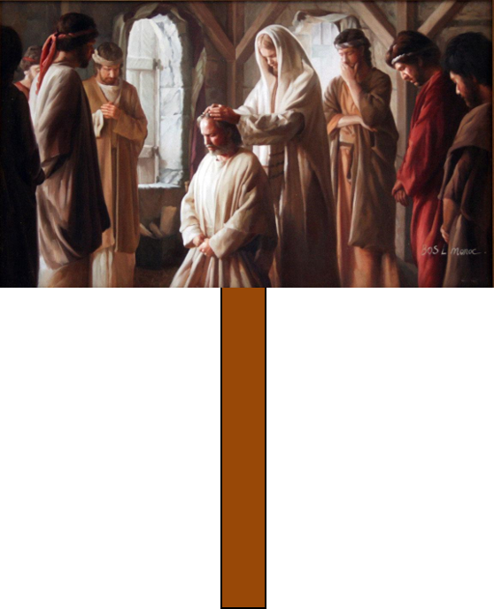
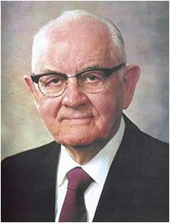
Prophets Rejected
“Sometimes people let their hearts get so set upon things and the honors of this world that they cannot learn the lessons they most need to learn. Simple truths are often rejected in favor of the much less demanding philosophies of men, and this is another cause for the rejection of the prophets. ..
Jesus said to his newly appointed apostles “And ye shall be hated of all men for my name’s sake: but he that endureth to the end shall be saved.”
The holy prophets have not only refused to follow erroneous human trends, but have pointed out these errors. No wonder the response to the prophets has not always been one of indifference. So often the prophets have been rejected because they first rejected the wrong ways of their own society.”
Spencer W. Kimball
Helaman 13:24-29

Slide 9
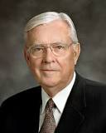
“My dear brothers and sisters, please pay attention to those things that the leaders of the Church have taught. …
Apply the teachings that will help you and your family. Let all of us, regardless of our family circumstances, bring into our homes the teachings of the prophets and the apostles to strengthen our relationships with each other and with our Father in Heaven and with the Lord Jesus Christ.
I promise you in the name of the Lord that if you will listen not just with your ears but also with your heart, the Holy Ghost will manifest the truth unto you of the messages delivered by [the President of the Church], his counselors, the Apostles, and other leaders of the Church.
The Spirit will prompt you to know what you should do as individuals and as families in order to follow our counsel, that your testimonies might be strengthened and that you might have peace and joy.”
Elder M. Russell Ballard
Helaman 13:27

Slide 10
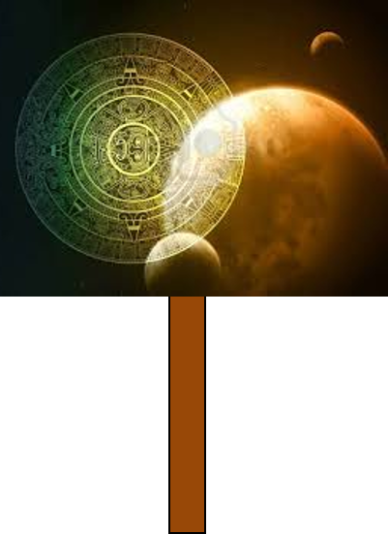
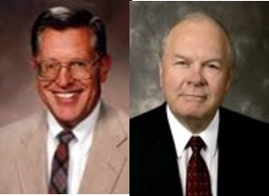
Treasures Are To Be Buried
“Because the Nephites had become worshippers of worldly things and had made gold, silver, and other precious things to the god to whom they bowed and to whom they rendered their praise and their offering of homage; the true and living God threatened that a curse would come upon the land, causing their riches to vanish and their buried treasures to disappear, never to be found again.”
JFM and RLM
Helaman 13:17-23

Slide 11
Procrastinate
“As the day will come when every corruptible thing upon the earth will be destroyed, so the day will come when every individual must account for that which he chose to do, as well as for that which he chose to leave undone. Those who chose to forget the Lord their God will have a bright recollection restore to them of all their forgetfulness.”
JFM and RLM
“And they shall be servants of the Most High; but where God and Christ dwell they cannot come, worlds without end.”
D&C 76:112
These are those who use their mortal probation on earth unwisely--
“Though they may accept the gospel there, to their everlasting benefit; they will have forfeited the chance for exaltation”
See D&C 76:73-75
If we reject the words of the Lord’s prophets, we will experience regret and sorrow
Helaman 13:30-39

Slide 12
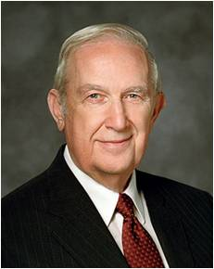
“Have you noticed how Satan works to capture the mind and emotions with flashing images, blaring music, and the stimulation of every physical sense to excess? He diligently strives to fill life with action, entertainment, and stimulation so that one cannot ponder the consequences of his tempting invitations. Think of it.
Some are tempted to violate the most basic commandments of God because of seductive actions portrayed as acceptable. They are made to seem attractive, even desirable. There seems to be no serious consequence, rather apparent lasting joy and happiness. But recognize that those performances are controlled by scripts and actors. The outcome of decisions made is likewise manipulated to be whatever the producer wants.
“Life is not that way. Yes, moral agency allows you to choose what you will, but you cannot control the outcome of those choices. Unlike the false creations of man, our Father in Heaven determines the consequences of your choices. Obedience will yield happiness, while violation of His commandments will not”
Elder Richard G. Scott
Helaman 13:38

Slide 13
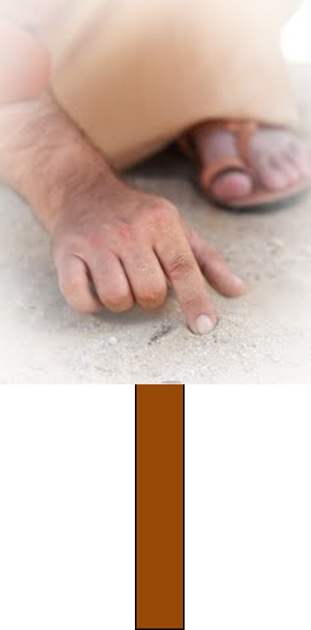
President Spencer W. Kimball taught:
“It is true that the great principle of repentance is always available, but for the wicked and rebellious there are serious reservations to this statement. For instance, sin is intensely habit-forming and sometimes moves men to the tragic point of no return.
Without repentance there can be no forgiveness, and without forgiveness all the blessings of eternity hang in jeopardy. As the transgressor moves deeper and deeper in his sin, and the error is entrenched more deeply and the will to change is weakened, it becomes increasingly near-hopeless, and he skids down and down until either he does not want to climb back or he has lost the power to do so.”
Helaman 13:38

Slide 14
Sources:
Book of Mormon Who’s Who by Ed J. Pinegar and Richard J. Allen pg. 162-162
President Boyd K. Packer(“Personal Revelation: The Gift, the Test, and the Promise,” Ensign, Nov. 1994, 60).
David A. Bednar That We May Always Have His Spirit to Be with Us April 2006
Joseph Fielding McConkie and Robert L. Millet Doctrinal Commentary on the Book of Mormon Vol. 3 pg.403
Spencer W. Kimball Listen to the Prophets Ensign, May 1978 and (The Miracle of Forgiveness [1969], 117).
Elder M. Russell Ballard (“His Word Ye Shall Receive,” Ensign, May 2001, 67).
Elder Richard G. Scott (“How to Live Well amid Increasing Evil,” Ensign or Liahona, May 2004, 102).
Presentation by ©http://fashionsbylynda.com/blog/

Slide 16
Helaman 13:30-33:
“How we respond to the words of a living prophet when he tells us what we need to know, but would rather not hear, is a test of our faithfulness” (Ezra Taft Benson, “Fourteen Fundamentals in Following the Prophet” [Brigham Young University devotional, Feb. 26, 1980], 3–4, speeches.byu.edu).
Helaman 13:38-39:
“During my training to become an airline captain, I had to learn how to navigate an airplane over long distances. Flights over huge oceans, crossing extensive deserts, and connecting continents need careful planning to ensure a safe arrival at the planned destination. Some of these nonstop flights can last up to 14 hours and cover almost 9,000 miles.
“There is an important decision point during such long flights commonly known as the point of safe return. Up to this point the aircraft has enough fuel to turn around and return safely to the airport of departure. Having passed the point of safe return, the captain has lost this option and has to continue on. That is why this point is often referred to as the point of no return.
“… Satan wants us to think that when we have sinned we have gone past a ‘point of no return’—that it is too late to change our course. …
“… To make us lose hope, feel miserable like himself, and believe that we are beyond forgiveness, Satan might even misuse words from the scriptures that emphasize the justice of God, in order to imply that there is no mercy. …
“Christ came to save us. If we have taken a wrong course, the Atonement of Jesus Christ can give us the assurance that sin is not a point of no return. A safe return is possible if we will follow God’s plan for our salvation” (Dieter F. Uchtdorf, “Point of Safe Return,” Ensign or Liahona, May 2007, 99).

