Slide 2
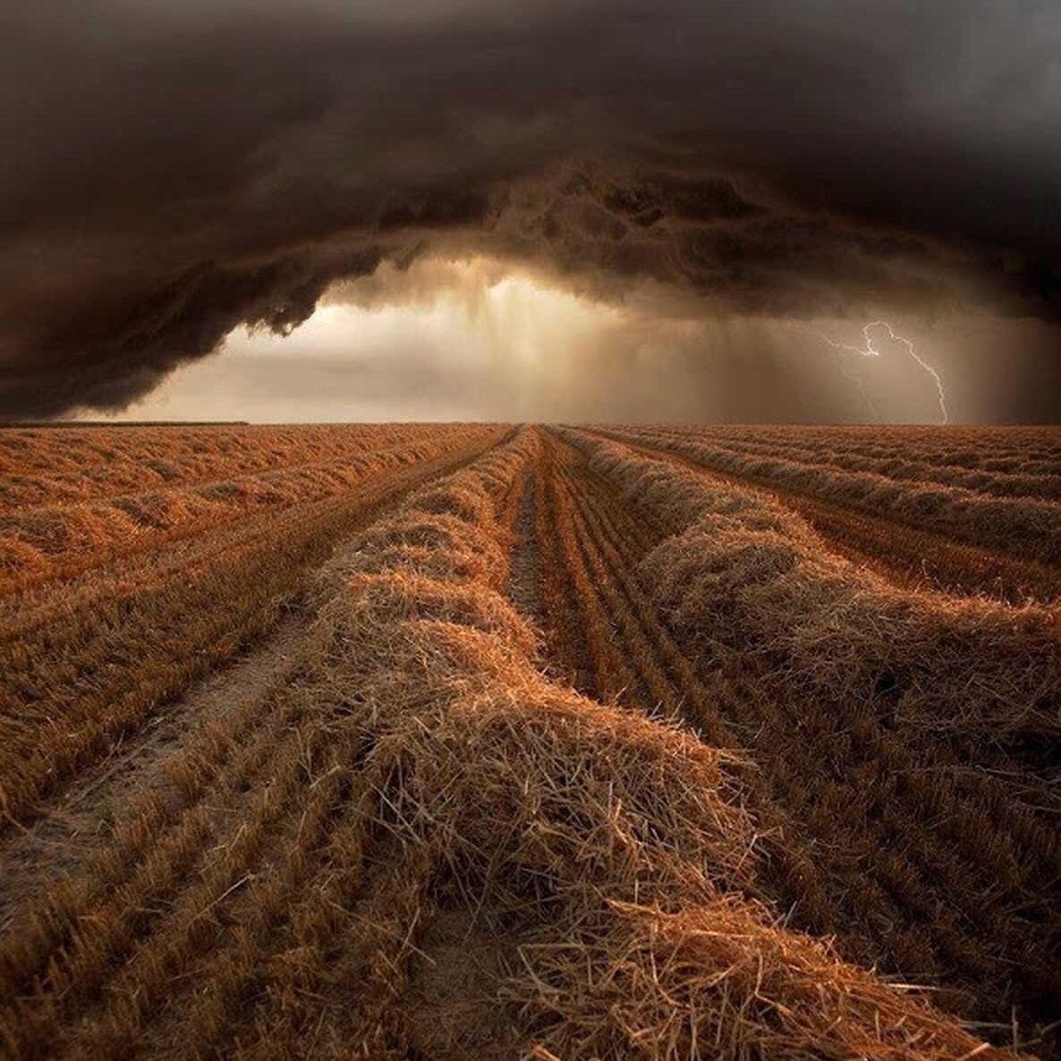
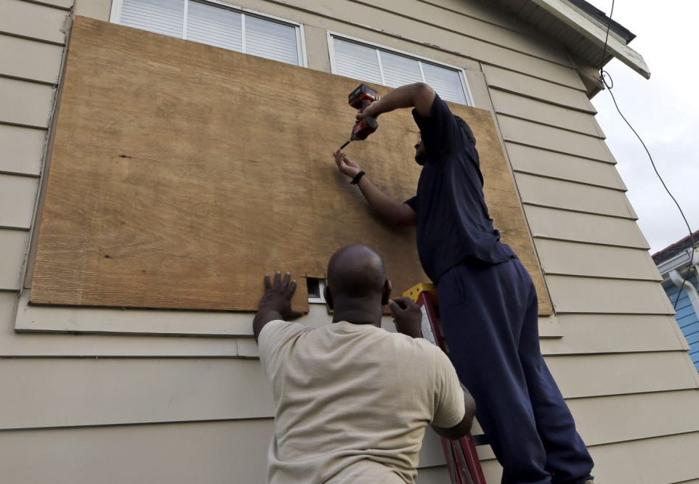
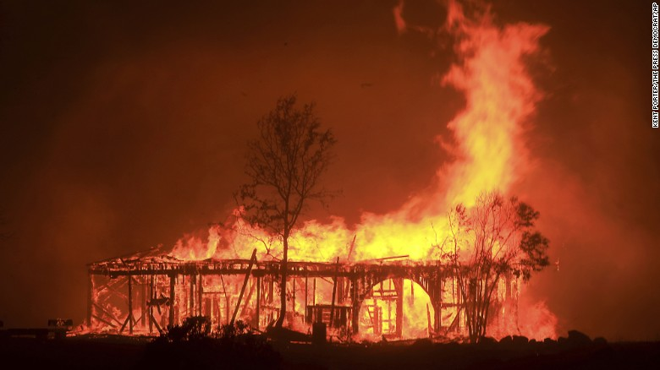
What are some signs that can indicate that a storm is coming?
How do people respond when they see these signs?
What kind of signs does God give?
Why do you think He gives signs?
What could be the danger in not recognizing or paying attention to these signs?

Slide 3
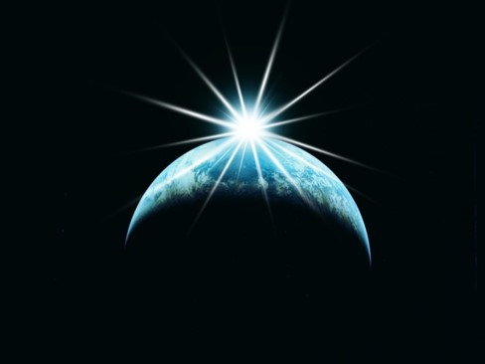
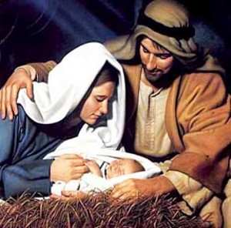
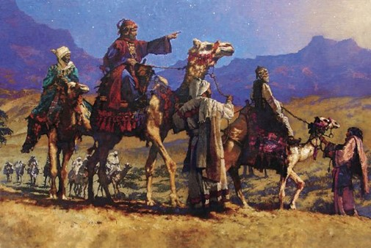
The Signs
A Great Light in the Heavens—no darkness—the Son of God is born
A new star arise—many wonders in heaven—”We have seen a star in the east and we have come to worship him”
(JST Matthew 3:2)
“When they had heard the king, they departed; and, lo, the star, which they saw in the east, went before them, till it came and stood over where the young child was.
When they saw the star, they rejoiced with exceeding great joy.”
Matthew 2:9-10
“And it shall come to pass that ye shall all be amazed, and wonder, insomuch that ye shall fall to the earth”
Helaman 14:1-7

Slide 4
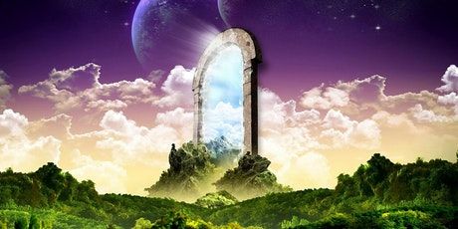
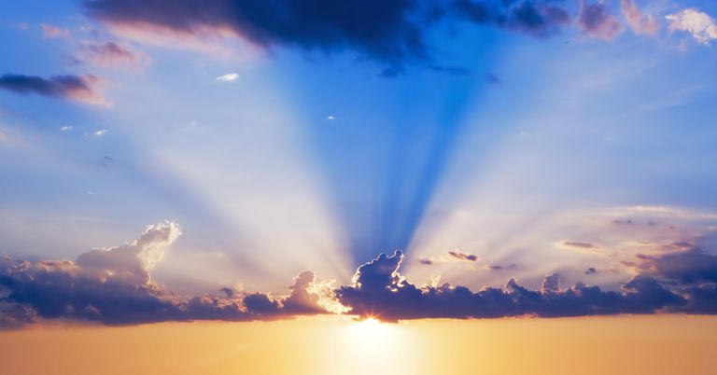
Everlasting Life
And, if you keep my commandments and endure to the end you shall have eternal life, which gift is the greatest of all the gifts of God.
D&C 14:7
For behold, this is my work and my glory—to bring to pass the immortality and eternal life of man.
Moses 1:39
Helaman 14:7-10

Slide 5
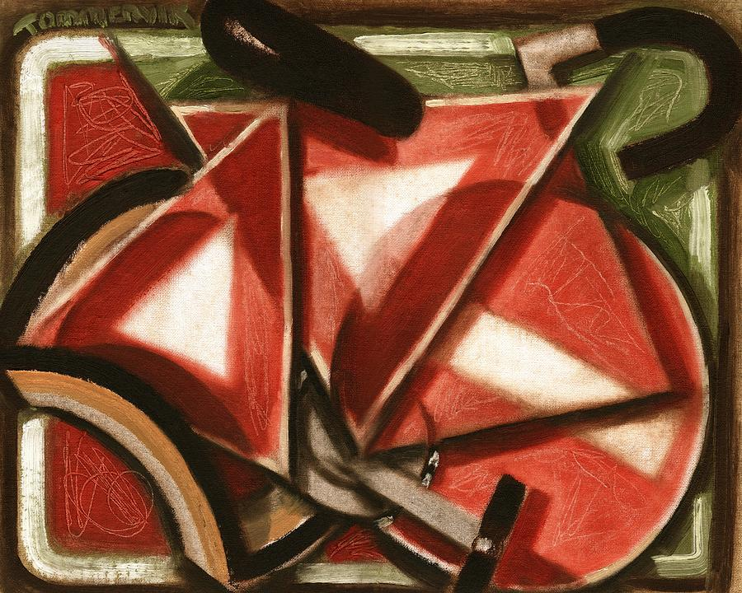
Recognizing Signs
Recognizing signs from God can help us believe on the name of Jesus Christ and repent of our sins.
Many scripture passages caution us not to seek signs.
When prophets warn against seeking signs, they refer to people who refuse to believe unless they are shown signs, not to people who exercise faith in seeking miracles according to the Lord’s will.
Tommervik
Helaman 14:11-14

Slide 6
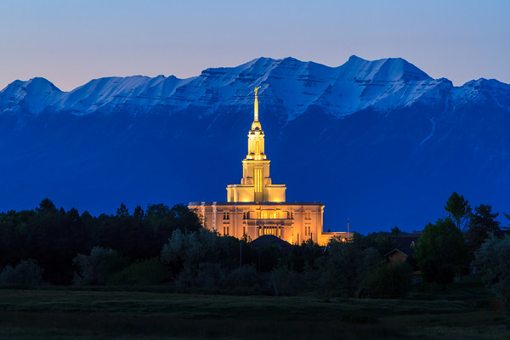
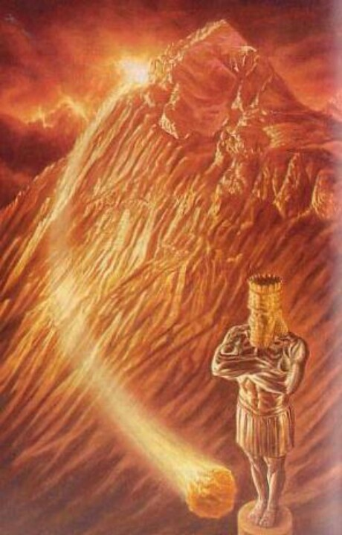
Signs of the Coming of the Savior
And in the days of these kings shall the God of heaven set up a kingdom, which shall never be destroyed: and the kingdom shall not be left to other people, but it shall break in pieces and consume all these kingdoms, and it shall stand for ever.
Daniel 2:44
The prophecy of the church covering the entire earth, a stone cut “out of a mountain without hands”, meaning that it is Gods’ work, not man’s.
Payson
And it shall come to pass in the last days, when the mountain of the Lord’s house shall be established in the top of the mountains, and shall be exalted above the hills, and all nations shall flow unto it.
And many people shall go and say, Come ye, and let us go up to the mountain of the Lord, to the house of the God of Jacob; and he will teach us of his ways, and we will walk in his paths; for out of Zion shall go forth the law, and the word of the Lord from Jerusalem. 2 Nephi 12:2-3

Slide 7
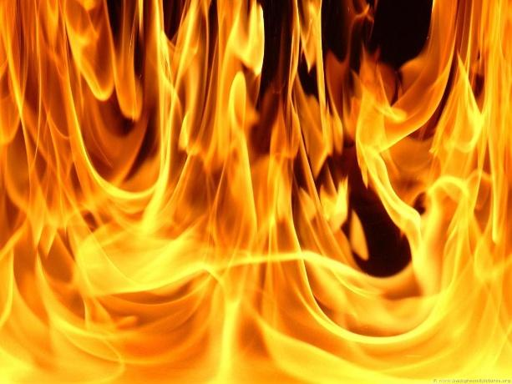
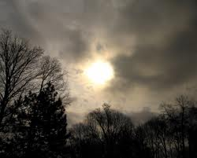
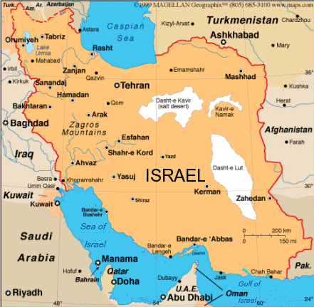
D&C 45:24-25, 28, 39-44
Blood, fire, and vapors of smoke—destructive agencies of modern warfare and their death-dealing effects
The sun shall be darkened
The remnant shall be gathered—return of the Jews to Jerusalem.
The spirit of gathering accompanies the acceptance of the gospel.
Those who received the glad message generally have a desire to go where the people of god dwell.
Look for me---many will be prepared
"The day will come when the Gentiles will sin against the fullness of the gospel and reject its supernal blessings, and the Lord will take away these privileges from the Gentile nations and once again make them available primarily to his ancient covenant people. In the purest sense this will not take place until Jesus sets His foot upon Olivet and the Jews acknowledge their long-awaited Messiah. Thus the fullness of the Gentiles is millennial."
Robert Millet

Slide 8
Personal Signs
The Lord may also bless us with signs that are personal to us.
Personal Repentance
Personal witness from reading the Book of Mormon
Personal Spiritual Experience
mission
Personal Revelation
The Lord provides signs and sends prophets, like Samuel, in our day to persuade people to believe in Him.

Slide 9
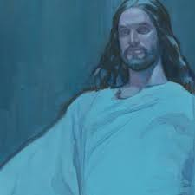
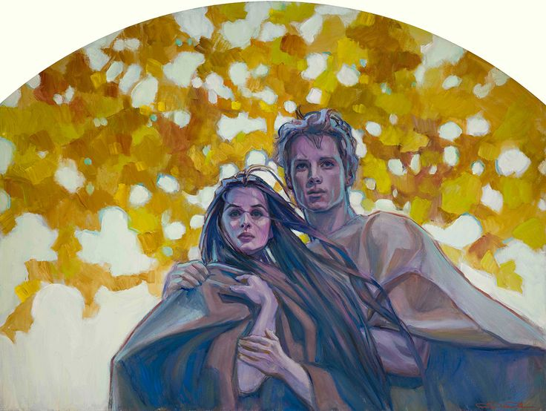
First Spiritual Death
Because of the Fall of Adam and Eve, we are born into a world where we are separated from the presence of God.
Through His Resurrection, Jesus Christ redeems all mankind from the first spiritual death, which was caused by the Fall, and brings us back into God’s presence
Rose Datoc Dall
The Savior was resurrected, all people will be resurrected and brought back into God’s presence to be judged. In this way, the first spiritual death, which was caused by the Fall, is overcome for all mankind.
Rose Datoc Dall
Helaman 14:15-16

Slide 10
Second Spiritual Death
Those who do not repent will be cut off from the Father’s presence again.
If we repent, then we will not experience the second spiritual death
Helaman 14:17-18

Slide 11
However…
condemnation refers to being pronounced guilty or worthy of punishment
If we receive a knowledge of the truth but choose not to believe it, then we bring upon ourselves our own condemnation
Helaman 14:28-29

Slide 12
Taking a Test
Imagine you are preparing to take a difficult test in a math class and the teacher informs you that in order to pass the test you will need to understand and use a certain equation.
The teacher then gives you the equation to study.
What would you choose to do in this situation?
What would be the consequence of choosing to not believe your teacher and rejecting the knowledge he or she is offering?
Helaman 14:28-29

Slide 13
Sources:
Robert Millet (The Second Coming of Christ: Questions & Answers
Presentation by ©http://fashionsbylynda.com/blog/

Slide 14
The Birth of Jesus Christ | Samuel Prophecies | The Fulfillment
1. Christ to be born in five years | Helaman 14:2 | 3 Nephi 1:13
2. No darkness for two day | Helaman 14:3-4 | 3 Nephi 1:15
3. A new star to arise | Helaman 14:5 | 3 Nephi 1:21
4. Other signs a. Many signs and wonders in heaven b. People to fall to the earth | Helaman 14:6 Helaman 14:7 | No mention
The Death of the Lord
1. Sun to be darkened, moon and stars not to give light for three days | Helaman 14:20, 27 | 3 Nephi 8:19-23
2. Signs of the earth a. Thunderings, lightnings for many hours b. Earth to shake and tremble and be broken up c. Tempests, mountains to be laid low, valleys raised d. Highways to be broken up, cities to become desolate | Helaman 14:21 Helaman 14:21-22 Helaman 14:23 Helaman 14:24 | 3 Nephi 8:6,7 3 Nephi 8:12, 17, 18 3 Nephi 8:5-6 3 Nephi 8:8-11, 13
3. Many graves to be opened and people resurrected, who shall appear unto many | Helaman 14:25 | 3 Nephi 23:9-14

Slide 15
Signs:
"In listing the signs to attend the birth of Jesus, Samuel the Lamanite prophesied: 'There shall a new star arise, such an one as ye never have beheld.' (Hela. 14:5.) That this new star was seen by the whole Nephite nation at the actual time of the heavenly birth, is also recorded in the Book of Mormon. (3 Ne. 1:21.) There is, however, no comparable Messianic prophecy in the Bible as we now have it. The nearest allusion to such is found in the prophecy of Balaam who, speaking of Messiah himself, said: 'There shall come a Star out of Jacob, and a Sceptre shall rise out of Israel.' (Num. 24:17.)
"But there can be little doubt that others besides the Nephites knew by revelation that great signs and wonders, including the rise of a new star, were to attend Messiah's birth. The language of the wise men, upon reaching Jerusalem, clearly assumes that the Jews were just as aware that a new star would bear record of the holy birth as they were that the birth itself should take place in Bethlehem." Bruce R. McConkie (Doctrinal New Testament Commentary, p. 103-4)
Spiritual death was introduced into the world by the Fall of Adam and Eve. As we are born into a fallen world, we inherit this condition—we are separated from the presence of God. Samuel the Lamanite referred to this condition as “the first death” (Helaman 14:16).
Samuel the Lamanite taught that all of Heavenly Father’s children who lived in mortality will overcome physical death and the first spiritual death through the power of the Atonement of Jesus Christ (see Helaman 14:17). Many other scriptures also testify of this truth (see 2 Nephi 2:9–10; 9:15, 22, 38; Alma 11:43–44; 12:12–15, 24; 42:23; 3 Nephi 26:4–5).
The second spiritual death. The second death is an ultimate or final spiritual death—being cast out of God’s presence forever because of unrepented personal sin (see D&C 76:37).
The Savior has also provided help to overcome this second spiritual death. He suffered for our sins so He could offer us the opportunity to repent. But to those who do not repent, “there cometh upon them again a spiritual death, yea, a second death, for they are cut off again as to things pertaining to righteousness” (Helaman 14:18). This means that a person with unresolved sin cannot remain in God’s presence after he or she is brought back to Him for judgment.
“Physical death is the separation of the spirit from the physical body. Because of the Fall of Adam, all mankind will suffer physical death” (Earl C. Tingey, “The Great Plan of Happiness,” Ensign or Liahona, May 2006, 73).
The first spiritual death. Spiritual death is being “cut off from the presence of the Lord” (Alma 42:9).
Spiritual Death:
“Our first parents, Adam and Eve, disobeyed God. By eating the forbidden fruit, they became mortal. Consequently, they and all of their descendants became subject to both mortal and spiritual death (mortal death, the separation of body and spirit; and spiritual death, the separation of the spirit from the presence of God and death as pertaining to the things of the spirit)” (Spencer W. Kimball, “The True Way of Life and Salvation,” Ensign, May 1978, 6).

