Slide 2
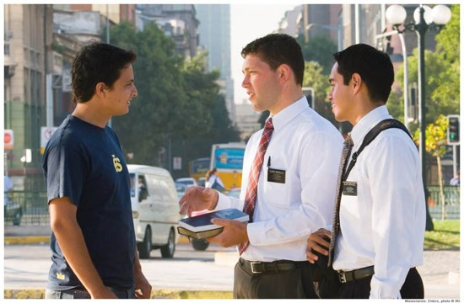
Young Man #1
One young man was raised by parents who were not members of the Church and did not emphasize the teachings of Jesus Christ.
They allowed him to drink alcohol, a practice he continued in college.
Then he met the Latter-day Saint missionaries.
After meeting with the missionaries a few times, he pledged to give up alcohol.
A few days later, he was with a group of friends. They offered him an alcoholic drink.
2013 Seminary Manual

Slide 3
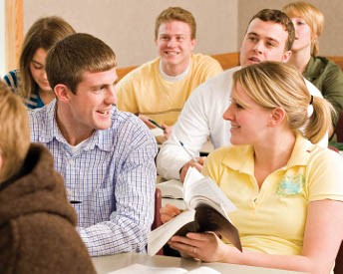
Young Man #2
Another young man was raised in a Latter-day Saint family. His parents held family home evening and family scripture study.
He developed a habit of daily scripture study and personal prayer.
He attended Primary, served in Aaronic Priesthood quorums, and graduated from seminary, gaining knowledge of the commandments and ways of the Lord. While attending college, he developed new friendships.
One night a friend offered him an alcoholic drink.
2013 Seminary Manual

Slide 4
Would accepting the alcoholic drink be a more serious offense for the first young man or the second?
Why or why not?
If people become unbelieving after having received the fulness of the gospel, they will receive greater condemnation
Helaman 15:9-17

Slide 5
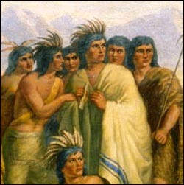
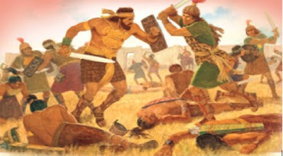
Spiritual condition of the Lamanites
Helaman 15:4-6
They were observing the commandments
Spiritual condition of the Nephites
Helaman 15:1-3, 17
They had become unbelieving, wicked, and unrepentant
Helaman 15:1-6, 17

Slide 6
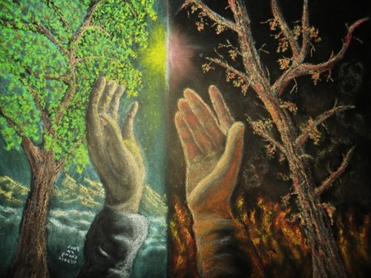
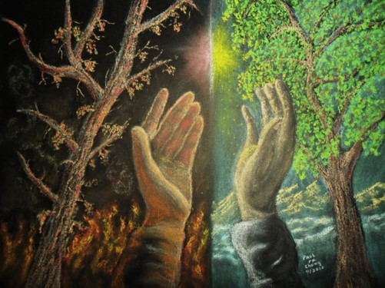
Spiritual condition of the Nephites
Helaman 15:1-3, 17
They had once been a chosen people.
However,
They had become unbelieving, wicked, and unrepentant
The Lord chastened them for their unrighteousness
Spiritual condition of the Lamanites
Helaman 15:4-6
They had once been the more wicked of the people
However,
They had become more believing, righteous, and repentant
The Lord blessed them
Helaman 15:1-6, 17

Slide 7
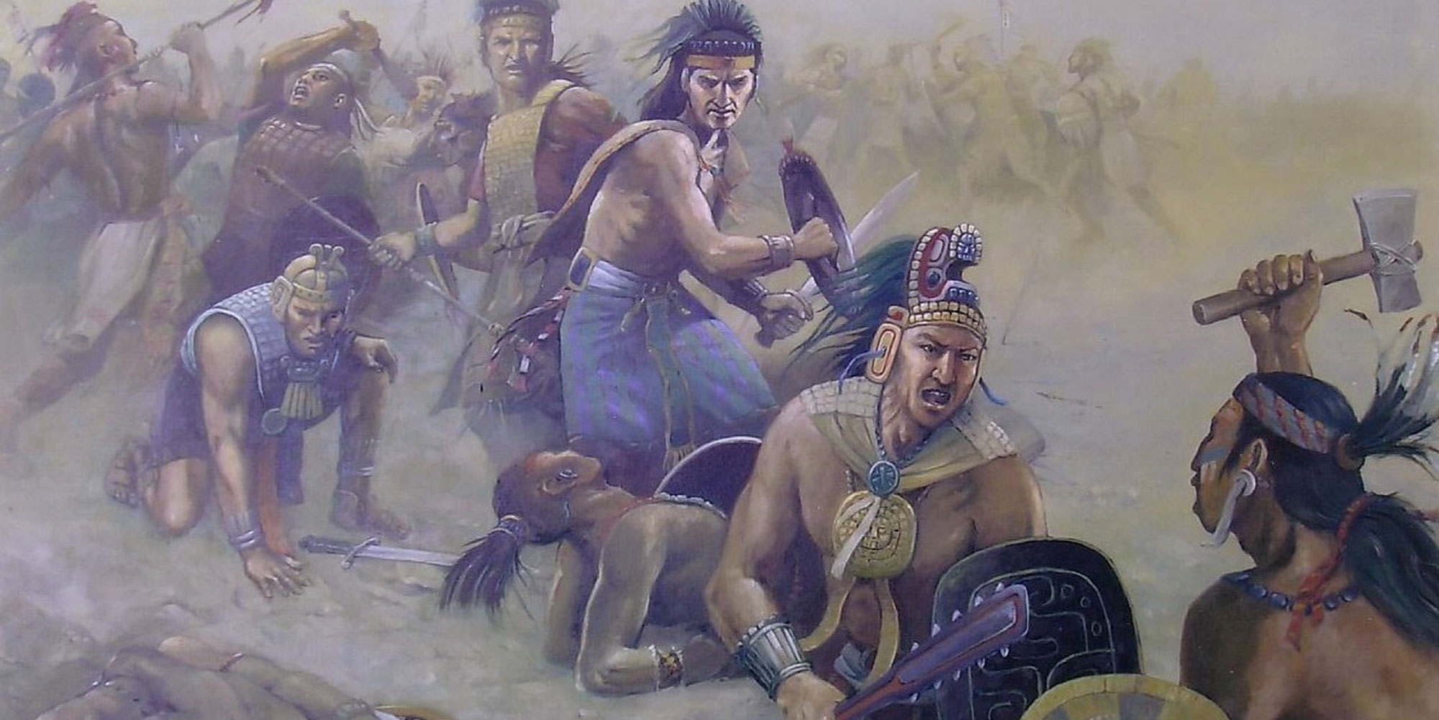
Why were the Nephites in danger of being destroyed?
Although the Lamanites had a long history of wickedness, why were they able to receive so many blessings?
chasten means to correct someone through punishment or suffering of some kind.
How is the Lord’s chastening a sign of His love?
When people know the truth and believe the scriptures, they are led to faith and repentance, which bring a change of heart
Helaman 15:7

Slide 8
A Change of Heart
Bringing the remainder of their brethren to the knowledge of the truth
Those who are truly converted are compelled to share the gospel with others
Faith in the scriptures and knowledge of the truth
Faith comes by hearing the words of leaders and reading the scriptures then believing on those words
Firm and steadfast
To be constant, consistent, and vigilant in one’s faith and approach to living the gospel
Helaman 15:6-10

Slide 9
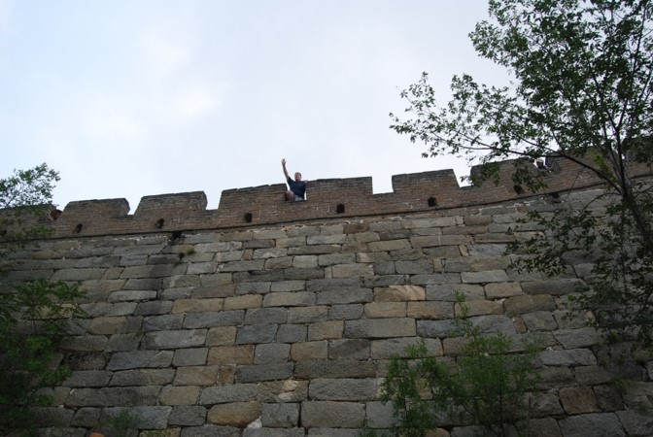
Those who Believed Samuel
Sought to be baptized by Nephi
Confessed their sins
Denied not—to be opened to counsel, direction, and the promptings of the Spirit
When we see or feel evidence of God’s power upon His prophets, we can choose to either believe or dismiss that evidence
Helaman 16:3-8

Slide 10
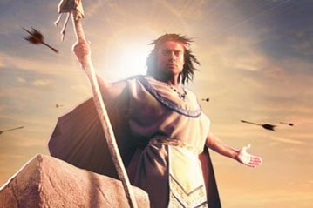
Those Who Did Not Believe
They were angry with Samuel
Sought to take Samuel life by throwing stones and arrows at him
They did not believe in the words of Samuel
Realizing they could not bind him, Samuel got off the wall and fled, and preached among his own people
Helaman 16:6-7

Slide 11
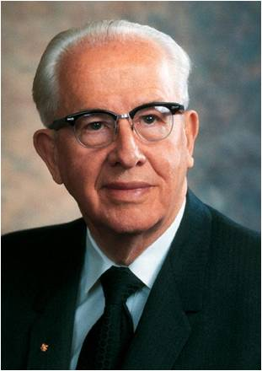
“When the prophet points out the sins of the world, the worldly, rather than repent of their sins, either want to close the mouth of the prophet or else act as if the prophet didn’t exist. Popularity is never a test of truth.
Many a prophet has been killed or cast out. As we come closer to the Lord’s second coming, you can expect that as the people of the world become more wicked, the prophet will be less popular with them.”
Ezra Taft Benson
Helaman 16:6-7

Slide 12
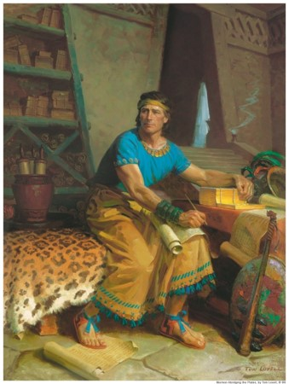
Rejecting the Signs
86th - 89th Year of the Reign of the Judges
There was little change in the people
90th Year of the Reign of the Judges
The signs and prophesies began to be fulfilled
nevertheless—
The people harden their heart, except for some
Some rejected the prophecies of a Christ
“This ended the book of Helaman, according to the record of Helaman and his sons.”
Helaman 16:9-25

Slide 13
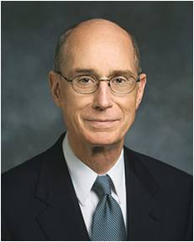
When we reject the Lord’s witnesses, we allow Satan to get hold upon our hearts
“When we reject the counsel which comes from God, we do not choose to be independent of outside influence. We choose another influence.
We reject the protection of a perfectly loving, all-powerful, all-knowing Father in Heaven, whose whole purpose, as that of His Beloved Son, is to give us eternal life, to give us all that He has, and to bring us home again in families to the arms of His love.
In rejecting His counsel, we choose the influence of another power, whose purpose is to make us miserable and whose motive is hatred.
We have moral agency as a gift of God. Rather than the right to choose to be free of influence, it is the inalienable right to submit ourselves to whichever of those powers we choose.”
President Henry B. Eyring
Helaman 15:9-17

Slide 14
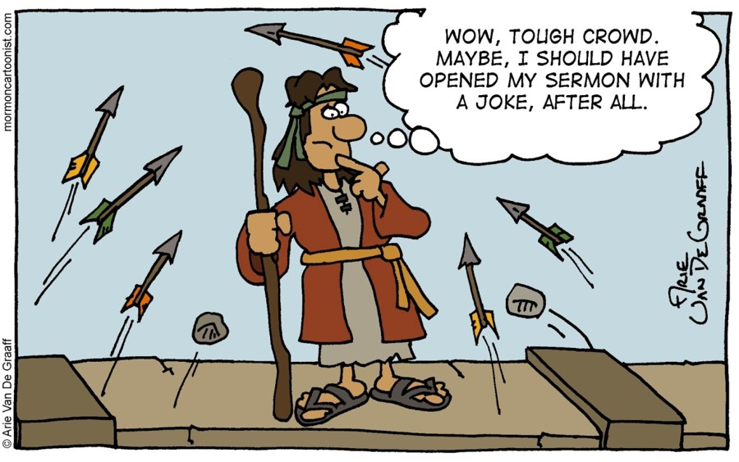
Sources:
Suggested Hymn 183 In Remembrance of Thy Suffering
Ezra Taft Benson (The Teachings of Ezra Taft Benson [1988], 133).
President Henry B. Eyring (“Finding Safety in Counsel,” Ensign, May 1997, 25).
Chart—Book of Mormon Student Manual Religion 121-122 pg. 375
Presentation by ©http://fashionsbylynda.com/blog/

Slide 15
The Birth of Jesus Christ | Samuel Prophecies | The Fulfillment
1. Christ to be born in five years | Helaman 14:2 | 3 Nephi 1:13
2. No darkness for two day | Helaman 14:3-4 | 3 Nephi 1:15
3. A new star to arise | Helaman 14:5 | 3 Nephi 1:21
4. Other signs a. Many signs and wonders in heaven b. People to fall to the earth | Helaman 14:6 Helaman 14:7 | No mention
The Death of the Lord
1. Sun to be darkened, moon and stars not to give light for three days | Helaman 14:20, 27 | 3 Nephi 8:19-23
2. Signs of the earth a. Thunderings, lightnings for many hours b. Earth to shake and tremble and be broken up c. Tempests, mountains to be laid low, valleys raised d. Highways to be broken up, cities to become desolate | Helaman 14:21 Helaman 14:21-22 Helaman 14:23 Helaman 14:24 | 3 Nephi 8:6,7 3 Nephi 8:12, 17, 18 3 Nephi 8:5-6 3 Nephi 8:8-11, 13
3. Many graves to be opened and people resurrected, who shall appear unto many | Helaman 14:25 | 3 Nephi 23:9-14

