Slide 2
King Benjamin
Nephi II
The Sacred Record Keepers
Nephi I
King Mosiah
Helaman II
Alma the Younger
Shilbon
Helaman I

Slide 3
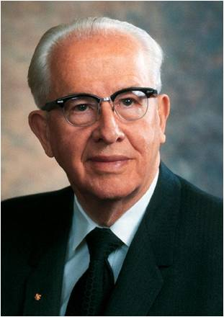
3 Nephi—The Book
“3 Nephi contains some of the most moving and powerful passages in all scripture. It testifies of Jesus Christ, His prophets, and the doctrines of salvation.”
Ezra Taft Benson
Mormon abridged records from the large plates of Nephi to create the book of 3 Nephi. The book is named for Nephi (the son of Nephi), whose labors spanned the periods before, during, and after the Savior’s appearances to the people.
During the time of great wickedness that preceded Jesus Christ’s visits, Nephi ministered “with power and with great authority” (3 Nephi 7:17).
His efforts were a prelude to the ministry of Jesus Christ, whose words and deeds constitute the focus of 3 Nephi. While abridging Nephi’s record, Mormon also included his own commentary and testimony (see 3 Nephi 5:8–26; 26:6–12; 29–30).
3 Nephi

Slide 4
Who is the Book For?
Two groups:
First, the descendants of Lehi (see 3 Nephi 26:8).
Second, Mormon addressed Gentiles in the latter days and recorded the Lord’s admonition that they come unto Him and become part of His covenant people (see 3 Nephi 30).
When and Where was it written?
The original records used as sources for the book of 3 Nephi were likely written between 1 B.C. and A.D. 35.
Mormon abridged those records sometime between A.D. 345 and A.D. 385. Mormon did not record where he was when he compiled this book.

Slide 5
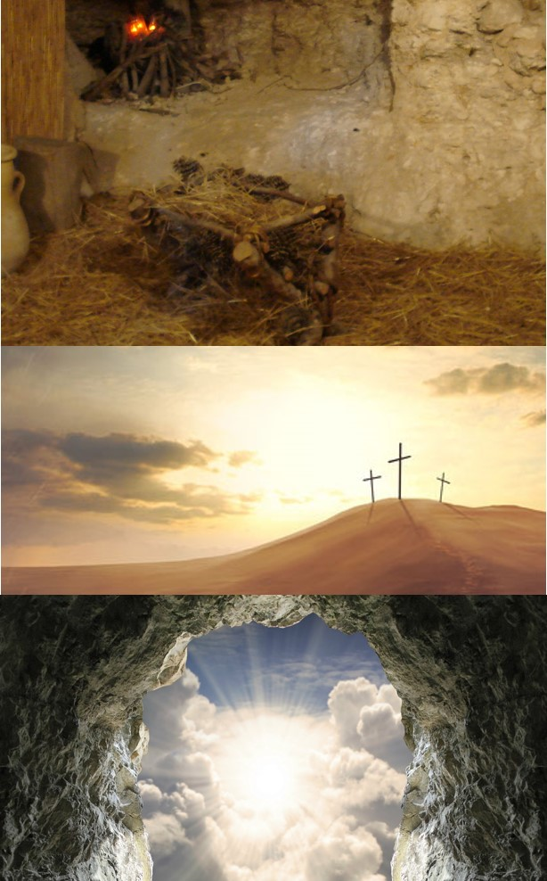
Preview
3 Nephi documents the fulfillment of prophecies regarding Jesus Christ’s birth, death, and Resurrection.
Its record of the Savior’s appearance to the Nephites represents “the focal point, the supreme moment, in the entire history of the Book of Mormon.”
Elder Jeffrey R. Holland
Twenty of the thirty chapters in 3 Nephi contain teachings the Savior delivered directly to the people
The book of 3 Nephi underscores this invitation with its powerful witness of Jesus Christ and its emphasis on the importance of covenants.

Slide 6
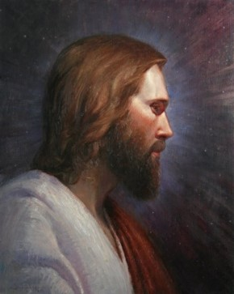
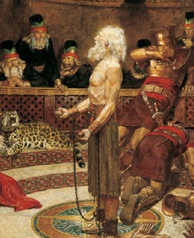
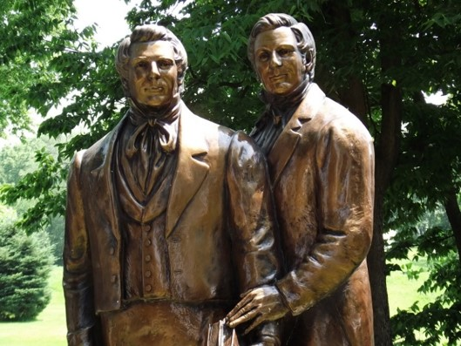
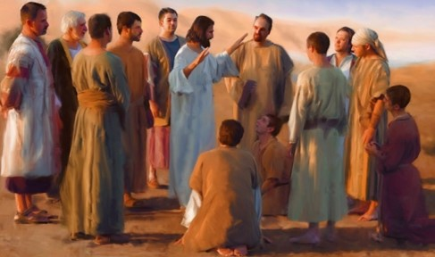
Those Who Sacrifice For Their Faith
What are you willing to sacrifice for your faith?
All the Apostles of Jesus Christ died a martyr’s death except for two

Slide 7
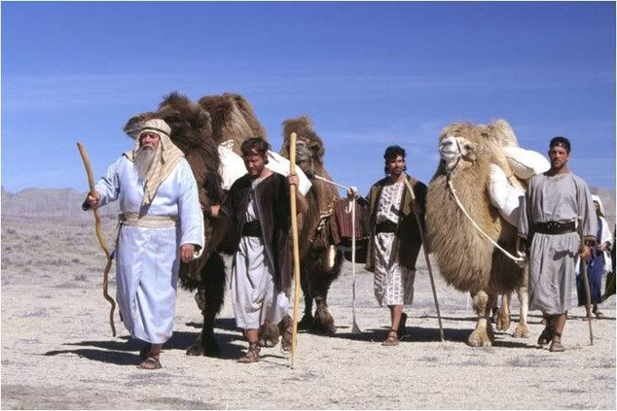
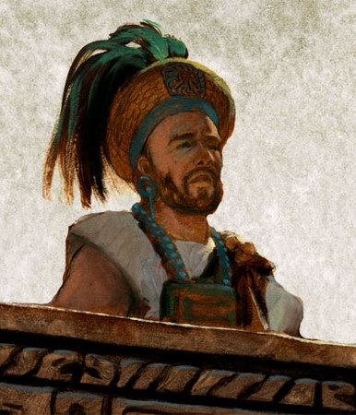
600 Years in the Promise Land
91st Year of the Reign of the Judges
Lachoneus—chief judge and governor over the land
Nephi—departs, giving charge to his eldest son Nephi the sacred records
3 Nephi 1:1-3

Slide 8
Lachoneus
He became chief judge and governor over the Nephite nation in the year AD 1 for about 30 years
During this time Nephi, son of Nephi, received the sacred records
He presided over a period of time when the people were lapsing again into prideful and wicked ways after Samuel, the Lamanite, left
He took the leadership in defeating the Gadianton movement around AD 16 to AD 21
He was asked by Giddianhi, leader of the Gadianton robbers, to turn over their lands, cities, and possessions or become extinct
Lachoneus asked for the Lord’s protection
He eventually established peace in the land
Who’s Who

Slide 9
Nephi
He was the eldest son of Nephi and grandson of Helaman
He succeeded his father and carried the sacred records about 1 AD
He bridged the transition to a new dispensation, one defined by the fulfillment of the Mosaic Law through the visit and ministration of the resurrected Lord and Savior bringing a new covenant of salvation and exaltation
His descendants included: Alma the Elder, Alma the younger, Helaman, the leader of 2,000 warriors, Helaman, the chief judge and Nephi, son of Helaman
He was chosen by Jesus Christ to become one of the first of the Twelve disciples and baptized the other Twelve disciples
He heard ‘the voice of the Lord’ on the eve of His birth and was visited daily by angels
He raised his brother Timothy from the dead (3 Nephi 7:19; 19:4)
He preformed miracles in the name of Jesus and ministered to the chosen as chief disciple by the resurrected Lord
His role was one of many to prepare the way for the coming of the Lord
Having lived in a peaceful land after Jesus’ visit, he died “with the passing of the first generation from Christ” (4 Nephi 1:18) in about AD 60
He passed the sacred records over to his son, Nephi
Who’s Who

Slide 10
Prophecies Began to be Fulfilled
Some did not believe Samuel’s words because the time had past and his word’s had not been fulfilled
92nd Year of the Reign of the Judges
What challenges did the Nephites who believed Samuel have to face?
“As we go about living from day to day, it is almost inevitable that our faith will be challenged. We may at times find ourselves surrounded by others and yet standing in the minority or even standing alone concerning what is acceptable and what is not. Do we have the moral courage to stand firm for our beliefs, even if by so doing we must stand alone?...
Increasingly, some celebrities and others who—for one reason or another—are in the public eye have a tendency to ridicule religion in general and, at times, the Church in particular. If our testimonies are not firmly enough rooted, such criticisms can cause us to doubt our own beliefs or to waver in our resolves.” --Pres. Thomas S. Monson
3 Nephi 1:4-9

Slide 11
A Painful Witness
“And it came to pass that he went out and bowed himself down upon the earth, and cried mightily to his God in behalf of his people, yea, those who were about to be destroyed because of their faith in the tradition of their fathers.”
What was Nephi’s response to those who ridiculed the believers?
What should we do when we see someone being ridiculed for their belief?
3 Nephi 1:11-12

Slide 12
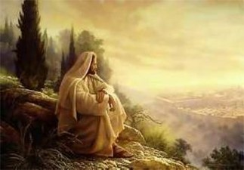
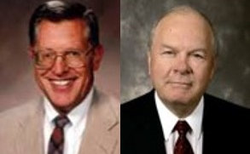
Show Unto the World
What was the sign to be given?
The Lord will fulfill all the words that He has caused to be spoken by His prophets
“Jesus was and is the Lamb slain from the foundation of the world. The plan of salvation, which is the gospel of God the Father, was taught and understood in our first estate. There it was decreed that this plan would entail a creation, a fall, and an atonement.”
JFM and RLM
What is the ‘foundation of the world’?
3 Nephi 1:13-14

Slide 13
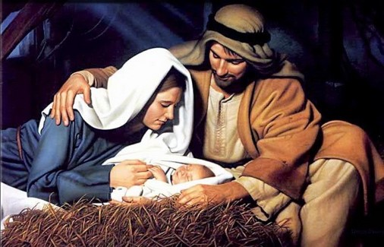
No Darkness
“…and they knew that it was the day the Lord should be born, because of the sign which had been given.”
What did the sign represent?
“And behold, this will I give unto you for a sign at the time of his coming; for behold, there shall be great lights in heaven, insomuch that in the night before he cometh there shall be no darkness, insomuch that it shall appear unto man as if it was day.”
Helaman 14:3
3 Nephi 1:15-20

Slide 14
Facing Satan’s Lies
“Satan always seeks to sow lies whenever there has been a great manifestation of the truth. He tries desperately to confuse, to confound, to complicate things.”
What happened to the people?
What did Nephi do?
What did the wicked do?
They started to have peace and prosper in the land
They started to become converted
Went forth baptizing unto repentance, and began to preach
Went about lying and deceiving to the people to which they saw these signs
“Despite Satan’s efforts, great numbers of humble and teachable souls now receive fuel for their faith…They are not convinced because of the sign, but rather their faith in Christ is now sustained by signs.”
3 Nephi 1:22-25 JFM and RLM

Slide 15
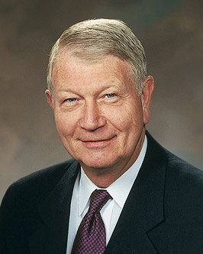
When we face Satan’s lies, we can choose to believe in Jesus Christ and be converted
“Because of the conflicts and challenges we face in today’s world, I wish to suggest a single choice—a choice of peace and protection and a choice that is appropriate for all.
That choice is faith. … Choose faith over doubt, choose faith over fear, choose faith over the unknown and the unseen, and choose faith over pessimism. …
“When logic, reason, or personal intellect come into conflict with sacred teachings and doctrine, or conflicting messages assault your beliefs … , choose to not cast the seed out of your heart by unbelief.
Remember, we receive not a witness until after the trial of our faith.”
Richard C. Edgley
3 Nephi 1:22-25; Alma 32:28; Ether 12:6 JFM and RLM

Slide 16
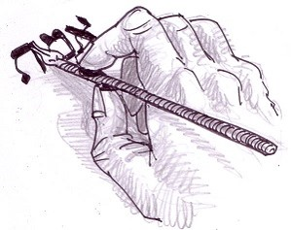
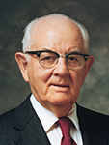
Jot or Tittle—a Tiny Amount
“Heaven and earth shall pass away, but not one jot or tittle of his revealed word shall fail to be fulfilled.”
Messages of the First Presidency, 1:263–64
jot is the name of the least letter of an alphabet or the smallest part of a piece of writing. It is the Anglicized version of the Greek iota - the smallest letter of the Greek alphabet, which corresponds to the Roman 'i'. This, in turn, was derived from the Hebrew word jod, or yodr, which is the the smallest letter of the square Hebrew alphabet. Apart from its specialist typographical meaning, we still use the word jot more generally to mean 'a tiny amount'. Hence, when we have a brief note to make, we 'jot it down'.
A tittle, rather appropriately for a word which sounds like a combination of tiny and little, is smaller still. It refers to a small stroke or point in writing or printing. In classical Latin this applied to any accent over a letter, but is now most commonly used as the name for the dot over the letter 'i'. It is also the name of the dots on dice. In medieval calligraphy the tittle was written as quite large relative to the stem of the 'i'. Since fixed typeface printing was introduced in the 15th century the tittle has been rendered smaller. --The Phrase Finder
“The principles of the gospel are unaltered. All of men’s evil speaking and all of men’s evil acting cannot alter one jot or tittle of the commandments of God.”
Pres. Spencer W. Kimball
3 Nephi 1:25

Slide 17
Gadianton Robbers
93rd-94th Year of the Reign of the Judges
“Dissenters from the Nephites and the Lamanites, as is almost always the case in the Book of Mormon record, find their way into the camps of the enemies, in this case the Gadianton hands.”
JFM and RLM
What happened to some of the Lamanite youth?
They “were led away by some who were Zoramites,” and they joined the Gadianton robbers.
If we give in to temptation, our example can have a negative impact on the faith and righteousness of others
3 Nephi 1:27-30

Slide 18
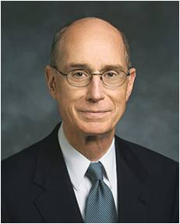
Lost Individuals
“The young people of the Church … hold the future in their hands. The Church has always been one generation away from extinction. If a whole generation were lost, which will not happen, we would lose the Church.
But even a single individual lost to the gospel of Jesus Christ closes doors for generations of descendants, unless the Lord reaches out to bring some of them back.”
President Henry B. Eyring

Slide 19
Sources:
Ezra Taft Benson (“The Savior’s Visit to America,” Ensign, May 1987, 6).
Jeffrey R. Holland (Christ and the New Covenant: The Messianic Message of the Book of Mormon [1997], 250).
The Book of Mormon Who’s Who by Ed J. Pinegar and Richard J. Allen pg. 98-99, 142-144
Elder Allan F. Packer Finding Strength in Challenging Times! April 2009 Gen. Conf.
President Thomas S. Monson Dare to Stand Alone Oct. 2011 General Conf.
Joseph Fielding McConkie and Robert L. Millet Doctrinal Commentary on the Book of Mormon Vol. 4 pg. 6, 9-10
The Phrase Finder: Jot and Tittle: It has passed into English via William Tindale's translation of the New Testament in 1526. It appears there in Matthew 5:18:
President Spencer W. Kimball “Hold Fast to the Iron Rod” Oct. 1978 Gen. Conf.
Richard C. Edgley, “Faith—the Choice Is Yours,” Ensign or Liahona, Nov. 2010, 31, 32–33
President Henry B. Eyring (“We Must Raise Our Sights” [address to CES religious educators, Aug. 14, 2001], 1,si.lds.org).
Presentation by ©http://fashionsbylynda.com/blog/

Slide 20
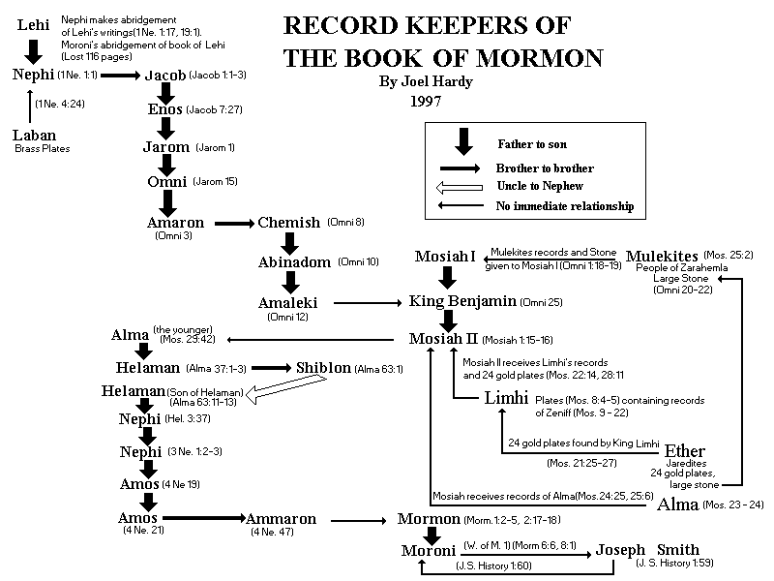

Slide 21
