Slide 2
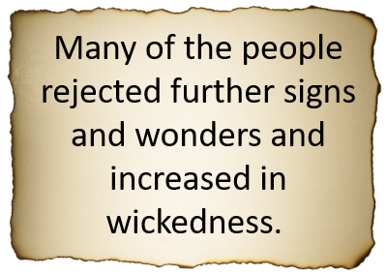
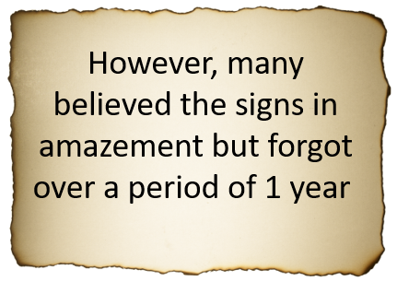
Remember the Signs?
Press any key to forget
3 Nephi 2:1-3

Slide 3
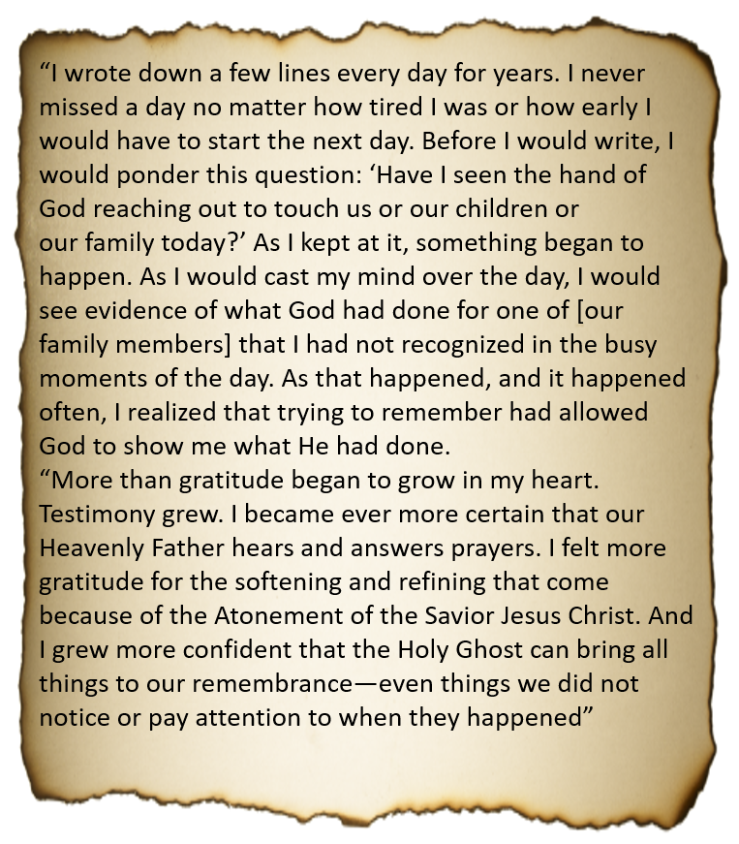
How to Remember
President Henry B. Eyring
3 Nephi 2:1-3

Slide 4
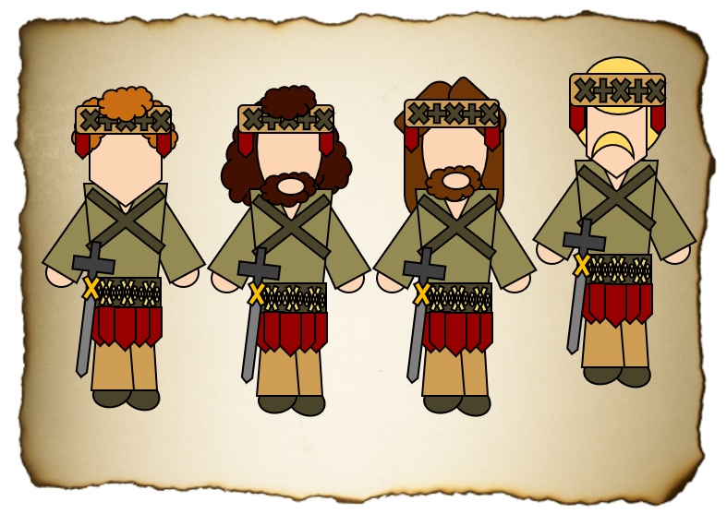
Gadianton Robbers
They followed the ancient secret combinations instituted by Satan from around 50 BC to the end of the Book of Mormon
They were both Nephites and Lamanites
They were destructive and would vanish into the shadows
They would gain wealth and property by secret plots and murders
They were destroyed after Jesus’ visit
They again revived a third century later after Christ was among the Nephites
Mormon was one who fought against them
They were also among the Jaradite nation and played a major role in their destruction of that civilization

Slide 5
Giddianhi
He was the leader of the Gadianton robbers following the birth of the Savior
After Samuel’s plea from the wall, the Gadianton robbers began to emerge as a growing threat
He sent an epistle to Lachoneus to ‘yield up your cities, your land, and your possession or become extinct’. His deadline was set for a month in about AD 18
He and the robbers went to claim the city but the Nephites had abandoned the city taking refuse elsewhere
Resources became scare for the robbers in the wilderness and they came upon the Nephites and there was a great battle
He was killed while some of the robbers disappeared into the wilderness, and some where slain
His successor was Zemnarihah
Who’s Who

Slide 6
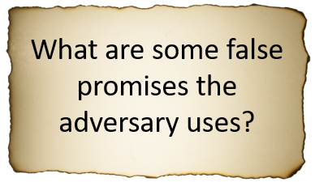
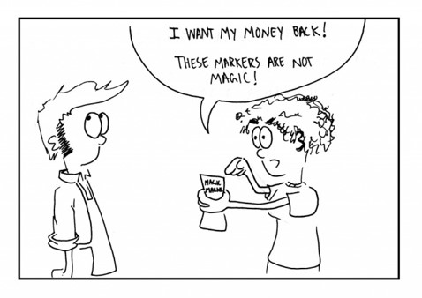
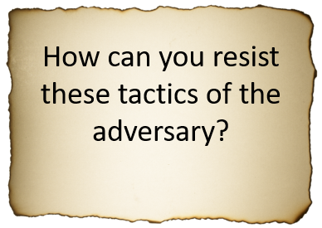
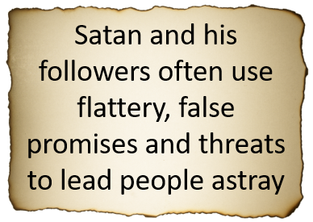
The Threat
3 Nephi 3:1-10

Slide 7
Satan’s Tactics
Technology
Entertainment
3 Nephi 3:2-10

Slide 8
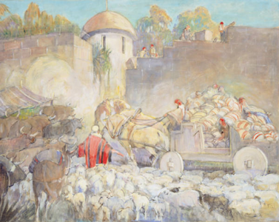
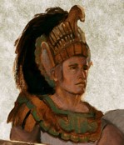
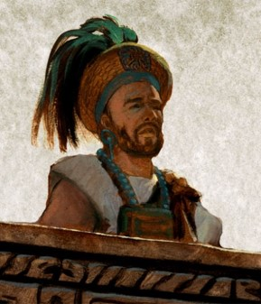
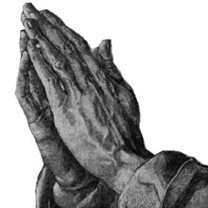
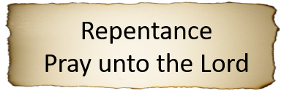
Lachoneus Fortifies the Nephites
16th year before the coming of Christ
AD 16-18
3 Nephi 2:12-25

Slide 9
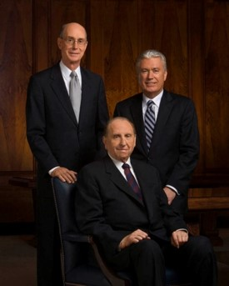
Fortifying Our Homes

Slide 10
Gidgiddoni
He was a captain over the Nephite forces during a fierce engagement with the Gadianton robbers around AD 16 to AD 21
Under the direction of Lachoneus, chief judge and governor, he strengthened the Nephite military forces
He was a spiritual and great prophet among them
(3 Nephi 3:19)
In AD 19 they were under attack by Giddianhi, who was killed and then Zemnariha, but their attempt to overtake the Nephites was not successful
Under his direction, the Nephite military staged nightly forays to decimate the enemy forces and prevent their escape. Those who were not slain were taken prisoners.
Zemnariha was one of the prisoners who was tried and executed
Who’s Who

Slide 11
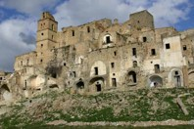
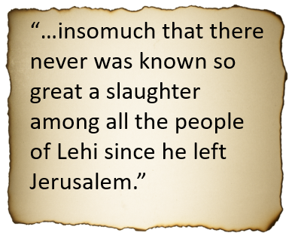
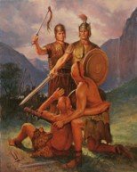
The Great Slaughter
18th -21st Year before the coming of Christ
3 Nephi 4

Slide 12
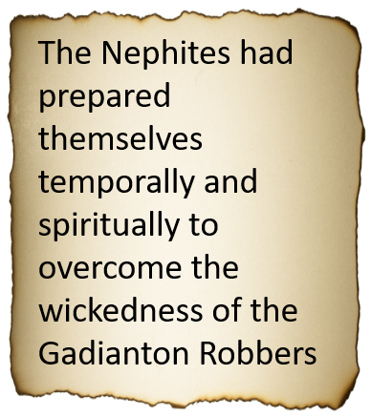
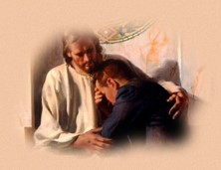
Temporal and Spiritual Blessings
18th -19th Year before the coming of Christ
3 Nephi 4:14-32

Slide 13
Zemnarihah
He was the successor of Giddianhi around AD 16 to AD 21
He tried to take over the capital Zarahemla
The Nephites had a stronghold led by Gidgiddoni
He was captured along with others and taken prisoner
He was ‘hanged upon a tree’ until dead (3 Nephi 28-29)
Some of the other prisoners were taught the gospel and renewed their covenants and were liberated by Lachoneus around AD 21
Those who did not change were punished ‘under the law’
Who’s Who

Slide 14
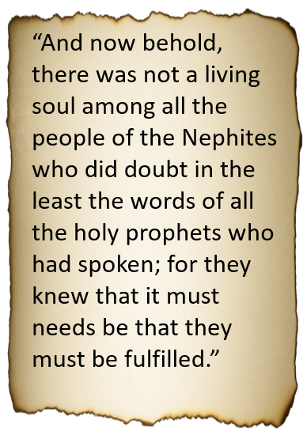
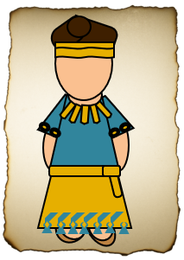
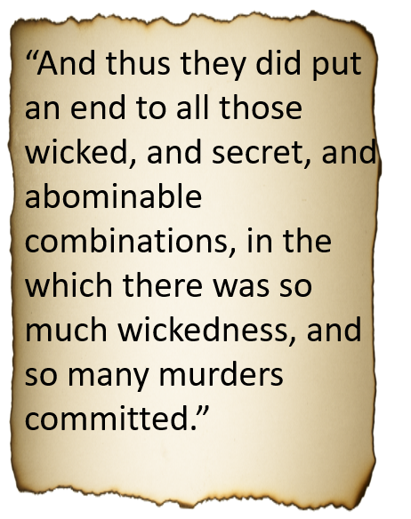
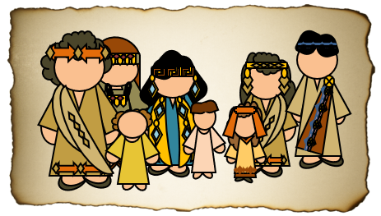
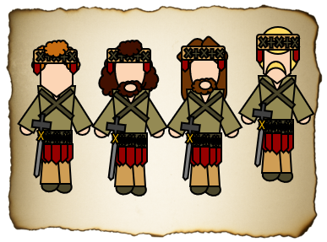
Peace is Restored
22nd-26th Year before the coming of Christ
3 Nephi 5

Slide 15
To Us Today:
“Yea, and surely shall he again bring a remnant of the seed of Joseph to the knowledge of the Lord their God.
And as surely as the Lord liveth, will he gather in from the four quarters of the earth all the remnant of the seed of Jacob, who are scattered abroad upon all the face of the earth.
And as he hath covenanted with all the house of Jacob, even so shall the covenant wherewith he hath covenanted with the house of Jacob be fulfilled in his own due time, unto the restoring all the house of Jacob unto the knowledge of the covenant that he hath covenanted with them.
And then shall they know their Redeemer, who is Jesus Christ, the Son of God; and then shall they be gathered in from the four quarters of the earth unto their own lands, from whence they have been dispersed; yea, as the Lord liveth so shall it be. Amen.
3 Nephi 5:23-26

Slide 16
Sources:
Henry B. Erying (“O Remember, Remember,” Ensign or Liahona, Nov. 2007, 67).
The Book of Mormon Who’s Who by Ed J. Pinegar and Richard J. Allen pg. 53-54, 56-60, 192-193
Presentation by ©http://fashionsbylynda.com/blog/

Slide 17
Throughout their history, the Nephites used three different points of reference for measuring time with their calendars:
(1) the time when Lehi left Jerusalem;
(2) the time when the government changed from kings to judges;
(3) the time when the sign of the birth of Jesus Christ was given.
It is not known exactly when the Nephites began to reckon their calendar from the time of Jesus Christ’s birth, but Mormon acknowledges this change in 3 Nephi 2:7–8.
REFERENCE POINT | APPROXIMATELY WHEN USED | SCRIPTURE BLOCK
From the time when Lehi left Jerusalem | 600–92 B.C. | 1 Nephi 1–Mosiah 29
From the time when the government changed from kings to judges | 92 B.C.–A.D. 1 | Mosiah 29–3 Nephi 1
From the time the sign of the birth of Jesus Christ was given | A.D. 1–421 | 3 Nephi 1–Moroni 10

Slide 18
Helaman- 3 Nephi 1-5
Righteousness
11:18-19
Reign of Judges
76th Year
Humility and Repentance
Prosperity and Blessings
3 Nephi 2-5
AD 5– 26 AD
Unite, Repentant, and give thanks
11:20-21
Reign of Judges
76th Year
Nephite Cycle
Destruction and Suffering
Pride
3 Nephi 1
1 AD – 4 AD
Gadianton Robbers
11:24 (War)
11:37
Reign of Judges
80th-85th Year
Wickedness
13:1
Reign of Judges
86th Year

