Slide 2
Rebuilding
There was order in the land
The cities were built ‘anew’ and highways connecting the cities
Gidgiddoni and Lachoneus were the leaders
3 Nephi 6:1-10

Slide 3
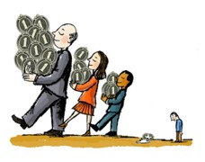
Great Are the Riches
Prideful
Some were lifted up unto pride and boastings because of their exceedingly great riches, yea, even unto great persecutions
Some did receive great learning because of their riches
Some did return railing for railing
Humble
Some were exceedingly humble
Some were ignorant because of their poverty
Some would receive railing (angry criticizing) and persecution and all manner of afflictions
Some would not turn and revile again, but were humble and penitent before God
People began to be distinguished by ranks, according to their riches and their chances for learning
3 Nephi 6:10-13

Slide 4
Equality VS Inequality
“Equity and justice are chief among the laws that rule the kingdom of heaven”
JFM and RLM
“Nevertheless, in your temporal things you shall be equal, and this not grudgingly, otherwise the abundance of the manifestations of the Spirit shall be withheld.” D&C 70:14
“For if ye are not equal in earthly things ye cannot be equal in obtaining heavenly things.” D&C 78:6
Inequality—
“It’s the unbalanced distribution of power and control over wealth and innovation, government and culture, society and neighborhoods…
…The same top end that gets the money also controls the …ways of defining morality, culture, and public life…”
--R.R.Reno
3 Nephi 6:10-14

Slide 5
Satan Strikes Again
With great power
Stirring up the people
Puffing them up with pride and authority
Tempting them to seek for power, riches, and the vain things of the world
He leads them away to do “all manner of iniquity”
Peace is destroyed
Power
Riches
Authority
“How ironic it is that this threesome make so many susceptible to the wiles of the adversary when each of the three could be used to such a marvelous effect in the cause of righteousness!”
JFM and RLM
3 Nephi 6:15

Slide 6
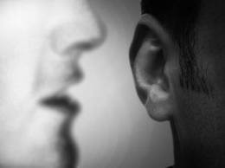
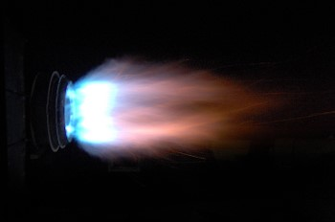
Pride VS The Holy Ghost
Why is it dangerous to no longer listen for the voice of the Spirit?
When we ignore the whisperings of the Holy Ghost, we are more susceptible to the temptations of the devil
“Pride creates a noise within us which makes the quiet voice of the Spirit hard to hear. And soon, in our vanity, we no longer even listen for it. We can come quickly to think we don’t need it”
President Henry B. Erying

Slide 7
Lachoneus II
He was the son of Lachoneus, the chief judge, and succeeded his father in about AD 30
This was a time that the lawyers and judges of high rank became prideful and corrupt in which they put prophets to death
The lawyers and judges also wanted to replace Lachoneus II with a king
With secret oaths and covenants, the wicked leaders murdered Lachoneus II
Thereafter, the government disintegrated and the people separated themselves into self-governing tribes
These dissenters eventually died when the Savior appeared to the Nephites in AD 33 – AD 34
Who’s Who

Slide 8
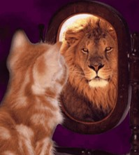
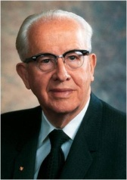
“The proud make every man their adversary by pitting their intellects, opinions, works, wealth, talents, or any other worldly measuring device against others.
In the words of C. S. Lewis: ‘Pride gets no pleasure out of having something, only out of having more of it than the next man. … It is the comparison that makes you proud: the pleasure of being above the rest. Once the element of competition has gone, pride has gone.’
“…Pride adversely affects all our relationships—our relationship with God and His servants, between husband and wife, parent and child, employer and employee, teacher and student, and all mankind. Our degree of pride determines how we treat our God and our brothers and sisters”
Ezra Taft Benson
When we are prideful, we allow Satan greater power to tempt us and lead us to commit more sin.
We can choose to be humble and faithful regardless of our circumstances

Slide 9
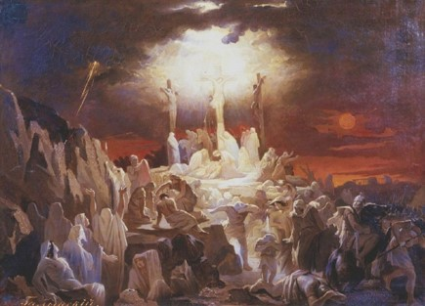
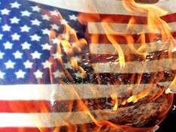
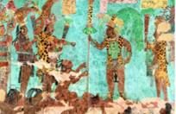
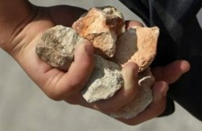
3 Nephi 6:19-24
3 Nephi 6:25-30
3 Nephi 7:1-8
3 Nephi 7:9-14
Vasili Golinsky
Secret combinations destroyed the Nephite government, and the people divided into tribes

Slide 10
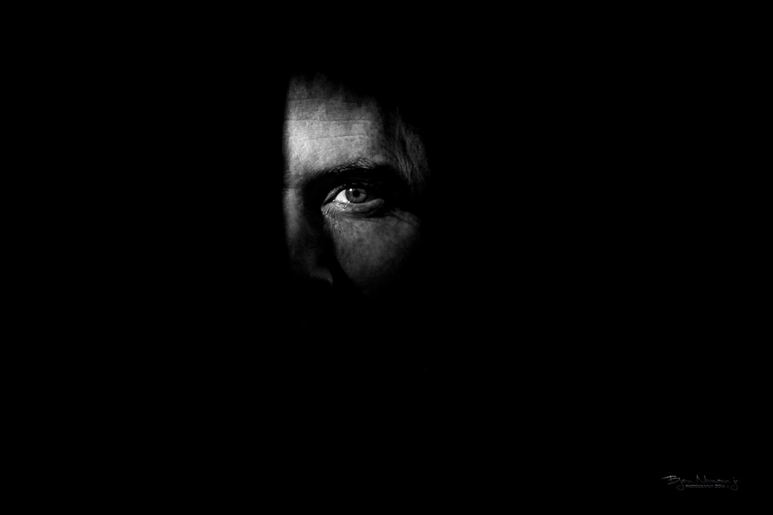
Works of Darkness
Satan is the author =
A brotherhood, group, society, or governments that operate in secrecy to perform evil acts for the purpose of gaining power over the minds and actions of people.
As the enemies of honest men and women governed by the rule of law, such secret combinations see to subvert public virtue and legally constituted authority.
They defile, defraud, murder, deceive, and destroy the elements of good government, religious or secular.
Their goal is to seize power and to rule over all the people which results in the destruction of human freedom and agency and the paralysis of peaceful and just communities.
3 Nephi 6:27-30
Ray Cole Hillam

Slide 11
Jacob
He was the King of the Nephite dissenters during AD 24 to AD 30
He was selected as the leader by the ‘secret brotherhood’ to be their king
He had a role in slaying the prophets who were sent to declare repentance among the people
He retreated to the north to gather strength in numbers to organize and contend with the other tribes
He made unholy oaths and covenants that bound his group together
His purpose was to destroy the republic and establish a monarchy—kings
His followers had assassinated the chief judge
During the Lord’s cleansing of the earth, the followers of secret combinations, including Jacob, were destroyed
Who’s Who & JFM and RLM

Slide 12
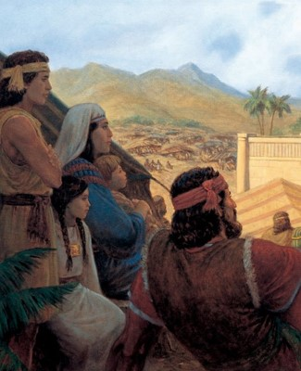
A Few Good Men
Nephi was visited by angels
Nephi testified of repentance and remission of sins through faith on the Lord Jesus Christ
Nephi cast out devils and unclean spirits
Nephi raise his brother Timothy from the dead who had been stoned by the people
Nephi did more miracles in the sight of the people in the name of Jesus.
Only a few were converted unto the Lord; but as many as were converted ‘did truly signify unto the people that they had been visited by the power and Spirit of God, which was in Jesus Christ, in whom they believed.’
3 Nephi 7:21
“Therefore, there were ordained of Nephi, men unto this ministry, that all such as should come unto them should be baptized with water, and this as a witness and a testimony before God, and unto the people, that they had repented and received a remission of their sins”
3 Nephi 7:25
3 Nephi 7:15-26

Slide 13
Baptism
“Baptism witnesses to both God and man that our spirit is contrite and humble and that we are willing to take the name of Christ upon us.
Baptism by immersion symbolizes the Christian commitment to Christ, the acceptance of our Lord’s death, burial, and rise unto a newness of life.”
JFM and RLM
“And again, by way of commandment to the church concerning the manner of baptism—All those who humble themselves before God, and desire to be baptized, and come forth with broken hearts and contrite spirits, and witness before the church that they have truly repented of all their sins, and are willing to take upon them the name of Jesus Christ, having a determination to serve him to the end, and truly manifest by their works that they have received of the Spirit of Christ unto the remission of their sins, shall be received by baptism into his church.”
D&C 20:37
3 Nephi 7:25

Slide 14
Righteousness
3 Nephi 6-7
3 Nephi 5
AD 22 – AD 26
Give thanks
Humility and Repentance
Prosperity and Blessings
3 Nephi 8
AD 33
The Awakening
3 Nephi 6:1-9
AD 26- AD 28
Nephite Cycle
Before the coming of the Savior
Destruction and Suffering
Pride
3 Nephi 7:1
AD 31-AD 32
Murder, separation, secret combinations, stoning of Prophets
3 Nephi 6:10-16
AD 29
Wickedness
3 Nephi 6:17-30
AD 30
6:25 Judges secretly put righteous to death
6:28 Covenant administered by the devil
6:30 subject to kings

Slide 15
Sources:
Pride is Enmity (1:22)
R.R. Reno http://www.firstthings.com/article/2014/03/the-public-square?gclid=CL3Owqmakr0CFY6Ufgod3m0AmA
Joseph Fielding McConkie and Robert L. Millet Doctrinal Commentary on the Book of Mormon Vol. 4 pg. 25-27, 34
Book of Mormon Who’s Who by Ed J. Pinegar and Richard J. Allen pgs. 75-76, 99
President Henry B. Eyring (“Prayer,” Ensign, Nov. 2001, 16).
Ezra Taft Benson (“Beware of Pride,” Ensign, May 1989, 4, 6).
C.S. Lewis (Mere Christianity, New York: Macmillan, 1952, pp. 109–10.)
Ray Cole Hilliam “The Gadianton Robbers and Protracted War” BYU Studies 15 (Winter 1975): 214-24.
Presentation by ©http://fashionsbylynda.com/blog/

Slide 16
If I Were The Devil By Paul Harvey
I would gain control of the most powerful nation in the world;
I would delude their minds into thinking that they had come from man's effort, instead of God's blessings;
I would promote an attitude of loving things and using people, instead of the other way around;
I would dupe entire states into relying on gambling for their state revenue;
I would convince people that character is not an issue when it comes to leadership;
I would make it legal to take the life of unborn babies;
I would make it socially acceptable to take one's own life, and invent machines to make it convenient;
I would cheapen human life as much as possible so that life of animals are valued more than human beings;
I would take God out of the schools, where even the mention of His name was grounds for a lawsuit;
I would come up with drugs that sedate the mind and target the young, and I would get sports heroes to advertise them;
I would get control of the media, so that every night I could pollute the minds of every family member for my agenda;
I would attack then family, the backbone of any nation. I would make divorce acceptable and easy, even fashionable. If the family crumbles, so does the nation;
I would compel people to express their most depraved fantasies on canvas and movies screens, and I would call it art;
I would convince the world that people are born homosexuals, and that their lifestyles should be accepted and marveled;
I would convince the people that right and wrong are determined by a few who call themselves authorities and refer to their agendas as politically correct;
I would persuade people that the church is irrelevant and out of date; the Bible is for the naive:
I would dull the minds of Christians, and make them believe that prayer is not important, and that faithfulness and obedience are optional;
I GUESS I WOULD LEAVE THINGS PRETTY MUCH THE WAY THEY ARE!

