Slide 2
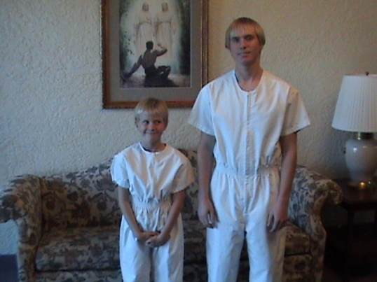
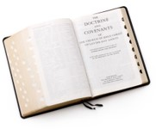
The Power to Baptize
Who has the power baptize?
Baptism must be performed by a person who holds proper authority
Aaronic Priesthood, or Melchizedek Priesthood
“The priest’s duty is to preach, teach, expound, exhort, and baptize, and administer the sacrament,”
D&C 20:46
“The duty of the elders, priests, teachers, deacons, and members of the church of Christ—An apostle is an elder, and it is his calling to baptize;
And to ordain other elders, priests, teachers, and deacons;”
D&C 20:38-39
3 Nephi 11:18-22

Slide 3
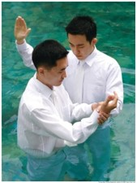
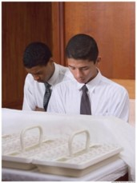
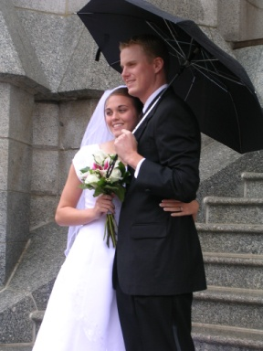
The Baptismal Words
“Having authority given me of Jesus Christ, I baptize you in the name of the Father, and of the Son, and of the Holy Ghost, Amen.
D&C 20:46
What if the words are spoken incorrectly?
Why is it important that baptisms be performed precisely in the manner set forth by the Lord?
Baptism must be done in the manner set forth by the Lord
What other ordinances are done in a set manner?
Sacrament Blessing of water and bread
All Temple Ordinances
3 Nephi 11:25

Slide 4
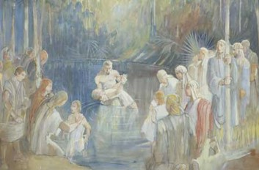
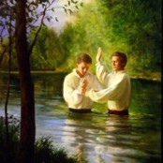
Rebaptism
“There is nothing strange in the fact that when the Lord came to the Nephites, Nephi was baptized and so was everybody else although they had been baptized before. The Church among the Nephites before the coming of Christ was not in its fulness and was under the law of Moses. The Savior restored the fulness and gave them all the ordinances and blessing of the gospel. Therefore, it actually became a new organization, and through baptism they came into it.
The Prophet Joseph Smith and Oliver Cowdery were baptized by command of the Angel John the Baptist. Several others were baptized before the organization of the church, However, on the day the Church was organized, all who had been previously baptized were baptized again, not for the remission of sins, but for entrance into the Church.”
Joseph Fielding Smith

Slide 5
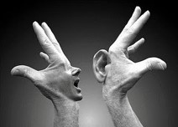
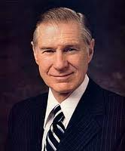
Contention is of the Devil
Thought:
There must have been an argument over how baptism was preformed by the Nephites.
The spirit of contention is not of God, but is of the devil
Why is it important to avoid contention when discussing the gospel with others?
Why is arguing the wrong way to teach the gospel?
“When there is contention, the Spirit of the Lord will depart, regardless of who is at fault”
President James E. Faust
“It matters not to Satan what the contention is all about…it only matters that contention and conflict be created in the hearts of men.”
JFM and RLM
3 Nephi 11:25-30

Slide 6
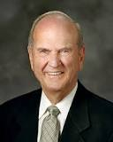
Steps for Personal Peace
“What can we do to combat this canker of contention?
What steps may each of us take to supplant the spirit of contention with a spirit of personal peace?
Show compassionate concern for others.
Control the tongue, the pen, and the word processor.
Whenever tempted to dispute, remember this proverb:
“He that is void of wisdom despiseth his neighbour: but a man of understanding holdeth his peace.” (Prov. 11:12; ).
Russell M. Nelson

Slide 7
“This is My Doctrine”
Actions
Consequences
3 Nephi 11:32–34
Believe in Him and be baptized
Believe not and not be baptized
Be saved and inherit the kingdom of God
Shall be damned
Nephi 11:35–36
Believe in Him and the Father
Will be visted with fire and with the Holy Ghost
3 Nephi 11:37–38
Repent, be baptized in my name, become as a little child
Inherit the kingdom of God
Build upon my rock
Do not seek to alter my doctrines—false teachings
The gates of hell shall
not prevai against them
Floods come and beat upon them
To enter the kingdom of God, we must repent, believe in Jesus Christ, be baptized, and receive the Holy Ghost
3 Nephi 11:39–40

Slide 8
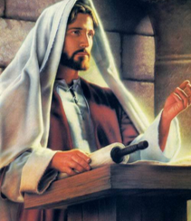
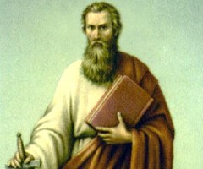
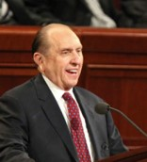
“And who is a false teacher, a false minister, a false prophet?
Anyone who does not teach the truth, minister the elements of true religion, or prophesy truly of that which is yet to be.
... A true preacher is one who belongs to the true Church, believes the true gospel, holds that priesthood which is in fact the power of God delegated to man on earth, and who receives revelation from the one true Spirit Being who is the Holy Ghost…”
Bruce R. McConkie
See Galatians 1:6-8

Slide 9
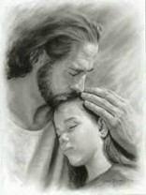
Sources:
Video:
Everyday Example: When Beliefs Are Questioned (12:52)
Joseph Fielding Smith answers to Gospel Question 3:205-6 see also 4:96-97
President James E. Faust “What I Want My Son to Know before He Leaves on His Mission,” Ensign, May 1996, 41).
Joseph Fielding McConkie and Robert L. Millet Doctrinal Commentary on the Book of Mormon Vol. 4 pg. 57
Russell M. Nelson Ensign May 1989 THE CANKER OF CONTENTION
Bruce R. McConkie Doctrinal New Testament Commentary 2:457-59
Presentation by ©http://fashionsbylynda.com/blog/

Slide 10
Russell M. Nelson: “My concern is that contention is becoming accepted as a way of life. From what we see and hear in the media, the classroom, and the workplace, all are now infected to some degree with contention. How easy it is, yet how wrong it is, to allow habits of contention to pervade matters of spiritual significance, because contention is forbidden by divine decree:
Divine doctrine of the Church is the prime target of attack by the spiritually contentious. Well do I remember a friend who would routinely sow seeds of contention in Church classes. His assaults would invariably be preceded by this predictable comment: “let me play the role of devil’s advocate.” Recently he passed away. One day he will stand before the Lord in judgment. Then, I wonder, will my friend’s predictable comment again be repeated?
Such contentious spirits are not new. In an epistle to Timothy, the Apostle Paul gave this warning, “that the name of God and his doctrine be not blasphemed.” (1 Tim. 6:1.)
“If any man teach otherwise, and consent not to wholesome words, even the words of our Lord Jesus Christ, and to [his] doctrine … doting about questions and strifes of words, … supposing that gain is godliness: from such withdraw thyself.” (1 Tim. 6:3–5; see also Isa. 29:21; 2 Ne. 27:32;D&C 19:30 ; D&C 38:41; D&C 60:14.)
Dissecting doctrine in a controversial way in order to draw attention to oneself is not pleasing to the Lord. He declared:
“Bring to light the true points of my doctrine, yea, and the only doctrine which is in me.”
Ensign May 1989 THE CANKER OF CONTENTION
PS the whole article is great
Authority to Baptize 3 Nephi 11:19-22:
“Although these Nephites had authority to baptize in the old Mosaic dispensation, Christ invited Nephi forward to affirm his priesthood authority to baptize in the new gospel dispensation, and perhaps to ordain him to the apostleship at the same time [see 3 Nephi 11:18–21; History of the Church, 4:538; D&C 20:38]. Then he called another group forward, instructing them how to baptize and noting that there would be ‘no disputations’ among them on this crucial doctrine” (Jeffrey R. Holland, Christ and the New Covenant: The Messianic Message of the Book of Mormon [1997], 259–60).
Contention 3 Nephi 11:28:
““Because … power resides in the Spirit of the Lord, we must never become contentious when we are discussing our faith. As almost every missionary learns, Bible bashing always drives the Spirit away. The Savior has said, ‘He that hath the spirit of contention is not of me’ (3 Nephi 11:29). More regrettable than the Church being accused of not being Christian is when Church members react to such accusations in an un-Christlike way! May our conversations with others always be marked by the fruits of the Spirit—‘love, joy, peace, longsuffering, gentleness, goodness, faith, meekness, [and] temperance’ (Galatians 5:22–23)” (Robert D. Hales, “Christian Courage: The Price of Discipleship,” Ensign or Liahona, Nov. 2008, 73)
Baptism 3 Nephi 11:30-34:
“Baptism is a sign to God, to angels, and to heaven that we do the will of God, and there is no other way beneath the heavens whereby God hath ordained for man to come to Him to be saved, and enter into the kingdom of God, except faith in Jesus Christ, repentance, and baptism for the remission of sins, and any other course is in vain; then you have the promise of the gift of the Holy Ghost (Teachings of Presidents of the Church: Joseph Smith[2007], 91).

