Slide 2
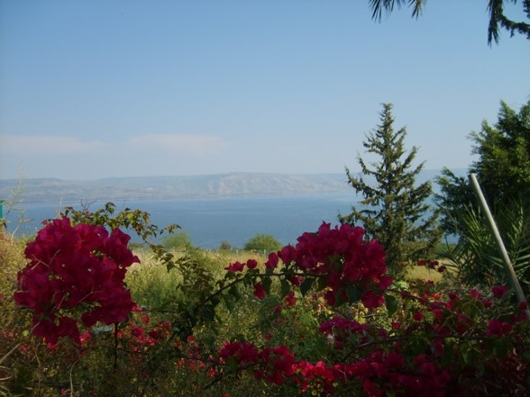
The Beatitudes
The term beatitude comes from the Latin adjective beātitūdō which means "happy", "fortunate", or "blissful“
The Beatitudes describe 8 blessings in the
Sermon on the Mount in Matthew.
Each Beatitude consists of two phrases:
the condition and the result.
In almost every case the condition is from familiar Old Testament context, but Jesus teaches a new interpretation.
Together, the Beatitudes present a new set of Christian ideals that focus on a spirit of love and humility different in orientation than the usual force and exaction taken. They echo the highest ideals of the teachings of Jesus on mercy, spirituality, and compassion.--wikipedia

Slide 3
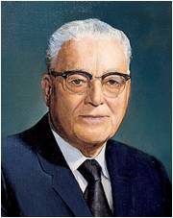
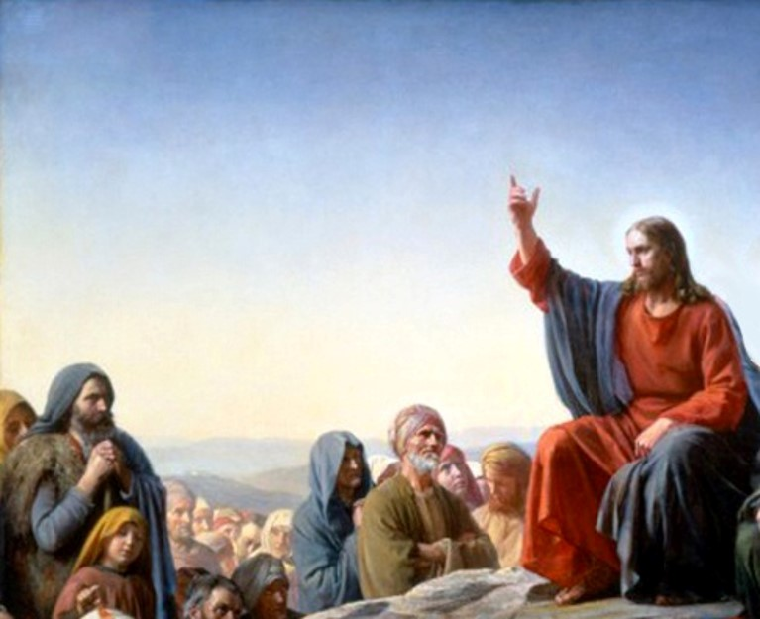
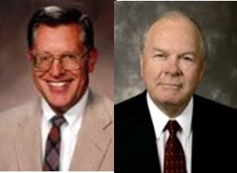
A Constitution for a perfect life
-- Harold B. Lee
“(The Beatitudes) not only set forth the blessed or happy life but also describe the kind of person our Savior was and is.”
JFM and RLM
We are blessed as we come unto Jesus Christ and follow His teachings

Slide 4
The Condition
Blessed are the poor in spirit who come unto me
Blessed are all they that mourn
Blessed are the meek
Blessed are all they who
do hunger and thirst after
righteousness
Blessed are the merciful
Blessed are all the pure in heart
Blessed are all the peacemakers
Blessed are all they who are persecuted for my name’s sake
3 Nephi 12:3-10
The Result
For theirs is the kingdom of heaven.
For they shall be comforted.
For they shall inherit the earth.
For they shall be filled with the Holy
Ghost.
For they shall obtain mercy.
For they shall see God.
For they shall be called the children of God.
For theirs is the kingdom of heaven.

Slide 5
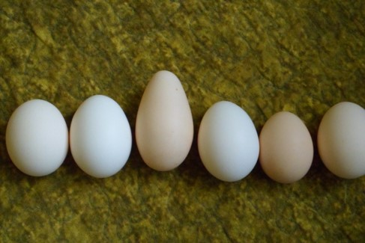
The Salt of the Earth
“The Saints are asked to stand as a spice, a seasoning, a flavor among the bland and often tasteless elements of the world. Because they are there, things are better; like salt, the people of the Lord are empowered to bring out the best in others…
In reality we can only make a difference if we are different. Not necessarily strange. Different. Indeed disciples of Christ are to stand in stark contrast to those who conform, concede, and thereby compromise.”
Salt is a healing medium.
Salt is a preservative. It preserves food from corruption.
“Salt will not lose its savor with age. Savor is lost through mixture and contamination…Flavor and quality flee a man when he contaminates his mind…”
Elder Carlos E. Asay
(See D&C 103:9-10)
3 Nephi 12:13 JFM and RLM

Slide 6
In what ways can we, as followers of
Jesus Christ, be like salt?
We are to help preserve or save people and to improve the world by influencing others for good.

Slide 7
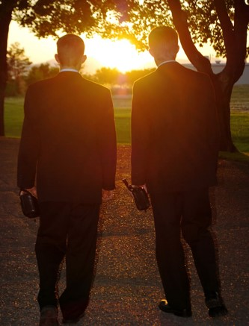
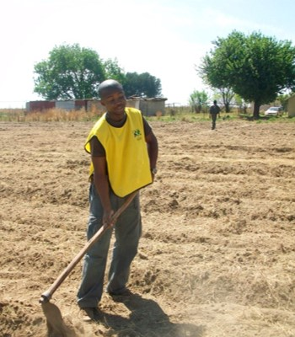
To Be The Light
Let our light shine.
To stand as beacons.
To certify our discipleship by teaching and living the gospel.
We can allow our light to shine through our testimonies, our witnesses of the truthfulness.
We allow our light to shine through our service to one another
3 Nephi 12:14-16

Slide 8
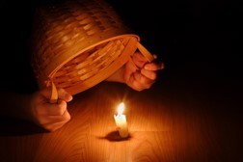
Why do some people cover their light?
Fear of rejection?
Fear of losing a friend?
Not quite certain of gospel principles?
Fear of inadequacy of knowledge of scriptures?
PS—you don’t have to a scriptorian to share your beliefs
Why does the Savior want us to let our light shine?
As we set a righteous example, we can help others glorify Heavenly Father
Regarding Member –missionary work:
1. Identify prayerfully your friends and neighbors who would be the most receptive to the gospel message.
2. Introduce the identified individuals to the missionaries.
3. Involve yourself in the teaching of the gospel, preferably in your home.
4. Integrate your friends and any other new members into the Church by being attentive and helpful.
3 Nephi 12:14-16

Slide 9
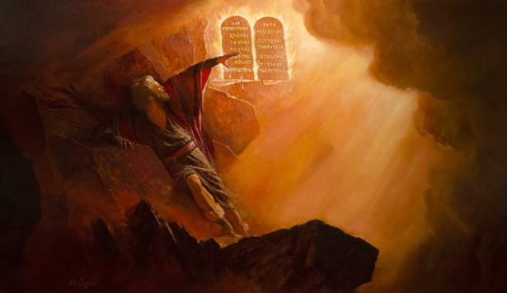
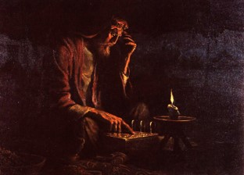
The Law
Jesus, as Jehovah, gave the law to Moses on Sinai.
He did not come to destroy the very system which he had set up and established among ancient Israel
He came to restore the gospel in it’s fulness…to a higher law
Did the Nephites have the Higher Law at this time?
3 Nephi 12:17

Slide 10
The Higher Law—Luke 6:27-30
Love your enemies
Do good to them which hate you
Bless them that curse you
Pray for them which despitefully use you
Unto him that smiteth thee on the one cheek offer also the other
Him that taketh away thy cloak forbid not to take thy coat also
Give to every man that asketh of thee
As ye would that men should do to you, do ye also to them likewise.

Slide 11
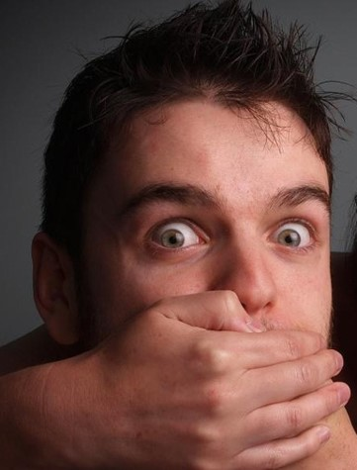
Thou Shalt Not Kill
…or have thoughts of it
“The prohibition against murder remained intact. People still were forbidden from wanton shedding of men’s blood.
One must require control over one’s emotions and avoid anger…(see wikihow article)
Bite your tongue
Stifle angry impulses
Throttle temper tantrums
3 Nephi 12:21

Slide 12
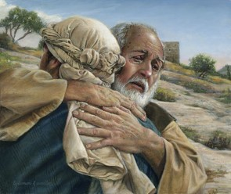
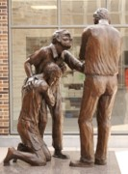
Forgive Your Brother
…and be responsible for him/her
The obligation of seeking peace
Resolving differences peaceably
Becoming peacemakers even if we are not responsible for the misunderstanding
“Am I my brother’s keeper” (Genesis 4:9)
Avoid law suits—
“…It is more important that they (apostles and missionaries) suffer legal wrongs than that their ministries be hindered or halted by legal processes.”
Bruce R. McConkie
Raca—Aramaic word meaning literally “empty head,” a statement of derision and abuse
“Then came Peter to him, and said, Lord, how oft shall my brother sin against me, and I forgive him? till seven times?
Jesus saith unto him, I say not unto thee, Until seven times: but, Until seventy times seven.”
Matthew 18:21-22
3 Nephi 12:22-26

Slide 13
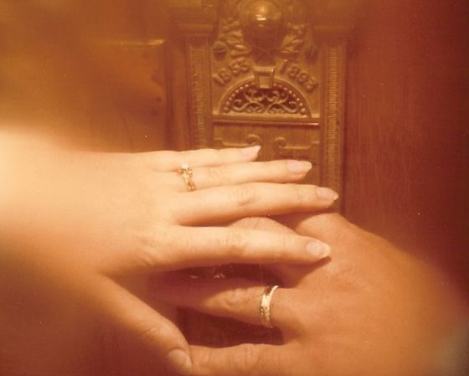
Do Not Commit Adultery
…even in your thoughts
“Thou shalt love thy wife with all thy heart, and shalt cleave unto her and none else.
And he that looketh upon a woman to lust after her shall deny the faith, and shall not have the Spirit; and if he repents not he shall be cast out.”
D&C 42:22-23
In the Old World, carnal and fallen men had begun to take advantage of the divorce laws in their culture.
JFM and RLM
“And verily I say unto you, as I have said before, he that looketh on a woman to lust after her, or if any shall commit adultery in their hearts, they shall not have the Spirit, but shall deny the faith and shall fear.”
D&C 63:16
3 Nephi 12:27-32

Slide 14
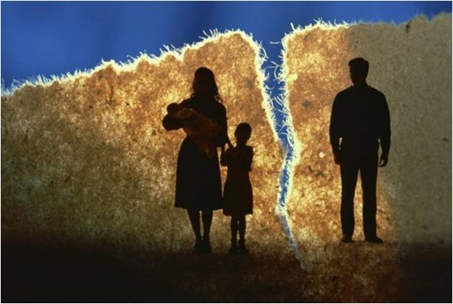
“Why is lust such a deadly sin? Well, in addition to the completely Spirit-destroying impact it has upon our souls, I think it is a sin because it defiles the highest and holiest relationship God gives us in mortality—the love that a man and a woman have for each other and the desire that couple has to bring children into a family intended to be forever. … Love makes us instinctively reach out to God and other people. Lust, on the other hand, is anything but godly and celebrates self-indulgence.
Love comes with open
hands and open heart;
lust comes with only an
open appetite”
Elder Jeffrey R. Holland
Personal Actions to avoid this kind of sin:
Start by separating yourself from people, materials, and circumstances that will harm you.
Acknowledge that people bound by the chains of true addictions often need more help than self-help, and that may include you.
Along with filters on computers and a lock on affections, remember that the only real control in life is self-control.
Cultivate and be where the Spirit of the Lord is.

Slide 15
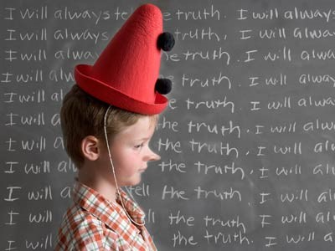
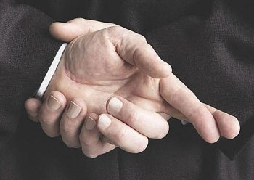
Do Not Lie
…especially under oath
From the beginning of time the oath was the most sacred, solemn attestation a person could make to affirm a statement or his word on a matter.
We believe in being honest…true—trustworthy
The oath, over time, had been misused—referring to secret combinations
3 Nephi 12:23-37

Slide 16
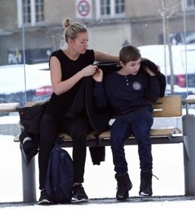
Turn the Other Cheek
…and avoid confrontations and counterattacks
“Though the Saints are in no way called upon to become the doormats of society, yet they are directed here to avoid reviling or striking back at an enemy.”
JFM and RLM
“And unto him that smiteth thee on the one cheek offer also the other; and him that taketh away thy cloak forbid not to take thy coat also.
Give to every man that asketh of thee; and of him that taketh away thy goods ask them not again.”
Luke 6:29-30
3 Nephi 12:38-42

Slide 17
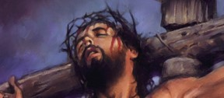
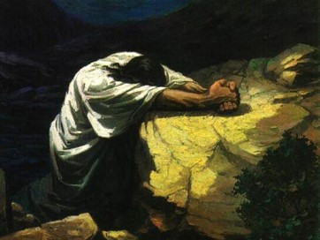
Love Your Enemies
…no matter how bad the situation is
“Thou shalt not hate thy brother in thine heart: thou shalt in any wise rebuke thy neighbour, and not suffer sin upon him.
Thou shalt not avenge, nor bear any grudge against the children of thy people, but thou shalt love thy neighbour as thyself: I am the Lord.”
Leviticus 19:17-18
“The followers of Christ is not just to tolerate or avoid his enemies…He bids us to do away with our enemies by making friends of them.”
JFM and RLM
We need to:
Act in loving and kind ways toward our enemies
Pray for them and asking for help in forgiving them
Be an example to them that have offended us in any manner
Zenos: “…yea, thou wast merciful when I prayed concerning those who were mine enemies, and thou didst turn them to me.”
Alma 33:4
3 Nephi 12:43-46

Slide 18
Being Perfect
Do we need to become perfect in this life to enter the celestial kingdom?
Does Heavenly Father expect us to be perfect?
Can we ever be perfect?
Heavenly Father does not expect us to become perfect during our mortal lives but that as we diligently strive to keep the commandments and as we rely upon the Atonement, we can ultimately be perfected.
3 Nephi 12:48

Slide 19
Doctrinal Mastery
“Therefore I would that ye should be perfect even as I, or your Father who is in heaven is perfect.”
3 Nephi 12:48

Slide 20
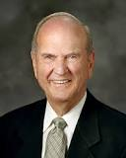
“We need not be dismayed if our earnest efforts toward perfection now seem so arduous [difficult] and endless.
Perfection is pending.
It can come in full only after the Resurrection and only through the Lord.
It awaits all who love him and keep his commandments”
Elder Russell M. Nelson

Slide 21
Sources:
Videos:
Come Join With Us (0:00 -2:18)
Salt of the Earth (1:06)
Be Ye Therefore Perfect (0:47)
Russell M. Nelson (“Perfection Pending,” Ensign, Nov. 1995, 88).
Wikipedia-- http://en.wikipedia.org/wiki/Beatitudes
Elder Carlos E. Asay (CR, April 1980)
Robert C. Oaks Sharing the Gospel Oct. 2000 Gen. Conf.
Bruce R. McConkie Doctrinal New Testament Commentary 1:223
Joseph Fielding McConkie and Robert L. Millet Doctrinal Commentary of the Book of Mormon Vol. 4 pgs. 69-77
Elder Jeffrey R. Holland (“Place No More for the Enemy of My Soul,” Ensign or Liahona, May 2010, 44–45).
Presentation by ©http://fashionsbylynda.com/blog/

Slide 22
WHAT WAS THE TRADITIONAL UNDERSTANDING IN THE LAW OF MOSES? | HOW DID THE SAVIOR COUNSEL THE NEPHITES TO LIVE? | WHAT MIGHT A YOUNG MAN OR WOMAN DO TO FOLLOW THE SAVIOR’S TEACHING TODAY?
3 Nephi 12:21 | 3 Nephi 12:22–26
3 Nephi 12:27 | 3 Nephi 12:28–30
3 Nephi 12:38 | 3 Nephi 12:39–42
3 Nephi 12:43 | 3 Nephi 12:44–45
WHAT WAS THE TRADITIONAL UNDERSTANDING IN THE LAW OF MOSES? | HOW DID THE SAVIOR COUNSEL THE NEPHITES TO LIVE? | WHAT MIGHT A YOUNG MAN OR WOMAN DO TO FOLLOW THE SAVIOR’S TEACHING TODAY?
3 Nephi 12:21 | 3 Nephi 12:22–26
3 Nephi 12:27 | 3 Nephi 12:28–30
3 Nephi 12:38 | 3 Nephi 12:39–42
3 Nephi 12:43 | 3 Nephi 12:44–45

Slide 23
The Beatitudes 3 Nephi 12:3-12
The poor in spirit who come unto me Those who are poor in spirit—who are broken in spirit, sad of spirit or depressed, or those who are sin-laden and thereby spiritually bankrupt—cannot be saved on their own. The words “who come unto me” in the Bountiful sermon complete the intended message. There is no virtue in being broken or in being a spiritual beggar, except to the degree that we come unto the Lord. “Ye, come unto Christ, and be perfected in him.” (Moroni 10:32)
All they that mourn One is not an heir of heavenly approbation who simply spends his or her days mourning. There are, however, certain kinds of mourning which are commanded and thus commended. Those who mourn for their sins—and more important, who, like Nephi, mourn because of their fallen nature. (see 2 Nephi 4:17-35) –and subsequently turn to Christ with full purpose of heart come to know the comfort and peace of forgiveness. The Saints who mourn with those that mourn—and who thus fulfill their covenantal obligations …shall in time gain eternal life. Those who mourn because of the cost of Christian discipleship, who face the challenges of a cynical and skeptical world head on, who “suffer his cross and bear the shame of the world” (Jacob 1:8), shall eventually find rest with him who mourned as none other has in time or in eternity.
The meek “They are the ones who willingly conform to the gospel standards, thus submitting their wills to the will of the Lord. They are not fearful, the spiritless, the time. Rather, the most forceful dynamic personality who ever lived…said of Himself, ‘I am meek and lowly in heart.’ “—Bruce R. McConkie Mormon Doctrine p. 474. Meekness is not just humility…Meekness may involve…the ability to be in control emotionally. The meek person is one who feels little or not attachment to this world’s trappings.
Inherit the earth A modern revelation declared that “the resurrection from the dead is the redemption of the soul. And the redemption of the soul is through him that quickeneth all things, in whose bosom it is decreed that the poor and the meek of the earth shall inherit it.’ (D&C 88:16-17)
Hunger and thirst after righteousness To hunger and thirst after righteousness is to yearn with all one’s soul for the things of the Spirit; to crave that goodness of character…to want more than anything else to enjoy the fruit of the Spirit, the gifts and sings and wonders which always accompany faith. …To have an eye single to the glory of God….to trust completely in the Savior, to rely wholly upon his mercy and grace, to yield one’s heart unto God.
Filled with the Holy Ghost The Spirit of God sanctifies—it cleanses and purges filth and dross out of the human soul as though by fire. The Spirit does far more, however, than remove uncleanness. It also fill. It fills one with a holy element, with a sacred presence that motivated the person to a godly walk and goodly worlds.
The merciful To the degree that we are merciful with others, God will be merciful with us. We shall be judged according to the judgment we render (JST Matthew 7:1-2)

Slide 24
The pure in heart When we manage to live in such a way that our actions are above reproach, we are said to have clean hands. When we live in such a way that our desires are appropriate and are but reflected by our righteous actions, then we are said to be pure in heart. To be pure in heart is to be single, focused, riveted, aligned with the ways and will of the Almighty. It is to have no desires but desires for righteousness. When a Latter-day Saint is pure in heart, he seeks to build up and establish the cause of Zion: Zion is the pure in heart (see D&C 97:21)
They shall see God In a metaphorical sense, a faithful person comes to “see God” as he or she begins to see more clearly the hand of God in all things. …In the ultimate sense, one who through the sanctifying powers of the Spirit, acquires true sainthood and therefore become pure in heart, is entitled to see the Lord face to face.
The peacemakers The Lord commissions his servants to do all they can to establish peace on earth. Treaties and agreements and armistices are to applauded, but the only ultimate peace in the world will come through the power of Jesus Christ. Jesus Christ is the Prince of Peace. His message, the gospel of salvation, is a message of peace. He brings peace—but not as the world does (see John 14:27)—to those who will receive him, come unto him, obey him follow him and submit to him. He remits sin, and that brings peace. He steadies the troubled souls, which brings peace. He comforts the bereaved, which brings peace. He offers heavenly perspective, which brings peace. His spirit teaches the “peaceable things of the kingdom” (D&C 39:6) In addition, those whom he calls and sends forth in his name are peacemaker; these are they which bear glad tiding, which publish peace, even the message that God reigns (see Mosiah 15:13-18)
“The peace the gospel brings is not just the absence of war. It is the opposite of war. Gospel peace is the opposite of any conflict, armed or unarmed. It is the opposite of national or ethnic hostilities, of civil or family strife…By preaching righteousness, our missionaries seek to treat the causes of war. They preach repentance form personal corruption, greed, and oppression because only by individual reformation can we overcome corruption and oppression by groups or nations. By inviting all to repent and come unto Christ, our missionaries ware working for peace in this world by changing the hearts and behavior of individual men and women”
(Dallin H. Oaks CR April 1990)
Joseph Fielding McConkie and Robert L. Millet Doctrinal Commentary on the Book of Mormon Vol. 4 pgs. 65-68

Slide 25
Matthew Chapter 5: 3-11
The Beatitudes
Blessed are the poor in spirit
Blessed are they that morn
Blessed are the meek
Blessed are they which do hunger and thirst after righteousness
Blessed are the merciful
Blessed are the pure in heart
Blessed are the peacemakers
Blessed are they which are persecuted

Slide 26
6 Ways To Help Your Kids Be A Good Influence On Their Friends
BY KARLA BOND
For Parents:
Many parents are concerned with who their kids are hanging out with, often unaware that their own children are the ones who are the bad influence. It’s important to incorporate certain values in the home to ensure that your children are a positive influence on their friends. Children who set good examples to others often learn how to be that way from their parents. Here are some ways you can help your kids be a good influence, which will keep them from making bad decisions that can affect them long-term:
Establish Communication
Spend time with your child both inside and outside of the home, and establish communication to form a strong relationship that will carry into their social life. Children who have a closer relationship with their family succeed outside of the home by having more self-confidence and respect for both themselves and others.
Teach the Dangers of Drugs and Alcohol
Children are often exposed to or offered drugs or alcohol as early as middle school, making it important to communicate the dangers at an early age. Discuss the consequences and how drugs or alcohol can often lead to jail time, addictions, and even poverty. It’s important that your children know how to deal with friends and peers struggle with addictions to drugs or alcohol as well. It’s nearly impossible to avoid someone at school who uses these substances, so teaching them how to help others and deal with it is essential.
Monitor Entertainment
The media is often the first place that children hear curse words, view mature scenes, and are overly exposed to adult content. Block certain channels on the television, while also monitoring their Internet use on a consistent basis. It’s also important to know what your children are doing on their social media accounts, if they have any. Although you can’t control everything they see and do on the internet, setting filters to block obscene material is crucial. The more they are exposed to questionable content, the more normal it becomes for them. Children who are positive influences on their friends aren’t exposed to many of the things teenagers are seeing and talking about at school. They typically don’t want to associate with those things.
Practice Discipline
Discipline is often difficult to establish in the home for parents who may have been raised in a strict environment and want to provide their children with freedom. However, the most rebellious children are often those who were never raised with rules, making it important to establish guidelines in and out of the home. By learning to respect authority inside of the home, they’ll be able to practice it in school.
Teach Respect
Children commonly model what they see their parents doing, which makes it important to watch your own behavior with your own friends. Avoid gossiping or slandering other people in the home, and show your child what it means to be a friend by serving those you’re around. If your children learn to respect their peers, they will get respect from them in return.
Serve in the Community
By establishing a routine of helping others or volunteering in the community as a family, it will naturally teach your children gratitude and the importance of living a selfless life. They’ll be able to help those in need, which will change their perspective on their role in school and amongst their friends in a positive way.
Knowing that your children are setting good examples for their friends can make raising your children much easier. Follow these steps, and you will give your children the tools they need to make good decisions and choose good friends.
http://bondwithkarla.com/6-ways-help-kids-good-influence-friends/

Slide 27
How to Control Your Temper
Edited by Flickety, Sondra C, Ben Rubenstein, Dave Crosby and 46 others
1. Remember that the reward for patience is happiness.
2. Realize that things can be handled well at all times; it's just a matter of what kind of attitude you put into it. Take deep breaths.
3. Get away from situations where your anger might get the better of you, such as when someone is teasing you. Ignore the other person and walk away. If you must, do this a few times until the person gets the hint that you will not tolerate it. It's okay to use your words or body language to tell somebody you will not tolerate how they are treating you, as long as you respond to them in a calm and matter of fact manner, without being overtly hurtful or trying to embarrass them as they have you. It's never okay to hit somebody for making fun of you.
4. Realize that no one likes to be around people who get angry easily, and act abusive. The only way you can change the situation is by starting with yourself.
5. Be considerate of others, and ultimately, yourself. The way you react will ultimately affect your surroundings. If you have to rebuke someone for doing something wrong, you can always do it calmly, in a private place. This method is always better for everyone in the long run.
6. If you are angry and you are standing, sit down; if you are sitting, lie down.
7. Remember, 5 seconds stand between you and logic. Count to 5, and remember that logic always beats anger.
8. Stop talking to that person for a few minutes to whom you are angry and take deep breath around 5-7 times. Try breathing slowly in through your nose, and out through your mouth. This will calm you down.
9. Take a deep breath.
10. Think about the good things that person has done for you. What bad have you done to them? Chances are, you've done at least something to them to make them resentful towards you. Make sure you have a clear conscience-then speak.
http://www.wikihow.com/Control-Your-Temper

Slide 28
Something of Interest
Salt 3 Nephi 12:13:
In ancient days, salt was used as payment. Ezra 4:14 refers to this, using an idiom we don’t relate to in our day: “Now because we are in the service of the palace…” The word “service” is sometimes translated “maintenance,” but a literal translation would be, “Now because we eat the salt of the palace,” meaning the king provided their salary. It could be it just refers to their dependence on the king or that he actually paid them with salt. The Latin word for a Roman’s salt ration is where we get our word “salary.” Slaves were exchanged for salt, from which came the expression that someone is “not worth his salt.”
In the days of Yeshua and Second Temple times, King Herod held a monopoly on salt coming from the Dead Sea, which supplied the priests with the salt needed for Temple ritual. Earlier, in Ezra’s time, it was the king of Persia who supplied the salt (Ezra 7:21–22). The worshipper, in fact, was not required to supply the salt for the sacrifices. Salt, as well as wood and oil, were provided by the Temple and kept in special chambers on the Temple compound. Other cultures of the time used salt in their religious rituals as well…and still do. In my search on salt through the Internet, I came across an article a Japanese man wrote, showing the similarities between some Japanese traditions and Jewish traditions. Here are some fascinating facts concerning salt in both cultures (my comments in brackets):
Japanese have the custom to use salt for sanctification. People sometimes sow the Samurai: a woman threw salt on the place where a man she hated left. This custom is the same as that of the ancient Israelites. After Abimelech captured an enemy city, “he sowed it with salt” (Judges 9:45). We Japanese quickly interpret this to mean to cleanse and sanctify the city. [Josephus mentions such a thing also: “and when he had overthrown the city to the very foundations, for it was not able to bear a siege, and had sown its ruins with salt, he proceeded on with his army” (Antiquities, V, 7). Rather than sanctifying the ground, some say it was used as a means to curse the ground of the enemy and make it unproductive.]
I hear that when Jews move to a new house, they sow it with salt to sanctify it and cleanse it. This is true also in Japan. In Japanese-style restaurants, they usually place salt near the entrance. [In 18th–century Scotland, Scots would carry a salt box into a new house!] Jews use salt for Kosher meat. [Salt draws the blood from the meat. It’s done in accordance with God’s command not to eat blood (Lev. 17:10–12).] All Kosher meat is purified with salt and all meals start with bread and salt.
Several commentators point out that the “salt of the covenant” mentioned in Leviticus 2:13 follows the prohibition of using leaven and honey (vs. 11). Both honey and leaven cause “corruption” or fermentation. Salt did not, but purified and preserved, or was “incorruptible.” Bridge for Peace.com
Salt Cave near the Dead Sea

Slide 29
To cross one's fingers is a hand gesture commonly used to wish for luck. Occasionally it is interpreted as an attempt to implore God for protection. The gesture is referred to by the common expressions "cross your fingers", "keep your fingers crossed", or just "fingers crossed". Some people, mostly children, also use the gesture to excuse their telling of a white lie. By extension, a similar belief is that crossing one's fingers invalidates a promise being made.
The origin of the gesture traces back to the biblical Kingdom of Israel. Courts of Mosaic law would often render verdicts with the phrase "May God have mercy upon your soul" in order to reaffirm God's supreme authority over the law. Most judges felt that while they could pass a sentence of death upon a person, they personally did not have the authority to destroy souls and that only God had the authority to do that. As a result, some judges would cross their fingers whenever they said the phrase as a result of concern for the criminal's soul as they said it as a prayer.
Common usage of the gesture traces back to the early centuries of the Catholic Church. Common use of crossed fingers is found in the Christians who would cross their fingers in order to invoke the power associated with Christ's cross for protection, when faced with evil. Moreover, Christians, when persecuted by the Romans, used the symbol of crossed fingers in order to recognize one another and assemble for Holy Mass. "When they were persecuted in Rome, Christians would secretly come together with the sign of the fish, and they would hold up their crossed fingers, as a Sign of the crossed emblem that had once been on the vestments of the army of Barabbas. It became a custom everywhere, for Christians when meeting, to make the sign of a cross by crossing their fingers." In 16th century England, people continued to cross fingers or make the sign of the cross in order to ward off evil, as well as when people coughed or sneezed.
This superstition thus became popular among many early European Christian cultures. In some places, a comrade or well-wisher placed his index finger over the index finger of the person making the wish, the two fingers forming a cross. The one person makes the wish, the other empathizes and supports. Over centuries, the custom was simplified, so that a person could wish on his own, by crossing his index and middle fingers to form an X. But traces remain—two people hooking index fingers as a sign of greeting or agreement is still common in some circles today.
Charles Panati believes that the act of crossing one's fingers as a sign of luck or making a wish traces back to pre-Christian times, speculating that the cross was a symbol of unity and benign spirits dwelt at the intersection point. A wish made on a cross was a way of "anchoring" the wish at the intersection of the cross until the wish was fulfilled. wikipedia
Something of Interest

