Slide 2
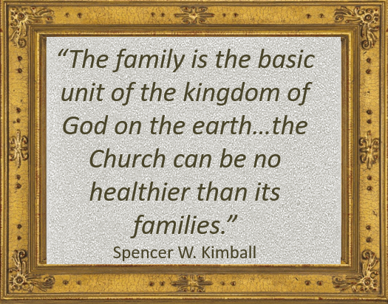
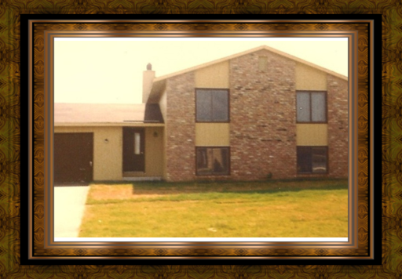
“My Time is At Hand”
“God be with you. I have the same feeling as perhaps the Master had when he bid goodbye to the Nephites. He said he perceived that they were weak, but if they would go to their homes and ponder what he said he would come again and instruct them on other occasions.
So likewise, you cannot absorb all that you have heard and that we have talked about, but go to your homes now and remember what you can, and get the spirit of what has been done and said, and when you come again, or we come to you, we will try to help you further with your problems.”
President Harold B. Lee
The most important gospel instruction should be in the home
3 Nephi 17:1-4

Slide 3
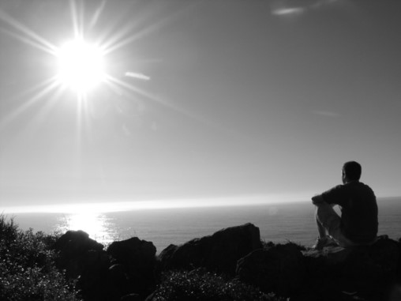
Ponder
“Reading, studying, and pondering are not the same. We read words and we may get ideas. We study and we may discover patterns and connections in scripture. But when we ponder, we invite revelation by the Spirit. Pondering, to me, is the thinking and the praying I do after reading and studying in the scriptures carefully.”
Henry B. Eyring
To Ponder:
To meditate
To think
To feast
To treasure
It is more than a mental method, it is a spiritual striving to obtain an to understand truth then it is to pray about the things
you pondered
How do you think pondering and prayer can work together to help us understand what we learn in church or seminary?
3 Nephi 17:3

Slide 4
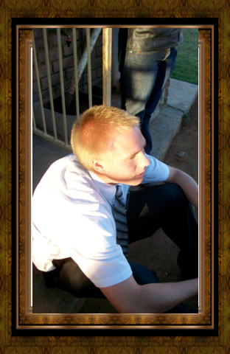
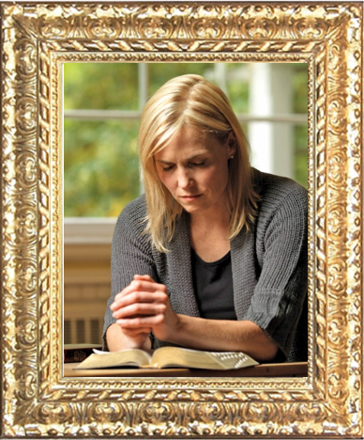
Preparing to Receive
How should you prepare to understand and learn what is taught during church or seminary?
What difference does it make when we prepare our minds for learning opportunities?
Pondering opens the mind to the Spirit
3 Nephi 17:3

Slide 5
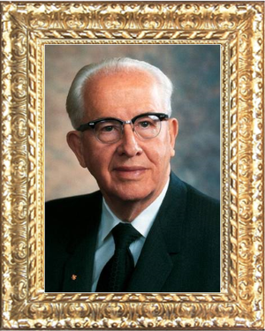
“Man must take time to meditate, to sweep the cobwebs from his minds, so that he might get a more firm grip on the truth and spend less time chasing phantoms and dallying in projects of lesser worth…Take time to mediate. Ponder the meaning of the work in which you are engaged. The Lord has counseled, “Let the solemnities of eternity rest upon your minds’ (D&C 43:34). You cannot do that when your minds are preoccupied with the worries and cares of the world.”
--Ezra Taft Benson

Slide 6
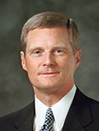
“Writing down what we learn, think, and feel as we study the scriptures is another form of pondering and a powerful invitation to the Holy Ghost for continuing instruction.”
David A. Bednar

Slide 7
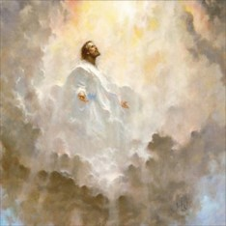
“I Go to the Father”
“The record does not tell us why he returns to the Father. Presumably he returned to report of his ministry among the Nephites and to receive any instructions that the Father would have him deliver when he came again”
JFM and RLM
“And now I go unto the Father, because it is expedient that I should go unto the Father for your sakes.”
3 Nephi 18:35
3 Nephi 17:4

Slide 8
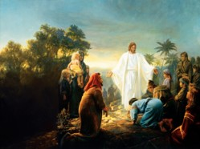
Tarry a Little Longer
Why did Jesus stay a little longer?
Bowels= The Semitic Root for “Mercy”
refers to that which is deep within
He saw tears in their eyes
He had compassion on them
“And he will take upon him death, that he may loose the bands of death which bind his people; and he will take upon him their infirmities, that his bowels may be filled with mercy, according to the flesh, that he may know according to the flesh how to succor his people according to their infirmities.”
Alma 7:12
The Savior feels great compassion for us. Jesus Christ can heal every kind of affliction. As we come unto Jesus Christ in faith, we can experience His healing power.
3 Nephi 17:5-6

Slide 9
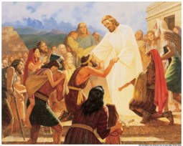
Faith To Be Healed
Jesus shows the Nephites what had been done in Jerusalem to their brethren
“…for I see that your faith is sufficient that I should heal you.”
“Healing of a physical nature and also healing of the spirit—forgiveness of sin—come to people as gifts of the grace of God as they exercise faith in the Lord Jesus Christ.”
JFM and RLM
“And again, to some it is given to have faith to be healed;”
D&C 46:19
“…thy faith hath made thee whole.”
Matthew 9:22
3 Nephi 17:7-9

Slide 10
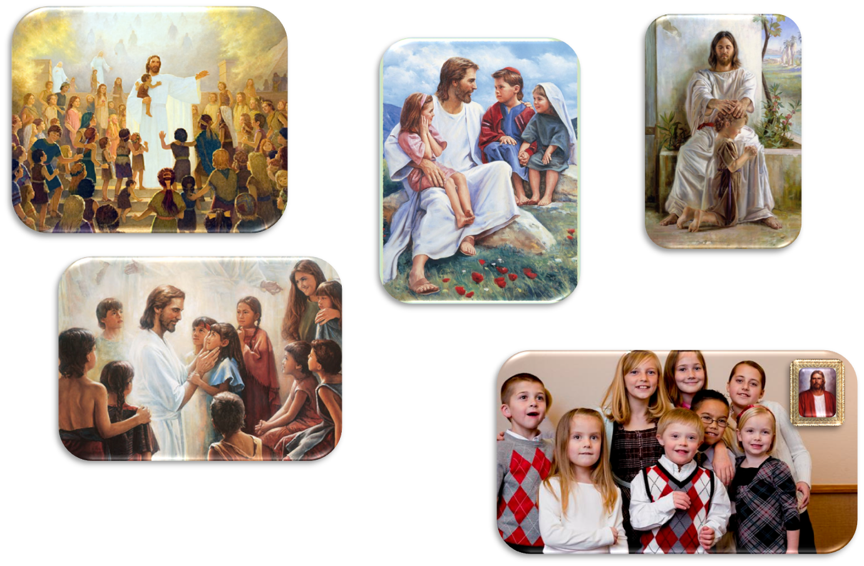
“My Joy is Full”
3 Nephi 17:13-20
There are no words to describe the prayer He offered upon the
little children

Slide 11
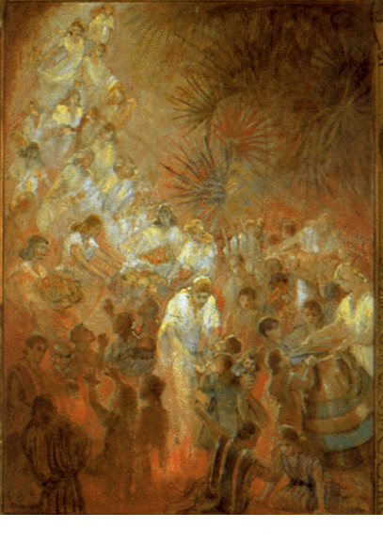
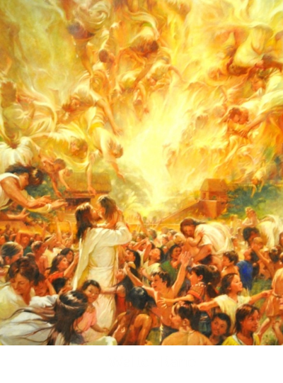
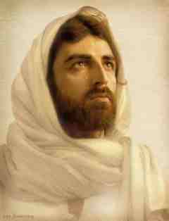
“Behold Your Little Ones”
“And when he had said these words, he wept, and the multitude bare record of it, and he took their little children, one by one, and blessed them, and prayed unto the Father for them.
And when he had done this he wept again;”
3 Nephi 17:21-25

Slide 12
Sources:
Video:
Jesus Blessed the Children One by One (3:17)
My Joy is Full (4:00)
President Harold B. Lee Conf Report Oct 1972
Spencer W. Kimball The Teachings of Spencer W. Kimball pg. 331-332
The Teachings of Ezra Taft Benson pg. 390
(David A. Bednar, “Because We Have Them before Our Eyes,” New Era, Apr. 2006, 6–7).
Henry B. Eyring (“Serve with the Spirit,” Ensign or Liahona, Nov. 2010, 60).
Joseph Fielding McConkie and Robert L. Millet Doctrinal Commentary on the Book of Mormon Vol. 4 pg. 114,115
Illustration of Jesus Healing—Gary Kapp
Presentation by ©http://fashionsbylynda.com/blog/

Slide 13
THE SAVIOR HEALS THE SICK AND AFFLICTED (SEE 3 NEPHI 17:6–10) | THE SAVIOR PRAYS FOR THE PEOPLE (SEE 3 NEPHI 17:11–18) | ANGELS APPEAR AND MINISTER TO THE CHILDREN (SEE 3 NEPHI 17:19–25)
THE SAVIOR HEALS THE SICK AND AFFLICTED (SEE 3 NEPHI 17:6–10) | THE SAVIOR PRAYS FOR THE PEOPLE (SEE 3 NEPHI 17:11–18) | ANGELS APPEAR AND MINISTER TO THE CHILDREN (SEE 3 NEPHI 17:19–25)

