Slide 1
3 Nephi 18

Slide 2
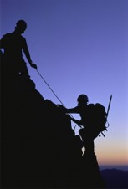
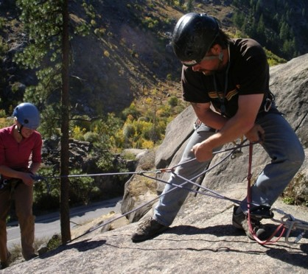
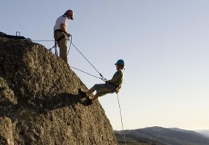
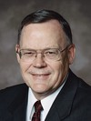
“Some time ago there was an interesting article about mountain climbing in a medical magazine. …
“The article was about a man named Czenkusch (ZEN-kush) who runs a climbing school. … Czenkusch was describing to the interviewer the belay system in mountain climbing.
This is the system by which climbers protect themselves from falls. One climber gets in a safe position and secures the rope for the other climber, usually around his or her own body.
‘You’re on belay,’ means, ‘I’ve got you. If something happens, I will stop you from falling.’ It is an important part of mountain climbing…

Slide 3
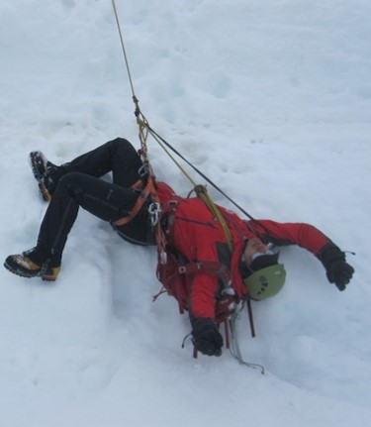
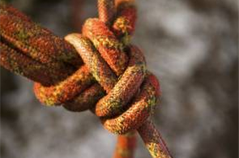
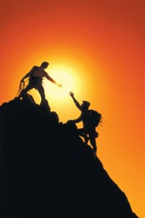
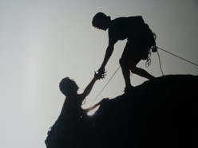
...‘Belaying has brought Czenkusch his best and worst moments in climbing.
Czenkusch once fell from a high precipice, yanking out three mechanical supports and pulling his belayer off a ledge. He was stopped, upside down, 10 feet from the ground when his spread-eagled belayer [Don] arrested the fall with the strength of his outstretched arms.
“Don saved my life,” says Czenkusch.
“How do you respond to a guy like that? Give him a used climbing rope for a Christmas present?
No, you remember him. You always remember him”’
Gerald Lund

Slide 4
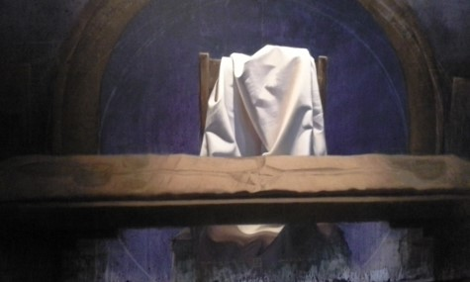
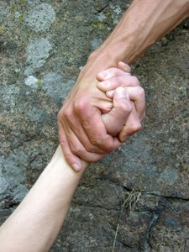
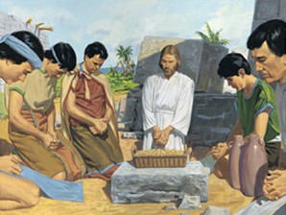
Our Rescuer
Who is our rescuer and how do we give thanks?
Jesus implements the sacrament to the Nephites as he did with His disciples at the Last Supper---in remembrance of Him who has rescued us from sin
3 Nephi 18:1-7

Slide 5
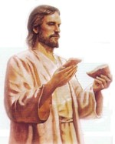
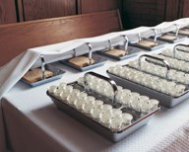
Hunger and Thirst—Bread and Wine
Hunger and thirst for the Spirit of Christ
We must come to the sacrament table hungry
We eat food to stimulate our physical bodies
It is also necessary for our spiritual body to receive spiritual strength
Bread and wine to always remember Him
Symbols of body and flesh
A merciful blessing
How does partaking of the sacrament help us remember the Savior’s sacrifice in our behalf?
3 Nephi 18:1-4

Slide 6
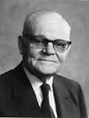
A Full Participant
“…witness before the church that they have truly repented of all their sins, and are willing to take upon them the name of Jesus Christ,…
D&C 20:37
As we partake of the sacrament, we witness unto the Father that we will always remember Jesus Christ.
“Now partaking of the sacrament is not to be a mere passive experience. We are not to remember the Lord’s suffering and death only as we may remember some purely secular historical event. Participating in the sacrament service is meant to be a vital and a spiritualizing experience.”
Elder Marion G. Romney
As we partake of the sacrament, we witness unto the Father that we are willing to do all that the Savior has commanded

Slide 7
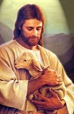
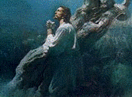
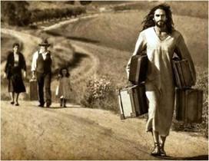
Remembering Him
We remember the life of the Jesus and the model He set for us by His own life.
We remember His atoning sacrifice made in our behalf through which He endured shame and incomprehensible pain in order to pay for our sins and bring about the Resurrection
We remember the covenants we have made with Him and examine how well we are keeping those covenants.
We remember him in our everyday life by asking ourselves:
“What would Jesus do in this situation?” or
“How would He respond to this challenge” or
“What would He say if he were here now?”
We use Him as the constant standard by which we measure all of our own thoughts, words, and actions.
Student Manual

Slide 8
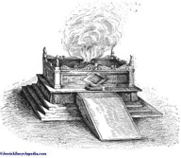
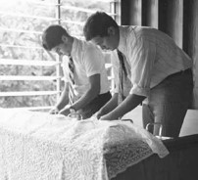
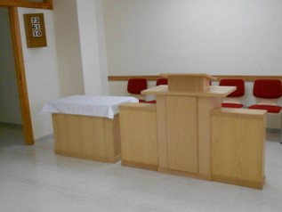
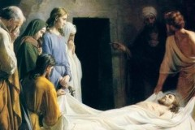
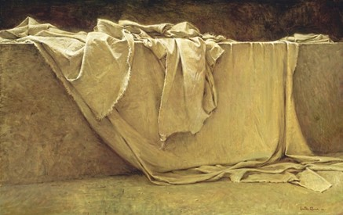
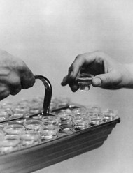
Submitting to the Will of the Lord
Where is our sacred alter?
Who prepares the sacrament?
What are we asked to do?
We partake of the sacrament. We submit our whole selves to the will of God
What happens at the alter when the sacrament is over?
To Cover—Atonement
The Savior has covered for our sins and transgressions, our sorrows and trials, our afflictions and pain

Slide 9
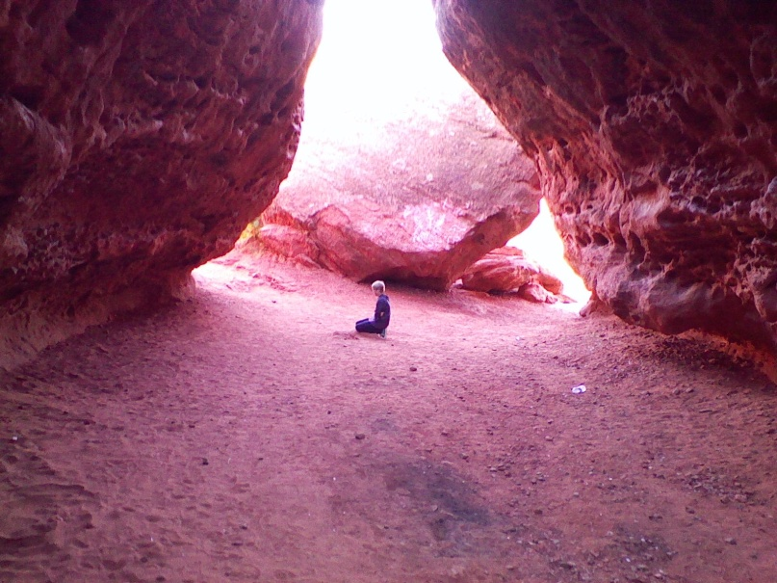
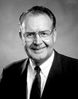
Pray Always
“Prayer is an act of faith
Bible Dictionary: ‘The object of prayer is not to change the will of God, but to secure for ourselves and for others blessings that God is already willing to grant, but that are made conditional on our asking for them.’
Surely, as our creator He knows our cares, our worries, our joys, our struggles without our informing Him. The reason our Heavenly Father asks us to pray cannot be that we are able to tell Him something He does not already know. Rather, the reason He asks us to pray is that the process of learning to communicate effectively with Him will shape and change our lives.”
David E. Sorensen
3 Nephi 18:15-25
Student Manual

Slide 10
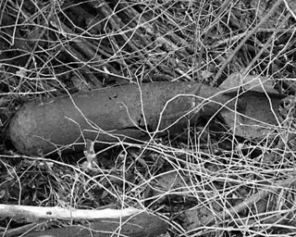
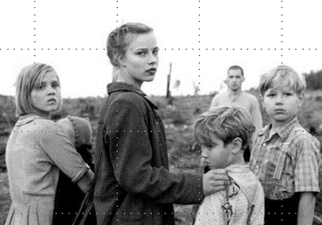
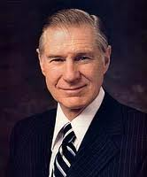
“Family prayer is a powerful and sustaining influence.
During the dark days of World War II, a 500-pound bomb fell outside the little home of Brother Patey, a young father in Liverpool, England, but the bomb did not go off.
His wife had died, so he was rearing his five children alone. He gathered them together at this very anxious time for family prayer. They ‘all prayed … earnestly and when they had finished praying, the children said: “Daddy, we will be all right. We will be all right in our home tonight.”
“‘And so they went to bed, imagine, with that terrific bomb lying just outside the door half submerged in the ground. If it had gone off it would have destroyed probably forty or fifty houses and killed two or three hundred people. …
“‘The next morning the … whole neighborhood was removed for forty-eight hours and the bomb was finally taken away. …
“‘On the way back Brother Patey asked the foreman of the A.R.P. Squad: “Well, what did you find?”
“‘“Mr. Patey, we got at the bomb outside of your door and found it ready to explode at any moment. There was nothing wrong with it. We are puzzled why it did not go off.”’
James E. Faust

Slide 11
Doctrinal Mastery
“Verily, verily, I say unto you, ye must watch and pray always, lest ye be tempted by the devil, and ye be led away captive by him.
And whatsoever ye shall ask the Father in my name, which is right, believing that ye shall receive, behold it shall be given unto you.
Pray in your families unto the Father, always in my name, that your wives and your children may be blessed.”
3 Nephi 18:15, 20-21

Slide 12
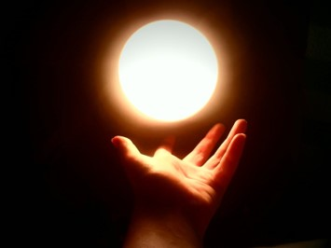
Hold Up Your Light
“Therefore, hold up your light that it may shine unto the world. Behold I am the light which ye shall hold up—that which ye have seen me do. Behold ye see that I have prayed unto the Father, and ye all have witnessed.”
“Ye are the light of the world. A city that is set on an hill cannot be hid.”
Matthew 5:14
“Let your light so shine before men, that they may see your good works, and glorify your Father which is in heaven.”
Matthew 5:16
Christ as the light in our lives:
Individually—By taking on His name—that it shine in our countenances
Institution of the Church—giving meaning to all that we do…all our ministering, meetings and efforts to build up the kingdom of God
3 Nephi 18:15-24

Slide 13
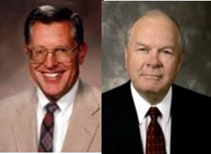
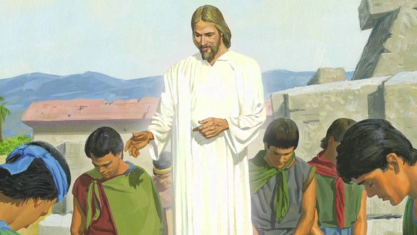
Instruction for the Disciples
They are to:
“fulfil other commandments”
Do not partake of sacrament unworthily
Minister to them and pray for them who are unworthy, but do not cast them out
“And now I go unto the Father, because it is expedient that I should go unto the Father for your sakes.”
“Forbidding someone from partaking of the sacrament on the grounds of person unworthiness is the responsibility of the “judge in Israel” who holds the key of the priesthood which direct priesthood ordinances. It is not the prerogative of members of the congregation to forbid anyone from partaking of the sacrament.
If they are aware of unworthiness, they may discuss it with the bishop or the appropriate priesthood leader, but it remains the right of the priesthood leader, through the spirit of discernment, to allow or disallow someone the blessing of the sacrament.”
JFM and RLM
3 Nephi 18:26-34

Slide 14
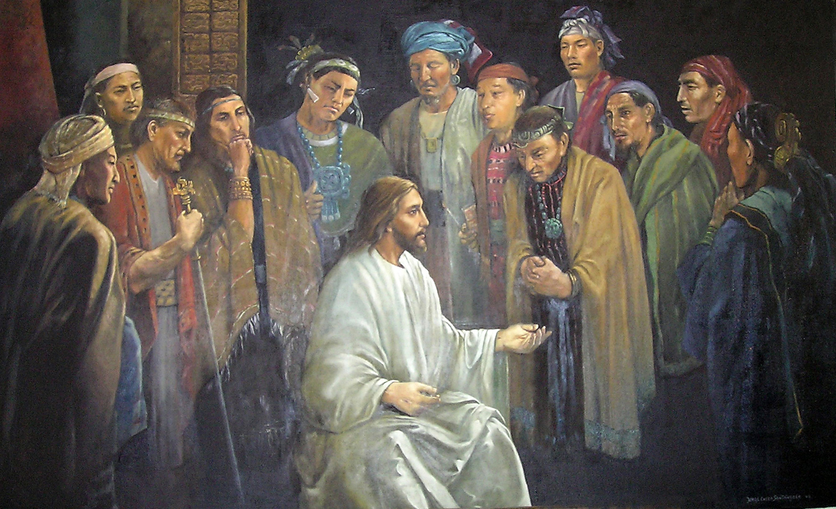
Ordaining the Twelve
Touching---laying on of hands—setting apart or ordination
“As a result of the fulfillment of the law and as part of the establishment of a new dispensation and new Church, the Savior ordains and sets apart his disciples and gives them authority to confer the gift of the Holy Ghost and set in order the new organization. The words spoken by Christ to the Twelve—which were not heard by the multitude—were preserved.”
JFM and RLM
Jorge Cocco
Read Moroni 2
3 Nephi 18:36-38

Slide 15
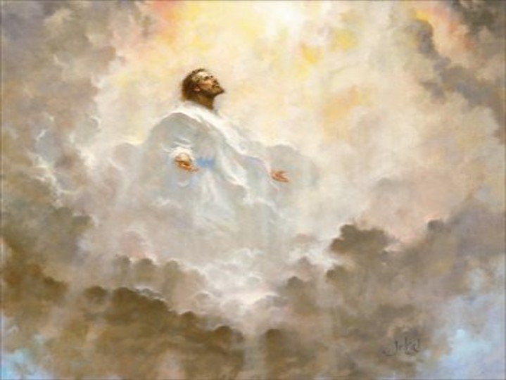
Day 1 of the Savior’s Visit
“And while they were overshadowed he departed from them, and ascended into heaven. And the disciples saw and did bear record that he ascended again into heaven.”
Compared with Acts 1:9-11
“And when he had spoken these things, while they beheld, he was taken up; and a cloud received him out of their sight.
And while they looked steadfastly toward heaven as he went up, behold, two men stood by them in white apparel;
Which also said, Ye men of Galilee, why stand ye gazing up into heaven? this same Jesus, which is taken up from you into heaven, shall so come in like manner as ye have seen him go into heaven.”
3 Nephi 18:39

Slide 16
Sources:
Video: Pray in You Families (1:58)
Always Remember Him
Gerald Lund [Eric G. Anderson, “The Vertical Wilderness,” Private Practice, November 1979, 21; emphasis added]” (“The Grace and Mercy of Jesus Christ,” in Jesus Christ: Son of God, Savior, ed. Paul H. Peterson, Gary L. Hatch, and Laura D. Card [2002], 48).
Elder Marion G. Romney Improvement Ira May 1946 p. 315
Student Manual 121-122 pg. 419
David E. Sorensen Prayer Ensign May 1993
James E. Faust [Andre K. Anastasiou, in Conference Report, Oct. 1946, 26.] Miraculous things happen when families pray together” (“The Lifeline of Prayer,” Ensign, May 2002, 61).
World War II children image--A scene from "Lore," a film by director Cate Shortland. (Courtesy of Music Box Films )
Joseph Fielding McConkie and Robert L. Millet Doctrinal Commentary on the Book of Mormon
Vol. 4 pgs. 129-130,131
Presentation by ©http://fashionsbylynda.com/blog/

Slide 17
President David O. McKay taught that when a spiritual price is paid, we can reap the blessings of being filled with the Spirit.
"No more sacred ordinance is administered in the Church of Christ than the administration of the sacrament ....
"There are three things fundamentally important associated with the administration of the sacrament. The first is self-discernment. It is introspection. 'This do in remembrance of me,' but we should partake worthily, each one examining himself with respect to his worthiness.
"Secondly, there is a covenant made; a covenant even more than a promise ....
"Thirdly, there is another blessing, and that is a sense of close relationship with the Lord. There is an opportunity to commune with oneself and to commune with the Lord ....
"Brethren, we recommend that we surround this sacred ordinance with more reverence, with
perfect order, that each one who comes to the house of God may meditate upon his goodness and silently and prayerfully express appreciation for God's goodness. Let the sacrament hour be one experience of the day in which the worshiper tries at least to realize within himself that it is possible for him to commune with his God.
"Great events have happened in this Church because of such communion, because of the responsiveness of the soul to the inspiration of the Almighty. I know it is real. ...
"But the lesson I wish to leave tonight is: Let us make that sacrament hour one of the most impressive means of coming in contact with God's spirit. Let the Holy Ghost, to which we are entitled, lead us into his presence, and may we sense that nearness, and have a prayer offered in our hearts which he will hear." (David O. McKay in CR, Apr. 1946, pp. 112, 114, 116.)
Student Manual 121-122 pg. 418
(43-4) 3 Nephi 18:22-32. What Does It Mean to Partake of the Sacrament Unworthily?
The sacrament is a very sacred ordinance and should be participated in only when one is striving sincerely to keep the covenants thereof. However, if one waits until he is totally free from sin, he will never partake of the sacrament. The sacrament is a source of spiritual power. Not to partake cuts one off from that power and compounds the problem of becoming more worthy. However, sins of a serious nature may cause us to lose the privilege of partaking of the sacrament through disfellowshipment or excommunication. Generally, if a sin is serious enough to warrant one's not partaking of the sacrament for any length of time, it is probably serious enough to warrant a discussion of that transgression with priesthood leaders. As Elder Delbert L. Stapley explained, there is a way to become worthy to partake again even in the case of transgression.
"Emphasizing as I have, the importance of worthiness in partaking of the sacrament of our Lord, maybe there are some of you, I hope not, that have a feeling you have been unworthily partaking. Remember, we have in the Church the principles of repentance, and of forgiveness.
Certainly one who truly repents with all their heart and [does] the works of righteousness can be forgiven and the Lord will remember their sins no more. Such an individual can reinstate himself [with the help and counsel of priesthood leaders] to worthily partake of the emblems of our Lord." (Delbert L. Stapley, The Sacrament, Brigham Young University Speeches of the Year, 8 May 1956, p. 9.)
There are perhaps other ways of being unworthy besides those we normally think of as serious sins. In the Sermon on the Mount, Jesus taught:
"Therefore if thou bring thy gift to the altar, and there rememberest that thy brother hath ought against thee;
"Leave there thy gift before the altar, and go thy way; first be reconciled to thy brother, and then come and offer thy gift." (Matthew 5:23,24.)
In giving that sermon to the Nephites, Jesus changed this particular admonition somewhat, saying: "If ye shall come unto me, or shall desire to come unto me, and rememberest that thy
brother hath aught against thee-Go thy way unto thy brother, and first be reconciled to thy brother, and then come unto me with full purpose of heart, and I will receive you." (3 Nephi 12:23,24.)
Occasionally there are Saints in the Church who have bitter or hostile feelings toward another ward member for some real or imagined offense. How can they come to the Lord with full purpose of heart when they are seething inwardly with enmity? Or what of the person who thoughtlessly partakes of the sacrament week after week without a serious contemplation of the covenants he is making?
The Lord said that he that eats and drinks unworthily eats and drinks "damnation to his soul." (3 Nephi 18:29.) Damnation is a scriptural term meaning stoppage or a halt in progress. As noted above, the sacrament can provide one of the most direct channels of spiritual power for mankind. To partake of those sacred emblems unworthily blocks that channel of power.
Student Manual 121-122 pg.420

