Slide 2
Nephi
He was chosen by Jesus Christ to become one of the first of the Twelve disciples and baptized the other Twelve disciples
He raised his brother Timothy from the dead (3 Nephi 7:19; 19:4)
He preformed miracles in the name of Jesus and ministered to the chosen as chief disciple by the resurrected Lord
Having lived in a peaceful land after Jesus’ visit, he died “with the passing of the first generation from Christ” (4 Nephi 1:18) in about AD 60
He passed the sacred records over to his son, Nephi
Who’s Who

Slide 3
Timothy and Jonas
Timothy was the brother of Nephi, son of Nephi
Timothy was one of the twelve disciples chosen by the resurrected Savior when He organized the Church among the remnant of Israel in ancient America
He was raised from the dead by Nephi
Jonas was the son of Timothy
Jonas was one of the twelve disciples—the second by this name—chosen by the resurrected Savior when He organized the Church among the remnant of Israel in ancient America
Who’s Who

Slide 4
Mathoni, Mathonihah, Kumen,and Kumenonhi
Mathoni and Mathonihah were disciples chosen by the resurrected Savior when He organized His Church among the remnant of Israel in ancient America
They were brothers
Kumen and Kumenonhi were also chosen to be the Savior’s disciples when He reorganized His Church among the remnant of Israel in ancient America
Who’s Who

Slide 5
Jeremiah, Shemnon, Jonas, Zedekiah, and Isaiah
Also chosen by the Savior when He organized His Church among the remnant of Israel in ancient America were:
Jeremiah
Shemnon
Jonas
Zedekiah
Isaiah
Who’s Who

Slide 6
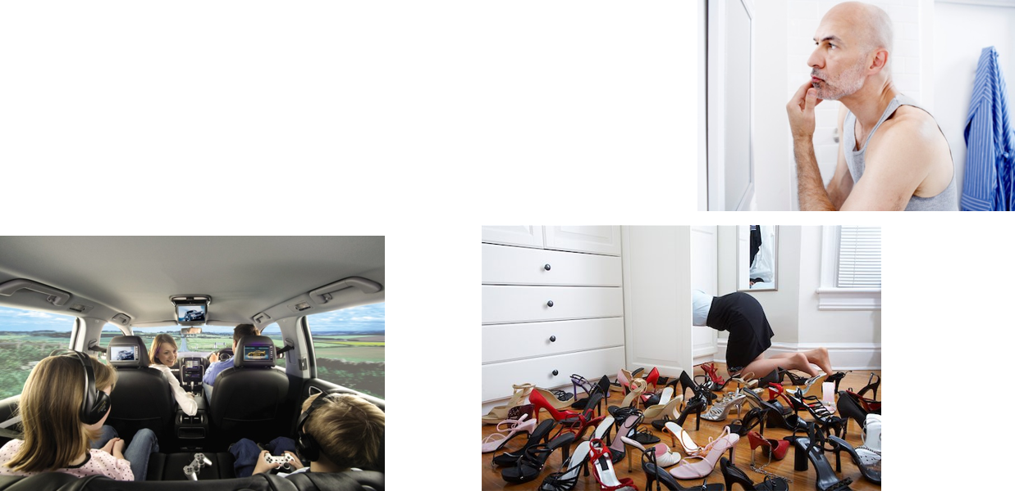
Preparing to Meet the Savior
What would you do to prepare to meet the Savior?
How would you get there?
OR

Slide 7
Separated Into 12 Bodies
So numerous were the people when they returned the second day they had to separate into 12 divisions…
I am assuming each of the disciples had a congregation and taught the principles of the Savior
3 Nephi 19:1-8

Slide 8
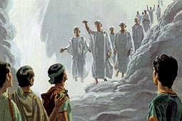
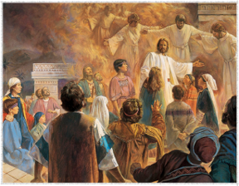
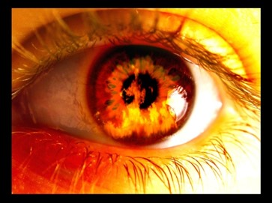
Nephite Apostles Are Baptized
Nephi received the authority from the Savior to baptize (3 Nephi 11:21)
“The record testifies that the greatest thing for which the disciples prayed was that they could receive the Holy Ghost and experience in their own lives what had been demonstrated by the Savior.”
JFM and RLM
“The cleansing sanctifying power of the Holy Ghost not only spiritually prepared these disciples for (their upcoming ministry) but it also transfigured them so that they could endure the presence of glorified heavenly beings.”
JFM and RLM
“And behold, they were encircled about as if it were by fire; and it came down from heaven, and the multitude did witness it, and did bear record; and angels did come down out of heaven and did minister unto them.”
3 Nephi 19:9-14

Slide 9
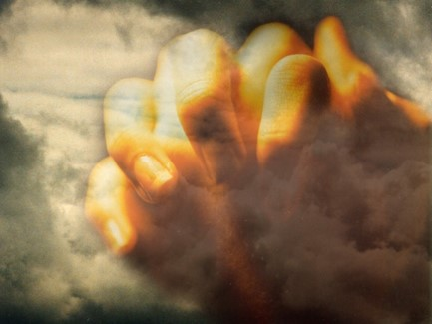
Jesus Came and Stood in the Midst
“Jesus was present before them as the symbol of the Father. Seeing him, it was as though they saw the Father; praying to him, it was as though they prayed to the Father. It was a special and unique situation that as far as we know has taken place only once on earth during all the long ages of the Lord’s hand-dealings with his children.”
Bruce R. McConkie
“He that asketh in the Spirit asketh according to the will of God; wherefore it is done even as he asketh.”
D&C 46:30
We can be filled with the Holy Ghost as we sincerely desire and pray for His companionship and as we participate in the ordinances of the gospel.
Faith and Spiritual desire lead to one who will commune with the Father in prayer
3 Nephi 19:15-24

Slide 10
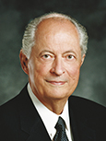
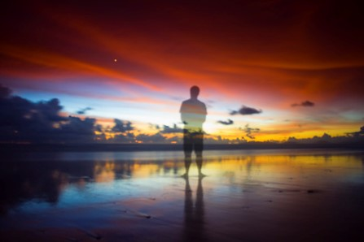
“The Holy Ghost … is the source of our testimony of the Father and the Son. …
“We need the Holy Ghost as our constant companion to help us make better choices in the decisions that confront us daily. …
Companionship with the Spirit will give them [our youth] the strength to resist evil and, when necessary, repent and return to the strait and narrow path. …
We all need the fortification available through the Holy Ghost. … Having the gift of the Holy Ghost helps family members make wise choices—choices that will help them return with their families to their Father in Heaven and His Son, Jesus Christ, to live with Them eternally.”
Robert D. Hales

Slide 11
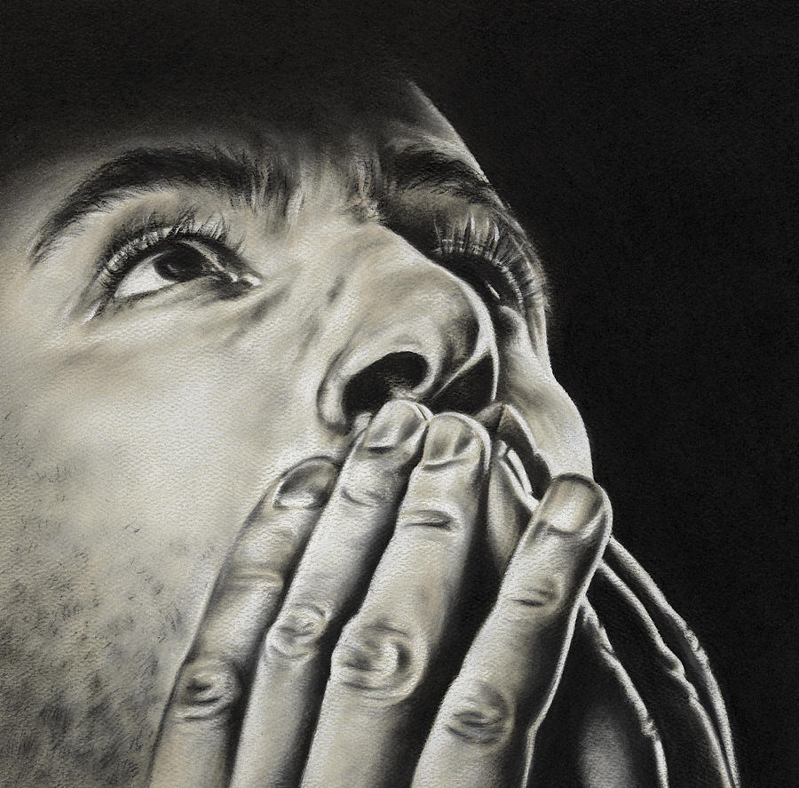
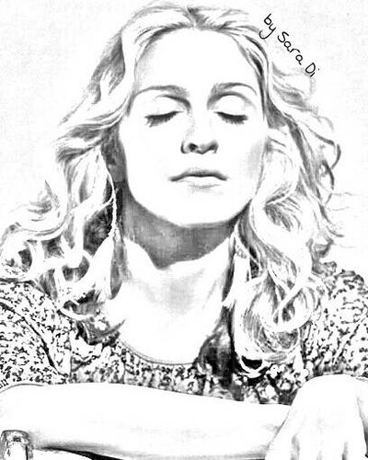
The Prayers
The Savior’s first prayer:
3 Nephi 19:19–23
The disciples’ prayer:
3 Nephi 19:24–26, 30
The Savior’s second prayer:
3 Nephi 19:27–29
We should express gratitude to God in our prayers.
The Holy Ghost can help us know what to pray for.
If we pray with the Spirit, our prayers will not include vain repetitions.
The Lord blesses us when we pray without ceasing.

Slide 12
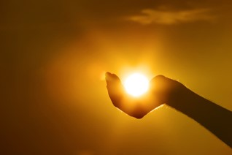
Literal and Symbolic Light
Disciples: Literal
Literal transfiguration –filled with light and their countenances shone with light like that of the Savior.
The Nephites: Symbolic
Feeling the Savior’s perfect love for us
Like feeling the joy when you are serving others and obeying the commandments
3 Nephi 19:25

Slide 13
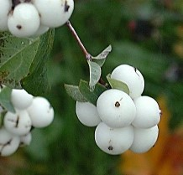
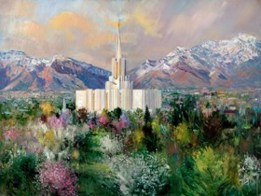
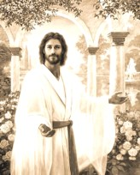
White As White
White is the symbol of purity, virtue, and cleanliness
“…Yea, and I beheld that the fruit thereof was white, to exceed all the whiteness that I had ever seen.”
1 Nephi 8:11
“But after repenting, and humbling himself sincerely, through faith, God ministered unto him by an holy angel, whose countenance was as lightning, and whose garments were pure and white above all other whiteness;”
D&C 20:6
3 Nephi 19:25

Slide 14
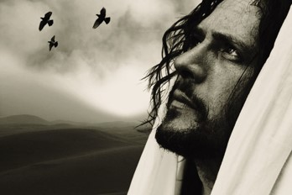
So Great the Words
Jesus gives the glory to His Father…not Himself
“Father, I pray not for the world, but for those whom thou hast given me out of the world, because of their faith, that they may be purified in me, that I may be in them as thou, Father, art in me, that we may be one, that I may be glorified in them.”
“And tongue cannot speak the words which he prayed, neither can be written by man the words which he prayed.
And the multitude did hear and do bear record; and their hearts were open and they did understand in their hearts the words which he prayed.
Nevertheless, so great and marvelous were the words which he prayed that they cannot be written, neither can they be uttered by man.”
3 Nephi 19:29-34

Slide 15
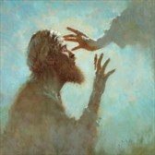
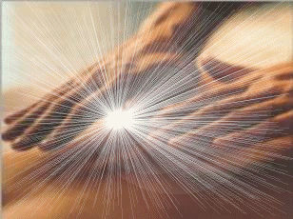
Miracles
“And he could there do no mighty work, save that he laid his hands upon a few sick folk, and healed them.”
Mark 6:5
“As great as were the miracles performed by Jesus among the Jews during his mortal ministry, they could not compare with the marvelous things seen, heard, and experienced by the Nephites. The great miracle and spiritual manifestations to which the Nephites were witnesses came as a result of their faith. Where there is greater faith there are greater miracles and spiritual outpourings.”
JFM and RLM
“And now, O all ye that have imagined up unto yourselves a god who can do no miracles, I would ask of you, have all these things passed, of which I have spoken? Has the end come yet? Behold I say unto you, Nay; and God has not ceased to be a God of miracles.”
Mormon 9:15.
3 Nephi 19:35-36

Slide 16
Sources:
Book of Mormon’s Who’s Who by Ed J. Pinegar and Richard J. Allen pgs. 69, 82, 86, 96, 119, 142-143, 182, 170,191
Joseph Fielding McConkie and Robert L. Millet Doctrinal Commentary on the Book of Mormon Vol. 4 pg. 133, 137
Robert D. Hales (“The Covenant of Baptism: To Be in the Kingdom and of the Kingdom,” Ensign, Nov. 2000, 8).
Bruce R. McConkie Promise Messiah pg. 561
Temple art Harry Conrad Winborg
Presentation by ©http://fashionsbylynda.com/blog/

Slide 17
Baptize Anew 3 Nephi 19:10-13:
“There is nothing strange in the fact that when the Lord came to the Nephites, Nephi was baptized and so was everybody else although they had been baptized before.
“The Church among the Nephites before the coming of Christ was not in its fulness and was under the law of Moses. The Savior restored the fulness and gave to them all the ordinances and blessings of the gospel. Therefore, it actually became a new organization, and through baptism they came into it. [See 3 Nephi 9:15–22; 11:10–40; 12:18–19; 15:4–10.]
“We have a similar condition in this dispensation. The Prophet Joseph Smith and Oliver Cowdery were baptized by command of the Angel John the Baptist [see Joseph Smith—History 1:68–72} Several others were baptized before the organization of the Church. However, on the day the church was organized, all who had been previously baptized were baptized again, not for the remission of sins, but for entrance into the Church. each case the reason was the same. [See Joseph Fielding Smith, Doctrines of Salvation, comp. Bruce R. McConkie (1955), 2:336.]” (Joseph Fielding Smith, Answers to Gospel Questions, comp. Joseph Fielding Smith Jr. [1960], 3:205–6).
Pray Unto Jesus 3 Nephi 19:18, 22:
“There was a special reason why this was done in this instance and on a onetime basis. Jesus had already taught them to pray in his name to the Father, which they first did. … Jesus was present before them as the symbol of the Father. Seeing him, it was as though they saw the Father; praying to him, it was as though they prayed to the Father. It was a special and unique situation” (Bruce R. McConkie, The Promised Messiah: The First Coming of Christ[1978], 560, 561).

