Slide 2
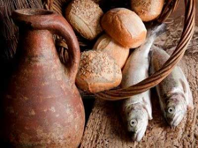
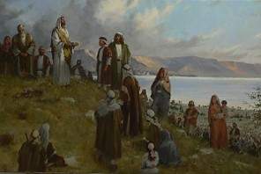
A Miraculous Sacrament
A Sacramental Ordinance:
‘there had been no bread, neither wine, brought by the disciples, neither by the multitude’
Feeding 5,000—12 baskets full
“And he commanded the multitude to sit down on the grass, and took the five loaves, and the two fishes, and looking up to heaven, he blessed, and brake, and gave the loaves to his disciples, and the disciples to the multitude.”
Matthew 14:19
What is the sacred nature of the Sacrament?
Feeding 4,000—7 baskets full
“And he took the seven loaves and the fishes, and gave thanks, and brake them, and gave to his disciples, and the disciples to the multitude.”
Matthew 15:36
3 Nephi 20:1-9

Slide 3
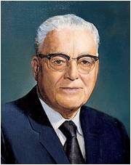
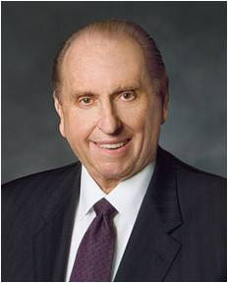
Worthy Aaronic Priesthood Holders
To be personally righteous and to stand approved in the sight of God and his appointed leaders.
“When one becomes a holder of the priesthood, he becomes an agent of the Lord. He should think of his calling as though he were on the Lord’s errand.” President Harold B. Lee
“In order to do so, each must be worthy. Let us have ready hands, clean hands, and willing hands, that we may participate in providing what our Heavenly Father would have others receive from Him. If we are not worthy, it is possible to lose the power of the priesthood; and if we lose it, we have lost the essence of exaltation. Let us be worthy to serve.”
President Thomas S. Monson
Who should or should not partake of the sacrament?
3 Nephi 20:1-9

Slide 4
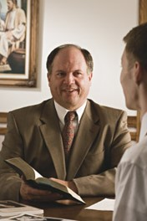
Worthy to Partake of the Sacrament
Should there be anything amiss in your life, there is open to you a way out.
Cease any unrighteousness.
Talk with your bishop.
Whatever the problem, it can be worked out through proper repentance.
You can become clean once again. Said the Lord, speaking of those who repent, “Though your sins be as scarlet, they shall be as white as snow,” (Isaiah 1:18)
“and I, the Lord, remember them no more.” (D&C 58:42)
President Thomas S. Monson
How do we qualify for the Savior’s Promises?
3 Nephi 20:1-9

Slide 5
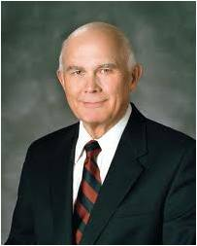
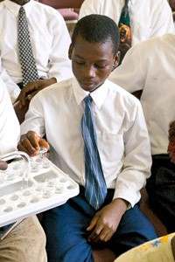
The Promises
“Let us qualify ourselves for our Savior’s promise that by partaking of the sacrament we will ‘be filled’, which means that we will be ‘filled with the Spirit’. That Spirit—the Holy Ghost—is our comforter, our direction finder, our communicator, our interpreter, our witness, and our purifier—our infallible guide and sanctifier for our mortal journey toward eternal life.
“… Out of the seemingly small act of consciously and reverently renewing our baptismal covenants comes a renewal of the blessings of baptism by water and by the Spirit, that we may always have his Spirit to be with us. In this way all of us will be guided, and in this way all of us can be cleansed.”
Dallin H. Oaks
Where should our hearts be during sacrament?
3 Nephi 20:1-9

Slide 6
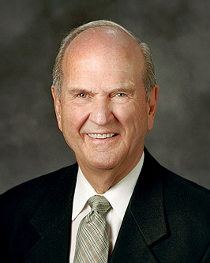
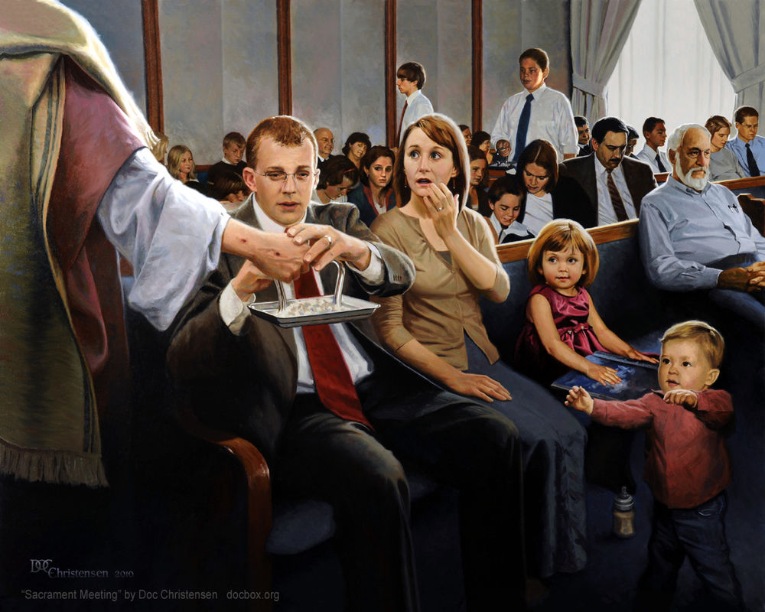
As we prayerfully partake of the sacrament, we can be filled with the Holy Ghost
“[The period before sacrament meeting begins] is not a time for conversation or transmission of messages but a period of prayerful meditation as leaders and members prepare spiritually for the sacrament.”
Russell M. Nelson
Why do you think it is important to avoid talking or transmitting messages to others before or during the sacrament?
How can praying before and during the sacrament help us to be filled with the Holy Ghost?

Slide 7
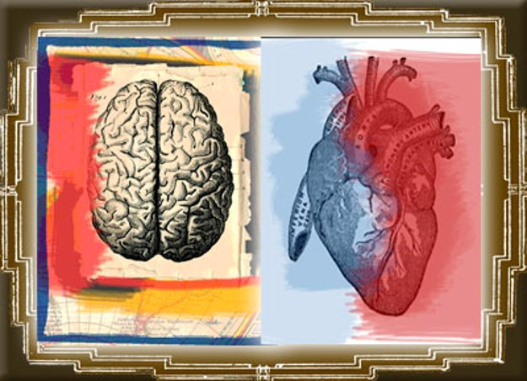
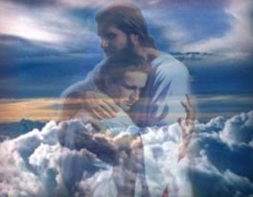
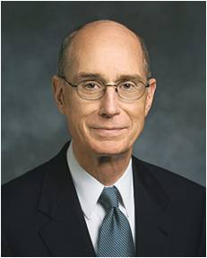
Not Cease to Pray
The sacramental prayers teach how to receive the constant companionship of the Holy Spirit.
When we partake... ...we open our mind and heart...
The Heart and Mind:
A symbol of the mind and will of man and the figurative source of all emotions and feelings
Guide to the Scriptures
“Our hearts can only be drawn out to God when they are filled with love for Him and trust in His goodness…”
Henry B. Eyring
3 Nephi 20:1

Slide 8
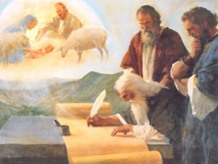
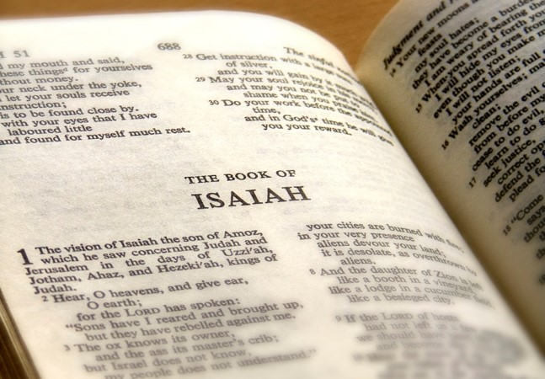
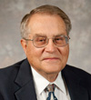
Christ Quotes Isaiah
To the Nephites:
“Ye remember that I spake unto you, and said that when the words of Isaiah should be fulfilled—behold they are written,
ye have them before you, therefore search them—”
For us today:
“You Latter-day Saints have the words of Isaiah; they are written in the Bible, and many of them are in the Book of Mormon; therefore search them!”
Victor L. Ludlow
3 Nephi 20:11

Slide 9
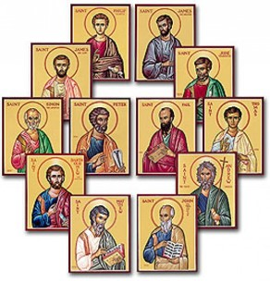
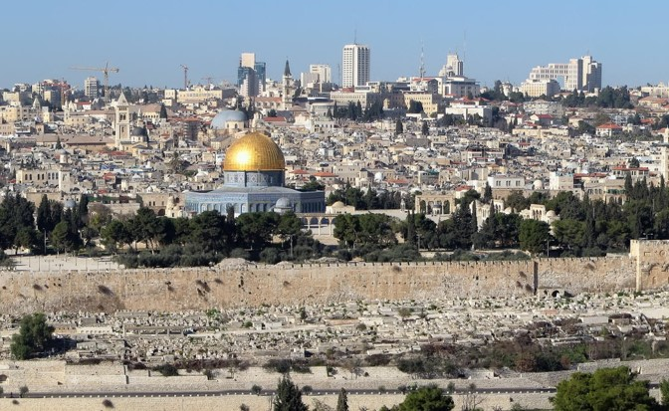
The House of Israel
“By divine command the name [Israel] was applied to the 12 tribes collectively. (Gen 49:28; Ex. 3:36) Hundreds of millions of persons have thus been Israelites, heirs of the promises made to their fathers. This great host, called while on earth to be a peculiar people. Were also a separate and distinct group in the pre-existence.”
Bruce R. McConkie
To be fulfilled in the last days:
“when the words of Isaiah are fulfilled, then God’s covenant with the house of Israel is fulfilled.”
Victor L. Ludlow
3 Nephi 20:11-12

Slide 10
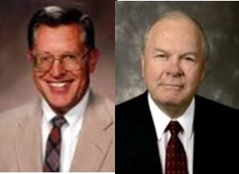
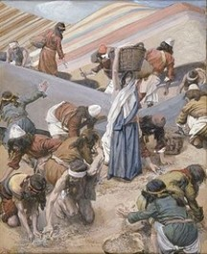
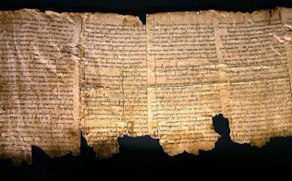
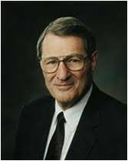
The Scattered to be Gathered
“How is it that they shall be gathered?
By coming to the knowledge of the Lord their God, who hath redeemed them.
1st spiritual to Christ—his gospel and His true Church
Salvation is not a place, but in a person, the person of Christ
We might find that prior to or during the Millennium there would be other scriptural records come forth.
JFM and RLM
God will fulfill His covenant to gather the house of Israel in the last days
“…Lost books are among the treasures yet to come forth…there will also be many more nourishing and inspiring scriptures.
However, we must first feast worthily upon that which we already have!”
Neal A. Maxwell
3 Nephi 20:13

Slide 11
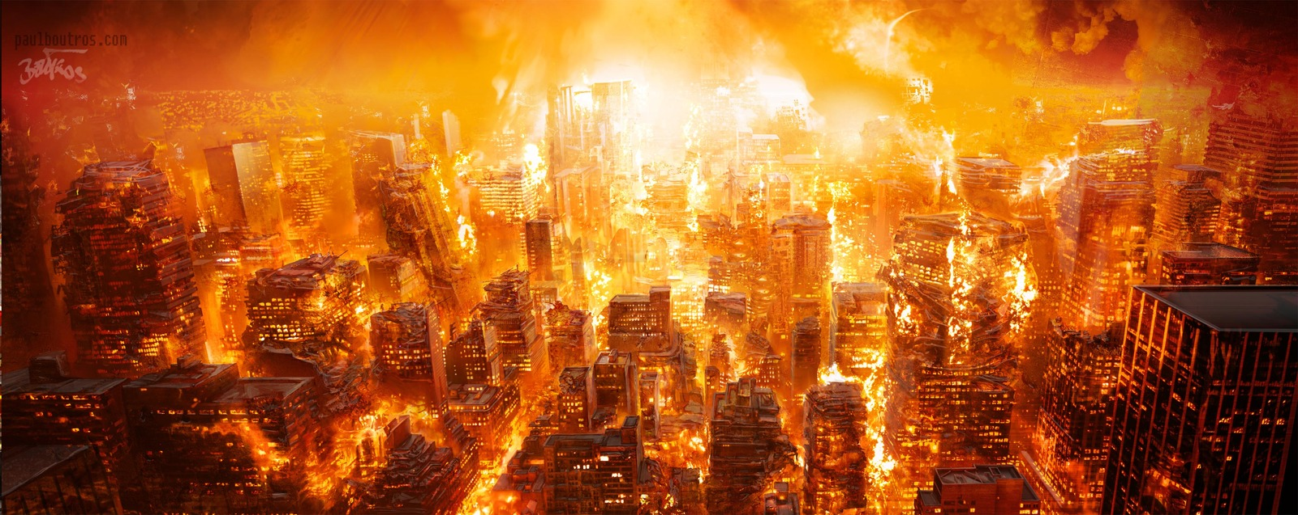
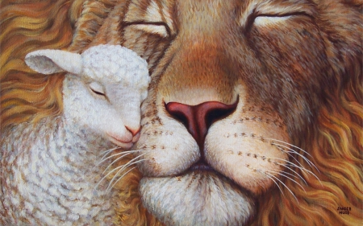
A Young Lion Among the Flocks of Sheep
“These words of our Lord to the Nephites are quoted from Micah 5:8–9 and have reference to the desolations and ultimate burning that shall destroy the wicked at the Second Coming.
Except for a few who are the humble followers of Christ, the Gentiles will not repent.
They will revel in their abominations and sin against the restored gospel, and they will be burned by the brightness of our Lord’s coming while the righteous—here called the remnant of Jacob—shall abide the day.
And then, in the prophetic imagery, it will be as though the remnant of Israel overthrew their enemies as a young lion among the flocks of sheep.”
Bruce R. McConkie
3 Nephi 20:16-17

Slide 12
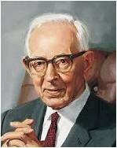
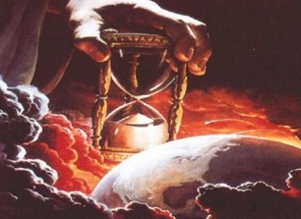
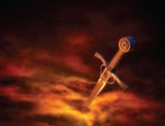
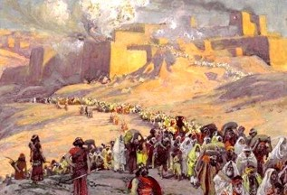
Sheaves, Horns, Hoofs, and Swords
2nd physical gathering—”The gathering of Israel during the thousand years of peace will be of a magnitude that is difficult for us in our present state to conceive.”
“…but the great body of the Jews who are there assembled will not receive Christ as their Redeemer until he comes himself and makes himself manifest unto them.”
Joseph Fielding Smith
Sword of Justice
Justice—wielded by the Almighty, shall fall upon the wayward and rebellious of all nations
Horn iron—hoofs brass
“Symbolic expressions of Might and power
The power of Christ and his destroying angels to cleanse the earth of all wicked persons and all wickedness,
Beat in pieces—those persons who have rejected the greater light of the gospel and gloried in their perversity.”
3 Nephi 20:18-20 and JFM and RLM

Slide 13
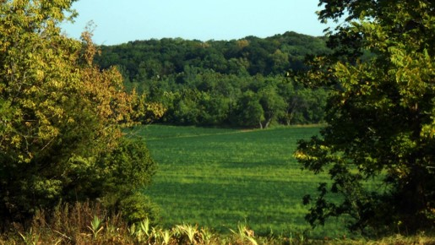
The New Jerusalem
American Continent
(Article of Faith 10):
“Hearken, O ye elders of my
church, saith the Lord your God,
who have assembled yourselves
together, according to my
commandments, in this land,
which is the land of Missouri,
which is the land which I have
appointed and consecrated for
the gathering of the saints.
Wherefore, this is the land of
promise, and the place for the
city of Zion.
And thus saith the Lord your God, if you will receive wisdom here is wisdom. Behold, the place which is now called Independence is the center place; and a spot for the temple is lying westward, upon a lot which is not far from the courthouse.”
D&C 57:1-3
3 Nephi 20:18-20 and JFM and RLM

Slide 14
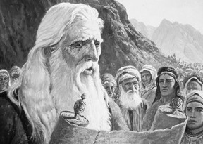
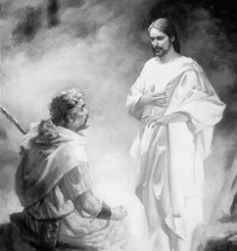
Jesus Testifies Himself
The Prophets knew:
“For Moses truly said unto the fathers, A prophet shall the Lord your God raise up unto you of your brethren, like unto me; him shall ye hear in all things whatsoever he shall say unto you.
And it shall come to pass, that every soul, which will not hear that prophet, shall be destroyed from among the people.
Yea, and all the prophets from Samuel and those that follow after, as many as have spoken, have likewise foretold of these days.”
Acts 3:22-24
Jehovah speaks through Moses:
“I will raise them up a Prophet from among their brethren, like unto thee, and will put my words in his mouth; and he shall speak unto them all that I shall command him.
And it shall come to pass, that whosoever will not hearken unto my words which he shall speak in my name, I will require it of him.”
Deuteronomy 18:18-19
3 Nephi 20:23-24 and JFM and RLM

Slide 15
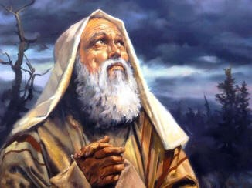
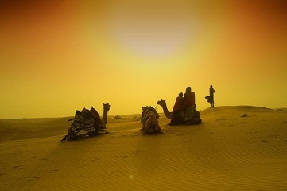
Abrahamic Covenant
Abraham made covenants with God when he received the gospel, when he was ordained a high priest, and when he entered into celestial marriage. In these covenants, God promised great blessings to Abraham and his family. These blessings, which extend to all of Abraham's seed, are called the Abrahamic covenant:
His posterity would be numerous
His seed, or descendants, would receive the gospel and bear the priesthood
Through the ministry of his seed, “all the families of the earth [would] be blessed, even with the blessings of the Gospel, which are the blessings of salvation, even of life eternal”
A person can receive all the blessings of the Abrahamic covenant—even if he or she is not a literal descendant of Abraham—by obeying the laws and ordinances of the gospel
Study Guide—see also Bible Dictionary
As the seed of Abraham, we have a covenant responsibility to bless all the people of the earth.
3 Nephi 20:25-46

Slide 16
Jesus quotes Isaiah Victor L. Ludlow Unlocking Isaiah in the Book of Mormon pgs. 231-240
3 Nephi 20 | Isaiah 52 | Today | Other references
Verses: 32-35 Watchmen works as Lord’s messengers to share the peace and joy that the gospel message brings. Bare His holy arm—power of God | Verses: 8-10 Watchmen-sing-give inheritance-bare His holy arm | These watchmen might be: Prophets, General Authorities, full-time missionaries, or local leaders and members. They all serve as Christ’s representatives as they take the joyous word to the world. Every member a missionary | D&C 18:15 D&C 65:2
Verses: 36-38 A joyful future of Israel when only the righteous and pure will dwell in Jerusalem. Put on the power and authority of the priesthood. Redemption through Christ | Verses: 1-3 Awake, shake off dust, put on thy strength. Loose bands, Redeemed without money.. | Both our clothing and our behavior reveal to others the principles we represent…Spiritual Attire Scattered Remnants of Israel return to the Lord---spiritual freeing through the Atonement of Christ…as sinners we are indebted to the Lord for His mercy | D&C 27:15 2 Nephi 9:14 D&C 113:9-10
Verses: 39-40 Standing on the Lord’s house to receive instruction | Verses: 6-7 I am—mountains of thy feet—brings good tidings | Going to the temple of the Lord. Receiving instruction from the General Authorities and leaders at conference | 2 Nephi 12:2 Isaiah 2:2
Verses: 41-45 They are called to repent after they receive the gospel blessing—if they refuse they will face God’s judgment | Verses: 11-15 Be clean (repent)—God will be your rearward (prudent in judgment)—sprinkle many nations | The need to be clean and pure, virtuous in all things “We counsel you not to pollute your minds with degrading matter…” Ezra Taft Benson Turn away from filth We will be judged upon our actions with Jesus is our mediator | 2 Timothy 2:20-22 Revelation 18:4 D&C 101:94

Slide 17
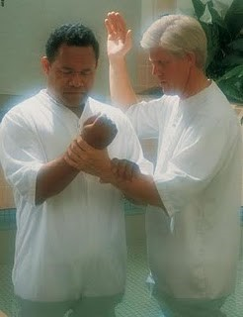
Will Surely Come to Pass
When the words of Isaiah are fulfilled, then the Father’s covenant with His people will be fulfilled, and they will be established in their lands of Inheritance
As latter-day heirs of the covenants made with Abraham, we need to be involved in this marvelous work.
As pure messengers of truth, we share a wonderful opportunity for significant service while we build His kingdom of peace.
Our Savior’s instruction to us:
Understand the words of Isaiah that gives us incentive to work toward their fulfillment”
3 Nephi 20:46

Slide 18
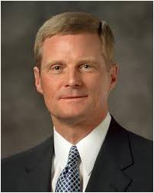
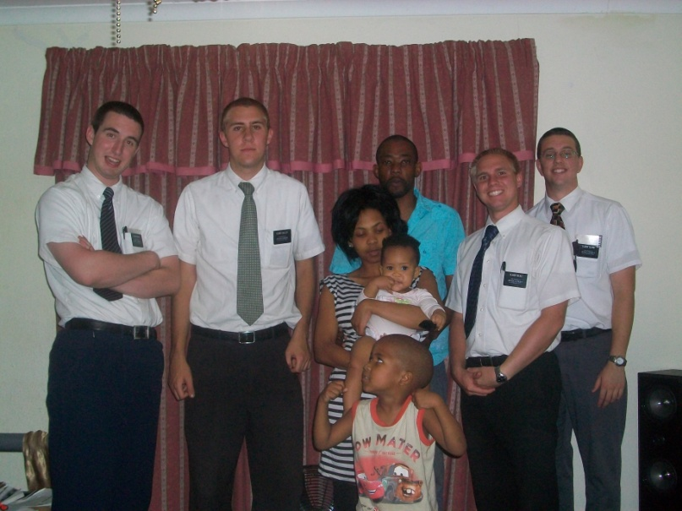
Sharing the Gospel
“You and I, today and always, are to bless all peoples in all the nations of the earth. You and I, today and always, are to bear witness of Jesus Christ and declare the message of the Restoration. You and I, today and always, are to invite all to receive the ordinances of salvation. Proclaiming the gospel is not a part-time priesthood obligation.
It is not simply an activity in which we engage for a limited time or an assignment we must complete as members of The Church of Jesus Christ of Latter-day Saints. Rather, missionary work is a manifestation of our spiritual identity and heritage.
We were foreordained in the premortal existence and born into mortality to fulfill the covenant and promise God made to Abraham. We are here upon the earth at this time to magnify the priesthood and to preach the gospel. That is who we are, and that is why we are here—today and always”
Elder David A. Bednar

Slide 19
Sources:
Feeding Five Thousand art of Brian Jekel
Stand Ye in Holy Places: Selected Sermons and Writings of President Harold B. Lee (1976), 255.
President Thomas S. Monson Willing and Worthy to Serve April 2012 Gen. Conf. and Priesthood Power May 2011 Gen. Conf.
James E. Talmage (Jesus the Christ,3rd ed. [1916], 342; italics added).
Dallin H. Oaks (“Always Have His Spirit,” Ensign, Nov. 1996, 61).
Henry B. Erying Prayer Oct. 2001 Gen. Conf.
Russell M. Nelson, “Worshiping at Sacrament Meeting,” Ensign, Aug. 2004, 27).
Victor L. Ludlow Unlocking Isaiah in the Book of Mormon pgs. 231, 241 (Chart 231-240)
Bruce R. McConkie Mormon Doctrine pg. 389; The Millennial Messiah: The Second Coming of the Son of Man[1982], 248).
Joseph Fielding McConkie and Robert L. Millet Doctrinal Commentary on the Book of Mormon Vol. 4 pg. 139-40
Elder Neal A. Maxwell God Will Yet Reveal CR, October 1986
Joseph Fielding Smith Doctrines of Salvation 3:9
Elder David A. Bednar (“Becoming a Missionary,”Ensign or Liahona, Nov. 2005, 47).
Presentation by ©http://fashionsbylynda.com/blog/

Slide 20
Jesus quotes Isaiah Victor L. Ludlow Unlocking Isaiah in the Book of Mormon pgs. 231-240
3 Nephi 20 | Isaiah 52 | Today | Other references
Verses: 32-35 Watchmen works as Lord’s messengers to share the peace and joy that the gospel message brings. Bare His holy arm—power of God | Verses: 8-10 Watchmen-sing-give inheritance-bare His holy arm | These watchmen might be: Prophets, General Authorities, full-time missionaries, or local leaders and members. They all serve as Christ’s representatives as they take the joyous word to the world. Every member a missionary | D&C 18:15 D&C 65:2
Verses: 36-38 A joyful future of Israel when only the righteous and pure will dwell in Jerusalem. Put on the power and authority of the priesthood. Redemption through Christ | Verses: 1-3 Awake, shake off dust, put on thy strength. Loose bands, Redeemed without money.. | Both our clothing and our behavior reveal to others the principles we represent…Spiritual Attire Scattered Remnants of Israel return to the Lord---spiritual freeing through the Atonement of Christ…as sinners we are indebted to the Lord for His mercy | D&C 27:15 2 Nephi 9:14 D&C 113:9-10
Verses: 39-40 Standing on the Lord’s house to receive instruction | Verses: 6-7 I am—mountains of thy feet—brings good tidings | Going to the temple of the Lord. Receiving instruction from the General Authorities and leaders at conference | 2 Nephi 12:2 Isaiah 2:2
Verses: 41-45 They are called to repent after they receive the gospel blessing—if they refuse they will face God’s judgment | Verses: 11-15 Be clean (repent)—God will be your rearward (prudent in judgment)—sprinkle many nations | The need to be clean and pure, virtuous in all things “We counsel you not to pollute your minds with degrading matter…” Ezra Taft Benson Turn away from filth We will be judged upon our actions with Jesus is our mediator | 2 Timothy 2:20-22 Revelation 18:4 D&C 101:94

Slide 21
“Not many of the Jews…will believe in Christ before He comes. The Book of Mormon tells us that they shall begin to believe in him (2 Nephi 30:7-18), etc.). They are now beginning to believe in him. The Jews today look upon Christ as a great Rabbi. They have accepted him as one of the great teachers; they have said that, ‘He is Jew of Jew, the greatest Rabbi of them all’ as one has stated it. When the gospel was restored in 1830, if a Jew had mentioned the name of Christ in one of the synagogues, he would have been rebuked. Had a rabbi referred to him, the congregation would have arisen and left the building. As so, we see the sentiment has changed. Now I state this on Jewish authority that they are beginning to believe in Christ, and some of them are accepting the gospel.
“But in the main they will gather to Jerusalem, in their unbelief; the gospel will be preached to them; some of them will believe. Not all of the Gentiles have believed when the gospel has been proclaimed to them, but the great body of the Jews who are there assembled will not receive Christ as their Redeemer until he comes himself and makes himself manifest unto them.”
Joseph Fielding Smith Doctrines of Salvation 3:9
“Zion, the New Jerusalem, on American soul? And we hasten to add, so also shall there be Zions in all lands and New Jerusalems in the mountains of the Lord in all the earth. But the American Zion shall be the capital city, the source whence the law shall go forth to govern all the earth. It shall be the city of the Great King. His throne shall be there, and from there he shall reign gloriously over all the earth.”
Bruce R. McConkie Millennial Messiah, pp. 301-2
A Person’s Identity 3 Nephi 20:10-46:
“You may enjoy music, athletics, or be mechanically inclined, and someday you may work in a trade or a profession or in the arts. As important as such activities and occupations can be, they do not define who we are. First and foremost, we are spiritual beings. We are [children] of God and the seed of Abraham” (David A. Bednar, “Becoming a Missionary,”Ensign or Liahona, Nov. 2005, 47).
3 Nephi 20:26–27. Fulfill the Abrahamic covenant
Elder Russell M. Nelson of the Quorum of the Twelve Apostles spoke of a way we can help fulfill the Abrahamic covenant:
“Ours is the responsibility to help fulfill the Abrahamic covenant. Ours is the seed foreordained and prepared to bless all people of the world. That is why priesthood duty includes missionary work. After some 4,000 years of anticipation and preparation, this is the appointed day when the gospel is to be taken to the kindreds of the earth. This is the time of the promised gathering of Israel. And we get to participate! Isn’t that exciting? The Lord is counting on us and our sons—and He is profoundly grateful for our daughters—who worthily serve as missionaries in this great time of the gathering of Israel” (“Covenants,” Ensign or Liahona, Nov. 2011, 88).
3 Nephi 20:26. Children of the covenant
Elder Russell M. Nelson of the Quorum of the Twelve Apostles spoke about the blessings of knowing that we are children of the covenant:
“When we realize that we are children of the covenant, we know who we are and what God expects of us. His law is written in our hearts. He is our God and we are His people. Committed children of the covenant remain steadfast, even in the midst of adversity. When that doctrine is deeply implanted in our hearts, even the sting of death is soothed and our spiritual stamina is strengthened” (“Covenants,” Ensign or Liahona, Nov. 2011, 88).
“The gathering of Israel consists in believing and accepting and living in harmony with all that the Lord once offered his ancient chosen people. It consists of having faith in the Lord Jesus Christ, of repenting, of being baptized and receiving the gift of the Holy Ghost, and of keeping the commandments of God. It consists of believing the gospel, joining the Church, and coming into the kingdom. It consists of receiving the holy priesthood, being endowed in holy places with power from on high, and receiving all the blessings of Abraham, Isaac, and Jacob, through the ordinance of celestial marriage. And it may also consist of assembling to an appointed place or land of worship” (Bruce R. McConkie, A New Witness for the Articles of Faith[1985], 515).
Other Quotes

