Slide 2
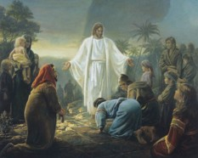
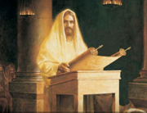
Jesus Returns a Third Time
The Twelve were seeking answers from the Lord on what to call themselves
There had been disputations (verbal controversy) among themselves
They were deeply troubled and spiritually turned to their Lord for direction
Spiritually—Fasting and Praying
This is a process for receiving revelation
Jesus’ response:
“Have they not read the scriptures, which ye must take upon you the name of Christ, which is my name?...”
3 Nephi 27:1-3

Slide 3
What Team Logo Best Represents Its Name?
New Zealand All Black Rugby
Cricket Ireland
German National Football Team
Arizona Cardinals
New York Yankees
Ramona Bulldogs
BYU University

Slide 4
Let Fate Decide?
The name Twitter was picked out of a hat. A small group of employees from Odeo, the San Francisco podcasting startup where Twitter initially began, had a brainstorming session.
They were trying to come up with names that fit with the theme of a mobile phone buzzing an update in your pocket.
After narrowing down the options (which included Jitter and Twitter), they wrote them down, put them in a hat, and let fate decide.
Fate decided on Twitter (because clearly asking someone if they saw your latest "jeep" is just weird).
http://mashable.com/2011/09/05/startup-names/

Slide 5
What is in a Name?
The true Church of Jesus Christ must be called by His name and be built upon His gospel
The official name of the Church is The Church of Jesus Christ of Latter-day Saints. This full name was given by revelation from God to Joseph Smith on April 26,1838.
(D&C 115:3-4)

Slide 6
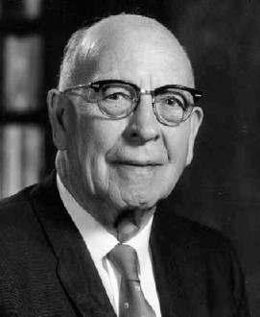
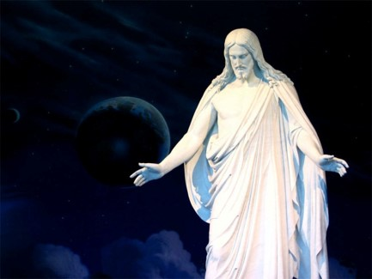
The Church Should Be Called In His Name
“The Matter of the name his Church should bear was of great importance to the Savior. Not only was this name reveled to Joseph Smith…, but also in reporting the visit of Jesus to the Nephites in America, following his ascension, when he had organized his Church among them, the Book of Mormon records their inquiry and the Lord’s rely as to what the name of his Church should be…
Thus the name of the Church was not obtained through study or research, but by revelation direct from the Lord…
“Therefore, whatsoever ye shall do, ye shall do it in my name; therefore ye shall call the church in my name; and ye shall call upon the Father in my name that he will bless the church for my sake.”
“…does it not seem incredible that of all the churches in the world, there was not one that bore his name when the Lord restored his Church in this dispensation?”
LeGrand Richards
3 Nephi 27:7

Slide 7
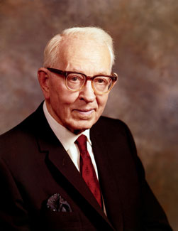
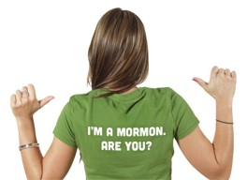
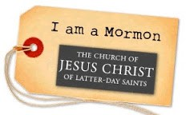
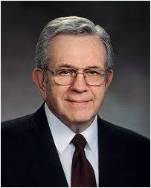
Mormon Nickname
The official name of the Church is The Church of Jesus Christ of Latter-day Saints. This full name was given by revelation from God to Joseph Smith in 1838.
Style Guide
“While there can be no disgrace nor condemnation in being called ‘Mormons,’ and the Church, the ‘Mormon Church,’ the fact remains, and this we should all emphasize, that we belong to the Church of Jesus Christ of Latter-day Saints, the name the Lord has given by which we are to be known and called.”
Joseph Fielding Smith
“… in obedience to revelation, we call ourselves The Church of Jesus Christ of Latter-day Saints rather than the Mormon Church”
Boyd K. Packer

Slide 8
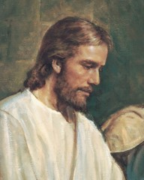
Built Upon His Gospel
“Both in and out of the church people quite commonly refer to “the gospel” when describing or alluding to all of a churches religious teachings.
This probably is the most common use of the word. The reason we use the word this way is that there really isn’t another suitable single word that will say what we are trying to say.”
Student Manual
Gospel = “good news” about Christ, his kingdom, and salvation through Him
3 Nephi 27:10

Slide 9
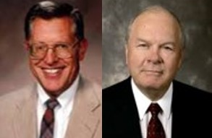
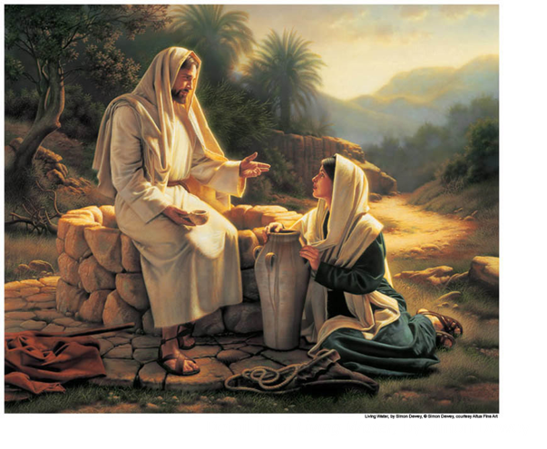
What is His Gospel?
“The gospel is truly the life, mission, teaching, atoning sacrifice, death, and resurrection of Christ…the “good news” and “glad tidings” of the gospel are found in Christ—in his atonement—not just in his teachings.”
JFM and RLM
“And this is the gospel, the glad tidings, which the voice out of the heavens bore record unto us—
That he came into the world, even Jesus, to be crucified for the world, and to bear the sins of the world, and to sanctify the world, and to cleanse it from all unrighteousness;
That through him all might be saved whom the Father had put into his power and made by him;”
D&C 76:40-42
3 Nephi 27:13-15

Slide 10
Principles of the Gospel
“the principles of the gospel –those things which allow us to partake of the powers of the atoning sacrifice
Faith
Repentance
Baptism
Reception of the Holy Ghost
Enduring to the end
Resurrection
Eternal judgments”
“Eternal life is not imposed on us against our will but is held out to us as a spiritual enticement and blessing.
We accept the Atonement and obtain the blessing of eternal life only through our own agency.
We are drawn unto Christ , not dragged”
3 Nephi 27:14 JFM and RLM

Slide 11
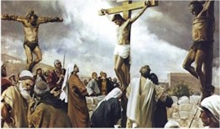
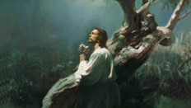
The Foundation
What did Heavenly Father send Jesus Christ into the world to do?
Draw men unto Him
Lifted up –on the cross—and the Atonement symbolism…
An unconditional and universal redemption from the Fall (good or evil) and brought before the Father to be judge of their works
What is the foundation of the gospel?
The foundation of the gospel is that Jesus Christ did the will of His Father in accomplishing the Atonement.
Because the Savior fulfilled the will of His Father, what will happen for all mankind?
We will be lifted up before Him to be judged of our works
3 Nephi 27:14-15

Slide 12
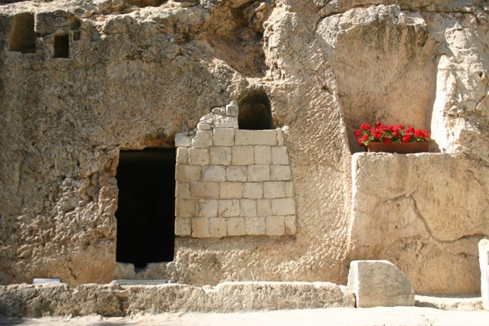
To Stand Before God
If we repent, are baptized, and endure to the end, we will be guiltless when we stand before God to be judged
What good news is there for us as we think about standing before the Lord to be judged?
“The ‘good news’ [is] that death and hell [can] be escaped, that mistakes and sins [can] be overcome, that there [is] hope, that there [is] help, that the insoluble [is] solved, that the enemy [has] been conquered. The good news [is] that everyone’s tomb [will] one day be empty, that everyone’s soul [can] again be pure, that every child of God [can] again return to the Father who gave them life”
Elder Jeffrey R. Holland
3 Nephi 27:17-19

Slide 13
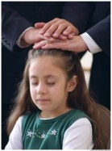
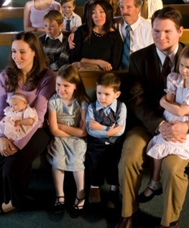
The Savior’s Invitation
Repent and be baptized—sanctified—cleansed from the effects of sin—spiritually renewed
Receive the Holy Ghost---the constant companion
Stand spotless before me at the last day—Prepare to enter into the presence of God
Know of these things—be one of faith and righteousness
Come to church and learn of Him—partake of the sacrament
Be an example to all those around you as He is an example for us—thinking His thoughts, speaking His words
Read D&C 76:40-42
3 Nephi 27:20-21

Slide 14
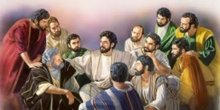
Judgment of the Twelve
“The Nephite twelve along with Jesus' original Twelve, probably coupled with all who have held keys of the priesthood, will be involved in judging the righteous of the house of Israel.
How these Nephite Twelve and all the others will be involved in judging of the righteous has not been fully revealed”
JFM and RLM
“And Jesus said unto them, Verily I say unto you, That ye which have followed me, in the regeneration when the Son of man shall sit in the throne of his glory, ye also shall sit upon twelve thrones, judging the twelve tribes of Israel.”
Matthew 19:28
“And again, verily, verily, I say unto you, and it hath gone forth in a firm decree, by the will of the Father, that mine apostles, the Twelve which were with me in my ministry at Jerusalem, shall stand at my right hand at the day of my coming in a pillar of fire, being clothed with robes of righteousness, with crowns upon their heads, in glory even as I am, to judge the whole house of Israel, even as many as have loved me and kept my commandments, and none else.”
D&C 29:12
3 Nephi 27:27

Slide 15
Doctrinal Mastery
Now this is the commandment: Repent, all ye ends of the earth, and come unto me and be baptized in my name, that ye may be sanctified by the reception of the Holy Ghost, that ye may stand spotless before me at the last day.
3 Nephi 27:20

Slide 16
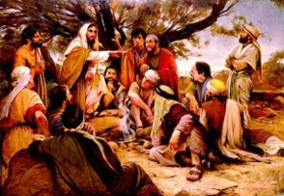
Even As He Is
The Savior gave instructions to His twelve Nephite disciples and taught them about their responsibilities.
He gave the disciples to help them fulfill their role as judges of the people.
The Lord expects His disciples to do His works and become as He is
3 Nephi 27:27

Slide 17
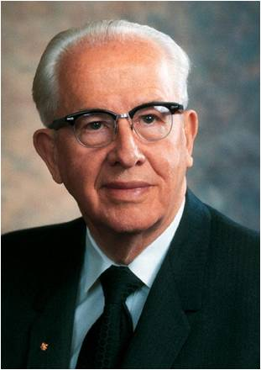
”That man is greatest and most blessed and joyful whose life most closely fits the pattern of the Christ. This has nothing to do with earthly wealth, power, or prestige. The only true test of greatness, blessedness, joyfulness is how close a life can come to being like the Master, Jesus Christ. He is the right way, the full truth, and the abundant life”
President Ezra Taft Benson
3 Nephi 27:27

Slide 18
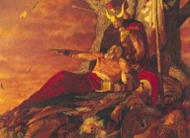
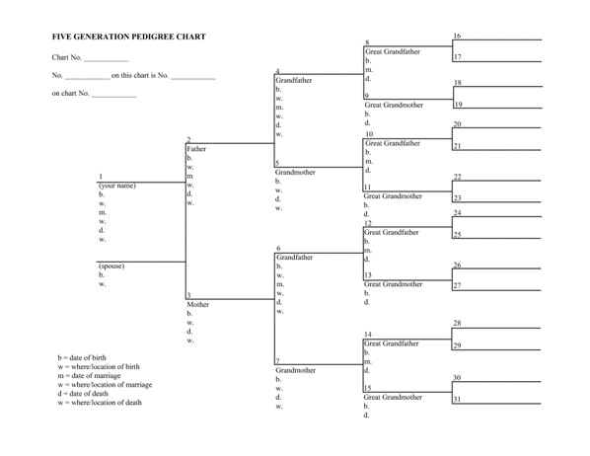
A Generation
“But behold, it sorroweth me because of the fourth generation from this generation, for they are led away captive by him even as was the son of perdition; for they will sell me for silver and for gold, and for that which moth doth corrupt and which thieves can break through and steal. And in that day will I visit them, even in turning their works upon their own heads.”
Generation—a length of time that it takes for a people to reproduce itself…somewhere around fourth years.
“since of measuring time by the lives of men, a generation, since the Abrahamic day, has been about 100 years.
From a generation from the time of Adam to the flood would have been nearly 1000 years.
A generation may be measured in terms of the life of the oldest persons who live in a particular period
Bruce R. McConkie
3 Nephi 27:30-33

Slide 19
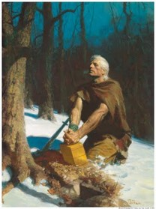
200 Years After the Savior’s Visit
“…Mormon speaks …in reference to the people who turned away with their eyes open, who turned against the truth some 200 years following the coming of Christ. The people rebelled; Mormon speaks about them and their condition beyond the power of redemption because of their wickedness and the hardness of their hearts, which the sprit of the Lord could no penetrate.”
Joseph Fielding Smith
“Behold, four hundred years have passed away since the coming of our Lord and Savior.”
Moroni 8:6
At the end of the Book of Mormon, Moroni figuratively looks out over the last remnant of his people. He knew their extinction could have been avoided if they had not forgotten God’s holy word and lost the Spirit of the Lord. Is it any wonder that Moroni writes personally to us, to you and to me, pleading for us to claim the blessings of the scriptures.
3 Nephi 27:32

Slide 20
Sources:
Video: Gospel is Good News (1:33)
Joseph Fielding Smith Answer to Gospel Questions 4:174-175. Doctrines of Salvation 2:194-195
Style Guide - http://www.mormonnewsroom.org/style-guide
Boyd K. Packer (“Guided by the Holy Spirit,” Liahona and Ensign, May 2011, 30).
LeGrand Richards A Marvelous Work and a Wonder pgs. 134-136
Student Manual of Religion 121-122 of the Book of Mormon
Joseph Fielding McConkie and Robert L. Millet Doctrinal Commentary on the Book of Mormon Vol. 4 pg. 178
Elder Jeffrey R. Holland (“Missionary Work and the Atonement,” Ensign, Mar. 2001, 8, 10).
President Ezra Taft Benson (“Jesus Christ—Gifts and Expectations” [BYU devotional address, Dec. 10, 1974], 1, speeches.byu.edu
Bruce R. McConkie Mormon Doctrine pg. 310 see Gen. 5, D&C 45:30-31; 84:4-5; 5:8-10
Robert D. Hales Holy Scriptures: The Power of God unto Our Salvation Oct. 2006 Gen. Conf.
Presentation by ©http://fashionsbylynda.com/blog/

Slide 21
Churches established in 1830’s:
Baltimore Hebrew Congregation
Baptist State Convention of North Carolina
Brothers of Our Lady of Lourdes
Cathedral Church of St. Paul (Burlington, Vermont)
Cathedral of the Immaculate Conception (Burlington, Vermont)
Cathedral of the Immaculate Conception (Syracuse, New York)
Church of Christ (Latter Day Saints) The Church of Jesus Christ of Latter-day Saints
Churches of God General Conference (Winebrenner)
Community of Christ
First Unitarian Church (Cincinnati, Ohio)
Kolel Chibas Yerushalayim
Netherlands Reformed Congregations
Remonstrant Synod of Ulster
St. Andrew's Church (Toronto)
St. John the Evangelist's Church (Manhattan)
St. Stephen's Episcopal Church (Olean, New York)
United Methodist Church of the Highlands
Zion Episcopal Church (Douglaston, New York)
From Wikipedia, the free encyclopedia
Not mentioned because they were established earlier
Catholic Methodist
Presbyterian
Baptist and many others
The official name of the Church is The Church of Jesus Christ of Latter-day Saints. This full name was given by revelation from God to Joseph Smith in (April 26, )1838. (D&C 115:3-4)
While the term "Mormon Church" has long been publicly applied to the Church as a nickname, it is not an authorized title, and the Church discourages its use.
When writing about the Church, please follow these guidelines:
In the first reference, the full name of the Church is preferred: "The Church of Jesus Christ of Latter-day Saints."
Please avoid the use of "Mormon Church," "LDS Church" or the "Church of the Latter-day Saints."
When a shortened reference is needed, the terms "the Church" or "the Church of Jesus Christ" are encouraged.
When referring to Church members, the term "Latter-day Saints" is preferred, though "Mormons" is acceptable.
"Mormon" is correctly used in proper names such as the Book of Mormon, Mormon Tabernacle Choir or Mormon Trail, or when used as an adjective in such expressions as "Mormon pioneers."
The term "Mormonism" is acceptable in describing the combination of doctrine, culture and lifestyle unique to The Church of Jesus Christ of Latter-day Saints.
When referring to people or organizations that practice polygamy, the terms "Mormons," "Mormon fundamentalist," "Mormon dissidents," etc. are incorrect. The Associated Press Stylebook notes: "The term Mormon is not properly applied to the other … churches that resulted from the split after [Joseph] Smith's death.“
Style Guide-- STYLE GUIDE NOTE: When reporting about The Church of Jesus Christ of Latter-day Saints, please use the complete name of the Church in the first reference. For more information on the use of the name of the Church, go to our online style guide.
Under the Category: Christian organizations based in the United States from Wikipedia…The Church of Jesus Christ of Latter-day Saints is not on their list…
Why is that?
http://en.wikipedia.org/wiki/Category:Christian_organizations_based_in_the_United_States

Slide 22
3 Nephi 27:4-5
“I say that we need to teach our people to find their answers in the scriptures. If only each of us would be wise enough to say that we aren’t able to answer any question unless we can find a doctrinal answer in the scriptures! And if we hear someone teaching something that is contrary to what is in the scriptures, each of us may know whether the things spoken are false—it is as simple as that. But the unfortunate thing is that so many of us are not reading the scriptures. We do not know what is in them, and therefore we speculate about the things that we ought to have found in the scriptures themselves. I think that therein is one of our biggest dangers of today.”
Harold B. Lee Find the Answers in the Scripture Ensign December 1972
THERE IS A BASIC DOCTRINE ONE MUST UNDERSTAND AND OBEY IN ORDER TO BE SAVED
Perhaps no two people, without a previous discussion, would come up with identical lists of doctrines from the text of 3 Nephi 27:13-22. But their lists would comprehend or cover the same ideas if carefully and thoroughly done. It may be that in place of a short list of doctrines, they would come up with a longer list of ordinances and precepts. These could be collected into or placed under eight main headings commonly called doctrines. The following diagram lists these eight principles and illustrates their interrelationships.
Student Manual—pg 446
THE ATONEMENT OF CHRIST (pays for the sins
of the truly penitent
and brings about)
THE RESURRECTION (of all men)
A UNIVERSAL JUDGMENT (in the flesh)
by which the blessings of eternal life are accorded to those who
exercise FAITH IN CHRIST sufficiently that they
REPENT of all their sins
and fully consummate their repentance in that they
enter the covenant of BAPTISM and thereafter
receive the GIFT OF THE HOLY GHOST
and subsequently maintain this spiritual capacity
in that they
ENDURE in faithfulness TO THE END
"The fulness of the gospel consists in those laws, doctrines, ordinances, powers, and authorities needed to enable men to gain the fulness of salvation. Those who have the gospel fulness do not necessarily enjoy the fulness of gospel knowledge or understand all of the doctrines of the plan of salvation. But they do have the fulness of the priesthood and sealing power by which men can be sealed up unto eternal life. The fulness of the gospel grows out of the fulness of the sealing power and not out of the fulness of gospel knowledge. (Mormon Doctrine, pp. 332-33.)

