Slide 2
The Desire of Jesus’ Disciples
What would you want Jesus to do for you?
What did His disciples desire?
Nine of them: “We desire that after we have lived unto the age of man, that our ministry, wherein thou hast called us, may have an end, that we may speedily come unto thee in thy kingdom.”
They would live to the age of 72 and promised an inheritance in Christ’s kingdom when they die
3 Nephi 28:1-3

Slide 3
The Desire of Three
Jesus said:
“Behold, I know your thoughts, and ye have desired the thing which John, my beloved, who was with me in my ministry, before that I was lifted up by the Jews, desired of me.”
What was said about John: “Then went this saying abroad among the brethren, that that disciple should not die: yet Jesus said not unto him, He shall not die; but, If I will that he tarry till I come, what is that to thee?”
John 21:23
3 Nephi 28:6

Slide 4
John, The Beloved
“It is to a modern revelation that we turn to learn what really became of John the Apostle, known also as the Beloved and the Revelator. In April of 1829 Joseph Smith and Oliver Cowdery were discussing the mission of John; whether he had died or been allowed to live on. Through the Urim and Thummim the Prophet saw a translated version of a record made by John and hidden up.”
JFM and RLM
Read D&C 7:1-8
3 Nephi 28:6

Slide 5
Never Taste of Death
Jesus said:
“Therefore, more blessed are ye, for ye shall never taste of death; but ye shall live to behold all the doings of the Father unto the children of men, even until all things shall be fulfilled according to the will of the Father, when I shall come in my glory with the powers of heaven.”
John and the 3 Nephites were translated and are allowed to live and minister on the earth until their Lord returns at His Second Coming
3 Nephi 28:7

Slide 6
Transfigured and Translated
Transfiguration is “the condition of persons who are temporarily changed in appearance and nature—that is, lifted to a higher spiritual level—so that they can endure the presence and glory of heavenly beings.”
The scriptures tell of people who have been transfigured, including Moses , Jesus Christ, Peter, James, and John, and Joseph Smith.
Translated beings are “persons who are changed so that they do not experience pain or death until their resurrection to immortality”
Their purpose is to bring souls to Christ. The scriptures contain accounts of people who have been translated, including Enoch, Moses, Elijah, and John the Beloved.
3 Nephi 28:9, 13-17; Guide to Scriptures

Slide 7
Translated Beings
They never taste of death or endure the pains of death (verses 7-8)
They will be changed from mortality to immortality in the twinkling of an eye (verse 8)
They experience no pain while in the flesh and no sorrow except for the sins of the world (verse 9)-- a mortal state
They have power over the evil men of the earth (verse 20)
They are like the angels of God, administering to whomsoever they will (verse 30)
A change is effected on their bodies so that Satan can have no power over them; they are sanctified in the flesh and are holy (verse 39)
They remain in this state until the judgment day of Christ (verse 40)
They were caught up into heaven:
They are also transfigured— “The Three Nephites were transfigured for a time so that they could view the visions of eternity. They were also translated, which condition is of a longer duration, until Judgment Day.” Student Manual
3 Nephi 28:7-40

Slide 8
The Father And I Are One
“Without question, Elohim and Jehovah—though separate as personages—are one: one in mind, one in purpose, one in glory. Indeed, they are infinitely more one than they are separate.
The whole plan of salvation centers in our learning to be one with Christ as he is one with the Father.”
JFM and RLM
There are three separate persons in the Godhead: God, the Eternal Father; his Son, Jesus Christ; and the Holy Ghost. We believe in each of them (A of F 1:1).
From latter-day revelation we learn that the Father and the Son have tangible bodies of flesh and bone and that the Holy Ghost is a personage of spirit, without flesh and bone These three persons are one in perfect unity and harmony of purpose and doctrine.
Guide to the Scriptures
It is generally the Father, or Elohim, who is referred to by the title God. He is called the Father because He is the father of our spirits
Guide to the Scriptures
3 Nephi 28:10

Slide 9
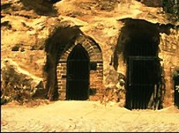
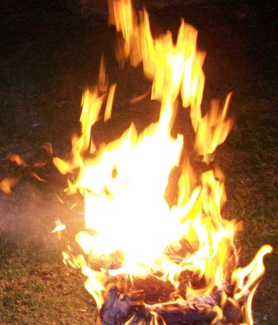
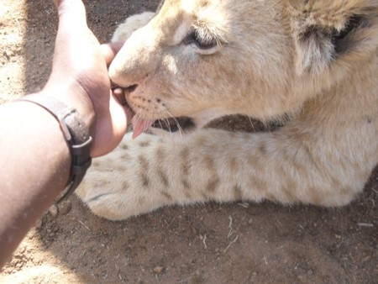
The Three Nephites Are Protected
The prisons could not hold them
They were cast down into the earth but could not be buried (‘not dig pits sufficient to hold them’)
Three times they were cast into a furnace and were not harmed
Two times they were cast into a den of wild beasts which they played ‘as a child with a suckling lamb’ and were not hurt
3 Nephi 28:19-22

Slide 10
Names Not To Be Recorded
Mormon was forbidden to reveal the names of the Three Translated Nephites who remain on the earth
Later around AD 400-421
“And there are none that do know the true God save it be the disciples of Jesus, who did tarry in the land until the wickedness of the people was so great that the Lord would not suffer them to remain with the people; and whether they be upon the face of the land no man knoweth.
But behold, my father and I have seen them, and they have ministered unto us.”
Mormon 8:10-11
3 Nephi 28:25-26

Slide 11
They Shall Minister to All
They will be among the Gentiles and the Gentiles will not know them.
They will be among the Jews and the Jews will not know them.
They shall be as angels of God
They shall pray unto the Father in the name of Jesus
They shall remain on the earth in their terrestrial state until the Coming of the Savior
“Yea even among the Gentiles shall there be a great and marvelous work wrought by them, before that judgment day.”
3 Nephi 28:27-40

Slide 12
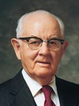
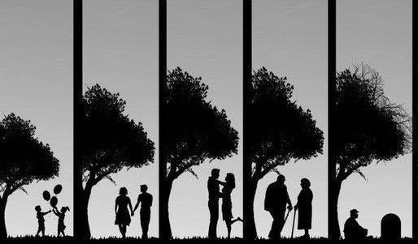
“We each have so much need for his help as we seek to learn gospel truths and then live them, as we seek his help in the major decisions of our lives, decisions involving schooling, marriage, employment, place of residence, raising our families, serving with each other in the work of the Lord, and seeking his forgiveness and continual guidance and protection in all we do. Our list of needs is long and real and heartfelt. …
“After a lifetime of prayers, I know of the love and power and strength that comes from honest and heartfelt prayer. I know of the readiness of our Father to assist us in our mortal experience, to teach us, to lead us, to guide us. Thus, with great love, our Savior has said, ‘What I say unto one I say unto all; pray always.’ (D&C 93:49.)”
Spencer W. Kimball
3 Nephi 28:27-40

Slide 13
Sources:
Joseph Fielding McConkie and Robert L. Millet Doctrinal Commentary on the Book of Mormon Vol. 4 pg. 188.190-191
Transfigured ” (Guide to the Scriptures, “Transfiguration,” scriptures.lds.org; see also D&C 67:11; Moses 1:11). Moses (see Moses 1:9–11); Jesus Christ, Peter, James, and John (see Matthew 17:1–8); and Joseph Smith (see Joseph Smith—History 1:14–20).
Translated (Guide to the Scriptures, “Translated Beings,” scriptures.lds.org; see also 3 Nephi 28:7–9, 20–22, 37–40). Enoch (see Genesis 5:24; Hebrews 11:5), Moses (see Alma 45:19), Elijah (see 2 Kings 2:11), and John the Beloved (see John 21:22–23; D&C 7).
Student Manual Religion 121-122 pg. 127, 444
Spencer W. Kimball, “Pray Always,” Ensign, Oct. 1981, 3, 6
Presentation by ©http://fashionsbylynda.com/blog/

Slide 14
"Transfiguration is a special change in appearance and nature which is wrought upon a person or thing by the power of God: This divine transformation is from a lower to a higher state; It results in a more exalted, impressive, and glorious condition ....
"By the power of the Holy Ghost many prophets have been transfigured so as to stand in the presence of God and view the visions of eternity. Speaking of such an occasion In his life, Moses recorded: 'Now mine own eyes have beheld God; but not my natural, but my spiritual eyes, for my natural eyes could not have beheld; for I should have withered and died in his presence; but his glory was upon me; and I beheld his face, for I was transfigured before him.' (Moses 1:11; D. & C. 67:11.) ...
"Similarly, when the Three Nephites 'were caught up into heaven, and saw and heard unspeakable things,’ they were transfigured."
Bruce R. McConkie (Mormon Doctrine p. 803)
“We are telestial mortals, translated being are terrestial mortals, while exalted resurrected beings are celestial immortals.”
Richard Cowan (Alma, The testimony of the word, ed. By Nyman and Tate, pp. 201-202
5 By faith Enoch was translated that he should not see death; and was not found, because God had translated him: for before his translation he had this testimony, that he pleased God.
Hebrews 11:5
5 ¶So Moses the servant of the Lord died there in the land of Moab, according to the word of the Lord.
6 And he buried him in a valley in the land of Moab, over against Beth-peor: but no man knoweth of his sepulchre unto this day.
Deutoronmy 34:5-6
19 Behold, this we know, that he was a righteous man; and the saying went abroad in the church that he was taken up by the Spirit, or buried by the hand of the Lord, even as Moses. But behold, the scriptures saith the Lord took Moses unto himself; and we suppose that he has also received Alma in the spirit, unto himself; therefore, for this cause we know nothing concerning his death and burial.
Alma 45:19
13 After this vision had closed, another great and glorious vision burst upon us; for Elijah the prophet, who was taken to heaven without tasting death, stood before us, and said:
D&C 110:13

