Slide 2
What is This Book About?
The blessings that come to people who are united in living the gospel of Jesus Christ.
Following the Savior’s ministry among the descendants of Lehi, all the people throughout the land were converted.
As they obeyed the commandments, they enjoyed peace, prosperity, and marvelous spiritual blessings.
Also:
The people’s gradual decline into a state of wickedness.

Slide 3
Who Wrote the Book?
Mormon compiled and abridged the records of four writers to create the book of 4 Nephi.
The first of these was Nephi, for whom the book was named.
Nephi was the son of Nephi, who was one of the twelve disciples chosen by the Lord during His ministry among the descendants of Lehi
The other three authors were Nephi’s son Amos and Amos’s sons Amos and Ammaron

Slide 4
Who is This Book Written For?
Mormon did not address the book of 4 Nephi to a particular audience, and he did not state why he wrote it.
However, this book contributes to the overarching purposes of the Book of Mormon—to witness that Jesus is the Christ and to make known the covenants of the Lord.
The 4th Book of Nephi
When Was It Written?
The original records used as sources for the book of 4 Nephi were likely written between A.D. 34 and A.D. 321.
Mormon abridged those records sometime between A.D. 345 and A.D. 385.
Mormon did not say where he was when he compiled this book.

Slide 5
In only 49 verses, the book of 4 Nephi narrates a period of nearly 300 years—almost one-third of the entire Nephite history covered by the Book of Mormon.
It highlights the contrast between the people’s righteousness immediately following the Savior’s ministry among them and their wickedness four generations later.
The book’s first 18 verses illustrate the blessings enjoyed by a society that is built upon the gospel of Jesus Christ.
Later verses provide a witness of the destructiveness of pride, showing how this society gradually weakened until it was almost entirely consumed in sin.

Slide 6
All Things In Common
100 Years of Unity
The Children of Christ—United
All converted to the Lord—both Nephites and Lamanites
There were no contentions
They dealt with each other justly
There was no rich, or poor, bond or free—all were made free
They were partakers of the heavenly gift—Gifts of God
They all experience peace and happiness
4 Nephi 1-4

Slide 7
What Makes You Truly Happy?
Temporary Happiness
Lasting Happiness
Eternal Happiness
True happiness cannot be found in temporal things like popularity, riches, and material belongings.

Slide 8
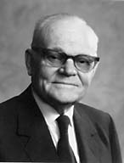
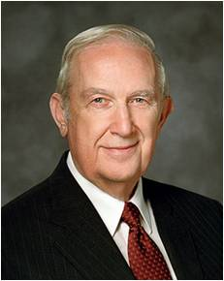
What Made the People Happy?
The people repented, were baptized, received the Holy Ghost, and were “all converted unto the Lord.”
President [Marion G.] Romney describes the steps you must follow:
“‘Membership in the Church and conversion are not necessarily synonymous. Being converted and having a testimony are not necessarily the same thing either.
A testimony comes when the Holy Ghost gives the earnest seeker a witness of the truth. A moving testimony vitalizes faith. That is, it induces repentance and obedience to the commandments. Conversion is the fruit or the reward for repentance and obedience.’ [In Conference Report, Guatemala Area Conference 1977, 8–9.]
“Your happiness now and forever is conditioned on your degree of conversion and the transformation that it brings to your life. How then can you become truly converted?
“Stated simply, true conversion is the fruit of faith, repentance, and consistent obedience. …
“True conversion yields the fruit of enduring happiness that can be enjoyed even when the world is in turmoil and most are anything but happy.”
Richard G. Scott
When we are converted unto the Lord, we avoid contention.

Slide 9
“Conversion is effected by divine forgiveness, which remits sins. The sequence is something like this.
An honest seeker hears the message. He asks the Lord in prayer if it is true.
The Holy Spirit gives him a witness.
This is a testimony.
If one’s testimony is strong enough, he repents and obeys the commandments. By such obedience he receives divine forgiveness which remits sin.
Thus he is converted to a newness of life. His spirit is healed.”
President Marion G. Romney
When we are converted unto the Lord, we are blessed with happiness and unity as the children of Christ
4 Nephi 5, 14

Slide 10
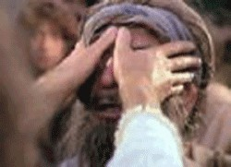
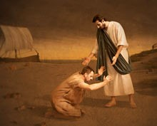
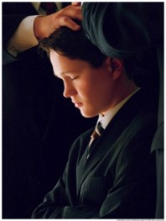
In the Name of Jesus
The disciples performed miracles:
They healed the sick
They raised the dead
They caused the lame to walk
They caused the blind to see
They passed away by the 100th year
Other disciples were ordained in their stead
4 Nephi 5, 14

Slide 11
Rebuilding Their Lives
They rebuilt Cities--Zarahemla
They prospered and had many children
They were a ‘fair and delightsome’ people
They married and were given in marriage after the promise which the Lord gave to them—Temple marriages?
They kept the higher Law of Christ and abandoned the Law of Moses
No jealousy, strifes, tumults, lyings, murders
They were One--United
They were blessed
When people work together to be converted to the Lord, they become unified and experience increased happiness
110 years past away—first generation
4 Nephi 7-13, 16-18

Slide 12
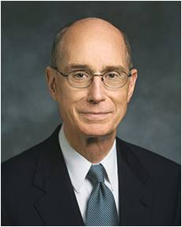
“The Lord’s prophets have always called for unity. The need for that gift to be granted to us and the challenge to maintain it will grow greater in the days ahead, in which we will be prepared as a people for our glorious destiny. …
“… We know from experience that joy comes when we are blessed with unity. We yearn, as spirit children of our Heavenly Father, for that joy which we once had with Him in the life before this one. His desire is to grant us that sacred wish for unity out of His love for us.
“He cannot grant it to us as individuals. The joy of unity He wants so much to give us is not solitary. We must seek it and qualify for it with others. It is not surprising then that God urges us to gather so that He can bless us. He wants us to gather into families. He has established classes, wards, and branches and commanded us to meet together often. In those gatherings, which God has designed for us, lies our great opportunity. We can pray and work for the unity that will bring us joy and multiply our power to serve”
President Henry B. Eyring
4 Nephi 5, 14

Slide 13
Our Happiness—Other’s Happiness
Our conversion and righteous actions contribute not only to our own happiness but also to the happiness and well-being of others
When members of
a family, quorum,
class, or other group
are unified in
righteousness, they can experience greater happiness than they would be able to experience on their own
Happiness
comes from true conversion and being united in righteousness.

Slide 14
Amos
He was the Son of Nephi, the grandson of Nephi
He received charge of the sacred records around AD 110 upon his father’s death… this means that Nephi was not one of the three disciples to remain on the earth
The counsel of the sacred records and preserving them were probably given to Amos as well as Nephi
Amos lived during a time of peace and prosperity—except for some small reports of revolts among the people who had departed from the church and assumed the name of Lamanites
Before Amos’ death he passed the records on to his son, Amos
Who’s Who

Slide 15
Amos II and Ammaron
They were the Sons of Amos
Amos received the records around AD 194
He traced the decline of the spiritual character of the people for several generations
He turned the records over to his brother Ammaron
Amos died around AD 305
Ammaron took the records around AD 306 about the time the Gadianton Robbers had taken over the entire land
Later Ammaron hid the plates and went to young Mormon (24) and gave Mormon charge of plates of Nephi and write on them, but leave the remaining records hidden around AD 321-325
Who’s Who

Slide 16
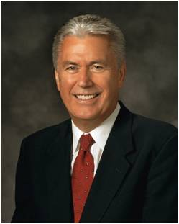
Destroying the Society
“Pride is the great enemy of unity”
“At its core, pride is a sin of comparison, for though it usually begins with ‘Look how wonderful I am and what great things I have done,’ it always seems to end with ‘Therefore, I am better than you.’
“When our hearts are filled with pride, we commit a grave sin, for we violate the two great commandments.
Instead of worshipping God and loving our neighbor, we reveal the real object of our worship and love—the image we see in the mirror” President Dieter F. Uchtdorf
President Henry B. Eyring
4 Nephi 7:24; Matthew 22:36-40

Slide 17
Taking on the Lamanite Name Again
A small part of the people began to take upon themselves the name of ‘Lamanite’ who revolted against the Church
They began to divide into classes
“And this church did multiply exceedingly because of iniquity, and because of the power of Satan who did get hold upon their hearts.”
The sin of pride creates division and leads to wickedness
4 Nephi 7:20, 26-28

Slide 18
How can the pride of a few people affect the happiness of a whole group?
Despite the encouragement of his family, an older brother decides to pursue selfish interests rather than serve a mission.
A member of a Young Women class or Aaronic Priesthood quorum is purposely disruptive, refuses to participate in class, and resists following instructions.
A young man or woman persistently teases or belittles another member of his or her group of friends.
4 Nephi 7:24

Slide 19
The New Names
Taking on the names of the unrighteous and willfully rebellious
They taught their children to hate the Nephites
They waxed strong and they were more numerous than the Nephites
They built churches unto themselves
The started ‘secret combinations’ a sign of the Gadianton robbers
Lamanites
Lemuelites
Ishmaelites
4 Nephi 7:38-43

Slide 20
Sorrow From the 3 Nephites
“And from this time the disciples began to sorrow for the sins of the world.”
More and more did the Nephites become unrighteous
4 Nephi 7:44

Slide 21
Sacred Record Hid
“And it came to pass that after three hundred and five years had passed away, (and the people did still remain in wickedness)Amos died; and his brother, Ammaron, did keep the record in his stead.”
“And he did hide them up unto the Lord, that they might come again unto the remnant of the house of Jacob, according to the prophecies and the promises of the Lord. And thus is the end of the record of Ammaron.”
“And it came to pass that when three hundred and twenty years had passed away, Ammaron, being constrained by the Holy Ghost, did hide up the records which were sacred—yea, even all the sacred records which had been handed down from generation to generation, which were sacred—even until the three hundred and twentieth year from the coming of Christ.
thus is the end of the record of Ammaron.”
4 Nephi 7:47-49

Slide 22
Sources:
Video:
Truly Converted to the Gospel of Jesus Christ (0:46)
Jesus and His Prophets (3:10)
Richard G. Scott (“Full Conversion Brings Happiness,” Ensign, May 2002, 25, 26).
President Marion G. Romney(in Conference Report, Oct. 1963, 24).
President Henry B. Eyring (“Our Hearts Knit as One,” Ensign or Liahona, Nov. 2008, 68, 69).
Book of Mormon Who’s Who by Ed J. Pinegar and Richard J. Allen pgs. 19, 23
President Dieter F. Uchtdorf (“Pride and the Priesthood,” Ensign or Liahona, Nov. 2010, 56).
Presentation by ©http://fashionsbylynda.com/blog/

