Slide 2
How Does the Lord Get Your Attention?

Slide 3
How Could the Lord Get Your Attention?
OR
The
Book
of
Mormon
ANOTHER TESTAMENT
OF JESUS CHRIST
Paying attention to what the prophets teach and testify of
Reading and studying the scriptures
Prayer
Attending Church Meetings

Slide 4
The Plea
10 Years of peace ---while the Nephites prepare for battle against the Lamanites
The Lord gives us sufficient opportunities to repent of our sins.
“And I did cry unto this people, but it was in vain; and they did not realize that it was the Lord that had spared them, and granted unto them a chance for repentance. And behold they did harden their hearts against the Lord their God.”
Mormon 3:1-3

Slide 5
“Satan wants you to think that you cannot repent, but that is absolutely not true.
The Savior has promised you forgiveness if you will humble yourself and make the effort that repentance requires.
If you have sinned, the sooner you repent, the sooner you begin to make your way back and find the peace and joy that come with forgiveness.”
Mormon 3:1-3

Slide 6
The Lord’s Protection
Rather than recognizing the Lord’s protection the Nephites boasted about their own strength and glorified their own works.
Did you see what we did to the Lamanites?
Yea man, we were the bomb ☺
“Fear thou not; for I am with thee: be not dismayed; for I am thy God: I will strengthen thee; yea, I will help thee; yea, I will uphold thee with the right hand of my righteousness.”
(Isa. 41:10).
Mormon 3:4-9

Slide 7
A Chance to Repent
Have you been willing to repent and make the changes God wants you to make?
Are there changes you can make now to become the person God wants you to be?
God is kind and patient in giving us opportunities to repent
Mormon 3:3

Slide 8
But No Avail
The Nephites ‘swear by the heavens’ and ‘also by the throne’
Let’s totally crush those Lamanites
I’m with you man
After 30 years Mormon refuses to be their commander and leader from this point on.
Mormon 3:10-11

Slide 9
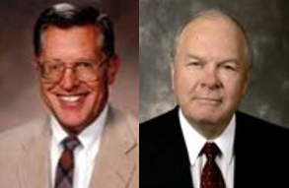
Avenge—Seeking Revenge
“And thrice have I delivered them out of the hands of their enemies, and they have repented not of their sins.”
You shall be avenged!!!
“Now, I speak unto you concerning your families—if men will smite you, or your families, once, and ye bear it patiently and revile not against them, neither seek revenge, ye shall be rewarded;”
D&C 98:23
“Those enlivened by the Spirit of the Lord have no room in their hearts for hatred, bitterness, and the seeking of revenge against those who offend and harm them.”
“When one understands and accepts the atonement of Jesus Christ there will be greater love, compassion, and forgiveness of others.”
Mormon 3:15 JFM and RLM

Slide 10
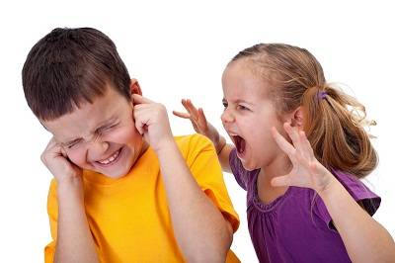
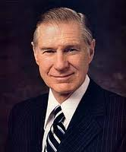
“We need to recognize and acknowledge angry feelings. It will take humility to do this, but if we will get on our knees and ask Heavenly Father for a feeling of forgiveness, He will help us. The Lord requires us ‘to forgive all men’ [D&C 64:10] for our own good because ‘hatred retards spiritual growth.’ [Orson F. Whitney, Gospel Themes (1914), 144.]
Only as we rid ourselves of hatred and bitterness can the Lord put comfort into our hearts. …
“… When tragedy strikes, we should not respond by seeking personal revenge but rather let justice take its course and then let go. It is not easy to let go and empty our hearts of festering resentment. The Savior has offered to all of us a precious peace through His Atonement, but this can come only as we are willing to cast out negative feelings of anger, spite, or revenge”
President James E. Faust

Slide 11
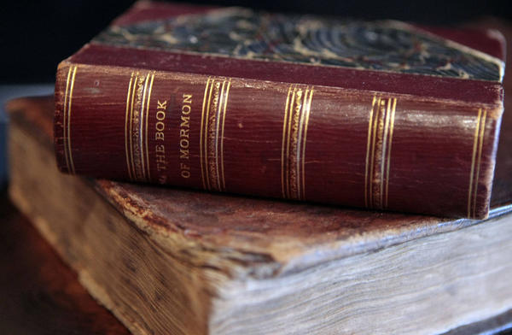
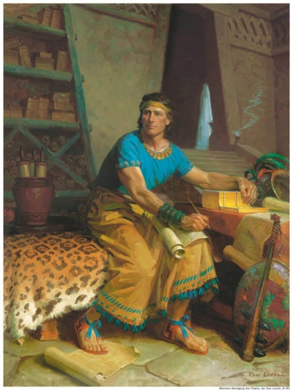
Witness to the World
“The Lord commanded Mormon to witness to the world all the things he had seen and heard and also all the prophecies and revelations that came by the power of the Holy Ghost.
Not only to witness…but words and warnings.”
JFM and RLM
“And also that ye may believe the gospel of Jesus Christ, which ye shall have among you; and also that the Jews, the covenant people of the Lord, shall have other witness besides him whom they saw and heard, that Jesus, whom they slew, was the very Christ and the very God.
And I would that I could persuade all ye ends of the earth to repent and prepare to stand before the judgment-seat of Christ.”
Mormon 3:21-22

Slide 12
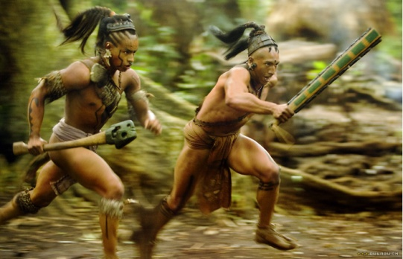
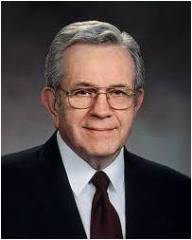
Wicked Punish Wicked
As the Nephites began to sink further and further into wickedness, the Lamanites began to sweep them off the face of the earth
Despite all the killings the Nephites would not repent or turn to the Lord
“It is by the wicked that the wicked are punished”
“Often, very often, we are punished as much by our sins as we are for our sins.”
Elder Boyd K. Packer
Mormon 4:1-5

Slide 13
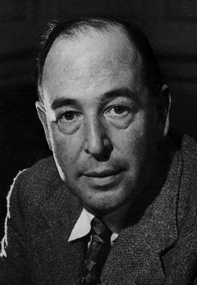
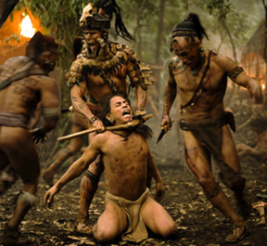
Actions of Men—Judgments of God
“It is men, not God, who have produced racks, whips, prisons, human stupidity, not by the churlishness of nature, that we have poverty and overwork.”
C.S. Lewis
The Nephites delighted in the shedding of blood
The judgments of God will overtake the wicked
“Delighting in bloodshed epitomizes the awful depths to which a person or society can fall when they are spiritually ‘past feeling’”. (Nephi 17:45)
JFM and RLM
Mormon 4:10-12

Slide 14
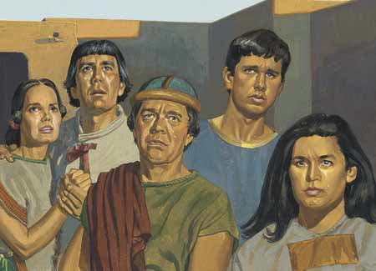
Possession of the Nephite Lands
The Lamanites gained possession of the land of Desolation and were more numerous than the Nephites
They marched toward the city of Teancum and drove them out, taking women and children prisoners, and offering them up as sacrifices to their idol gods.
“Even as the dew before the sun”
Mormon 4:13-22

Slide 15
“If you have made covenants, keep them. If you haven’t made them, make them.
If you have made them and broken them, repent and repair them. It is never too late so long as the Master … says there is time.
Please listen to the prompting of the Holy Spirit telling you right now, this very moment, that you should accept the atoning gift of the Lord Jesus Christ and enjoy the fellowship of His labor.
Don’t delay. It’s getting late.”
Jeffrey R. Holland
We will all stand before the judgment seat of Christ to be judged of our works, whether they be good or evil
Mormon 4:22

Slide 16
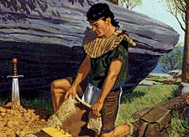
Hill Shim
“And now I, Mormon, seeing that the Lamanites were about to overthrow the land, therefore I did go to the hill Shim, and did take up all the records which Ammaron had hid up unto the Lord.”
Mormon 4:23

Slide 17
Sources:
(For the Strength of Youth [booklet, 2011], 28).
Joseph Fielding McConkie and Robert L. Millet Doctrinal Commentary on the Book of Mormon pg. 223
President James E. Faust (“The Healing Power of Forgiveness,” Ensign or Liahona, May 2007, 69).
Elder Boyd K. Packer Teach Ye Diligently pg. 262
Jeffrey R. Holland, “The Laborers in the Vineyard,” Ensign or Liahona, May 2012, 33.
Presentation by ©http://fashionsbylynda.com/blog/

Slide 18
“In a business law class at the university I attended, I remember that one particular classmate never prepared for the class discussions. I thought to myself, ‘How is he going to pass the final examination?’
“I discovered the answer when he came to the classroom for the final exam on a winter’s day wearing on his bare feet only a pair of sandals. I was surprised and watched him as the class began. All of our books had been placed upon the floor, as per the instruction. He slipped the sandals from his feet; and then, with toes that he had trained and had prepared with glycerin, he skillfully turned the pages of one of the books which he had placed on the floor, thereby viewing the answers to the examination questions.
“He received one of the highest grades in that course on business law. But the day of reckoning came. Later, as he prepared to take his comprehensive exam, for the first time the dean of his particular discipline said, ‘This year I will depart from tradition and will conduct an oral, rather than a written, test.’ Our favorite trained-toe expert found that he had his foot in his mouth on that occasion and failed the exam” President Thomas S. Monson:(“Preparation Brings Blessings,” Ensign or Liahona, May 2010, 65).
“This matter of swearing with an oath in ancient days was far more significant than many of us have realized.
“For instance: Nephi and his brethren were seeking to obtain the brass plates from Laban. Their lives were in peril. Yet Nephi swore this oath: ‘As the Lord liveth, and as we live, we will not go down unto our father in the wilderness until we have accomplished the thing which the Lord hath commanded us.’ (1 Ne. 3:15)
“Thus Nephi made God his partner. If he failed to get the plates, it meant God had failed. And because God does not fail, it was incumbent upon Nephi to get the plates or lay down his life in the attempt” (“The Doctrine of the Priesthood,” by Elder Bruce R. McConkie Ensign, May 1982, 33
If Time:
Forgiveness: My Burden Was Made Light
Forgiveness and the power of Jesus Christ enable a man to survive losing his wife and several children in a car accident—and allow the offending driver to begin rebuilding his own life. (8:24)

