Slide 2
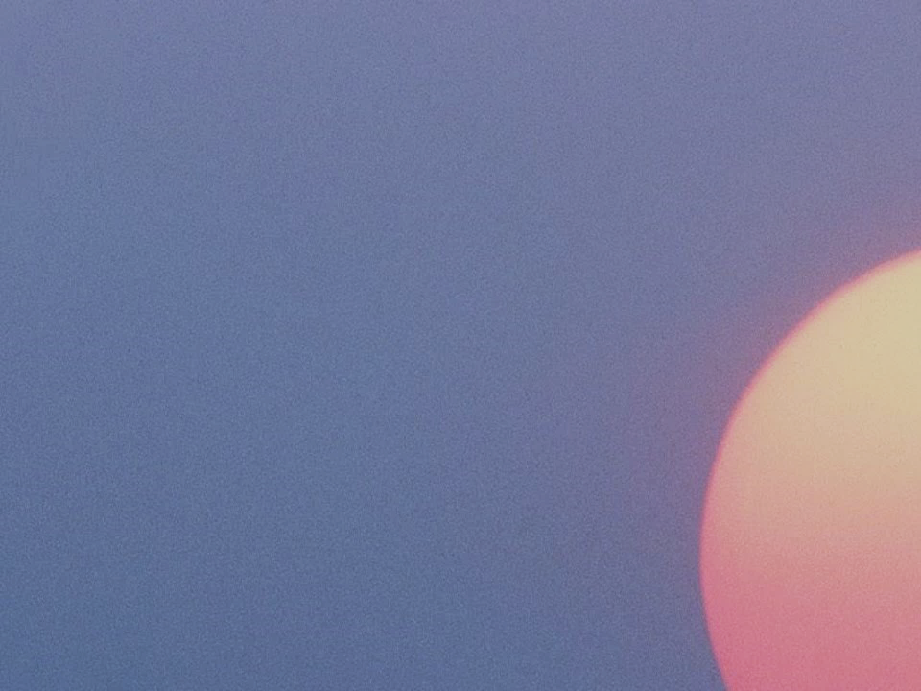
Moroni Remains Alone
AD 400-421
He knew that his words would come forth in the last days that give a special meaning to the Lamanites of our day, whom he called “the remnant of this people who are spared,…”
The Lamanites of today are descendants of great Book of Mormon leaders. Therefore, they are the house of Israel.
Alone to witness and write the destruction of his people
Lamanites
Lamanites
The Lord visited the American continent
The Lamanites today are descendants of the people who lived after the appearance of Christ
Lehi
Of the House of Israel
Great wickedness begins again
No Lamanites or Nephites; all were called children of Christ
(4 Nephi 1:17)
Destroyed in approximately AD 400
Nephites
Nephites
BC 600
AD 34
AD 400
AD 201
Mormon 8

Slide 3
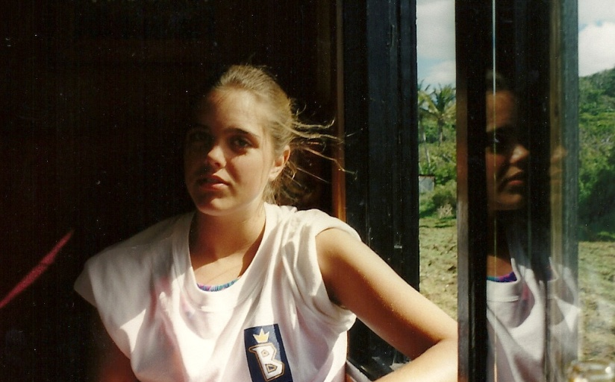
Challenging Your Faith
Even when you are alone you can choose to remain faithful
If we are faithful to God in lonely or difficult circumstances, He will help us remain faithful.
Mormon 8:1-3

Slide 4
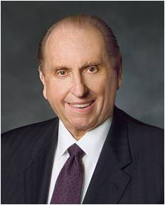
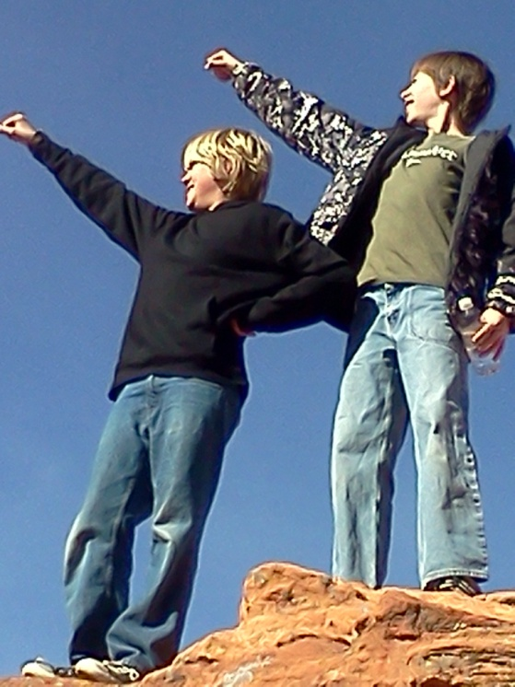
“As we go about living from day to day, it is almost inevitable that our faith will be challenged.
We may at times find ourselves surrounded by others and yet standing in the minority or even standing alone concerning what is acceptable and what is not.
Do we have the moral courage to stand firm for our beliefs, even if by so doing we must stand alone? …
May we ever be courageous and prepared to stand for what we believe, and if we must stand alone in the process, may we do so courageously, strengthened by the knowledge that in reality we are never alone when we stand with our Father in Heaven”
President Thomas S. Monson
Mormon 8:10-11

Slide 5
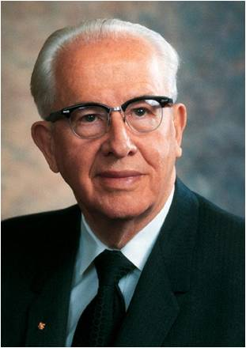
“I would like to speak about one of the most significant gifts given to the world in modern times. The gift I am thinking of is more important than any of the inventions that have come out of the industrial and technological revolutions.
This is a gift of greater value to mankind than even the many wonderful advances we have seen in modern medicine. It is of greater worth to mankind than the development of flight or space travel. I speak of the gift of …”
President Ezra Taft Benson

Slide 6
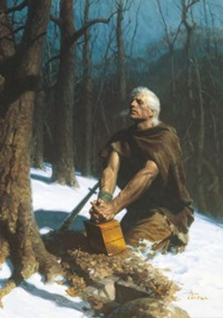
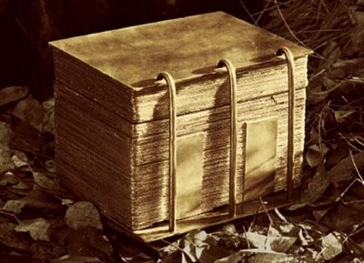
“And whoso receiveth this record, and shall not condemn it because of the imperfections which are in it, the same shall know of greater things than these. Behold, I am Moroni; and were it possible, I would make all things known unto you.”
Moroni 8:12

Slide 7
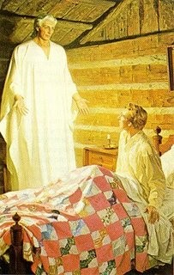
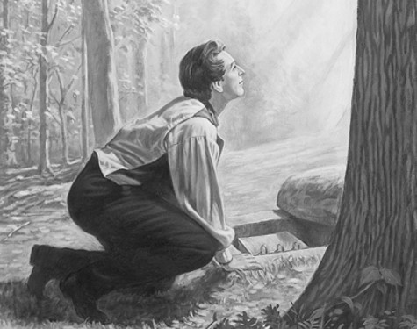
Records Are Not There To Get Gain
The Lord’s commandment is that no one was to use the plates to get gain.
“During his third appearance to Joseph Smith Moroni told Joseph that Satan would tempt him to use the plates for the purpose of getting rich.”
Joseph Smith—History 1:46
“Later, when Joseph Smith went to the hill to obtain the plates, he was beset by conflicting emotions. The adversary sorely tempted him to desire the plates to relieve his family’s poor financial situation.
When the Prophet attempted to get the plates, he was forbidden to do so because, as Moroni stated, “You have not kept the commandments of the Lord.”
Joseph Fielding Smith
Moroni 8:14

Slide 8
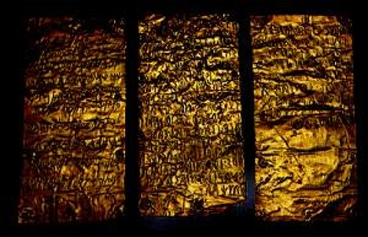
The Records Are of Great Worth
Monetarily the plates are of little worth to mortal man
However, eternally the message in the Book of Mormon is vital and indispensable
It is up to us to decide whether we accept or reject the message contained in the Book of Mormon
So:
What is written is of more worth to the souls of men that the plates that they are made on
Moroni 8:14

Slide 9
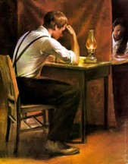
None Can Have the Power—A Seer
“For none can have power to bring it to light save it be given him of God; for God wills that it shall be done with an eye single to his glory, or the welfare of the ancient and long dispersed covenant people of the Lord.”
Joseph Smith brought forth the Book of Mormon by the power of God
Ammon to King Limhi:
“O king, of a man that can translate the records; for he has wherewith that he can look, and translate all records that are of ancient date; and it is a gift from God. And the things are called interpreters, and no man can look in them except he be commanded, lest he should look for that he ought not and he should perish. And whosoever is commanded to look in them, the same is called seer.”
Mosiah 8:13
Moroni 8:15

Slide 10
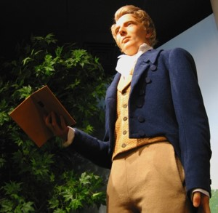
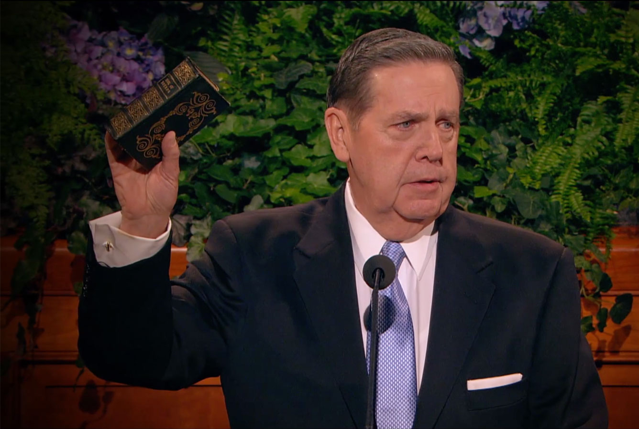
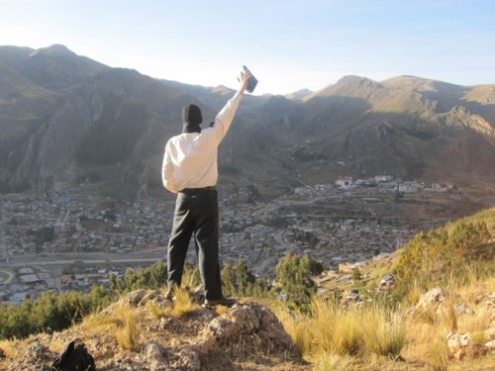
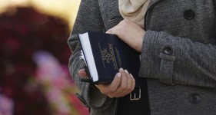
Blessed Is He
“And blessed be he that shall bring this thing to light; for it shall be brought out of darkness unto light, according to the word of God; yea, it shall be brought out of the earth, and it shall shine forth out of darkness, and come unto the knowledge of the people; and it shall be done by the power of God.”
Moroni 8:16

Slide 11
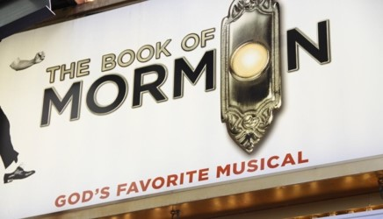
Those Who Criticize or Condemn
“Moroni assured us that if there were faults in this record they were the faults of men.”
Student Manual
“And if they are not the words of Christ, judge ye—for Christ will show unto you, with power and great glory, that they are his words, at the last day; and you and I shall stand face to face before his bar; and ye shall know that I have been commanded of him to write these things, notwithstanding my weakness.”
2 Nephi 33:11
Moroni 8:17

Slide 12
Moroni’s Warnings and Advice
Do not seek for signs
“Yea, signs come by faith, unto mighty works, for without faith no man pleaseth God; and with whom God is angry he is not well pleased; wherefore, unto such he showeth no signs, only in ^{c} wrath unto their condemnation.”
D&C 63:11
Judgment is up to the Lord, not men
“Now it is better that a man should be judged of God than of man, for the judgments of God are always just, but the judgments of manare not always just.”
Mosiah 29:12
“Ye remember that I spake unto you, and said that when the words of Isaiah should be fulfilled—behold they are written, ye have them before you, therefore search them—”
3 Nephi 20:11
Study Isaiah
Moroni 8:18-23

Slide 13
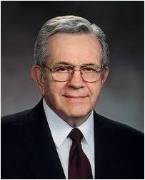
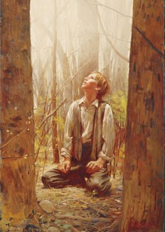
“The truth is, simply, that he was a prophet of God—nothing more and not one whit less!
The scriptures did not come so much from Joseph Smith as they did through him. He was a conduit through which the revelations were given. …
The Prophet Joseph Smith was an unschooled farm boy. To read some of his early letters in the original shows him to be somewhat unpolished in spelling and grammar and in expression.
“That the revelations came through him in any form of literary refinement is nothing short of a miracle.”
President Boyd K. Packer
Moroni 8:23-25

Slide 14
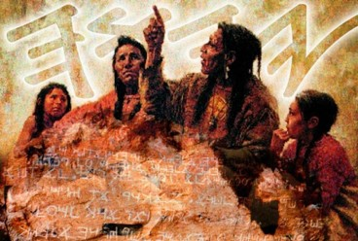
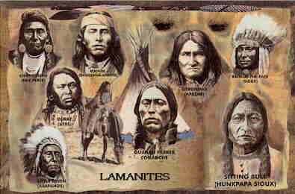
Ancient Saints Pray
“And he knoweth their prayers, that they were in behalf of their brethren. And he knoweth their faith, for in his name could they remove mountains; and in his name could they cause the earth to shake; and by the power of his word did they cause prisons to tumble to the earth; yea, even the fiery furnace could not harm them, neither wild beasts nor poisonous serpents, because of the power of his word.”
To the Lamanites:
“Now, this is not all—their faith in their prayers was that this gospel should be made known also, if it were possible that other nations should possess this land;”
D&C 10:46
Moroni 8:24

Slide 15
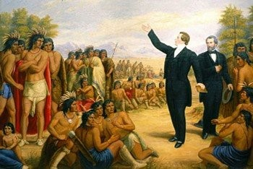
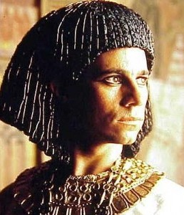
Moroni’s Vision of the Future
“The Ancients Prayer for Joseph Smith. They knew of him. They were aware of his noble and vital mission in the earth. They looked to the time of the coming of the “Choice seer” of the Lord.”
JFM and RLM
Lehi to Jacob, Joseph of Egypt about Joseph Smith in the latter days:
“A seer shall the Lord my God raise up, who shall be a choice seer unto the fruit of my loins.”
See 2 Nephi 3
Moroni 8:25

Slide 16
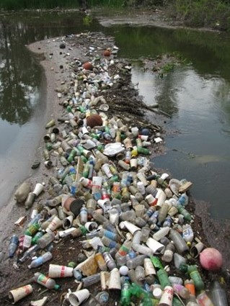
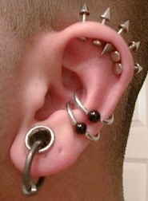
The Book of Mormon will come forth by the power of God during a day of great wickedness
In a day that miracles are done away
The blood of saints shall cry unto the Lord
Envying of them who belong to their churches
A time period between opening of the heaven and the millennial era would be a time of war, hatred and natural disaster
Great pollutions—the wicked ways of men—murders, robbing, lying, deceivings
A day when men and women are thoughtless and careless about their bodies, dress, manners, appearance, and care of the earth
Moroni 8:26-41

Slide 17
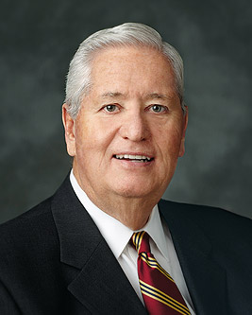
“The purpose, promises, and principles that reinforce our work of caring for the poor and needy extend far beyond the bounds of mortality.
This sacred work is not only to benefit and bless those who suffer or are in need. As sons and daughters of God, we cannot inherit the full measure of eternal life without being fully invested in caring for each other while we are here on earth.
It is in the benevolent practice of sacrifice and giving of ourselves to others that we learn the celestial principles of sacrifice and consecration”
Bishop H. David Burton
Moroni 8:37-39

Slide 18
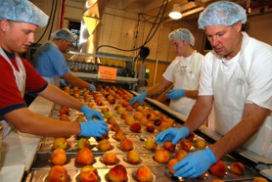
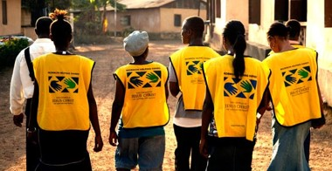
“This prophecy is a solemn warning, not just to the Christian world in general but also to the Latter-day Saints, particularly those in the United States.
The Saints of God need to labor day and night to retain purity of heart and thus propriety in their dealing with God and one another.
Zion can only be established among a people who are pure in heart, a people who search out the poor and needy, who see to those needs, and who focus their attention, their loyalties, and their time on people and on things which have eternal relevance and worth.”
JFM and RLM
Moroni 8:37-39

Slide 19
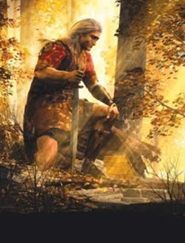
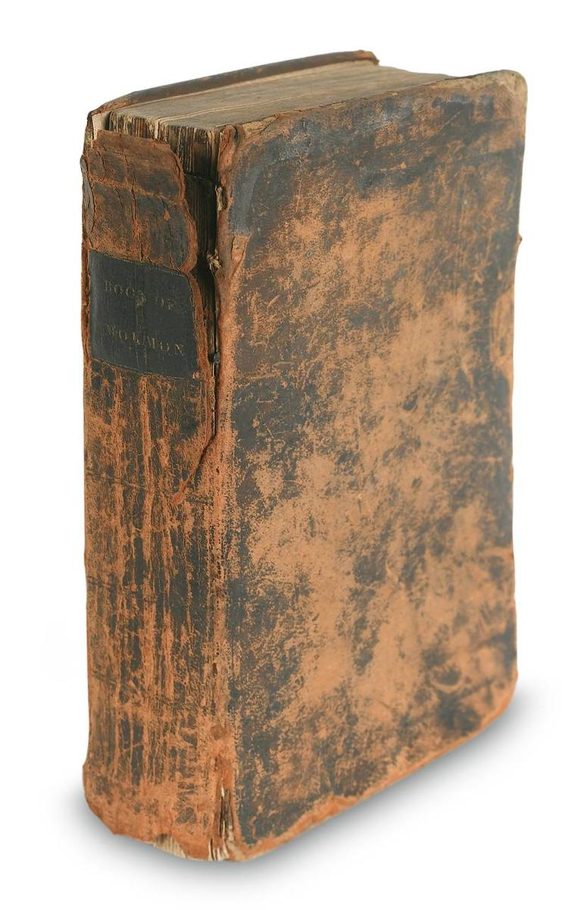
All Will Be Fulfilled
The revelations of God will all be fulfilled.
“If they saw our day, and chose those things which would be of greatest worth to us, is not that how we should study the Book of Mormon?
We should constantly ask ourselves, ‘Why did the Lord inspire Mormon (or Moroni or Alma) to include that in his record? What lesson can I learn from that to help me live in this day and age?’”
Ezra Taft Benson

Slide 20
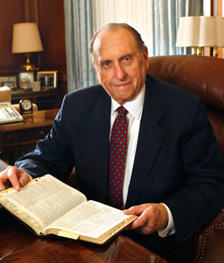
“I implore each of us to prayerfully study and ponder the Book of Mormon each day. As we do so, we will be in a position to hear the voice of the Spirit, to resist temptation, to overcome doubt and fear, and to receive heaven’s help in our lives. I so testify with all my heart.”
Thomas S. Monson

Slide 21
Sources:
Video: Prepared For Our Day (2:48)
President Thomas S. Monson(“Dare to Stand Alone,” Ensign or Liahona, Nov. 2011, 60, 67). ; “The Power of the Book of Mormon,” Ensign or Liahona, May 2017, 87
President Ezra Taft Benson(“The Book of Mormon—Keystone of Our Religion,” Ensign, Nov. 1986, 4).
Joseph Fielding Smith (as cited by) Essentials in Church History pg. 49
Student Manual Religion 121-122 Book of Mormon pg. 471
President Boyd K. Packer (“We Believe All That God Has Revealed,” Ensign, May 1974, 94).
Joseph Fielding McConkie and Robert L. Millet Doctrinal Commentary on the Book of Mormon Vol 4 pgs. 246, 250
Bishop H. David Burton (“The Sanctifying Work of Welfare,” Ensign or Liahona, May 2011, 81–82).
Presentation by ©http://fashionsbylynda.com/blog/

Slide 22
Some events which prophesied are outlined below.
The Book of Mormon accurately describes the conditions of the Christian world at the time of its publication and shortly thereafter (vss, 26-33).
1. Religious apostasy and perversion
2.Absence of divine power of miracles among the people
3.Persecution of the Saints
4.Crime, violence, and widespread iniquity
5.Warfare
6.Natural disasters
7.Great evil among the people
8.Perversion of the churches for money and gain
B. Next the Book of Mormon examines the conditions of a day a little later "when these things [ the above prophecies] shall come forth among you." (Mormon 8:34.) And here, accurately depicted, are conditions present today. (See Mormon 8;35-40.)
1.People will become fashionable, status I conscious, and competitive.
2.Common vices will be vanity, intolerance, and lack of charity.
3.People will ignore the needs of the poor.
4.There will be hypocrites who use religion to get gain.
5.Some will be ashamed to be known as disciples of Christ.
6.Some will not respond to the needs of their less fortunate brothers and sisters.
C. But all is not gloom and darkness. After having denounced the disbelief of latter-day gentiles, Moroni cites the promises of the Lord that signs and miracles will follow the true and faithful. (Read Mormon 9:24, 25.) What is the promise to the righteous of the latter days?
Student Manual Religion 121-122 Book of Mormon pg 475

Slide 23
Lamanites
Lamanites
The Lord visited the American continent
The Lamanites today are descendants of the people who lived after the appearance of Christ
Lehi
Of the House of Israel
Great wickedness begins again
No Lamanites or Nephites; all were called children of Christ
(4 Nephi 1:17)
Destroyed in approximately AD 400
Nephites
Nephites
BC 600
AD 34
AD 400
AD 201
Lamanites
Lamanites
The Lord visited the American continent
The Lamanites today are descendants of the people who lived after the appearance of Christ
Lehi
Of the House of Israel
Great wickedness begins again
No Lamanites or Nephites; all were called children of Christ
(4 Nephi 1:17)
Destroyed in approximately AD 400
Nephites
Nephites
BC 600
AD 34
AD 400
AD 201

