Slide 2
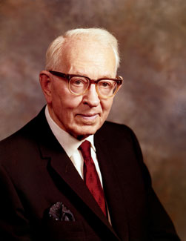
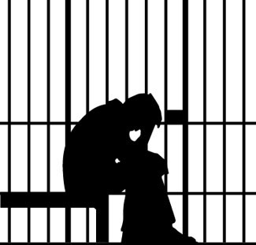
“There can be no salvation without repentance. A man cannot enter into the kingdom of God in his sins. It would be a very inconsistent thing for a man to come into the presence of the Father and to dwell in God’s presence in his sins. …
“I think there are a great many people upon the earth, many of them perhaps in the Church—at least some in the Church—who have an idea they can go through this life doing as they please, violating the commandments of the Lord and yet eventually they are going to come into his presence. They think they are going to repent, perhaps in the spirit world.
Those who turn from their unbelief to the Lord can be cleansed from their sins through the Atonement of Jesus Christ
“They ought to read these words of Moroni [quoting Mormon 9:3–5].
“Do you think that a man whose life has been filled with corruption, who has been rebellious against God, who has not had the spirit of repentance, would be happy or comfortable should he be permitted to come into the presence of God?”
Joseph Fielding Smith
Mormon 9:1-6

Slide 3
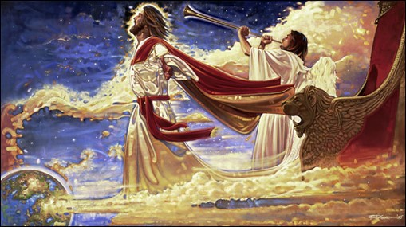
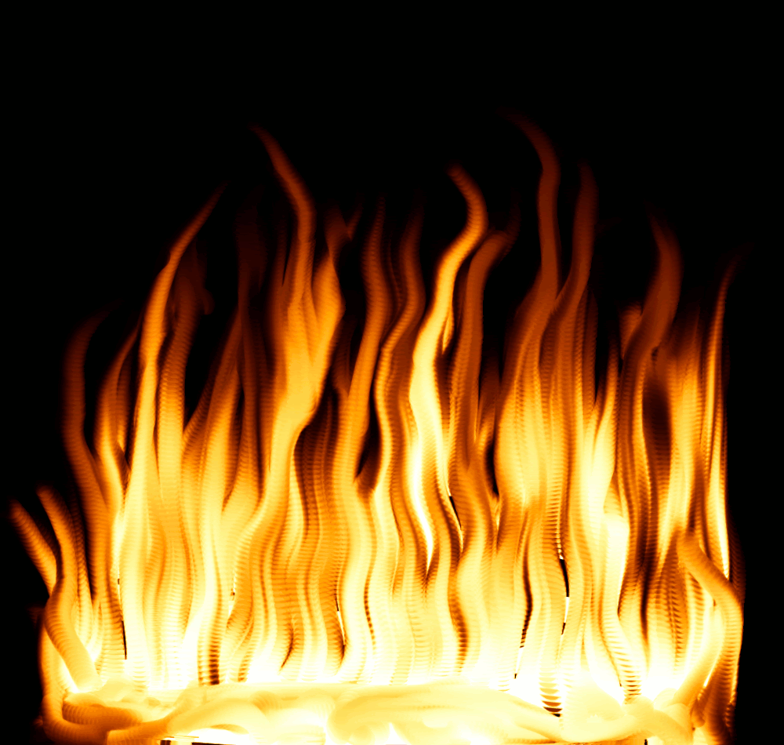
Those Who Reject Christ
The day of your visitation = The day the Lord visits the earth (The Millennium)
The elements shall melt with fervent heat = The bodies of those who are in the telestial or lower status will be consumed in the fires of glory and their spirits sent immediately to hell in the spirit world…They will remain for a time until the second resurrection at the end of the Millennium.
Ron DiCiann
Ye shall be brought to stand before the Lamb of God = Judgment Day
When your souls are racked with a consciousness of guilt = eternal torment, pains of hell, become extinct in body and soul (Alma 36:12-16)
A flame of unquenchable fire = inner torment
Why do we need to repent of our sins today and not wait until the Judgment?
Mormon 9:1-6

Slide 4
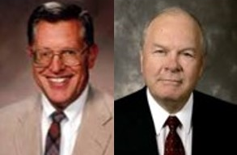
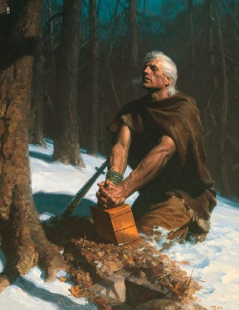
Moroni’s Plea
Moroni’s plea is that all people – including those who have to that point rejected Christ—come unto Christ now, in the light of day, partake of his goodness and grace, be cleansed by his atoning blood, and come to know the sweet joy of his redemption; all this that the final day of judgment may be glorious and great rather than awful and terrible.”
JFM and RLM
Mormon 9:1-5

Slide 5
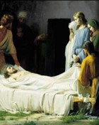
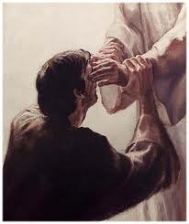
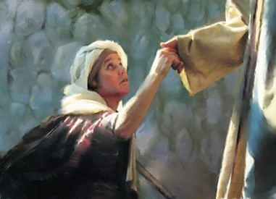
An important element in the work of Jesus Christ, being not only divine acts, but forming also a part of the divine teaching. Christianity is founded on the greatest of all miracles, the Resurrection of our Lord.
If that be admitted, other miracles cease to be improbable. Miracles should not be regarded as deviations from the ordinary course of nature so much as manifestations of divine or spiritual power. Some lower law was in each case superseded by the action of a higher.
They were intended to be a proof to the Jews that Jesus was the Christ (Matt. 11:4–5; John 2:11;10:25; 20:30–31). Many of them were also symbolic, teaching such divine truths as the result of sin and the cure of sin; the value of faith; the curse of impurity; and the law of love.
The miracles of healing also show how the law of love is to deal with the actual facts of life. Miracles were and are a response to faith and its best encouragement. They were never wrought without prayer, felt need, and faith.
Bible Dictionary
God has always performed miracles, and because He is unchangeable, He still works miracles according to our faith.

Slide 6
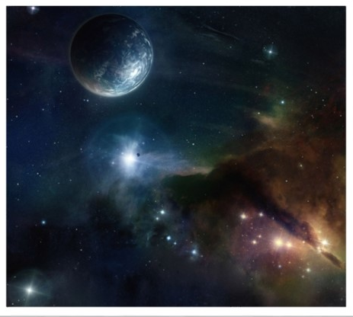
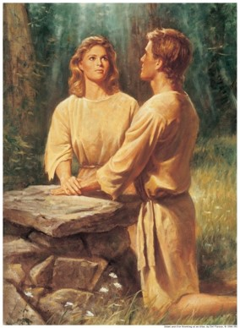
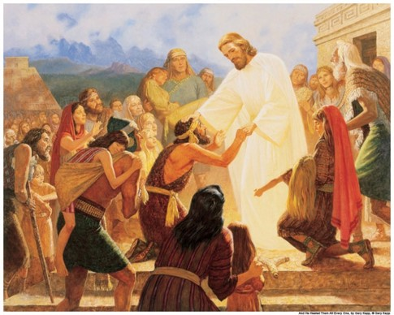
Miracles
Moroni Speaks to Those Who Say That God Is Not a God of Miracles
The Creation of Heaven and Earth (vs. 17)
The Creation of Man
(vs. 17)
The Scriptural Testimonies of the Miracles of Jesus and His Apostles (vs. 18)
Mormon 9:7-26

Slide 7
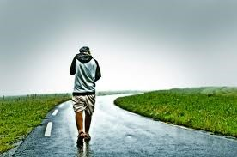
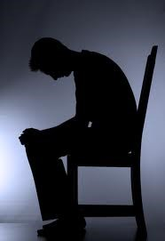
Miracles Cease When We:
Dwindle in unbelief
Know not the God in whom we should trust
Depart from the right way
Mormon 9:7-26

Slide 8
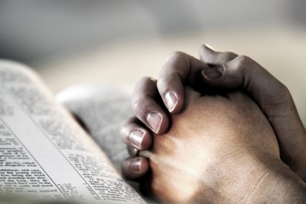
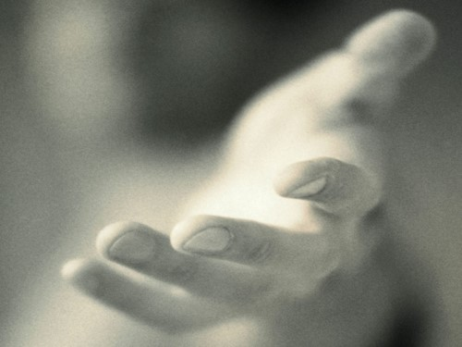
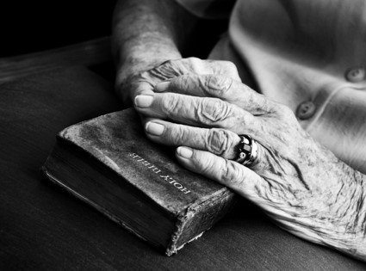
Miracles Can happen When We:
Increase our faith
Live in the right way, or keep God’s commandments
Come to know and trust in God
Mormon 9:7-26 Student Manual

Slide 9
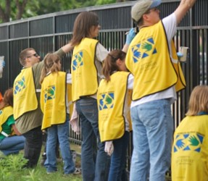
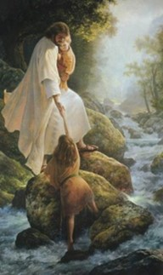
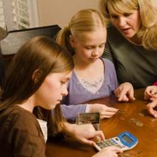
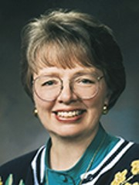
God has always performed miracles, and because He is unchangeable, He still works miracles according to our faith.
“I have learned … that the Lord will help us in every aspect of our lives when we are trying to serve Him and do His will.
“I believe that all of us can bear witness to these small miracles. We know children who pray for help to find a lost item and find it. We know of young people who gather the courage to stand as a witness of God and feel His sustaining hand.
We know friends who pay their tithing with the last of their money and then, through a miracle, find themselves able to pay their tuition or their rent or somehow obtain food for their family.
We can share experiences of prayers answered and priesthood blessings that gave courage, brought comfort, or restored health. These daily miracles acquaint us with the hand of the Lord in our lives”
Sister Sydney S. Reynolds

Slide 10
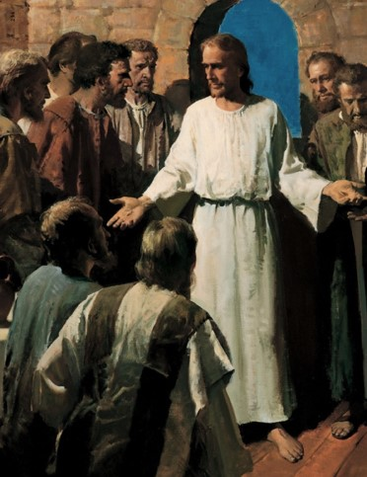
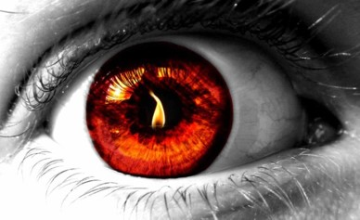
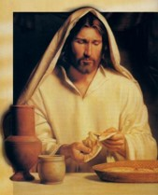
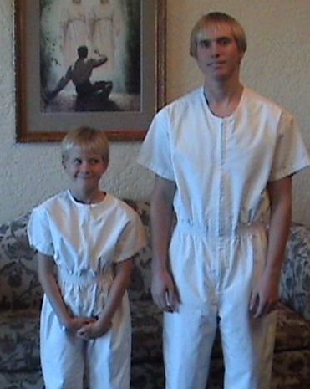
Moroni’s Counsel to the latter-day readers:
Doubt not but be believing (vs. 27)
Come unto the Lord with all your heart (vs. 27)
Strip yourself of all uncleanness (vs.28)
Pray for the strength to meet temptation (vs. 28)
Do not be baptized unworthily (vs. 29)
Do not partake of the sacrament unworthily (vs. 29)
Endure to the end (v.29)
Mormon 9:27-31 Student Manual

Slide 11
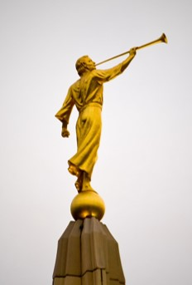
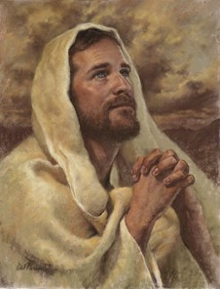
Moroni’s Promise
If we pray in faith and in the name of Christ, Heavenly Father will give us whatever we ask for.
Brooks Crandell
“…whatsoever he shall ask the Father in the name of Christ it shall be granted him; and this promise is unto all,…”
¶Ask, and it shall be given you; seek, and ye shall find; knock, and it shall be opened unto you:”
Matthew 7:7
Del Parson
Mormon 9:21-37

Slide 12
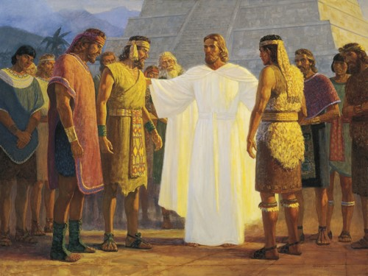
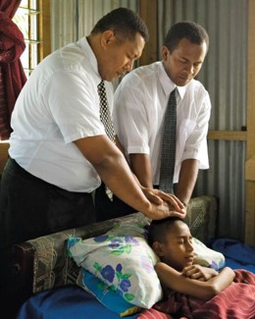
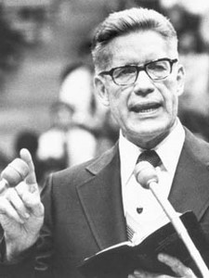
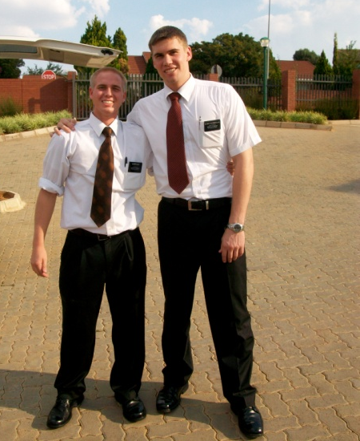
Moroni’s Promise to the Disciples
^{Those who tarry---}
Go and preach– and those who believe are to be baptized and saved
They shall cast out devils
They shall speak in new tongues
They will not be hurt
They shall heal the sick
Mormon 9:21-37

Slide 13
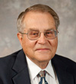
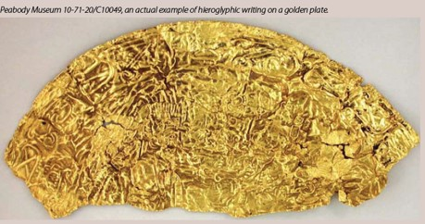
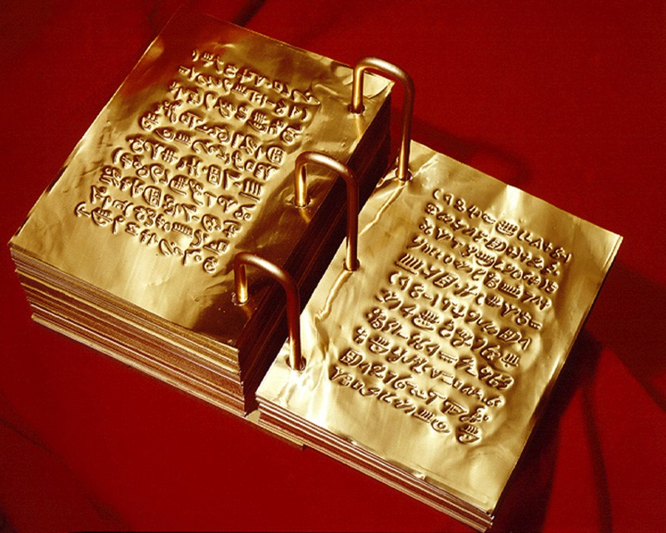
Did the Nephites Speak Hebrew?
"Moroni's statement in Mormon 9:32-34 pertains to the plates of Mormon and does not necessarily pertain to the small plates of Nephi from which we get the first 132 pages in our present Book of Mormon.
Concerning the script of the plates of Mormon, Moroni says: ' ... We have written this record according to our knowledge, in the characters which are called among us the reformed Egyptian, being handed down and altered by us, according to our manner of speech.' (Mormon 9:32.)
He seems to indicate in the following verse that the Nephites are still speaking a version of Hebrew, for he admits that 'if our plates had been sufficiently large we should have written in Hebrew; but the Hebrew hath been altered by us also.' (Mormon 9:33.)" (Ludlow, Companion, p. 307.)
Mormon 9:32-37

Slide 14
Sources:
Joseph Fielding Smith (Doctrines of Salvation, ed. Bruce R. McConkie, 3 vols. [1954–56], 2:195–96; italics in original removed).
Joseph Fielding McConkie and Robert L. Millet Doctrinal Commentary on the Book of Mormon Vol. 4 pg. 252
Sister Sydney S. Reynolds (“A God of Miracles,” Ensign, May 2001, 12).
(Ludlow, Companion, p. 307.) Religion 121-122 Book of Mormon Student Manual pg. 472
Plates of gold (an interesting article http://www.bmaf.org/articles/plates_of_gold__johnson
Presentation by ©http://fashionsbylynda.com/blog/

Slide 15
“Many miracles happen every day in the work of our Church and in the lives of our members. Many of you have witnessed miracles, perhaps more than you realize.
“A miracle has been defined as ‘a beneficial event brought about through divine power that mortals do not understand and of themselves cannot duplicate’ [Encyclopedia of Mormonism (1992), “Miracles,” 2:908]. The idea that events are brought about through divine power is rejected by most irreligious people and even by some who are religious. …
“… Miracles worked by the power of the priesthood are always present in the true Church of Jesus Christ [see George Q. Cannon, Gospel Truth, sel. Jerreld L. Newquist (1987), 151–52]. The Book of Mormon teaches that ‘God has provided a means that man, through faith, might work mighty miracles’ (Mosiah 8:18). The ‘means’ provided is priesthood power (see James 5:14–15; D&C 42:43–48), and that power works miracles through faith (see Ether 12:12; Moro. 7:37)” (Dallin H. Oaks, “Miracles,” Ensign, June 2001, 6, 8).
Hebrew and Egyptian:
Moroni stated that he had the ability to write in at least two languages: Hebrew and reformed Egyptian. He noted that if the “plates had been sufficiently large,” he would have written in Hebrew; however, those who kept the record used “reformed Egyptian” due to the lack of space (see Mormon 9:32–33). Previously in the Book of Mormon, both Nephi and King Benjamin acknowledged their use of Egyptian. Nephi stated that he wrote in “the language of the Egyptians” when he engraved the small plates (1 Nephi 1:2).
When speaking to his sons about the importance of the brass plates, King Benjamin noted that Lehi could read the record because he had “been taught in the language of the Egyptians” (Mosiah 1:4). Therefore, we understand that Lehi taught both the gospel and the Egyptian language “to his children, that thereby they could teach them to their children” (Mosiah 1:4). Evidently, this pattern continued through the generations of record keepers who followed until Moroni learned the language from his father. However, Moroni acknowledged that he wrote in “reformed Egyptian” that had been “handed down and altered … according to [their] manner of speech” (Mormon 9:32),
indicating that some adaptations in the use of the language had occurred over the thousand years since the time of Lehi. This could explain why Moroni concluded with the comment that “none other people knoweth our language” but that God had “prepared means for” the eventual interpretation and translation of the record (Mormon 9:34).
Egyptian was commonly used in Lehi’s day, especially by merchants and traders who traveled widely throughout the region around Jerusalem. If, as some have suggested, Lehi’s profession required him to travel throughout the region, he likely would have made sure his sons learned the language of the Egyptians to support the family occupation.

